Slide 1

TELECOM CHURN
Elnaz Eslami

Slide 2
Introduction
Nowadays, companies are increasingly aware of the importance of subscription services, and the churn rate is a critical indicator to track the health of a subscription-based company.
To be more precise, the company can take measures in advance by predicting the customer churn rate to retain customers consistently. Therefore, this project’s goal is to make a churn prediction so that Telco can optimize products and services proactively.

Slide 3
Data Description
The Churn dataset gives the details about their different customer’s tuners, services, and charges of the call. We have to find out the reasons why our customers want to churn(change their company).
In this, we have to perform an in-depth analysis of each variable and try to find out insights for the service provided to increase their revenue and customer as.

Slide 4
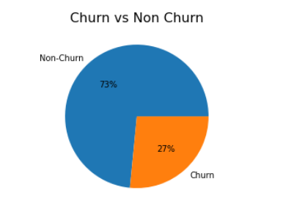
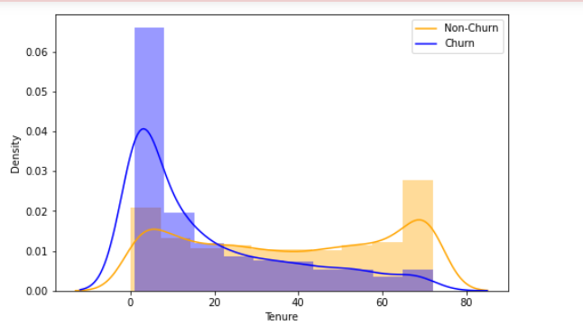
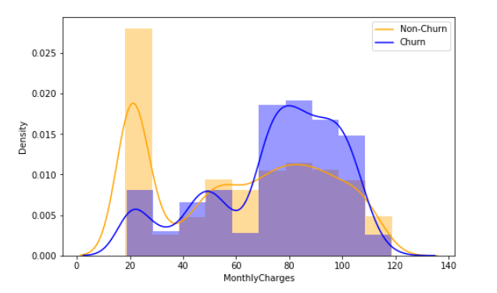
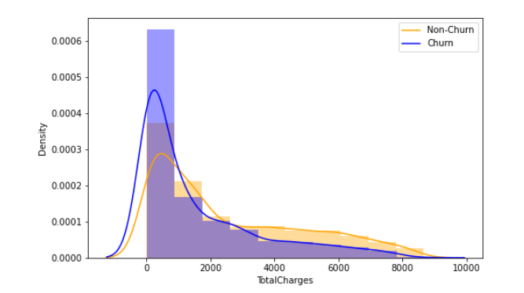
Churn: The customer churn rate of Telco from this dataset is 27%
Tenure: Customer with less tenure is more likely to churn.
Monthly Charges: Customer with low monthly charges is less likely to churn
Total Charges: The distribution is similar for both churn customers and non-churn.

Slide 5
top five Loyal customers
So with this insight, we can provide these customers with a special offer in calling and gives loyalty benefits to stay longer with the company.
4737-AQCPU | 193 9680-NIAUV | 4553 5914-XRFQB
483 5168-MQQCA | 3266 0464-WJTKO

Slide 6
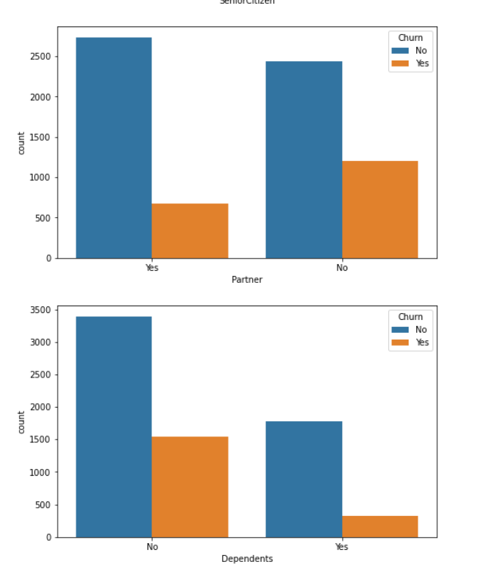
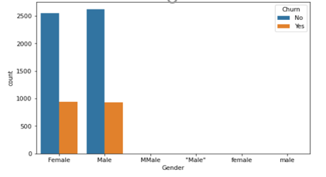
Gender, Partner, Dependent
Gender: The churn rate is similar between males and females, indicating Gender may not be a good predictor.
Partner: A customer who does not have a partner is more likely to churn.
Dependents: Customer who does have dependents are more likely to churn.

Slide 7
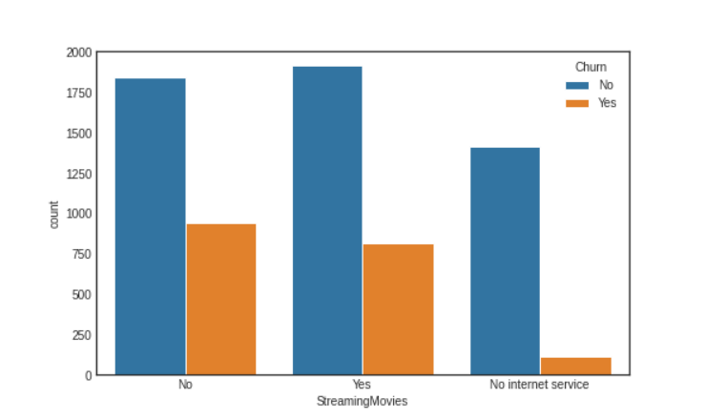
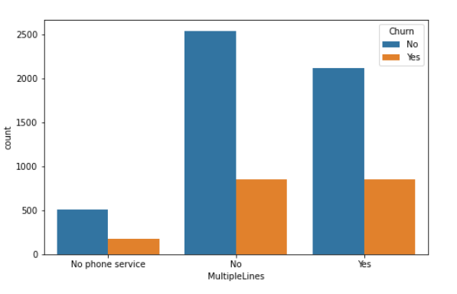
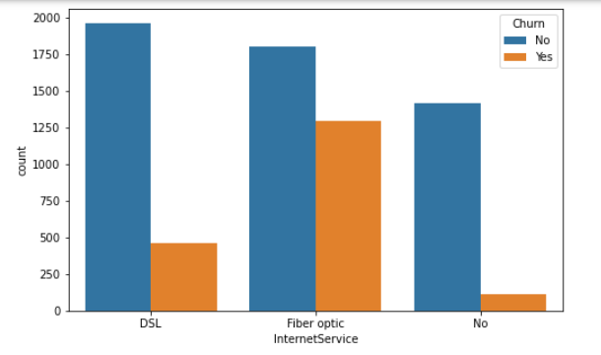
Internet Srvice, Multiple Lines,Streaming
Streaming TV / Streaming Movies: Streaming TV and Streaming Movies have no big effect on the churn rate; however, if the customer does not have internet service, then he/she is less likely to churn.
Internet Service: If a customer's Internet service provider is Fiber optic, then he/she is more likely to churn.
Multiple Lines: A customer who has multiple lines is slightly more likely to churn.

Slide 8
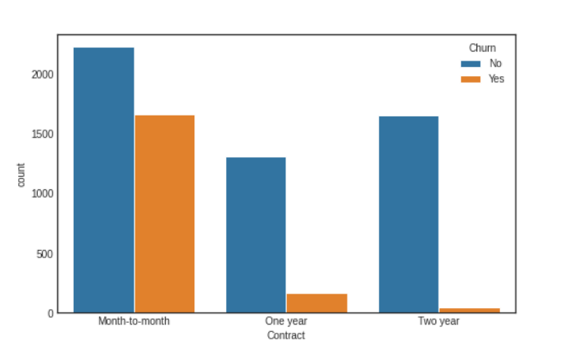
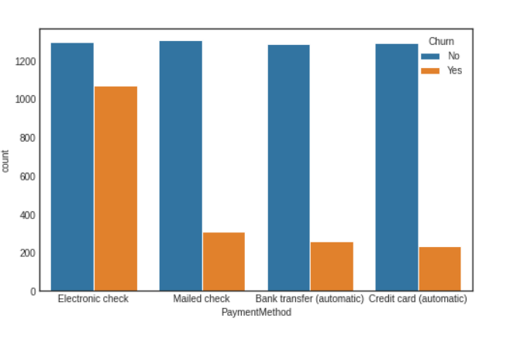
Contract Type, Payment Method
Payment Method: Customer who uses electronic check to pay bills is more likely to churn than those who use other payment methods.
Contract: The churn rate goes down as the length of the contract increases.

Slide 9
Conclusion
- The company should offer different plans according to Gender factors.
- The company should try to provide more stable and reliable internet service.
- Offering alternative payment methods.
- Encouraging longer contract lengths may help to reduce churn.
- Additionally, offering incentives or promotions to customers with multiple phone lines may help to retain them as loyal customers.
-Logistic Regression model appears to be the best among the models.

