Slide 1
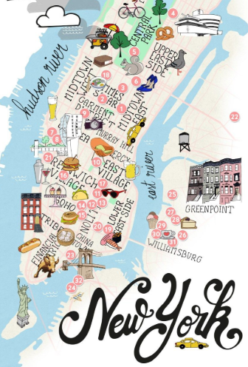
Know-b4-u-go
ERIC LIEU
MJ VILLACRESES
FRANCIS IMPERIAL
AMANDA WISHNIE

Slide 2
How are we going to help you?
WHITESPACE OPPORTUNITY Application that provides all the data you need to plan your next trip
FEATURES AirBnB pricing history Crime Data overview Where to eat & drink Sentiment Analysis
MOTIVATIONS:
SIMPLIFYING THE DECISION MAKING PROCESS WHEN PLANNING A TRIP
WHERE:
AIRBNB OPEN SOURCE
ZOMATO
VADER PYTHON PACKAGE
HOW:
PYTHON
API’s
MACHINE LEARNING

Slide 3
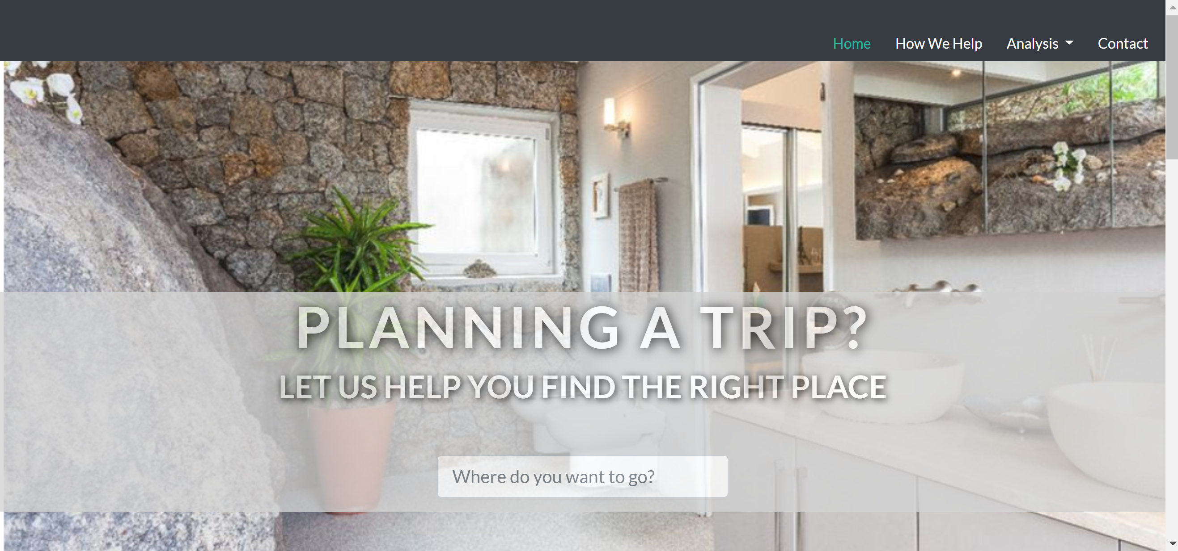
UI – HTML/CSS & JAVASCRIPT

Slide 4
KNOW-B4-U-GO FUTURE IMPLEMENTATIONS
GLOBAL EXPANSION:
ADD ALL GLOBAL MAJOR CITIES TO THE SITE
EVENTUALLY ADD SMALLER CITIES THAT ARE TRYING TO INCREASE TOURISM
Apt Owner
&
Renter
Global Expansion
Search Function
&
Homepages
Airbnb Price Predictor & Scale
Suggestions
Feature
SEARCH FUCNTION & HOMEPAGES:
HOMEPAGE FORM BUTTON THAT ALLOWS YOU TO SEARCH FOR THE CITY YOU WANT TO LEARN MORE ABOUT
CREATE HOMEPAGES FOR EACH CITY WE FEATURE ON THE SITE
PRICE PREDICTOR & SCALE:
WITH MACHINE LEARNING, DEVELOP AN AIRBNB PRICE PREDICTOR THAT LEVERAGES HISTORICAL DATA BY NEIGHBORHOOD OR CITY
GOAL OF THIS IS TO HELP APT OWNERS UNDERSTAND THE CURRENT AND FUTURE PRICING ENVIORNMENT
SUGGESTIONS FEATURE:
MAKE SUGGESTIONS ON WHERE TO TRAVEL BASED ON DIFFERENT USER INPUT CONDITIONS
RELAXING VACATION WITH LITTLE CRIME?
BUDGETED TRIP? TRAVEL BASED ON AIRBNB PRICING
PARTY ANIMAL? STAY WHERE THE BARS ARE

