Slide 1

Statistics for Social Science
Week 2
Getting to Know and Transforming Data: Descriptive Statistics and Data Preparation
Elif Ceyhan | elif.ceyhan@marmara.edu.tr | Office: C733

Slide 2
Outline
Levels of measurement
Introduction to SPSS
Type vs. Measure in SPSS
Missing values
Practise
Frequencies
Descriptives and z-scores
Recode into Different Variables
Compute Variable (with If)
1

Slide 3
Variables and Units of Analysis
Unit of analysis: who or what we collect data about – individuals, households, regions
Variable: a characteristic of the unit that varies across units – sex, age, education
Values: what a variable takes for each unit – e.g., 1 = Female, 2 = Male; 34 years
In a data set: rows are units (cases), columns are variables (variable-case matrix)
2

Slide 4
Naming your variable
No Turkish characters
Don’t start with a number
No spaces
3

Slide 5
Type ≠ Measure in SPSS
SPSS: TYPE
How the value is stored
Numeric · String · Date
→ What the software can calculate
SPSS: MEASURE
What the value means
Nominal · Ordinal · Scale
→ What it makes sense to calculate
Example: sex coded 1 = Female, 2 = Male is Numeric, but still Nominal. SPSS will happily report a mean of 1.52 – it just means nothing.
4

Slide 6
Levels of Measurement
Level | What the values tell us | Examples | What is meaningful
Nominal | Categories only – no order | Sex, region, department, type of housing | Counts, %, mode
Ordinal | Ordered categories – distances unknown | Education level, class year, life satisfaction (1–5) | + median, percentiles
Interval | Equal distances – no true zero | Temperature (°C) | + mean, SD, differences
Ratio | Equal distances and a true zero | Age, monthly income, commuting time, number of children Example: «who is forty is twice as old as someone who is twenty | + ratios ("twice as much")
In SPSS, interval and ratio share one label: Scale.
5

Slide 7
Your Turn: Which Level?
1. Respondent ID
2. Sex
3. Region of residence
4. Highest degree completed
5. Life satisfaction
6. Age in years
7. Commuting time (minutes)
8. Body mass index (BMI)
And why? Would SPSS know the answer on its own?
6

Slide 8
Missing Values: Two Kinds
System-missing: the cell is empty – no value was recorded (shown as “.” in SPSS)
User-missing: a value exists (e.g., -98 = Don’t know, -99 = Refused), but we tell SPSS not to use it
Undefined missing codes are treated as real values: an “age” of -99, a “satisfaction” score of -98
Always ask: did not answer, did not know, or the question did not apply?
7

Slide 9
Part 2: Describing and Transforming Data
Frequencies
Descriptives
Transform → Recode into Different Variables
Transform → Compute Variable
8

Slide 10
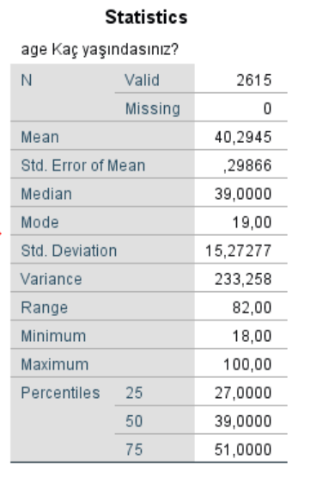
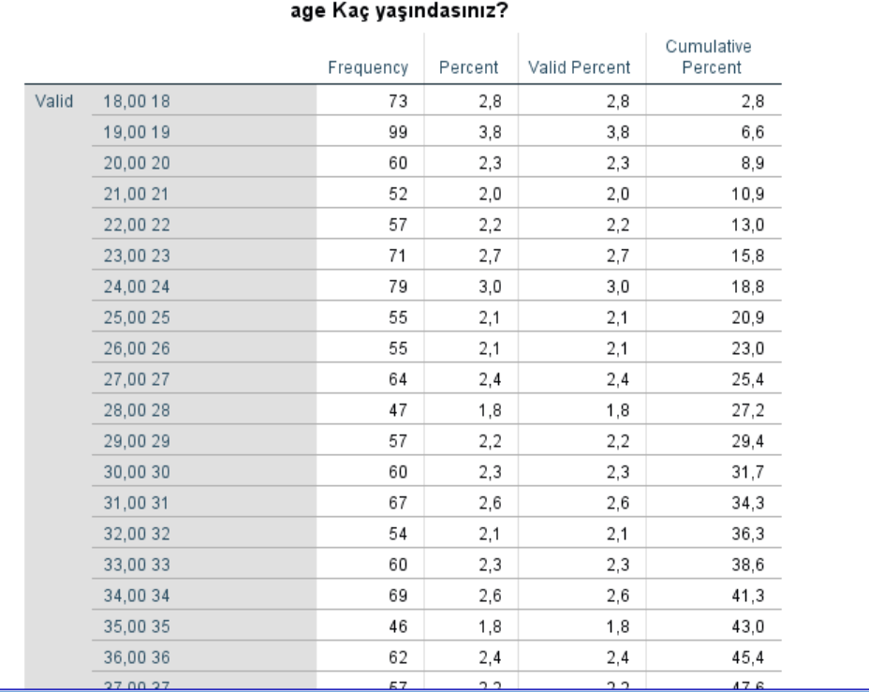
Frequencies – Age
9

Slide 11
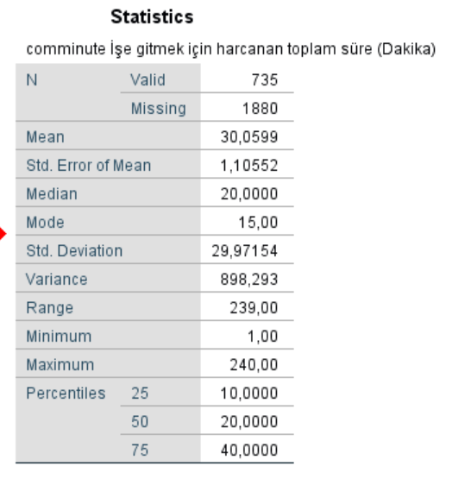
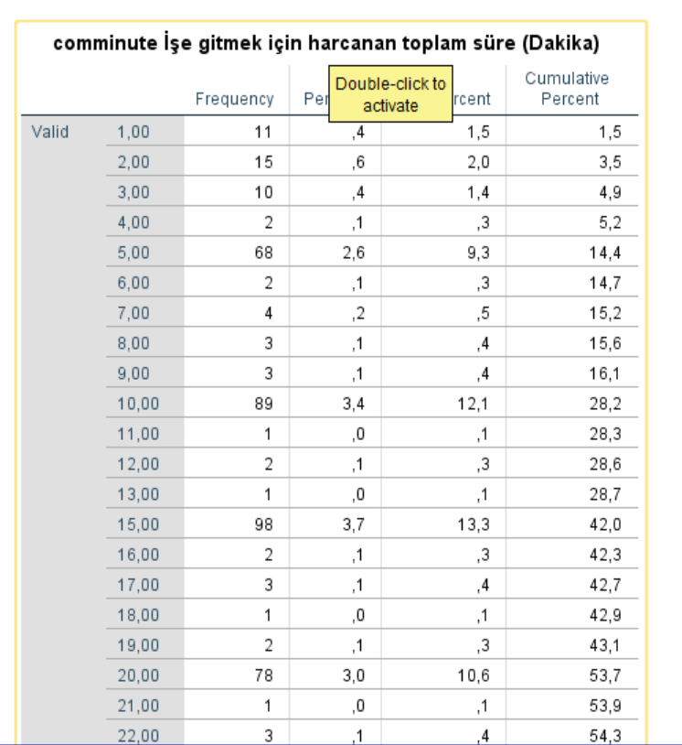
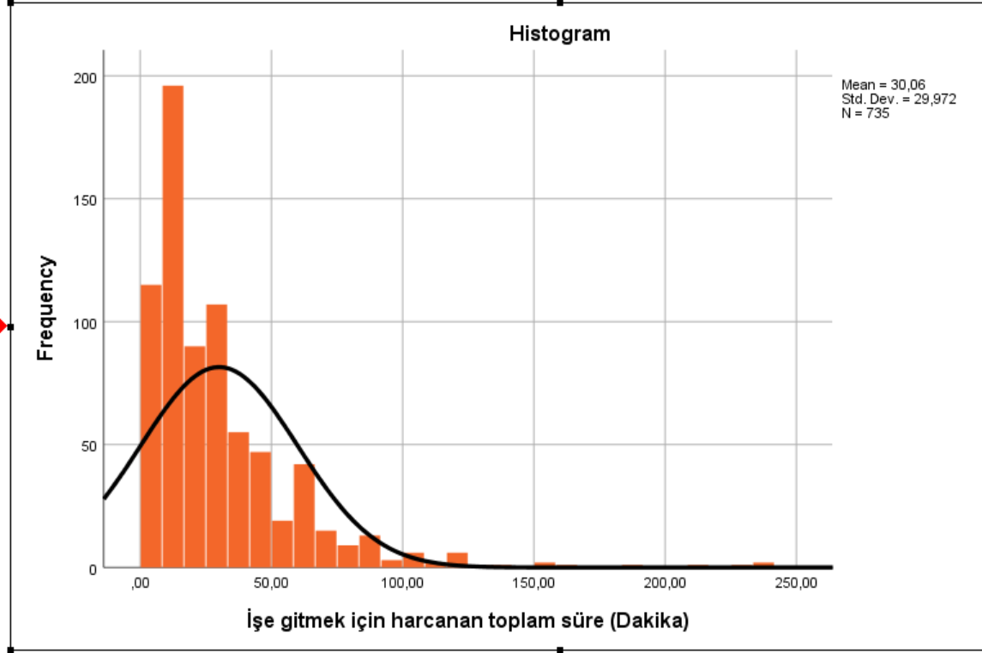
Frequencies – Commute
10

Slide 12
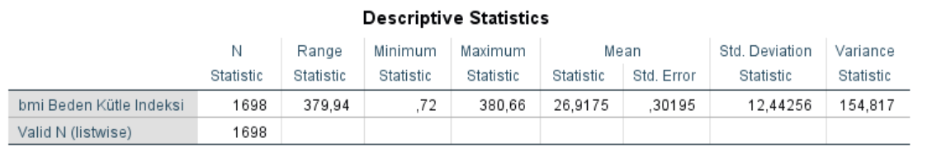

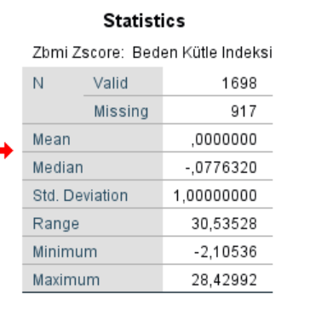
Descriptives – Save Standardized Values as Variables
11

Slide 13
Transform
Recode into Different Variables
Recode into Same Variable
Compute
12

