Slide 1

Statistics for Social Science
Week 3
Describing Distributions: Centre, Shape and Spread
Elif Ceyhan | elif.ceyhan@marmara.edu.tr | Office: C733

Slide 2
Outline
Part 1 – Last week's practice, solved
  Data View and Variable View
  Measure, values, missing
Part 2 – Data management in syntax
  RECODE, labels, measure
One question: 30 or 20 minutes?
  Central tendency
  Shape
  Dispersion
  z-scores
Part 3 – Practice
1

Slide 3
One Data Set, Two Views
DATA VIEW rows = people, columns = variables
VARIABLE VIEW rows = variables, columns = properties
 | gender | age | comminute
1 | 2 | 34 | 20
2 | 1 | 61 | -90
3 | 2 | 27 | 45
… | … | … | …
Name | Values | Missing | Measure
gender | 1 Erkek, 2 Kadın | None | Nominal
age | None | None | Scale
comminute | -90 Uygun değil | -90 | Scale
A value about a person → Data View. A fact about a variable → Variable View.
Example rows only – open TGSS to see the real ones.
2

Slide 4
Practice A1: What Kind of Variable?
Variable | TGSS name | Codebook says | Correct measure
Sex | gender | nominal | Nominal
Region of residence | nuts1 | nominal | Nominal
Highest degree completed | degree | nominal | Ordinal
Life satisfaction (1 item) | lifesat | ordinal | Ordinal
Age | age | ordinal | Scale
Commuting time | comminute | ordinal | Scale
DO YOU AGREE?
Labels can be wrong
Even the codebook.
Ask: what do the numbers mean?
Categories only → nominal
Ordered → ordinal
True zero, 'twice as much' → scale
3

Slide 5
Practice A2 and B1
A2 · VALUES AND MISSING
Two different columns
Values: what each code means (labels).
TGSS: -88 don't know, -99 refused, -90 not applicable.
Missing: which codes SPSS ignores in calculations.
Not defined? Average commute = −56 minutes!
B1 · REGION (NUTS1)
A nominal variable
Frequencies → the largest region is the mode.
A mean of region codes would be meaningless.
Nominal: counts, %, mode.
4

Slide 6
Syntax: Practice C1 in Code
File → New → Syntax · * = comment · every command ends with a full stop · select + Ctrl+R
RECODE age (18 THRU 29=1) (30 THRU 44=2)
(45 THRU 64=3) (65 THRU HIGHEST=4)
INTO age4.
VARIABLE LABELS age4 'Age, 4 groups'.
VALUE LABELS age4
1 '18-29' 2 '30-44'
3 '45-64' 4 '65+'.
VARIABLE LEVEL age4 (ORDINAL).
EXECUTE.
FREQUENCIES VARIABLES=age4.
WHAT EACH LINE DOES
Four jobs
RECODE … INTO: a new variable
VARIABLE LABELS: labels the variable
VALUE LABELS: what 1–4 mean
VARIABLE LEVEL: its measure
age is scale – age4 is …?
5

Slide 7
Getting to Work: 30 or 20 Minutes?
30 min
20 min
the mean
the median
Same data: TGSS 2024, 735 people who commute to work.
Both are correct. Which one would you put in a headline? Which one in your paper?
6

Slide 8
Centre, Shape, Spread
CENTRE · CENTRAL TENDENCY
Where is the typical person?
One value that sums up the group
mode · median · mean
SHAPE
Is it lopsided? Extreme values?
Can we trust centre and spread?
skewness · kurtosis
SPREAD · DISPERSION
How far are the others from the typical person?
The same centre can hide very different groups
range · IQR · SD
We answer all three today – with commuting time.
7

Slide 9
Central Tendency
MODE
Most frequent value
age: 19 · comminute: 15
→ All levels, incl. nominal
MEDIAN
The middle person
age: 39 · comminute: 20
→ Ordinal/Interval/Ratio
MEAN
Sum ÷ n
age: 40.3 · comminute: 30.1
→ Interval / ratio only
age: mean ≈ median. comminute: mean ≫ median. Why?
→ a few very long commutes pull the mean up.
8

Slide 10
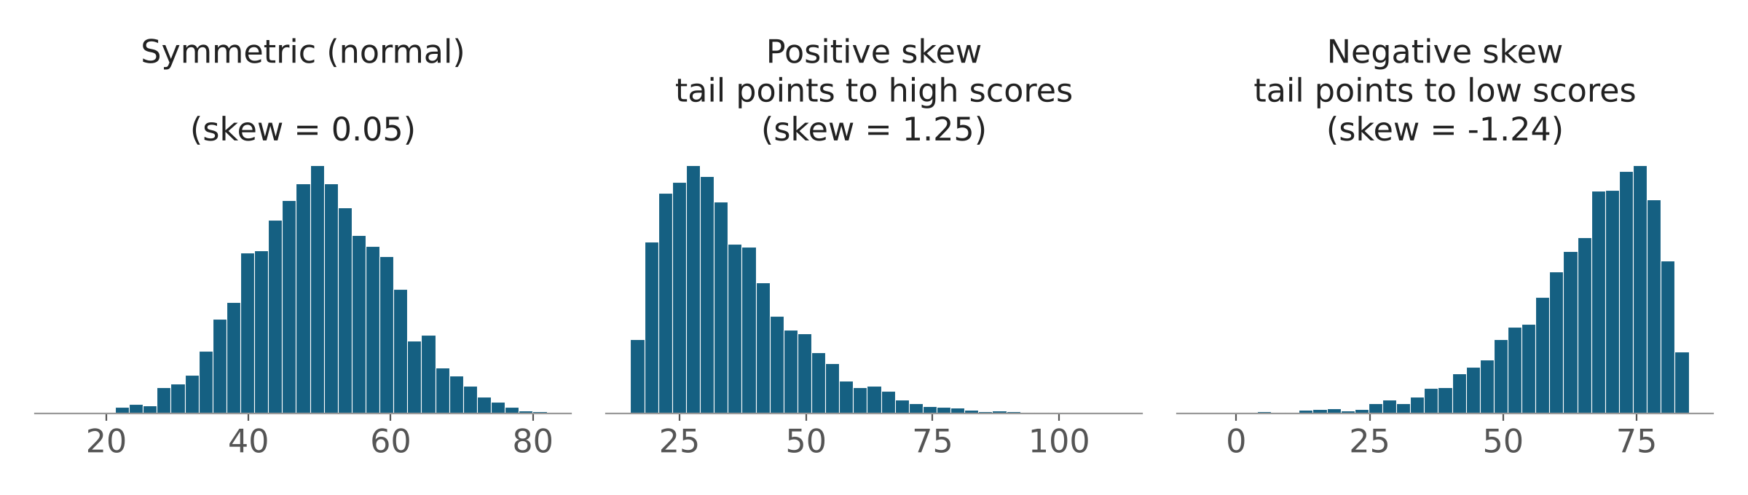
Why Do They Differ? The Shape
SPSS: 0 = NORMAL
Rules of thumb
|skew|, |kurtosis| < 1.5 – stricter
< 2 – more lenient
comminute: skew 2.82, kurtosis 12.56
age: close to 0
Why are large samples more forgiving? Next week.
Tail to the right = positive skew. Kurtosis = how heavy the tails are. (Illustration)
A long tail to the right is positive skew – and that tail is what pulls the mean up.
Kurtosis is about the tails: how many people sit far from the centre. In SPSS both are zero for a perfect normal.
9

Slide 11
Dispersion: Range and Inter Quartile Range (IQR)
 | Min | Max | Range | Q1 | Q3 | IQR
age | 18 | 100 | 82 | 27 | 51 | 24
comminute | 1 | 240 | 239 | 10 | 40 | 30
RANGE = MAX − MIN
Two people decide it
One 240-minute commuter sets the range.
IQR = Q3 − Q1
The middle 50%
Half of commuters need 10–40 minutes.
Quartiles cut the sorted data into four equal parts – NTILES equals 4 gives them.
Q2 = MEDIAN.
10

Slide 12
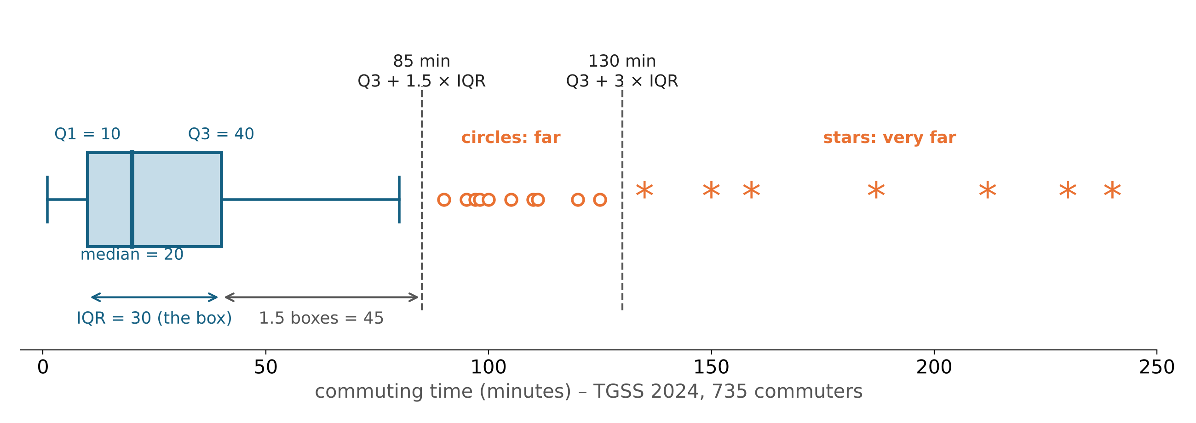
The Boxplot: a Picture of the IQR
Circle = far (above 85 min). Star = very far (above 130 min). In TGSS: 40 circles, 9 stars.
TGSS: COMMINUTE
Q1 = 10, Q3 = 40, IQR = 30
Outlier above: 40 + 1.5 × 30 = 85 min Extreme above: 40 + 3 × 30 = 130 min
Below: 10 − 45 < 0 → none possible Result: 40 outliers, 9 extremes
11

Slide 13
SD: Typical Distance from the Mean
Five values: 2, 4, 4, 5, 10 (mean = 5)
1 DISTANCE
x − mean
−3, −1, −1, 0, 5 → sum = 0
2 SQUARE & ADD
SS = Σ(x − mean)²
9 + 1 + 1 + 0 + 25 = 36
3 VARIANCE
SS / (n − 1)
36 / 4 = 9
4 SD
√variance
√9 = 3
That is the standard deviation: on average, a value is about 3 away from the mean.
In TGSS, the SD of age is 15.3: a typical person is about 15 years away from the mean age of 40.
For commuting time the SD is 30 – as large as the mean itself. Very spread out
TGSS: age SD = 15.3 around 40.3. comminute SD = 30.0 around 30.1 – as large as the mean.
Mean goes with SD. Median goes with IQR.
12

Slide 14
z: Distance from the Mean, in SDs
z = (value − mean) / SD
The mean becomes 0.
z = 2 → two SDs above the mean
z = −1 → one SD below the mean
A 70-year-old: (70 − 40.3) / 15.3 ≈ 2
Is z = 2 rare? How rare? Next week.
A z-score tells us how far a person is from the mean – measured in SDs.
When we turn a variable into z-scores, the mean becomes 0.
z = 2 means two SDs above the mean; z = −1 means one SD below.”
* 1. Our own formula.
COMPUTE z_age =
(age - 40.29) / 15.27.
EXECUTE.
* 2. SPSS does it for us.
DESCRIPTIVES VARIABLES=age
/SAVE.
* Compare z_age and Zage
* in Data View.
13

Slide 15
Which Summary for Which Variable?
Variable | Central tendency | Dispersion | TGSS example
Nominal | Mode | Frequencies, % | gender, nuts1
Ordinal | Median | IQR, range | degree, lifesat, age4
Scale, roughly symmetric | Mean | SD | age
Scale, skewed | Median (+ mean) | IQR (+ SD) | comminute
The typical worker needs 20 minutes.
Next week: How rare is z = 2? Is age normal? And a life satisfaction index.
14

Slide 16
Part 3: Practice
Open TGSS 2024 and your syntax file from class
Work through the Week 3 worksheet – in pairs, in breakout rooms
Save your syntax as W3_name.sps
Ask in the chat or in your breakout room
15

