Slide 1

Classifier comparison application using fruit dataset
Elif Ozdemir & Szymon Majorek & Assyl Salah

Slide 2

Application Description
Application Purpose
Dataset Choice
Chosen Models
Application User Interface
Graphs
Summary

Slide 3
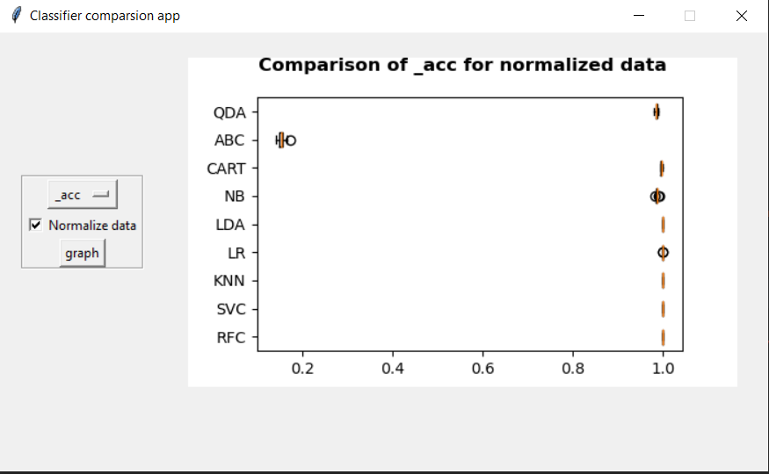
Application description
We've aimed to keep the application as simple as possible, hence the minimalistic interface.
It has 2 main areas.
Control panel
Graph display area
In the control panel we can set metric for which we want to compare classifiers, as well as whether we want to use normalized data.

Slide 4
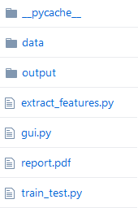
Application – behind the scenes
The application is composed of few simple python scripts responsible for different tasks.
gui.py is only responsible for the layout and showing selected information to the user in the form of boxplot.
extract_features.py takes fruit images (located in data directory) as an input and produces HDF5 files (output directory).
train_test.py Takes beforementioned HDF5 files as an input and trains, as well as tests given machine learning models.
The natural flow of logics is extract_features -> train_test -> gui

Slide 5
Application Purpose
Image recognition, in the context of machine vision, is the ability of software to identify objects, places, people, writing and actions in images. Computers can use machine vision technologies in combination with a camera and artificial intelligence software to achieve image recognition.
The main purpose of this project application is to test efficiency of different Python machine learning models based on different criteria.
Our application will give an idea to the user about the accuracy, error rate, fitting and scoring time which define the success rate of the models.
Criteria with which the user will be able to compare different models against each other
Accuracy
Mean squared error
Fit time
Score time

Slide 6
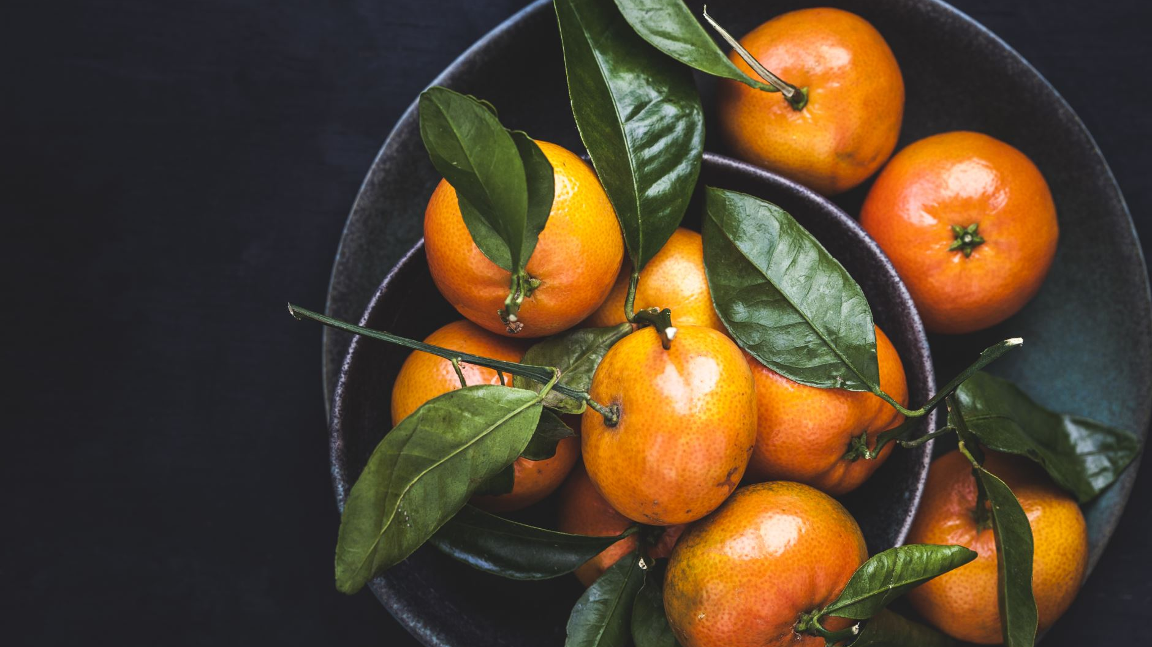
Dataset choice

Slide 7
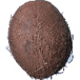
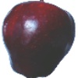
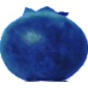
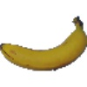
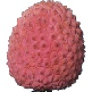
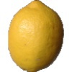
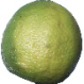
Diversity of fruits/ vegetables
28,666 images in total
44 species
21,444 -training set size
7,222 -testing set size
More than 490 pictures per a fruit in training set
More than 150 pictures per a fruit in validation set
Good lighting
Stable background
Fixed object size
100x100 pixels

Slide 8




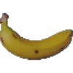




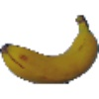


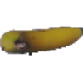
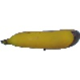

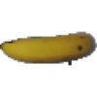
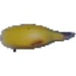
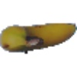
Camera Angle diversity (360 degrees)

Slide 9

Chosen Models
Logistic Regression
Linear Discriminant Analysis
K-Nearest Neighbors
Decision Tree
Random Forests
Gaussian Naive Bayes
Support Vector Machine
Quadratic Discriminant Analysis
Ada Boost classiﬁer

Slide 10
cross validation score based on
Accuracy
Mean squared error
Fit time
Score time

Slide 11
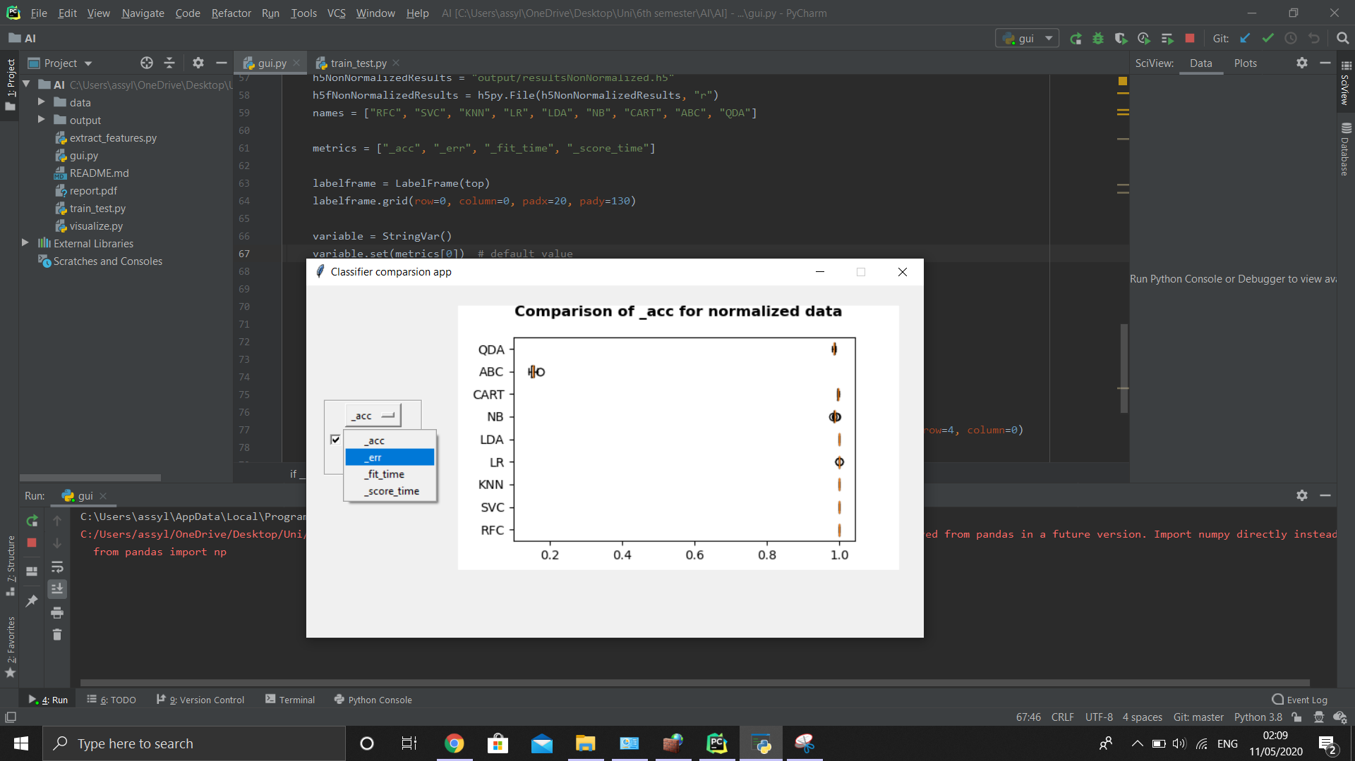
Graphical User Interface

Slide 12
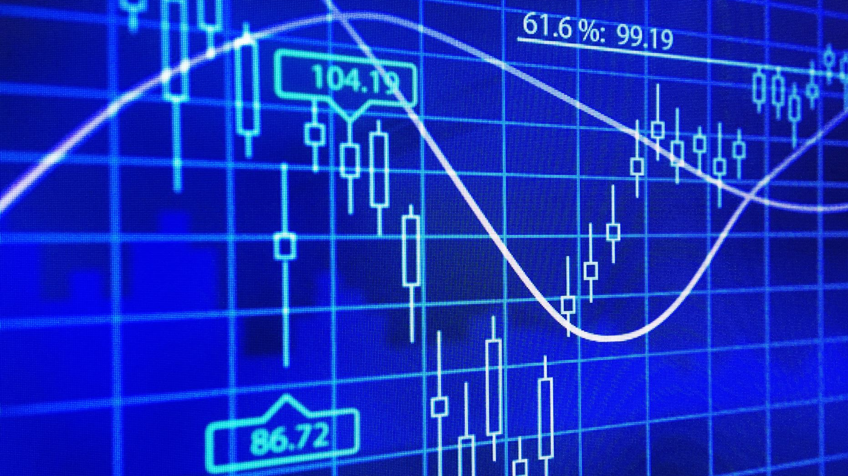
Graphs

Slide 13
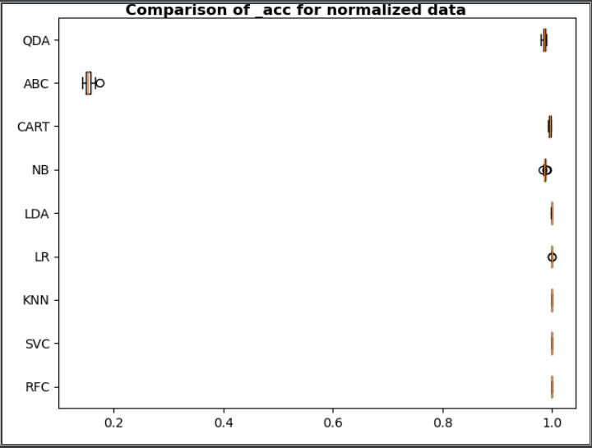
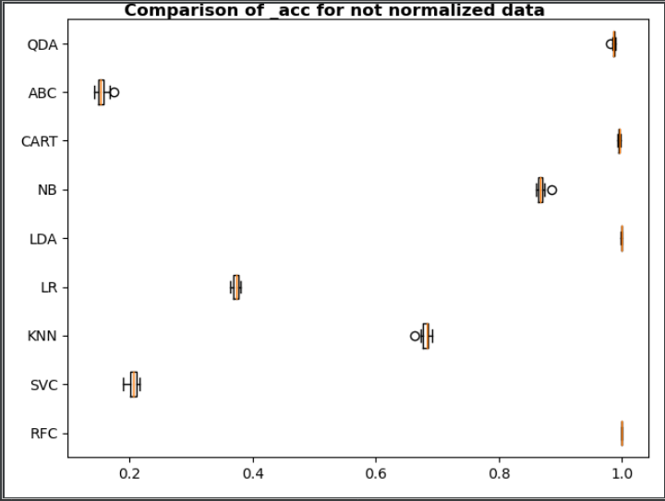
Ada Boost classiﬁer gives low accuracy
But normalization of the data helps in favor of the other classiﬁers. .
Random Forests, Linear Discriminant Analysis and Decision Tree are highly successful. However, ABC and SVC have very low accuracy.

Slide 14
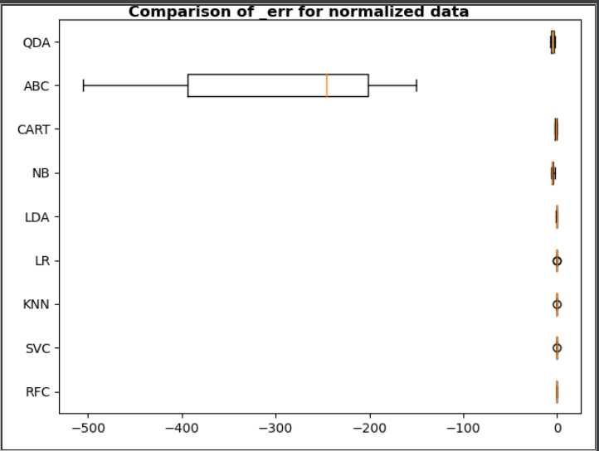
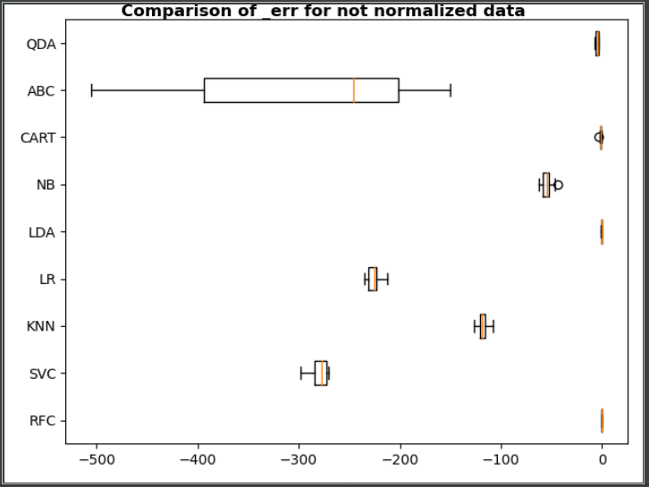
The amount of errors is close to 0 in the majority of classiﬁers. However, Ada Boost is an exception
For Quadratic Discriminant Analysis, Decision Tree, Linear Discriminant Analysis and Random Forests classiﬁers error rate is low

Slide 15
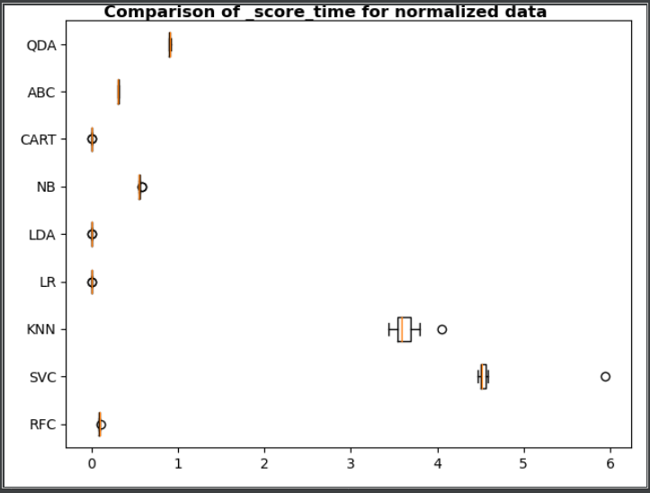
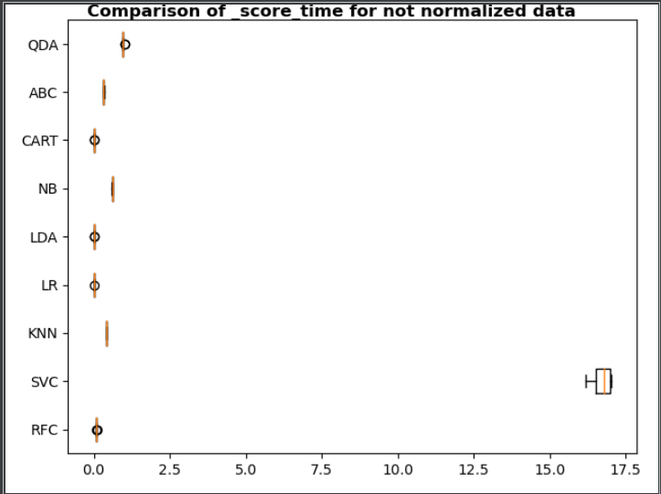
Support Vector Machine Model has the highest scoring time
The second worst result is for K-Nearest Neighbors Model.
Scoring time is the worst for Support Vector Machine Model.

Slide 16
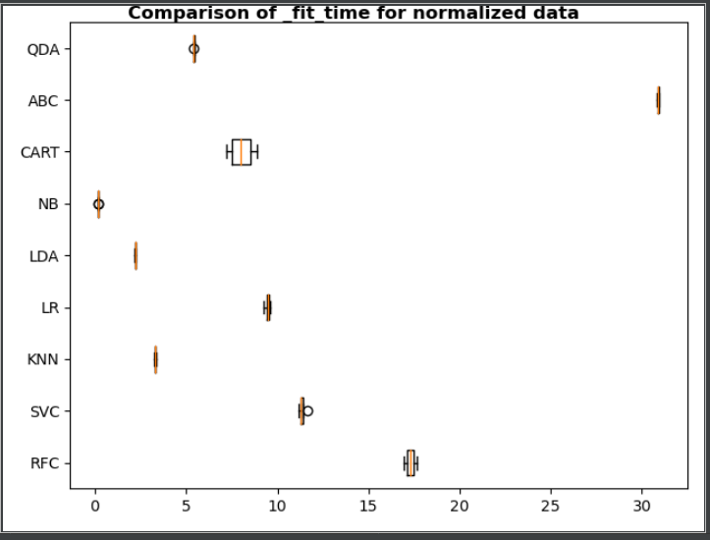
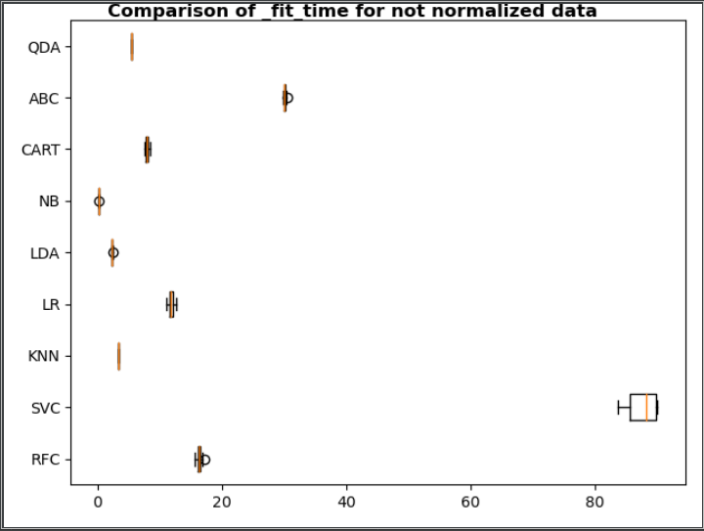
Gaussian Naive Bayes is the fastest in ﬁtting the data.
Ada Boost classiﬁer is the slowest.
Support Vector Machine Model takes at least 4 times more time compared to other classiﬁers. Except Support Vector Machine and Ada Boost classiﬁer all the models ﬁt the data at 20 seconds

Slide 17
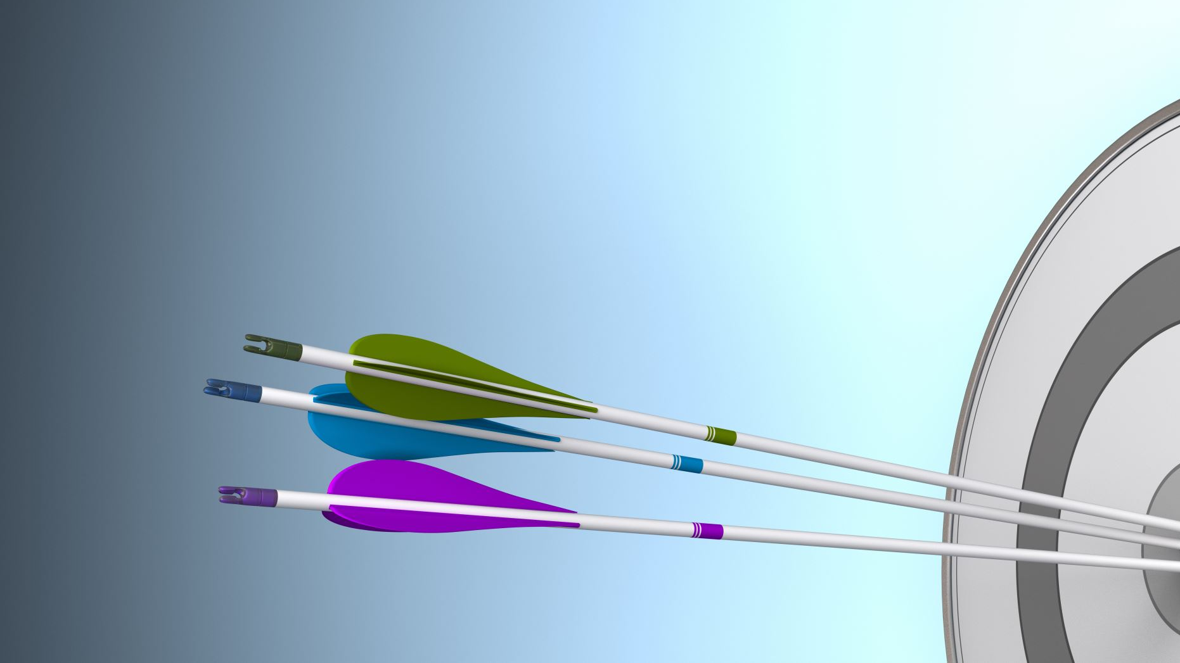
summary

Slide 18
Main takeaways
The app finds out accuracy, error rate, fitting and scoring time depending on:
quality of the data
quantity
normalization
Best in non-normalized data
Linear Discriminant Analysis
Quadratic Discriminant Analysis
Decision Tree
Random Forests
Worst in the normalized data
Ada Boost classifier

Slide 19

A Question
Which of the fruits was upside down?

Slide 20

Thank You

