Slide 1
CS 204
Advanced Programming
Instructor: Albert Levi
FENS 1091, levi@sabanciuniv.edu

Slide 2
Content
Couple of different items are discussed in these slides:
Course info
Good programming practice – style, commenting
Preprocessor, compiler, linker
Debugging
  using preprocessor directives
  assert statement

Slide 3
CS204 in a Nutshell
Continuation of CS201
  I will assume only CS201 knowledge; however, no CS201 review will be done.
CS204 is an integral part of CS curriculum and required/core course of several other programs
Coverage (Tentative)
  Advanced structured and object-oriented programming
    Templates, templated classes and templated functions
    Data representation, bitwise operations
    Advanced issues on classes and object oriented programming
    Inheritance, polymorphism and advanced object oriented design
  Introduction to data structures
    Pointers and dynamic memory allocation
    Linked lists, stacks and queues
  Writing better, more efficient programs
    Preprocessing and compiler directives
    Reusable software (using/creating libraries)
    Exception handling
  Visual programming and graphical user interfaces
  Programming with threads

Slide 4
CS204 in a Nutshell
Instructor
  Albert Levi, levi@sabanciuniv.edu, ext.9563, FENS 1091
Text Book
  Main text is "Ivor Horton's Beginning Visual C++ 2012", by Ivor Horton,
  ISBN: 978-1-118-36808-4.
  We'll also use "A Computer Science Tapestry" (CS201 book)
  Reference books are
    "Starting out with C++ Early Objects", 7th edition, by T. Gaddis, J. Walters and G. Muganda
    "Objects, Abstraction, Data Structures and Design using C++" by Koffman and Wolfgang.
  We may not stick to the textbooks; you are responsible material covered in class too.
  No rush to buy the book; wait a couple of weeks to see if you can do without the book.
Grading
  Midterm1: 23% (around 7th week, to be announced soon);
  Midterm2: 23% ((around 11th or 12th week, to be announced soon);
  Final: 34% (to be scheduled by the administration)
  Homeworks: 20%
  There will be 7-9 homeworks; the individual weights of the homeworks will be determined later
  No retake exam. Passing grade and letter grade boundaries will go to grave with me ☺
  Overall grade is not the only criterion for the letter grades. I will also consider exam grades to determine the passing grade and letter grade boundaries!

Slide 5
CS204 in a Nutshell
Webpage and electronic media
  http://people.sabanciuniv.edu/levi/cs204
  Visit the web page frequently; lecture notes will be posted there weekly after the lectures (on Tuesday or Wednesday)
  We will use SUCourse to submit/collect homeworks.
  For formal announcements I will use course email list and/or SUCourse announcements
    So please check your emails frequently
    Also check SUCourse
  For discussions you may use SUCourse
  If one creates a Whatsapp group and wants to add me to it, I’d be more than happy to join.

Slide 6
Schedule, Labs and TAs
Course Schedule:
  Monday, 11:40 – 13:30, FMAN 1099 (auditorium)
  Tuesday, 13:40 -14:30, FMAN 1099 (auditorium)
Lab Schedule
  Thursday 10:40 - 12:30, (Sections A1, A2 and A3) – see schedule for the places
  Thursday 15:40 - 17:30, (Sections B1, B2 and B3) – see schedule for the places
  Friday 10:40 - 12:30, (Sections C1, C2 and C3) – see schedule for the places
  Friday 12:40 - 14:30, (Sections D1, D2 and D3) – see schedule for the places
TAs
  To-Be-Determined and posted on website
TAs will cover some examples related to the topics covered that week and explain that week’s homework in the lab time. So this is half recitation, half lab hour.
For scheduling reasons, please attend to the registered lab section

Slide 7
Homeworks (1/2)
Homeworks really help you to understand the topics
Submission is through SUCourse only. Anything else will be ignored.
Submit all homework related files in a compressed archive
  Zip format must be used. Do not use rar or other formats.
Label your homework as
  SUNETUserName_Lastname_Firstname_Othernames_hw#.zip
  e.g. aliko_Koduguzel_Ali_hw3.zip
  Otherwise, we cannot find your homework
Write your name inside the files as well
The file types must be native ones
  For example, do not copy and paste your code to a MS word file
Any missing files in your submission will lose you points.
  If a critical file is missing (for example, your source code) your grade may be zero.
Grade checker will NOT be used
Do not expect too much detailed explanations in the homework specifications
  You are now grown-ups ☺
  You have to think how to design, code and test!

Slide 8
Homeworks (2/2)
Late Submissions
  Only one day (24 hours) late submission is allowed with a penalty of 10 pts.
  After 24 hours, no submissions are allowed. We need such cutoff to start the grading on time.
  If you resubmit after the deadline, last submission date and time will be considered.
  SUCourse time will be taken into account even if it is wrong.
  If you submit exactly at the deadline time, you are late.
Grading
  Homework must compile and run, but submit your final version in any case.
  Test cases will be different than the sample cases in the homework specification
    So you have to create your own test cases as well in order to make sure about correctness
  Grades will mostly be assigned based on proper functionality
    not based on how big is the mistake or how much time you spend; the problem may be with only one character in the code, but it may lose you 80 points
    Indentation, proper naming, comments, efficiency issues will also be taken in consideration
  During grading, no debugging will be done by the graders to understand what is wrong with the code. Even if you specify the wrong part, no code changes are allowed after the submission. If you submit wrong file, you get 0.
Please read the related policy at the website
  http://people.sabanciuniv.edu/levi/cs204/Homework_grading_policy.html

Slide 9

Plagiarism Policy for Homeworks
  Homeworks are to be done personally and you have to submit your own work
  Cooperation is not an excuse
  If you do not know how to cooperate, don’t do it
Sanctions
  -100 for the first case, fail the course in the next one.
  Plus, will be reported to the Dean
We use automated and intelligent tools for detection
We use all legal techniques to track down homework traders and people who contact freelancers, who make homeworks for money
  inside and outside of SU
  Any incident will be reported to the disciplinary committee with no exceptions
  Valid and useful denouncements will be awarded with bonus grades
Please read the related policy at the website
  http://people.sabanciuniv.edu/levi/cs204/policy_plagiarism.html
  I really mean it, read!!!
  In order to understand which cases are considered as plagiarism and to take actions before you have bad surprises

Slide 10


Make-up Policy
All medical reports must be submitted and all excuses must be reported BEFORE the exam.
In addition to applying to health center, you also have to write me about your case BEFORE the exam.
According to the by-laws, acceptance of report is up to the instructor
  I mean, do not rely on fake medical reports
The make-up exams may be given as oral exams
The make-up exams will be harder
than regular ones for fairness reasons
  because, make-up takers will have more
  time to study
  Please read the policy at
  http://people.sabanciuniv.edu/levi/cs204/make-up_rules.html

Slide 11
Good Programming practices,
Style, Debugging
You will be responsible from the style/practice guidelines listed here for all future homeworks/projects.

Slide 12
Programming
Time spent as a software engineer will be spent mostly on maintaining and improving/upgrading code:
  80-90% time
  Yours or others
# of lines per major application:
  May go as much as >1 million!
  It has to be written well so that upgrading/maintaining is manageable
Some old programs cannot be improved because nobody understands the code!

Slide 13
Good Programming Habits: Overview
Develop and test your code incrementally
Code defensively
Code clearly
Use modular code
Include debugging code
Include comments
Hocanın dediğini yap, yaptığını yapma ☺
Do what the teacher says, not what the teacher does ☺

Slide 14
Good Programming Habits: Comments
How much?
  Enough for someone to be able to understand/modify your code in the future
  Ideally when the comments are read without looking at the code, everything should be clear
Where?
  program header: describe purpose, usage, inputs, outputs, known bugs, author, date, version history, external references
  each function and major part: purpose, input and output parameters, returning value
  each variable: describe the purpose and usage
  instructions: not as paraphrasing the code, describe semantically.
When?
  Comment when first writing
    then update as necessary
  Check the comments before finalizing
You must use sufficient comments in each of your homework submissions
  penalty: up to 10pts over a 100pts-homework
Style
  There are different conventions. Consistency is important.
  A suggestion: comments and codes should be separable
  A sample is in the next slide

Slide 15
Good Programming Habits: Comments
/******************************************************************************
      Purpose: This program is a CD title maker.
      Usage: cdmake songlist.txt
      Input, output:
      Author: Berrin Yanikoglu
      Date: 22/2/2005
      Any known bugs: It works fine for txt files but crashes on empty input files
      References: Any source used besides the ones you used etc.
    ******************************************************************************/
    ...
    int TotalTime; //total time of the songs in CD in seconds
    ...
  /*****************************************************************************
  This function computes the remaining length in the CD, after
  writing all the songs in the input file.
  Input: ...
  Returns: ...
  *****************************************************************************/
  int RemainingLength(....)
  {
  ...
  }
  /*****************************************************************************/
    /************* Process Input and Format Output *********************/
/*****************************************************************************/
int ctr; //counter for ...

Slide 16
Good Programming Habits: Comments
Clear?
temp = box1.x;
box1.x = box2.x;
box2.x = temp;
temp = box1.y;
box1.y = box2.y;
box2.y = temp;

Slide 17
Good Programming Habits: Comments
What you should do may be the following.
  /* swap the two corners of two box objects*/
  /* swap the x coordinate */
  temp = box1.x;
  box1.x = box2.x;
  box2.x = temp;
/* swap the y coordinate */
temp = box1.y;
box1.y = box2.y;
box2.y = temp;

Slide 18
Good Programming Habits: Naming Conventions
Naming Style suggestions:
  balanceOwedToMe //first word lowcase, then capitalized initials //good for normal vars
  RecordsInFile //capitalized initials, good for global variables
  MAX_STUDENT_NUM //all caps - good for constants
  e.g. const short MAX_STUDENT_NUM = 1000;
  See http://geosoft.no/development/cppstyle.html
  for a very structured convention that is used by many software professional.
  DO NOT USE dummy names such as myvar, Ali_stat, ImparatorFatihTerim, a, b, c, x, y, z
    Use context specific and self-explanatory names
    This improves the readability of your code
  Similarly, do not call your homeworks deneme, test etc. ☺

Slide 19
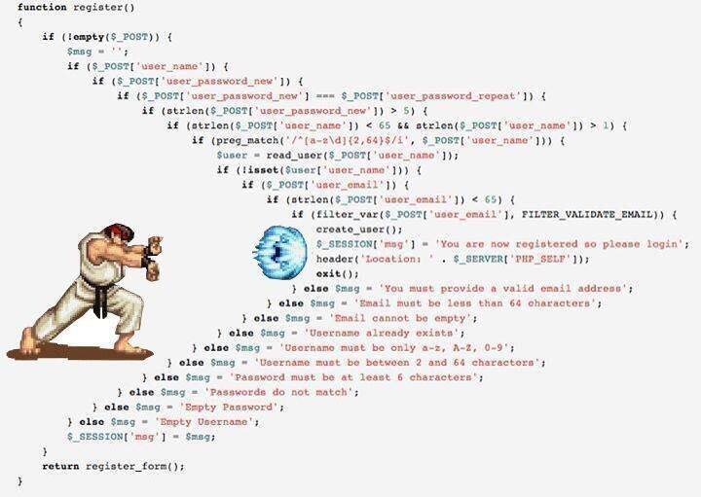
Good Programming Habits: Indentation
Vertical alignment of the programming blocks
  Beginning and end of blocks should be distinguishable
Use and location of the curly brackets { }
  It is a good idea to always use it even for single-statement blocks
  Two schools. Whatever you choose, adopt and stick to one format
    for (i=0; i < NUMCLASS; i++) {
      ...
    }
    or
    for (i=0; i < NUMCLASS; i++)
    {
      ...
    }
I prefer this

Slide 20
Good Programming Habits: Clarity
Use empty spaces in your code to separate logical blocks
  As you make paragraphs in essays
Do not code for compactness
  We are not encoding knowledge
  Clarity is very important
Do not use obscure notations
o = 5;
o = --o + o-- ; //Use one ++ or -- only, on one line
value = 1;
res = (value++ * 5) + (value++ * 3);
// do not even do this, even though it looks a little more innocent
Do not confuse "compactness" with "programming efficiency"
  Efficient programming is to move out unnecessary code or to avoid unnecessary iterations, so that no extra computation is done.
  Compactness refers to how short your code is. You don’t want to make your program unnecessarily long.
  But compactness must not yield cryptic code: rule is to put only as much code on one line as it is still clearly understandable.

Slide 21
Good Programming Habits: Code development
Develop and test incrementally
  Rather than writing the whole program first
    oneof the biggest source of frustration when trying to start a project or homework.
Code modularly
  Think the solution in pieces
    Without losing their connection to the big picture
Code defensively
  Robustness
  Proactive defense
    Take precautions to all possible mistakes
  Do not trust yourself
    Anybody can make mistakes
  Especially do not trust the user of your program; he/she can do anything!
  Example: Check if a file is opened successfully or not. Otherwise, you can get a crash or I/O operations do not work out.
  ifstream input(filename.c_str());
  if (input.fail() )
  {
  cout << "could not open file " << filename << endl;
  return 0;
  }

Slide 22
Good Programming Habits:
Code development
Other’s code
  You will often have to deal with!
  Add comments as you understand the code, for your sake and others in the future.
Don’t ignore warnings
  Try to fix
  or at least understand why they exist.
    They may be precursors of catastrophes
  For example
    int j – unreferenced variable
    Maybe you wanted to use j, but instead of j you wrote jj and jj is another variable.
  In ideal case, you should see no warnings when you compile
  You can change your project’s warning settings (see Warning levels under Project → Properties→C/C++) so that more important warnings do not get overlooked in a flood of warnings
    Of course, with the risk of missing some potential problems.

Slide 23
Preprocessor, Compiler, Linker

Slide 24
Preprocessor
A preprocessor is a program that takes your source file and outputs an intermediate file (translation unit) before compilation.
It does text substitutions controlled by preprocessor directives, which are lines starting with # character
  #include "filename" #include <filename>
  Ex: #include "date.h" #include <string>
contents of the include file (date.h in the example) is inserted into the translation unit
  The process is recursive such that if a #include file has other #include files inside, they are also inserted.
Full path may be given between " and "
Difference between " " and < >
  If quotes are used, first folder of the file containing the include statement is checked. Then the standard folders are searched for the included file.
  İf angle brackets, < > , are used, then only the standard folders are searched
Caution: You have to avoid multiple inclusions of the same file in different include files.
  Using if family compiler directives (will see later)

Slide 25
#define
#define identifier token-string
  to define a preprocessor identifier
  All occurrences of identifier are replaced by token-string before compilation
  commonly used to define constants (but const definitions can also be used; it is up to you)
#define PI 3.1416
#define MAXSIZE 10000
#define PROMPT "Please enter your move: "
  Alternatively you may define constants, but this is not a compiler directive (it is directly compiled)
const double PI = 3.1416;
  A #define without a token-string removes occurrences of identifier from the source file (starting from that line). The identifier remains defined.
    #define MYDEBUGCODE
  See testdefine.cpp for an example

Slide 26
Conditional Preprocessing
#ifdef identifier
statements
#endif
  statements are included translation unit if identifier is defined (with or without a token-string)
#ifndef identifier
statements
#endif
  statements are included translation unit if identifier is not defined
  In both cases, for identifiers defined using #define
    regular identifiers do not count
  See next slide for an example and testdefine.cpp for another example

Slide 27
An example
Actual cpp file
Translation Unit
#include "dice.h"
#define MYDEBUG
#ifdef MYDEBUG
cout << n;
#endif
DoSmthg();
class dice
…
…
}
cout << n;
DoSmthg();

Slide 28
Conditional Preprocessing (Cont'd)
More general conditional preprocessing can be performed using #if, #elif, #else, #endif preprocessor directives
  Main idea is similar to nested if statements (but this is done at preprocessing stage)
  #if constant-expression
  statements
  #elif constant-expression
  statements
  #else
  statements
  #endif
  Constant expression must include only #defined identifiers and literals
    Comparison and boolean operators can be used
  Do not use regular variables here. In VC++, they are considered as 0 no matter their values are. Thus it causes unexpected results
  See testdefine.cpp for an example
- Optional,
- Can have multiple times
- Optional

Slide 29
#undef
#undef identifier
  Removes identifier which is previously created with #define
  In other words, it becomes undefined
  Only affects subsequent occurrences of identifier
    not the previous ones
  CAUTION FOR Visual Studio:
    If you use an #undef'ed identifier in an expression, it is considered as zero, rather than a compiler error in MS Visual Studio.

Slide 30
Macros
The #define directive is also used to define macros with parameters:
    #define MULTIPLY(a, b) a*b
    #define SQUARE(x) x*x
After theses macro definitions, the preprocessor will replace any text in the forms of
  MULTIPLY (something, anotherthing) with something*anotherthing
  SQUARE(something) with something*something
These macros are supposed to define a squaring/multiplication operation without writing a real C++ function
  But this is not so correct, they are not functions! (See next)

Slide 31
Preprocessor Macros are Dangerous
Consider the following code
#define SQUARE(x) x*x
int x = SQUARE(3+5);
int y = 100/SQUARE(5);
int k=5;
int z = SQUARE(++k);
What is the value of of x?
  Answer: 23, why?
What is the value of of y?
  Answer: 100, why?
What is the value of z?
  Answer: 49, why?
More correct way of defining this macro is
#define SQUARE(x) ((x)*(x))
This corrects first two cases above. But even this does not solve the third problem above.

Slide 32
Use of Macros is not much recommended
To be on the safe side, do not use macros
Use functions instead
  int Square (int x)
  {
    return x*x;
  }

Slide 33
Compiler & Linker
The input to the compiler is the translation unit generated by the preprocessor (starting from a single source file - e.g. main.cpp).
The compiler generates an object file (e.g. main.obj). Sometimes object files have .o extension.
If the project has several cpp files, normally they are compiled separately yielding different object files
The linker combines all necessary object files and libraries in the project together to create an executable program.
  More on the libraries later.

Slide 34
Debugging

Slide 35
Debugging: Diagnostic Messages
cout is sometimes the best debugger
  No kidding
Sometimes, to debug your program, you will include some diagnostic messages
For example,
//See if all values are correct
for (i=0; i < 26; i++)
cout << counter[i] << " ";
cout << endl;

Slide 36
Debugging
When you think you are done debugging, you can do one of the followings to turn debug statements off (so that your program runs fast and without debug messages)
  1) remove all these debug codes (e.g. cout’s)
    Too much work. Moreover, you may need them again when some other problem shows up (i.e. if you need debugging later on)
  2) make them conditional to a program variable. For instance:
    if (debug == 1)
    {
for (i=0; i < 26; i++)
cout << counter[i];
cout << endl;
}
    Then by setting the variable debug to 1 or 0 on top of the program, you can control whether the statements will be output or not.
    Tests such as if (debug == 1) are still done (slows the release version)!

Slide 37
Debugging
Best way: Using the preprocessor directive _DEBUG and conditional preprocessing
    #ifdef _DEBUG
for (i=0; i < 26; i++)
cout << counter[i];
    #endif
  This code will only be compiled if the _DEBUG is defined
  _DEBUG is a standard preprocessor identifier which is defined in the Debug configuration, but not defined in the Release configuration.
  This is automatic when you switch between these two configurations
  So when the preprocessor parses your code:
      If the _DEBUG preprocessing identifier is defined, it will remove the #ifdef and #endif, but will include the lines between in your program.
      If the _DEBUG prep. identifier is NOT defined, the preprocessor will remove the #ifdef and #endif and the lines between them out of your program. So your program will be as if you have never written those lines (no extra tests done)

Slide 38
Debugging: Debug/Release
You normally develop under Debug mode (a.k.a. Debug configuration)
  After testing your program, you may want to submit it in release mode (release configuration)
When you are developing with Debug option, the compiler keeps track of symbolic information so that you can watch over variable values, function call hierarchy etc., at every step in your code.
Once you are done debugging and you will release the code to the customer (or teacher), you want to remove this information and any other debugging code you may have added so that your executable is cleaner, smaller and faster.
  This is done by switching to Release mode (a.k.a. Release configuration).
  In Release mode _DEBUG is not defined

Slide 39
Debugging: Debug/Release
In VS 2012, you can change configuration between debug and release by
  selecting from the Build tab, then from Configuration Manager (see the next screenshot)
CAUTION:
Programming is tricky; sometimes a code working in debug mode may not work properly in release mode.
Test your program in release mode as well.

Slide 40
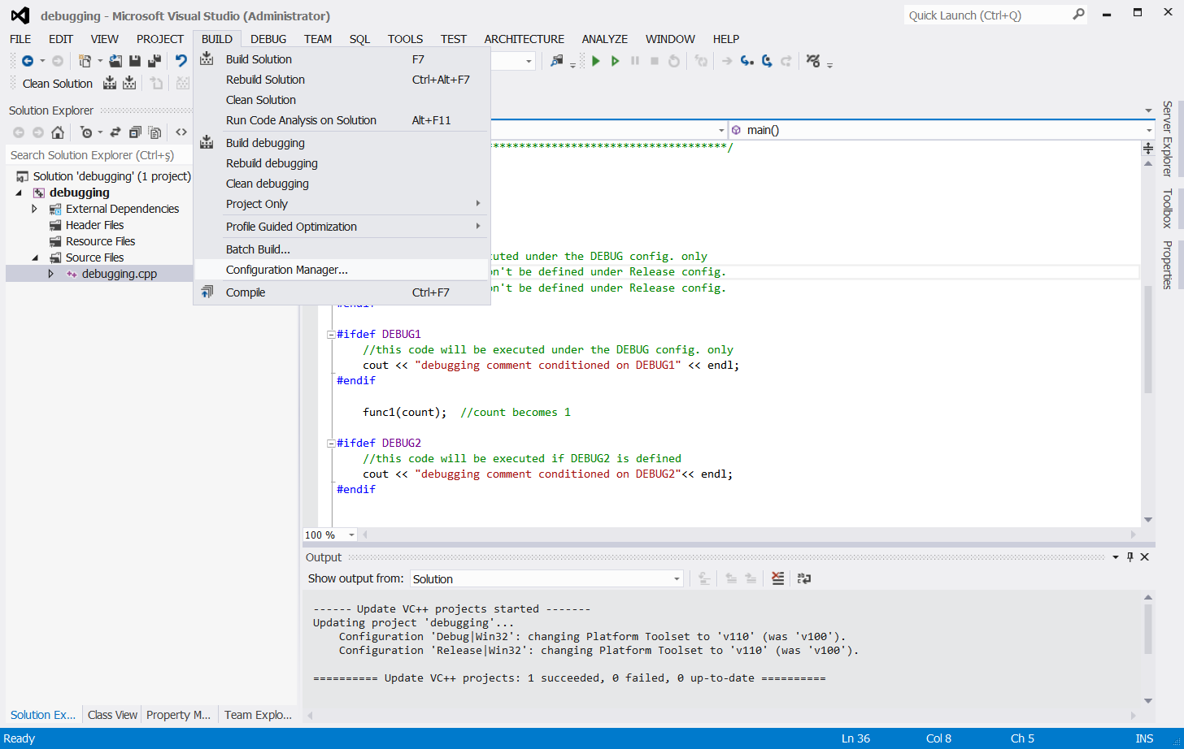

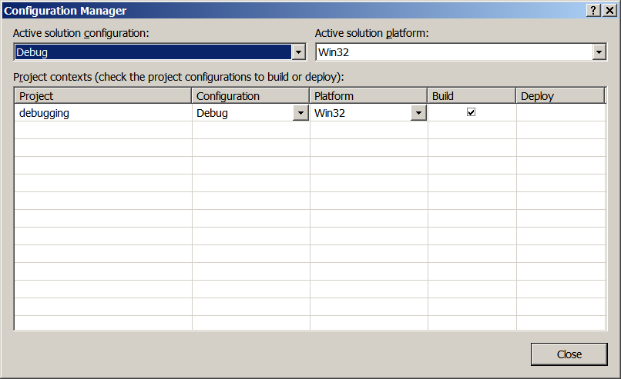

Slide 41
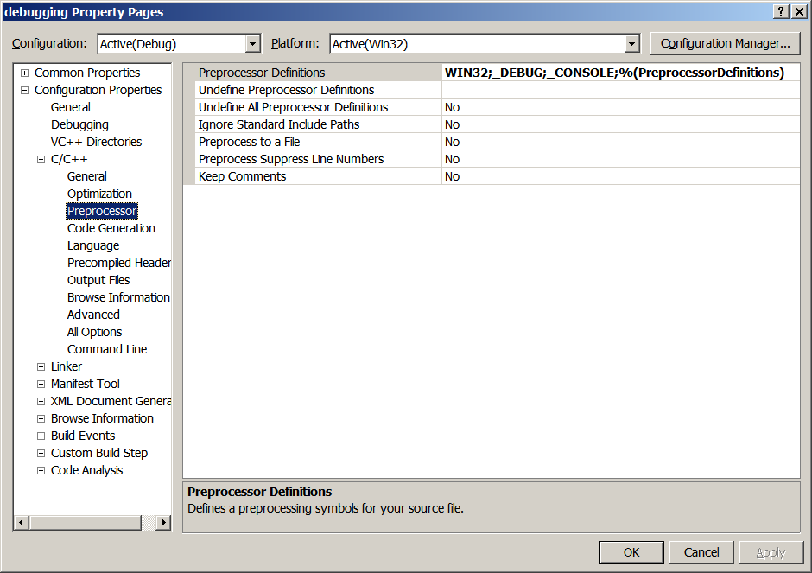
Preprocessor Directives Under Debug Setting

Slide 42
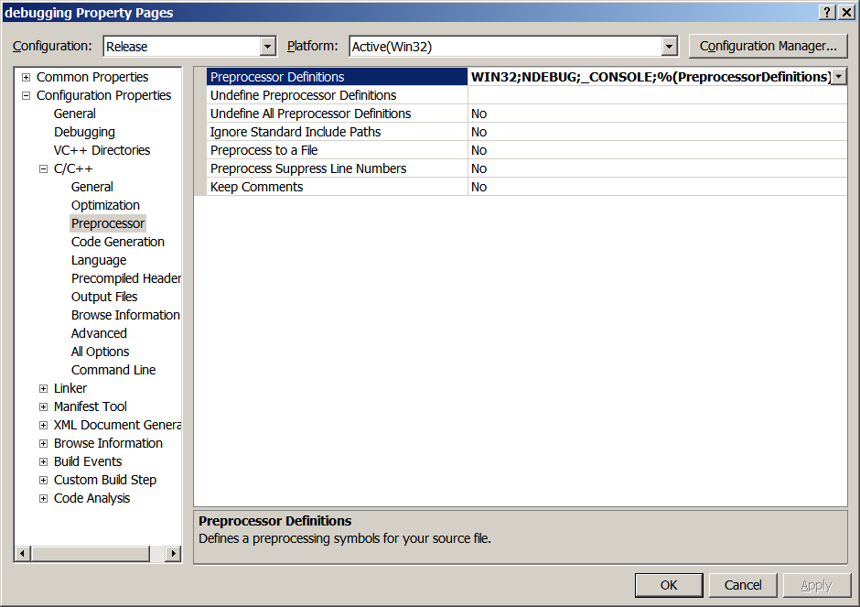
Preprocessor Directives Under Release Setting

Slide 43
Preprocessor Output: debug version
n = 1;
#ifdef _DEBUG
cout << n;
#endif
DoSmthg();
DoSmthgElse();
n = 1;
cout << n;
DoSmthg();
DoSmthgElse();
_DEBUG is defined as a standard preprocessor identifier under the Debug build of your code.

Slide 44
Preprocessor Output: release version
n = 1;
#ifdef _DEBUG
cout << n;
#endif
DoSmthg();
DoSmthgElse();
n = 1;
DoSmthg();
DoSmthgElse();
_DEBUG is not defined as a preprocessor identifier under the release build of your code.

Slide 45
Debugging
You can also use your own preprocessor definitions:
  You can either add them to the preprocessor definitions under Project/Properties/... where _DEBUG was defined
  Or you can define them with #define in the beginning of the file
    //You can define or not define your debug flags:
      #define SHORTDBG
      //#define MAJORDBG
      ...
      #ifdef SHORTDBG
      cout << "*** Value of num = " << num << endl;
      #endif
      #ifdef MAJORDBG
      cout << "*** Value of num = " << num << endl;
      cout << "*** Value of info = " << info << endl;
      cout << "*** Value of t = " << t << endl;
      ...
      #endif

Slide 46
Debugging
Previous solutions require to comment out user defined preprocessor definitions for the release config.
Alternatively, you can also make them conditioned on the automatic flag _DEBUG
  #ifdef _DEBUG
  #define SHORTDBG //this code won’t be compiled under release config
  //#define MAJORBG //this code won’t be compiled under release config
  #endif
This way, if you are running under the release config., you don’t need to turn SHORTDBG or MAJORDBG off. Since their definition won’t even be compiled, your flags won’t be defined.
See debugging.cpp for an example

Slide 47
Debugging: Assert statements
Syntax:
  assert (boolean-expression);
If the boolean-expression evaluates to true, execution continues.
If the boolean-expression evaluates to false, execution is halted (program aborts)
  A message is dumped at this point, something like the following
    assertion failed: i < j file code.cpp, line 543
You have to have #include <cassert> at the beginning of the program to use assert
Use assert statements to check for conditions that should be true
    #include <cassert>
    ...
    assert (p != NULL);
    ...
    assert ( i < j );

Slide 48
Debugging: Assert statements
assert statement should not replace checking and handling errors (e.g. if the file is found or not)
provides compact checks for things that should not happen (e.g. would cause the program crash)
  Exceptions
Other alternative methods?
  We will see exception handling in the coming weeks for a neat organization of error handling

Slide 49
Debugging: Assert statements
The assert statement can be "turned off" by defining the preprocessor identifier NDEBUG before including cassert
#define NDEBUG // No Debug
#include <cassert>
If you use the release configuration, NDEBUG is already defined, so you do not need to define it yourself.
In cassert, NDEBUG is checked if it is defined or not:
  If it is defined, the assert statement evaluates to an empty statement, which is what we want for the Release configuration, so the tests are not done and do not slow the program.
  If it is not defined (Debug mode/configuration), the assert statements stay and do the tests as intended.

Slide 50
Debugging: VC++ environment
Visual Studio has lots of facilities for debugging
  Breakpoints
    F9
  Run until next breakpoint
    F5
  Step in: F11
  Step out: Shift-F11
  Step over: F10
  Run to cursor: Ctrl-F10
  Inspecting variables:
    Variables window (Auto, Locals)
    Watch window
  CAUTION: Even in release mode, these work! Release mode and having NDEBUG defined (or DEBUG undefined) does not mean that you cannot use these debugging tools. However, in release mode, tracing capabilities reduce

Slide 51
Preprocessor, Compiler, Linker ctd.

Slide 52
Header Guards
  A very important use of conditional compilation is to prevent multiple inclusion of header files
    Multiple inclusion would duplicate declarations, resulting in compiler errors.
    Maybe you can manually check multiple inclusions of the same file in a single .cpp or .h, but when header files include themselves, this manual check becomes very hard → so we need an automatic way for that.
    Automatic way is to assign a preprocessor definition for each header file (convention is _HEADERFILENAME, where the dot is replaced by _ character) and check if it is defined before including the content of the header file. It is defined for the first time of inclusion, so in the next trials of inclusion, it is not going to be included.
  In the following example, _DICE_H is defined when "dice.h" is included the first time, hence later inclusions of "dice.h" won’t have any effect on translation unit.
  #ifndef _DICE_H
  #define _DICE_H
  ... //dice content is here
  #endif

Slide 53
Compilation with Several Files
Sometimes we may need to compile several cpp files
  dice.cpp, randgen.cpp, prompt.cpp, ...
  because some functions and class implementations are in those files
    if you are using them in your program, you have to compile them together with your main cpp file
    add to the same project
  But there must be only one cpp file with main function
Sometimes, the class and function implementations are in precompiled libraries
  ready-to-use object code
  need not to compile, but add the .lib file to the project

Slide 54
Linker
Combines all necessary object files and libraries together to create an executable program.
May create errors even if compilation is successful
  unresolved external symbol ...
  undefined Symbol ...
  Primary reason would be missing libraries or implementation files (like date.cpp, prompt.cpp)
    header files provide the definition, but body is missing!
  If you have such errors, try to find where those symbols are implemented and include those libs or cpps in your project

Slide 55
Putting Everything Together
…
cpp and header files in the project
preprocessing
translation units
…
compilation
libraries
object files
…
linking
Executable File

Slide 56
Libraries
Creating a statically linked library
  choose your project as win32 console application but select "static library " as the application type
  Add or write the necessary header and cpp files for your class and/or library
  No main function
  Build – the output is a .lib file
  Example: Use staticlib.h and staticlib.cpp to create such a .lib file
Using this library
  Create your project that will use this library
  Add a main cpp file that will do the job by using this library
    This is the cpp file with main function
  Add the library (.lib file) as a resource file to the project
  You do not need to add the cpp file that contains the library function/class implementation
  Compile, link and run
  See testlib.cpp for an example

Slide 57
Static versus Dynamic (shared) Libraries
The libraries you link statically are linked into the final executable by the linker (remember that they are pre- compiled).
Dynamic libraries are libraries that have the library name embedded into the executable but the library itself is not linked to the final executable.
  Thus the size of executable is smaller
When you build a program, the linker verifies that all the symbols (functions, variables …) required by the program, are either linked into the program, or in one of its shared libraries. However, the object files from the dynamic library are not inserted into the executable file.
Instead, when your program is started, a program in the operating system (called dynamic loader) checks out which shared (dynamic) libraries are needed for the program, loads them to memory, and attaches them to the copy of your program in memory.
  Thus, launching your program is a bit –insignificantly – slower

Slide 58
Miscellaneous Info

Slide 59
How to Redirect Output
  Right click on Project, choose properties, Debugging properties under Configuration Properties. Add >filename to Command Arguments to redirect Standard output that normally goes to the DOS console to filename in Project directory
  However, in this case, input remains in console
  See next slide for a snapshot of how to redirect output in VS 2012.

Slide 60
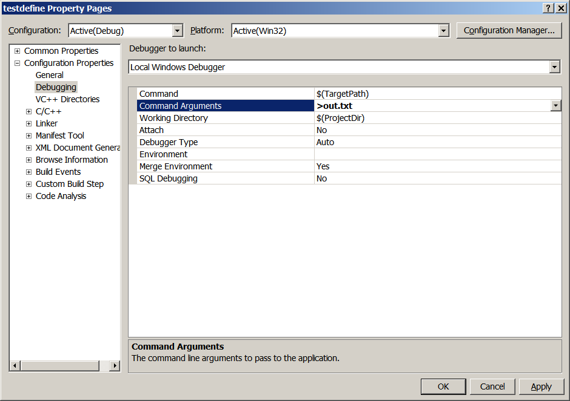

Slide 61
How to Add a Folder to Include Directories for a project - 1
Right click on Project, choose properties, click on VC++ Directories under Configuration Properties.
Edit Include Directories line on the right of the window to add the folder that you want to add.
See next slide for a snapshot

Slide 62
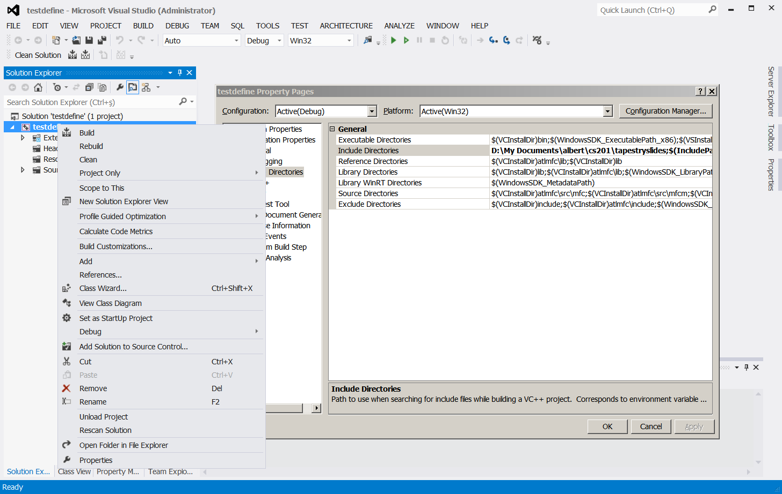

Slide 63
How to Add a Folder to Include Directories for a project - 2
However, the previously described method is only for a specific project.
If you want to make this change default to all projects , select "Property Manager" tab on the left pane of VS2012 (or via the View Menu). Expand the project on Property Manager and right-click on "Microsoft.Cpp.Win32.User" under "Debug | Win32"
Choose "Properties" and change the Include folder as in the previous method.
See next slide for a snapshot

Slide 64
