Slide 1



CS395 INTERNSHIP PROJECT PRESENTATION: SECURE AND PRIVATE USER-BASED KNN RECOMMENDER
Elif Cemre Durgut
Sabancı University
Faculty of Engineering and Natural Sciences
Computer Science & Engineering
0026493
Supervised by Albert Levi
EPFL – Scalable Computing Systems Laboratory
Supervised by Rafael Pires
13/06/2022-26/08/2022

Slide 2


Recommendation systems play an important role in terms of increasing the profit of commercial websites and helping customers to pick what they want to buy, watch, or eat.
Figure 1: Different recommendations taken from Amazon

Slide 3
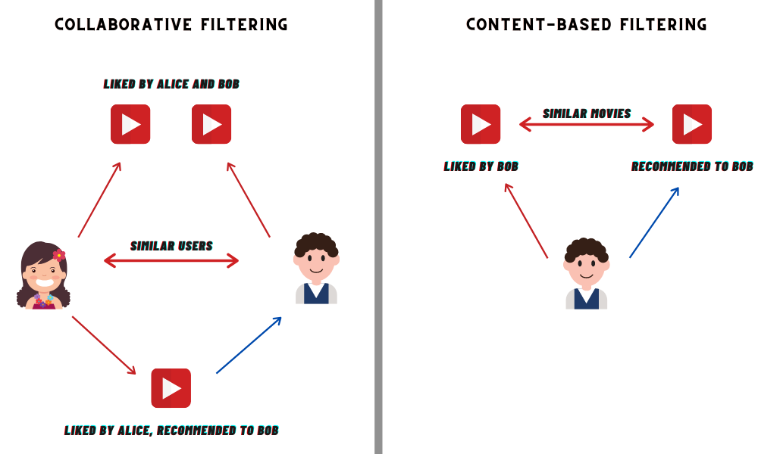
Figure 2: The comparison between collaborative and content-based filtering (Anand, 2020)

Slide 4
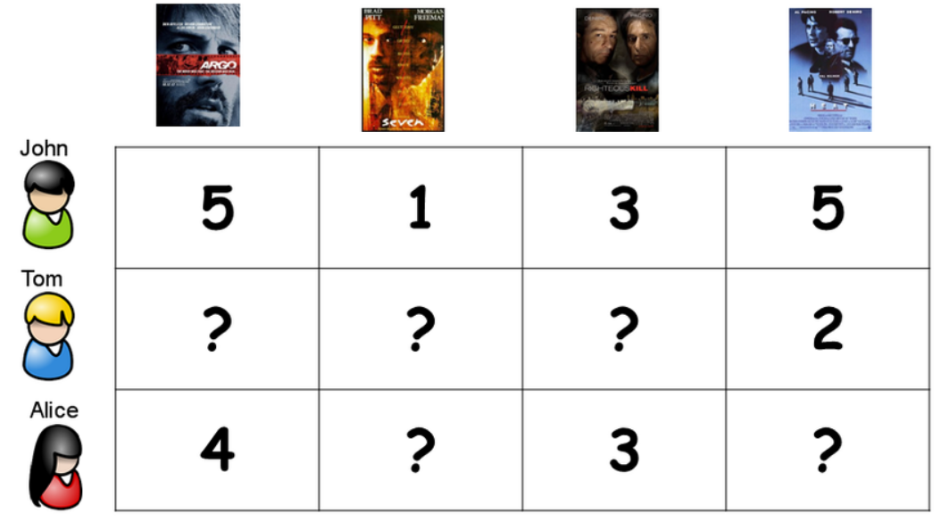
Figure 3: The users and movies matrix with movie rating entries

Slide 5

PROBLEM DEFINITION
KNN recommenders involves the access to sensitive data in the form of user profiles and this poses a privacy threat.

Slide 6
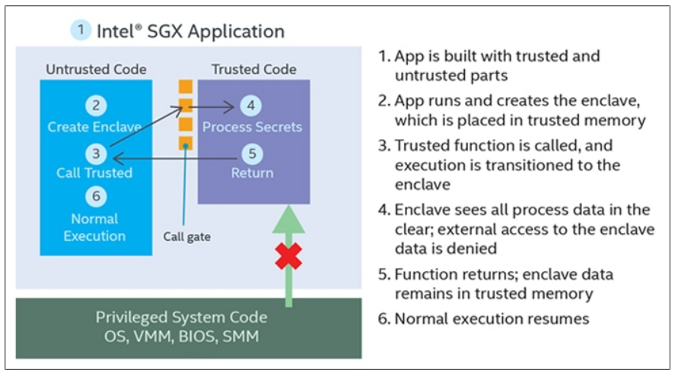
OBJECTIVES
- To build a user-based Knn movie recommender using SGX which keeps the user profiles private and secure from attacks
- To test the system with SGX in different scenarios where the clients send 10, 100 and 1000 requests at a time
- To measure the overhead of using SGX compared to non-SGX system
Figure 4: Intel SGX working flow (Mechalas&Odom, 2016)

Slide 7




METHODS & TOOLS
- MovieLens dataset has been used.
- Intel SGX was used to protect users’ privacy
- ZeroMQ was used for the communication between the server and the clients
- Development was made using C, C++ and Python
- The scenarios were tested on machines at EPFL IC Clusters

Slide 8

OUTCOME & DELIVERABLES
The project is succesfully completed and shared on GitLab.
The objectives are achieved with the help of Intel SGX that keeps user neighbors graph secure and operates on user profiles privately.
- I presented what I have done to my supervisor in the end.

Slide 9
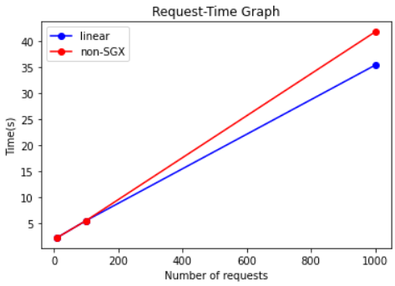
RESULTS
The recommender system without SGX has been tested with 10, 100 and 1000 requests. The average time taken per request increases as the total number of requests increases.
The recommder system with SGX is completed but the tests are ongoing.
FUTURE WORK
The messages sent between the server and the clients should be encrypted.
Before the clients send private data, the attestation should be done so that the enclave is verified by the client.
Differential privacy techniques to increase privacy should be investigated.
Figure 5: Number of requests vs Time(s) graph in points 10, 100 and 1000 on the x-axis

Slide 10
REFERENCES
Anand A. (2020). User-User Collaborative Filtering For Jokes Recommendation. Retrieved on 02/10/2022 from https://towardsdatascience.com/user-user-collaborative-filtering-for-jokes- recommendation-b6b1e4ec8642
Mechalas J. P., Odom B. J. (2016). Retrieved on 02/10/2022 from https://www.intel.com/content/www/us/en/developer/articles/training/intel-software-guard-extensions-tutorial-part-1-foundation.html
Taesoo, K. SGX 101. Retrieved on 02/10/2022 from https://sgx101.gitbook.io/sgx101/

