Slide 1
Visualisation for Data Analytics: Data Collection: Direct and Web Scraping

Slide 2
Learning Outcome
To learn basics of HTML
To get information about various website useful for data collection
To learn web scraping to data collection

Slide 3
Outline
Introduction to Direct data download
Web scraping
Introduction to Web scraping
Introduction to basic HTML
Introduction to Beautiful Soup
Data Extraction using Beautiful Soup

Slide 4
Data Collection
Direct Download: Many companies and websites make data publicly available for research purpose
Web Scraping: you can scrape data set from the websites
API: Several companies for example, google, twitter etc. provide API to access their data
In this lecture, we will focus on direct data download and web scraping

Slide 5
Direct Data Download

Slide 6
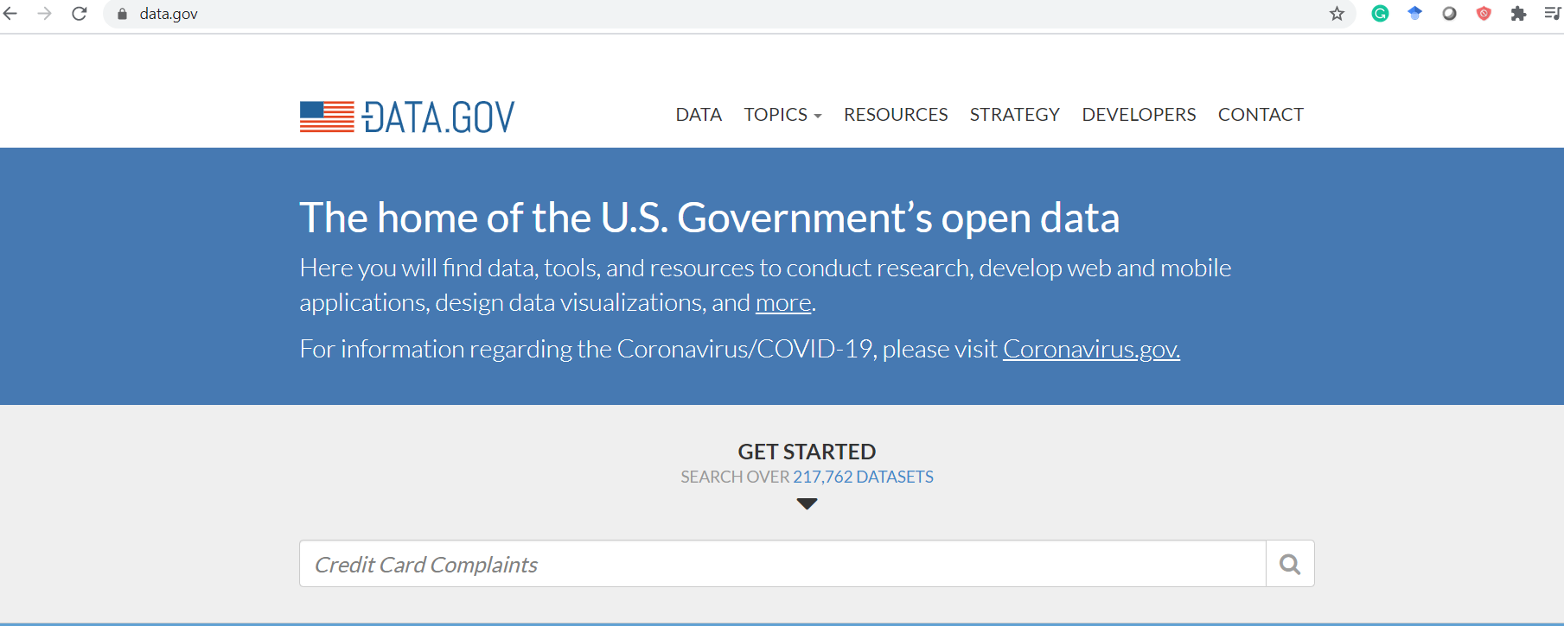

Direct Data Download
Data.Gov: The home of the U.S. Government’s open data

Slide 7
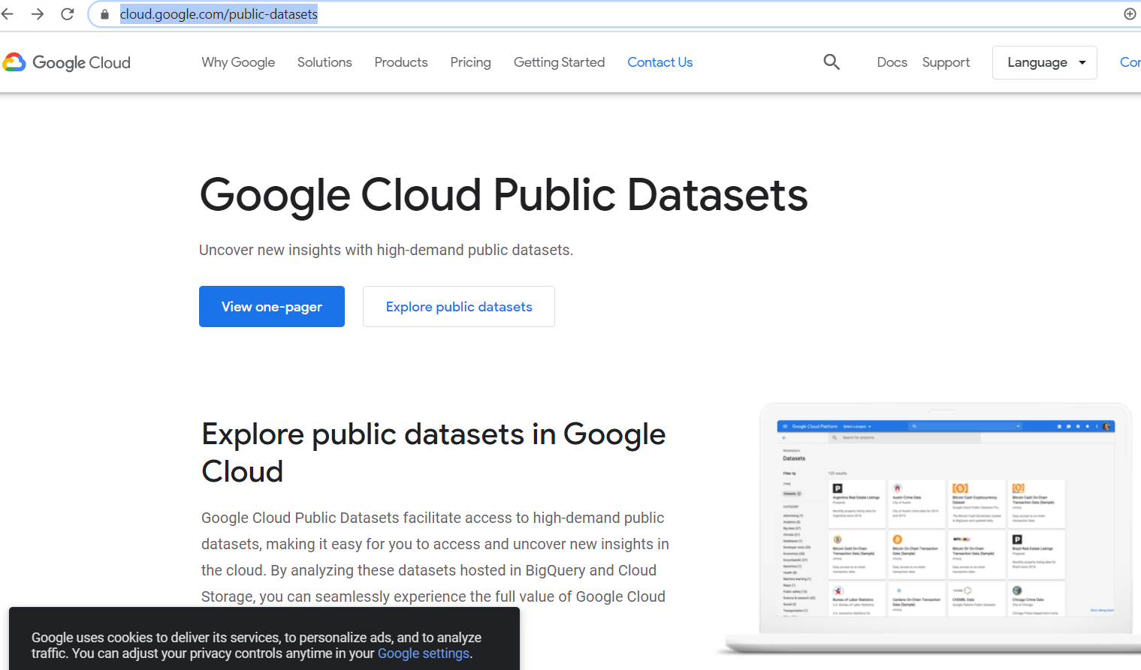
Direct Data Download
https://cloud.google.com/public-datasets

Slide 8
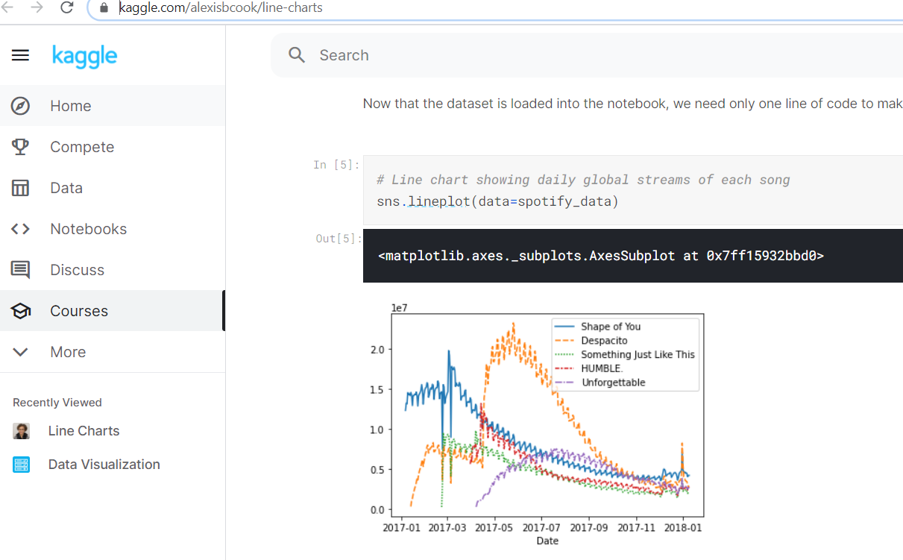

Direct Data Download
https://www.kaggle.com/
Have lots of useful resources for data science enthusiast

Slide 9
Direct Data Download
There are several website which provide various data sets and you can use these data sets
UCI Machine Learning Repository
https://archive.ics.uci.edu/ml/datasets.php?format=&task=clu&att=&area=&numAtt=greater100&numIns=&type=&sort=nameUp&view=table
SatckExchange: Data of Q&A websites
https://archive.org/details/stackexchange

Slide 10
Export the data
SQL format: Database (relational or non-relational)
CSV
JSON
XML format
Many other format are possible

Slide 11
Web Scraping

Slide 12
Web Scraping
Web scraping (web harvesting) is a software technique of extracting information from websites
It focuses on transformation of unstructured data on the web (typically HTML), into structured data that can be stored and analysed

Slide 13
Introduction to HTML

Slide 14
Introduction To HTML
Before we learn how to extract data from a website
It is important to learn basics of HTML

Slide 15
Introduction To HTML
HTML is the standard mark-up language for creating Web pages
Basic Tags
The <!DOCTYPE html> declaration defines that this document is an HTML5 document
The <html> element is the root element of an HTML page
The <head> element contains meta information about the HTML page
The <title> element specifies a title for the HTML page (which is shown in the browser's title bar or in the page's tab)
The <body> element defines the document's body, and is a container for all the visible contents, such as headings, paragraphs, images, hyperlinks, tables, lists, etc.
The <h1> element defines a large heading
The <p> element defines a paragraph
https://www.w3schools.com/html/html_intro.asp

Slide 16
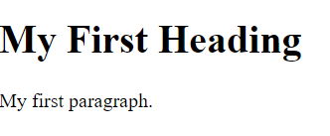
Introduction To HTML
Example 1:basic
<!DOCTYPE html>
<html>
<head>
<title>Page Title</title>
</head>
<body>
<h1>My First Heading</h1>
<p>My first paragraph.</p>
</body>
</html>
https://www.w3schools.com/html/html_styles.asp

Slide 17
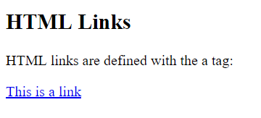
Introduction To HTML
Example 2: Hyperlink
<!DOCTYPE html>
<html>
<body>
<h2>HTML Links</h2>
<p>HTML links are defined with the a tag:</p>
<a href="https://www.w3schools.com">This is a link</a>
</body>
</html>

Slide 18
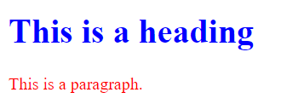
Introduction To HTML
Example 3: Color change
<!DOCTYPE html>
<html>
<body>
<h1 style="color:blue;">This is a heading</h1>
<p style="color:red;">This is a paragraph.</p>
</body>
</html>

Slide 19
HTML
You can check the following link for getting some information about HTML
http://www.w3schools.com/html/
http://www.codecademy.com/tracks/web

Slide 20
Fetching Data from a website

Slide 21
Fetching the data from Static Website
Involves finding the endpoint - URL or URL’s
Sending HTTP requests to the server
Using “requests” library
Code:
import requests data = requests.get('https://www.cu.edu.tr/') page_content = data.content print(page_content)

Slide 22
Output
Look something like this:
<meta name="viewport" content="width=device-width, initial-scale=1">\r\n <meta http-equiv="X-UA-Compatible" content="IE=edge" />\r\n \r\n\t\t<title>Cukurova University - Home </title>\r\n\r\n\t\t<meta name="DC.author" content=“Cukurova University" />\r\n\t\t<meta name="DC.title" content="Home" />\r\n\t\t<meta name="DC.description" content="No.1 in England in the National Student Survey (2018), with research that tackles the world\'s most urgent problems." />\n\r\n\t\t\r\n\r\n\t\t<!-- navigation object : k-core-global-cookie-first-load-head --><!-- OneTrust initial initial script on page load -->\r\n\r\n<!-- OneTrust Cookies Consent Notice start -->\r\n\r\n<!-- important - autoblocking is not on and OneTrustGroupsUpdated is added -->\r\n\r\n<script src="https://cdn-ukwest.onetrust.com/scripttemplates/otSDKStub.js" type="text/javascript" charset="UTF-8" data-domain-script="1ccdea98-8961-4ffc-91e0-ae57e6d8c0e3"></script>\r\n<script type="text/javascript">\r\nfunction OptanonWrapper() { }\r\n{window.dataLayer.push({event:\'OneTrustGroupsUpdated\'});}\r\n</script>\r\n<!-- OneTrust Cookies Consent Notice end -->\r\n\t\t<!-- navigation object : k-core………………………………………………….

Slide 23
Output
It can be difficult to wrap your head around such a long block of HTML code.
To make it easier to read, you can use an HTML formatter to automatically clean it up a little more.
Good readability helps you better understand the structure of any code block. While it may or may not help to improve the formatting of the HTML, it’s always worth a try.
In case you ever get lost in a large pile of HTML, remember that you can always go back to your browser and use developer tools to further explore the HTML structure interactively.

Slide 24
Beautiful Soup

Slide 25
Use BeautifulSoup for parsing
Provides simple methods to-
search
navigate
select
Deals with broken web-pages really well
Auto-detects encoding
Philosophy- “You didn't write that awful page. You're just trying to get some data out of it. Beautiful Soup is here to help.”

Slide 26
BeautifulSoup Example
#check file: beautiful_soup.py
import requests
from bs4 import BeautifulSoup
data = requests.get('https://www.cu.edu.tr/')
c = data.content
# Set as Beautiful Soup Object
soup = BeautifulSoup(c)
print(soup)
output
<div class="carousel carousel--events">
<!-- navigation object : k-core-Events-carousel-homepage --><div class="carousel-pane">
<div class="event-card">
<div class="event-card__date">
<div class="event-date">
<span class="event-date__day">04</span>
<div class="event-date__right">
<span class="event-date__month">November</span>
<span class="event-date__year">2020</span>

Slide 27
Some Functions
Some functions:
Print title
Print all the links present on a web page (note: the use of HTML tags, ‘a’ and ‘href’)
Print all the text
print(soup.title)
for link in soup.find_all('a'):
print(link.get('href'))
print(soup.get_text())

Slide 28

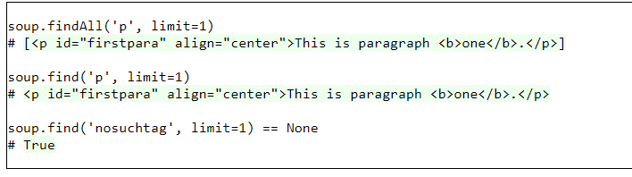
‘Find’ function
The find method is almost exactly like findAll, except that instead of finding all the matching objects, it only finds the first one.
It's like imposing a limit of 1 on the result set, and then extracting the single result from the array.
https://www.crummy.com/software/BeautifulSoup/bs3/documentation.html#The%20basic%20find%20method:%20findAll(name,%20attrs,%20recursive,%20text,%20limit,%20**kwargs)

Slide 29
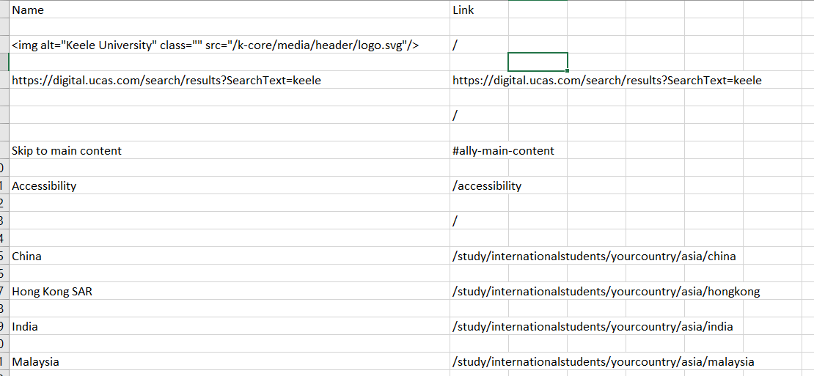
Writing Data to a CSV file
from bs4 import BeautifulSoup
import csv
import requests
data = requests.get('https://www.cu.edu.tr/')
c = data.content
soup = BeautifulSoup(c)
f = csv.writer(open("Link.csv", "w"))
f.writerow(["Name", "Link"]) # Write column headers as the first line
links = soup.find_all('a')
for link in links:
names = link.contents[0]
fullLink = link.get('href')
print(names)
print(fullLink)
f.writerow([names, fullLink])
You can write these data to csv file as per your requirement

Slide 30
Some Tutorials
Some tutorial:
https://github.com/franniez/Python-Tutorials/blob/master/ipython_notebooks/Web%20Scraping%20with%20Beautiful%20Soup.ipynb
CSV File:
https://programminghistorian.org/en/lessons/intro-to-beautiful-soup

Slide 31
More function Beautiful Soup
More functions related to beautiful soup
Check the following link:
Using BeautifulSoup to parse HTML and extract press briefings URLs
http://www.compjour.org/warmups/govt-text-releases/intro-to-bs4-lxml-parsing-wh-press-briefings/#finding-a-tag-with-find

