Slide 1
Visualisation for Data Analytics: Data Pre-Processing

Slide 2
Learning Outcome
To learn about data pre-processing and its benefit
To learn some popular techniques used for data pre-processing

Slide 3
Outline
Introduction to Data Pre-processing
Missing Data
Duplicate Data
Encoding
Discretization

Slide 4
Introduction to Data Pre-Processing
Data Pre-processing. This is a part of the data analytics and machine learning process that data scientists spend most of their time on.
Real-world data is often incomplete, inconsistent, and/or lacking in certain behaviours or trends and is likely to contain many errors.
Data pre-processing is used for resolving such issues.

Slide 5
Techniques Data Pre-Processing
There are many techniques or steps for data pre-processing. Some of them are as follows:
Handling missing values
Duplicate Data Points removal
Encoding
Discretization
Note: Different types of data pre-processing techniques are used for different types of data.
In this lecture, we will focus on general data pre-processing techniques.
In later lectures, we will discuss some more data pre-processing techniques for ‘text’ data

Slide 6
Missing Data

Slide 7



Missing data
Missing data is a common problem and challenge for analysts.
There are many reasons why data could be missing, including:
Respondents forgot to answer questions.
Respondents refused to answer certain questions.
Respondents failed to complete the survey.
A sensor failed.
Someone purposefully turned off recording equipment.
There was a power cut.
The method of data capture was changed.
An internet connection was lost.
A network went down.
A hard drive became corrupt.
A data transfer was cut short.
http://n8prp.org.uk/wp-content/uploads/2018/02/Session-3_Missing_Data.pptx

Slide 8
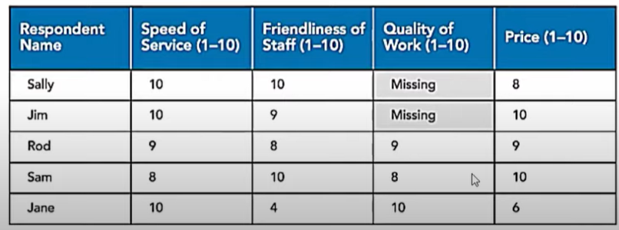
Missing Data: Example
For example, Sally and Jim have missing values for the ‘Quality of Work’ attribute

Slide 9
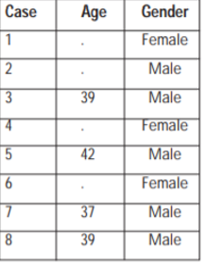
Why Missing values cause problem in data analysis?
Missing values cause problems in data analysis:
Misleading results: Missing values can lead to misleading results.
Task (m): Compute the average age of people.
https://www.bauer.uh.edu/jhess/documents/2.pdf

Slide 10
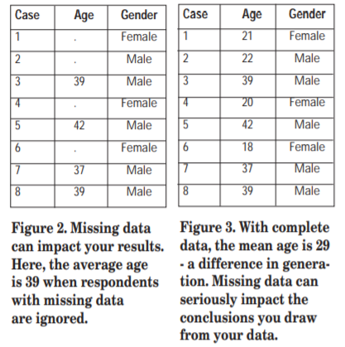
Why Missing values cause problem in data analysis?
Compute Average of the Age?
For example, suppose you surveyed a group of customers, but many people refused to answer the question about their age. If you calculate the average age based on the data you have, you would conclude that the average age of your customers is 39 (Figure 2)
Whereas the average age would have been ‘29’ if all the people had responded
https://www.bauer.uh.edu/jhess/documents/2.pdf

Slide 11
How to handle Missing data?
Generally, the procedure for dealing with missing data is as follows:
Identify the missing data and identify the cause of the missing data. We can then take one of the following approaches:
A: Remove the rows containing the missing data
Also called the naïve approach.
Make sure missing data isn’t biased!
B: Remove a particular column if it has more than 75% of missing values.
C: Replace missing values with alternative values., also known as Impute the missing values.
Mean substitution – replacing the missing values with the mean of all observed values at the same variable
Hot deck imputation – replacing missing values with values from a “similar” responding unit
There are several other approaches as well for imputation
Deciding between A, B, and C depends on which outcome you think will produce the most reliable and accurate results.

Slide 12
Removing Missing Values
Be cautious while removing Missing Values
This method is advised only when there are enough samples in the data set.
One has to make sure that after we have deleted the data, there is no addition of bias.

Slide 13
Using Python to process missing/null values

Slide 14
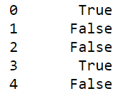
Checking for ‘null’ value Using Python
Checking for null value
It can differ for numeric and text data type
First, read the data using the ‘pandas’ library
If the data is numeric, we can use the ‘isnull()’ function available in Python
isnull() function will return true if the data is missing, and it will return false if the data is present
print(data[‘column_name'].isnull())
‘true’ indicates that the first value is missing

Slide 15
Checking for ‘null’ value Using Python
contd
For ‘text data’ the isnull() function does not work.
Or sometimes there are different types of null values for example, na, NaN, n\a, ?, -- and many more
In such cases it becomes difficult to identify all the null values.
In such cases, we create a list of missing values and supply that at the time of reading data.
missing_values = ["n/a", "na", "--", ' ', '?']
data = pd.read_csv('breast-cancer.csv', na_values = missing_values)
print(data[‘column name'].isnull())

Slide 16
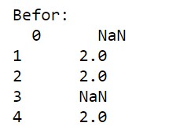
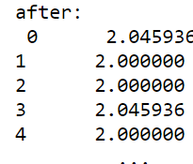
Replacing null values with ‘mean or average ’ value
Replacing ‘null or missing ’ values by the average value using ‘fillna()’ function
mean = data[‘column name'].mean()
print(mean)
print('Before:\n ', data[' column name '])
data[' column name '].fillna(mean, inplace=True)
print('after:\n',data[' column name '])
Notice that NaN values are replaced by mean values

Slide 17
Replacing null values with ‘specific ’ values
You can give any value to ‘fillna()’ function
data[' column name '].fillna(0, inplace=True)
All the ‘null or missing‘ values will be replaced by 0

Slide 18
Dropping ‘rows’ that consist of ‘missing values’
Dropping a ‘row’ that consists of missing values
You can use the ‘dropna()’ function to drop the rows that consist of missing values
data.dropna(inplace=True)

Slide 19
Dropping a column that consist of more that 75% of ‘missing values’
Dropping column
You can find what % of a column consists of missing value. If more than 75% data is missing, you can drop that column
missing_val_count = data[‘column name'].isnull().sum()
print('Number of missing values = ', missing_val_count)
rows = data['column name '].count()
print('count =', rows)
percentage_missing = (missing_val_count *100)/rows
print('Percentage missing = ', percentage_missing)
if percentage_missing >=75.0:
print('Delete this column')
data.drop('column name ', axis= 1,inplace = True)
print(data)

Slide 20
Duplicate Data Points

Slide 21
Introduction to Duplicate Data Points
You want to call all the customers to give information about some new product launch
If you consider only name and credit card number, you may call ‘Sally’ 3 times.
Name | Zip-Code | Credit card number
Sally | 1003 | 12345
Sally | 1003 | 32456
Sally | 1003 | 24546

Slide 22
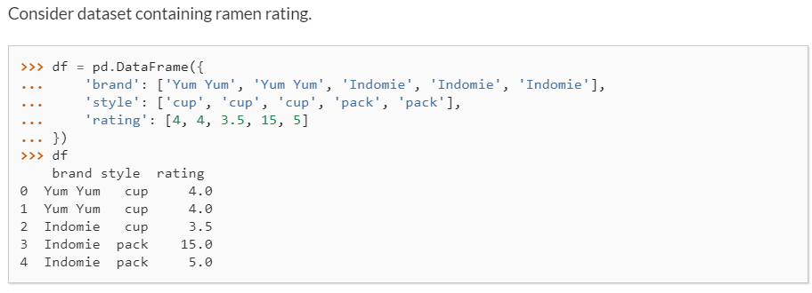
Finding Duplicates rows in Python
Finding duplicate rows using the function ‘duplicated()’
This function will return ‘true’ for the rows which are duplicates of other rows

Slide 23
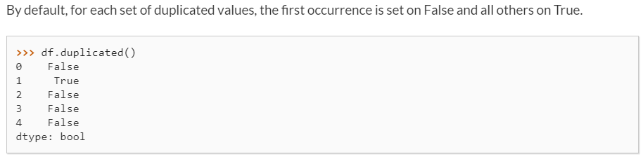
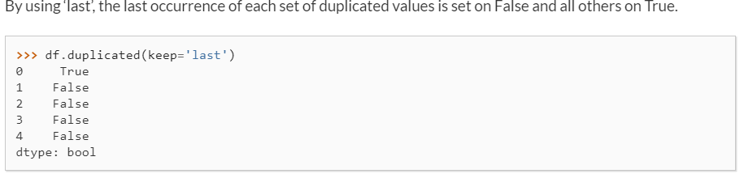
Finding Duplicates rows in Python
contd

Slide 24
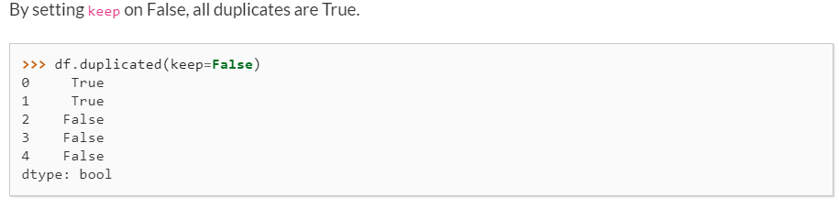
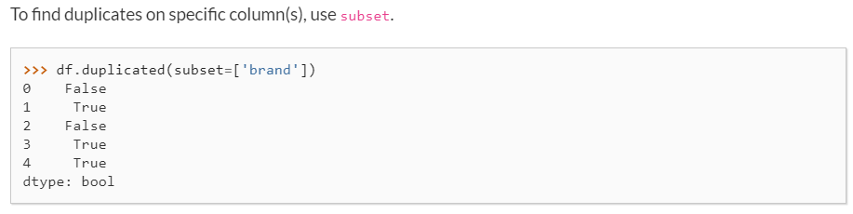
Finding Duplicates rows in Python
contd

Slide 25
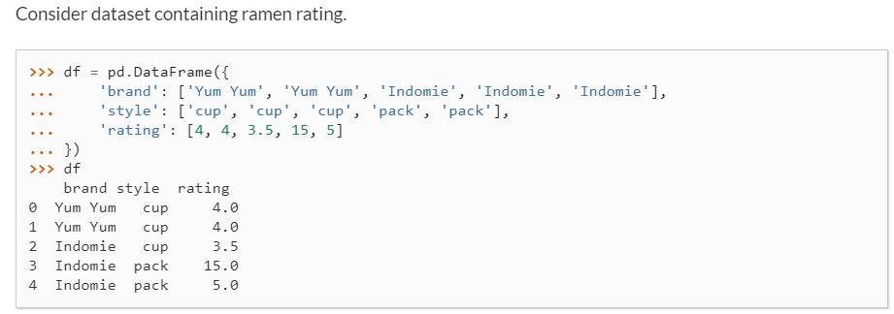
Drop ‘duplicate’ rows
pandas.DataFrame.drop_duplicates
Return DataFrame with duplicate rows removed.

Slide 26
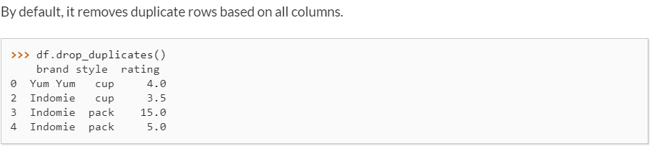
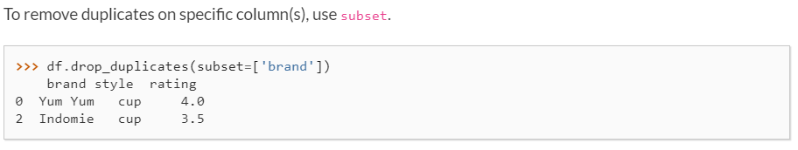
Drop ‘duplicate’ rows
contd

Slide 27
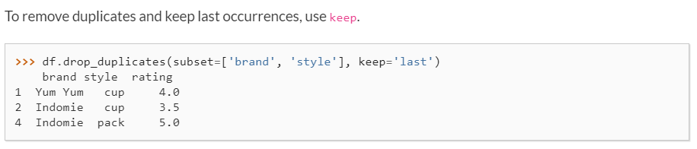
Drop ‘duplicate’ rows
contd

Slide 28
Encoding categorical features

Slide 29
Why we need to ‘encode’ features?
Often, features are not given as continuous values but as categorical ones.
For example, a person could have features ["male", "female"], ["from Europe", "from the US", "from Asia"], ["uses Firefox", "uses Chrome", "uses Safari", "uses Internet Explorer"].
Many machine learning algorithms cannot work with categorical data. They need numbers as input. Hence, we need to apply encoding in such cases
For example, ["male", "from US", "uses Internet Explorer"] could be expressed as [0, 1, 3]
while ["female", "from Asia", "uses Chrome"] would be [1, 2, 1]. We could take any integer values

Slide 30
OrdinalEncoder
In ordinal encoding, each unique category value is assigned an integer value.
For example, “red” is 1, “green” is 2, and “blue” is 3.
This is called an ordinal or integer encoding and is easily reversible.
Often, integer values starting at zero are used.

Slide 31
OrdinalEncoder Examples
sklearn.preprocessing.OrdinalEncoder: Encode categorical features as an integer array.
We can demonstrate the usage of this class by converting colour categories “red”, “green” and “blue” into integers.
First, the categories are sorted then numbers are applied. For strings, this means the labels are sorted alphabetically and that blue=0, green=1 and red=2.
# example of a ordinal encoding
from numpy import asarray
from sklearn.preprocessing import OrdinalEncoder
# define data
data = asarray([['red'], ['green'], ['blue']])
print(data)
# define ordinal encoding
encoder = OrdinalEncoder()
# transform data
result = encoder.fit_transform(data)
print(result)
[['red']
['green']
['blue']]
[[2.]
[1.]
[0.]]

Slide 32
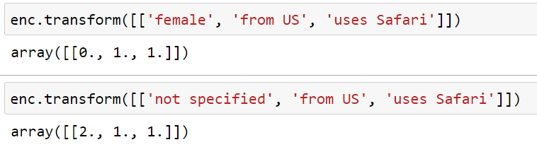
OrdinalEncoder Examples
sklearn.preprocessing.OrdinalEncoder: Encode categorical features as an integer array.
from sklearn import preprocessing
from sklearn.preprocessing import OrdinalEncoder
import numpy as np
enc = preprocessing.OrdinalEncoder()
X = [['male', 'from US', 'uses Safari'], ['female', 'from Europe', 'uses Firefox'], ['male', 'from US', 'uses Safari'],
['not specified', 'from Europe', 'uses Firefox']]
enc.fit(X)
Enc.transform(data)

Slide 33
Issues of Ordinal Encoding
It is a natural encoding for ordinal variables.
For categorical variables, it imposes an ordinal relationship where no such relationship may exist. This can cause problems, and a one-hot encoding may be used instead
For example, red = 2, and green =1, does that mean red > green =? -> NO

Slide 34
OneHotEncoder Examples
sklearn.preprocessing.OneHotEncoder: Encode categorical features as a one-hot numeric array or we can say each label is mapped to a binary vector.
For example, if our variable was “color” and the labels were “red,” “green,” and “blue,” we would encode each of these labels as a three-element binary vector as follows:
Red: [1, 0, 0]
Green: [0, 1, 0]
Blue: [0, 0, 1]

Slide 35

OneHotEncoder Examples
contd
#One-hot Encoding
from sklearn import preprocessing
from sklearn.preprocessing import OneHotEncoder
import numpy as np
enc = preprocessing.OneHotEncoder()
single_att_data_set= [['male'], ['female'], ['not sepecified']]
enc.fit(single_att_data_set)
print('Male:' ,enc.transform([['male']]).toarray())
print('Female:',enc.transform([['female']]).toarray())

Slide 36
OneHotEncoder Examples
contd
enc = preprocessing.OneHotEncoder()
X = [['male', 'from US', 'uses Safari'],
['female', 'from Europe', 'uses Firefox'],
['male', 'from US', 'uses Safari'],
['not specified', 'from Europe', 'uses Firefox']]
enc.fit(X)
print(‘transformed data:' ,enc.transform([['male', 'from US', 'uses Safari']]).toarray())

Slide 37
Discretization

Slide 38
Discretization
Discretization (otherwise known as quantisation or binning) provides a way to partition continuous features into discrete values or finite sets of intervals with minimum data loss

Slide 39
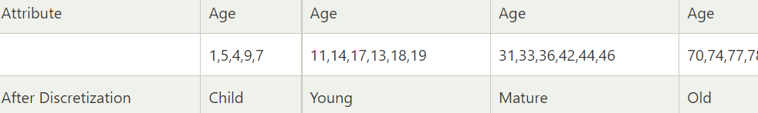
Discretization
Example
Suppose we have an attribute of Age with the given values
After Discretization:
https://www.javatpoint.com/discretization-in-data-mining

Slide 40
Discretization
Certain datasets with continuous features may benefit from discretisation because discretisation can transform the dataset of continuous attributes to one with only nominal attributes.
There are some machine learning algorithms which cannot work with continuous data, and hence, you may have to apply discretisation

Slide 41
Discretization using Python
contd
Discretization in Python
# Discretization
value = np.array([ 42, 82, 91, 108, 121, 123, 131, 134, 148, 151])
np.digitize(value, bins=[100] )
100 is a threshold. If a value is less then 100 it will be given value 0 otherwise it will be given value 1
array([0, 0, 0, 1, 1, 1, 1, 1, 1, 1], dtype=int64)

Slide 42
Discretization using Python
contd
Discretization in Python
# Discretization
value = np.array([ 42, 82, 91, 108, 121, 123, 131, 134, 148, 151])
np.digitize(value, bins=[83] )
Change this value to 83
array([0, 0, 1, 1, 1, 1, 1, 1, 1, 1], dtype=int64)

Slide 43
Summary
Introduction to Data Pre-processing
Popular data pre-processing techniques
Missing Data
Duplicate Data
Encoding
Discretization

Slide 44
References
Some portion of these slides are taken from the following places:
Missing Data slides: http://n8prp.org.uk/wp-content/uploads/2018/02/Session-3_Missing_Data.pptx
Code of duplicate finding: https://pandas.pydata.org/pandas-docs/stable/reference/api/pandas.DataFrame.duplicated.html
Code duplicate removal: https://pandas.pydata.org/pandas-docs/stable/reference/api/pandas.DataFrame.drop_duplicates.html
Ordinal encoder: https://scikit-learn.org/stable/modules/preprocessing.html
OneHotEncoder: https://scikit-learn.org/stable/modules/preprocessing.html
https://scikit-learn.org/stable/modules/preprocessing.html

Slide 45
References
Data pre-processing: https://hackernoon.com/what-steps-should-one-take-while-doing-data-preprocessing-502c993e1caa
Scikit learn data pre-processing
https://scikit-learn.org/stable/modules/preprocessing.html
Missing values:
https://towardsdatascience.com/data-cleaning-with-python-and-pandas-detecting-missing-values-3e9c6ebcf78b

