Slide 1
Data Types and Visualization Tools

Slide 2
Learning Outcome
To get an understanding about data object
To learn about different types of data objects
To get an overview about different types of data analytics and visualization tools

Slide 3
Outline
Introduction To Data objects
Structured and Unstructured data
Data Types
Data Types Based on Number of Attributes
Tools for Data analytics and Visualization

Slide 4
Data Objects
Data sets are made up of data objects.
A data object represents an entity.
Examples:
sales database: customers, store items, sales
medical database: patients, treatments
university database: students, professors, courses
Also called samples , examples, instances, data points, objects, tuples.
Data objects are described by attributes.

Slide 5
Example: Student Database
Database rows -> data objects; columns ->attributes.
Examples:
Data Object =3
Attributes =4
ID | Number | Course | Email
101 | 1111 | MSc AI &DS | 1111@gmail.com
102 | 1112 | MSc SEM | 1112@gmail.com
103 | 1113 | MSc AI&DS | 1113@gmail.com

Slide 6
Structured and Unstructured Data

Slide 7
Question
What is Structured and Unstructured Data?

Slide 8
Structured Data
Structured data: Properly organized in the form of tables or relational tables
Attributes are well defined.
ID | Number | Course | Email
101 | 1111 | MSc AI &DS | 1111@gmail.com
102 | 1112 | MSc SEM | 1112@gmail.com
103 | 1113 | MSc AI&DS | 1113@gmail.com

Slide 9
Unstructured Data
Unstructured data: Does not reside in traditional databases and data warehouses
May have an internal structure, but does not fit a relational data model
Generated by both humans and machines
Textual and multimedia content
Machine-to-machine communication
Examples include
Personal messaging – email, instant messages, tweets, chat
Business documents – business reports, presentations, survey responses
Web content – web pages, blogs, wikis, audio files, photos, videos
Sensor output – satellite imagery, geolocation data, scanner transactions

Slide 10

Unstructured Data
Emails

Slide 11
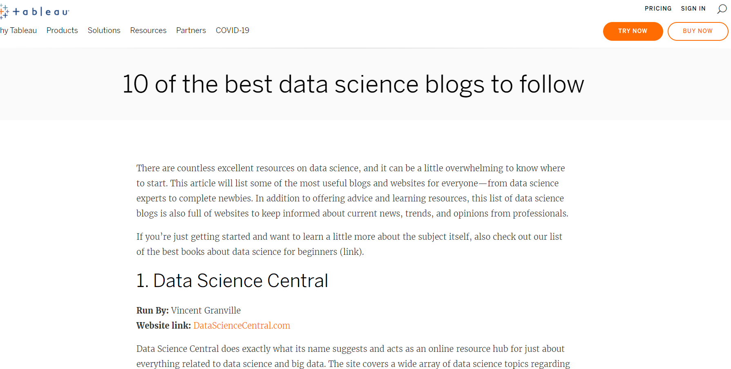
Unstructured Data
Blogs

Slide 12
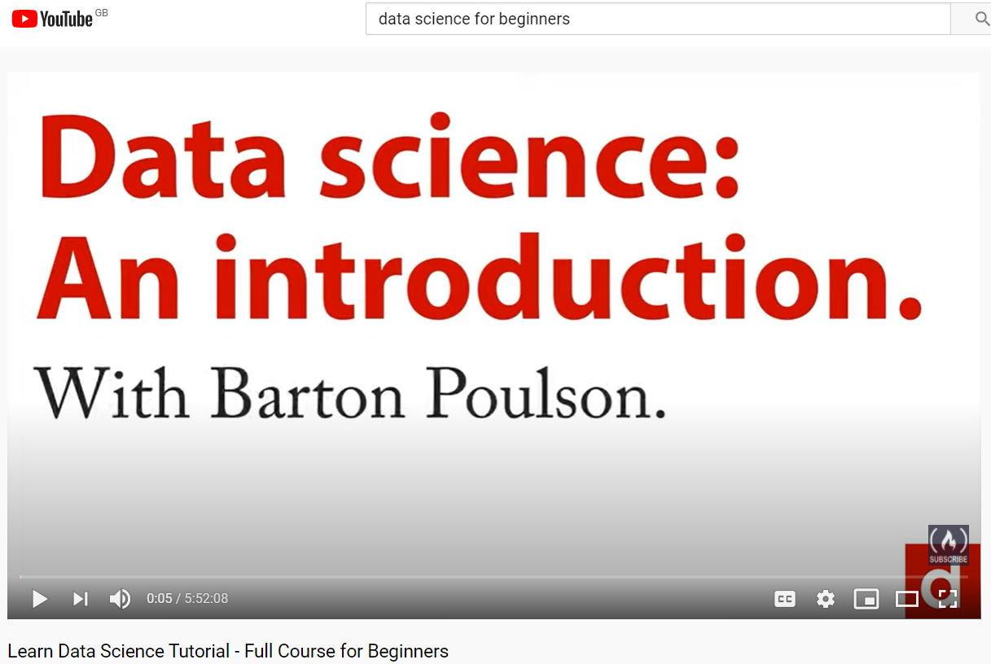
Unstructured Data
Videos

Slide 13
Question
Compare structured and unstructured data with respect to
Storage: Which is easier to store? Why?
Analysis: Which is easier to analyze ? Why?
Availability: Companies consists of structure or unstructured data?

Slide 14
Structured Vs. Unstructured Data
1. Structured data is easier to store.
Structured data is easy to export, store, and organize in typical databases like Excel, Google Sheets, and SQL.
On the contrary, unstructured data is difficult to export, store, and organize in typical databases. Most of the time, you must store unstructured data in Word documents or NoSQL databases.
2. Structured data is easier to analyze.
With structured data, you can easily examine the information with standard data analysis methods and tools like regression analysis and pivot tables.
However, with unstructured data, you can't. You'll have to manually analyze it or use the analysis tools in a NoSQL database to examine this type of data.

Slide 15
Structured Vs. Unstructured Data
contd
3. Unstructured data offers more freedom.
While structured data is easier to store and collect, unstructured data gives analysts more freedom since it's in its native format.
Additionally, companies usually have more unstructured data since the data is adaptable and not restricted by format.

Slide 16
The value of unstructured data sources
Provide a rich source of information about people, households and economies
May enable the more accurate and timely measurement of a range of demographic, social, economic and environmental phenomena
Combined with traditional data sources
As a replacement for traditional data sources
So presents unprecedented opportunities for official statistics to
Improve delivery of current statistical outputs
Create new information products not possible with traditional data sources

Slide 17
The value of unstructured data sources
contd
The new database applications include handling spatial data (such as maps), engineering design data (such as the design of buildings, system components, or integrated circuits), hypertext and multimedia data (including text, image, video, and audio data), time-related data (such as historical records or stock exchange data), stream data (such as video surveillance and sensor data, where data ﬂow in and out like streams), and the World Wide Web (a huge, widely distributed information repository made available by the Internet).
These applications require efﬁcient data structures and scalable methods for handling complex object structures; variable-length records; semistructured or unstructured data; text, multimedia data; and database schemas with complex structures and dynamic changes.

Slide 18
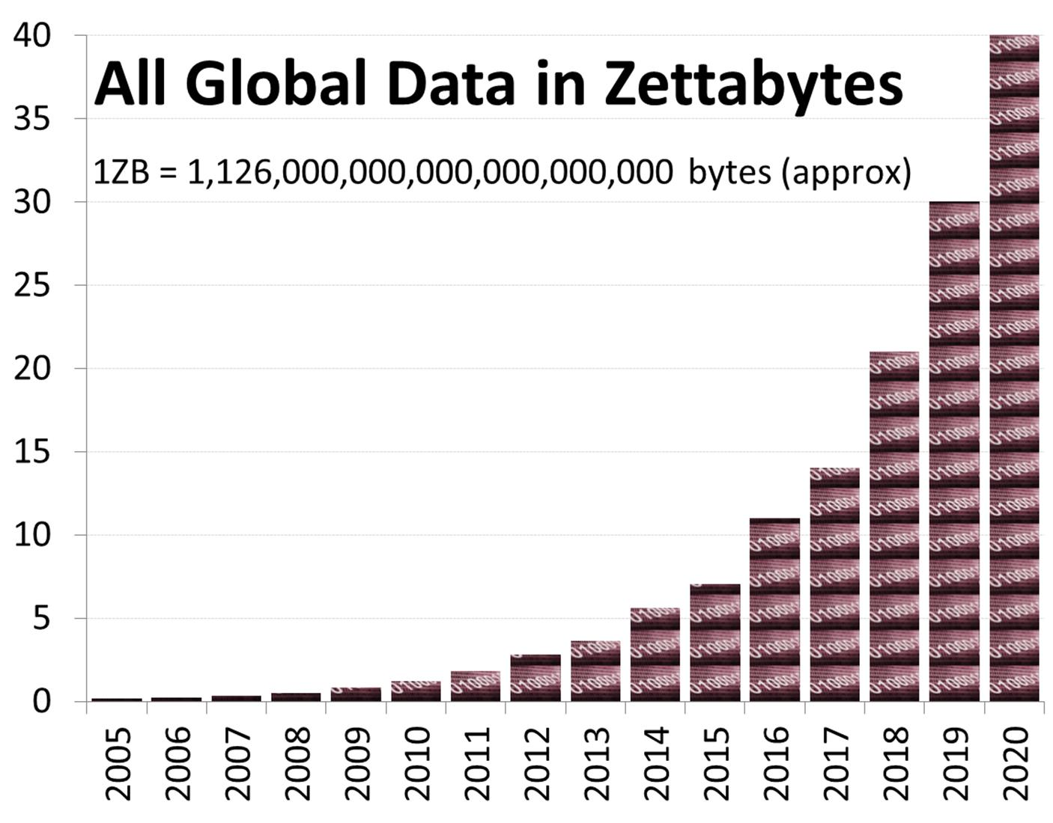
But the scale is mind-boggling
1 ZB = 10²¹ bytes = 1024 Exabytes
About 85% is unstructured data
Notes:
According to IDC’s Digital Universe Study
The world’s “digital universe” is in the process of generating 1.8 Zettabytes of information
With continuing exponential growth this projects to 40 Zettabytes in 2020
Two put this into perspective, 1ZB is 1000 EB or a billion TB.
Five exabytes (10^18 gigabytes) of data would contain all words ever spoken by human beings on earth
The source?
Over 5 billion mobile devices in use worldwide. Each call, text and instant message is logged as data. Mobile devices, particularly smart phones and tablets, also make it easier to use social media and use other data-generating applications. Mobile devices also collect and transmit location data
Billions of internet transactions – purchases, funds transfers, share trades – every day, including countless automated transactions. Each creates a number of data points collected by retailers, banks, credit card issuers, credit agencies and others
Millions of networked electronic devices – including servers and other IT hardware, smart energy meters and temperature and other sensors – all create semi-structured log data that record every action
Hundreds of millions of social networking users and resources. Each Facebook update, Tweet, blog post and comment creates multiple new data points, both structured and unstructured

Slide 19
Data Types

Slide 20
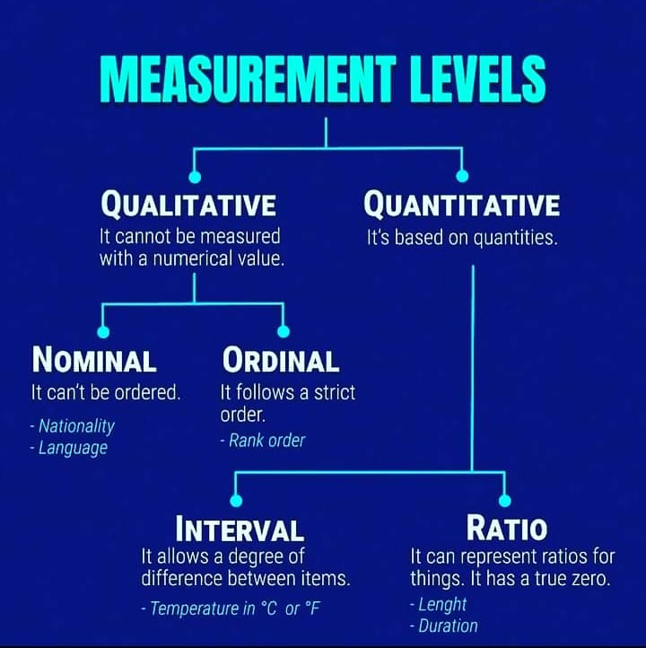
Attributes Types
Attribute (or dimensions, features, variables): a data field, representing a characteristic or feature of a data object.
E.g., customer _ID, name, address
Types:
Nominal
Binary
Ordinal
Numeric: quantitative
Interval-scaled
Ratio-scaled

Slide 21
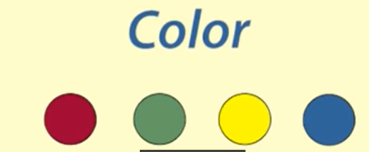
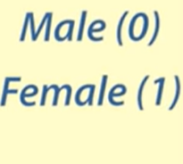
Attribute Types: Nominal
Nominal/Categorical: categories, states, or “names of things”
Hair_color = {auburn, black, blond, brown, grey, red, white}
marital status, occupation, ID numbers, zip codes
They don’t have any order
Nominal variables can be stored as text or word or can be given a number.
However, number do not imply order.
https://www.youtube.com/watch?v=hZxnzfnt5v8

Slide 22

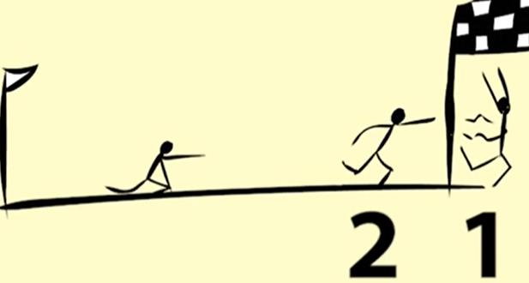
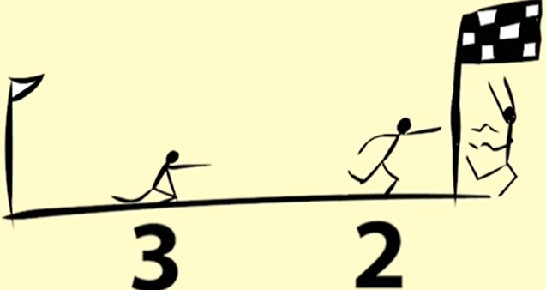
Attribute Types: Ordinal
Ordinal
Values have a meaningful order (ranking) but magnitude between successive values is not known.
Size = {small, medium, large}
Rank: The difference between rank 1 and rank 2, and rank 2 and rank 3 is not the same.
https://www.youtube.com/watch?v=hZxnzfnt5v8

Slide 23
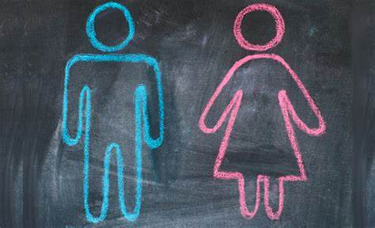

Attribute Types: Binary
Binary
Nominal attribute with only 2 states (0 and 1)
Symmetric binary: both outcomes equally important
e.g., gender (boy or girl)
Asymmetric binary: outcomes not equally important.
e.g., medical test (positive vs. negative)
Convention: assign 1 to most important outcome (e.g., HIV positive, cancer prediction)
Notes:
The two states are not equally important for asymmetric binary attributes, such as the positive (1) and negative (0) outcomes of a disease test. Given two asymmetric binary attributes, the agreement of two 1s (a positive match) is considered more significant than that of two 0s (a negative match).

Slide 24
Numeric Attribute Types
Numeric: A numeric attribute is quantitative because, it is a measurable quantity, represented in integer or real values.
Numerical attributes are of 2 types: interval and ratio
The difference between interval and ratio scales comes from their ability to dip below zero.
Interval scales hold no true zero and can represent values below zero. For example, you can measure temperature below 0 degrees Celsius, such as -10 degrees.
Ratio variables, on the other hand, never fall below zero. Height and weight measure from 0 and above, but never fall below it.
https://www.questionpro.com/blog/ratio-scale-vs-interval-scale/#:~:text=The%20difference%20between%20interval%20and,hand%2C%20never%20fall%20below%20zero

Slide 25
Numeric Attribute Types
Example,
Measuring temperature is an excellent example of interval scales. The temperature in an air-conditioned room is 16 degrees Celsius, while the temperature outside the room is 32 degrees Celsius. You can conclude the temperature outside is 16 degrees higher than inside the room.
But if you said, “It is twice as hot outside than inside,” you would be incorrect. By stating the temperature is twice that outside as inside, you’re using 0 degrees as the reference point to compare the two temperatures. Since it’s possible to measure temperature below 0 degrees, you can’t use it as a reference point for comparison. You must use an actual number (such as 16 degrees) instead
A ratio scale displays the order and number of objects between the values of the scale.
Where you cannot imply that the temperature is twice as warm outside because it’s an interval scale, you can say you are twice another’s age because it’s a ratio variable.
https://www.questionpro.com/blog/ratio-scale-vs-interval-scale/#:~:text=The%20difference%20between%20interval%20and,hand%2C%20never%20fall%20below%20zero

Slide 26
Discrete vs. Continuous Attributes
Discrete Attribute
Has only a finite or countably infinite set of values (counted)
E.g., zip codes, profession, or the set of words in a collection of documents
Sometimes, represented as integer variables
Note: Binary attributes are a special case of discrete attributes

Slide 27
Discrete vs. Continuous Attributes
Continuous Attribute
Has real numbers as attribute values (measured)
E.g., temperature, height, or weight
Practically, real values can only be measured and represented using a finite number of digits
Continuous attributes are typically represented as floating-point variables

Slide 28

Question? (m)
Identify the data type:
Preferred chocolate Name: {Dark, Milk, White}:

Slide 29
Question?
Identify the data type:
Preferred chocolate Name: {Dark, Milk, White}: Nominal

Slide 30
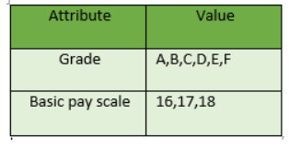
Question?
Size = {small, medium, large}
Grades
Payscale
https://www.geeksforgeeks.org/understanding-data-attribute-types-qualitative-and-quantitative/#:~:text=Ordinal%20Attributes%20%3A%20The%20Ordinal%20Attributes,indicate%20how%20important%20it%20is.

Slide 31
Question?
Ordinal
Size = {small, medium, large}
Grades
Payscale
https://www.geeksforgeeks.org/understanding-data-attribute-types-qualitative-and-quantitative/#:~:text=Ordinal%20Attributes%20%3A%20The%20Ordinal%20Attributes,indicate%20how%20important%20it%20is.

Slide 32
Question?(m)
Can you think of other types of data?

Slide 33
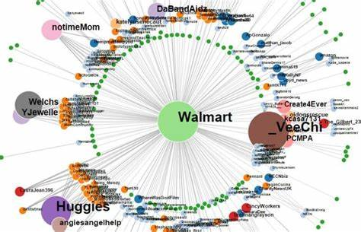


Many other Types of Data
Many other types such as,
Graph and network
Social or information networks
Molecular Structures
Video data: sequence of images
Temporal data: time-series
Image data:
Date data type: 12/11/2020

Slide 34
Data Types Based on Number of Attributes

Slide 35
Type of Data
Type of data univariate, bivariate, multivariate, graph
Univariate Data
It is the simplest form of data analysis where the data being analyzed contains only one variable, e.g. age, height
The main purpose of univariate analysis is to describe the data and find patterns that exist within it.
Some ways you can describe patterns found in univariate data include looking at mean, mode, median, range, variance, maximum, minimum, quartiles, and standard deviation.
Additionally, some ways you may display univariate data include frequency distribution tables, bar charts, histograms, frequency polygons, and pie charts.

Slide 36
Type of Data
Bivariate Data
Bivariate analysis is used to find out if there is a relationship between two different variables.
Something as simple as creating a scatterplot by plotting one variable against another on a Cartesian plane (think X and Y axis) can sometimes give you a picture of what the data is trying to tell you. I
If the data seems to fit a line or curve then there is a relationship or correlation between the two variables.
For example, one might choose to plot calorie intake versus weight.

Slide 37
Type of Data
Multivariate Analysis
Multivariate analysis is the analysis of three or more variables. There are many ways to perform multivariate analysis depending on your goals. Some of these methods include:
Cluster Analysis, Multiple Regression Analysis, Partial Least Square Regression, Principal Component Analysis, Redundancy Analysis.

Slide 38
Tools for Data Analytics and Visualization

Slide 39
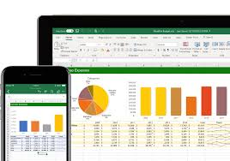
Microsoft Excel
Microsoft Office uses a variety of tools and combined with their data source, excel, it can create simple, well designed, and intuitive graphs.
Excel is a very popular tool for viewing raw data, and there are tools within the program to create graphs based on the data.
https://www.google.com/url?sa=i&url=https%3A%2F%2Fm.youtube.com%2Fwatch%3Fv%3D9kgLz-i5pjk&psig=AOvVaw0GsXoYjYc5ANmH0uofIr9F&ust=1610541725568000&source=images&cd=vfe&ved=2ahUKEwiD2-3MtZbuAhXHweAKHU37Bs8Qr4kDegUIARDNAQ

Slide 40


SQL
Mysql
Orcale
A very good tool structured data processing
Visualization is not possible directly but can be integrated with programming languages like Python

Slide 41

Python
Provides a rich source of libraries for data analysis and visualization
Matplotlib, plotly, pandas, numpy and many more libraries that you can work with
One of the most popular tool for data visualisation

Slide 42

R
Another popular programming language for data analysis and visualisation
For example, Shiny is an open package from RStudio, which provides a web application framework to create interactive web visualization called Shiny apps. The ease of working with Shiny has what popularized it among R users.

Slide 43

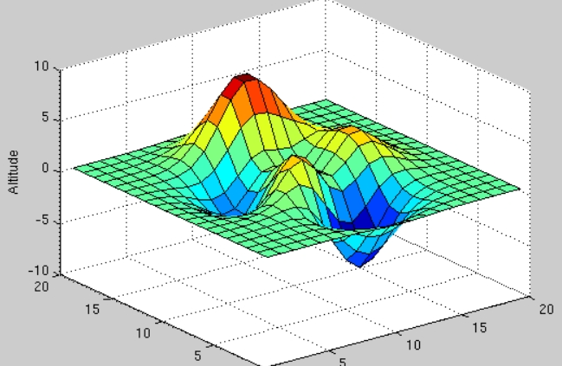
MATLAB
MATLAB has extensive facilities for displaying vectors and matrices as graphs, as well as annotating and printing these graphs.
It includes high-level functions for two-dimensional and three-dimensional data visualization, image processing, animation, and presentation graphics.
There are two basic ways to create graphs in MATLAB. You can either use the MATLAB GUI plotting tools you can use the command interface by entering MATLAB graphics commands in the Command Window.
https://www.bu.edu/tech/support/research/training-consulting/online-tutorials/visualization-with-matlab/

Slide 44

WEKA
Provide a good source for libraries for data analysis and Visualization
Classification
Clustering
Association rule analysis
You can use GUI directly
Or, you can use JAVA api’s

Slide 45
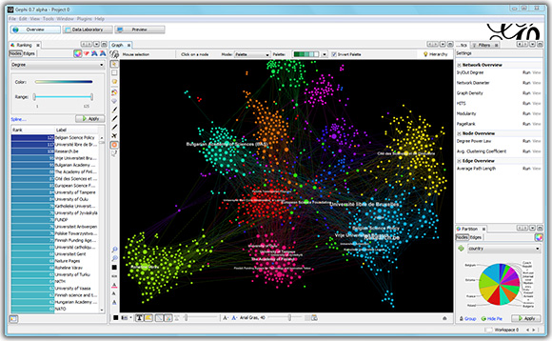
Gephi
Gephi is the leading visualization and exploration software for all kinds of graphs and networks.
Gephi is open-source and free.
Runs on Windows, Mac OS X and Linux.
https://gephi.org/

Slide 46
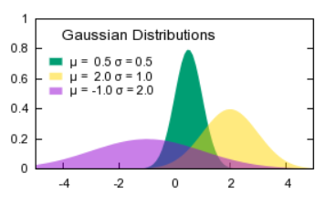
Gnuplot
Gnuplot is a portable command-line driven graphing utility for Linux, OS/2, MS Windows, OSX, VMS, and many other platforms.
It was originally created to allow scientists and students to visualize mathematical functions and data interactively, but has grown to support many non-interactive uses such as web scripting.
It is also used as a plotting engine by third-party applications like Octave.
Useful in drawing high quality graphs
But provides limited or no data processing alone
http://www.gnuplot.info/

Slide 47
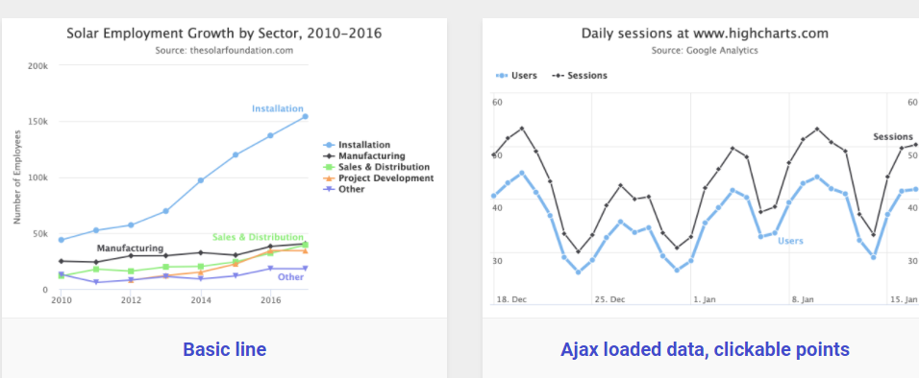
Highcharts
It proudly claims to be used by 72% of the 100 biggest companies in the world.
It is a simple tool that does not require specialized training and quickly generates the desired output.
Unlike some tools, Highcharts focuses on cross-browser support, allowing for greater access and use.
https://www.highcharts.com/demo

Slide 48
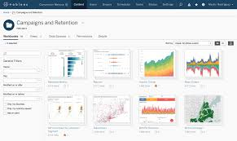
Tableau
Tableau is amid the market leaders for the Big Data visualization, especially efficient for delivering interactive data visualization for the results derived from Big Data operations, deep learning algorithms and multiple types of AI-driven apps (AbsentData 2018)
It provides a non-technical user the ability to build complex reports and dashboard with zero coding skills.
Using drag-n-drop functionalities of Tableau, user can create a very interactive visual within minutes.
https://www.google.com/imgres?imgurl=https%3A%2F%2Fcdns.tblsft.com%2Fsites%2Fdefault%2Ffiles%2Fpages%2Ftableau_server_dashboard_0.png&imgrefurl=https%3A%2F%2Fwww.tableau.com%2Fen-gb%2Fproducts%2Flinux&tbnid=qFT5Nqkv_JIF3M&vet=12ahUKEwixgZfD0JbuAhUNKRQKHaPiBBcQMygEegUIARDBAQ..i&docid=WrSrEGpbZ639UM&w=2000&h=1190&q=tableau%20image&ved=2ahUKEwixgZfD0JbuAhUNKRQKHaPiBBcQMygEegUIARDBAQ

Slide 49

See you in Teams
Teams Channel: Visualisation for Data Analytics [CSC-40048-2022-SEM3-A]

Slide 50
Question?(m)
Which of these tools have you used?
MATLAB
Python
Gephi
R
Gnuplot
Tableau
HighCharts
WEKA
SQL

Slide 51
Projects/Presentation

Slide 52
Projects/Presentation
You need to work in group of 3-4
Start identifying/building groups

Slide 53
Summary
We discussed basics of different types of data
We leaned about different types of data analytics and visualization tools

Slide 54
References
Some portion of these slides are taken from the following places:
https://unstats.un.org/unsd/China_UNSD_Project/seminars/2013_TianjinChina/Session%207/S7-2%20Australia-Unstructured%20Data%20Tienjin%20presentation.pptx
https://blog.hubspot.com/marketing/unstructured-data
https://mschermann.github.io/data_viz_reader/fundamentals.html#data-visualization-tools
https://modernanalyst.com/Careers/InterviewQuestions/tabid/128/ID/4904/Describe-the-difference-between-univariate-bivariate-and-multivariate-analysis.aspx
Univariate, Bivariate and Multivariate, Chapter-2, A general Introduction to Data Science by João Mendes Moreira

Slide 55

Big Data
Data sets of such size, complexity and volatility that their business value cannot be fully realised with existing data capture, storage, processing, analysis and management capabilities
The systematic use of unstructured data is a Big Data challenge!
Notes:
Existing computational models for the most common statistical problems very poorly for Big Data problems
In particular, traditional relational database and data warehouse approaches are not sufficiently flexible for handling large unstructured data sets in a computationally efficient way
We need to develop techniques for reducing data volume and complexity while preserving statistical validity, and new techniques for representing, manipulating, visualising and analysing data on a vast scale.

Slide 56
Some other significant challenges
Validity of statistical inference
Sample biases
Model biases
Privacy and public trust
Disclosure threat due to mosaic effect
Data integrity
Missing, inconsistent and inaccurate data
Volatile sources
Data ownership and access
Public good versus commercial advantage
Value of private sector data
Notes:
Validity of Statistical Inference
Data sets derived from Big Data sources are not necessarily random or representative samples of the target population. For example, social media services (such as Twitter) are a rich data source for the measurement of public opinion. However, there is little verifiable information about the users of these services, and it is difficult to determine whether their distribution by sex, age, location and socioeconomic profile is consistent with that of the population in general. In fact, it is to be expected that some population subgroups will be under-represented in any sample of social media data, due to the differential adoption rate of new technologies. Where significant biases exist in the data, derived estimates of population characteristics will not be statistically valid. National statistical organisations (NSOs) are uniquely positioned to assess the nature of bias. In some cases the big data might be supplemented with survey data to get coverage of un-represented segments of the population. In other cases it may be useful to publish statistics that describe sub-populations.
A related issue is that the statistical analysis of large, complex heterogeneous datasets will inevitably yield significantly more spurious model-dependent correlations than would be expected from traditional data sources. This can actually accentuate any modelling bias by reinforcing the selection of the wrong variables, algorithms and metrics of fitness. For example, Google Flu Trends – which uses the number of online searches as a measure of the prevalence of flu in the general population – mistakenly estimated that peak flu levels reached 11% of the US public in the 2012 flu season. This was almost double the correct estimate of 6% produced by public health officials. While Google will not comment on the reason for the overestimation, it seems likely that it was caused by extensive media coverage of the flu season, which created a spike in search queries. NSOs will play a role in helping others assess the accuracy of models and calibrate them.
Privacy and Public Trust
The privacy landscape is fundamentally changed by the emergence of big data. There is an obvious contention between the systematic exploitation of Big Data sources for better decision-making across government, and the acknowledged need to establish and maintain public trust in the use of personal information by government agencies. The ABS does have a framework and relevant legislation (own and the Privacy Act) to set the ground rules for how such data sets can be acquired, combined, protected, shared, exposed, analysed and retained. The framework is designed to promote trust and privacy and big data sources will further test our decision-making in adherence to the framework.
A significant unresolved issue is the threat of disclosure through data accumulation. Every individual is a unique mosaic of publicly visible characteristics and private information. In a data rich world, distinct pieces of data that may not pose a privacy risk when released independently, are likely to reveal personal information when they are combined – a situation referred to in the intelligence community as the “mosaic effect”. The use of Big Data greatly amplifies the mosaic effect because large rich data sets typically contain many visible characteristics, and so individually or in composition enable spontaneous recognition of individuals and the consequential disclosure of their private information. This is a possible issue for the ABS dissemination of microdata sets from Big Data sources, since there is not yet a consistent, methodologically rigorous framework for assessing disclosure risk in terms of the utility of data set for analytical purposes. Currently, ABS does not assess disclosure risk in terms of utility. If there is a disclosure risk then we do not disclose – regardless of the utility of the analysis.
Data Integrity
The ABS has a multi-dimensional Data Quality Framework. Big data will present challenges on each dimension. It will be difficult to describe the quality of statistics produced using non-survey methods. Data integrity broadly covers its quality, provenance and reliability for statistical purposes. Many Big Data sources are inherently ‘noisy’, and will typically need extensive data filtering and repair to deal with inaccuracy, inconsistency and incompleteness. For example, real-time sensor networks are susceptible to sensor malfunction and network latencies, satellite imagery is adversely affected by atmospheric conditions, and social media opinion is invariably contaminated by ambiguity and deception. Existing statistical methods are not tolerant of erroneous data, and there is presently no generalised framework for treating missing and inconsistent data from non-survey sources.
Much Web content is also unstructured and ungoverned – the metadata describing its usage and provenance (origin, derivation, history, custody, and context) are either incomplete or incongruous. Indeed, the long-term reliability of Big Data sources may be an issue for ongoing statistical production. Reputable statistics for policy making and service evaluation are generally required for extended periods of time, often many years. However, large data sets from dynamic networks are volatile – the data sources may change in character or disappear over time. What becomes of time series in a world where data streams and sources are transient?
Data Ownership and Access
Data ownership and access presents as a key issue and one where there is a lack of legislation and a supporting framework. The challenge is to unlock public good from privately collected data where there may be a strong private interest in keeping the data private.
The Big Data opportunity for the ABS spans a vast array of direct sources beyond the government sector, such as commercial transactions (e.g. scanner data from supermarkets), sensors (e.g. satellite imagery), tracking devices (e.g. location-sensitive services associated with mobile devices), and administrative product (e.g. electronic health records). It also includes data derived from the results of analysis on public and private data sets, such as behavioural profiling (e.g. activity analysis of online purchases or credit card transactions), opinion mining (e.g. topic or sentiment analysis of Twitter feeds and on-line searches), and social network analysis (e.g. link and influence analysis of Facebook data).
In many cases, a commercial value is placed on primary and derived non-government data sets by their owners – since either the provision of such data is the basis of their business, or its possession is a significant element of competitive advantage. This raises the issue of how the ABS might acquire commercially valuable or sensitive data for statistical production, particularly if the statistics compete directly with information products created by the data owner or they compromise its market position. This issue is made more complex by the fact that there may be several parties with some form of commercial right in relation to a data set, either through ownership, possession or licensing arrangements.
Computational Efficacy
The exploitation of Big Data will have a significant impact on the ICT resource demands of data acquisition, storage, processing, integration, and analysis. Existing computational models for the most common statistical problems in the ABS scale very poorly for the number, diversity and volatility of data elements, attributes and linkages associated with Big Data sources.
In particular, traditional relational database approaches are not sufficiently flexible for handling dynamic multiply-structured data sets in a computationally efficient way, and the execution of complex statistical algorithms at the scale of Big Data problems is likely to exceed the memory and processor resources of existing platforms. For example, probabilistic data linking under the Fellegi-Sunter model is generally treated as a constrained Maximum Likelihood problem using simplex-based algorithms. The complexity of this problem is at least O(N³), which cannot be solved with existing computing resources when the size of the data set N is at the scale of Big Data.
One likely approach will be to outsource the analytics to the data owner. Statistics NZ is looking to do this with scanner data as the data owner has the necessary infrastructure and performing the analysis where the data is stored is cheaper and easier. An added and important benefit of this approach is that the data owner does not need to share the underlying data which may be very sensitive. A joint effort by methodologist and technologist is needed to develop techniques for reducing data volume and complexity while preserving statistical validity, and for improving algorithmic tractability and efficiency. This will involve explicitly recasting existing problems into a form that is better suited for distributed computing approaches, making greater use of approximate techniques, and favouring heuristic predictive models in the appropriate circumstances.
Technology Infrastructure
Big data technology has emerged from the extreme scale of Internet processing and progressively been applied to a growing range of business domains in the last decade. Industry supported open source technology developments have rapidly matured to the point where ‘enterprise class’ processing in conjunction with traditional processing technologies provide a stronger integrated set of solution choices. Stand-alone and ‘point’ big data solutions are diminishing as they are integrated into wider solution architectures. Most established technology suppliers now include big data technology as part of their product portfolio. Big data infrastructure and tools are evolving and there will continue to be proprietary and point solutions. Big data processing also requires new types of data representation (semantic data, graph database), inference (AI-based analytical techniques in conjunction with robust statistical analysis), visualisation (for complex network relationships), analytical languages (such as R and SAS), and the use of scale-out commodity hardware. A number of these technologies have value when applied to ‘traditional’ processing and analysis.
Where big data capabilities enhance the CSIP solution architecture, these should be included.

Slide 57
ABS work in this area
Established an research program led by Methodology Division to build a sound foundation for the mainstream use of Big Data – particularly unstructured data – in statistical production and analysis
Investigating techniques and technology solutions for future enterprise systems – such as open-source, NSI-source, and commercial software products
Particular areas of interest
Machine learning
Multidimensional data visualisation
Semantic Web methods
Distributed computing

Slide 58
Content analysis
For unstructured data to be useful it must be analysed to extract and expose the information it contains
Different types of analysis are possible, such as:
Entity analysis – people, organisations, objects and events, and the relationships between them
Topic analysis – topics or themes, and their relative importance
Sentiment analysis – subjective view of a person to a particular topic
Feature analysis – inherent characteristics that are significant for a particular analytical perspective (e.g. land coverage in satellite imagery)
Many others
Techniques and tools already exist or being developed …

Slide 59
Some key initiatives for 2013-14
Satellite imagery for agricultural statistics – use of satellite sensor data for the production of agricultural statistics such as land use, crop type and crop yield.
Mobile device location data for population mobility – use of mobile device location-based services and/or global positioning for measuring population mobility
Visualisation for exploratory data analysis – advanced visualisation techniques for the exploratory analysis of structured and unstructured data sets
Automated entity analysis of unstructured data –techniques for the extraction and resolution of concepts, entities and facts from text data

Slide 60
Getting to Know Your Data

Slide 61
Chapter 2: Getting to Know Your Data
Data Objects and Attribute Types
Basic Statistical Descriptions of Data
Data Visualization
Measuring Data Similarity and Dissimilarity
Summary

Slide 62
Basic Statistical Descriptions of Data
Motivation
To better understand the data: central tendency, variation and spread
Data dispersion characteristics
median, max, min, quantiles, outliers, variance, etc.
Numerical dimensions correspond to sorted intervals
Data dispersion: analyzed with multiple granularities of precision
Boxplot or quantile analysis on sorted intervals
Dispersion analysis on computed measures
Folding measures into numerical dimensions
Boxplot or quantile analysis on the transformed cube

Slide 63
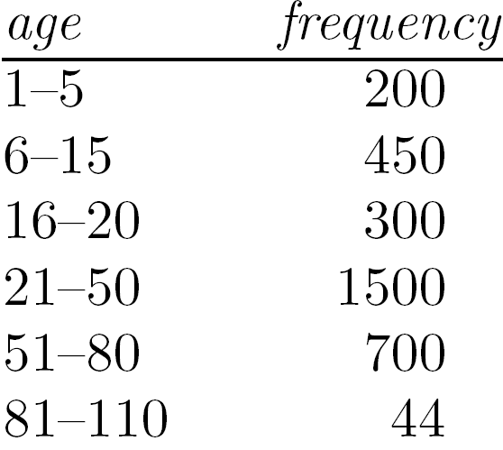
Measuring the Central Tendency
Mean (algebraic measure) (sample vs. population):
Note: n is sample size and N is population size.
Weighted arithmetic mean:
Trimmed mean: chopping extreme values
Median:
Middle value if odd number of values, or average of the middle two values otherwise
Estimated by interpolation (for grouped data):
Mode
Value that occurs most frequently in the data
Unimodal, bimodal, trimodal
Empirical formula:

Slide 64
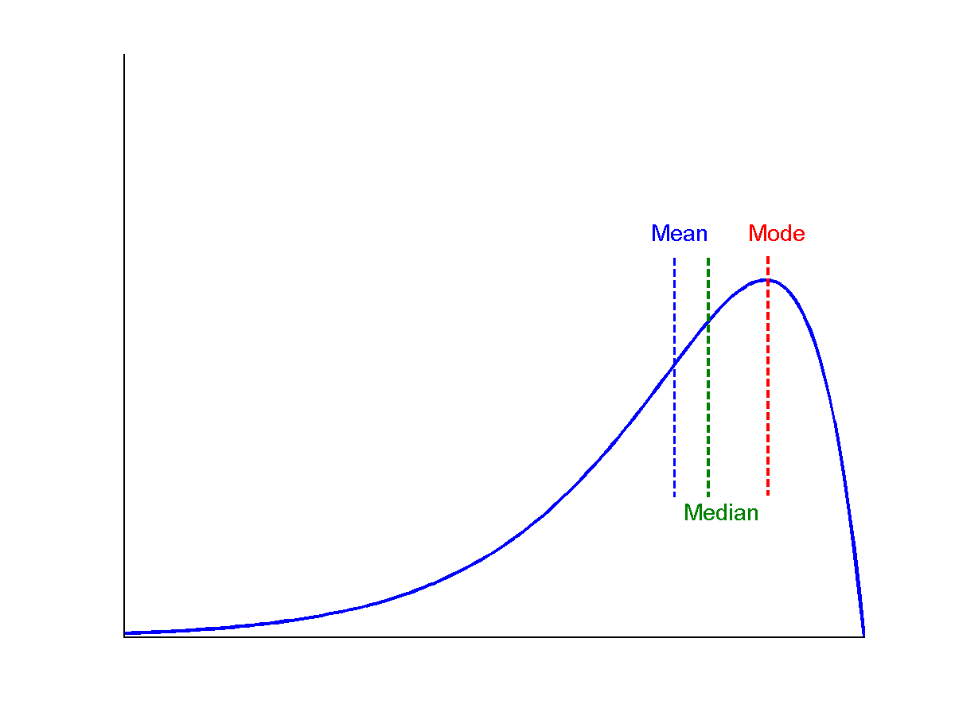
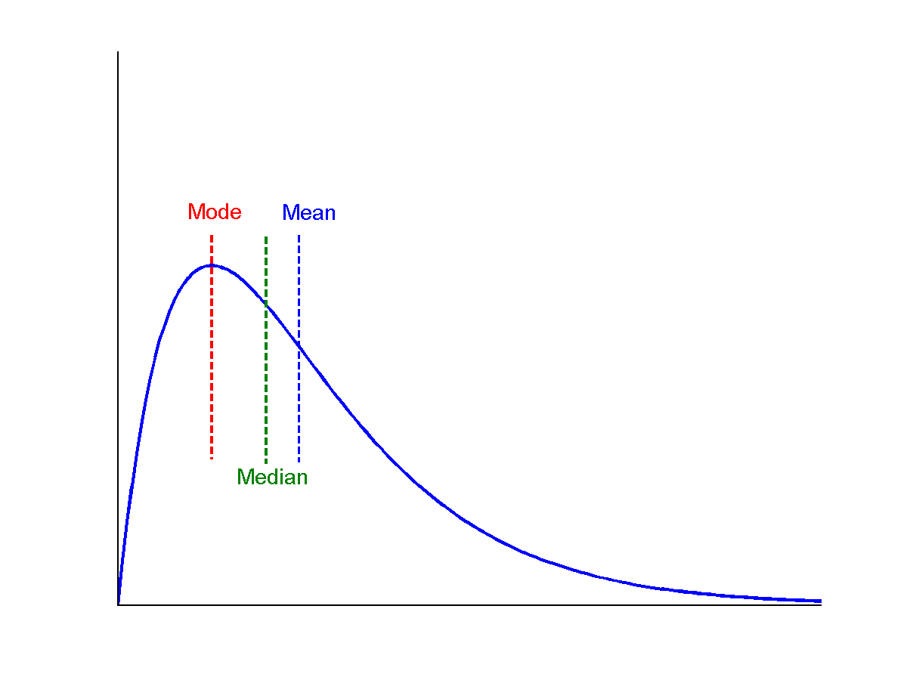
Symmetric vs. Skewed Data
Median, mean and mode of symmetric, positively and negatively skewed data
symmetric
positively skewed
negatively skewed

Slide 65
Measuring the Dispersion of Data
Quartiles, outliers and boxplots
Quartiles: Q₁ (25th percentile), Q₃ (75th percentile)
Inter-quartile range: IQR = Q₃ – Q₁
Five number summary: min, Q₁, median, Q₃, max
Boxplot: ends of the box are the quartiles; median is marked; add whiskers, and plot outliers individually
Outlier: usually, a value higher/lower than 1.5 x IQR
Variance and standard deviation (sample: s, population: σ)
Variance: (algebraic, scalable computation)
Standard deviation s (or σ) is the square root of variance s² ⁽or σ²⁾

Slide 66
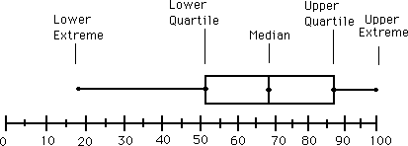
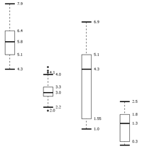
Boxplot Analysis
Five-number summary of a distribution
Minimum, Q1, Median, Q3, Maximum
Boxplot
Data is represented with a box
The ends of the box are at the first and third quartiles, i.e., the height of the box is IQR
The median is marked by a line within the box
Whiskers: two lines outside the box extended to Minimum and Maximum
Outliers: points beyond a specified outlier threshold, plotted individually

Slide 67
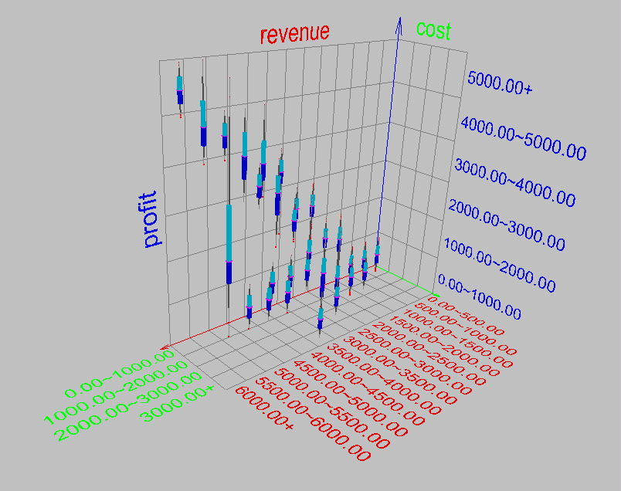
Visualization of Data Dispersion: 3-D Boxplots

Slide 68
Properties of Normal Distribution Curve
The normal (distribution) curve
From μ–σ to μ+σ: contains about 68% of the measurements (μ: mean, σ: standard deviation)
From μ–2σ to μ+2σ: contains about 95% of it
From μ–3σ to μ+3σ: contains about 99.7% of it

Slide 69
Graphic Displays of Basic Statistical Descriptions
Boxplot: graphic display of five-number summary
Histogram: x-axis are values, y-axis repres. frequencies
Quantile plot: each value x_{i} is paired with f_{i} indicating that approximately 100 f_{i} % of data are ≤ x_{i}
Quantile-quantile (q-q) plot: graphs the quantiles of one univariant distribution against the corresponding quantiles of another
Scatter plot: each pair of values is a pair of coordinates and plotted as points in the plane

Slide 70
Histogram Analysis
Histogram: Graph display of tabulated frequencies, shown as bars
It shows what proportion of cases fall into each of several categories
Differs from a bar chart in that it is the area of the bar that denotes the value, not the height as in bar charts, a crucial distinction when the categories are not of uniform width
The categories are usually specified as non-overlapping intervals of some variable. The categories (bars) must be adjacent

Slide 71
Histograms Often Tell More than Boxplots
The two histograms shown in the left may have the same boxplot representation
The same values for: min, Q1, median, Q3, max
But they have rather different data distributions

Slide 72
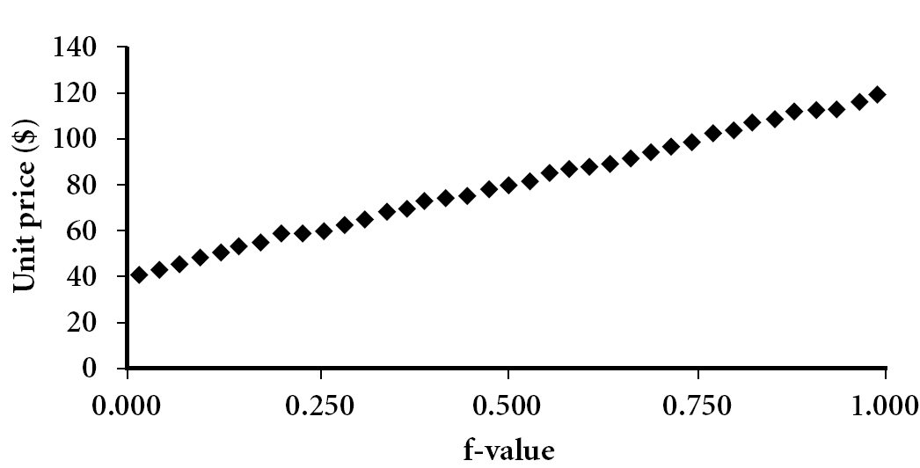
Quantile Plot
Displays all of the data (allowing the user to assess both the overall behavior and unusual occurrences)
Plots quantile information
For a data x_{i} data sorted in increasing order, f_{i} indicates that approximately 100 f_{i}% of the data are below or equal to the value x_{i}

Slide 73
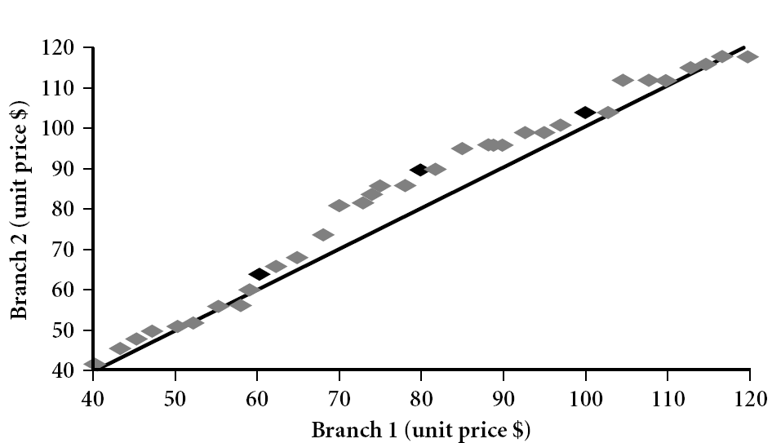
Quantile-Quantile (Q-Q) Plot
Graphs the quantiles of one univariate distribution against the corresponding quantiles of another
View: Is there is a shift in going from one distribution to another?
Example shows unit price of items sold at Branch 1 vs. Branch 2 for each quantile. Unit prices of items sold at Branch 1 tend to be lower than those at Branch 2.
Notes:
Note: We need to label the dark plotted points as Q1, Median, Q3 – that would help in understanding this graph.
Tell audience: There is a shift in distribution of branch 1 WRT branch 2 in that the unit prices of items sold at branch 1 tend to be lower than those at branch 2.

Slide 74
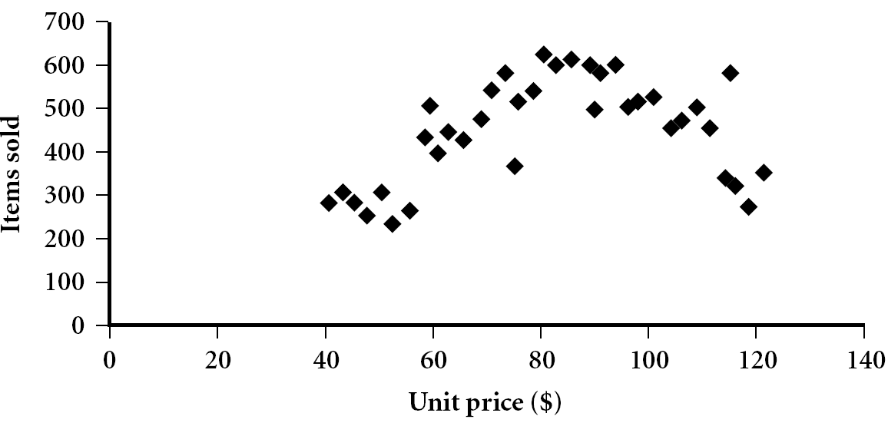
Scatter plot
Provides a first look at bivariate data to see clusters of points, outliers, etc
Each pair of values is treated as a pair of coordinates and plotted as points in the plane

Slide 75
Positively and Negatively Correlated Data
The left half fragment is positively correlated
The right half is negative correlated

Slide 76
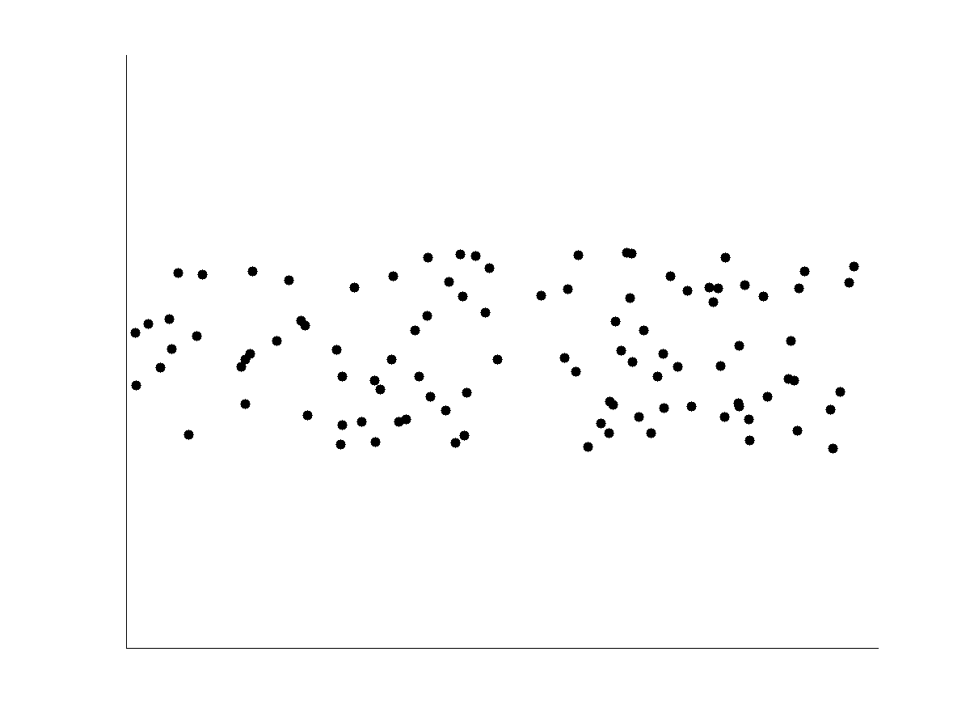
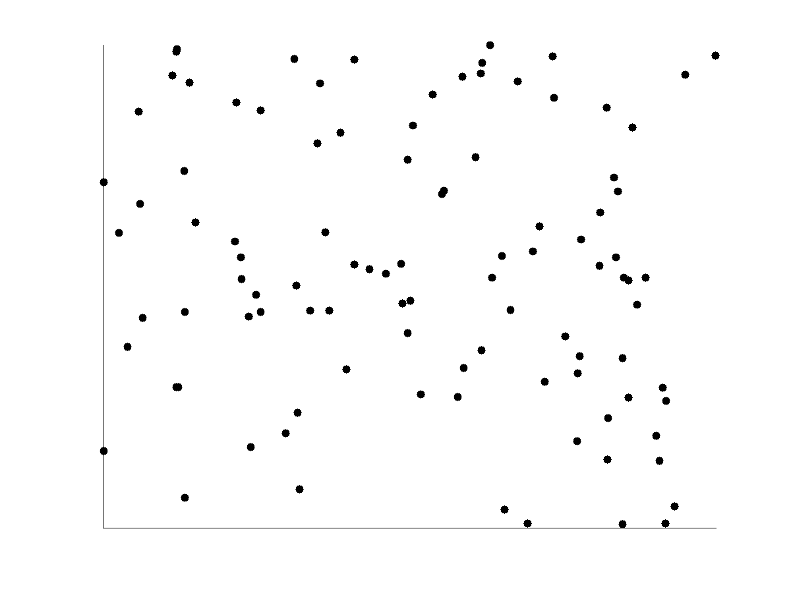
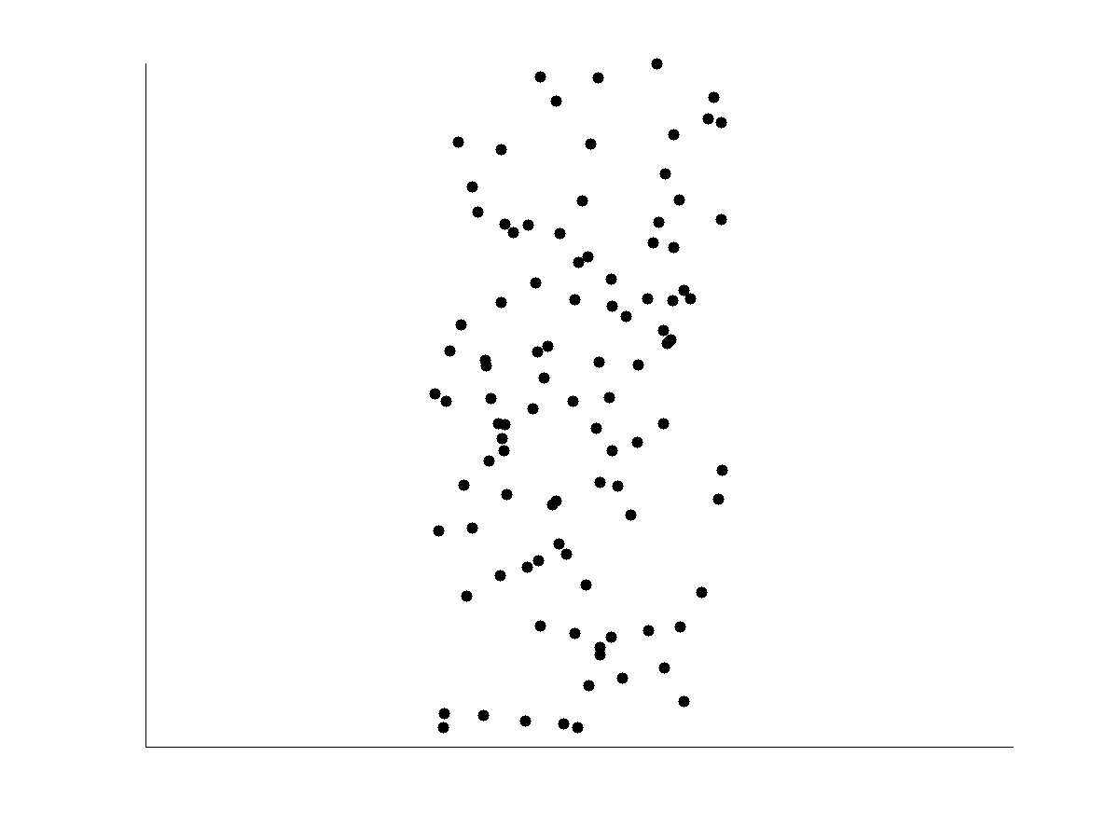
Uncorrelated Data

Slide 77
Important Characteristics of Structured Data
Dimensionality
Curse of dimensionality
Sparsity
Only presence counts
Resolution
Patterns depend on the scale
Distribution
Centrality and dispersion

