Slide 1
Introduction to data analytics and visualization

Slide 2
Learning Outcome
To get an understanding about data
To understand the needs data science
To know about the KDD process
Different types of data analytics techniques

Slide 3
Outline
Data is the new oil
What is data?
How much data we generate?
Why we need data science?
The KDD Process
Data Analytics and Visualization
Are All of the Patterns Interesting?

Slide 4
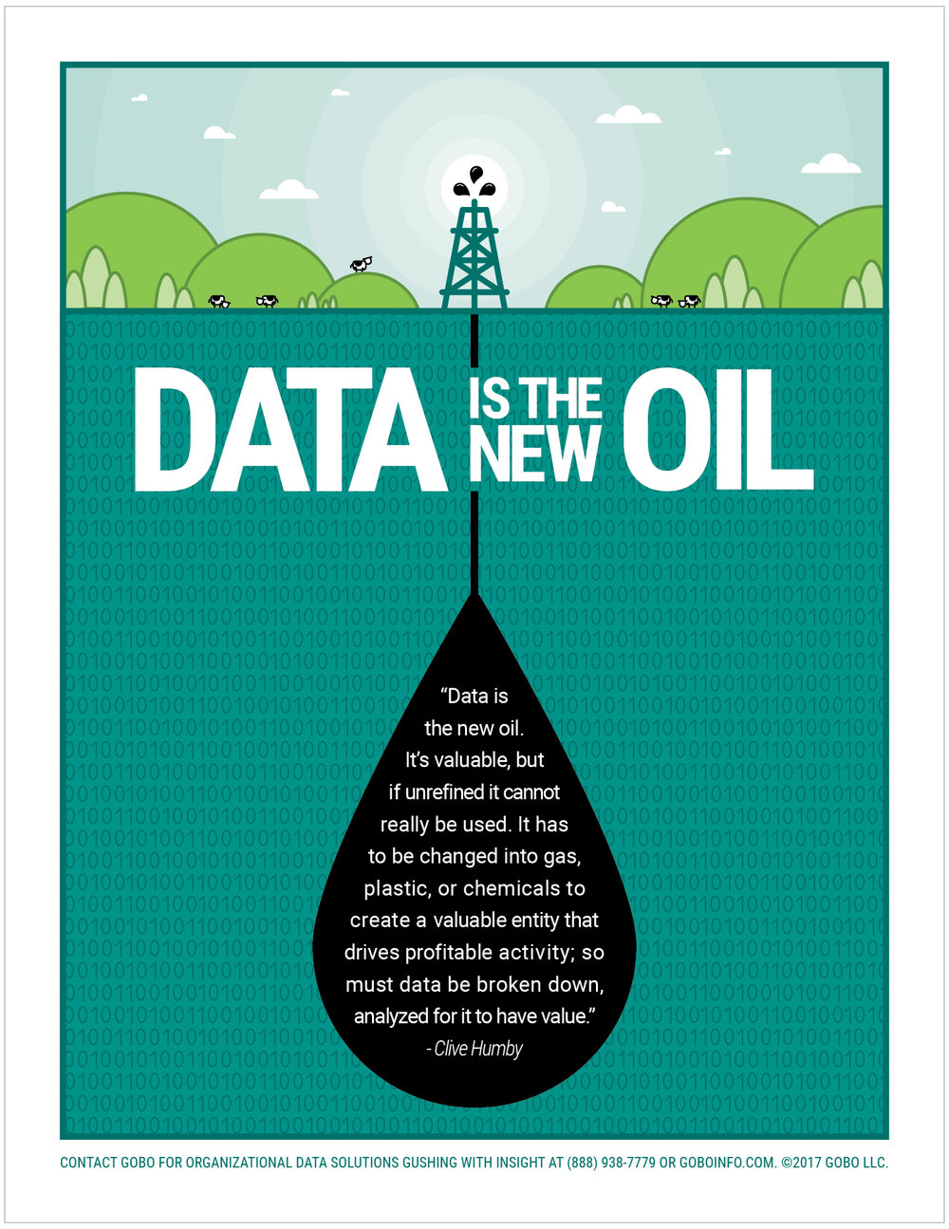
Data is the new Oil
“Data is the new oil” may be a cliche, but it is true.
According to the World Economic Forum, the world produces 2.5 quintillion bytes of data every day, and 90% of all data has been created in the last two years. With so much data, it’s become increasingly difficult to manage and make sense of it all.
https://www.google.com/url?sa=i&url=https%3A%2F%2Fjasonheglund.com%2Fdata-is-the-new-oil&psig=AOvVaw0H9emOMFYc6YZjrxWROUat&ust=1603383278665000&source=images&cd=vfe&ved=0CAIQjRxqFwoTCNjD-KiKxuwCFQAAAAAdAAAAABAS

Slide 5
What is Data?
But what is data about?
Data, in the information age, are a large set of bits encoding numbers, texts, images, sounds, videos, and so on.
Unless we add information to data, they are meaningless. When we add information, giving a meaning to them, these data become knowledge.
But before data become knowledge, typically, they pass through several steps where they are still referred to as data, despite being a bit more organized; that is, they have some information associated with them.

Slide 6
How much data we generate?

Slide 7
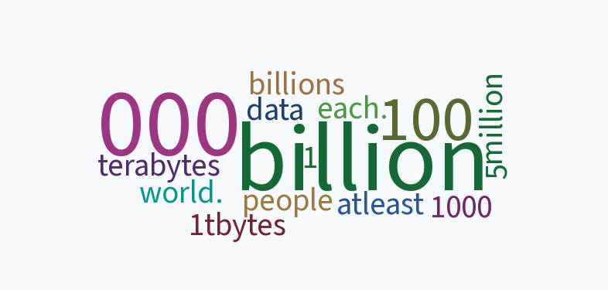
Can You think about it?
How many mails, tweets, facebook posts, whatsapp message are created daily?

Slide 8




some key daily statistics highlighted
Here are some key daily statistics highlighted in the infographic:
500 million tweets are sent
294 billion emails are sent
4 petabytes of data are created on Facebook
65 billion messages are sent on WhatsApp
By 2025, it’s estimated that 463 exabytes of data will be created each day globally – that’s the equivalent of 212,765,957 DVDs per day!
Note: these figure are for 2020

Slide 9
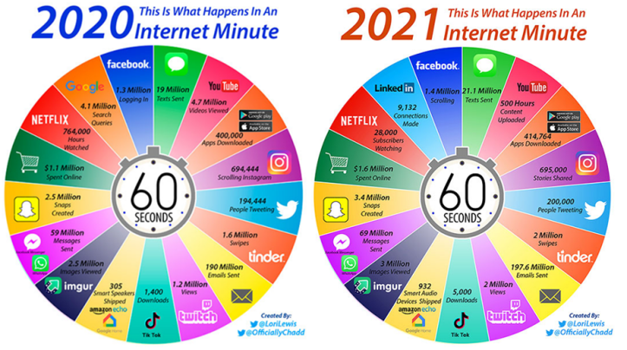
What Happens in an Internet Minute

Slide 10
Why we need data science?

Slide 11
Why we need data science?
Like oil, data in its raw, unrefined form is pretty worthless.
To unlock its value, data needs to be refined, analyzed and understood (Disney 2017).
More and more organizations are seeing potential in their data connections, but how do you allow non-experts to analyze data at scale and extract potentially complex insights? One answer is through interactive graph visualization.
https://www.google.com/url?sa=i&url=https%3A%2F%2Fjasonheglund.com%2Fdata-is-the-new-oil&psig=AOvVaw0H9emOMFYc6YZjrxWROUat&ust=1603383278665000&source=images&cd=vfe&ved=0CAIQjRxqFwoTCNjD-KiKxuwCFQAAAAAdAAAAABAS

Slide 12
The KDD(Knowledge Discovery in Databases) Process

Slide 13
Data Analytics: The KDD process
Data Analytics The science that analyze crude data to extract useful knowledge (patterns) from them.
The KDD process: The KDD process proposes a sequence of nine steps. In spite of the sequence, the KDD process considers the possibility of going back to any previous step in order to redo some part of the process. The nine steps are as follows:
1. Learning the application domain: What is expected in terms of the application domain? What are the characteristics of the problem; its speciﬁcities? A good understanding of the application domain is required
Taken from Chapter 1:1.7.2 page 24 th KDD process, General Introduction to Data Analytics, by João Mendes Moreira, André C. P. L. F. de Carvalho

Slide 14
Data Analytics: The KDD process Contd..
2. Creating a target dataset: What data are needed for the problem? Which attributes? How will they be collected and put in the desired format (say, a tabular data set)? Once the application domain is known, the data analyst team should be able to identify the data necessary to accomplish the project.
3. Data cleaning and pre-processing: How should missing values and/or outliers such as extreme values be handled? What data type should we choose for each attribute? It is necessary to put the data in a speciﬁc format, such as a tabular format.
4. Data reduction and projection: Which features should we include to represent the data? From the available features, which ones should be discarded? Should further information be added, such as adding the day of the week to a timestamp? This can be useful in some tasks. Irrelevant attributes should be removed.
Taken from Chapter 1:1.7.2 page 24 th KDD process, General Introduction to Data Analytics, by João Mendes Moreira, André C. P. L. F. de Carvalho

Slide 15
Data Analytics: The KDD process contd…
5. Choosing the data mining function: Which type of methods should be used? Four types of method are: summarization, clustering, classiﬁcation and regression. The ﬁrst two are from the branch of descriptive analytics while the latter two are from predictive analytics.
6. Choosing the data mining algorithm(s): Given the characteristics of the problem and the characteristics of the data, which methods should be used? It is expected that speciﬁc algorithms will be selected.
7. Data mining: Given the characteristics of the problem, the characteristics of the data, and the applicable method type, which speciﬁc methods should be used? The choice of method depends on many diﬀerent factors: interpretability, ability to handle missing values, capacity to deal with outliers, computational eﬃciency
Taken from Chapter 1:1.7.2 page 24 th KDD process, General Introduction to Data Analytics, by João Mendes Moreira, André C. P. L. F. de Carvalho

Slide 16
Data Analytics: The KDD process Contd…
8. Interpretation: What is the meaning of the results? What is the utility for the ﬁnal user? To select the useful results and to evaluate them in terms of the application domain is the goal of this step. It is common to go back to a previous step when the results are not as good as expected.
9. Using discovered knowledge: How can we apply the new knowledge in practice? How is it integrated in everyday life? This implies the integration of the new knowledge into the operational system or in the reporting system.
For simplicity sake, the nine steps were described sequentially, which is typical. However, in practice, some jumps are often necessary. As an example, steps 3 and 4 can be grouped together with steps 5 and 6. The way we pre-process the data depends on the methods we will use
Taken from Chapter 1:1.7.2 page 24 th KDD process, General Introduction to Data Analytics, by João Mendes Moreira, André C. P. L. F. de Carvalho

Slide 17
Data Analytics and Visualization

Slide 18
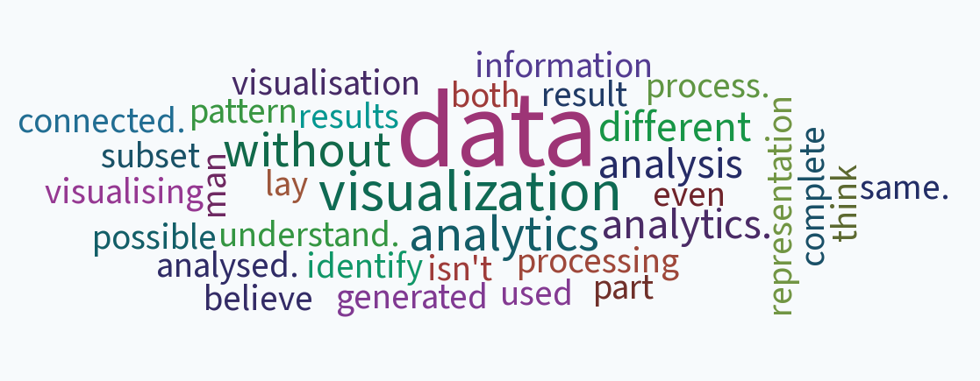
Question
What do you think about data analytics & Visualization ? Are they same? Different?

Slide 19
Data Analytics
Data analytics is the method of examining data sets (structured or unstructured) in order to get useful insights to draw conclusions about the datasets. Data analytics techniques and technologies are widely used in many organizations.
https://www.educba.com/data-visualisation-vs-data-analytics/

Slide 20
Data visualization
Data visualization is a graphic representation that expresses the significance of data.
It reveals insights and patterns that are not immediately visible in the raw data. It is an art through which information, numbers, and measurements can be made more understandable.
Data visualisation helps data analytics to get better insights

Slide 21
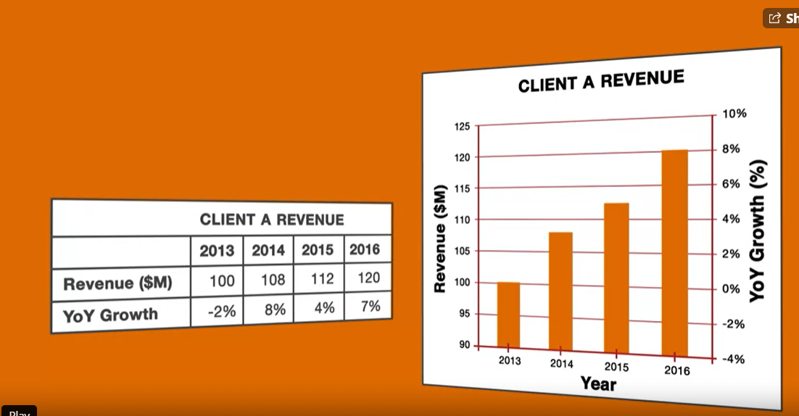
Data Visualisation Contd..
Which one is easier to understand?

Slide 22
Data Visualisation Contd..
The main goal of data visualization is to communicate information clearly and effectively through graphical means.
It doesn’t mean that data visualization needs to look boring to be functional or extremely sophisticated to look beautiful.
To convey ideas effectively, aesthetic form and functionality must go hand in hand, providing insights into a rather sparse and complex data set by communicating its key aspects more intuitively.

Slide 23
Why data visualization is such a powerful tool?
Intuitive: Presenting a data through different graph instantly makes sense, even to people who have never worked with graphs before.
Fast: It is fast because our brains are great at identifying patterns, but only when data is presented in a tangible format. Armed with visualization, we can spot trends and outliers very effectively.
Insightful: Exploring graph data interactively allows users to gain more in-depth knowledge, understand the context and ask more questions, compared to static visualization or raw data.

Slide 24
Effective data visualization
Criteria | Description
Informative | The visualization should be able to convey the desired information from the data to the reader.
Efficient | The visualization should not be ambiguous.
Appealing | The visualization should visually pleasing.
Interactive and Predictive (Optional) | The visualizations can contain variables and filters with which the users may interact to predict results of different scenarios.

Slide 25
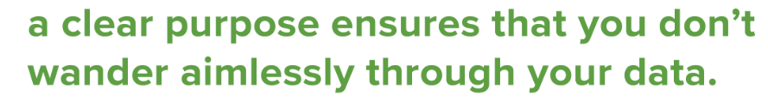
Effective data visualization Contd..
tip #1 - data visualizations should have a clear purpose and audience.

Slide 26
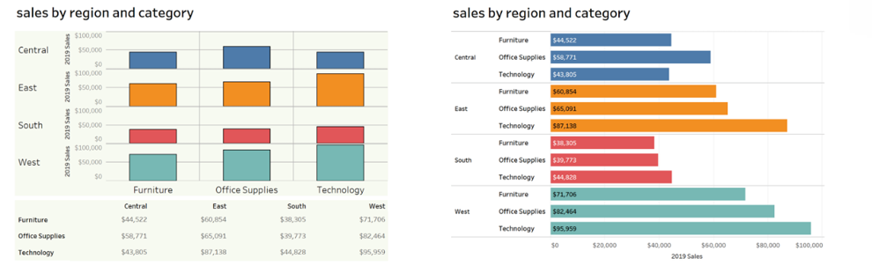
Effective data visualization Contd….
Tell me furniture sales in the Central and West regions?
https://blog.csgsolutions.com/6-tips-for-creating-effective-data-visualizations

Slide 27
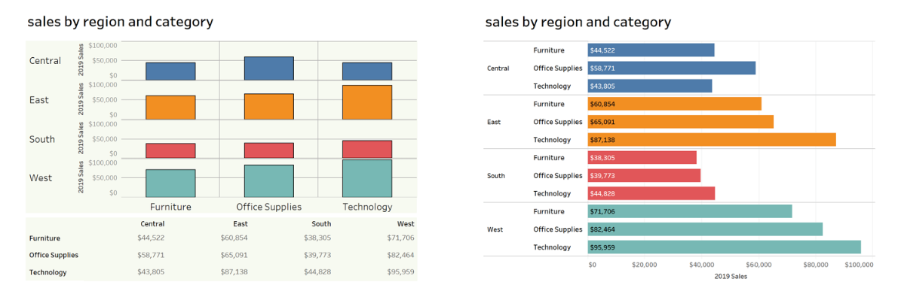
Effective data visualization Contd….
Tell me furniture sales in the Central and West regions?
The visualization on the right makes it easier to compare sales by category or by region by representing all amounts visually (not numerically) and grouping them by region in one chart.
https://blog.csgsolutions.com/6-tips-for-creating-effective-data-visualizations

Slide 28
Effective data visualization Contd….
tip #2 - choose the right type of viz or chart for your data.

Slide 29
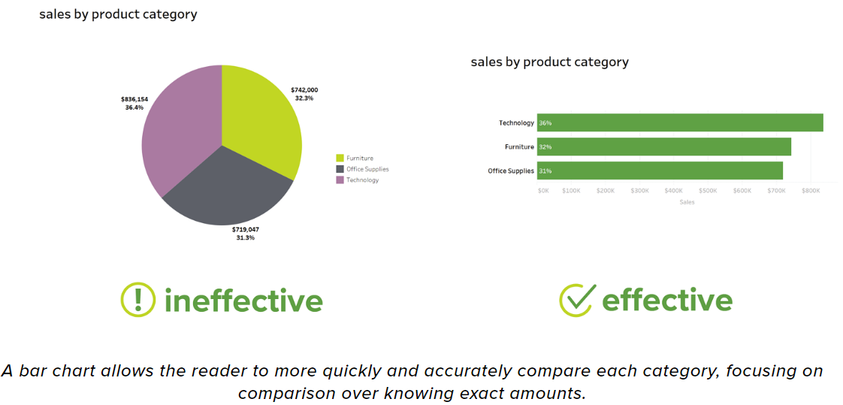
Effective data visualization Contd….
https://blog.csgsolutions.com/6-tips-for-creating-effective-data-visualizations

Slide 30

Effective data visualization Contd….
tip #3 - use text and labels to clarify, not clutter.

Slide 31
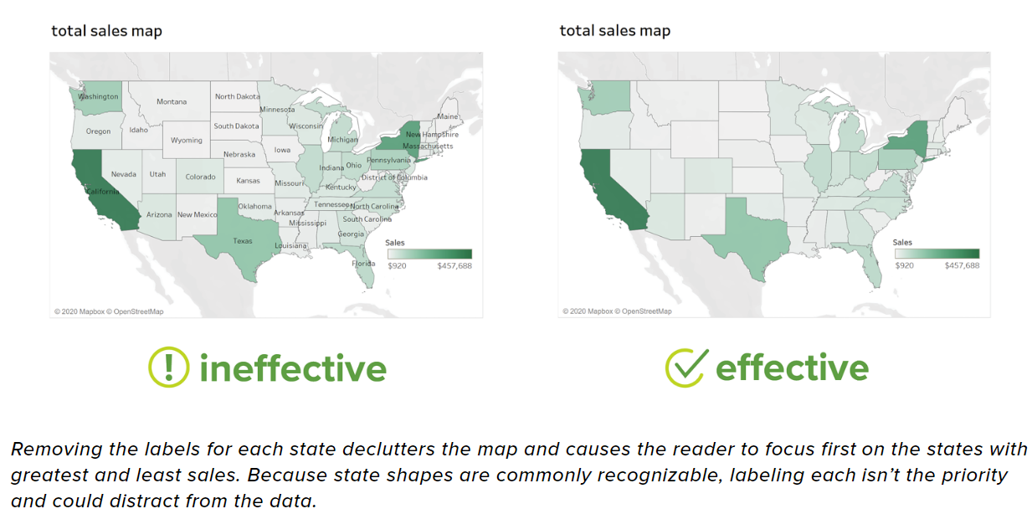
Effective data visualization Contd….
https://blog.csgsolutions.com/6-tips-for-creating-effective-data-visualizations

Slide 32
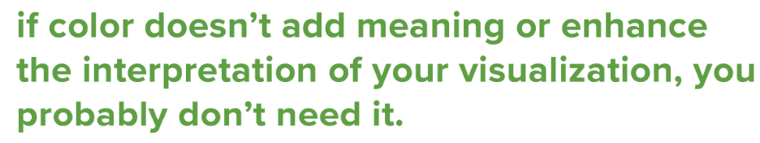
Effective data visualization Contd….
tip #4 - use color to highlight important information or to differentiate or compare.

Slide 33
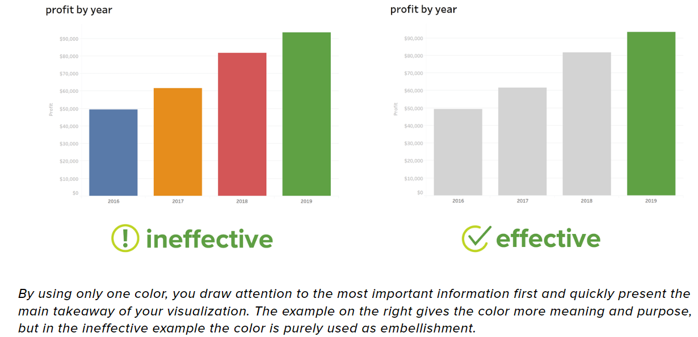
Effective data visualization Contd….
https://blog.csgsolutions.com/6-tips-for-creating-effective-data-visualizations

Slide 34
Effective data visualization Contd….
tip #5 - avoid misleading visualizations.

Slide 35
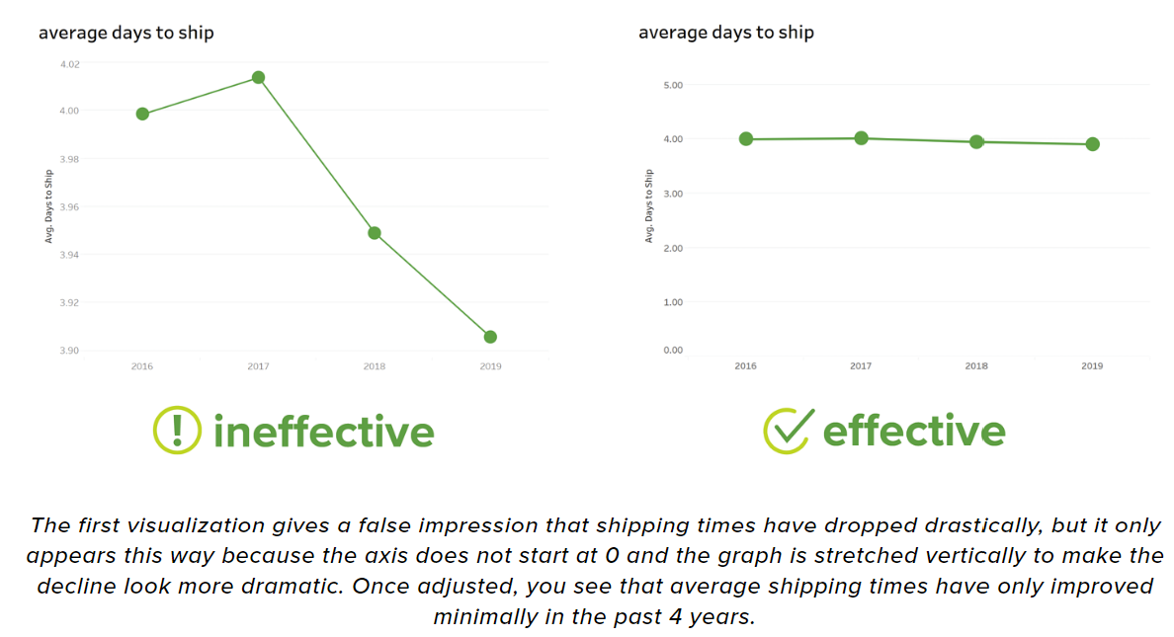
Effective data visualization Contd….
https://blog.csgsolutions.com/6-tips-for-creating-effective-data-visualizations

Slide 36
Are All of the Patterns Interesting?

Slide 37
What makes a pattern interesting?
A pattern is interesting if it is
easily understood by humans,
valid on new or test data with some degree of certainty,
potentially useful
novel.
A pattern is also interesting if it validates a hypothesis that the user sought to conﬁrm. An interesting pattern represents knowledge.

Slide 38
Are All of the Patterns Interesting?
A data mining system has the potential to generate thousands or even millions of patterns, or rules.
“So,” you may ask, “are all of the patterns interesting?” Typically not—only a small fraction of the patterns potentially generated would actually be of interest to any given user.
“What makes a pattern interesting? Can a data mining system generate all of the interesting patterns? Can a data mining system generate only interesting patterns?”

Slide 39
What makes a pattern interesting?
contd
Subjective interestingness measures are based on user beliefs in the data.
These measures ﬁnd patterns interesting if they are unexpected (contradicting a user’s belief) or offer strategic information on which the user can act.
In the latter case, such patterns are referred to as actionable.
Patterns that are expected can be interesting if they conﬁrm a hypothesis that the user wished to validate, or resemble a user’s hunch

Slide 40
Outlier analysis
A database may contain data objects that do not comply with the general behavior or model of the data. These data objects are outliers.
Most data mining methods discard outliers as noise or exceptions.
However, in some applications such as fraud detection, the rare events can be more interesting than the more regularly occurring ones.
The analysis of outlier data is referred to as outlier mining.
Example: Outlier analysis may uncover fraudulent usage of credit cards by detecting purchases of extremely large amounts for a given account number in comparison to regular charges incurred by the same account.

Slide 41
Summary
Introduction to data
Discussed the KDD process
Different types of data analytics techniques

