Slide 1
Numeric and Categorical Structured Data Visualization- Part2 (Multivariate)

Slide 2
Learning Outcome
To learn more about bivariate and multivariate data visualization

Slide 3
Outline
Bivariate and Multivariate Visualization
Scatter Plot for 2D data
Scatter Plot for 3D data
Box Plot
Violin Plot
Sunburst Chart
Treemap

Slide 4
Bivariate and Multivariate Visualization

Slide 5
Scatter Plot for 2D data

Slide 6
Scatter Plot
Scatter plots illustrate how the values of two attributes are correlated.
They make it possible to see how an attribute varies according to the variability of the other attribute.

Slide 7

Scatter Plot
contd
Example: can you see any trend?
Ice Cream Sales vs Temperature
Temperature °C | Ice Cream Sales
14.2° | $215
16.4° | $325
11.9° | $185
15.2° | $332
18.5° | $406
22.1° | $522
19.4° | $412
25.1° | $614
23.4° | $544
18.1° | $421
22.6° | $445
17.2° | $408

Slide 8
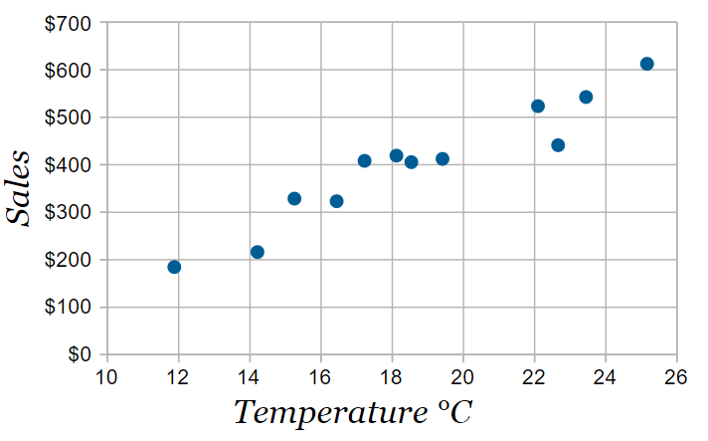
Scatter Plot
contd
Example continued
We can create scatter plot to find the hidden relationship
Any observation from this graph?
https://www.mathsisfun.com/data/scatter-xy-plots.html

Slide 9
Scatter Plot
contd
Example continued
Analysis: It is now easy to see that warmer weather leads to more sales, but the relationship is not perfect.
https://www.mathsisfun.com/data/scatter-xy-plots.html

Slide 10
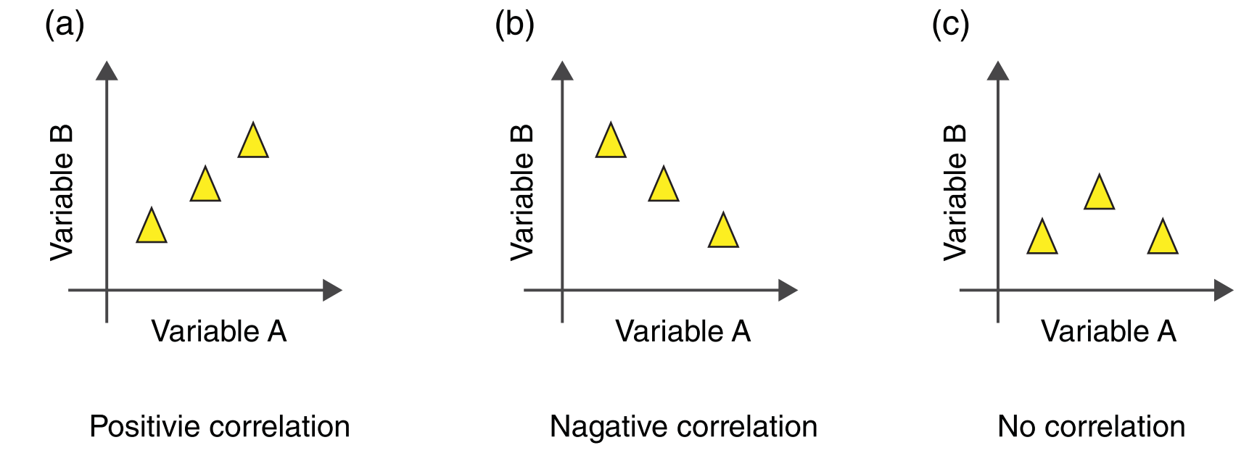
Three Types of Corelation between the attributes

Slide 11
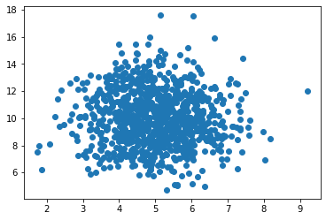
Scatter Plots in Python
Type 1: Random Data
You can see no correlation here
import numpy
import matplotlib.pyplot as plt
x = numpy.random.normal(5.0, 1.0, 1000)
y = numpy.random.normal(10.0, 2.0, 1000)
plt.scatter(x, y)
plt.show()
https://www.w3schools.com/python/python_ml_scatterplot.asp

Slide 12
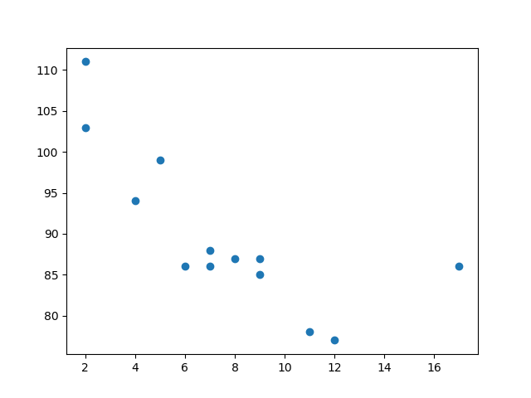
Scatter Plots in Python
contd
Type 2: Related Data
You can see negative correlation between the data points
import matplotlib.pyplot as plt x = [5,7,8,7,2,17,2,9,4,11,12,9,6] y = [99,86,87,88,111,86,103,87,94,78,77,85,86] plt.scatter(x, y) plt.show()
https://www.w3schools.com/python/python_ml_scatterplot.asp

Slide 13
Scatter Plot for 3D data

Slide 14
Question?(m)
Can you visualize 3D data using Scatter plots?

Slide 15
Question?(m)
Can the same visualization be used if the 3rd attribute is numerical? What will happen if its categorical?

Slide 16
Scatter Plot For 3 dimensional Data set
contd
A three dimensional data can still be visualized in a bivariate plot, associating the values of the third attribute with how each data object is represented in the plot.
If the third attribute is quantitative, the value can be represented by the size of the object representation in the plot.
If, on the other hand, the third attribute is qualitative, its value can be repre-sented in the plot by either the color or by the shape of the object

Slide 17
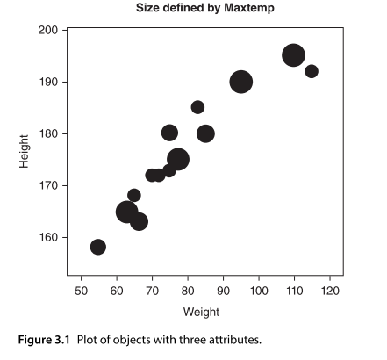
Scatter Plot For 3 dimensional Data set
contd
In Figure 3.1, the size of each object in the plot is proportional to the value of the third attribute for this object.
The third attribute is quantitative.

Slide 18
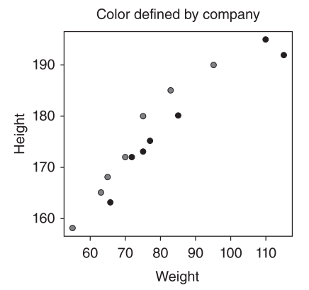
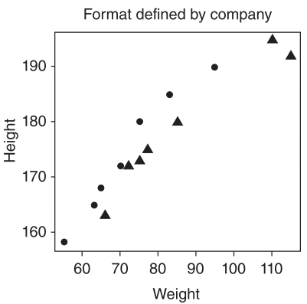
Scatter Plot For 3 dimensional Data set
contd
As an example, consider the following 2 plots, where the third attribute is qualitative.
On the left-hand size, it represents each qualitative value by a diﬀerent color.
On the right-hand size it represents each qualitative value as a diﬀerent shape.

Slide 19
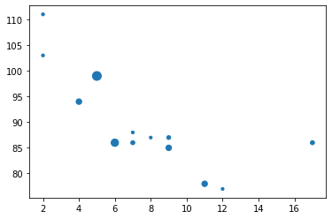
Scatter Plots for 3D data in Python
Using Matplotlib
We have used ‘size’ to represent the value of variable Z in this scatter plot
import numpy as np
import matplotlib.pyplot as plt
x =[5, 7 ,8, 7, 2, 17, 2, 9, 4, 11,12,9,6]
y =[99,86,87,88,111,86,103,87,94,78,77,85,86]
z= [100,21,10,11,11,21,11,19,40,40,10,40,70]
plt.scatter(x, y, z)
plt.show()

Slide 20
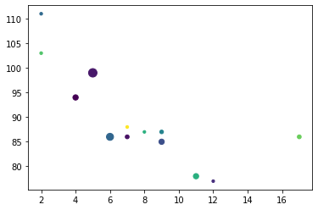
Scatter Plots for 3D data in Python
Add colour
import numpy as np
import matplotlib.pyplot as plt
N = 13
x =[5, 7 ,8, 7, 2, 17, 2, 9, 4, 11,12,9,6]
y =[99,86,87,88,111,86,103,87,94,78,77,85,86]
z= [100,21,10,11,11,21,11,19,40,40,10,40,70]
colors = np.random.rand(N) # Not a necessary step
plt.scatter(x, y, z, c=colors)
plt.show()

Slide 21
Scatter Plots for 3D data in Python Contd…
Any observations on this graph?

Slide 22
Scatter Plots for 3D data in Python Contd…
Any observations on this graph?
Some Negative correlation between x and y, but no co-relation with z

Slide 23
Scatter Plots for 3D data in Python
Using Seaborn
You can also plot scatter plots using seaborn library
Specially useful when you don’t have numeric data

Slide 24
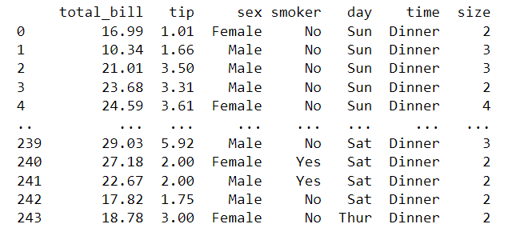
Scatter Plots for 3D data in Python
Dataset: According to the tips dataset documentation,
the Tips dataset is a data frame with 244 rows and 7 variables which represents some tipping data where
one waiter recorded information about each tip he received over a period of a few months working in one restaurant.
In all the waiter recorded 244 tips. The waiter collected several variables: The tip in dollars, the bill in dollars, the gender of the bill payer, whether there were smokers in the party, the day of the week, the time of day and the size of the party.

Slide 25
Scatter Plots for 3D data in Python
We are interested in seeing the relationship between total bill, tip and time

Slide 26
Seaborn
Seaborn is a Python data visualization library based on matplotlib. It provides a high-level interface for drawing attractive and informative statistical graphics.
Seaborn.scatterplot(data, x, y, hue,…..)
Data: Input data structure. It can be pandas.DataFrame, numpy.ndarray, mapping, or sequence. Either a long-form collection of vectors that can be assigned to named variables or a wide-form dataset that will be internally reshaped.
x, y : vectors or keys in data variables that specify positions on the x and y axes.
Hue: vector or key in data grouping variable that will produce points with different colors. Can be either categorical or numeric, although color mapping will behave differently in latter case.

Slide 27
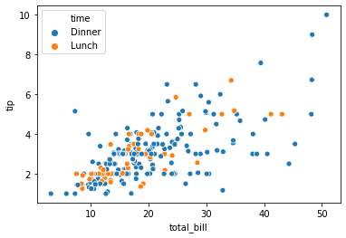
Scatter Plots for 3D data in Python
Using Seaborn
You can how tip is varying depending on total bill as well as lunch or dinner
import matplotlib.pyplot as plt
import seaborn as sns
tips = sns.load_dataset("tips")
sns.scatterplot(data=tips, x="total_bill", y="tip", hue="time")
plt.legend(loc='upper left’)
plt.show()

Slide 28
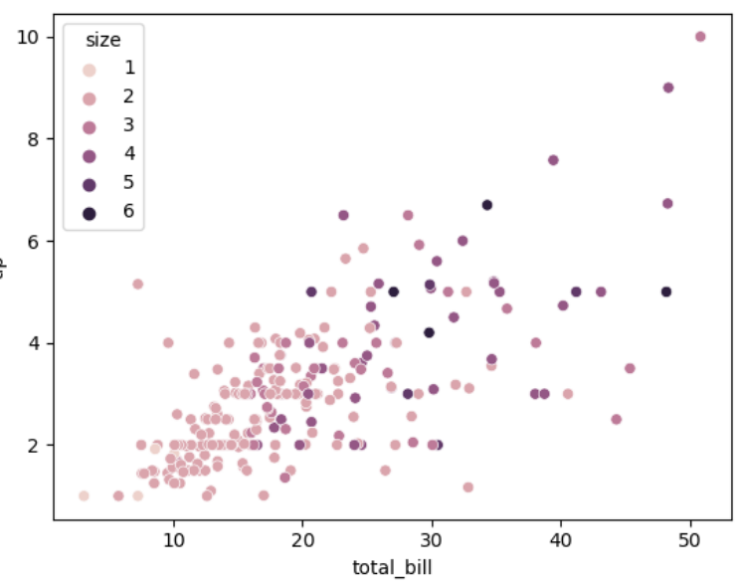
Lets plot size
sns.scatterplot(data=tips, x="total_bill", y="tip", hue="size")
Any observation?
What if I change the sizes by colours?

Slide 29
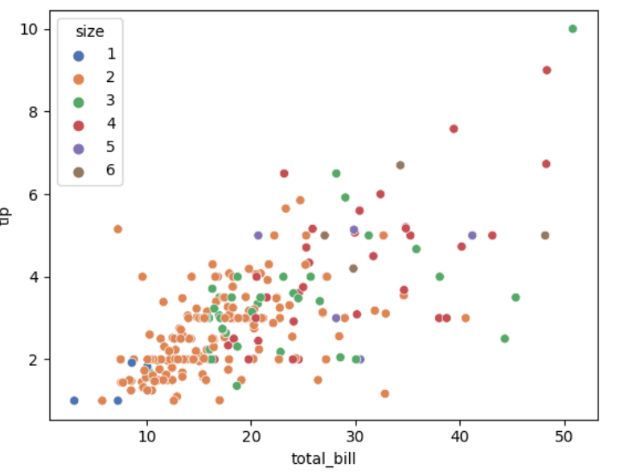
Lets plot size
sns.scatterplot(data=tips, x="total_bill", y="tip", hue="size", palette="deep")

Slide 30
Question?(m)
Lets plot size
sns.scatterplot(data=tips, x="total_bill", y="tip", hue="size", palette="deep")
Any observation?

Slide 31
Answer
Lets plot size
sns.scatterplot(data=tips, x="total_bill", y="tip", hue="size", palette="deep")
Any observation?
People are doing party in groups of two or three more
Try adding “style”
sns.scatterplot(data=tips, x="total_bill", y="tip", hue="day", style="time")

Slide 32
Box Plot

Slide 33
Box Plot
A box plot is a method for graphically depicting groups of numerical data through their quartiles.
What is quartile?
https://pandas.pydata.org/pandas-docs/stable/reference/api/pandas.DataFrame.boxplot.html

Slide 34
Quartile: Tutorial
Quartile: A quartile is a statistical term that describes a division of observations into four defined intervals based on the values of the data and how they compare to the entire set of observations.
Along with the minimum and maximum values of the data set, the quartiles divide a set of observations into four sections, each representing 25% of the observations
just like the median divides the data into half so that 50% of the measurement lies below the median and 50% lies above it, the quartile breaks down the data into quarters so that 25% of the measurements are less than the lower quartile(Q1), 50% are less than the median (Q2), and 75% are less than the upper quartile (Q3).
https://www.investopedia.com/terms/q/quartile.asp#:~:text=A%20quartile%20is%20a%20statistical,the%20entire%20set%20of%20observations.

Slide 35
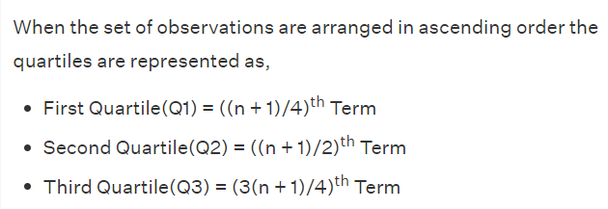
Quartile: Tutorial Contd…
https://www.cuemath.com/quartile-formula/

Slide 36
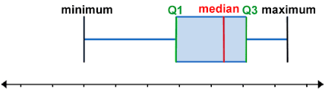
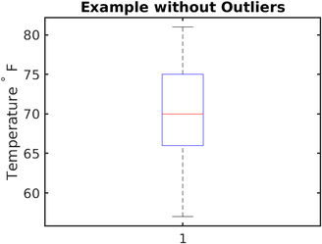
Quartile: Tutorial Contd…
Find the quartiles of this data set: 6, 47, 49, 15, 43, 41, 7, 39, 43, 41, 36
Steps 1: Find the rank:
Formulas for finding quartile

Slide 37
Quartile: Tutorial Contd…
Step 2: Find median = (n + 1) ÷ 2 = (11 + 1) ÷ 2 = 6
The rank of the median is 6, which means there are five points on each side.
Median = 41
Now the data set is divided into two parts. Above the median and below the median
Step 3:split the lower half of the data in two again to find the lower quartile. The lower quartile will be the point of rank (11 + 1) ÷ 4 = 3.
The result is Q1 = 15.
Step 4: The second half must also be split in two to find the value of the upper quartile. The rank of the upper quartile will be 3(11 + 1)/4 = 9. So Q3 = 43.

Slide 38
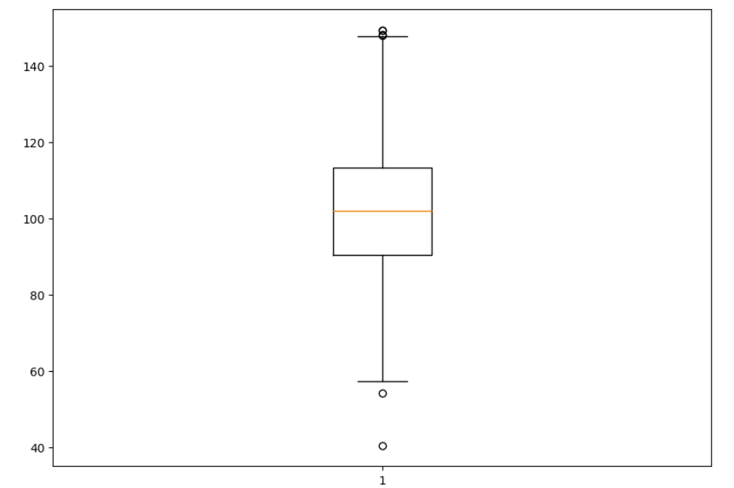
Box Plot
A box plot is a method for graphically depicting groups of numerical data through their quartiles.
The box extends from the Q1 to Q3 quartile values of the data, with a line at the median (Q2).
The whiskers extend from the edges of box to show the range of the data. By default, they extend no more than 1.5 * IQR (IQR = Q3 - Q1) from the edges of the box, ending at the farthest data point within that interval.
Outliers are plotted as separate dots.
https://pandas.pydata.org/pandas-docs/stable/reference/api/pandas.DataFrame.boxplot.html

Slide 39
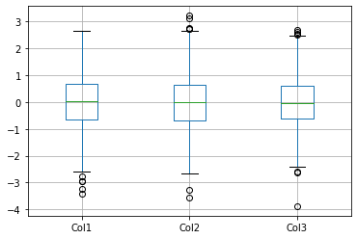
Box Plot
Example:
57, 57, 57, 58, 63, 66, 66, 67, 67, 68, 69, 70, 70, 70, 70, 72, 73, 75, 75, 76, 76, 78, 79, 81.
The minimum day temperature is 57 °F.
The maximum day temperature is 81 °F.
The median is the "middle" number of the ordered set. The median of this ordered set is 70 °F.
The first quartile value is the number that marks one quarter of the ordered set. In other words, there are exactly 25% of the elements that are less than the first quartile and exactly 75% of the elements that are greater. For our data it is 66 °F.
The third quartile value is the number that marks three quarters of the ordered set. In other words, there are exactly 75% of the elements that are less than that. In our data it is 75 °F.
https://en.wikipedia.org/wiki/Box_plot

Slide 40
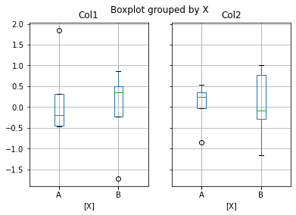
Box Plot Python
There are several ways of creating box plots in Python
# Import libraries
import matplotlib.pyplot as plt
import numpy as np
# Creating dataset
np.random.seed(10)
data = np.random.normal(100, 20, 200)
fig = plt.figure(figsize =(10, 7))
# Creating plot
plt.boxplot(data)
# show plot
plt.show()

Slide 41
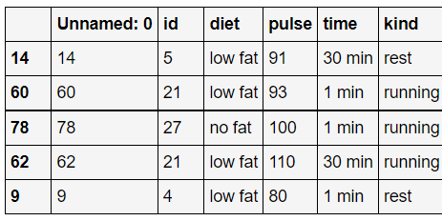
Box Plot in Python
Type 2: Basic box plot, One box for each attribute
import pandas as pd
import numpy as np
np.random.seed(1234)
df = pd.DataFrame(np.random.randn(1000, 4),
columns=['Col1', 'Col2', 'Col3', 'Col4'])
boxplot = df.boxplot(column=['Col1', 'Col2', 'Col3'])
By default all the columns will be shown. However, you can input which column you want
https://pandas.pydata.org/pandas-docs/stable/reference/api/pandas.DataFrame.boxplot.html

Slide 42
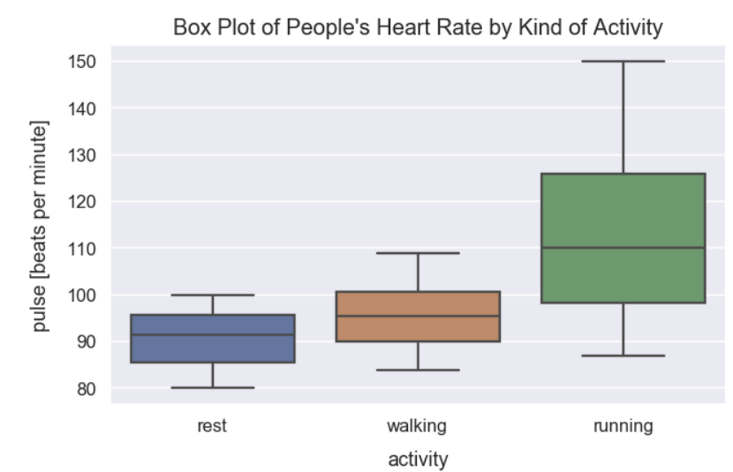
Box Plot in Python
Type 3: Grouping by a particular attribute
df = pd.DataFrame(np.random.randn(10, 2),
columns=['Col1', 'Col2'])
df['X'] = pd.Series(['A', 'A', 'A', 'A', 'A’, 'B', 'B', 'B', 'B', 'B'])
boxplot = df.boxplot(by='X')
https://pandas.pydata.org/pandas-docs/stable/reference/api/pandas.DataFrame.boxplot.html

Slide 43
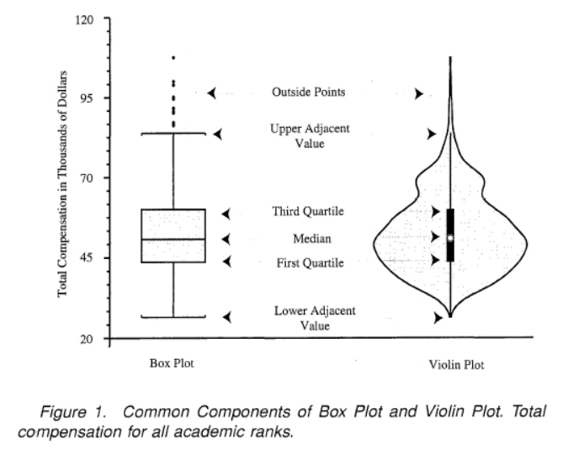
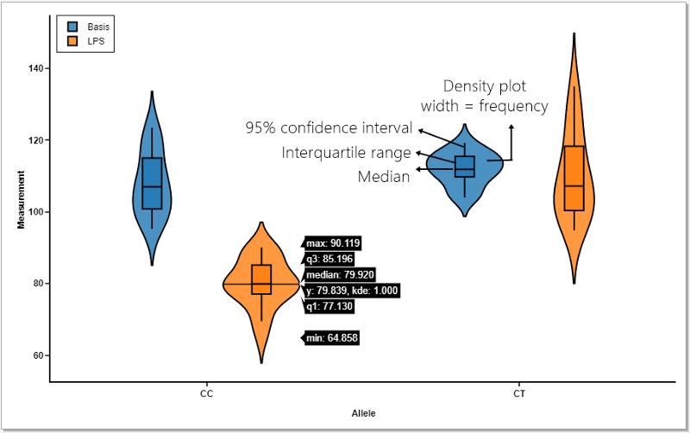
Boxplots
In which kinds of plots Box-plot is useful?
Box plots help visualize the distribution of quantitative values in a field.
They are also valuable for comparisons across different categorical variables or identifying outliers, if either of those exist in a dataset.
https://dfrieds.com/data-visualizations/when-use-box-plots.html

Slide 44
Violin Plot

Slide 45
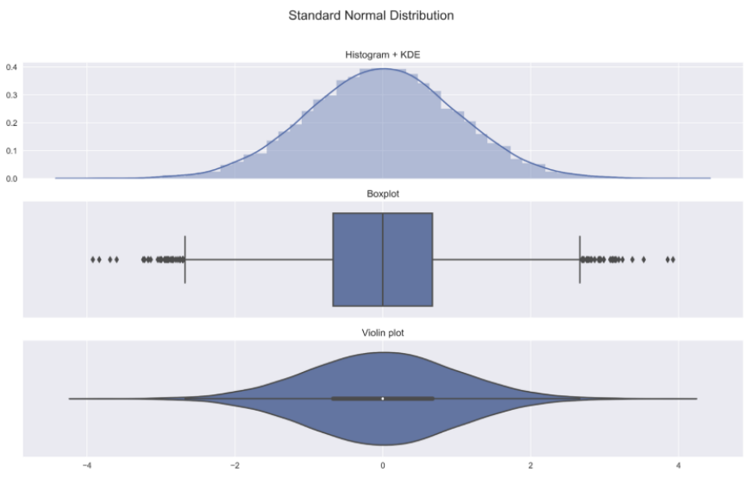
Violin Plot
Violin plot allows to visualize the distribution of a numeric variable for one or several groups.
Each ‘violin’ represents a group or a variable.
The shape represents the density estimate of the variable: the more data points in a specific range, the larger the violin is for that range.
It is really close to a boxplot, but allows a deeper understanding of the distribution

Slide 46
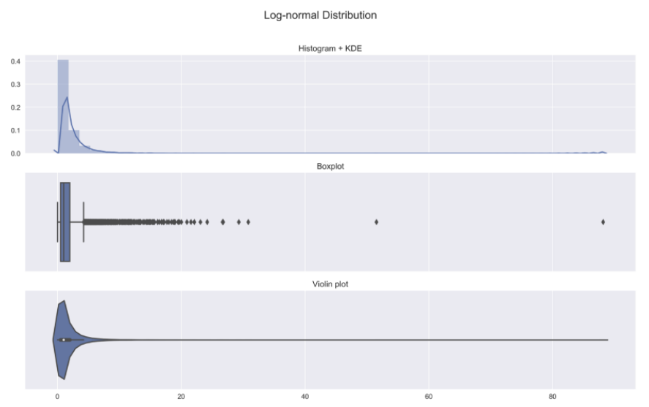
Violin Plot
In general, violin plots are a method of plotting numeric data and can be considered a combination of the box plot with a kernel density plot.
In the violin plot, we can find the same information as in the box plots:
median (a white dot on the violin plot)
interquartile range (the black bar in the center of violin)

Slide 47
Violin Plot
They are particularly useful when the data distribution is multimodal (more than one peak).
In this case a violin plot shows the presence of different peaks, their position and relative width.
It can not be identified using Box-plots and hence, this is the advantage of violin plots over box plots

Slide 48
Violin Plot
Example image
https://www.google.com/url?sa=i&url=https%3A%2F%2Fblog.bioturing.com%2F2018%2F05%2F16%2F5-reasons-you-should-use-a-violin-graph%2F&psig=AOvVaw2VlfgVEDusOX8ZQGjenAuI&ust=1611612677546000&source=images&cd=vfe&ved=0CAIQjRxqFwoTCOCLj7vLte4CFQAAAAAdAAAAABAD

Slide 49
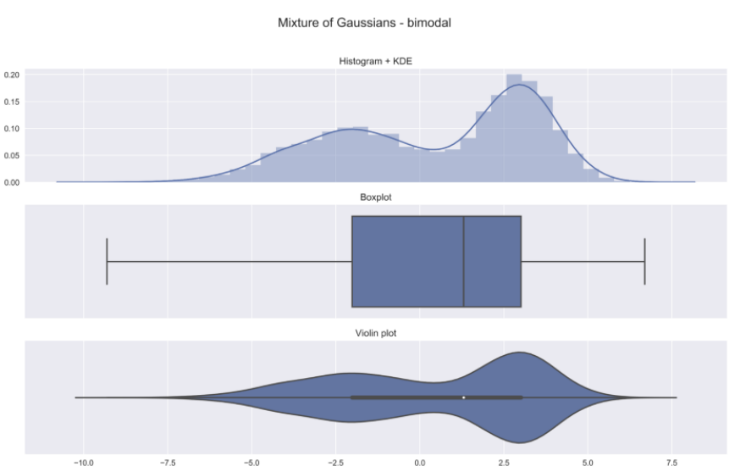
Violin Plot
Standard Normal distribution
In the histogram we see the symmetric shape of the distribution
We can see the previously mentioned metrics (median, IQR, outliers) in both the box plot as well as the violin plot
Wider sections of the violin plot represent a higher probability of observations taking a given value, the thinner sections correspond to a lower probability.
https://towardsdatascience.com/violin-plots-explained-fb1d115e023d

Slide 50
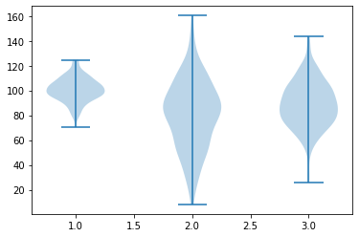
Violin Plot
Log-normal distribution
In the second example, we consider the log-normal distribution, which is definitely more skewed than the Normal distribution.
https://towardsdatascience.com/violin-plots-explained-fb1d115e023d

Slide 51
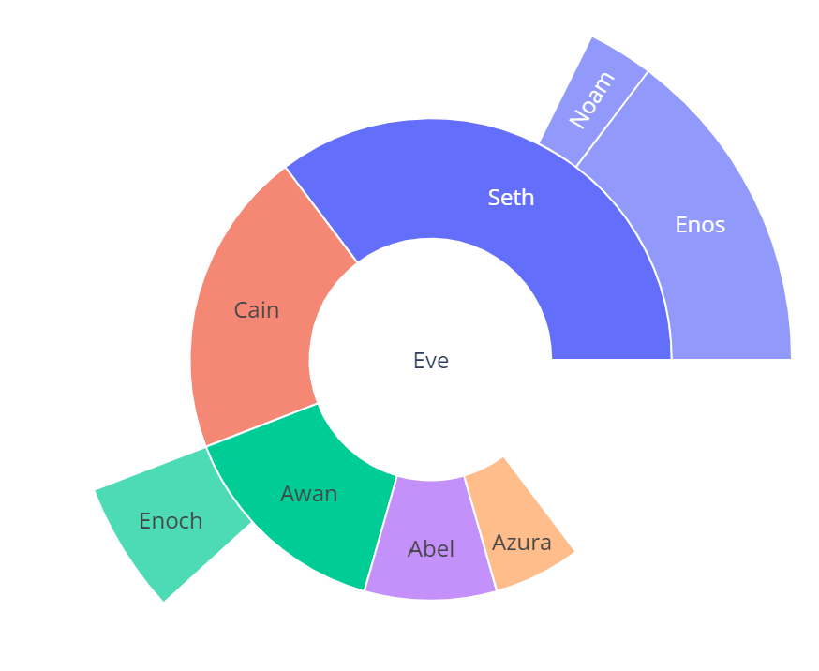
Violin Plot
Mixture of Gaussians — bimodal
Without looking at a histogram/density plot, it would be impossible to spot the two peaks in our data.
https://towardsdatascience.com/violin-plots-explained-fb1d115e023d

Slide 52
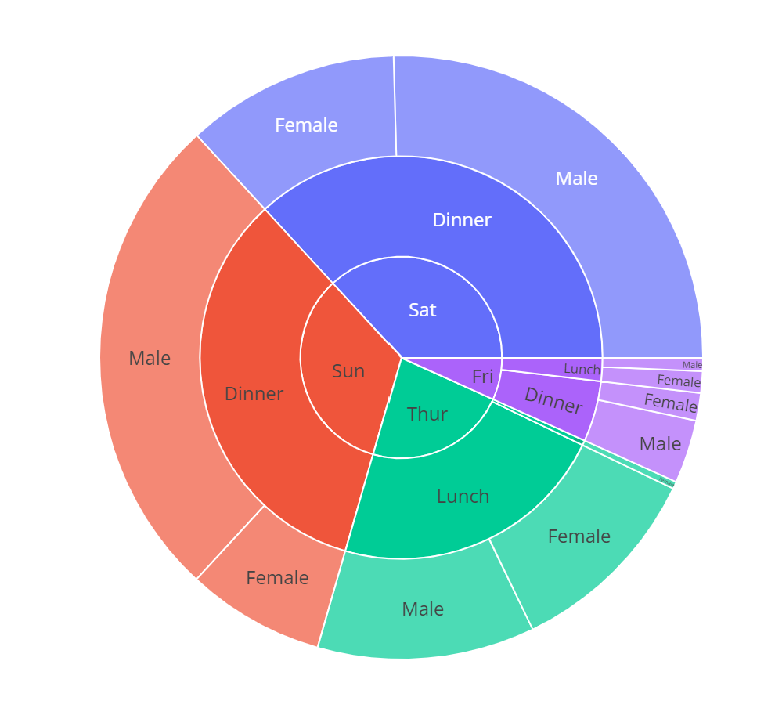
Violin Plot
import matplotlib.pyplot as plt
np.random.seed(10)
collectn_1 = np.random.normal(100, 10, 200)
collectn_2 = np.random.normal(80, 30, 200)
collectn_3 = np.random.normal(90, 20, 200)
## combine these different collections into a list
data_to_plot = [collectn_1, collectn_2, collectn_3]
plt.violinplot(data_to_plot)
plt.show()
#Note the function here
np.random.normal(mu, sigma, 1000)

Slide 53
Sunburst Chart

Slide 54
Sunburst Chart
The sunburst chart can be used to visualize the distribution of hierarchical variables of data. It represents distribution with a list of rings around the center circle.
The central circle represents the total quantity of a particular attribute and then each ring around it represents distribution at that level to a relationship with parent ring which is inside of it.
The sunburst chart is also sometimes referred to as multi-level pie chart or ring chart or donut chart or doughnut chart or radial treemap.
The sunburst chart is very similar to treemap charts with the only difference being that data is laid out radially.

Slide 55
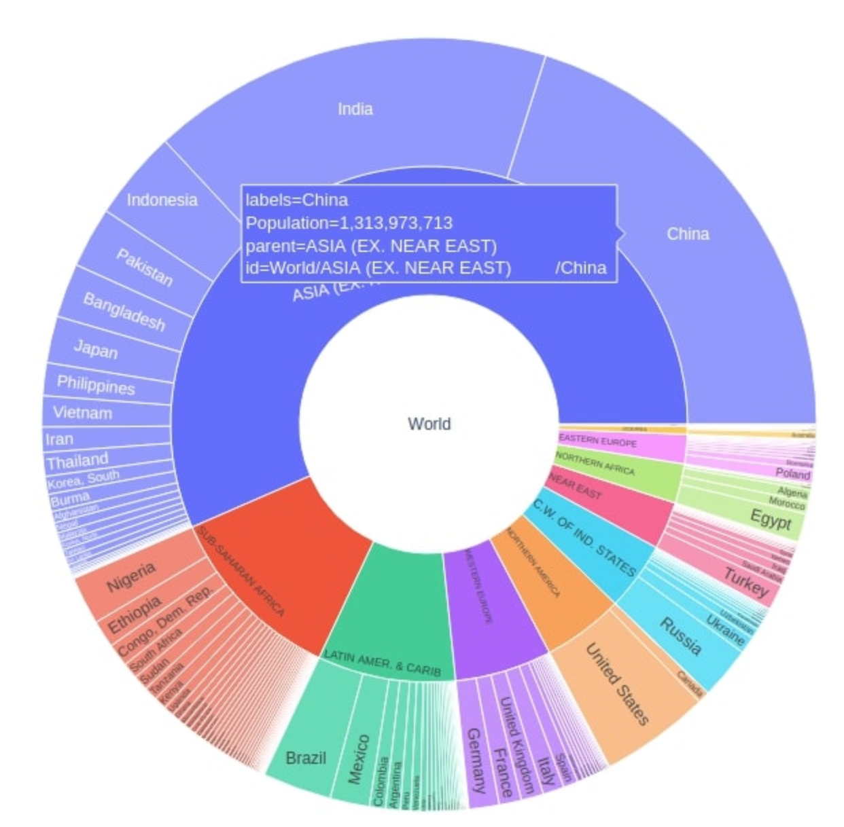
Sunburst Chart
import plotly.express as px
data = dict(
character = ["Eve", "Cain", "Seth", "Enos", "Noam", "Abel", "Awan", "Enoch", "Azura"],
parent = ["", "Eve", "Eve", "Seth", "Seth", "Eve", "Eve", "Awan", "Eve" ],
value = [10, 14, 12, 10, 2, 6, 6, 4, 4])
fig = px.sunburst( data, names='character’, parents='parent’, values='value')
fig.show()
https://plotly.com/python/sunburst-charts/

Slide 56
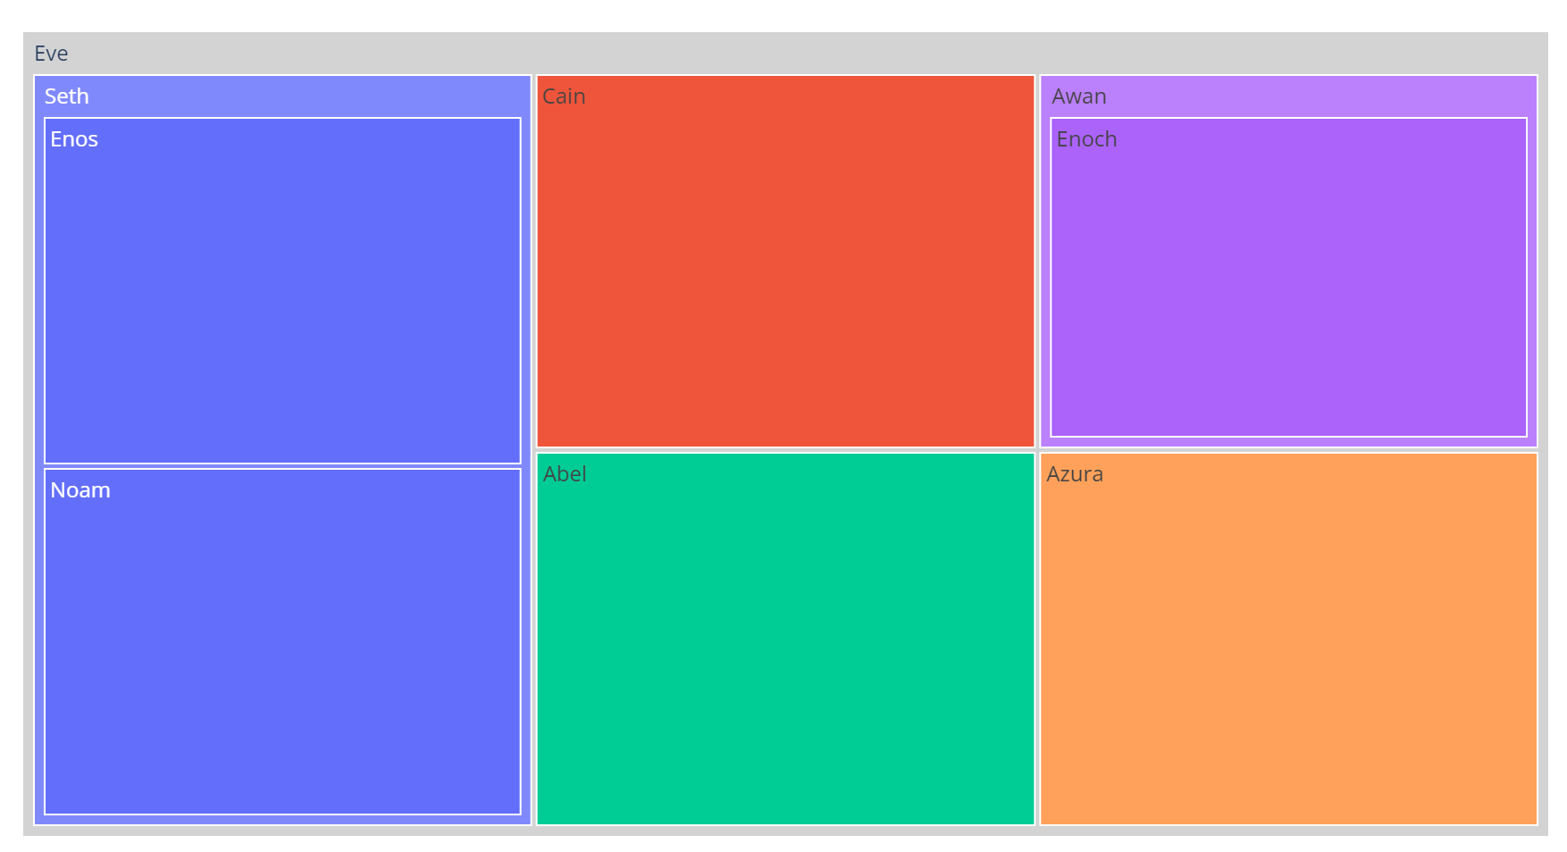
Sunburst Chart
import pandas as pd
import plotly.express as px
df = pd.read_csv(“tips.csv”)
fig = px.sunburst(df, path=['day', 'time’, ‘gender'], values='total_bill')
fig.show()

Slide 57
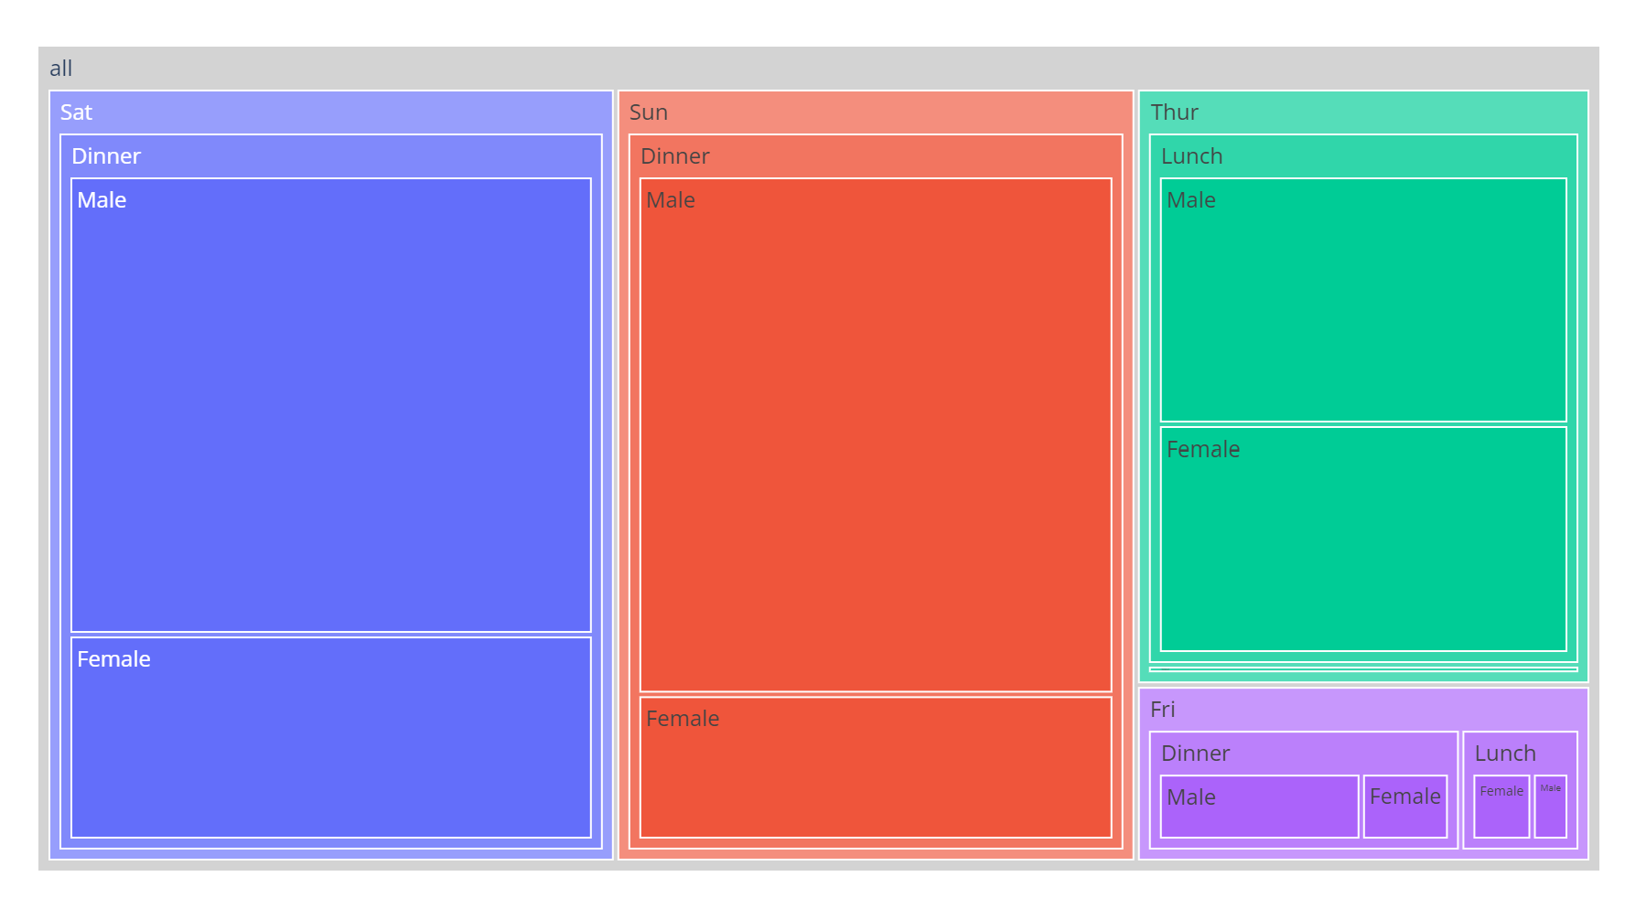
Sunburst Chart
import pandas as pd
import numpy as np
import plotly.express as px
import plotly.graph_objects as go
world_countries_data = pd.read_csv(“WorldCountries.csv")
world_countries_data["World"] = "World"
world_countries_data.head()
fig = px.sunburst(world_countries_data,
path=["World", "Region", "Country"],
values='Population',
width=750, height=750)
fig.show()
https://coderzcolumn.com/tutorials/data-science/how-to-create-sunburst-chart-in-python-plotly

Slide 58
Treemaps

Slide 59
Treemaps
A treemap displays hierarchical data as a set of nested rectangles. A treemap displays each element of a dataset as a rectangle. It allows to see what proportion each element has compared to the whole.
Also, the area size of the parent category is the total of its subcategories. The way rectangles are divided and ordered into sub-rectangles depends on the tiling algorithm used. Many tiling algorithms have been developed, but the "squarified algorithm", which keeps each rectangle as square-like as possible is the one commonly used.

Slide 60
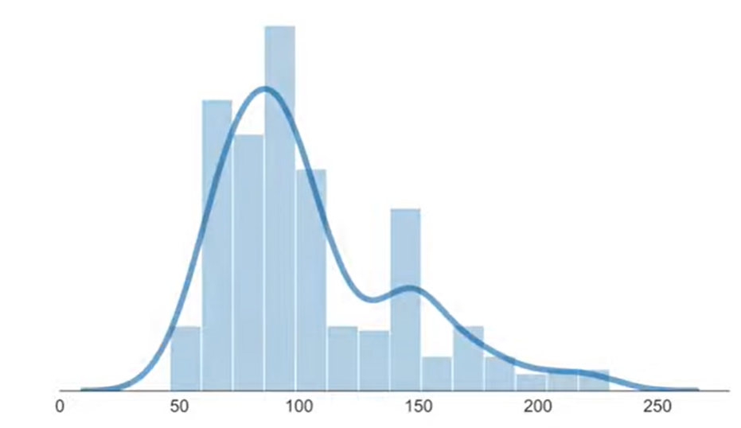
Treemaps
import pandas as pd
import plotly.express as px
fig = px.treemap(
names = ["Eve","Cain", "Seth", "Enos", "Noam", "Abel", "Awan", "Enoch", "Azura"],
parents = ["", "Eve", "Eve", "Seth", "Seth", "Eve", "Eve", "Awan", "Eve"] )
fig.update_traces(root_color="lightgrey")
fig.update_layout(margin = dict(t=50, l=25, r=25, b=25))
fig.show()
https://plotly.com/python/treemaps/

Slide 61
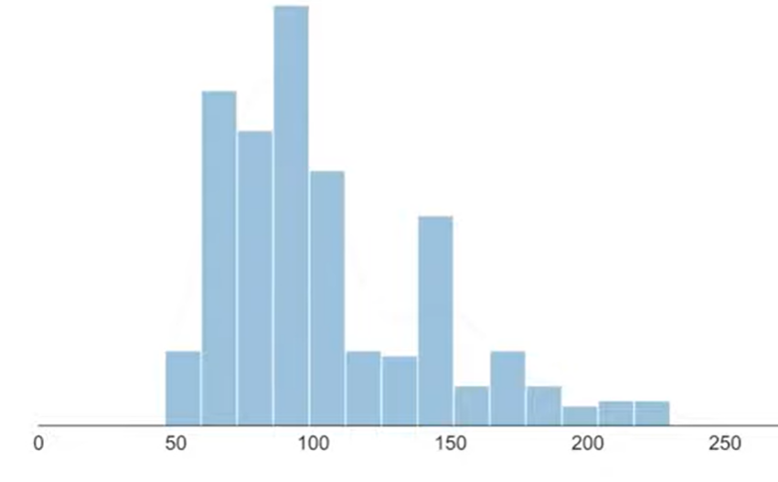
Treemaps
import pandas as pd
import plotly.express as px
df = pd.read_csv(“tips.csv”)
fig = px.treemap(df, path=[px.Constant("all"), 'day', 'time’, ‘gender'], values='total_bill')
fig.update_traces(root_color="lightgrey")
fig.update_layout(margin = dict(t=50, l=25, r=25, b=25))
fig.show()
https://plotly.com/python/treemaps/

Slide 62
Group Activity -1
Dataset: on KLE or download from the following link: https://www.kaggle.com/datasets/mirichoi0218/insurance?resource=download
You will work in groups of 3-5 students.
Understand the dataset
Find out some visualizations and show them.
Related code can be found here: https://www.kaggle.com/code/alexisbcook/scatter-plots
age | sex | bmi | children | smoker | region | charges
19 | female | 27.9 | 0 | yes | southwest | 16884.92
18 | male | 33.77 | 1 | no | southeast | 1725.552
28 | male | 33 | 3 | no | southeast | 4449.462
33 | male | 22.705 | 0 | no | northwest | 21984.47

Slide 63
Summary
Bivariate and Multivariate Visualization
Scatter Plot for 2D data
Scatter Plot for 3D data
Box Plot
Violin Plot

