Slide 1
Chapter 4: Networking and the Internet
4.1 Network Fundamentals
4.2 The Internet
4.3 The World Wide Web
4.4 Internet Protocols
4.5 Security
4-<number>

Slide 2
The Internet
The Internet: one internet spanning the world, involving millions of machines
  Started by DARPA in 1973: ARPANET
  Development of the Internet shifted from a government-sponsored project to an academic research project.
  1990’s - the Internet expanded into commercial areas
  ISP’s allowed access to individuals
Initially text based, today any digital format
4-<number>
Notes:
The goal was to develop the ability to link various computer networks to function as a connected system that local disasters would not disrupt.
(Advanced Research Projects Agency Network) 60’lı yılların sonunda ABD Savunma Bakanlığı tarafından araştır­ma kuruluşları arasındaki iletişimi ger­çekleştirmek için uygulanan bir proje­dir. Çok sayıda bilgisayar kullanıcısının birbirleriyle iletişim kurabilmesini sağ­layan ilk çalışmalar 1962’de başlamıştır.

Slide 3
The Internet is an internet (network of networks) operating with different hardware and software platforms but still communicating with each other
It is run by the individual networks co-operating through communications protocols which facilitate the inter-platform communication.
Familiar protocols are;
  TCP/IP
  HTTP
  FTP
4-<number>

Slide 4
The Internet allows a user to:
  Communicate with people on the other side of the world
  Tap into the resources of other computers
  Search libraries and visit virtual places (museums, exhibitions,…)
  Watch videos, listen to music, read multimedia magazines
  Shop (goods, tickets), compare, sell, …
  Value of online sales in UK (2023) around 2.22 billion pounds
4-<number>

Slide 5
How is the Internet’s development governed?
The Internet Society (ISOC) is an international non-profit organization that acts as a guide and conscience for the workings of the Internet
Internet activities board (IAB), part of ISOC, handles architectural issues and the TCP/IP protocols
World wide web consortium (W3C) develops standards for the world wide web
Private companies, e.g. www.znet.com, oversee the registering of internet domains
4-<number>

Slide 6
How does this development occur?
Networks belong to ;
Private companies
Universities
Government agencies
Online services
Funding comes from ;
Corporate support
Grants (Government etc)
Taxes (Local, National)
User fees from (ISPs) internet service providers
4-<number>

Slide 7
How are networks inter-connected
Networks are connected in a variety of ways:
Local area networks connect to regional networks, and "virtually to each other" via leased lines
Regional networks are linked together by a very high-speed backbone (vBNS)
Stand alone PCs connect to the Internet though several ways; dialup, cable, ISDN, ADSL
4-<number>

Slide 8
Individual
user
Individual
user
Individual
user
ISP
Local
network
Local
network
Regional
network
Supercomputer
Center
Local
network
Regional
network
Local
network
ISP
Individual
user
vBNS backbone
Individual
user
Individual
user
4-<number>

Slide 9
Strategies for connecting to the Internet
Large organization: buy a direct connection
Small organization or individual: link domain to the domain of an ISP
  ISP = Internet Service Provider
Individual: temporarily link computer into ISP’s domain, by modem
  may link by wireless to local wireless network’s router
Permanent connections through higher bandwidth systems: -- DSL, cable TV lines, satellite links
4-<number>

Slide 10
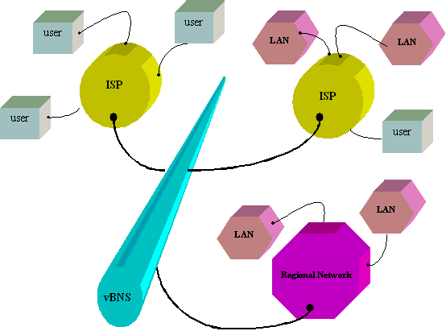
Internet connections
4-<number>

Slide 11
Connecting to the Internet
Requires software that can understand and interpret the TCP/IP protocols
  i.e. a socket or TCP/IP stack
  e.g. Winsock used on PC
Full internet access (usually) achieved by:
  Computer on a network using a network card or
  Dialling to an ISP with a modem
4-<number>
Notes:
Winsock, is a type of application programming interface (API) used to communicate between Windows network software and network services.
The Internet protocol suite, commonly known as TCP/IP (Tranmission Control Protocol/Internet Protocol), is a framework for organizing the set of communication protocols used in the Internet
TCP/IP stack got its name from the layer model. There is no software that provide all networking functions. Breaking it into logical chunks (similar purpose groups) or layers. A known layer model is the OSI 7 layer model
Application: Client
Presentation: removes machine dependencies
Session: timing and flow control
Transport: establish, maintain and terminate communication between two machines
Network: routing
Data Link: error correction
Physical: wiring or other transmission form

Slide 12
Connecting to the Internet
A network card and
A local area network connection
Computer
Local
Area Network
(LAN)
TCP/IP
stack
Network
card
4-<number>

Slide 13
Connecting to the Internet (cont.)
ISP
Computer
Modem
+
SLIP/PPP
TCP/IP
stack
A modem,
A communication protocol
  Serial Line Internet Protocol (SLIP)
  Point-to-point Protocol (PPP)
And an Internet service provider
4-<number>

Slide 14
Connecting to the internet
Network Interface Card (NIC)
  Transmission Control Protocol (TCP) and Internet Protocol (IP)
or
Modem
  Serial Line Internet Protocol (SLIP)
  or
  Point-to-point Protocol (PPP)
NIC
TCP/IP
stack
LAN
Computer
Modem
TCP/IP
stack
ISP
SLIP or PPP
vBNS
4-<number>

Slide 15
TCP/IP
To send information on the internet
Break up every piece of information and messages into packets
Deliver the packets to the appropriate destination
Reassemble the packets into their original form
4-<number>
Notes:
TCP/IP is an universal standard, which can even be applied to a network with pigeons as packet carriers

Slide 16
TCP/IP
Transmission control protocol (TCP)
  Is responsible for the break down of the message into packets and the re-assembly of the packets into the original message
Internet protocol (IP)
  Is responsible for making sure the packets are sent to the correct destination
4-<number>

Slide 17
Internet is a packet-switched network
There is no single, unbroken connection between sender and receiver
information is broken into small chunks called packets
packets are sent over many different routes at the same time
packets are reassembled at the receiving end into the original information
4-<number>

Slide 18
Circuit-switched network, e.g. PSTN
once a connection is made, that part of the network is dedicated only to that single connection
4-<number>

Slide 19
Message split
into packets
<1,500 chars
TCP
Header added with assembly order and checksum
Packet is put into separate IP “envelopes” containing
address information: where to send the data, where the data came from, etc.
IP
Packets are sent out over the Internet
Notes:
Message is broken into pieces and packed into packets
IP information (source, destination) is enclosed as well as a order

Slide 20
Packets arrive at destination and
checksum calculated for each packet
If the checksum doesn’t match with packet’s header then error has occurred during transmission. Then:
discard packet
request for retransmission of packet
TCP
Assemble into original message
when all packets have arrived

Slide 21
Internet Addressing: IP Addresses
Any internet needs a system for assigning identifying addresses to each computer in the system. In the Internet these are the “Internet Protocol” addresses
IP address = 32 bit identifier for a machine
  = network identifier + host address
  Network identifier = part assigned by ICANN
  Host address = part assigned by domain owner
4-<number>

Slide 22
Dotted decimal notation
An IP address is represented in dotted decimal notation, e.g. 192.207.177.133
Each decimal number is in the range 0-255 and specifies 8 bits
  the above IP address is
    11000000.11001111.10110001.10000101
4-<number>

Slide 23
Internet Architecture
Domain: network or internet controlled by one organisation
Gateway: router connecting a domain to the rest of the Internet (the Internet cloud’)
Domains must be registered by their owners
  Internet Corporation for Assigned Names & Numbers (ICANN) serves as registrar
4-<number>
Notes:
a unique, easy-to-remember address used to access websites.
Each domain must be registered with ICANN—a process handled by companies, called registrars,
that have been assigned this role by ICANN. As a part of this registration
process, the domain is assigned a mnemonic domain name, which is unique
among all the domain names throughout the Internet.

Slide 24
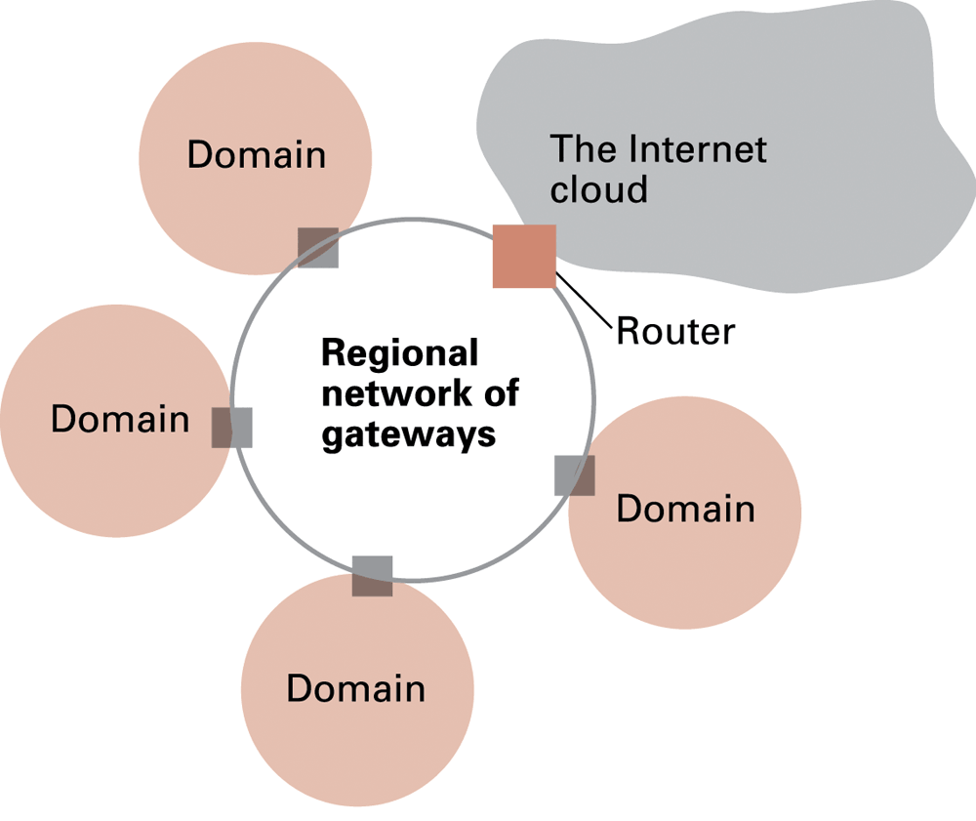
Figure 4.7 A typical approach to connecting to the Internet
4-<number>

Slide 25
Internet addressing: host names
Host name = mnemonic name
  Example: mymachine.aw.com
  Domain name = part assigned by a registrar
    Example: aw.com
    Top level domain = classification of domain owner
      By country – Example: .au = Australia
      By usage – Examples
        .com = commercial
        .edu = educational
        .org = nonprofit organizations
        .gov = governmental
      .
4-<number>

Slide 26
Internet addressing: host names
Sub-domains and individual machine names
    Assigned by domain owner
    Domain owner must run a name server, maintaining a directory of mnemonic addresses and corresponding IP address for computers in the domain
    The domain name system (DNS) is an Internet-wide directory system converting between mnemonic and IP addresses: “DNS lookup”
  Note: Dots in host names are not related to the dots in the dotted decimal notation used for the host IP address
      .
4-<number>

Slide 27
Some Numbers (2006)
No. of domain name registrations | 94.546.719 | www.whois.net
No. IP addresses responding to query | 394.991.609 | http://www.isc.org/index.pl?/ops/ds/
4-<number>

Slide 28
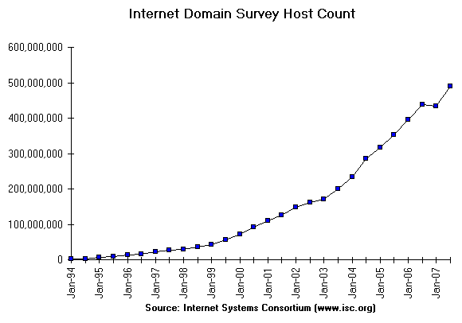
http://www.isc.org/index.pl?/ops/ds/
4-<number>

Slide 29
Internet applications
“traditional” applications
Electronic mail (e-mail)
File Transfer Protocol (FTP)
Remote login: telnet, Secure Shell (SSH)
World Wide Web
4-<number>

Slide 30
Electronic mail
Mail server: set up by domain owner
  Mail sent from domain members goes through mail server
  Mail sent to domain members is collected by mail server
  Mail delivered to clients on demand
    POP3 (Post Office Protocol - version 3)
    IMAP (Internet Mail Access Protocol)
4-<number>

Slide 31
E-Mail
Mail server: computer which handles email within a domain.
Email address formats:
individual@mailservermnenomic
individual@domain name
4-<number>

Slide 32
Telnet and Secure Shell
Telnet is a protocol system to allow computer users to access computers remotely.
A user running telnet client software can contact the telnet server at a distant computer and follow its login procedure to access
Telnet has several weaknesses. The main problem is communication is not encrypted, including username and password information: these could be intercepted and misused.
Secure Shell (SSH) is a communication system that solves this problem, by providing encryption of data being transferred, and authentication - making sure the two parties communicating are who they claim to be.
4-<number>

Slide 33
File Transfer Protocol (FTP)
client-server protocol
access to files can be guarded by password
anonymous FTP for unrestricted access
  “text file” : the transfer process will include conversions to handle <CR> and <LF> problems
  “binary file” : no conversions are made
4-<number>

Slide 34
World Wide Web (WWW)
WWW is just one of many applications supported by the basic inter-network message transfer service of the internet
Originated in the European centre for nuclear research (CERN). Developed as a method to simplify the exchange of information between physics researchers in different countries
Dr. Tim Berners-Lee is credited with inventing the WWW through the development of HTTP
W3C define the WWW as
  "The World Wide Web is the universe of network-accessible information, an embodiment of human knowledge."
4-<number>
Notes:
The World Wide Web or the Web is the part of the Internet associated with HTML documents.
Together with electronic mail (email) and Usenet discussion groups (Newsgroups), the Web is the most popular Internet service

Slide 35
World Wide Web
The data is the collection of documents (pages) while the structure comes from the links between the documents (hypertext)
Server disseminates hypertext (or hypermedia) documents
  Web site = all hypertext documents controlled by one organization or individual
    Usually all at same internet address
  HTML = language of hypertext documents
  Other content can also be disseminated
    Example: images
4-<number>

Slide 36
World Wide Web implementation
Web server: provides access to documents on its machine as requested
Browser: allows user to access web pages
Hypertext Transfer Protocol (HTTP): communication protocol used by browsers and web servers
Uniform Resource Locator (URL): unique address of a document on the web
4-<number>

Slide 37
Original HTTP Protocol (1991)
Client: connect to server.
Server: accept connection.
Client: request document (GET document address).
Server: Send message (= stream of ASCII characters).
Server: close connection.
In order to locate & retrieve documents on the World Wide Web each document is given a unique address called the Uniform Resource Locator (URL).
4-<number>

Slide 38
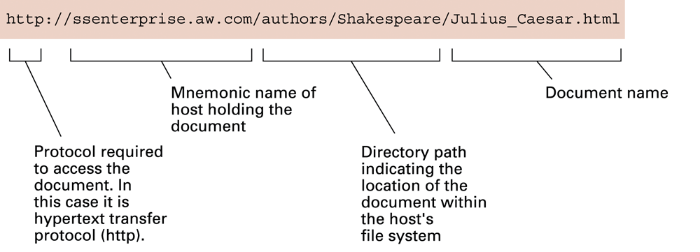
Figure 4.8 A typical URL
4-<number>

Slide 39
Hypertext Transfer Protocol (HTTP)
Standard protocol for accessing Web pages designed for the WWW
Various commands used within the protocol, e.g.:
  GET Retrieve data identified by URL
  HEAD Retrieve header information about document
  POST append a resource to document
4-<number>

Slide 40
Client Server Communication
Client Server Communication is a two-stage ‘handshake’.
1. a request containing a URL is sent to the server from the client.
2. a response containing the required WWW page is sent to the client from the server.
HTTP's handshake involves an exchange of textual messages
based on the format of electronic mail messages
4-<number>

Slide 41
Client request
  e.g.
  GET http://www.crawl.non/searcher/front-page.html HTTP/1.0
  If-Modified-Since: Friday, 10-May-96 14:27:43 GMT
  User-Agent: Tapestry/11.96
4-<number>

Slide 42
Server reply
  e.g.
    HTTP/1.0 200 Document follows
    Date: Mon, 20 May 1996 07:47:41 GMT
    Server: Webwide/7.2.18
    Content-type: text/html
    Last-modified: Tue, 14 May 1996 23:32:16 GMT
    Content-length: 1523
    <html>
    <head><title>Web Crawl Inc. Home Page </title></head>
    <body bgcolor ="#ffffff">
    <center>
    <h1> Web Crawl Inc. - Surfing the Internet for you!<h1/>
    </center>
    .
    .
    </body>
    </html>
4-<number>

Slide 43
Retrieving a Web Page
Client
Host Server
1. Web browser sends TCP/IP a signal that it is ready to request a Web page.
2. TCP/IP makes a connection with the host server TCP/IP software.
4. HTTP Server receives the transmitted URL.
3. Browser makes the URL request using HTTP over the TCP/IP connection
5. If the Web page is found it is sent to the client.
6. Browser displays requested Web page
4-<number>

Slide 44
Hypertext document format
Entire document is printable characters
Contains tags to control display
  Display appearance
  Links to other documents and content
  Dynamic functions
This system of tags is Hypertext Markup Language (HTML)
An HTML document contains the text, etc. and the instructions for its display
4-<number>

Slide 45
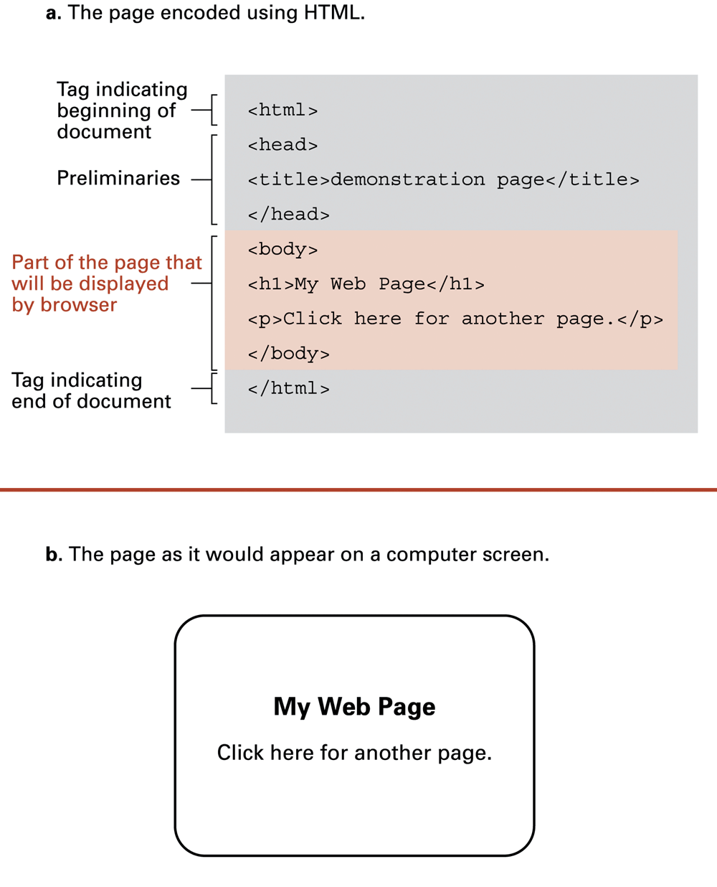
Figure 4.7 A simple Web page
4-<number>

Slide 46
Figure 4.7 A simple Web page (cont’d)
4-<number>

Slide 47
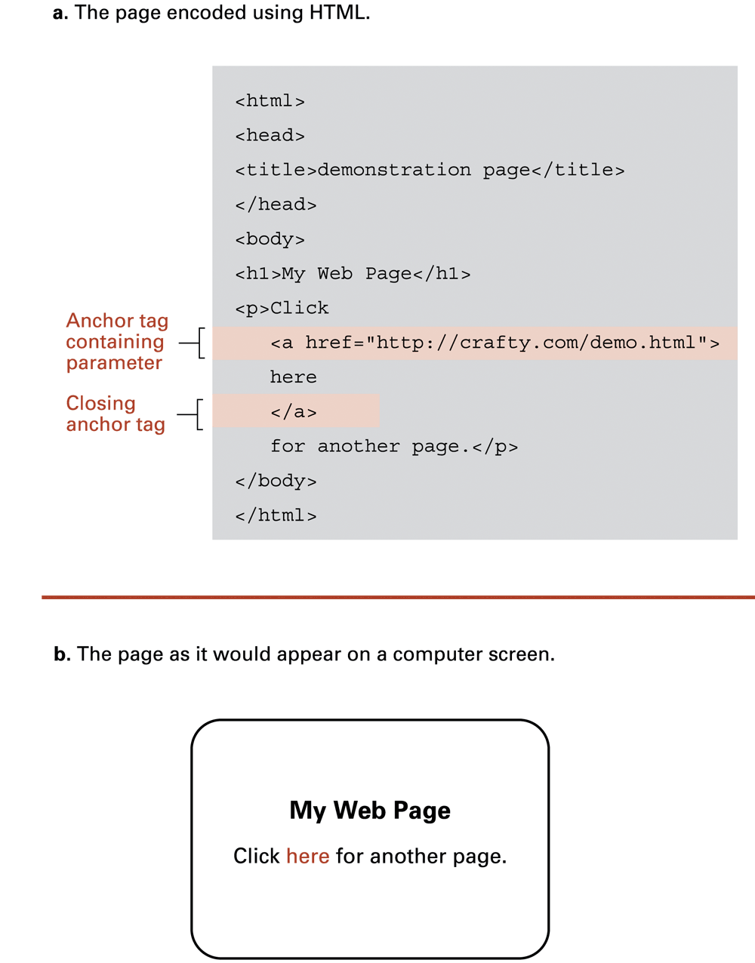
Figure 4.8 An enhanced simple Web page
4-<number>

Slide 48
Figure 4.8 An enhanced simple Web page (cont’d)
4-<number>

Slide 49
Extensible Markup Language (XML)
XML: a standardised style for constructing markup languages similar to HTML
  A descendant of SGML (Standard Generalized Markup Language)
  XHTML is the version of HTML that strictly conforms to XML standards
  XML standard supports the development of markup languages for various applications, describing many kinds of data
4-<number>

Slide 50
XML
Its primary purpose is to facilitate the sharing of data across different systems, particularly systems connected via the Internet.
Languages based on XML (for example, Geography Markup language (GML), RDF/XML, RSS, Atom, MathML, XHTML, SVG and MusicXML) are defined in a formal way, allowing programs to modify and validate documents in these languages without prior knowledge of their particular form
XML allows the development of new markup languages which emphasise semantics rather than appearance. This would allow search engines to be much more effective, and would support the development of a semantic web
4-<number>

Slide 51
Here is an example of a simple recipe expressed using XML:
<?xml version="1.0" encoding="UTF-8"?>
<recipe name="bread" prep_time="5 mins" cook_time="3 hours">
<title>Basic bread</title>
<ingredient amount="3" unit="cups">Flour</ingredient>
<ingredient amount="0.25" unit="ounce">Yeast</ingredient>
<ingredient amount="1.5" unit="cups" state="warm">Water</ingredient>
<ingredient amount="1" unit="teaspoon">Salt</ingredient>
<instructions>
<step>Mix all ingredients together, and knead thoroughly.</step>
<step>Cover with a cloth, and leave for one hour in warm room.</step>
<step>Knead again, place in a tin, and then bake in the oven.</step>
</instructions>
</recipe>
4-<number>

Slide 52
Dynamic web pages
Client-side
  Examples: Java applets, Javascript, Macromedia Flash
Server-side
  Common Gateway Interface (CGI)
  Servlets
  PHP
4-<number>

Slide 53
4.4 Internet Protocols
Internet software layers
Application layer:
  Example: browser
Transport layer: TCP/IP
Network layer: handles routing through the internet
Link layer: handles actual transmission of packets
  Token ring or Ethernet
4-<number>

Slide 54
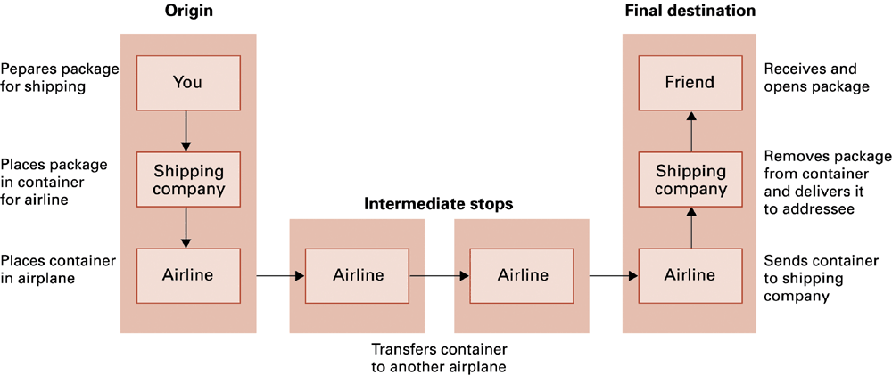
Figure 4.12 Package-shipping analogy
Internet message passing is analogous to sending a package across USA: 3-level hierarchy of (1) user level, (2) shipping company, (3) airline.
4-<number>

Slide 55
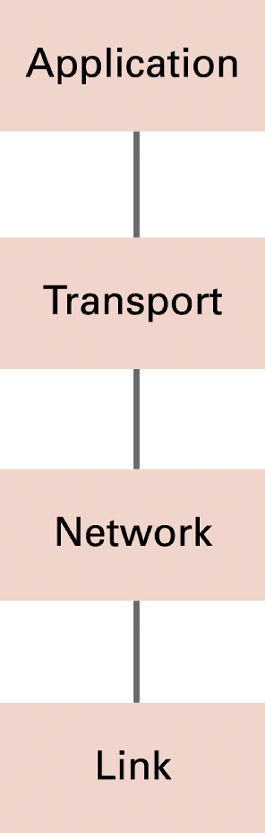
Figure 4.13 The Internet software layers
4-<number>

Slide 56
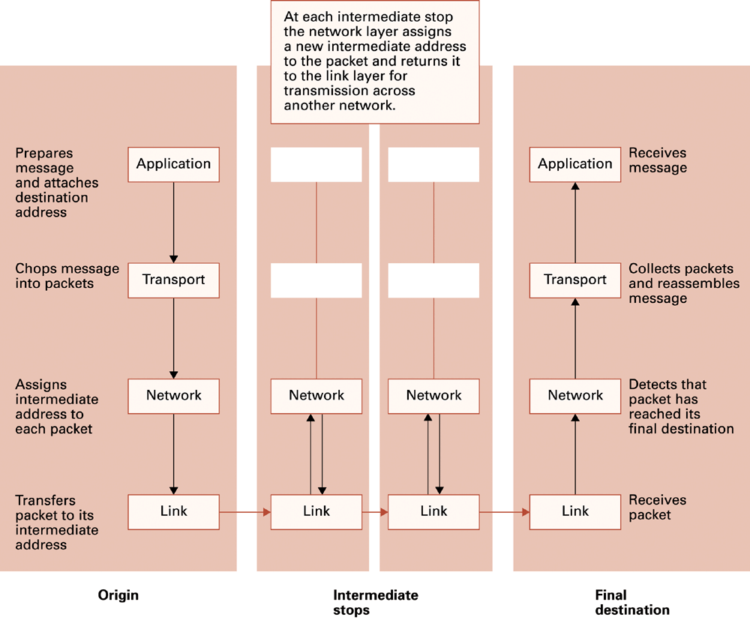
Figure 4.14 Following a message through the Internet
4-<number>

Slide 57
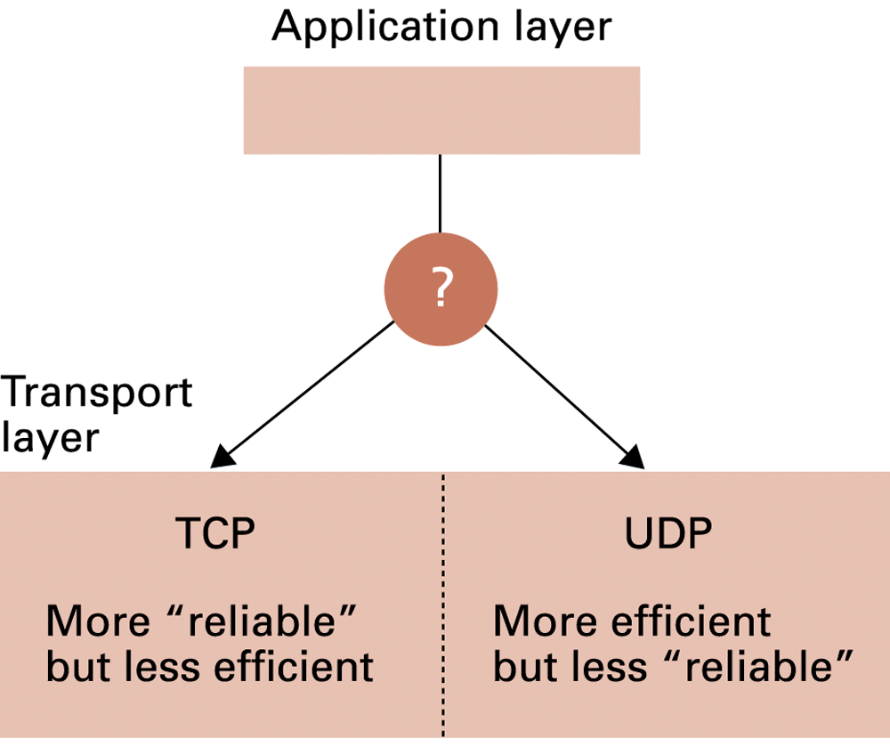
Figure 4.15 Choosing between TCP (transmission control protocol) and UDP (user datagram protocol)
4-<number>

Slide 58
4.5 Network security
Integrity of machine exposed to internet
  Attacks: (malicious software, “malware”)
    virus
    worm
    Trojan horse
    spyware
    denial of service attack
  Defense
4-<number>

Slide 59
Software that may be transferred to and executed on the computer itself
A virus infects a computer by inserting itself into programs that already reside in the machine.
When the ‘host’ program is executed, so is the virus
  some viruses just try to transfer themselves to other programs in the computer
  others also corrupt data and programs with devastating effects:
    damaging the operating system
    erasing blocks of mass storage
4-<number>

Slide 60
A worm is an autonomous program -- it doesn’t need a host program
It transfers itself through networks by forwarding copies of itself to other computers
May be designed just to replicate or perform extreme vandalism
A characteristic result of a worm is an explosion of worm copies that interfere with / block legitimate applications and can overload an entire network or internet
4-<number>

Slide 61
A Trojan horse program enters a computer system disguised as a desirable program, e.g. a game or utility that is imported by the computer user. Often they arrive as attachments to e-mails, and are activated when the attachment is opened. The effects of the Trojan horse can be very harmful.
!! Never open attachments to mail from unknown sources
The Trojan horse may activate immediately, or wait for a trigger, such as a specific date
4-<number>

Slide 62
Spyware (or sniffing software) collects information about activities on the computer, and sends the information back to the instigator of the attack.
May be used by companies to build customer profiles. May be used to record keyboard input in search of passwords and credit card numbers
Phishing is trying to get such information by asking for it, with the criminal sending emails pretending to be from a bank, law enforcement agency, government bureau, etc
4-<number>

Slide 63
Attacking a computer from a remote computer
Denial of service attack: overload a computer with requests, disrupting the company’s business and in some cases stopping them.
Attack requires many requests over a brief period of time, usually achieved by illicitly planting software on numerous computers that can be triggered by a signal to swamp the target computer(s)
4-<number>
Notes:
Hizmet reddi saldırısı: Bir bilgisayarı isteklerle aşırı yükleyerek şirketin işini bozar ve bazı durumlarda onları durdurur.
Saldırı, kısa bir süre içinde çok sayıda istek gerektirir; bu genellikle, hedef bilgisayar(lar)ı batıracak bir sinyalle tetiklenebilecek çok sayıda bilgisayara yasa dışı yazılım yerleştirilmesiyle gerçekleştirilir.

Slide 64
Destructive Attacks
“How can I cause most damage by attacking this system?”
Work of terrorists, malicious employees or ‘black-hat’ hackers.
Usually criminal! Examples include the distributed denial-of-service attacks against Yahoo!, Amazon.com, E*Trade, Buy.com, CNN, and eBay
4-<number>

Slide 65
Top 10 Internet Frauds (2002)
Internet Fraud Statistics: Jan.- June 2002
Online Auctions 87% | Internet Access Services. 4%
General Merchandise 6% | Information/Adult Services. 2%
Nigerian Money Offers 5% | Travel/Vacations. 0.5%
Comp. Equip/Software 1% | Advance Fee Loans. 0.5%
Work-at-Home Plans. 5% | Prizes/Sweepstakes. 0.4%
4-<number>

Slide 66
Criminal Attacks
  Main Internet Scams
  Sale of Internet Services
  Sales of General Merchandise
  Auctions
  Pyramid and Multilevel Marketing Schemes
  Business Opportunities
4-<number>

Slide 67
Hackers
In a recent survey of around 3,000 large and small UK businesses, over 44 percent reported that they had suffered an information security breach due to a malicious attack.
The average cost of such an attack to the business was £30,000, with some costing over £500,000.
4-<number>

Slide 68
Protection
Firewall
Filtering traffic attempting to pass through a point in the network, e.g. at a domain’s gateway
  block outgoing messages with certain addresses
  Block incoming messages from certain addresses
  Block incoming messages with addresses inside the domain: they must be from an outsider pretending to be an insider (i.e. someone is spoofing)
Also used to protect individual computers, e.g. Any web server, email server, name server
4-<number>

Slide 69
Protection
Proxy servers
To shield a client from adverse actions of a server
  The server could collect lot of information about the client’s domain, and possibly use it in attacks
Instead of dealing directly with a server the client deals with a proxy; the proxy server plays the role of the client in dealing with the actual server
  Server cannot gather information about the client or its domain
  Proxy server can check/filter all messages from the server to the client
4-<number>

Slide 70
Protection
Auditing software
  Detect sudden increases in message traffic
  Monitor firewalls
  Analyse patterns of requests from individual computers
  Identify problems before they get out of control
Antivirus software
  detect and remove known viruses
  But viruses are constantly ‘evolving’, so antivirus software needs regular updating
Caution
  Never open email attachments from unfamiliar sources
  Do not download software without first confirming its reliability
  Do not respond to pop-up ads
  Do not leave a PC connected to the internet when the connection isn’t needed
4-<number>

Slide 71
Privacy of communication
Cryptography – ‘hidden writing’
Encrypt (encode) data for protection in transfer over networks and internets
Many Internet applications have been altered to incorporate encryption:
FTPS, secure version of FTP
SSH, secure replacement for telnet
HTTPS, secure version of HTTP
- uses the Secure Sockets Layer (SSL) protocol
4-<number>

Slide 72

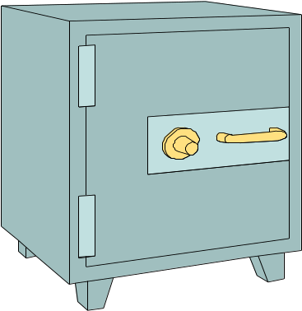
Encryption
Encryption is the process of taking some data and a key and feeding it into a function and getting encrypted data out
Encrypted data is, in principal, unreadable unless decrypted
Data
Encryption
Function
4-<number>
Notes:
Data is treated as bit streams.

Slide 73
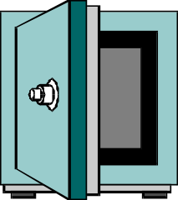
Decryption
Decryption is the process of taking encrypted data and a key and feeding it into a function and getting out the original data
  Encryption and decryption functions are linked
Decryption
Function
Data
4-<number>
Notes:
Decryption again is a mathematical function of taking the encrypted data and key and getting original data
If you encrypt with a particular algorithm, you want to decrypt with the same one

Slide 74
Symmetric Encryption
Encryption and decryption functions use same key
Data
Encrypt
Decrypt
Data
4-<number>

Slide 75

Asymmetric Encryption
Encryption and decryption functions that use a key pair are called asymmetric
  Keys are mathematically linked
4-<number>

Slide 76

Asymmetric Encryption
Data
Data
When data is encrypted with one key, the other key must be used to decrypt the data
  And vice versa
Decrypt
Encrypt
Encrypt
Decrypt
Data
Data
4-<number>
Notes:
Asymmetric vs. symmetric encryptions –
symmetric is cheaper computationally
Symmetric less secure
Real world assymentric
Next: Public/Private

Slide 77

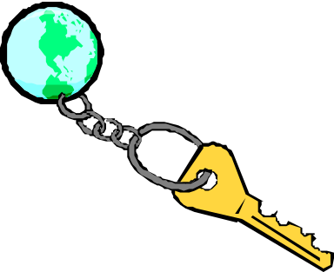
Public and Private Keys
With asymmetric encryption each user can be assigned a key pair: a private and public key
Private key is known only to owner
Public key is given away to the world
4-<number>
Notes:
Grid scenario

Slide 78
Public and Private keys
Data
Anything encrypted with the public key can only be decrypted with the private key
And vice versa
Since the private key is known only to the owner, this is very powerful.
Message Privacy!
Encrypt
Decrypt
4-<number>
Data

Slide 79
Public-key cryptography
Bob lets his public key be known to everyone, but keeps the private key secret.
Alice may send a confidential message to Bob like this:
A gets B's public key (she can get it from his web page, or he can just send it to her).
A encrypts the message with B's public key, and sends it to B.
B decrypts the message with his private key.
And even if Carol knows the public key and intercepts the message, she cannot decrypt it
4-<number>

Slide 80
For this method to work, the system must guarantee that it is (effectively) impossible to decrypt the message without knowledge of the private key.
In particular, it must be impossible to decrypt using the public key, or to derive the private key from the public key.
Public key cryptography is secure provided it is computationally unfeasible to reverse the encryption.
(see Chapter 11 section 6 of Brookshear 9th edition)
4-<number>

Slide 81
Infeasibity of reversing PK encryption
(http://www.cs.bham.ac.uk/~mdr/teaching/modules03/security/public_key.html)
“…The only difficulty is in the first step: finding p,q such that pq=n. If n is a 1024 bit number (i.e. 308 decimal digits) then it is likely to take you 10 million mips-years A 1GHz Pentium has about 500 mips power, so it will take 20,000 years. Nevertheless, authorities recommend using 2048 bit keys. … If you harnessed the power of 100 million computers on the internet (each providing 500 mips), you could factor it in about 2000 years.”
(1 mip = 1 million instructions per second)
4-<number>

Slide 82
Certification and authentication
The PK encryption method requires that the public key being used is the correct key for the destination party.
Trusted internet sites, called certificate authorities, maintain accurate lists of parties and their keys.
These authorities, as servers, provide a certificate to clients. This is a package containing the party name and its public key.
4-<number>

Slide 83
Certification and authentication
In some PK encryption methods the roles of the two keys can be reversed – i.e. the public key can be used to decrypt a message encrypted with the private key.
Therefore, text encrypted with the private key must have come from the private key’s owner.
The party holding the private key can use it to produce a bit pattern called a digital signature that will be unique to the party.
This can be attached to any messages sent. The receiver uses the public key to decrypt and so verifies the sender’s authenticity.
(The digital signature could be an encrypted version of the message itself)
4-<number>

