Slide 1
Chapter 5: Algorithms
5.1 The Concept of an Algorithm
5.2 Algorithm Representation
5.3 Algorithm Discovery
5.4 Iterative Structures
5.5 Recursive Structures
5.6 Efficiency and Correctness

Slide 2
Algorithm: definition
Informal: An algorithm is a set of steps that define how a task is performed
Formal: An algorithm is an ordered set of unambiguous, executable steps that defines a terminating process.

Slide 3
Algorithms: levels of abstraction
Problem = motivation for algorithm
Algorithm = procedure to solve the problem
  Often one of many possibilities
Representation = description of algorithm sufficient to communicate it to the desired audience
  Always one of many possibilities

Slide 4
Algorithm 1 for XOR
Input: binary digits a,b
Output: a XOR b
If a==0 and b==0 Return 0
If a==0 and b==1 Return 1
If a==1 and b==0 Return 1
If a==1 and b==1 Return 0
Halt

Slide 5
Algorithm 2 for XOR
Input: binary digits a,b
Output: a XOR b
If a==b Return 0
Else Return 1
Halt

Slide 6
Algorithm 3 for XOR
Input: binary digits a,b
Output: a XOR b
Convert a to the integer ia
Convert b to the integer ib
ic=remainder on dividing ia+ib by 2
Return ic
Halt

Slide 7
Abstract nature of algorithms
An algorithm is abstract and distinct from its representation.
One algorithm may be represented in many ways
Different representations may be appropriate for different audiences
Different levels of detail may be appropriate for different audiences

Slide 8
5.2 Algorithm representation
Algorithm representation requires a form of language
Natural languages (English, French, Turkish,...) have problems of ambiguity
  syntactic ambiguity
    fruit flies like vegetables / visiting friends can be boring ...
  lexical ambiguity:
    open a window / green studies / lose your bottle ....
Representational ambiguities must be eliminated

Slide 9
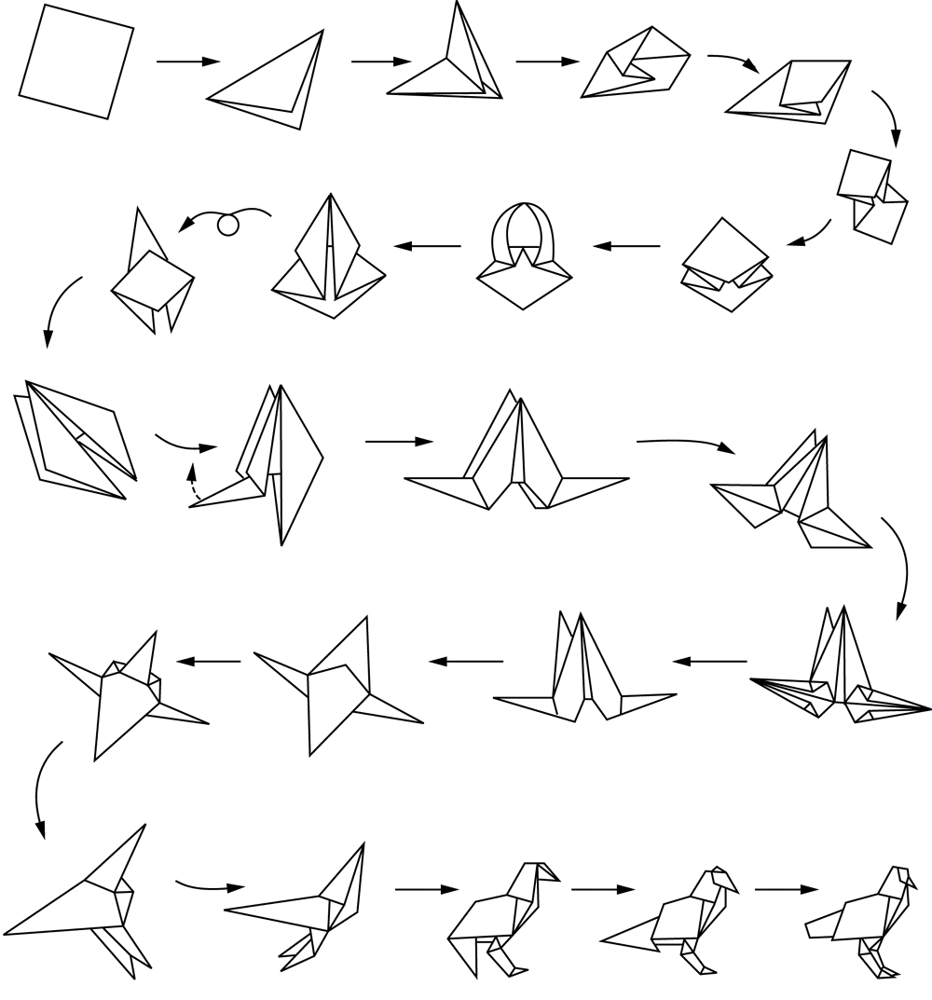
Pictorial language: Folding a bird from a square piece of paper
adequate level of detail?

Slide 10
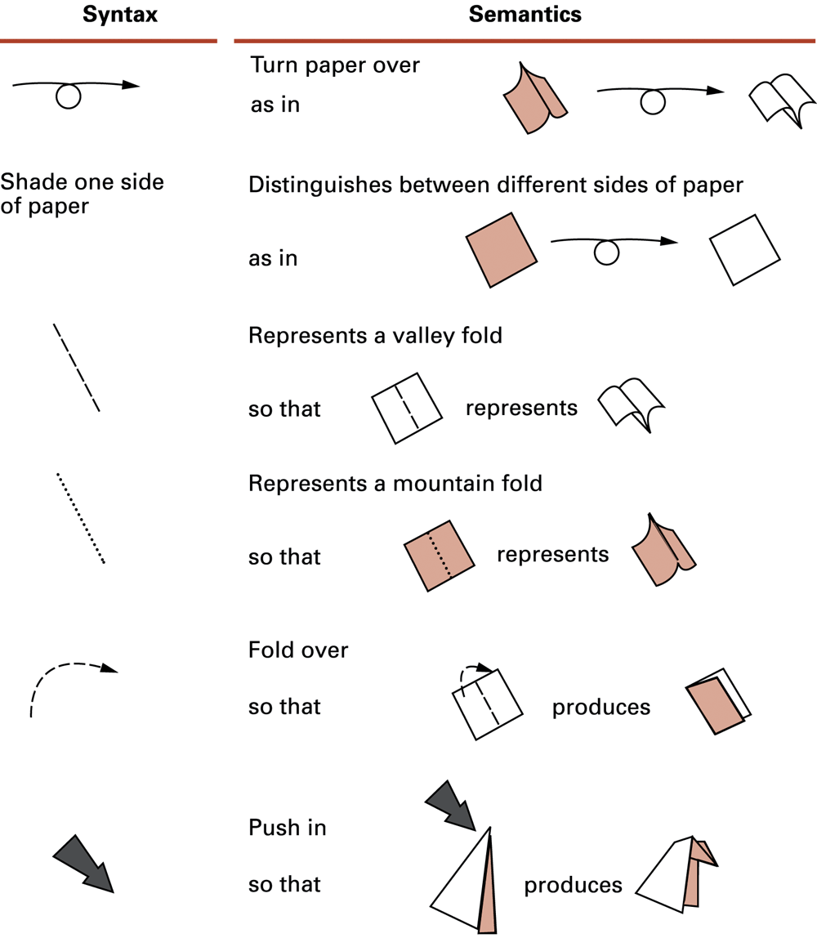
Figure 5.3 Origami primitives (basic building blocks of language)
To represent algorithms remove ambiguity by assigning precise definitions to primitives, with a set of rules stating how they can be combined - i.e. a programming language
Using primitives also establishes a uniform level of detail in describing algorithms

Slide 11
Pseudocode
Pseudo = false, not real. Pseudocode resembles program code but is more loosely defined
A system for expressing ideas informally during algorithm development
  often similar to the target programming language (i.e. the language to be used in the final implementation), but with relaxed rules
The pseudocode presented by Brookshear tries to represent the frequently occurring semantic structures found in algorithms, without being modelled on any particular programming language

Slide 12
Pseudocode
assignment statement
  to save a computed value
takes the form:
  name ← expression
  name is the name that refers to the result
  expression describes the computation whose result is to be saved
  e.g. Balance ← Balance + Deposit

Slide 13
Performing an activity, depending on truth of some condition
takes the form:
if (condition) then (activity1)
e.g. if (month is May)
then (number of days ← 31)

Slide 14
Selecting one of two possible activities, depending on truth of some condition
takes the form:
if (condition) then (activity1)
else (activity2)
e.g. if (year is leap year)
then (daily total ← total / 366)
else (daily total ← total / 365)

Slide 15
Repeated execution of a statement or sequence of statements as long as some condition remains true
takes the form:
while (condition) do (activity1)
e.g. while (tickets remain to be sold)
do (sell a ticket)

Slide 16
Indentation
Enhances the readability of a program
  if (not raining)
  then (if (temperature = hot)
  then (go swimming)
  else (play golf)
  )
  else (watch TV)
is easier to understand than the one below
  if (not raining) then (if (temperature = hot) then (go swimming) else (play golf) ) else (watch TV)

Slide 17
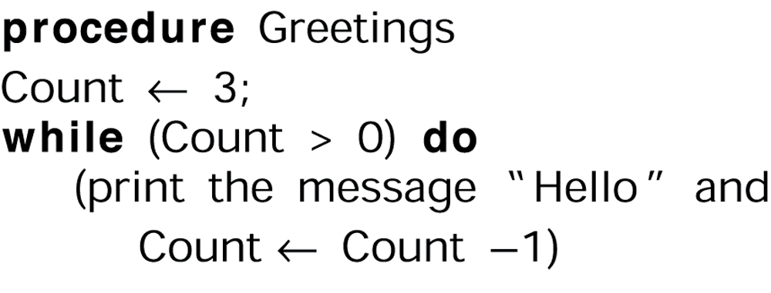
Create program units for use as abstract tools in applications
takes the form:
procedure name
or procedure name (parameter list)
e.g.

Slide 18
5.3 Algorithm Discovery
Program Development:
  1. Discover / create the algorithm
  2. Represent the algorithm as a program
Of the two stages, algorithm discovery/creation
-- is more challenging, and
-- requires more creativity
It is a form of problem solving

Slide 19
Problem solving
Common to many activities
Not a precise science to learn
A skill to be developed
  -- artistic skill / there is scope for creativity

Slide 20
General problem solving phases
1. Understand the problem.
2. Devise a plan for solving the problem.
3. Carry out the plan.
4. Evaluate the solution for accuracy and for its potential as a tool for solving other problems.
“How to Solve It” [1945] by G. Polyà (mathematician)

Slide 21
In terms of algorithm development
1. Understand the problem.
2. Get an idea how an algorithmic procedure might solve the problem.
3. Formulate the algorithm and represent it as a program.
4. Evaluate the program for accuracy and its potential as a tool for solving other problems.
NB Phases are not steps to be followed, but phases that will be completed during the solution process

Slide 22
Sample problem
Person A is charged with the task of determining the ages of B’s three children.
B tells A that the product of the children’s ages is 36.
A replies that another clue is required.
B tells A the sum of the children’s ages.
A replies that another clue is needed.
B tells A that the oldest child plays the piano.
A tells B the ages of the three children.
How old are the three children?

Slide 23
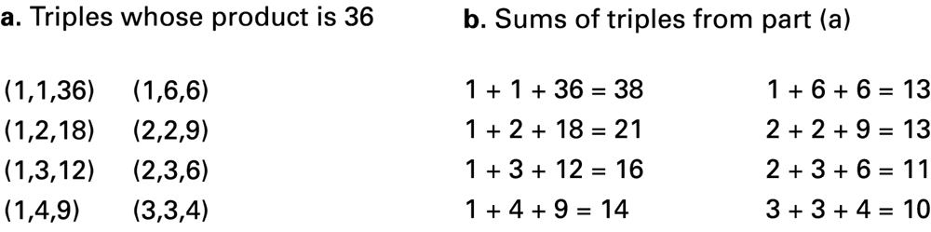
solution

Slide 24
solution
c. sum of triples did not identify the triple
therefore triple is either (1, 6, 6) or (2, 2, 9)

Slide 25
solution
c. Sum of triples did not identify the triple
-- therefore triple is either (1, 6, 6) or (2, 2, 9)
d. Final clue indicates there is an eldest child, hence the triple must be (2, 2, 9)

Slide 26
Techniques for
“getting a foot in the door”
Work the problem backwards
Solve an easier related problem
  Relax some of the problem constraints
  Look at special cases
  Solve pieces of the problem first = bottom up methodology
Stepwise refinement = top-down methodology
  Break problem into sub-problems (“divide and conquer”). Break down sub-problems if necessary.
  Popular technique because it produces modular programs

Slide 27
Algorithm Strategies: Enumeration
List all the possible states of the problem and search for the solution.
Example 1: find all numbers which divide 10 by checking 1,2,…10.
Advantages: thorough, simple.
Disadvantages: very long run times, inefficient.

Slide 28
Search Example: solving the eight-puzzle
1
3
5
1
2
3
4
2
4
5
6
7
8
6
7
8
An unsolved eight puzzle
A solved eight puzzle
Number of configurations = 9x8x…x1 = 362,880

Slide 29
Possible Moves
1
3
5
4
2
7
8
6
1
3
5
1
3
5
1
3
4
2
6
4
2
4
2
5
7
8
7
8
6
7
8
6

Slide 30
Search Strategy
Build the tree of all possible moves, breadth first.
Stop when the solved eight puzzle is found.
Assumption: a solution exists.
Problem: low efficiency
More efficient forms of this sort of strategy are used in ‘artificial intelligence’applications

Slide 31
Additional Strategies
Find out if somebody else has solved the problem.
Solve a simpler but related problem.
Solve part of the problem.
Look for symmetries or regular patterns.
Describe the problem in a different way

Slide 32
5.4 Iterative Structures in algorithms
Iteration: a collection of instructions is repeated in a looping manner
e.g. We want an algorithm to search a given list for a given target value. The list will be ordered (e.g. alphabetically ordered list of names, or ordered list of numbers).
Algorithm should report success (or failure) if it finds (or fails to find) the target value in the list.

Slide 33
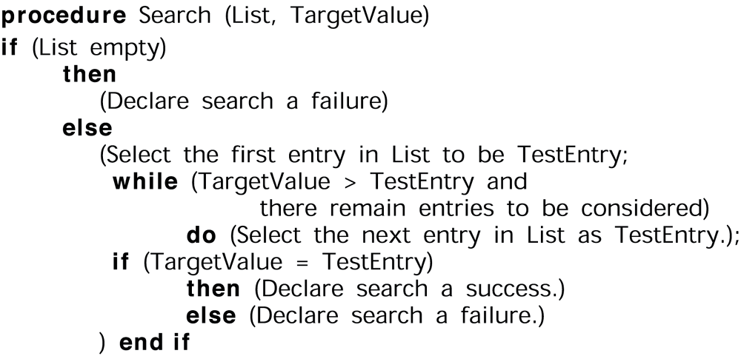
A sequential search algorithm in pseudocode
A general algorithm: use it to find if John Smith is on a passenger list, or spinach is in a list of recipe ingredients, ...

Slide 34
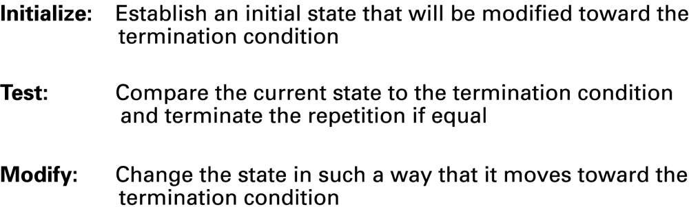
Figure 5.7 Components of repetitive control

Slide 35
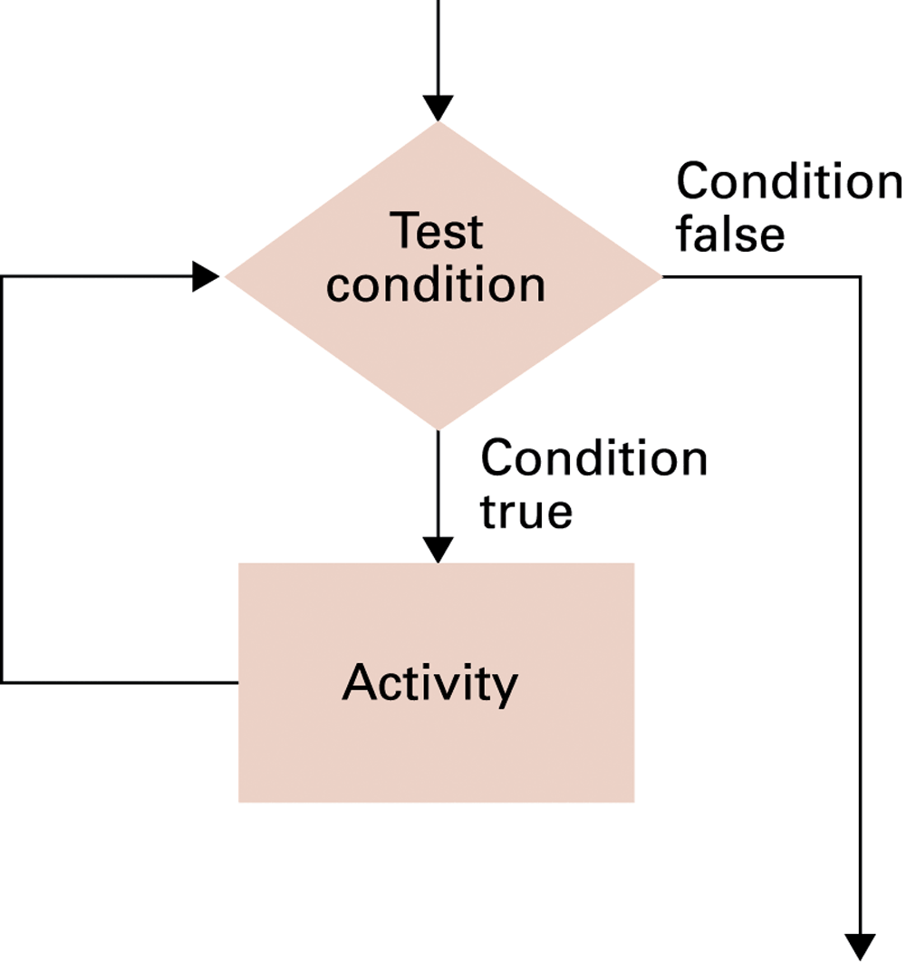
Figure 5.8 The while loop structure
while (condition) do (activity)
A pre-test loop
activity body may never be executed

Slide 36
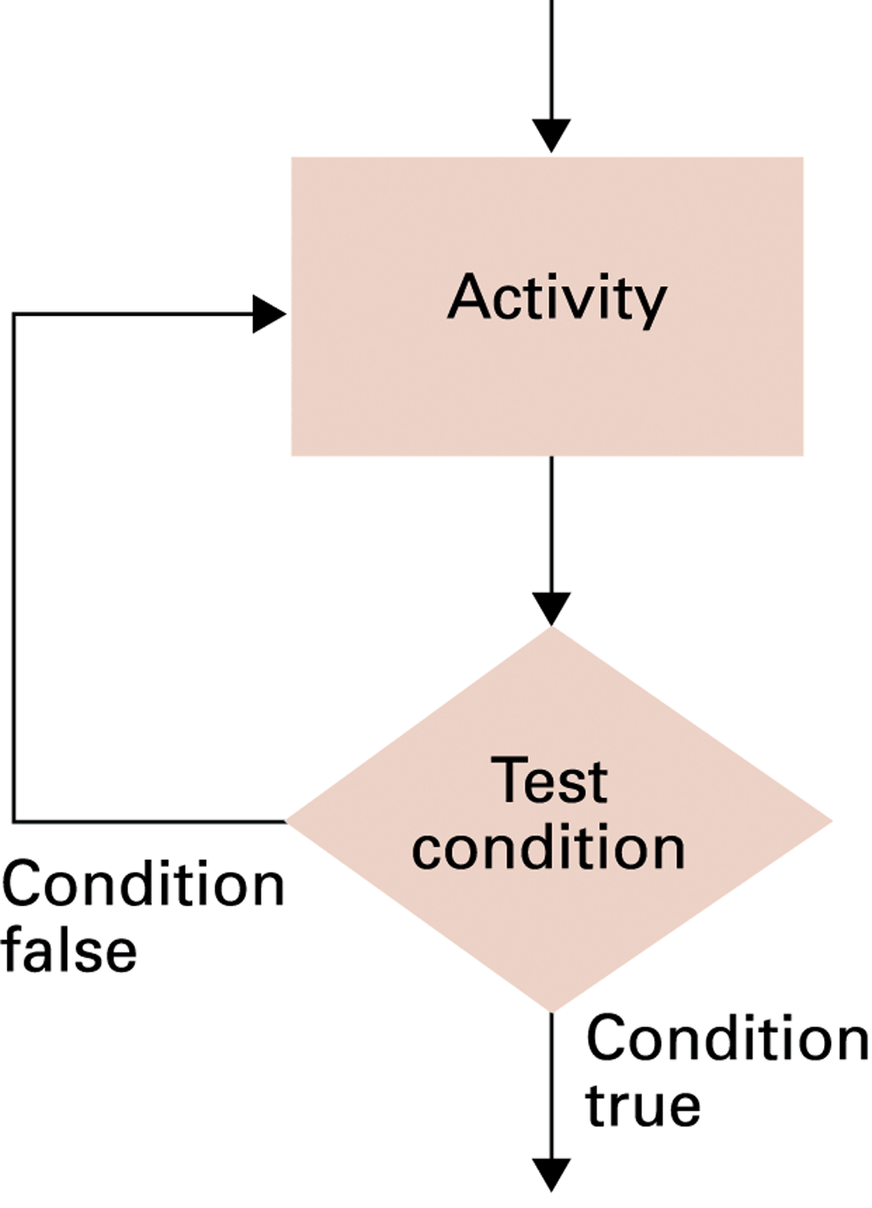
Figure 5.9 The repeat loop structure
repeat (activity) until (condition)
A post-test loop
activity body will be executed at least once

Slide 37
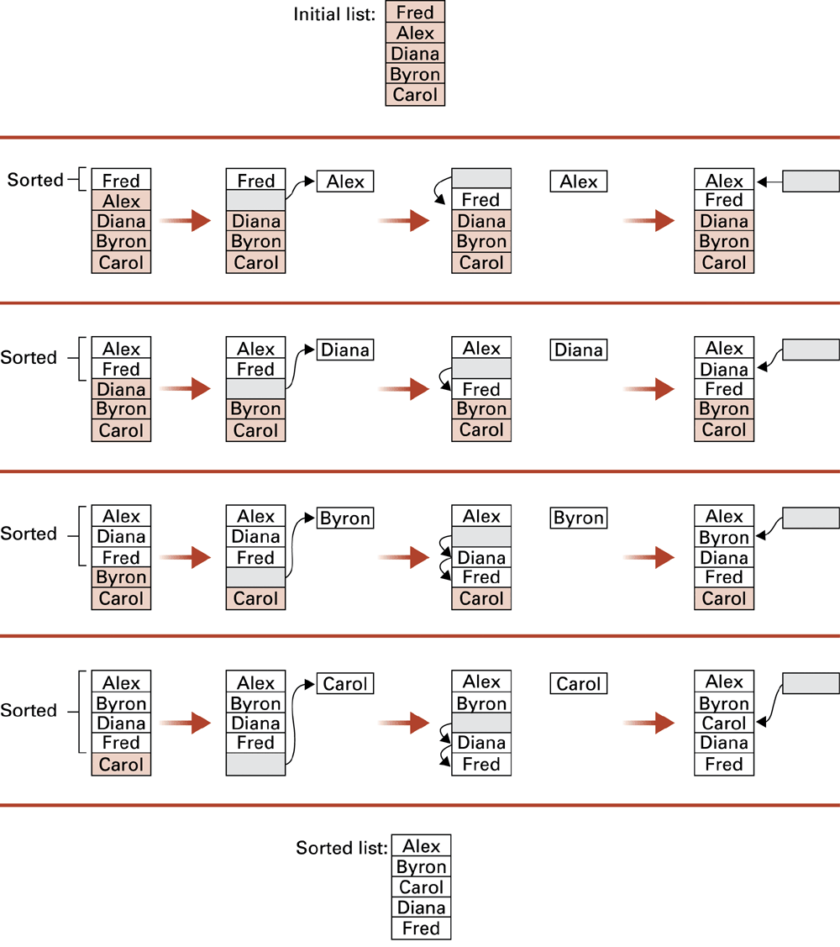
Insertion Sort: Sorting the list Fred, Alex, Diana, Byron, and Carol alphabetically

Slide 38
5.5 Recursive structures
In an iterative structure a set of instructions is completed and repeated
In a recursive structure a set of instructions is repeated as a subtask of itself

Slide 39
Example of Recursion:
Reading linked Web Pages
A1
Page 1
B1
A2
Page 2
B2
A3
Page 3

Slide 40
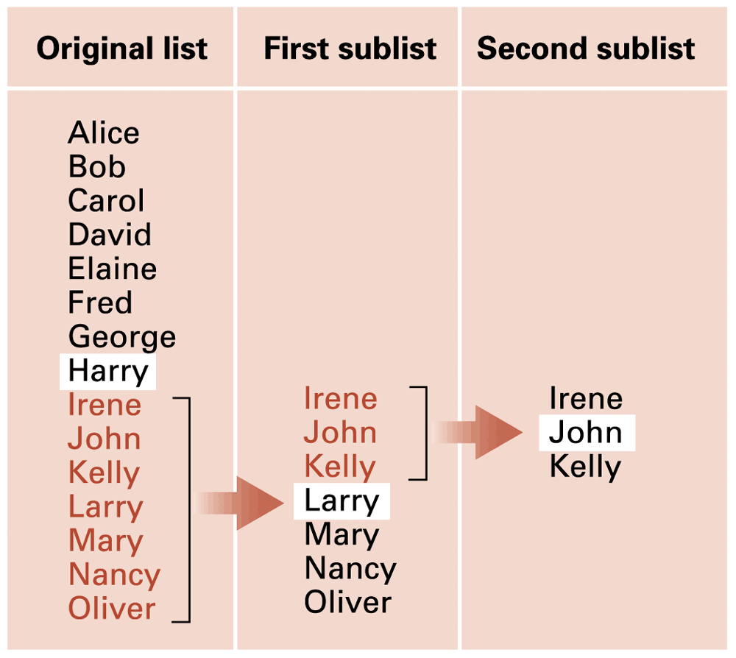
Figure 5.12 Applying recursive strategy to search a list for the entry John

Slide 41
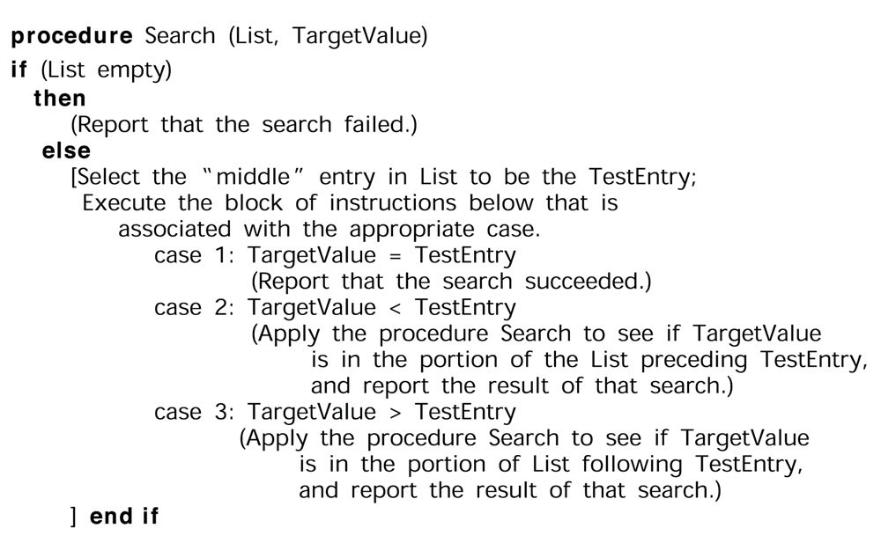
Figure 5.14 The binary search algorithm in pseudocode

Slide 42
Control of Recursion
Note that when writing a recursive procedure the test for the termination condition(s) must be made before requesting further activations of the procedure
  termination condition: ‘base case’ or ‘degenerative case’

Slide 43
Greatest Common Divisor
Let m, n be integers such that m>=0, n>=0. Then GCD(m, n) is the largest integer which divides both m and n.
GCD(m, n)=GCD(n, m).
GCD(m, 0)=m.
Example: GCD(56,21)=7

Slide 44
Recursive Property of GCD
Suppose m, n are integers such that m>=n>=0.
Let q be the largest integer such that
  q>=1 and m>=q.n.
Then; GCD(m, n)=GCD(m-q.n, n)
Example:
GCD(56, 21)=GCD(56-2*21, 21) =GCD(14, 21)

Slide 45
Recursive Algorithm for GCD
procedure RecursiveGCD(m, n)
r ← m % n /* m>= n and r=m-q.n */
if (r == 0) then (return n)
return RecursiveGCD(n, r)

Slide 46
Example Run of RGCD
{
{
{
}
}
}
RecursiveGCD(256,120)
r=16;
RecursiveGCD(120,16)
r=8;
RecursiveGCD(16,8)
r=0
return(8)
return(8)
return(8)
Note analogy
with
Bracketing.

Slide 47
Non-Recursive Algorithm for GCD
procedure GCD(m, n)
r ← m % n /* m>= n and r=m-q*n*/
while (r > 0)
do ( m ← n
n ← r
r ← m % n )
return n

Slide 48
Example Run
GCD(256,120)
r=16;
while loop: m=120; n=16; r=8;
while loop: m=16; n=8; r=0;
Return 8

Slide 49
Recursion vs Iteration
The factorial function (!) has a natural recursive definition
  0! = 1
  N! = N.(N-1)! for all positive integers N
Direct implementation of this definition:
  procedure Factorial (n)
  if ( n == 0 ) then (return 1)
  else ( return ( n * Factorial (n-1) ) )

Slide 50
example: value of 5!
factorial (5)
= 5 * (factorial (4))
= 5 * (4 * (factorial (3)))
= 5 * (4 * (3 * (factorial (2))))
= 5 * (4 * (3 * (2 * (factorial (1)))))
= 5 * (4 * (3 * (2 * (1 * (factorial (0))))))
= 5 * (4 * (3 * (2 * (1 * 1))))
= 5 * (4 * (3 * (2 * 1))))
= 5 * (4 * (3 * 2)))
= 5 * (4 * 6)
= 5 * 24
= 120

Slide 51
Iterative algorithm for factorial
procedure IterativeFact (n)
answer ← 1
for i ← 1 to n step 1
do (answer ← answer * i)
return answer

Slide 52
Iterative algorithm for factorial
IterativeFact (5)
answer ← 1
i ← 1 answer ← 1
2 2
3 6
4 24
5 120
return answer

Slide 53
Assessment of Recursion
Gives elegant algorithms for solving certain problems.
  but may be inefficient for practical implementation (waste time and storage)
Termination needs careful thought.
May fail if the programming language has an upper bound on the depth of recursion.

Slide 54
5.6 Efficiency and Correctness
Algorithm efficiency
Measured as number of instructions executed
  Compare sequential search with binary search on an ordered list of n entries
  Sequential search will require on average n/2 comparisons
  Binary search requires at most log₂(n) comparisons
  Example: n=30 000, comparison time 10ms = 0.01s
    sequential search: average 15 000 comparisons, 150s
    binary search: at most 15 comparisons, 0.15s

Slide 55
Algorithm efficiency
How can algorithm efficiency be analyzed?
There are 2 aspects to computational complexity
space complexity:
  amount of computer memory required to implement the algorithm
time complexity:
  time taken by computer to solve a problem using the algorithm
Time complexity is better expressed in terms of the number of operations used by the algorithm

Slide 56
Time complexity is expressed in terms of the number of operations used by the algorithm when input values are of a specified size
  e.g. to sort a list of n items
The operations used to measure complexity can be
  comparison of integers
  additions or subtractions
  multiplications or divisions
  any other basic operation

Slide 57
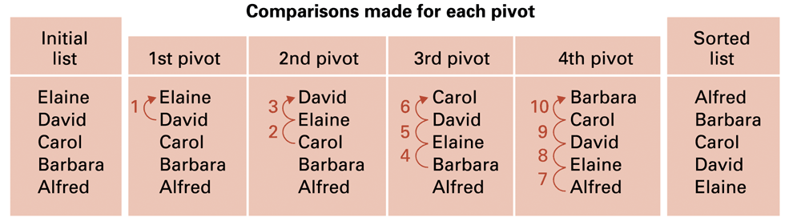
Figure 5.18 Applying the insertion sort in a worst-case situation
When the list to be sorted is in reverse order: each pivot must be compared with all preceding entries
In worst case, the total number of comparisons when sorting a list of n entries is 1+2+..+(n-1) = (n²-n)/2 which is O(n²)

Slide 58
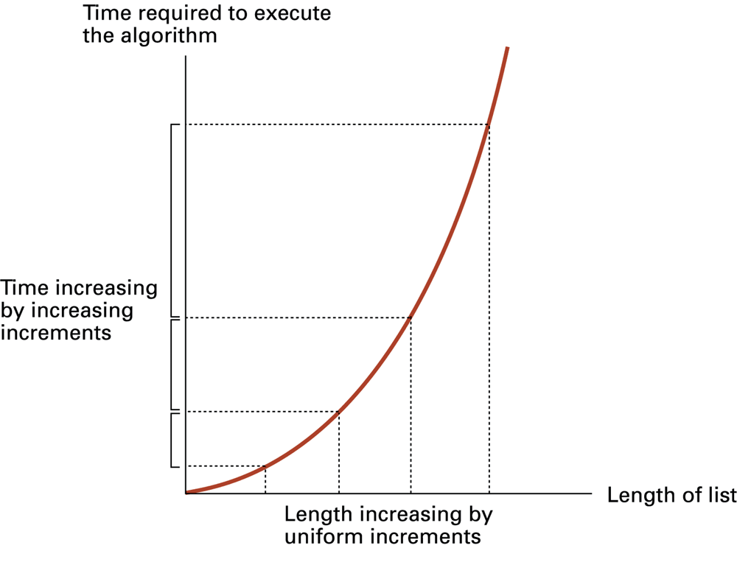
Figure 5.19 Graph of the worst-case analysis of the insertion sort algorithm

Slide 59
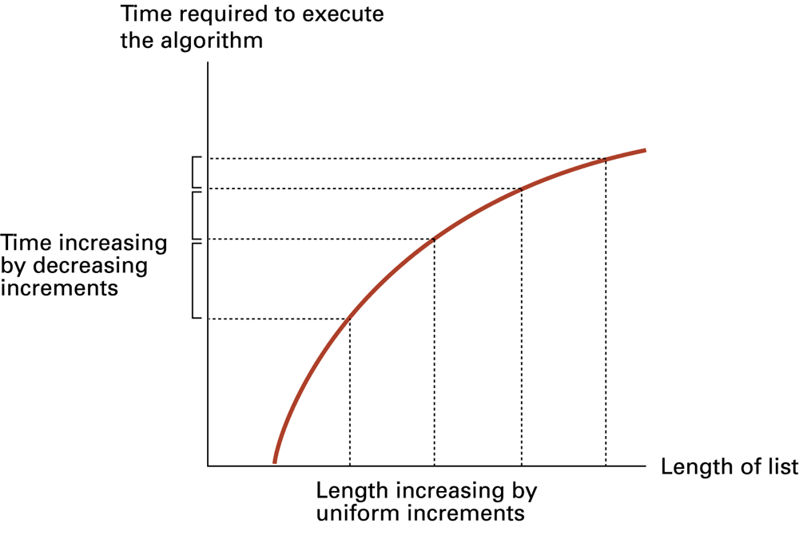
Figure 5.20 Graph of the worst-case analysis of the binary search algorithm

Slide 60
Big-O notation
Example
f(x) = x² + 2x + 1 is O(x²)
Proof: whenever x>1
0 ≤ x² + 2x + 1 ≤ x² + 2 x² + x² = 4x²
let C=4, k=1 in the definition
OR
for x>2 x²>2x and x² >1
0 ≤ x² + 2x + 1 ≤ x² + x² + x² = 3x²

Slide 61
Big-O notation
f(x) = x² + 2x + 1 g(x) = x²
f(x) is O(g(x))
But note that since g(x)<f(x) for x>1
g(x) is O(f(x))
We can say that f(x) and g(x) are of the same order.
In using big-O notation the function g in the relation is chosen to be as small or as simple as possible.

Slide 62
Big-O notation
Example
f(x) = 5x² + 2x + 1 is O(g(x)). Find g(x)
The simple method is to find the dominant term – here it is the highest power term 5x² – and remove any constant factor – giving g(x) = x² : f(x) is O(x²)

