Slide 1
Programming Languages
6.1 History
6.2 Traditional Programming Concepts
6.3 Procedural Units
6.4 Language Implementation

Slide 2
Programming Languages
Allow humans to:
  avoid having to deal with the low-level details of machine-language programming
  concentrate on the problem being solved

Slide 3
Historical Perspective (1)
“1st Generation”
In the beginning there was:
  Machine Language:
    156C 166D 5056 306E C000
Sequences of instructions are encoded as numeric digits
e.g. “Move the contents of register 5 to register 6”
could be expressed as 4056
Writing programs in such a language is tedious and error-prone
By the 1940s notational systems were being introduced by which instructions could be represented in mnemonic form
e.g. The above instruction could become MOV R5 R6

Slide 4
Historical Perspective (2)
To make life a little easier:
  Mnemonics assigned to op-codes and operands:
  Names for all registers
  Identifiers = descriptive names for operands, referring to memory cells, chosen by the programmer.
Such a mnemonic system is called an assembly language
Programs called assemblers were developed to convert assembly language into machine language
“mnemonic” ~ making something easier to remember

Slide 5
Assembly language example
Machine language
156C
166D
5056
30CE
C000
Assembly language
LD R5, Price
LD R6, ShippingCharge
ADDI R0, R5 R6
ST R0, TotalCost
HLT
Assembly Language: “2nd Generation”
Assembly language is still used today whenever precise and fast control of hardware is needed.

Slide 6
Historical Perspective (3)
Assembly Languages were a big step forward,
but they have their limitations/problems:
  Primitives differ only in syntax
    One-to-one correspondence between machine instructions and assembly instructions
  Entirely machine dependent
    Programs developed on one machine cannot be easily transported to another computer design because they must be rewritten to conform to the new computer’s register configuration and instruction set
  Programmer’s focus still on instructions - not the problem itself.
    No ‘high-level primitives’, larger units that better model the problem
Notes:
In computing, language primitives are the simplest elements available in a programming language. A primitive is the smallest 'unit of processing' available to a programmer of a given machine or can be an atomic element of an expression in a language.

Slide 7
Historical Perspective (4)
“3rd Generation”
To make life much, much easier:
  Introduction of high-level primitives
    Similar to pseudocode
  Automatic translation to machine code (more later)
  Examples: Fortran, COBOL, Algol, BASIC, Pascal, C, Java, …
Each primitive corresponds to a short sequence of machine language instructions
Converted to machine language by a program called a compiler

Slide 8
Historical Perspective (5)
3rd Generation Languages:
  Achieve machine independence…( by use of different compilers)
  … but only to a certain degree
Certain machine characteristics often still reflected in language (e.g.: I/O operations).
    => multiple dialects of same language often exist
Multiple ‘standard’ definitions of same language exist
    => vendor specific extensions

Slide 9
High level language
Programming with symbols and operations that are not (directly) implemented by the hardware.
Combines low level hardware operations within various high level operations. Many languages have ‘for’ and ‘while’ loops that are converted into machine language sequences.
Detailed knowledge of the machine hardware is not required.
Uses a vocabulary and structure closer to the problem being solved.

Slide 10
High level language
For high-level languages we need a compiler a program that translates high-level language programs into machine language.
Machine-independent – high-level languages are not designed with a particular type of computer in mind
A program written in C can be executed on many different types of computers (e.g. PC, Apple, Sun) once we have a C compiler for the brand of machine.
Source code: a program written in a high-level language (e.g. Java, C, Pascal)
Executable code: a program that has been translated (usually by an assembler or compiler) into machine language code

Slide 11
Programming language
temp = v[k];
v[k] = v[k+1];
v[k+1] = temp;
High Level Language Program (e.g., C)
Compiler
lw $15, 0($2)
lw $16, 4($2)
sw $16, 0($2)
sw $15, 4($2)
Assembly Language Program
Assembler
Machine Language Program
0000 1001 1100 0110 1010 1111
1010 1111 0101 1000 0000 1001
1100 0110 1010 1111 0101 1000
0101 1000 0000 1001 1100 0110
Hardware
°
°

Slide 12
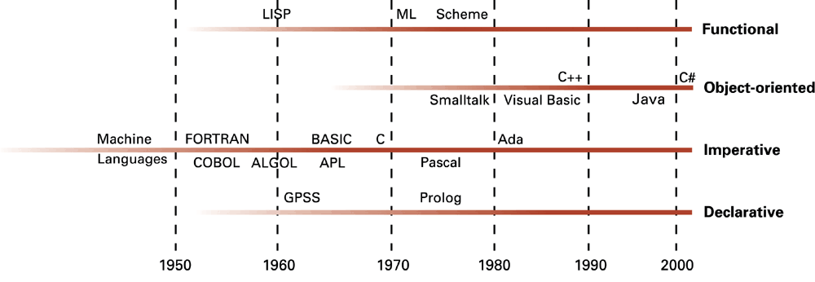
The development of programming languages

Slide 13
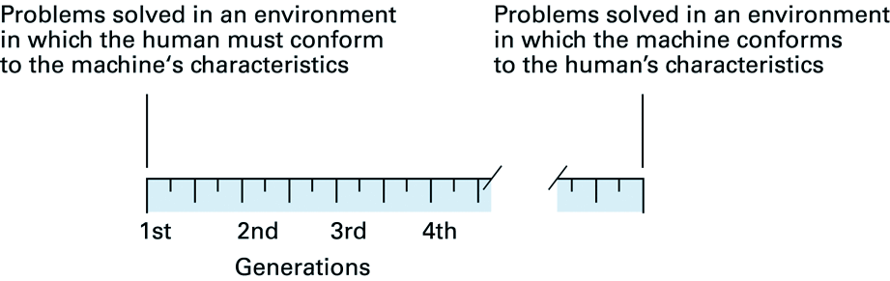
‘Generations’ of Programming Languages
Generations indicate ‘distance’ from machine-specific details
But development is better represented showing different paths for alternative approaches to programming that have developed
Notes:
Nesiller, makineye özgü ayrıntılara 'mesafeyi' gösterir.
Ancak gelişme, programlamaya yönelik geliştirilen alternatif yaklaşımlar için farklı yollar gösterilerek daha iyi temsil edilmektedir.

Slide 14
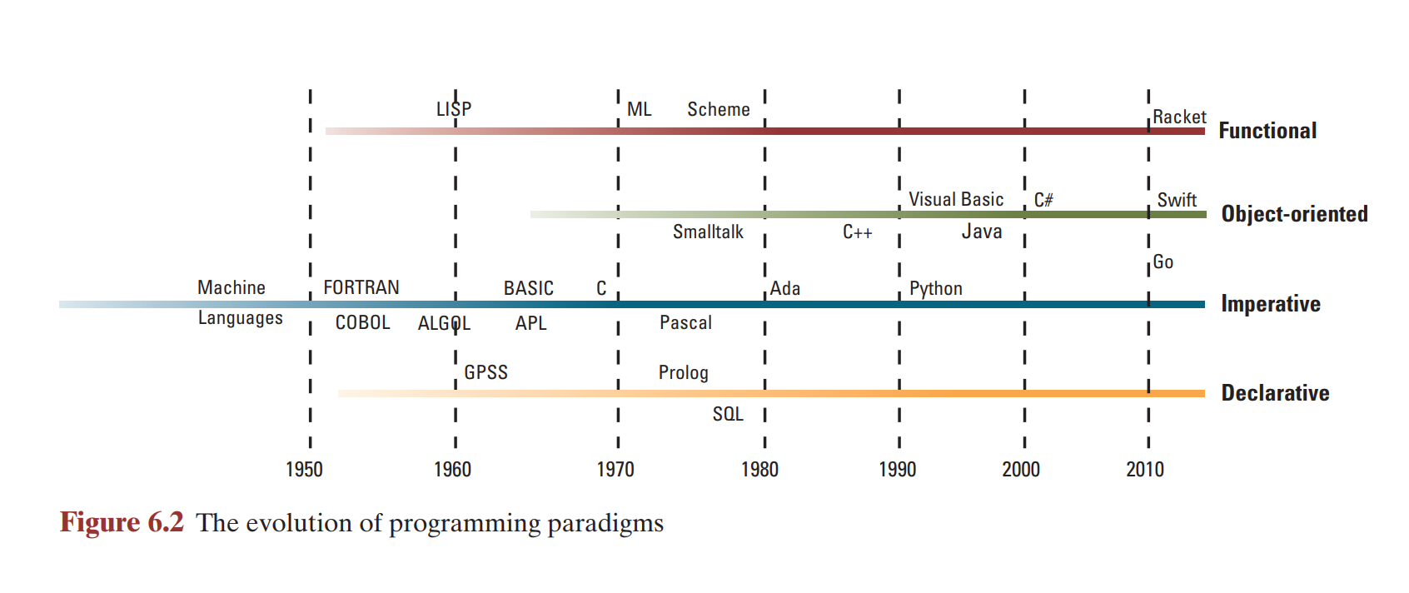
Evolution of Programming Paradigms
Paradigm:
  informally: ‘method of expression’ / ‘philosophy’

Slide 15
Programming Paradigms
These represent different approaches to building solutions to problems
Software development paradigms
  Imperative / procedural
  Declarative
    Logic programming
  Functional
  Object-oriented

Slide 16
Imperative programming
An imperative program has:
  A set of data items (variables)
  A sequence of statements that evaluate expressions,
  Assignments that replace old values with new ones.
  During programming, programmer must keep track of:
  The correct sequence of operations,
  The variables whose values are being used,
  The variables whose values are being replaced.
Which is difficult, especially for larger programs.
Notes:
It specifies steps that computers should take to complete or finish a goal. Functions are coded implicitly in each and every step that is required to solve a problem.

Slide 17
Declarative programming
The programmer describes the problem to be solved, rather than an algorithm to be followed
More precisely, a declarative programming system applies a pre-established problem-solving algorithm to solve problems presented to it
  Programmer’s task is to develop a precise statement of the problem
Early examples were special-purpose languages, usually simulation models
Logic programming provided a general-purpose problem-solving model for declarative programming

Slide 18
Functional programming
The program is viewed as a function
  An entity that accepts inputs and produces outputs
A program is constructed by connecting smaller pre-defined program units (pre-defined functions) so that one’s output becomes another’s input
  Building nested complexes of simpler functions
  i.e. Functions of functions
  Examples: LISP, Scheme, ML, Haskell
  Example - the factorial function in Haskell:
  let { fac 0 = 1; fac n | n > 0 = n * fac (n-1) }
Notes:
F: It mainly focuses on what programs should be executed or operate i.e., results.
I: It mainly focuses on describing how the program executes or operates i.e., process.

Slide 19
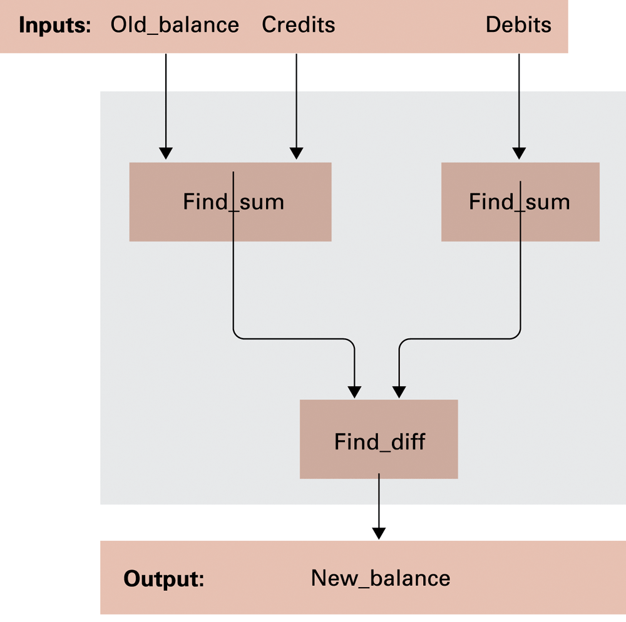
Figure 6.3 A function for checkbook balancing constructed from simpler functions

Slide 20
Object-oriented programming
- Example: Smalltalk, Java, C#
- Data and methods are grouped into classes which are used as templates to create objects
- Distinguish between public and private data and procedures
private: available only within the object
public: available to other parts of the software
- Chief advantage is that it simplifies code reuse
- Can have multiple instances of an object because each has its own data and procedures
- Inheritance: classes of objects are derived from other classes (can share common procedures and data structures)

Slide 21
Imperative vs. Object-Oriented
Imperative:
  develop sequence of commands that manipulate data, which is executed in the order specified
  variables are very important
Object-Oriented:
  design units of data as active objects, instead of passive entities
  compare:
    imperative: procedure doSort( List )
    object-oriented: method List.doSort( )

Slide 22
Q. In what sense is Java object-oriented, and in what sense is it imperative?
Java allows definition / instantiation of ‘active’ objects (based on classes)
Java allows each method (function or procedure) to be implemented in a traditional procedural/imperative manner

Slide 23
4th generation languages:
…-generators, domain-specific
Programs are designed by making choices that cause code (typically 3rd generation code) to be generated
- Specific problems can be solved without a person designing new code
- The interface is typically graphical and users work at a conceptual level, such as using icons to represent data objects and arrows to represent connections

Slide 24
5th generation languages:
Advanced Declarative Programming ("Fifth Generation")
- Users describe the problem and the system devises an appropriate way to solve it, and does so.
- A general algorithm is applied to solve problems
- Logic Programming: formal logic is used to specify a problem and the resolution algorithm is used to solve it
- Example: Prolog. But Prolog programs have a procedural aspect: you must specify the parts of the logical description in the right order.
- Constraint Programming: user specifies all the constraints on the solution and the system finds one or all possible solutions that meet this constraint.
- Has not been as successful as its proponents claimed it would be

Slide 25
6.2 Traditional Programming Concepts
Language-statements fall into 3 categories:
  (1) declarative statements
    variables and data types
    data structure definitions
    constants
  (2) imperative statements
    assignment statements
    control statements
  (3) comments

Slide 26
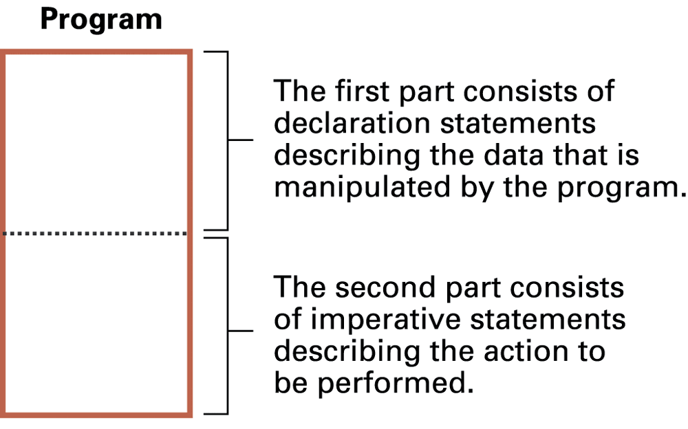
Figure 6.4 The composition of a typical imperative program or program unit

Slide 27
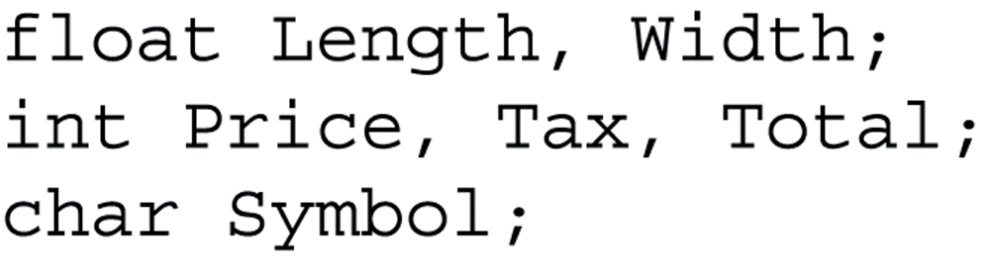
Figure 6.5 Variable declarations in C, C++, C#, and Java

Slide 28
Example of a Typical Imperative Program
/* program to manipulate a list */
#include <stdio.h>
#include <string.h>
int main()
{
char names[10][9], pivot[9];
int i, j;
/* get the names */
for (i=0; i<10; ++i) {
scanf(“%s”, names[i]);
}
/* sort the list */
for (i=0; i<10; ++i) {
strcpy(pivot, names[I]);
j = i - 1;
while ((j >=0) && (strcmp(pivot, names[j]) < 0)) {
(strcpy(names[j+1], names[j];
--j;
}
strcpy(names[j+1], pivot);
/* print the list */
for (i=0; i<10; ++i) {
printf(“%s\n”, names[i]);
}
}
functional unit
functional unit
declarative statements
declarative statements
imperative statements
imperative statements
comments

Slide 29
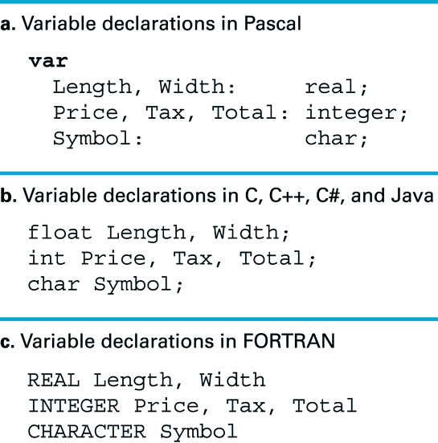
Declarative statements: variables & data types
Variables:
  descriptive name for location(s) in main memory
  declared in combination with data type

Slide 30
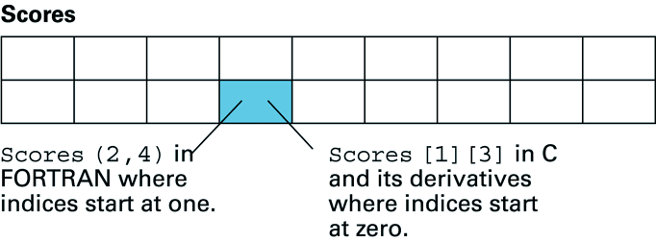
Declarative statements: data structures (1)
Data Structures:
  arrangement of multiple data units (possibly of different types)
  e.g.: homogeneous array, such as one-dimensional lists, and two-dimensional tables (all elements of same type)
  declaration example in C: int Scores[2][9];

Slide 31
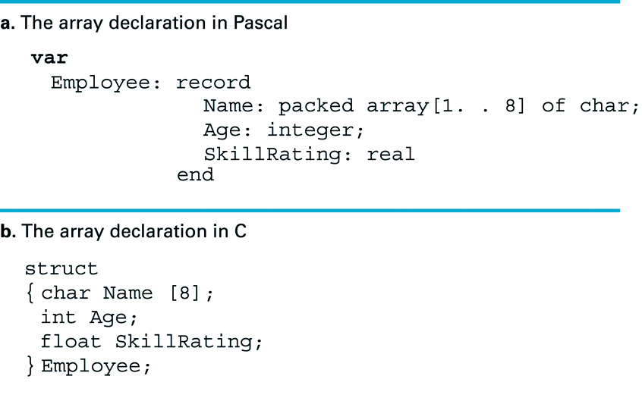
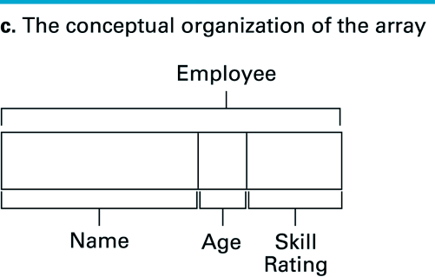
Declarative statements: data structures (2)
Data Structures:
    e.g.: heterogeneous array, a block of data in which different elements can have different types
(total: 14 bytes)

Slide 32
Declarative statements: constants and literals
Constants:
  descriptive names for non-changeable values
  for better readability / understanding of code
Example:
  const WaterDensity20C = 998.2071
  ….
  wMass = waterVol * WaterDensity

Slide 33
A literal is the explicit use of a value such as 645 or “Smith” in a program
A reader of the program code may not be able understand the meaning of these literal values and so it is usually better to use constants

Slide 34
Q. A company’s number of employees rises from 5 to 6. Two programs now must be altered to reflect this.
- Indicate what changes must be made.
- What problems arise in Program 1 that are avoided in Program 2?
Program 1:
:
DailySalary := TotalSal/5;
AvgSalary := TotalSal/5;
DailySales := TotalSales/5;
AvgSales := TotalSales/5;
:
Program 2:
:
NumEmpl constant Integer := 5;
DaysWk constant Integer := 5;
:
DailySalary := TotalSal/NumEmpl;
AvgSalary := TotalSal/DaysWk;
DailySales := TotalSales/NumEmpl;
AvgSales := TotalSales/DaysWk;
:

Slide 35
Imperative statements: assignment
Assignment:
  pseudo-code example: TotalCost ← 100
  requests that a value be stored in the memory area identified by a variable
General form:
  name ← expression
  where ‘expression’ can be complex, and needs evaluation before the assignment takes place:
    Z = X + Y;
    searchSuccessful = doSearch(namesList, ‘David’);
    result = 2 * 4 + 6 / 2; (operator precedence must be defined!!!)

Slide 36
Operator precedence
The expression 1 + 2 * 3 is ambiguous
Does this give result 9 = (1+2)*3
or 7 = 1 + (2*3) ?
In order to eliminate ambiguity, and reduce the need for brackets, operator precedences are set:
Multiplication and division have precedence over addition and subtraction (so above expression has value 7)
Check the rules for your programming language, and if in doubt add brackets to force an order of execution

Slide 37
Overloading of operators
Many programming languages allow the use of one symbol to represent more than one operation.
the meaning of the operator is determined by the data type of the operands
e.g the symbol + can be used for addition of numbers, and sometimes (e.g. in Java) for concatenation of strings: “a” + “bc” = “abc”
Multiple use of an operator in this way is called overloading

Slide 38
Q. What is the difference between the "equals" symbol in if (X = 5) then ( . . . ) as opposed to the statement
X = 2 + Y
The first '=' is a comparison function which returns 'true' or 'false'.
The second '=' is an assignment operation.

Slide 39
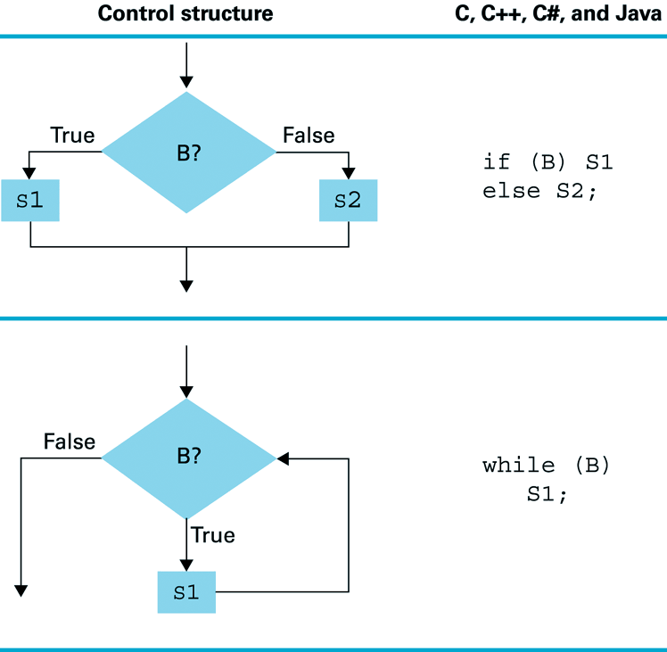
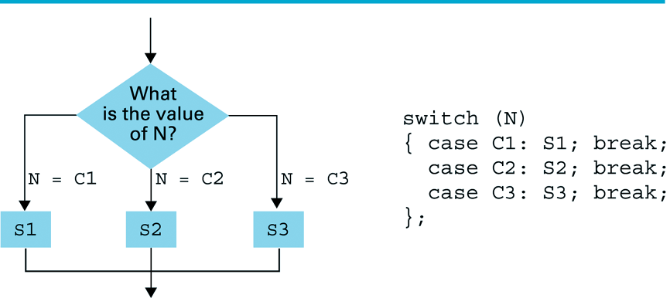
Imperative statements: control structures
Control statements:
  change the execution sequence of a program

Slide 40
Imperative statements: control structures (2)
Possible, but bad programming practice: GOTO statement
goto 40
Apply procedure StayIndoors
  Goto 70
If (PollutionLevel < Hazardous) then goto 60
Goto 20
Apply procedure GoOutdoors
. . .
c.f. If (PollutionLevel < Hazardous)
then (Apply procedure GoOutdoors)
else (Apply procedure StayIndoors)

Slide 41
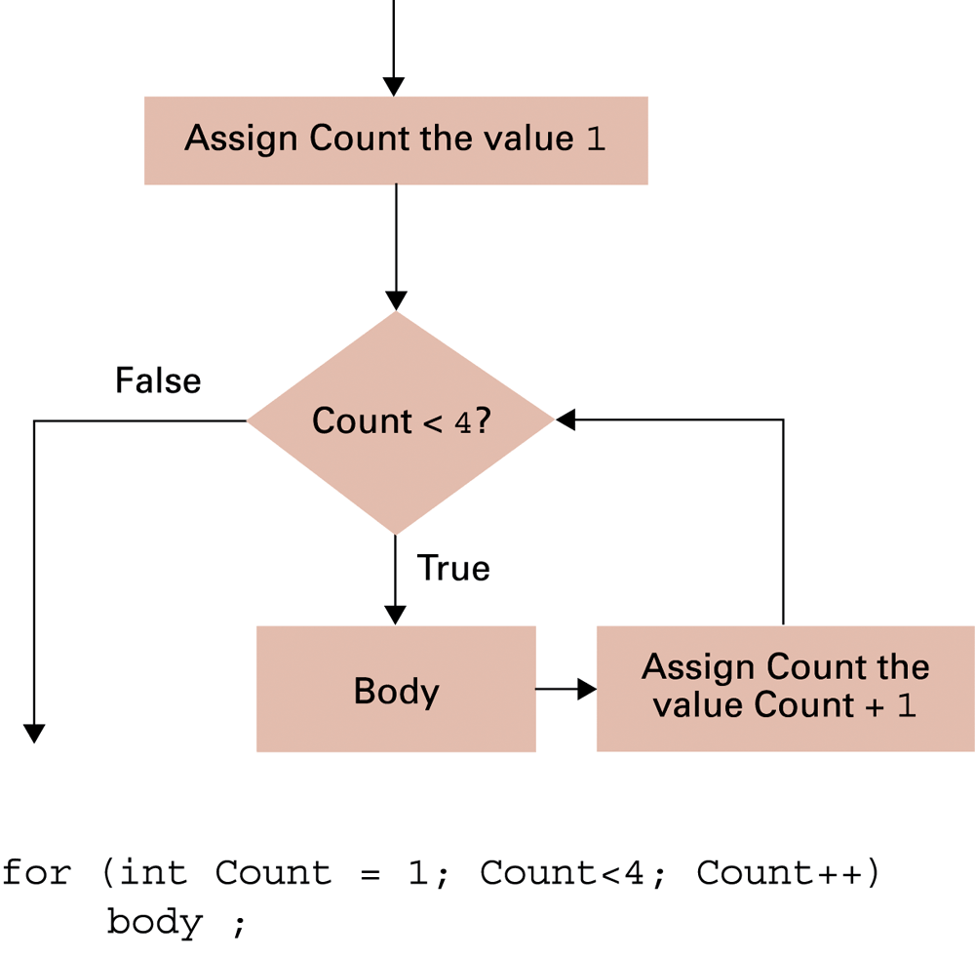
Figure 6.8 The for loop structure and its representation in C++, C#, and Java
The for-loop structure is a natural way to access the elements in a homogeneous array

Slide 42
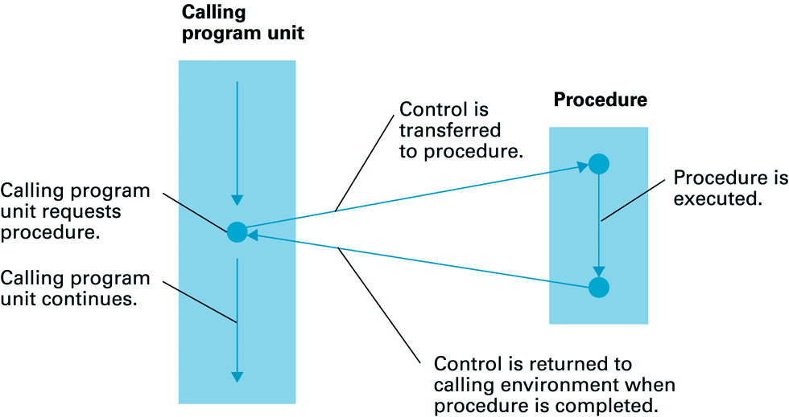
Procedural / Functional Units
Procedure:
  encapsulated set of instructions for performing a task that can be used (called or invoked) by other program units
Control:
  transferred to the procedure when called, and returned back to original program when finished

Slide 43
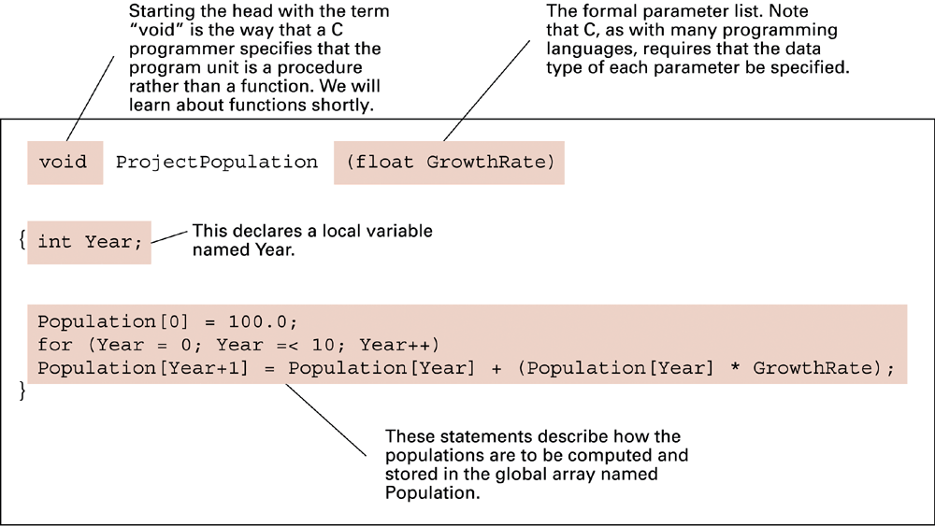
The procedure ProjectPopulation written in C

Slide 44
Parameters
Procedures usually written using generic terms
  write once - use many times for manipulation of different blocks of data
  example: procedure Sort(List)
Generic terms:
  parameters
    used in writing procedure: formal parameters
    used in applying procedure: actual parameters
e.g.: void ProjectPopulation( float GrowthRate, int BaseValue )
e.g.: rate = 17.3;
ProjectPopulation( rate, 100 );

Slide 45
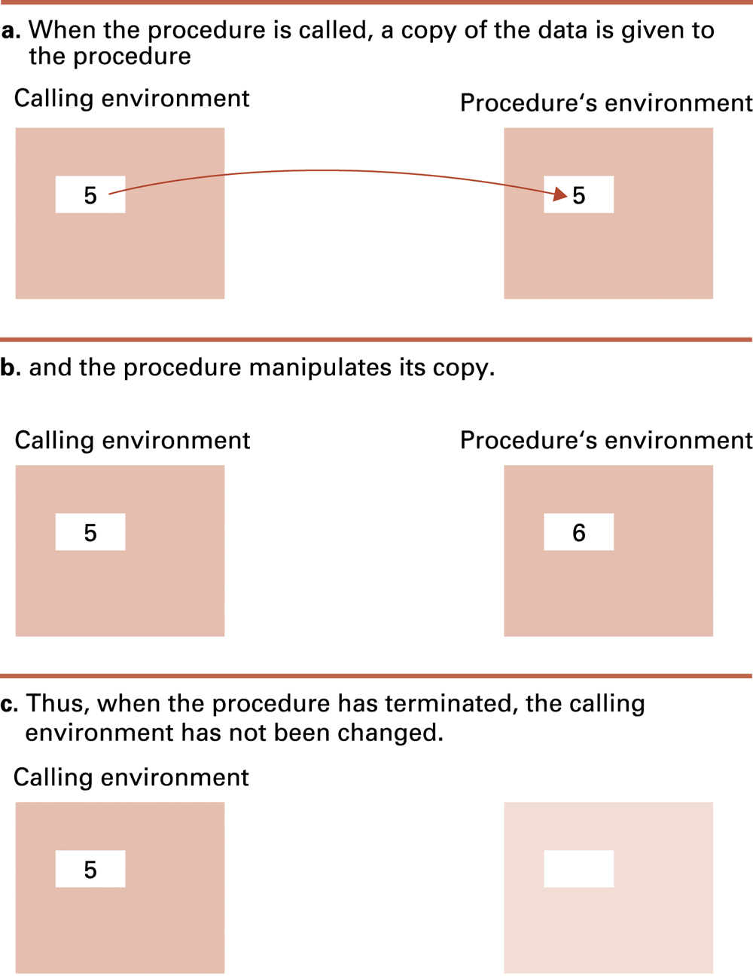
Figure 6.12 Executing the procedure Demo and passing parameters by value

Slide 46
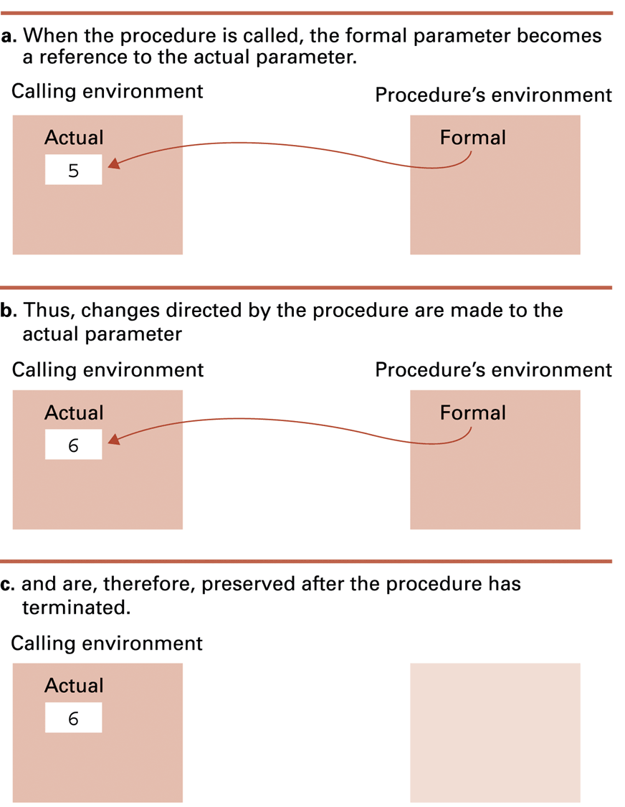
Figure 6.13 Executing the procedure Demo and passing parameters by reference

Slide 47
Parameters - pass by value / pass by reference
Parameter Passing:
  (1) pass by value
calling environment
procedure’s environment
actual
formal
formal
5
5
16
does not change!
16
  (2) pass by reference (the address of actual parameter)
calling environment
calling environment
procedure’s environment
procedure’s environment
actual
actual
formal
formal
5
16
16
does change!

Slide 48
Q. Suppose a procedure 'Modify' is defined by procedure Modify(Y)
Y := 7; print the value of Y;
If parameters are passed by value, what is printed when the following program is executed? And what if passed by reference?
X := 5; apply the procedure Modify to X; print the value of X;
By value: 75 is printed
  value of ‘X’ is given to Modify, but ‘X’ cannot be changed
By reference: 77 is printed
  address of ‘X’ is given to Modify, so ‘X’ can be changed

Slide 49
Functions
Function:
  procedure that produces a value (rather than performing an action only)
  produced value is returned back to the calling program unit
Example:
float CylinderVolume( float Radius, float Height )
{
float Volume;
Volume = 3.14 * Radius * Radius * Height;
return Volume;
}
Cost = CostPerVolUnit * CylinderVolume( 3.45, 12.7 );
Usage:

Slide 50
Non-structured language
(Earlier versions of Basic, Cobol, Fortran)
  Variables are global
  Subroutines/procedures can access any variable and change its value.
A number of problems:
  Very little programming discipline.
  Not suitable for programming teams,
  Code cannot be shared or reused easily.

Slide 51
Block-structured language
All recent major (imperative) programming languages are block-structured.
Note that block structured languages:
  force a higher programming discipline.
  are suitable for programming teams (write your section of code independently)
  produce code can be reused easily.

Slide 52
Block-structure
  Note that in C, any { } indicates a block:
  Function definitions
  Block statements
  if, for, while statements working on a block
  switch statements
int funcA(void)
{ ...
}
{ i=1; k=2; ... }
if(...)
{ ... }
else
{ ... }

Slide 53
Imperative vs. Object-Oriented (1)
Imperative example:
#define MAX-SIZE 8
typedef enum { OK, FULL, EMPTY } stack_state;
typedef struct {
int table[ MAX_SIZE ];
int top;
stack_state state;
} Stack;
void push( Stack *s, int element )
{
( s->state != FULL ) ? (s->table[(s->top)++]==element) :
printf( “*** Stack full ***\n” );
s->state = (s->top >= MAX_SIZE) ? FULL : OK;
}
int pop( Stack *s )
{
int element = 0;
( s->state != EMPTY ) ? (element = s->table[--(s->top)) :
printf( “*** Stack empty ***\n” );
s->state = (s->top <= 0) ? EMPTY : OK;
return element;
}
13
32
65
97
48
17
33
Stack (state=OK, top=4)
Stack (state=OK, top=5)
Stack (state=OK, top=6)
Stack (state=OK, top=7)
Stack (state=OK, top=6)
Stack (state=OK, top=5)

Slide 54
Imperative vs. Object-Oriented (2)
Disadvantages of imperative Stack-code:
  no relation enforced between ‘Stack’-definition & ‘Stack’-operations ‘push()’ and ‘pop()’
    potential difficulties in understanding large programs, as each program unit could directly relate to any other
  worse even: other program units can freely change ‘Stack’-data without using ’Stack’-operations
    all program units need to be checked when ‘Stack’-definition is changed
    difficult to maintain consistent & bug-free code

Slide 55
Imperative vs. Object-Oriented (3)
OO-paradigm circumvents these problems by:
  definition of objects: combined specification of data structure & operations on that data
  encapsulation: restricting (or even: denying) access to objects internal properties
    by definition of ‘public’ & ‘private’ data + operations
      public: accessible by other program units
      private: hidden from other program units
    in other words: separation of object implementation

Slide 56
Imperative vs. Object-Oriented (4)
#define MAX-SIZE 8
typedef enum { OK, FULL, EMPTY } stack_state;
class Stack {
public: void push ( int );
int pop();
private: int table[ MAX_SIZE ];
int top;
stack_state state;
} ;
void Stack::push( int element )
{
(state != FULL) ? (table[top++]==element) :
cout << *** Stack full *** << endl;
state = (top >= MAX_SIZE) ? FULL : OK;
}
int Stack::pop()
{
int element = 0;
(state != EMPTY ) ? (element = table[--top]) :
cout << *** Stack empty *** << endl;
state = (top <= 0) ? EMPTY : OK;
return element;
}
OO stack-example:
put together what
belongs together...
...show only what
needs to be shown
97
48
17
33
Stack (state=OK, top=4)

Slide 57

6.4 Language Implementation
Translation / Compilation:
  converting high-level language code into machine language
3 stages of activities:
lexical analysis
parsing
code generation

Slide 58
  Lexical analyser:
    recognizes / classifies strings of symbols into single entities (tokens)
    token packages each unit and its classification
    all program comments are ignored
    int maximum(int x, int y) {
      if (x > y) return x;
      else
      return y;
    }
Lexeme | Token
int | Keyword
maximum | Identifier
( | Operator
int | Keyword
x | Identifier

Slide 59
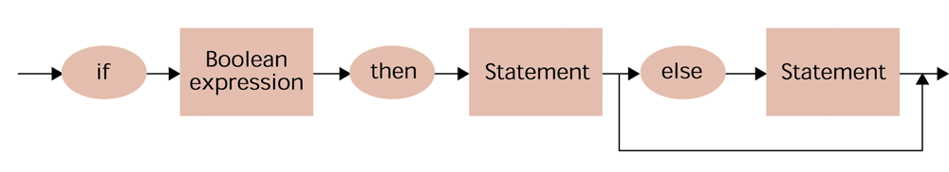
  Parser (syntax analysis):
    groups lexical units(tokens) into statements (i.e. finds the grammatical structure)
    based on ‘syntax diagrams’
A syntax diagram of an if-then-else statement
Notes:
Syntax analysis is a crucial step in understanding and interpreting the meaning of the text, whether it is written in a natural language or a computer language.
It involves checking the source code of a program to ensure that it follows the correct syntax of the programming language in which it is written.

Slide 60
Parsing difficulties – examples from English
Mice cats chase eat cheese
That that is is. That that is not is not. That that is not is not that that is.
Dogs dogs dog dog dogs
Buffalo buffalo buffalo buffalo buffalo
  Buffalo is a verb (= to confuse) and a noun
The man who whistles tunes pianos.
The old man the boat.
The cotton clothing is made of grows in Mississippi
Every woman that admires a man that paints likes Monet
Relevant ın Computational Linguistics and Machine Translation

Slide 61
  In order to simplify parsing many early programming languages were fixed-format languages - each program statement had to be positioned in a particular manner on the printed page
  Now most languages are free-format languages, and program code can be laid out in a way that improves readability from a human’s point of view
  Free-format languages use punctuation marks and keywords (e.g. if, else, while) to mark beginnings and ends of phrases
  The keywords are usually reserved words – meaning that the programmer cannot use them for other purposes in the program

Slide 62
Syntax diagrams and parse trees
A grammar is a set of rules defining the syntax of a language
The grammar rules may be expressed as syntax diagrams
e.g. a syntax diagram of an if-then-else statement:
Terms in rectangles are nonterminals and require further description.
Terms in ovals are terminals.

Slide 63
How a particular code string matches to a set of syntax diagrams can be represented in pictorial form by a parse tree
e.g if B1 then S1 else S2 has the following parse tree:
Statement
Boolean expression
if
then
Statement
else
Statement
B1
S1
S2
However, this grammar is flawed - it is ambiguous: it allows two parse trees for the single statement if B1 then if B2 then S1 else S2

Slide 64
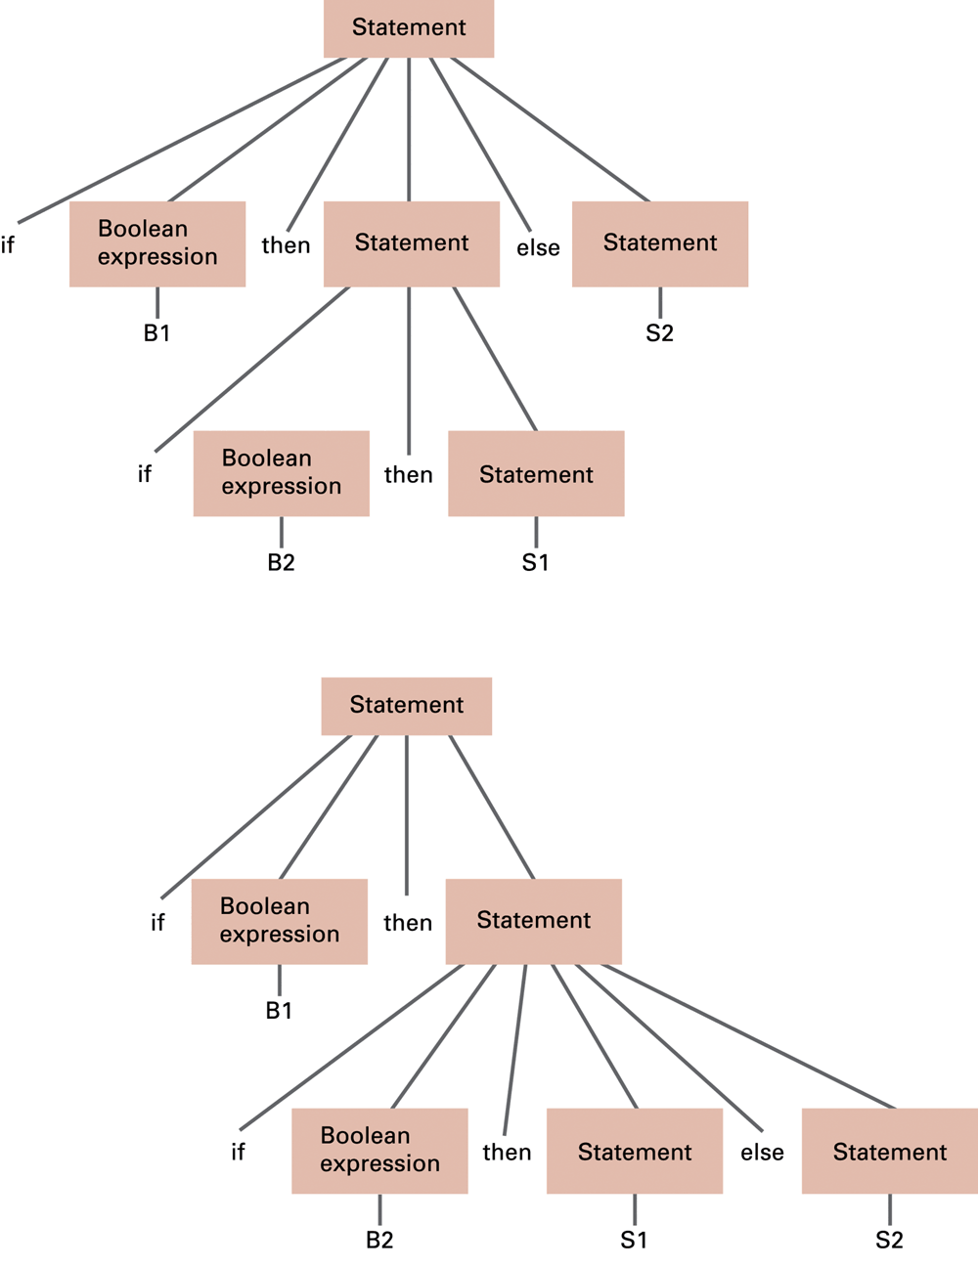
Figure 6.18
Two distinct parse trees for the statement if B1 then if B2 then S1 else S2
if B1 then (if B2 then S1) else S2
If B1=false statement S2 executes
If B1=true, B2=false statement s2 does not execute
if B1 then
(if B2 then S1 else S2)
If B1=false statement S2 does not execute
If B1=true, B2=false statement S2 executes

Slide 65
  The parser records information being declared in the program in a table called the symbol table
  The symbol table contains information on variable names and their associated data type or data structure
  The parser relies on this information when analysing imperative statements such as “z = x + y;”
  - if x and y are both int then integer addition will be required at the code-generation stage
  - if x is float and y is int then perhaps y will be converted to a float value. This implicit conversion between types is called coercion

Slide 66
  Code Generator:
    constructs sequences of machine instructions from the statements recognized by the parser
    producing efficient machine-language versions of programs requires code optimisation
    e.g. in translating
    x = y + z;
    w = x + z;
    transfers of data between main memory and CPU can be avoided by recognising that at the end of the first statement the values of x and z are already in the CPUs registers

Slide 67
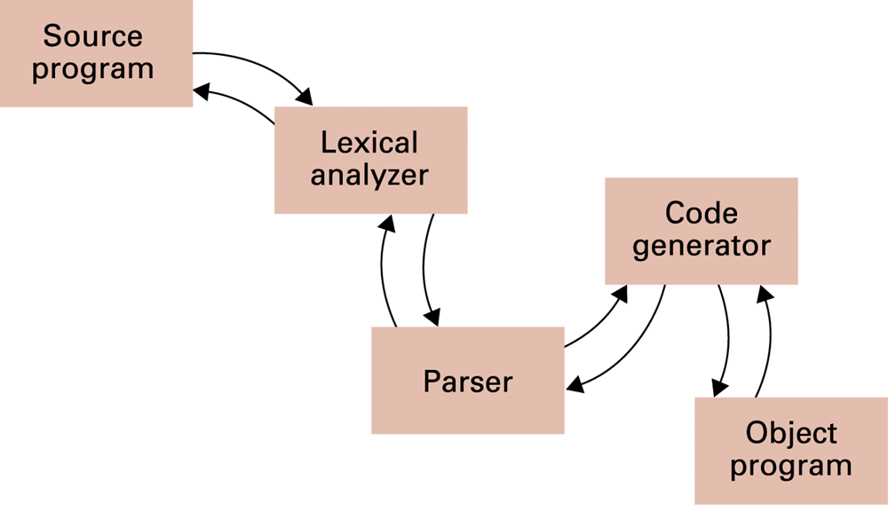
Figure 6.19 An object-oriented approach to the translation process

Slide 68
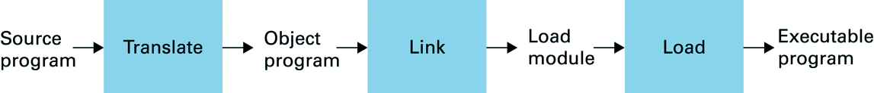
Complete Program Preparation Process
Object program usually not executable
Often needs to work together with other modules
Modules must be connected to create executable code
  Linker:
    connects several object programs to produce executable program (usually in form of: program.exe)
  Loader:
    places program code in main memory
    notifies OS scheduler

Slide 69
Chapter 6 - Programming Languages: Conclusions
High-level languages
  allow concentration on problem to be solved
  important property: machine independence
Multiple programming paradigms
  most popular: imperative & object-oriented
General program statements:
  declarative, imperative, comments
Procedure calls:
  generic due to parameter passing (by value or reference)
Imperative vs. Object-Oriented
  OO encourages putting together what belongs together

Slide 70
Software - Programming Languages
General purpose programming languages
FORTRAN Physics, Math, Engineering
COBOL Business oriented
APL Math, scientific
GPSS Simulation
Lisp Artificial intelligence - Functional programming
PL/1 Application oriented
C Systems and applications programming
C++ Object oriented
Java Platform (OS) independent object oriented

Slide 71
Terminology
Machine language Makine dili
Assembly language Çeviri dili
High-level language Yüksek düzey dil
Language processor Dil işleyici
Assembler Çevirici
Compiler Derleyici
Interpreter Yorumlayıcı
Structured programming Yapısal programlama
Object-oriented programming Nesneye-yönelik programlama
Functional programming İşlevsel programlama

Slide 72
Terminology
Medium (Plural: media) Ortam
Communications medium İletişim ortamı
Block structured (language) Blok yapılı (dil)
Record Kayıt
Activation Record Etkinleştirme kaydı
Scope Kapsam
Nesting (içerde) yuvalanma
Stack Yığın
Procedure Prosedür/Yöntem
Routine Yöntem/Usül
Subroutine Alt-prosedür

