Slide 1
Ch. 7
Software Engineering
Building LARGE / complex software systems

Slide 2
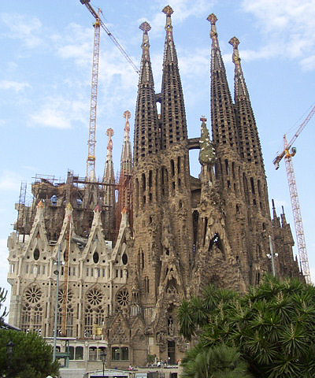
7.1: Engineering Example
Cost estimation (time, money, etc.)
Dividing work into manageable pieces
Compatibility between pieces
Progress measurement
Coping with details
…

Slide 3
7.1: Software Engineering
Software engineering deals with design, development, testing, and maintenance of software applications
Building large software systems is an engineering effort too, including
  division of problem into manageable parts
  integration of separately developed units
  cost assessment (time / money, …)
  personnel management

Slide 4
Large/complex software systems
Common idea/mistake:
  Large/complex = many lines of code
More realistic:
  Large/complex = many interrelated entities that need to work together as a single system
Note:
  goal of software engineering is to make such systems ‘manageable’

Slide 5
Computer-aided software engineering (CASE)
The application of computer technology to software engineering
CASE tools
  project planning systems
  project management systems
  documentation tools
  prototyping and simulation systems
  interface design systems
  programming systems
  ...

Slide 6
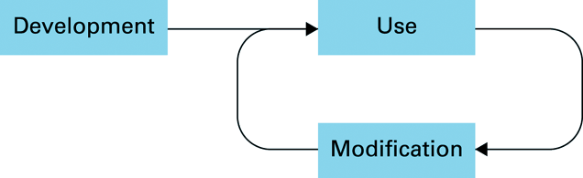
7.2: The Software Life Cycle
For real-world objects: modification = repair
Modification phases taken together are often much more costly than the development phase
  ‘modification’ often is: ‘redesign from scratch’
  note: comments in code are essential; avoid literals
  design software to be easily modifiable

Slide 7
Modification is needed for:
- Correction of errors in design or implementation
- Adaptation to changing technology or user needs
Modification occupies about twice as much of the total effort as does initial development: (1/3 development and 2/3 modification)
Modification requires
-The existing system be comprehensible
Factors: modularity, documentation, good programming style
-The existing system be modifiable
Factors: minimal interdependence plus above factors
-

Slide 8
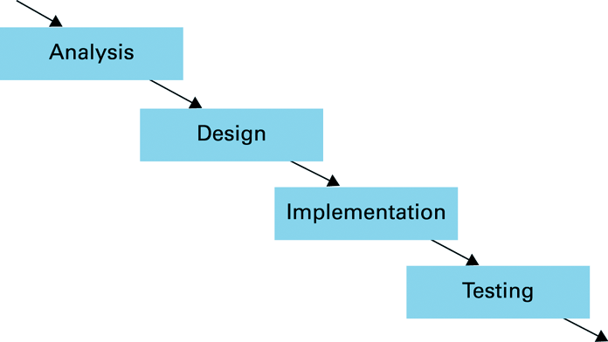
Development Phase
General cost estimate (in time):
  Analysis: 30% - Design: 20% Implementation: 10% - Testing: 40%

Slide 9
Analysis
System requirements
  the needs of the user, described in terms of the application
Specifications
  requirements converted into more technical terms
Software requirements document
  concludes the analysis stage
  effectively a written agreement between all parties concerned, intended to guide the software’s development and help solve disputes

Slide 10
Targeting the project: requirements analysis / gathering
Functional requirements
Data requirements
Usability requirements
Task requirements
Environmental requirements

Slide 11
Requirements gathering is the process of finding out what the client requires from the product. Typically client produces only a vague proposal. Requirements gathering is intended to clarify the clients needs, identify omissions, ambiguities and vagueness.
Functional requirements - What the system must do
Data requirements - The structure of the system and the data that must be available
Environmental requirements - The physical environment in which the system must function.

Slide 12
Usability requirements - The acceptable level of user satisfaction, is the system:
  easy to learn
  efficient to use
  easy to remember
  subjectively pleasing
  Need to know who the users are, what tasks they will be performing, the benefits to them and the costs to them.
Task requirements - What the user wants to achieve, what are their goals, sub-goals and so on, what are the sequences in which these goals must be achieved.

Slide 13
Design
Establish how the system will meet its goals
Decompose the system into manageable modules
Interface design
Writing the programs, building the database,...
Software analyst
  involved in entire development
  perhaps more concerned with analysis and design
Programmer
  primarily concerned with implementing the design
Implementation

Slide 14
Testing
Validation testing
  confirming that the software system as implemented conforms to the requirements and specifications identified in the original analysis
Defect testing
  identifying and correcting errors
  can be extremely difficult to do successfully

Slide 15
7.3 Software engineering methodologies
The traditional approach to software development -- with the four rigid steps of Analysis-Design-Implementation-Testing -- is now referred to as the waterfall model because there was no turning back.

Slide 16
Prototyping
Prototypes allow identifying potential issues and making adjustments before reaching the final design phase, saving time and resources.
Prototyping helps designers elicit ideas and information regarding:
  the necessary functionality of the system
  operation sequences, interaction
  user support needs
  required representations, symbols, icons, menus
  look and feel of the interface
  Look: elements such as colours, shapes, layout, and typefaces
  Feel: the behavior of dynamic elements such as buttons, boxes, and menus – how the user interacts with interface

Slide 17
Iterative design
When designing interactive systems it is often difficult to fully specify the system at the beginning of the development.
In many cases, the only way to be sure about a design decision is to build a prototype and test it on real users. As a result of this testing the design can be modified if necessary.
This cyclical development with incremental improvement is referred to as iterative design.

Slide 18
Iterative design
Initial Design
Prototype
Redesign
Test / Evaluate
Code
Field Test

Slide 19
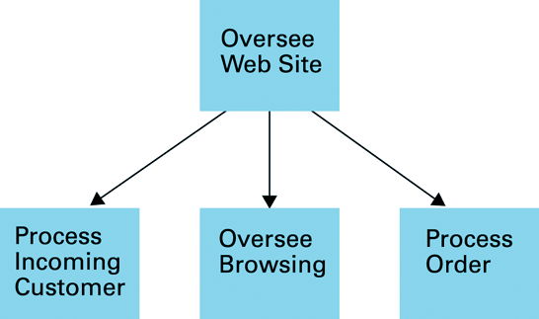
7.4: Modularity
Modularity:
  division of software into manageable parts, each of which performs a subtask only
    e.g.: procedures, objects, …
Representation of procedural modularity
  structure chart:

Slide 20
7.5 Tools of the Trade
Modelling techniques and notational systems for software engineering
- structure charts
- dataflow diagrams
- entity-relationship diagrams
- data dictionaries

Slide 21
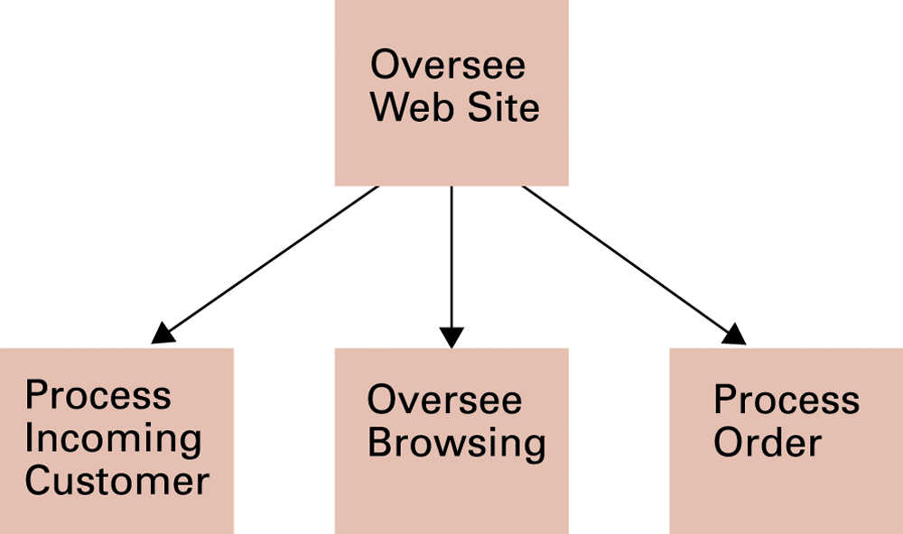
Structure Charts
- A structural chart is a pictorial representation of the subprogram
structure of a program. Each subprogram (sometimes called a module)
is represented by a rectangle and dependencies between modules are
represented by arrows connecting them.
- A technique to aid in top-down design

Slide 22
Entity Relationship Diagrams
Used in Computer-Aided Software Engineering (CASE) tools
- Manipulation of information and relations between those pieces
of information in a pictorial representation
- Useful in studying structure of data
- Used in data analysis for database design
Teaches/Attends: Relationships
Professor/Students: Entities

Slide 23
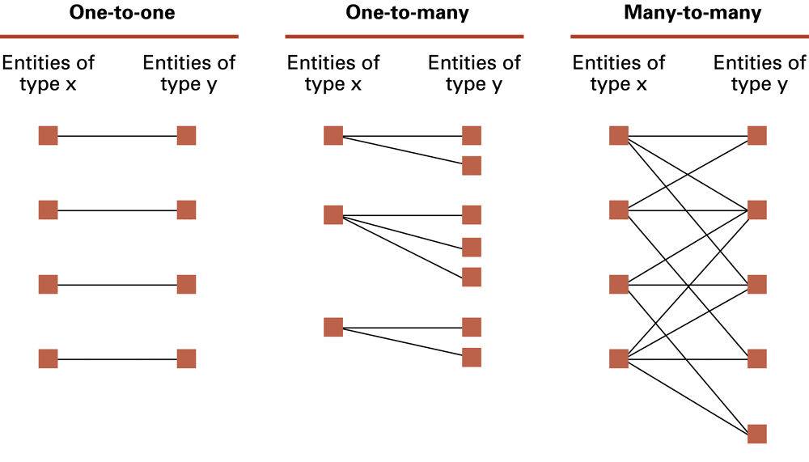
Figure 7.10 One-to-one, one-to-many,
and many-to-many relationships between entities of types X and Y

Slide 24
Data Dictionary
Definition: A centralised guide to all data in software (e.g. all variables, types, and fields of structured variables)
- Contains information about fields and types normally only available in file headers
- Example information:
type: is the information numeric or alphabetic?
range: what values may be assigned to the variable?
storage: is the item stored in a file or a database, and if so, where?
references: which modules refer to this item?

Slide 25
Data Dictionary (2)
- Purposes:
- Improve communication among software designers
- Identify redundancies and inconsistencies
- Same name used for two different items
- Different names used for same item

Slide 26
7.6 Software testing strategies
Glass-box testing (White-box) :
  - Where the tester uses knowledge of the software in testing it
  - Basis path testing: Develop set of test data that ensures each instruction in the software is executed at least once
Black-box testing:
- Treat the software as a black box (can't see inside)
- Pick sample data based only on possible inputs and outputs
Notes:
Testteki her hangi bir potansiyel hata verecek kod yapısını tespiti.
İlerleyen süreçlerde çıkacak olan gizli hataların olmaması birim aşamada emin olmak.

Slide 27
Design for testability
- Consider testing when coding
- Strive for independence of modules (loosely coupled)
Assertions
- An assertion is a statement placed in a program that reflects a
condition that the programmer believes must be true
- small programs can be "proven correct" through mathematical
analysis of the statements and assertions
- If the assertion is false, the program is terminated
- Useful in testing and proving a program to be correct; protect against
errors in software

Slide 28
7.7 Documentation
Needed to:
- Teach people how to use the software (user manual)
- Describe the software for later modification (implementation manual)
Problems:
- No one wants to do it
- Existing documentation is poorly written

Slide 29
User documentation: user's manual
- Introductory guide for commonly used features
+ Detailed reference
+ Installation guide/hardware requirement
- Formats: Printed, on-line manual, on-line tutorial
System documentation
- System specifications
- Structure description:
dataflow diagrams, data dictionary, structure charts, design trees
- Collection of programs
- Collection of test data for every feature

Slide 30
Documentation: When?
Documentation should be done in parallel with the development and modification of the system
- Maintains consistency, reduces chance of forgetting
There is a normal human temptation not to document but CASE tools help ensure that documentation is kept up-to-date

Slide 31
Chapter 7 - Software Engineering: Conclusions
Creating large software systems is engineering effort…
...but properties of software not identical to those of real-world objects
Modularity enhances software analysis, design, implementation, testing...
...

