Slide 1
Chapter 1: Data Storage
1.1 Bits and Their Storage
1.2 Main Memory
1.3 Mass Storage
1.4 Representing Information as Bit Patterns
1.5 The Binary System
1.6 Storing Integers
1.7 Storing Fractions
1.8 Data Compression
1.9 Communications Errors
1-<number>

Slide 2
Bits and their meaning
Bit = Binary Digit = a symbol whose meaning depends on the application at hand.
Some possible meanings for a single bit
  Numeric value (1 or 0)
  Boolean value (true or false)
  Voltage (high or low)
1-<number>

Slide 3
Bit patterns
All data stored in a computer are represented by patterns of bits:
  Numbers
  Text characters
  Images
  Sound
  Anything else…
1-<number>

Slide 4
Boolean operations
Boolean operation = any operation that manipulates one or more true/false values
  Can be used to operate on bits
  often referred to as a logical operation
Specific operations
  AND
  OR
  XOR (‘exclusive OR’: X or Y but not both)
  NOT
1-<number>
Notes:
George Boole 19th century english linguist, teacher & mathematician

Slide 5
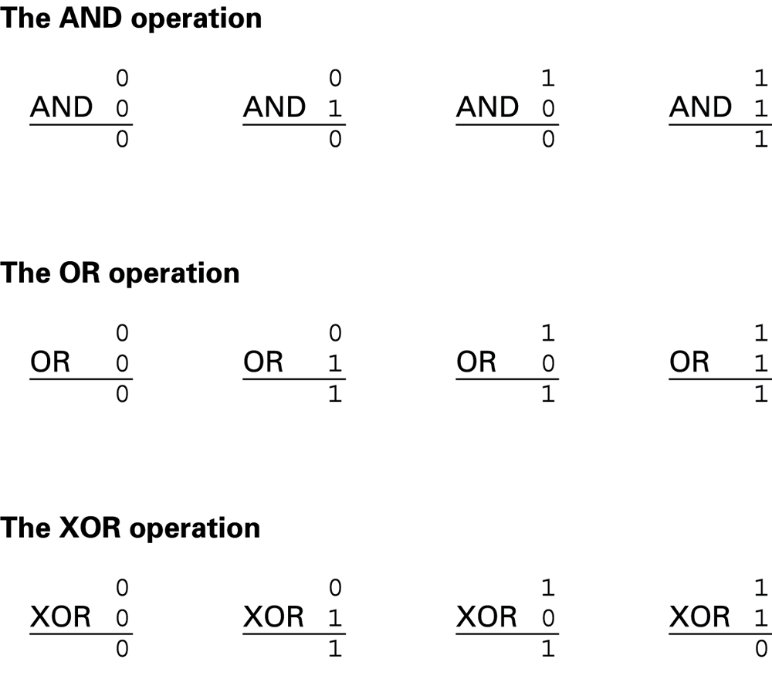
Figure 1.1 The Boolean operations AND, OR, and XOR (exclusive or)
1-<number>

Slide 6
Gates
Gates = devices that produce the outputs of Boolean operations when given the operations’ input values
  Often implemented as electronic circuits
  Provide the building blocks from which computers are constructed
1-<number>

Slide 7
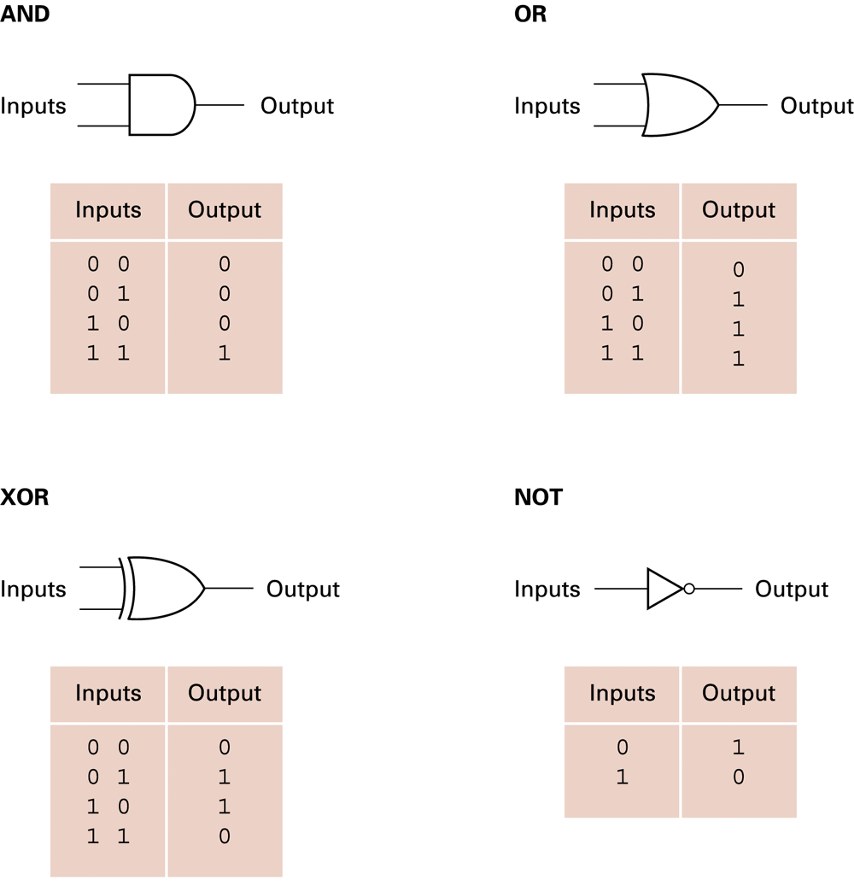
A pictorial representation of AND, OR, XOR, and NOT gates, as well as their input and output values
1-<number>

Slide 8
Flip-flops
Flip-flop = a circuit built from gates that can store one bit of data.
  Has an input line which sets its stored value to 1
  Has an input line which sets its stored value to 0
  While both input lines are 0, the most recently stored value is preserved
1-<number>

Slide 9
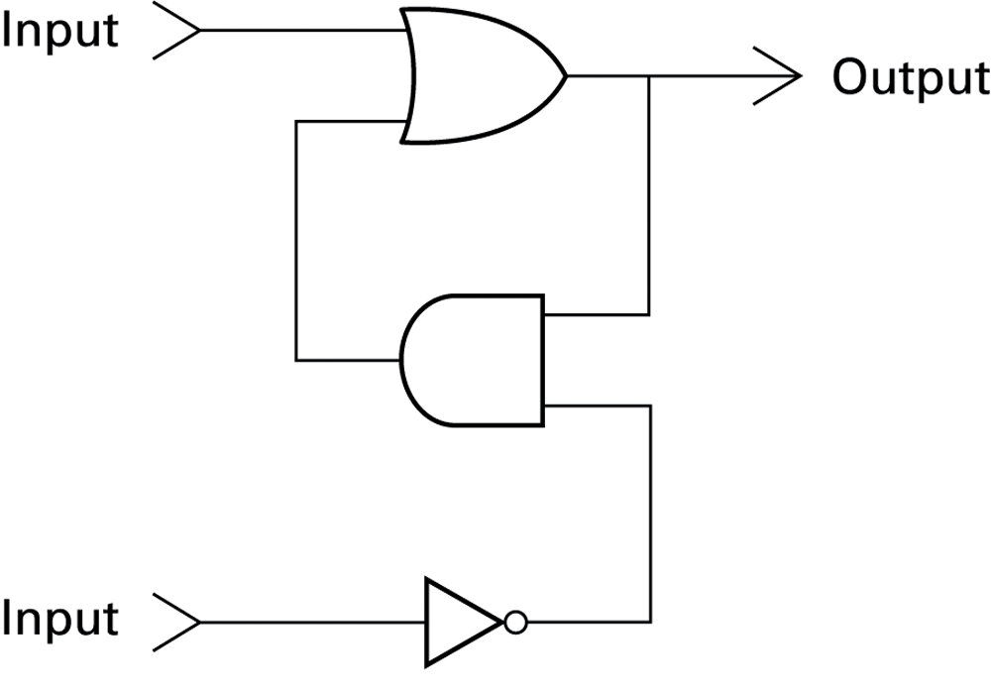
Figure 1.3 A simple flip-flop circuit
1-<number>

Slide 10
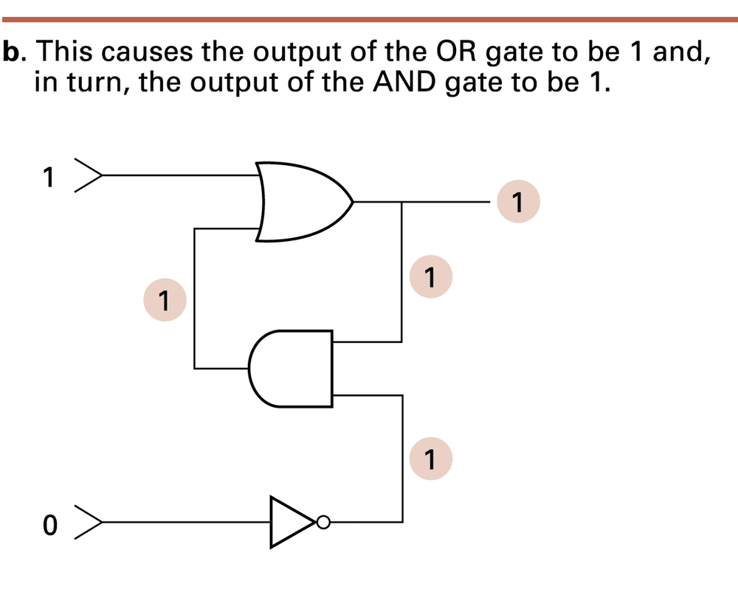
Figure 1.4 Setting the output of a flip-flop to 1 (cont’d)
1-<number>

Slide 11
Hexadecimal notation
The hexadecimal system is a counting system using base 16 (c.f. decimal, which uses base 10 -see later notes)
Hexadecimal notation = a shorthand notation for streams of bits.
  Stream = a long string of bits.
  Long bit streams are difficult to make sense of.
  The lengths of most bit streams used in a machine are multiples of four.
  Hexadecimal notation is more compact.
    Less error-prone to manually read, copy, or write
1-<number>

Slide 12
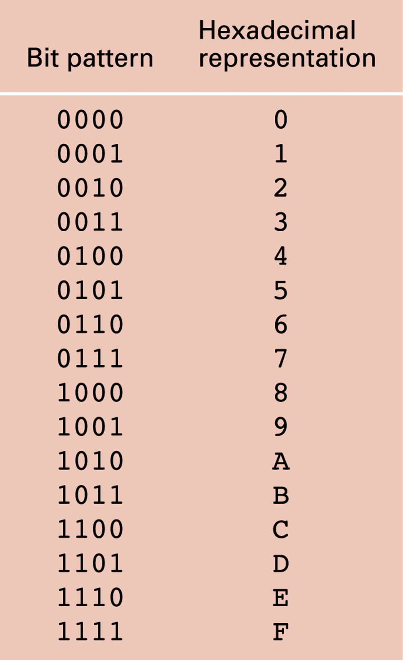
Figure 1.6 The hexadecimal coding system
1-<number>

Slide 13
Main memory: cells
Cells = manageable units (typically 8 bits) into which a computer’s main memory is arranged.
Byte = a string of 8 bits.
  Smallest addressable unit of data storage
High-order end = the left end of the conceptual row in which the contents of a cell are laid out.
  Most significant bit = the last bit at the high-order end.
Low-order end = the right end of the conceptual row in which the contents of a cell are laid out.
  Least significant bit = the last bit at the low-order end.
1-<number>

Slide 14
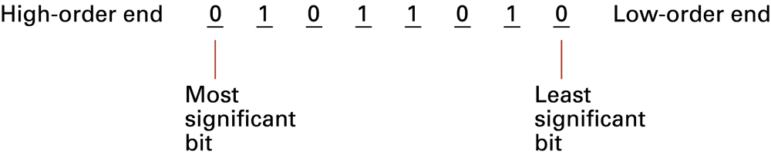
Figure 1.7 The organization of a byte-size memory cell
MSB
LSB
1-<number>

Slide 15
Word : Is a general term describing several consecutive bytes in memory (usually 2 or 4).
15 | 14 | 13 | 12 | 11 | 10 | 9 | 8 | 7 | 6 | 5 | 4 | 3 | 2 | 1 | 0
⬆ 2-byte word MSB ⬇ |  |  |  |  |  |  |  | ⬆ LSB ⬇
31 | 30 | 29 | 28 | 27 |  |  |  |  |  | 5 | 4 | 3 | 2 | 1 | 0
4-byte word
1-<number>

Slide 16
Main memory addresses
Address = a “name” to uniquely identify one cell in the computer’s main memory
The names for cells in a computer are consecutive numbers, usually starting at zero
Cells have an order, so “previous cell” and “next cell” have reasonable meanings
Random Access Memory = memory where any cell can be accessed independently
1-<number>

Slide 17
Main Memory, Physical view
Memory is composed of a number of (modules) banks
Each bank has a number of bytes arranged as an array
Each byte has an address of the form (Bank#, byte#)
Bank 0
 | 0
 | 1
 | 2
 | 3
 | .
 | .
 | .
 | .
 | .
 | N
Bank K
 | 0
 | 1
 | 2
 | 3
 | .
 | .
 | .
 | .
 | .
 | N
1-<number>

Slide 18
Main Memory, Physical view
Bank 0
ROM
Port 1
Port 2
Port n
RAM
Some bytes are kept in RAM, some in ROM, some in I/O ports (special purpose registers).
Address control logic circuits handle addressing correct bytes.
Bytes in RAM can be read/written
Bytes in ROM can be read only
1-<number>

Slide 19
Main Memory, Logical view
("Logical" means "As a programmer would imagine it")
Main Memory
 | 0
 | 1
 | 2
 | 3
 | .
 | .
 | .
 | .
 | .
Memory is composed of a number of bytes
Bytes are arranged as an array
Each byte has an address (byte#)
All bytes are R/W
1-<number>

Slide 20
Measuring memory capacity: Not quite like the metric system
“Kilo-” normally means 1,000;
Kilobyte = 2¹⁰ = 1024
“Mega-” normally means 1,000,000;
Megabyte = 2²⁰ = 1,048,576
“Giga-” normally means 1,000,000,000;
Gigabyte = 2³⁰ = 1,073,741,824
BUT disc capacity now sometimes specified using decimal definitions (10³ , 10⁶ , 10⁹ …)!
1-<number>

Slide 21
Mass Storage Systems
Non-volatile: data remains when computer is off
Usually much bigger than main memory
Usually rotating disks
  Hard disk, floppy disk, CD-ROM
  Much slower than main memory
    Data access must wait for seek time (head positioning)
    Data access must wait for rotation delay or latency time
    (time for desired data to rotate to read/write head)
    Access time = seek time + latency time
1-<number>

Slide 22
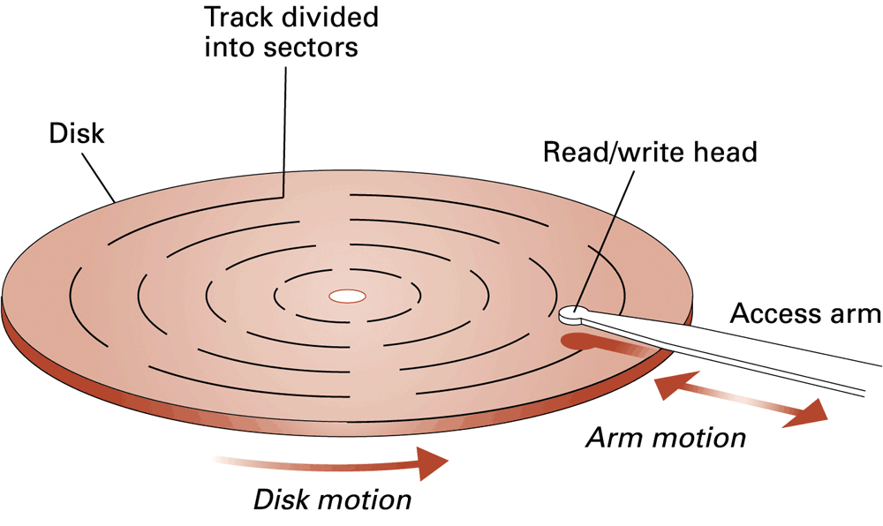
Figure 1.9 A disk storage system
Each track contains same number of sectors, each with same number of bits – unless zoned-bit recording is used to add more sectors to longer, outer tracks
1-<number>

Slide 23
CD & DVD data storage
One continuous spiral data track
  in one revolution more data is read from outer part of track than from inner
Uniform rate of data transfer can only be achieved by varying the rotation speed
Most systems use constant rotation speed therefore the system must handle varying data transfer rates
Typical capacity: 600-700 MB (CD)
several GB (DVD)
1-<number>

Slide 24
Files
File = the unit of data stored on a mass storage system.
  Logical record natural groups of data within a file
    i.e. natural from the programmer point of view
  Field : sub-unit of logical record
    Key field holds identifier key
Physical record = a block of data conforming to the physical characteristics of the storage device.
Buffer = main memory area sometimes set aside for assembling logical records or fields of a file
1-<number>

Slide 25
Representing Data
External representation: (for people) to use data easily, data must be represented (visually, graphically, ...) on paper or on some other directly useable media.
Internal representation: (for computing machines) to support storage and computation, data must be represented as a sequence of 0's and 1's.
1-<number>

Slide 26
Representing Data
How to represent data on paper? in memory?
Coding is representing data according to a system, internally or externally.
Information is coded:
For internal computations
For presentation purposes (text, graphics, sound)
For long-term archival storage (databases, archives)
1-<number>

Slide 27
Representing Data
In all cases, data must be coded as a data type, in order to be recognized later.
In a computer system:
  Text data must be represented according to standard coding table(s),
  Numerical data must be represented by some notation (a number system)

Slide 28
Representing Numeric Data
Internal number representation: Always a sequence of 0's and 1's: ...01100111001010 ...
External number representation:
Many notations (number representation systems)
  Context-dependent notations
  Positional (fixed point) notations
  Floating point notation
1-<number>

Slide 29
Representing Numeric Data (Externally)
Non-positional notation
Roman Numerals:
Positions do not carry weights
Digits are interpreted according to context
Numeral | means
I | 1 or -1 (add 1 or subtract 1)
V | 5 or -5
X | 10 or -10
L | 50 or -50
C | 100 or -100
D | 500 or -500
M | 1000
XIV = 14
MCMLXXIV = 1974
Negative numbers had not been invented yet!
1-<number>

Slide 30
Representing Numeric Data (Externally)
Positional notation
For representing data externally, the most commonly used number systems:
Number System | Radix (base) | Digits used
Decimal | 10 | 0123456789
Binary | 2 | 01
Octal | 8 | 01234567
Hexadecimal | 16 | 0123456789ABCDEF
1-<number>

Slide 31
Representing Non-numeric Data
When the computing device has to handle letters and special symbols, each symbol is coded separately.
Two dominant coding schemes are:
ASCII (American Standard Code for Information Interchange)
EBCDIC (Extended Binary Coded Decimal Interchange Code)
1-<number>

Slide 32
Representing Strings in ASCII
String: a sequence of bytes (characters).
Generally contains text characters,
Can have any number of characters,
The end point must be specified in some way.
A | N | K | A | R | A | ...
 Code for 'A' in ASCII table
1-<number>

Slide 33
Figure 1.13 The message “Hello.” in ASCII
1-<number>

Slide 34
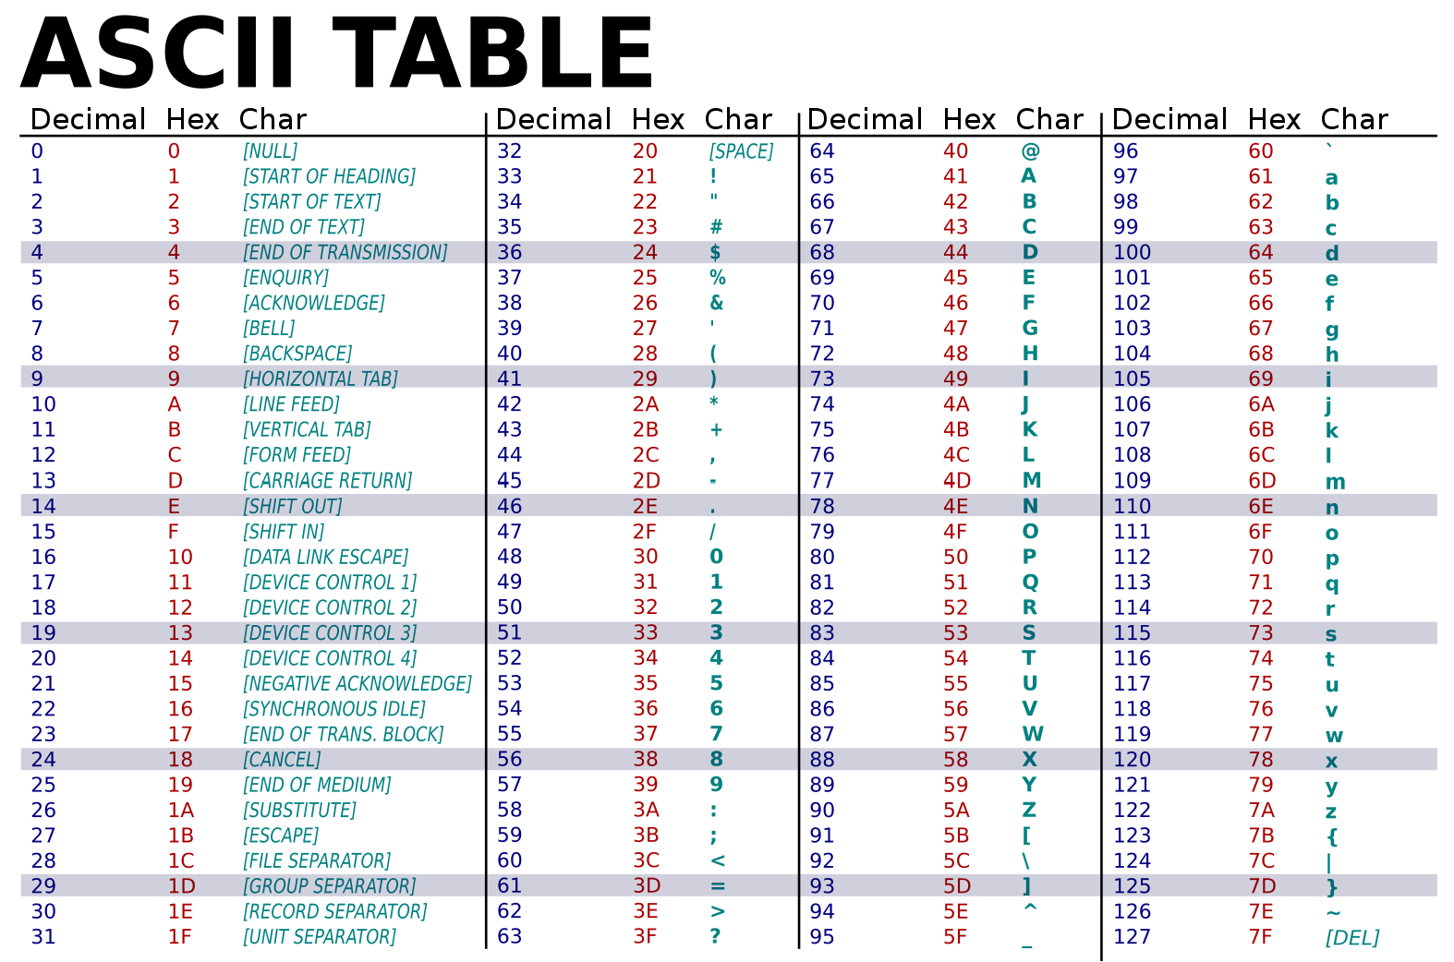
1-<number>
Notes:
https://www.mathsisfun.com/binary-decimal-hexadecimal-converter.html
(3F)₁₆ = (3 × 16¹) + (15 × 16⁰) = (63)₁₀

Slide 35
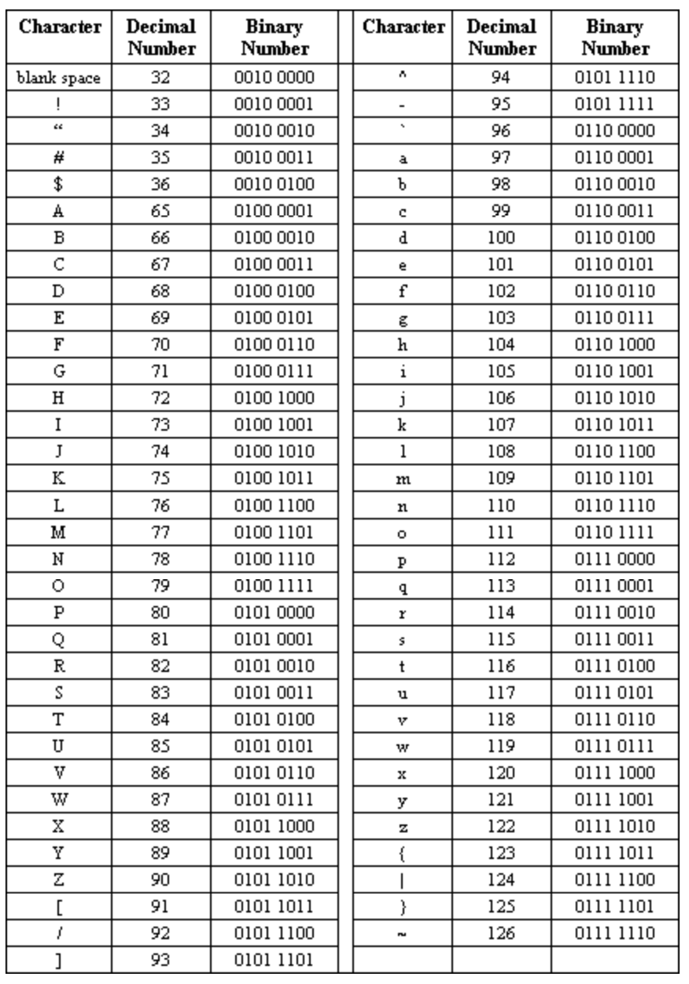
1-<number>

Slide 36
Octal encoding: for encoding a bit stream in groups of three
Bit pattern | Octal representation
000 | 0
001 | 1
010 | 2
011 | 3
100 | 4
101 | 5
110 | 6
111 | 7
1-<number>

Slide 37
Representing Still Images
Two approaches:
(1) Bit map techniques
  Represent image as collection of dots (pixels)
  Black and white binary images
    Pixel values either 0 (black) or 1 (white)
  Black and white (monochrome) images
    Pixel values range from 0 to 255 (commonly)
  Colour images
    Pixel represented as 3 colour components
      Red, Green & Blue
      Luminance, red chrominance & blue chrominance
Problems with resizing, zooming
1-<number>

Slide 38
Representing Still Images
(2) Vector techniques
Image represented as set of lines and curves, specified as a description
Details of drawing left to the device
  Used in computer-aided design (CAD) systems
  Scalable fonts
    TrueType (MS / Apple)
    Postscript (Adobe)
1-<number>

Slide 39
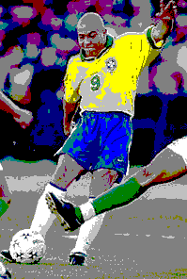
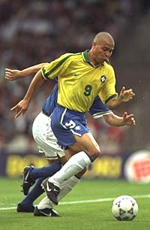
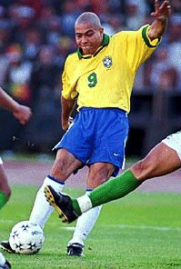
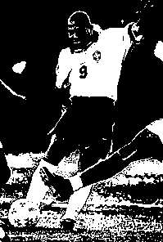
Colour depth
4-bit colour
1-bit colour
24-bit colour
8-bit colour
1-<number>

Slide 40
The colour depth of an image is determined by the available palette size
  1-bit images support 2 “colours” black/white binary images
  8-bit images support 256 grey levels
  24-bit images support 16 Million colours
Many image formats:
  .png - Portable Network Graphics Format
  .bmp - Windows bitmap
  .pic – PC Paint graphics format
  .mac – Macintosh MacPaint format
  .gif (Graphics Interchange Format) – common for graphics on the world wide web
  .jpg – JPEG image (Joint Photographic Experts Group) – platform independent – used for photos
  .tif ( Tagged image file format (TIFF)
1-<number>

Slide 41
Representing numeric values
Binary notation – uses bits to represent a number in base two
Limitations of computer representations of numeric values
  Overflow – happens when a number is too big to be represented. If the bit sequence is cut off to fit the space available, this is truncation.
  Truncation also happens when a number is between two representable numbers.
1-<number>

Slide 42
Types of Numbers
N : Natural or Whole numbers. 0, 1, 2, 3, 4, ….
Z : Integers. … -3, -2, -1, 0, 1, 2, 3, …
Q : Rational numbers. { p/q | p, q∈Z, q ≠ 0 }
R : Real numbers
irrational numbers = R \ Q
C : Complex numbers
(irrationals cannot be expressed as a quotient of whole numbers, hence their decimal or binary representation can never terminate)
1-<number>

Slide 43
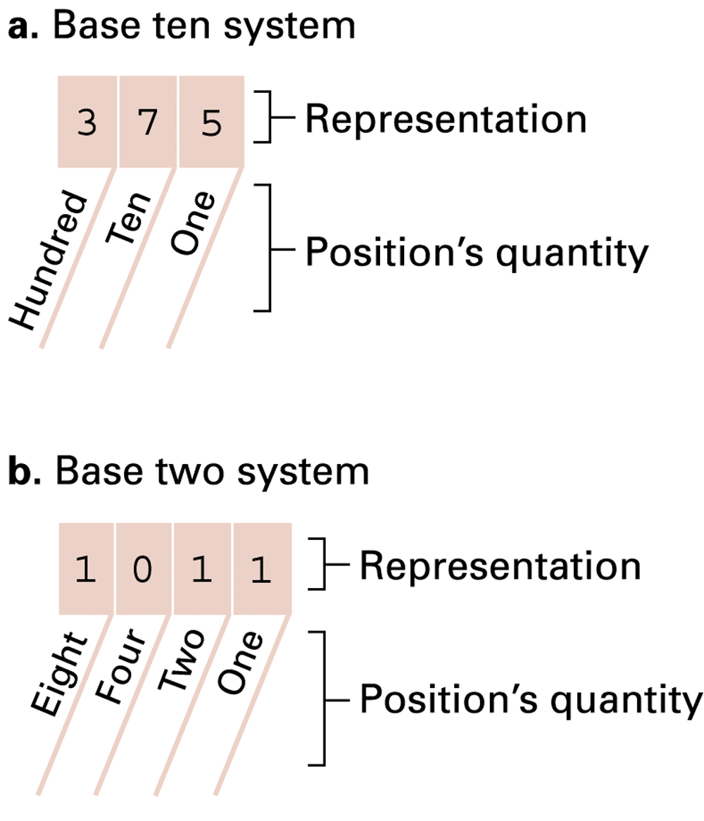
base ten (decimal - or denary)
& base two (binary) systems
1-<number>

Slide 44
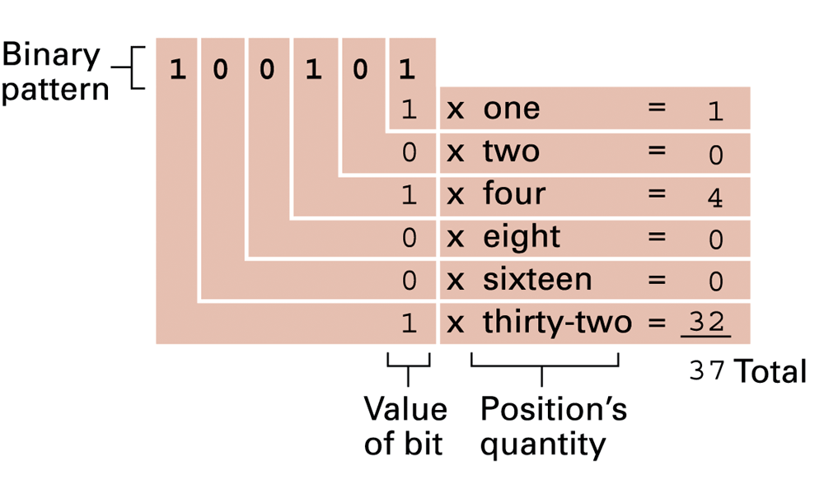
Figure 1.16 Decoding the binary representation 100101
1-<number>

Slide 45
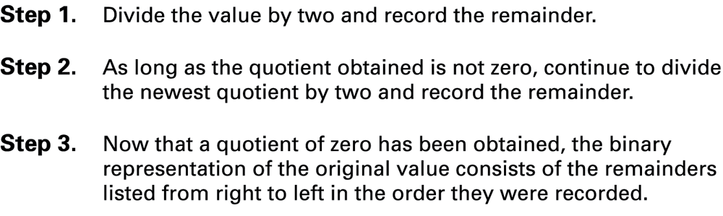
Figure 1.17 An algorithm for finding the binary representation of a positive integer
1-<number>

Slide 46
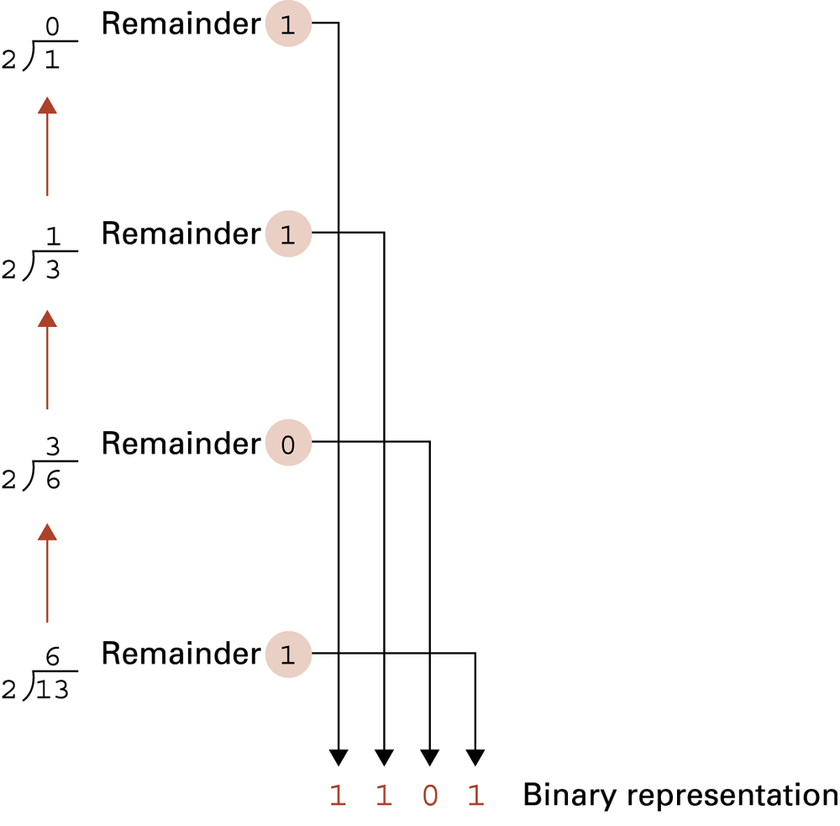
Figure 1.18 Applying the algorithm in to obtain the binary representation of thirteen
1-<number>

Slide 47
Informal restatement of the algorithm
Finding the binary representation of a positive integer P:
  Repeatedly divide P by 2, recording the remainders from right to left. Stop when you get 0 in the result (not as the remainder)
Example: P=13
13 = 2 x 6 +1 1.
6 = 2 x 3 + 0 01.
3 = 2 x 1 + 1 101.
1 = 2 x 0 + 1 1101. STOP
1-<number>

Slide 48
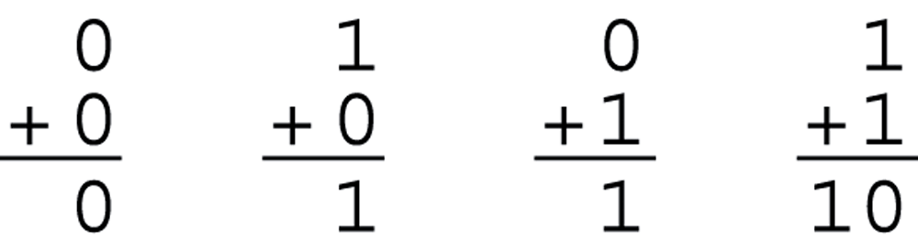
Figure 1.19 The binary addition facts
1-<number>

Slide 49
Decimal addition
Addition in base 10:
1 8 0 9
+ 0 3 2 3
2 1 3 2
• • (carry)
We start with a carry value of 0.
Whenever the sum gets larger than 9, we add 1 to the carry.
The carry is added at the next position.
1-<number>

Slide 50
Binary addition
Addition in base 2:
1 1 0 1
+ 0 1 0 1
1 0 0 1 0
• • • (carry)
We start with a carry value of 0.
Whenever the sum gets larger than 1, we add 1 to the carry.
The carry is added at the next position.
1-<number>

Slide 51
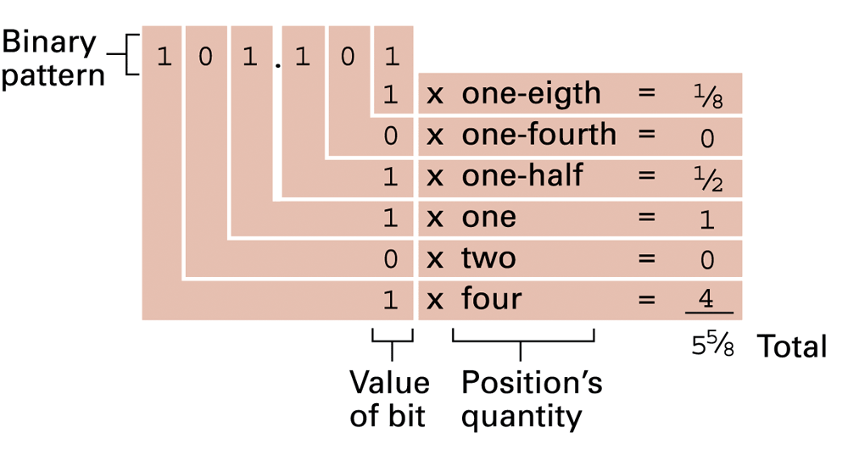
Fractions in binary:
Decoding the binary representation 101.101
1-<number>

Slide 52
Finding the binary representation of a fraction
Informal algorithm for encoding:
  Repeatedly subtract successive negative powers of 2, recording the success (1) or failure (0) of the subtraction, from left to right after the radix point. Stop when subtraction gives result 0
Example: N = 5/8
5/8 = 1/2 +1/8 .1
1/8 = 0 x 1/4 + 1/8 .10 subtraction failed
1/8 = 1/8 + 0 . 101 STOP
2⁻¹ = 1/2
2⁻² = 1/2² = 1/4
2⁻³ = 1/8
1-<number>

Slide 53
binary representation of a fraction
- same method
Example, M = 0.33
0.33 = 0 x 0.5 + 0.33 .0
0.33 = 1 x 0.25 + 0.08 .01
0.08 = 0 x 0.125 + 0.08 .010
0.08 = 1 x 0.0625 + 0.0175 .0101
0.0175 = 0 x 0.03125 + 0.0175 .01010
0.0175 = 1 x 0.015625 + ….. .010101
Process may not terminate.
Stop when available space filled
i.e. truncate the representation
1-<number>

Slide 54
Representing Integers
Unsigned integers can be represented in base two, ranges from 0 to 255
Integers occupy 2^{n} bytes in memory (n usually is 1, 2, 3, 4)
It is usual that the sign information is explicitly encoded
1-<number>

Slide 55
Signed integers = whole numbers that can be positive or negative, ranges from -128 to 127
An integer can be coded in:
  Sign-magnitude notation
  One's complement notation
  Two’s complement notation ⎯ the most popular representation
  Excess notation ⎯ another, less popular representation, often used for exponent values in floating point representations
1-<number>

Slide 56
Representing Integers (Internally)
Sign-magnitude
MSB carries sign 0 : + 1 : -
Sign | Magnitude (= absolute value)
-6 : 1000 0000 0000 0110
6 : 0000 0000 0000 0110
1-<number>

Slide 57
Representing Integers (Internally)
Sign-magnitude
Two representations for 0:
-0 : 1000 0000 0000 0000
+0 : 0000 0000 0000 0000
What are the maximum and the minimum values that can fit in S/M in 2-bytes?
1-<number>

Slide 58
Representing Integers (Internally)
Sign-magnitude
What are the maximum and the minimum values that can fit in S/M in 2-bytes?
16 bits: 1 sign bit + 15 bits for magnitude
Max magnitude: 2⁰ + 2¹ + … + 2¹⁴ = 2¹⁵-1 = 1 + 2 + … + 16384 = 32767
maximum value = 32767
minimum value = - 32767
1-<number>

Slide 59
Representing Integers (Internally)
Complement notations
Complement notation provides another way of representing negative numbers.
Two complement types are used frequently, differing in how negative numbers are coded:
1's Complement
Subtract each digit of the number from (base-1)
i.e. 0 becomes 1, 1 becomes 0.
2’s Complement
Subtract each digit of the number from 1, as above
Add 1 to the result
1-<number>

Slide 60
Ranges of values that can be represented in n bits are:
1's Complement
-2^{n-1} -1 to 2^{n-1} -1
e.g. For one byte, from -127 to +127
2’s Complement
-2^{n-1} to 2^{n-1} -1
e.g. For one byte, from -128 to +127
1-<number>

Slide 61
The 1's complement representation of a positive integer is the same as the original binary, with MSB is set to 0
- i.e. Same as sign/magnitude representation
The 1's complement of a negative integer is obtained by subtracting its magnitude from 2^{n} -1 where n is the number of bits used to store the integer in binary.
e.g. One byte, n=8, subtract from 1111 1111
-1 becomes:
1111 1111
-0000 0001
= 1111 1110
1-<number>

Slide 62
Ones’ complement example using 8 bits (1 byte)
Has two representations of zero: 00000000 (+0) and 11111111 (-0).
To add two numbers represented in this system, one does a conventional binary addition, but it is then necessary to add any resulting carry back into the resulting sum: “end-around carry”
e.g. add -1 and 2
  11111110 + 00000010 = 00000000
  with carry 1.
  Add this to LSB, giving result 00000001
1-<number>

Slide 63
One’s complement was popular in older computers (e.g UNIVAC, PDP-1)
The problems of multiple representations of 0 and the need for the end-around carry are eliminated using two's complement.
2’s Complement of negative integer:
  Subtract each digit of its magnitude from 1
  Add 1 to the result
1-<number>

Slide 64
Representing Integers (Internally)
2's complement notation
Representing binary numbers (here, in one byte only)
2's complement of -17
Binary code for +17 = 0001 0011
1’s complement => 1111 1111 - 0001 0011 (means flip)= 1110 1100
2's complement = 1110 1100 + 1 = 1110 1101
1-<number>

Slide 65
2’s Complement
The 2's complement of a positive integer is the same as the original binary, with MSB set to 0
- i.e. Same as sign/magnitude representation
For a negative integer, begin as with 1’s complement: Subtract each digit of the number’s magnitude from 1
Then add 1 to the result
e.g. One byte, n=8,
-1 becomes: 0000 0001 with bits complemented
= 1111 1110
& finally 1111 1111 after adding 1
1-<number>

Slide 66
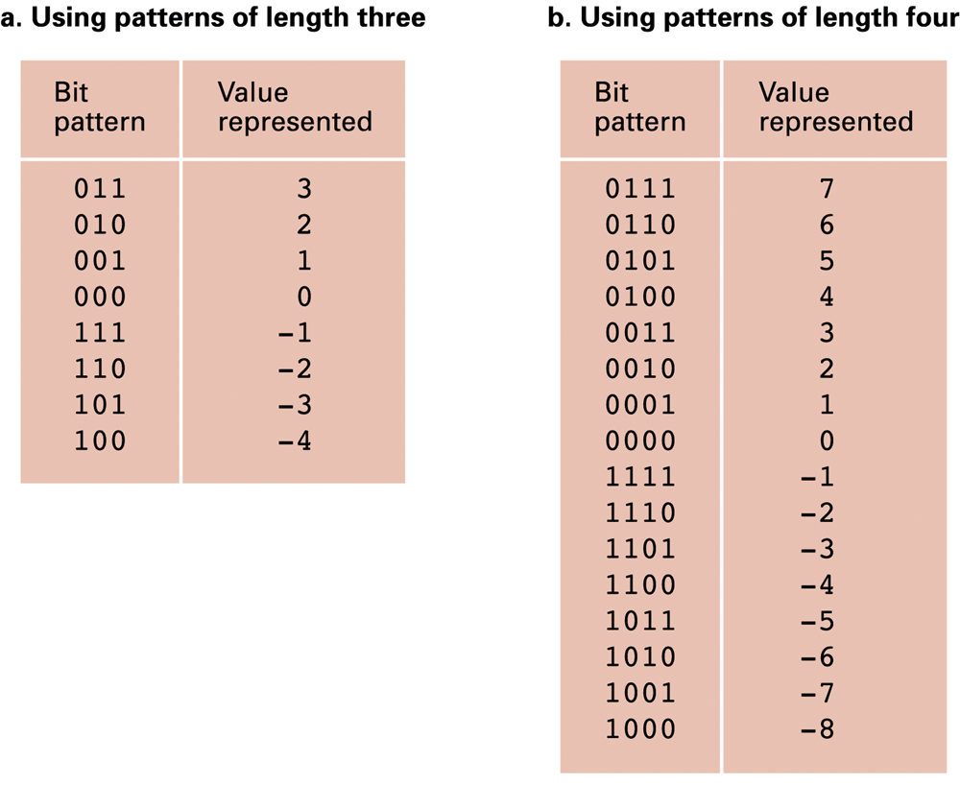
Figure 1.21 Two’s complement notation systems
1-<number>

Slide 67
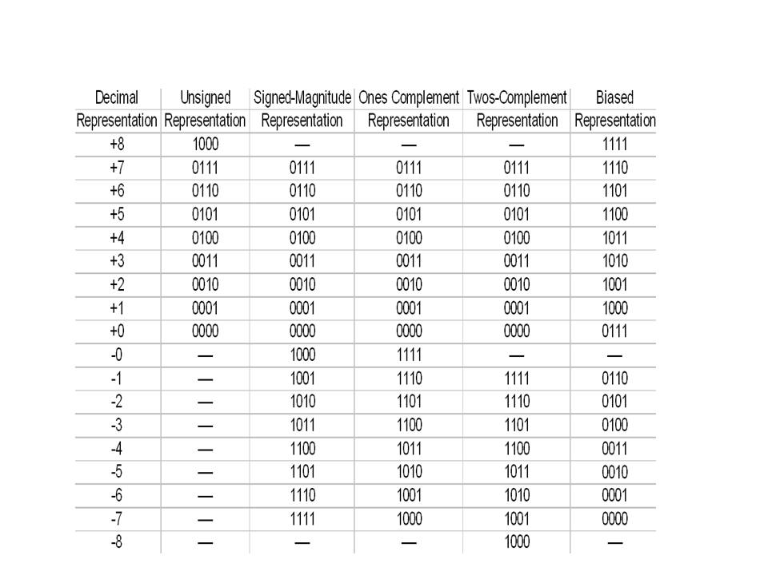
1-<number>
Notes:
Signed bit 5+(-5) → 0101+1101=10010 (ignore 1 carry, 2 which is not true)
Ones Complement → flipped bits 1 to 0, result is close, the pattern, add 1
5+(-5) → 0101+1010 =1111 (-0)
3+(-3) → 0011 + 1100 = 1111 (-0)
5+(-3) → 0101 + 1100 = 10001 (ignore 1 carry, +1)
6+(-2) → 0110 + 1101 = 10011 (+3, close)
Twos Complement
5+(-5) → 0101+1011 =10000 (0)
6+(-2) → 0110 +1110 = 10100 (+4)

Slide 68
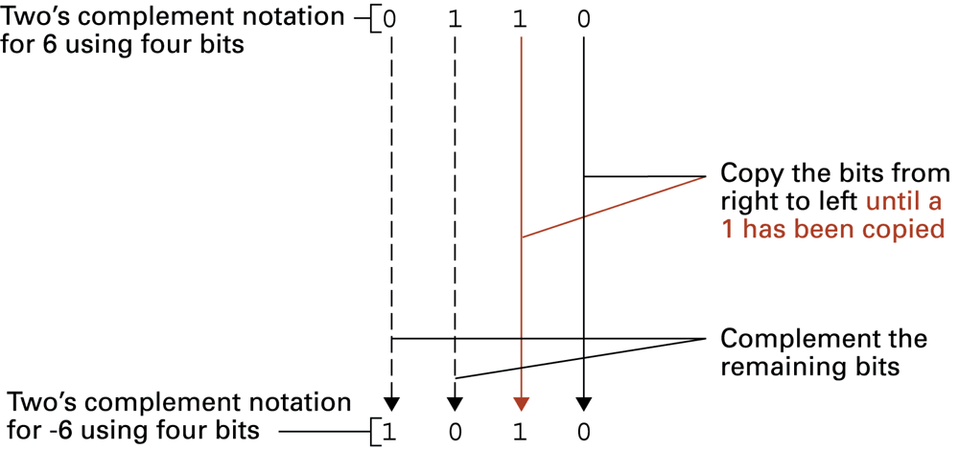
Figure 1.22 Coding the value -6 in two’s complement notation using four bits (using an alternative algorithm)
Start with binary representation of the +ve value:
1-<number>

Slide 69
Two's-complement
There is only one zero (00000000).
Negating a number (whether negative or positive) is done by inverting all the bits and then adding 1 to that result.
Addition of a pair of two's-complement integers is the same as addition of a pair of unsigned numbers (except for detection of overflow, if that is done).
1-<number>

Slide 70
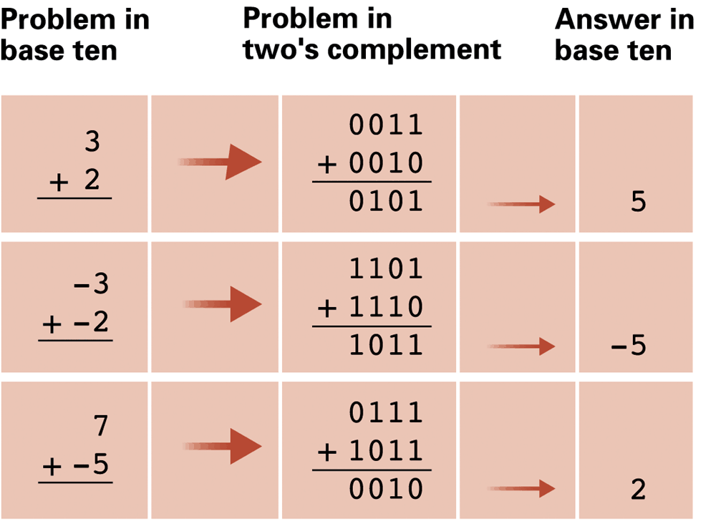
Figure 1.23 Addition problems converted to two’s complement notation
1-<number>

Slide 71
Two's-complement addition
The largest positive integer that can be stored in N bits in 2's complement form is 2^{N-1} -1, whose binary bit pattern is one 0 followed by N-1 1s
  e.g one byte, N=8,
  largest +ve value = 2⁷-1 = 127
  127₁₀ = 0111 1111₂
Therefore, if two positive 2's complement integers are added and their sum is greater than +127 an overflow will occur.
  e.g. 100 + 30 : 01100100
  + 00011110
  = 10000010
  MSB (sign bit) indicates –ve value
1-<number>

Slide 72
2-complement addition
  Rule for overflow detection:
  2's complement overflow occurs when the carry into the MSB is not equal to the carry out from the MSB. (Overflow detector circuit is used)
  e.g. in previous example, one carry into MSB, but no carry-out → overflow
  e.g. 100 + 30 : 01100100
  + 00011110
  = 10000010
  ..... ← carries
1-<number>

Slide 73
2-complement addition
  second example:
  e.g. -60 -68
  -68 : 10111100
  -60 + 11000100
  = 10000000
  ......
  one carry into MSB, but one carry-out
  – no overflow: answer is -128
1-<number>

Slide 74
Excess-N representation
A value is represented by the unsigned number which is N greater than the intended value. Thus 0 is represented by N, and −N is represented by the all-zeros bit pattern.
e.g. with 4 bits use excess-8 [ 4th bit is 8 in binary ]
NB MSB = 0 for –ve values
1 for +ve values
1-<number>
Notes:
Sonraki hafta

Slide 75
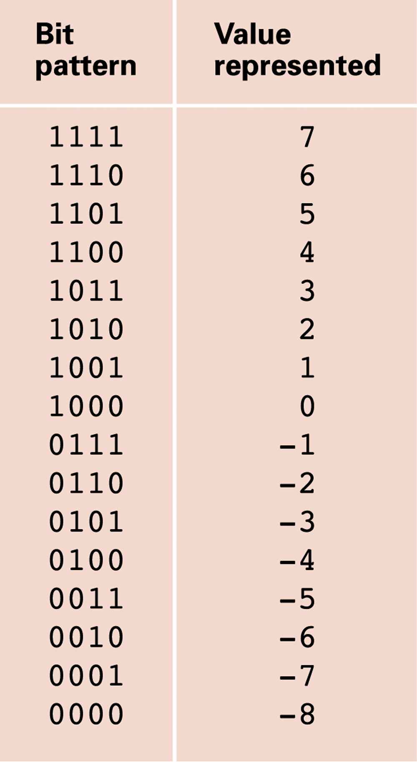
Figure 1.24 An excess eight conversion table
1-<number>

Slide 76
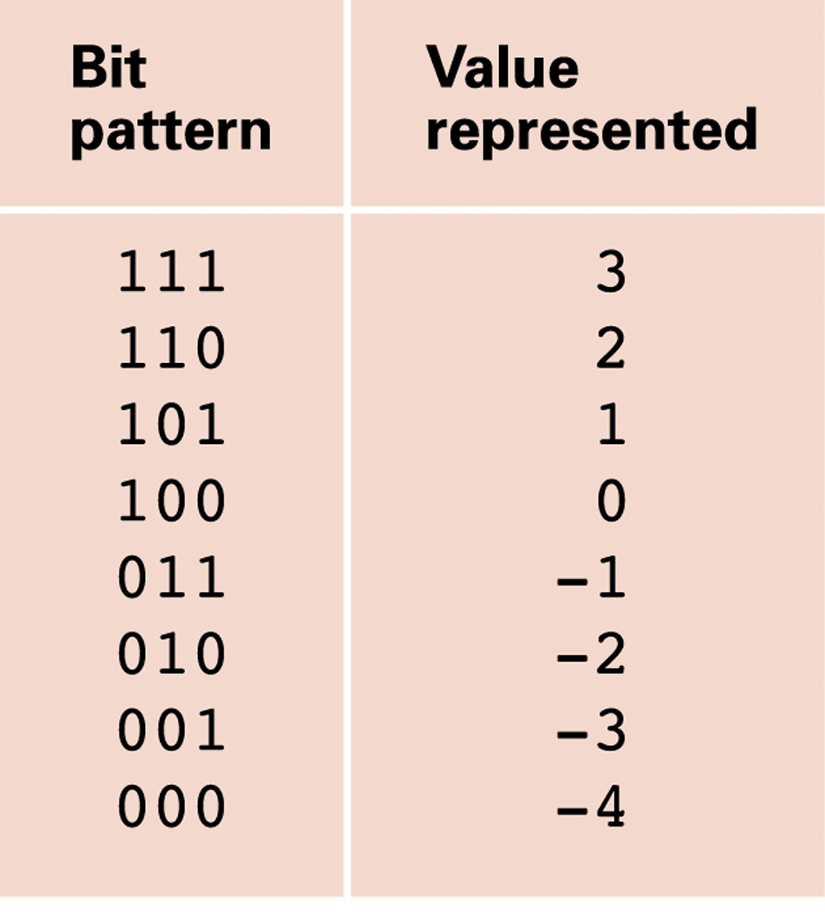
Figure 1.25 An excess notation system using bit patterns of length three (excess-4)
1-<number>

Slide 77
Representing Integers (Internally)
External data is converted into internal form, with the aid of the programming language being used:
Using C, a programmer would:
Select concrete type for the data (according to rules) int, long, char, double ...
Select a name for the data (to be able to use it): int A ; double F;
Specify the value (in external notation) to be used A = 0xFF; or A = 255;
1-<number>

Slide 78
Representing Integers (Internally)
During compilation, compiler will:
Check for correctness, overflows, underflows
Select the size of data (2-byte, 4 byte)
Convert value into internal form (sign magnitude, 2's complement, Floating point ...)
Allocate memory and place data in memory
Generate code to correctly manipulate data (integers in 2's complement arithmetic, floats in FP arithmetic, etc)
1-<number>

Slide 79
Terminology
Data type Veri türü
Base Taban
Representation Gösterim
Notation Yazım
Sign-Magnitude (representation) İşaret/büyüklük (gösterimi)
One's complement 1’in tümleri
Two's complement 2’nin tümleri
Prefix Ön-ek
1-<number>

Slide 80
Fractional (Real) numbers
Radix (base) : Number of different digit symbols.
Positions are numbered, around the dot (if any).
Each digit resides in a weighted position and the weight of each position is a power of the radix.
An N.M digit number:
D_{N-1} | D_{N-1} | ... | D₂ | D₁ | D₀ |  | D₋₁ | D₋₂ | D₋₃ | ... | D_{-M}
N-1 | N-2 | ... | 2 | 1 | 0 |  | -1 | -2 | -3 | ... | -M
1-<number>

Slide 81
Representing Numeric Data (Externally)
Positional notation
D_{N-1} | D_{N-2} | ... | D₂ | D₁ | D₀ |  | D₋₁ | D₋₂ | D₋₃ | ... | D_{-M}
N-1 | N-2 | ... | 2 | 1 | 0 |  | -1 | -2 | -3 | ... | -M
Integer part = (D_{N-1} r ^{N-1} ) + (D_{N-2} r ^{N-2} ) + … + (D₀ r⁰ )
Fractional part = (D₁ r⁻¹) + (D₂ r⁻²) + … (D_{M} r ^{-M} )
N-1
r = radix (base)
D = digits
N: # of digits (integer)
M: # of digits (fraction)
∑ D_{i} r ^{i}
Value =
i = -Μ
1-<number>

Slide 82
Representing Numeric Data (Externally)
Positional notation Base 10 (Decimal)
Example
Numeral: 809.25
r =10
N = 3
M = 2
Integer part = 8 × 10² + 0 × 10 ¹ + 9 × 10⁰ = 809.
Fractional part = 2 × 10⁻¹ + 5 × 10⁻² = .25
1-<number>

Slide 83
Representing Numeric Data (Externally)
Positional notation Base 2 (Binary)
r = 2, D= 0 or 1
D_{N-1} | D_{N-2} | ... | D₂ | D₁ | D₀ |  | D₋₁ | D₋₂ | D₋₃ | ... | D_{-M}
N-1 | N-2 | ... | 2 | 1 | 0 |  | -1 | -2 | -3 | ... | -M
Integer part = (D_{N-1} 2 ^{N-1} ) + (D_{N-2} 2 ^{N-2} ) + … + (D₀ 2⁰ )
Fractional part = (D₁ 2⁻¹) + (D₂ 2⁻²) + … (D_{M} 2 ^{-M} )
N-1
∑ D_{i} 2 ^{i}
Value =
i = -Μ
1-<number>

Slide 84
Fractions: Decoding the binary representation 101.101
1-<number>

Slide 85
Fixed Point notation
A number of bits sufficient for the precision and range required must be chosen to store the fractional and integer parts of a number. For example, using a 32-bit format, 16 bits might be used for the integer and 16 for the fraction.
  used for applications where high precision is required, e.g. finance
1-<number>

Slide 86
Floating-point
In the decimal system, we are familiar with floating-point numbers of the form:
  1.1030402 × 10⁵ = 1.1030402 × 100000 = 110304.02
  or, more compactly: 1.1030402E5
  where E5 can be viewed as an instruction to move the decimal point 5 places to the right
1-<number>

Slide 87
Representing Numeric Data
Floating point notation
To manipulate very large or small numbers.
General form is:
N = sign × M × R^{E}
Only the red parts need to be stored; the rest are implied
sign: - , + , or not shown(+) M : Mantissa, a fixed-point number R: Radix (base) usually 10 E: Exponent, an integer
1-<number>

Slide 88
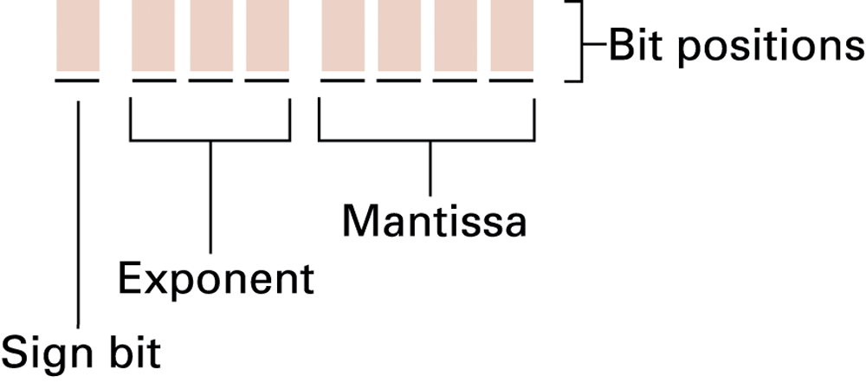
Figure 1.26 Floating-point notation components
1-<number>

Slide 89
Floating point notation
Bits considered as three fields of fixed size:
  Sign bit (MSB)
  Exponent field
  Mantissa field
Previous example using 1 byte
  1 sign bit; 3 bits for exponent; 4 bits for mantissa
Zero is encoded as string of 0s, e.g. 0000 0000
1-<number>

Slide 90
Encoding a number in floating-point notation
Example: -4 (decimal)
Convert to binary: -100.
Sign bit = 1, magnitude = 100. with Exponent 0
Copy magnitude into Mantissa field, from left to right, starting with leftmost 1, padding with 0s if necessary:
1 EEE 1000
!!But we must imagine radix point to left of leftmost 1
1-<number>

Slide 91
Encoding a number in floating-point notation (continued)
Example: -4 (decimal) = -100. (binary)
With sign bit set and magnitude copied to mantissa:
1 EEE 1000
But the implicit radix point to left of leftmost 1 would indicate the value 1/2 for this pattern
To get the correct value of 4 we would need to multiply by 8, i.e. 2³ (representing moving radix point 3 places left). This gives us the necessary exponent value 3.
Enter this in excess-4 notation:
1 111 1000
1-<number>

Slide 92
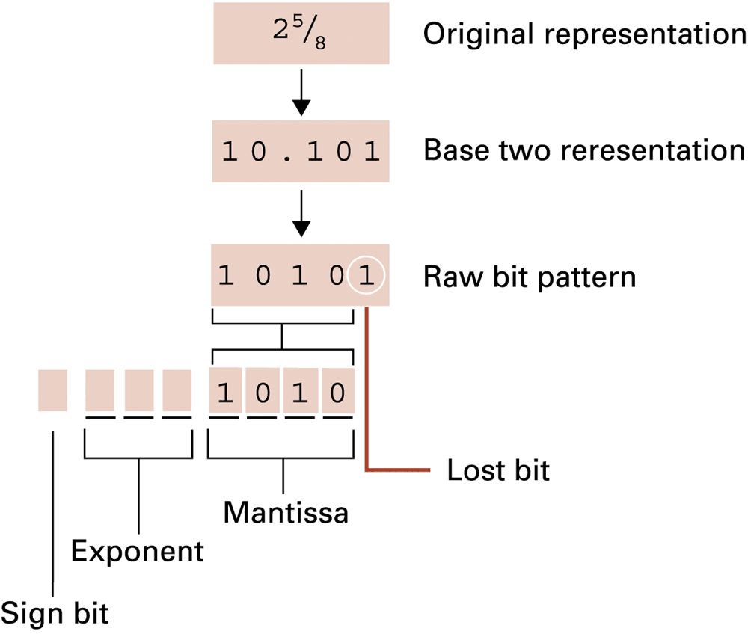
1-<number>

Slide 93
Normalised form
RULE: Leading digit in mantissa field must be 1
  Increment / decrement exponent to compensate for each shift of one position
Example: 3/8 (decimal) = 0.011
0.011 x 2⁰ = 0.11 x 2⁻¹
Store as 0 011 1100 and not 0 100 0110
exponent is -1 in excess-4 notation, not zero
1-<number>

Slide 94
Normalised form
Normalised form prevents the possibility of multiple representations for the same value
  e.g. 00111100 and 01000110 would both decode to the value 3/8, but only the first is normalised
The only exception to the normalised form rule that the mantissa starts with 1 is the special case of the value zero
  zero is represented by a bit pattern of all 0s
1-<number>

Slide 95
Decoding a number in floating-point notation (SEEEMMMM)
Example: 11101110
Sign bit = 1,
Magnitude = 0.1110 !!Note radix point inserted on left
Exponent = 110 in excess-4 notation = 2
We could decode at this point by converting 0.111 to decimal = ¹/₂ + ¹/₄ + ¹/₈ = ⁷/₈ and then multiplying by 2²
⁷/₈ X 4 = 7/2 = 3¹/₂
But remember sign bit: final answer is -3¹/₂
1-<number>

Slide 96
Decoding a number in floating-point notation (SEEEMMMM) continued
Example: 11101110
Sign bit = 1, Magnitude = 0.1110 Exponent = 2
But it is easier to apply the exponent before converting to decimal. Applying exponent of 2 simply shifts the radix point in the magnitude 2 places right, giving:
Sign bit = 1, Magnitude = 11.10 Exponent = 0
Now convert magnitude to decimal, giving 2+1+ ¹/₂ = 3¹/₂
Apply sign bit: final answer = -3¹/₂
1-<number>

Slide 97
Truncation Errors e.g Coding the value 2⁵⁄₈
1-<number>

Slide 98
Floating point encoding
The fixed mantissa field size can lead to truncation error (round-off error)
Truncation errors can be reduced by using longer mantissa fields
Common representation uses at least 32 bits for sign bit + mantissa + exponent. But errors can still happen.
1-<number>

Slide 99
Floating point encoding
1/10 does not terminate as a binary fraction
(just as 1/3 does not terminate as a decimal: 0.33333333… )
Truncation errors in numerical calculations
Truncation may occur in adding very large and very small values.
Example 2¹/₂ + 1/8 + 1/8, using 1 byte representation
(S EEE MMMM): 2¹/₂ + 1/8 is truncated, result is 2¹/₂
Repeatedly adding 1/8 has no effect !
1-<number>

Slide 100
truncation errors
Minimise the problem by adding small numbers first, then add to larger numbers
Such strategies to reduce errors can be hidden from the user.
Modern spreadsheet software should not give problems unless range of values >= 10¹⁶
1-<number>

Slide 101
Normalised form
RULE: Leading digit in mantissa field must be 1
  Increment / decrement exponent to compensate for each shift of one position
Example: 3/8 (decimal) = 0.011
0.011 x 2⁰ = 0.11 x 2⁻¹
Store as 0 011 1100 and not 0 100 0110
exponent is -1 in excess-4 notation, not zero
1-<number>

