Slide 1
Computer Block Diagram
CPU
ALU
Input
Output
Unit
Unit
Control
Register
Unit
Unit
Data and Address Busses
Memory
1-<number>

Slide 2
A computer’s CPU (Central Processing Unit) controls the manipulation of data.
The CPU consists of the arithmetic / logic unit (ALU) and the control unit.
  The control unit coordinates the computer’s activities
  The ALU performs operations on data
The CPU contains cells or registers for temporary storage of information. Registers are conceptually like main memory cells
General-purpose registers serve as temporary holding places for data being manipulated by the CPU. They hold inputs to the ALU and store results from the ALU.
Data in main memory are moved to these registers to be operated on by the CPU (Control Unit moves the data, ALU operates on them)
1-<number>

Slide 3
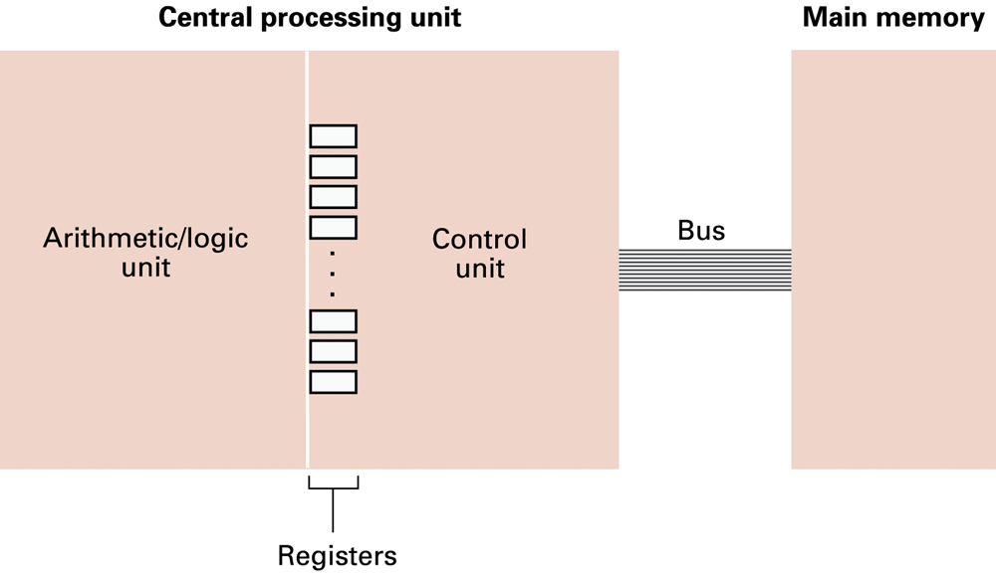
CPU and main memory connected via a bus
1-<number>

Slide 4
Arithmetic/Logic Instructions
(Brookshear section 2.4)
Logic: AND, OR, XOR
Rotate and Shift: circular shift, logical shift, arithmetic shift
Arithmetic: add, subtract, multiply, divide
  Often separate instructions for different types of data
1-<number>

Slide 5
Logic operations
The logic operations AND, OR and XOR can be extended to operations that combine two strings of bits to produce a single output string by applying the basic operation to individual columns
  eg 10011010
  AND 11001001
  10001000
1-<number>

Slide 6
Logic operations
The AND operation may be used to place 0s in part of a bit pattern without disturbing the other parts. E.g , setting the four most significant bits to value 0:
  eg 10011010
  AND 00001111
  00001010
  This process is called masking
  The 00001111 operand is the mask
1-<number>

Slide 7
Example uses of masking:
ANDing a pattern with the mask 00100000 checks if the bit 3rd from the high-order end has value 0 or 1
  Output is 00000000 if and only if that bit is 0
Reset the same bit to value 1 by the OR operation, using the mask 00100000
Reset the same bit to value 0 by the AND operation, using the mask 11011111
In both cases all other bits are not changed
1-<number>

Slide 8
Such operations are useful in manipulating a bit map - a string of bits where each bit marks the presence or absence of a particular object.
1-<number>

Slide 9
Complementing a bit string by masking:
Using a mask of all 1s and the XOR operation produces the complement of the bit string:
11111111
XOR 10101010
= 01010101
Question: What would using a mask of all 0s and the XOR operation produce?
1-<number>

Slide 10
Rotation and Shift operations
Move bits within a register
  often used to solve alignment problems
Shifts may be right-shifts or left-shifts
Shifts are classified according to what happens to the bits that “fall off” the end of the register
1-<number>

Slide 11
Example:
Left shift:
Shift bits one place left
1
1
1
1
1
1
1
1
1
1
1
1
1
1
1
1
?
What happens
to this bit?
What goes in here?
RSB may be lost, or moved to LSB position
If the bit that falls off is used to fill the hole at the other end then the result is a circular shift, also called a rotation
1-<number>

Slide 12
Discarding the bit that falls off the edge, and always filling the ‘hole’with a 0 is called a logical shift
Shifts that leave the sign bit unchanged are sometimes called arithmetic shifts
1-<number>

Slide 13
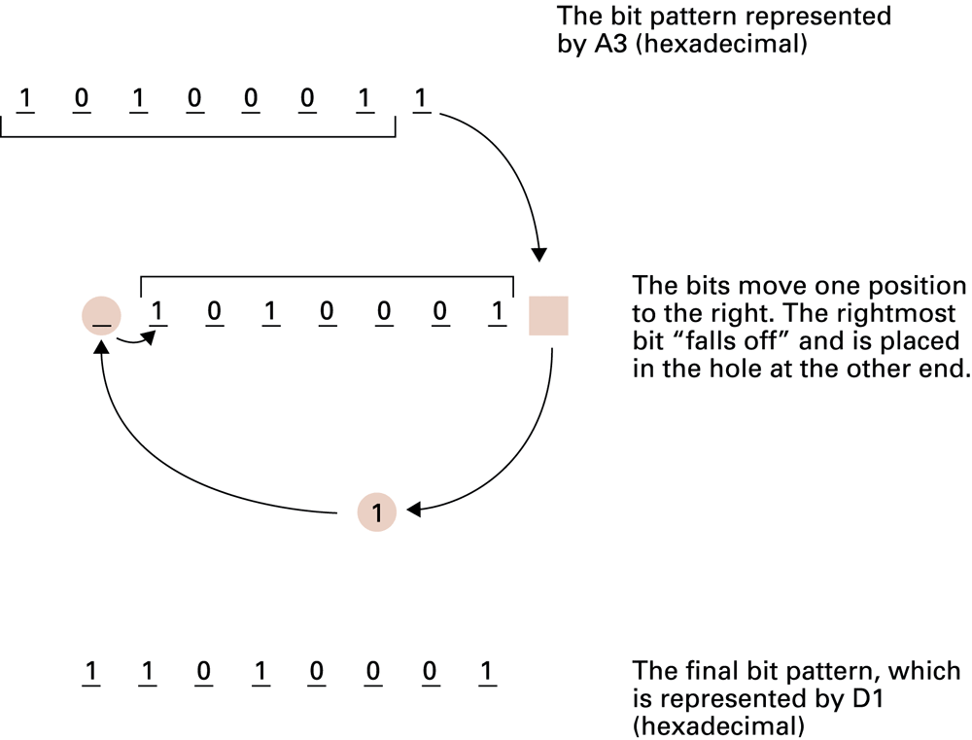
Figure 2.12 Rotating the bit pattern A3 one bit to the right
With a register 8 bits long, one right circular shift (rotation) is equivalent to seven left circular shifts
1-<number>

Slide 14
1.8 Data Compression
Reduce amount of data needed
  For data storage
  For data transfer
Compression Ratio
Describes ratio of original data size to compressed size e.g. 14:1
compress
decompress
store/transfer
1-<number>

Slide 15
Lossy vs. Lossless Compression
Lossy: decompressed data is different from the original (data is permanently lost) (JPEG, MP3, MPEG)
Lossless: decompressed data always exactly the same as the original (GIF, PNG, WAV, ZIP)
  Also called bit-preserving or reversible compression
1-<number>

Slide 16
Generic Data Compression Techniques I
Run-length encoding: Instead of storing the colour code for every pixel, the data can be compressed by storing a single colour code, followed by the number of times that the colour is repeated in a run. E.g. 888888833333 encoded as 8[7]3[5]
Relative encoding: Information consists of blocks of data, differing slightly in between (frames of a motion picture) Record the differences between consecutive data units and each unit is encoded in terms of its relationship to the previous unit.
1-<number>
Notes:
More traditional run-length encoding and relative encoding techniques are applied to obtain additional compression.
RLE: It works by finding runs of repeated binary patterns and replacing them with a single instance of the pattern and a number that specifies how many times the pattern is repeated.
RE: In these cases, techniques using relative encoding, also known as differential encoding, are helpful. These techniques record the differences between consecutive data units rather than entire units; each unit is encoded in terms of its relationship to the previous unit.

Slide 17
Generic Data Compression Techiques II
Frequency-dependent encoding: length of the bit pattern to represent a data item inversely related to the frequency of the item’s use (variable length coding)
  Huffman codes: It is most commonly used to compress text documents. It works particularly well when characters appear multiple times within the file that is going to be compressed.
1-<number>
Notes:
As an example of frequency-dependent encoding, consider the task of encoded English language text. In the English language, the letters e, t, a, and i are used more frequently than the letters z, q, and x. So, when constructing a code for text in the English, space can be saved by using short bit patterns to represent the former letters and longer bit patterns to represent the latter ones. The result would be a code in which English text would have shorter representations than would be obtained with uniform-length codes.

Slide 18
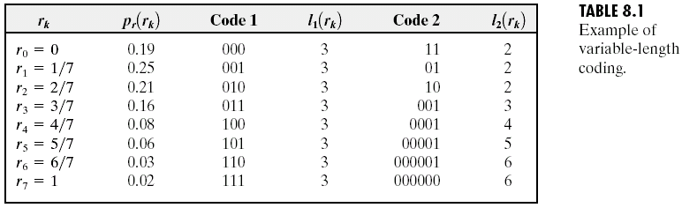
variable length coding
fixed length coding
1-<number>
Notes:
Variable length encoding scheme uses different number of bytes or octets (set of 8 bits) to represent different characters whereas fixed length encoding scheme uses a fixed number of bytes to represent different characters.

Slide 19
Adaptive Dictionary Encoding
Or “Dynamic Dictionary Encoding” e.g. Lempel-Ziv encoding systems (LZW)
“Dictionary” = set of blocks/units from which the message/file to compress is constructed
Message is encoded as a sequence of references to the dictionary. Instead of storing the whole text as a set of character codes (letter by letter), the compression algorithm would allocate a code for each different word and store the code instead of the word.
Dictionary is allowed to change during encoding.
1-<number>

Slide 20
LZW encoding: simplified example
Encoding
  Message is xyx xyx xyx xyx
  Dictionary initially has 3 entries: “x” “y” “ ”
  First encode xyx as 121 – i.e. As 1st, 2nd and 1st dictionary entries.
  Then the space, giving 1213
  Space means that preceding string xyx is recognised as a word. Add it to dictionary as 4th entry
  Encoding proceeds, using new entry. Entire message is encode as 121343434
1-<number>

Slide 21
LZW encoding: simplified example
Decoding
  Encoded message is 121343434
  Coding Dictionary initially has 3 entries: “x” “y” “ ”
  First decode 1213 as xyx with following space
  Space means that preceding string xyx is recognised as a word. Add it to dictionary as 4th entry
  Decoding proceeds, using new dictionary entry.
  12134 produces xyx xyx
  Entire message is decoded as xyx xyx xyx xyx which is the original message
1-<number>

Slide 22
Compressing Images
GIF (graphic interchange format)
  lossy compression
  limits number of colours available to 256
    this can lead to data loss, depending on the image
  uses dictionary encoding
    256 encodings stored in dictionary (the ‘palette’)
    pixel can be represented by 1 byte (referring to 1 dictionary entry)
    the colour represented is defined by 3 bytes (for Red, Green & Blue components, RGB)
    can be made adaptive, using LZW techniques
    unsuitable for high precision photography
1-<number>
Notes:
It approaches the compression problem by reducing the number of colors that can be assigned to a pixel to only 256. The red-green-blue combination for each of these colors is encoded using three bytes, and these 256 encodings are stored in a table (a dictionary) called the palette. Each pixel in an image can then be represented by a single byte whose value indicates which of the 256 palette entries represents the pixel’s color.

Slide 23
Compressing Images
JPEG (Joint Photographic Experts Group)
  encompasses several different modes
    has lossless mode but does not produce high levels of compression,
  lossy modes are widely used
    often default compression method in digital cameras
  JPEG’s baseline standard (lossy sequential mode) has become the standard of choice in many applications
    uses a series of lossy and lossless techniques to achieve significant compression without noticeable loss of image quality
1-<number>

Slide 24
Compressing Images
JPEG baseline standard (“lossy sequential mode”) uses a series of compression techniques
  exploits perceptual limits and simplifies colour data, preserving luminance
    blurs the boundaries between different colours while maintaining all brightness information
  divides image into 8x8 pixel blocks
  applies DCT-based compression (difference of blocks)
  additional compression achieved using run-length encoding, relative encoding and variable length encoding
1-<number>
Notes:
In particular, the human eye is more sensitive to changes in brightness than to changes in color.
The important point is that this transformation converts the original eight-by-eight block into another block whose
entries reflect how the pixels in the original block relate to each other rather than the actual pixel values.

Slide 25
1.9 Communication Errors
Data bits may get corrupted in transfer or retreival from storage
  Dirt/damage on disc surface
  Circuit malfunctions
  Static electricity on transmission path
  may cause data to be incorrectly recorded or read.
Encoding techniques have been developed to detect errors, and even to correct them
1-<number>
Notes:
To resolve such problems, a variety of encoding techniques have been developed to allow the detection and even the correction of errors. Today, because these techniques are largely built into the internal components of a computer system, they are not apparent to the personnel using the machine.

Slide 26
Parity Bits
Parity : oddness or evenness
If each bit pattern is adjusted to have an odd (or even) number of 1s then a pattern with and even (odd) number must contain an error
Example: odd parity
  Add an extra bit – the Parity bit – to each pattern
  If pattern has odd number of 1s, parity bit = 0
  If pattern has even number of 1s, parity bit = 1
1-<number>

Slide 27
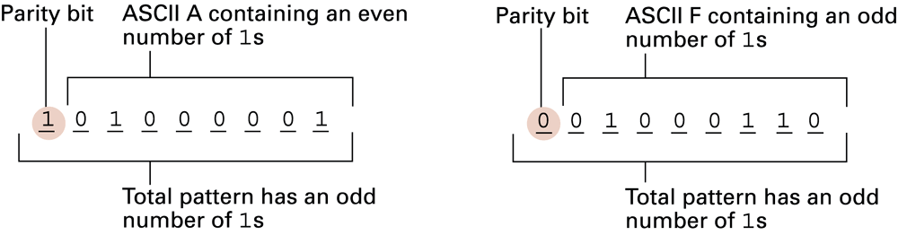
Figure 1.28 The ASCII codes for the letters A and F adjusted for odd parity
1-<number>

Slide 28
Parity checking
An even number of errors in the pattern will leave parity unchanged
Reduce this problem by copying many scattered parity bits into a checkbyte
  Component parity bits give multiple coverage of some areas
Variations of this checkbyte concept lead to error detection schemes known as checksums and cyclic redundancy checks (CRC).
1-<number>

Slide 29
Error-Correcting Codes
Error-Correcting Codes are the codes that allow the reciver of a message to detect errors in the message and to correct them.
The Hamming Distance between two patterns of bits is the number of bits in which the patterns differ
  e.g. distance between 010101 & 011100 is 2
  or, distance between 11100111 & 11011011 is 4
  [ XOR the bits then sum bits in the result ]
1-<number>

Slide 30
Error-correcting codes
How Hamming distance is used to produce an error-correcting code
By designing a code in which each pattern has a Hamming distance of n from any other pattern, patterns with fewer than n/2 errors can be corrected by replacing them with the code pattern that is closest
1-<number>

Slide 31
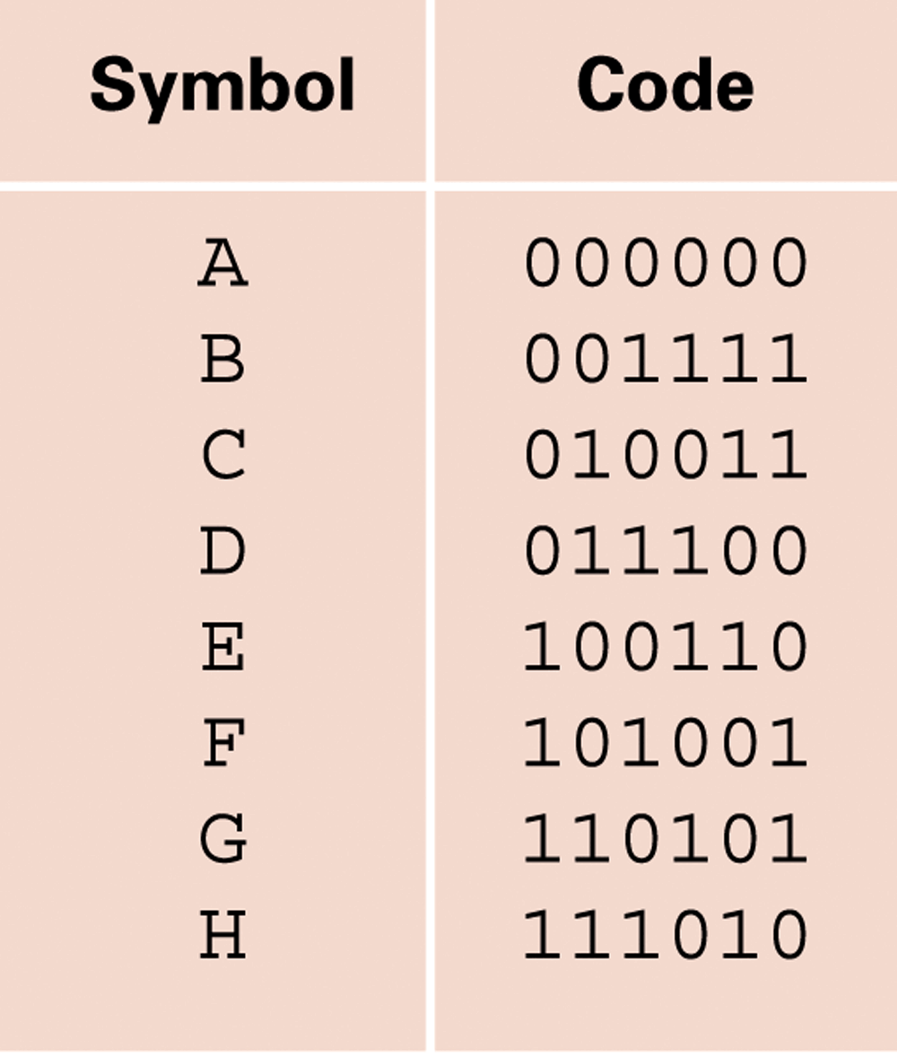
Figure 1.29 An error-correcting code
If one bit is changed in a code it will not be in the list (i.e. will not be a legal code) and so the error is recognised
1-<number>

Slide 32
Hamming distances for given code
A B C D E F G H
000000 A 4 3 3 3 3 4 4
001111 B 3 3 3 3 4 4
010011 C 4 4 4 3 3
011100 D 4 4 3 3
100110 E 4 3 3
101001 F 3 3
110101 G 4
111010 H
Hamming distance between any two legal patterns is at least 3.
1-<number>

Slide 33
When the Hamming distance between any two patterns in the code is 3 then:
  Changing 1 bit in a pattern will mean it is still closer to its original pattern than any other (distance = 1)
  And its distance from any other pattern in the code will be at least 2
  Hence we can reasonably deduce which is the original pattern
1-<number>

Slide 34
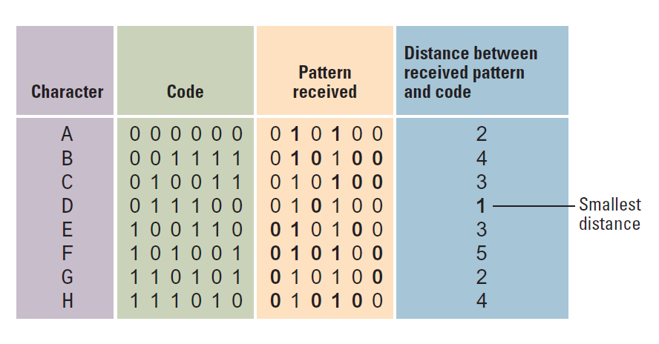
Decoding the received pattern 010100
1-<number>
Notes:
Thus, we would conclude that the character transmitted must have been a D because this is the closest match.

Slide 35
Error-correcting codes
Used in (high capacity) magnetic disk drives
  Reduce possible flaws corrupting data
Used in CDs for data storage
  CD-DA format (for audio) reduced data errors to one error two discs (1/2)
  CD for data storage have errors at 1/20000
1-<number>

