Slide 1
Chapter 3 Operating Systems (OS)
3.1 The Evolution of Operating Systems
3.2 Operating System Architecture
3.3 Coordinating the Machine’s Activities
3.4 Handling Competition Among Processes
3.5 Security
3-<number>

Slide 2
Some basic functions of an operation system
Control operation of computer
Store and retrieve files
Schedule programs for execution
Execute programs
Example operating systems
Windows, UNIX, LINUX, MacOS, Multics, VMS, MS-DOS, Mobile OS (IOS, Android)
3-<number>

Slide 3
Operating System
A program that acts as an intermediary between a user of a computer and the computer hardware.
Operating system goals:
  Execute user programs and make solving user problems easier.
  Make the computer system convenient to use.
  Use the computer hardware in an efficient manner.
The OS depends on and complements the hardware
3-<number>
Notes:
provides the interface by which a user can request the execution of programs, and the environment necessary to execute the programs requested.

Slide 4
Some Operating Systems functions
Interface manager
  Human interaction made easy
  Interfacing, abstraction, control and sharing
    Graphical User Interface
      GUI: recognize and point/click
    Command Line Interface
      CLI: remember and type (Mac Terminal, Command Prompt)
Resource manager
  Efficient use of resources: Memory management and processor scheduling
System and data security and protection provider
3-<number>

Slide 5
3.1 History of Operating Systems
Evolution of shared computing
Batch processing
  Job queue
Time-sharing
  Interactive processing
  Real-time processing
  Multi-tasking: multiple tasks for a single user
Scheduling multiprocessor machines
3-<number>

Slide 6
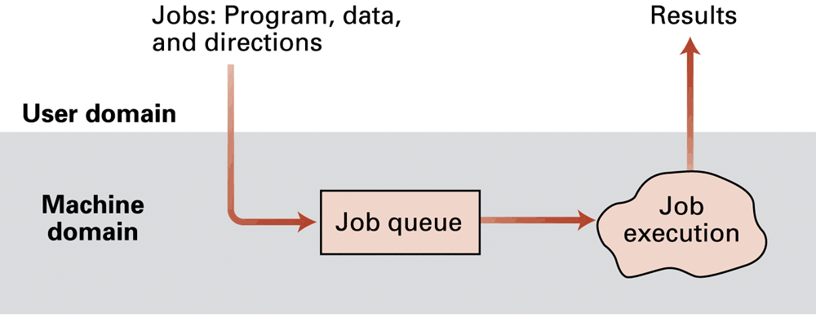
Figure 3.1 Batch processing
programmer
FIFO
operator
Execute jobs with no interaction with the user
OS to simplify program setup. Instructions to operator encoded using Job Control Language (JCL), stored with job in job queue e.g. network not available, printer not responding
3-<number>
Notes:
In reality, most job queues do not rigorously follow the FIFO structure, since most operating systems provide for consideration of job priorities. As a result, a job waiting in the job queue can be bumped by a higher-priority job.
In early batch processing systems, each job was accompanied by a set of instructions explaining the steps required to prepare the machine for that
particular job., known as JCL, and stored with the job in the job queue. When the job was selected for execution, the operating system printed these instructions at a printer where they could be read and followed by the computer operator. Still seen examples.

Slide 7
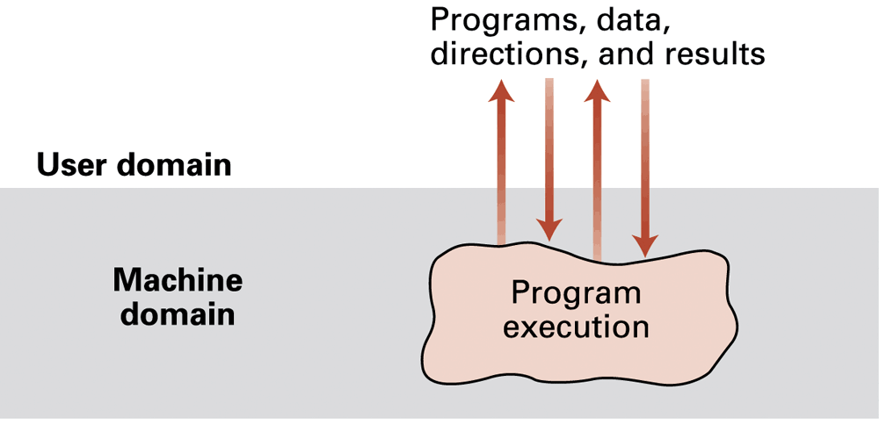
Figure 3.2 Interactive processing
Interaction with executing program through remote terminal
3-<number>
Notes:
To accommodate these needs, new operating systems were developed that
allowed a program being executed to carry on a dialogue with the user through remote terminals—a feature known as interactive processing
A remote terminal consisted of little more than an electronic typewriter by which the
user could type input and read the computer’s response that was printed on
paper.

Slide 8
real-time processing
Computer performs the processing tasks quickly enough to be able to keep up with activities in its external (real-world) environment
3-<number>
Notes:
real-time processing, in which the actions performed are said to occur in real time that also means the computer performs the task in accordance with deadlines in
its (external real-world) environment.

Slide 9
Uniprogramming: One CPU, one program, Program runs until completion
Multiprogramming /multitasking: One CPU, many programs. Programs run without interruption until an I/O request or termination (Non-preemptive scheduling).
Supporting interactive processing for several users of the computer working at the same time, perhaps in ‘real-time’ applications, required a change to operating systems.
One solution: Design the OS so that it rotates various jobs in and out of execution.
Time-sharing: One CPU, many programs. Each program can run a short amount of time before being interrupted by the system (Preemptive scheduling)
3-<number>
Notes:
it was common for several users, working at remote terminals, to seek
interactive service from a machine at the same time, and real-time considerations
presented obstacles. If the operating system insisted on executing only
one job at a time, only one user would receive satisfactory real-time service.
The solution to this problem was to design operating systems that provided
service to multiple users at the same time: a feature called time-sharing.
One means of implementing time-sharing is to apply the technique called
multiprogramming, in which time is divided into intervals and then the execution
of each job is restricted to only one interval at a time

Slide 10
When computer usage evolved from batch mode (serial processing) to interactive mode, multiprogramming (non-preemptive) was no longer a suitable approach.
Each user wanted to see his/her program running as if it was the only program in the computer (parallel processing).
3-<number>

Slide 11
Time-sharing
- creates the illusion of several jobs being executed simultaneously
- originally used for multiple users, each running one job (to avoid, e.g., one user’s job hogging the CPU)
- now used to allow one user to execute multiple processes at the same time: multitasking
multitasking is time-sharing for one user’s processes on a single-processor machine
3-<number>

Slide 12

multitasking
If memory can hold several programs, then CPU can switch to another one whenever a program is awaiting for an I/O to complete
This is multitasking (multiprogramming)
3-<number>

Slide 13
3.2 OS Architecture
Types of software
Application software
  perform specific tasks for users
  Spreadsheets, games, etc.
System software
  perform tasks common to computer systems in general
  Operating system
  Utility software
    extend the capabilities of the OS
      format disks, copy from disk to CD, compress/decompress data, handling network communications, etc
3-<number>

Slide 14
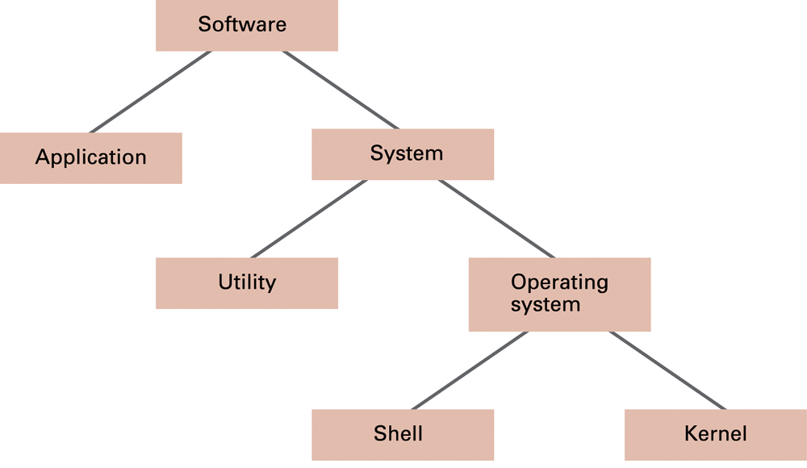
Figure 3.3 A machine’s software classification
3-<number>
Notes:
include spreadsheets, database systems, desktop publishing systems, accounting
systems, program development software, and games

Slide 15
Utility software: The majority of an installation’s utility software consists of programs for performing activities that are fundamental to computer installations but not included in the operating system. In a sense, utility software consists of software units that extend the capabilities of the operating system. the ability to format a disk or to copy a file from a magnetic disk to a flash drive is often not implemented within OS.
3-<number>

Slide 16
Components of an OS
Shell: portion that communicates with users
  Graphical user interface (GUI)
    Window manager
Kernel: contains components performing basic required functions
  File manager
  Device drivers
  Memory manager
  Scheduler and dispatcher
3-<number>

Slide 17
The shell and the kernel are two important components that work together to enable the user to interact with the system.
Shell : A shell is an environment or a special user program which provide an interface to user to use operating system services. It executes programs based on the input provided by the user.
Kernel : Kernel is the heart and core of an Operating System that manages operations of computer and hardware. It acts as a bridge between the user and the resources of the system by accessing various computer resources like the CPU, I/O devices and other resources.
3-<number>
Notes:
Shell: A command-line interface that allows the user to enter commands to interact with the operating system. It acts as an intermediary between the user and the kernel, interpreting commands entered by the user and translating them into instructions that the kernel can execute.
Kernel: the core component of the operating system that manages system resources and provides services to other programs running on the system. It is responsible for tasks such as memory management, process scheduling, and device drivers. The kernel interacts directly with the hardware of the computer.

Slide 18
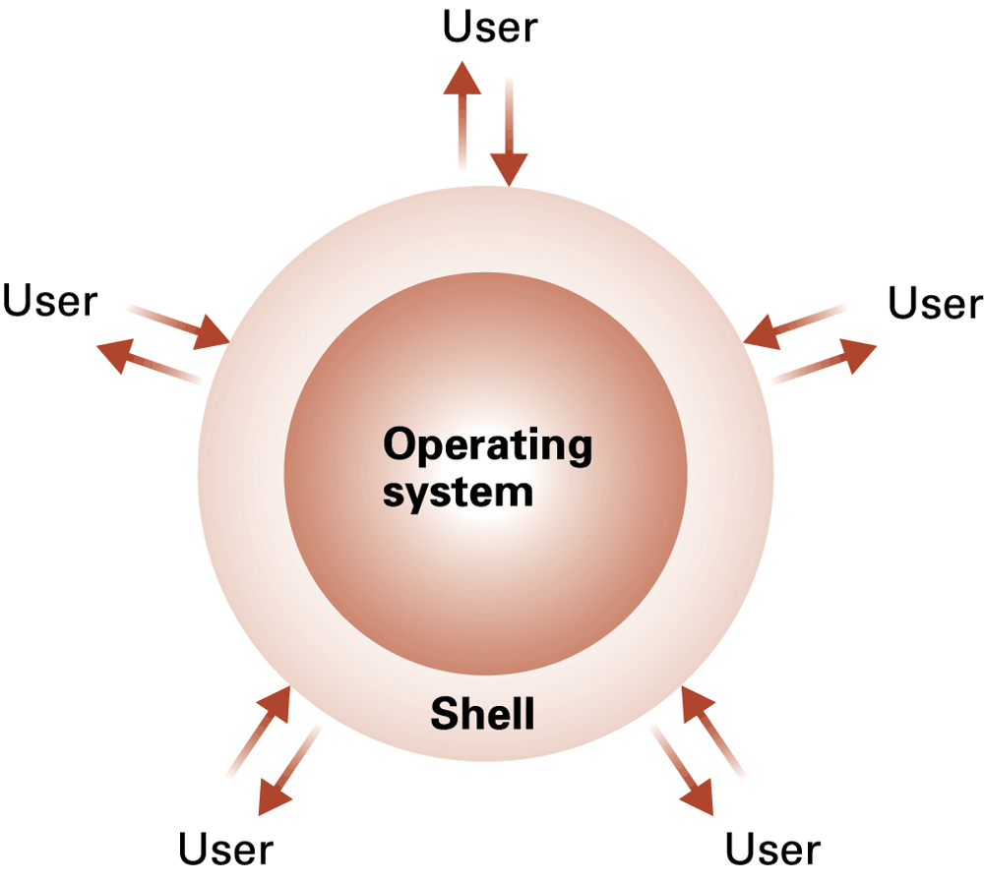
Figure 3.4 The shell as an interface between users and the operating system
3-<number>
Notes:
When an application wants to display something on the screen, it notifies the window manager,
and the window manager places the desired image in the window assigned
to the application. In turn, when a mouse button is clicked, it is the window
manager that computes the mouse’s location on the screen and notifies the
appropriate application of the mouse action. Window managers are responsible
for what is generally called the “style” of a GUI, and most managers
offer a range of configurable choices.

Slide 19
File Manager
Coordinates the use of the mass storage facilities: maintain records (on the storage media) of
  all files stored, including their location
  which users are allowed access to which files
  where free storage space is available
Directory or folder: user-created group or bundle of files
Path: position of a file in directory hierarchy
File descriptor: information (in main memory) needed to access a file
3-<number>
Notes:
An operating system’s kernel contains software components that perform the very basic functions required
by the computer installation. One such unit is the file manager, whose job is
to coordinate the use of the machine’s mass storage facilities. More precisely,
the file manager maintains records of all the files stored in mass storage,
including where each file is located, which users are allowed to access the
various files, and which portions of mass storage are available for new files or
extensions to existing files.

Slide 20
Device Drivers
Software units that communicate with the controllers (or sometimes directly with peripheral devices.)
Controller: intermediary device that handles communication between the computer and a device.
Drivers
  are uniquely designed for particular types of devices.
  translates generic requests into more technical steps
Thus, other software do not deal with details.
3-<number>
Notes:
device drivers, which are the software units that communicate with the controllers to carry out operations on the peripheral
devices attached to the machine (mouse, keyboard, printer). Each device driver is uniquely designed
for its particular type of device (such as a printer, disk drive, or monitor)
and translates generic requests into the more technical steps required by the
device assigned to that driver.

Slide 21
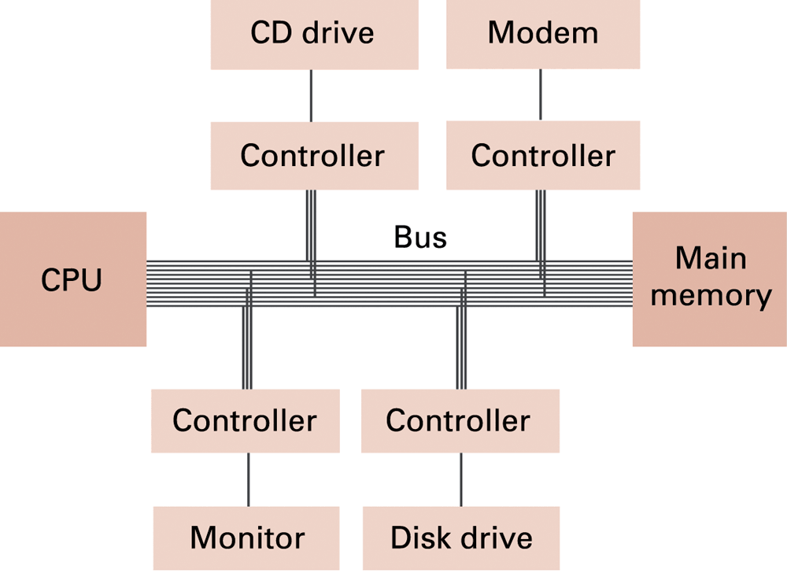
Controllers attached to a machine’s bus
3-<number>

Slide 22
Memory manager
Coordinates the use of main memory
In multi-tasking / multi-user environments many programs and blocks of data must reside in main memory concurrently. Hence memory manager must:
  find and assign memory space for these needs
  ensure the actions of each program are restricted to its allotted space
  keep track of memory areas no longer occupied
3-<number>

Slide 23
Memory manager
When total memory required is greater than available memory, memory manager moves programs to and from between main memory and mass storage (paging)
The fictional memory space created by paging is called virtual memory.
2 other components of kernel (scheduler and dispacther).
  Studied in the next section ...
3-<number>
Notes:
Örneğin, 8GB'lık bir ana bellek gerekiyorsa ancak bilgisayar yalnızca 4GB'a sahipse, bellek yöneticisi daha büyük bir bellek alanı illüzyonu yaratmak için manyetik bir diske 4GB'lık bir depolama alanı ayırabilir. Burada, ana bellekte 8GB'lık gerçek bir kapasitesi olsaydı ana bellekte depolanacak bit desenlerini kaydeder. Sonra bellek yöneticisi, bu sayfaları ana bellek ile kitlesel depolama arasında ileri geri hareket ettirir, böylece herhangi bir zamanda ihtiyaç duyulan sayfalar aslında 4GB'lık ana bellekte mevcut olur. Sonuç olarak, bilgisayar aslında 8GB ana belleğe sahipmiş gibi çalışabilir. Sayfalama ile oluşturulan bu büyük "hayali" bellek alanına sanal bellek denir.

Slide 24
Getting it Started
Do we know how the operating system gets started?
Boot strapping (a.k.a. booting):
  Main memory is empty when computer is first turned on. OS is permanent on mass storage.
  This procedure brings OS into main memory.
  A small ROM memory contains the program called bootstrap. CPU runs bootstrap when turned on.
  Transfers operating system from mass storage to main memory
  directs the CPU to execute a jump instruction to that memory area
3-<number>
Notes:
Onyükleme yükleyicisi (boot loader) adı verilen bir program, makinenin ROM'unda kalıcı olarak depolanır. Bu, makine açıldığında başlangıçta yürütülen programdır. Önyükleme yükleyicisindeki talimatlar, CPU'yu işletim sistemini belirlenen bir konumdan ana belleğin uçucu alanına aktarmak için yönlendirir (Şekil 3.5).
Örneğin, akıllı telefonlar gibi gömülü sistemlerde, işletim sistemi özel flash (uçucu olmayan) bellekten kopyalanır; büyük şirketlerde veya üniversitelerdeki küçük iş istasyonları gibi durumlarda, işletim sistemi ağ üzerinden uzak bir makineden kopyalanabilir. İşletim sistemi ana belleğe yerleştirildikten sonra, önyükleme yükleyicisi CPU'yu bu bellek alanına bir atlamalı komut yürütmeye yönlendirir. Bu noktada, işletim sistemi makinenin faaliyetlerini kontrol etmeye başlar. Önyükleme yükleyicisinin yürütülmesi ve böylece işletim sisteminin başlatılması işlemine bilgisayarın başlatılması (booting) denir.

Slide 25
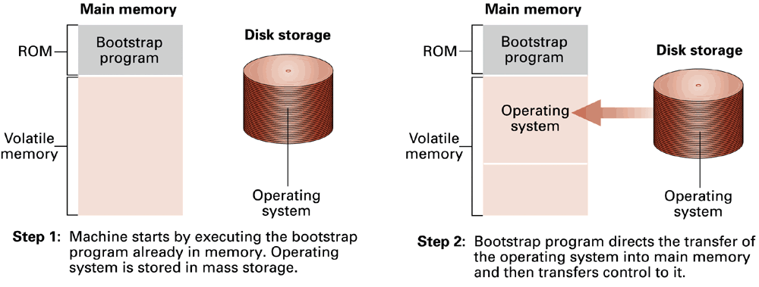
Figure 3.5 The booting process
3-<number>

Slide 26
3.3 Coordinating Machine’s Activities
The words Program and Process are sometimes used instead of each other, BUT there is actually a distinction between the two.
  Program: a static set of directions, whereas
  Process: the dynamic activity of executing a program (whose properties change with time).
Process state: current status of the activity (or, snapshot of machine at a particular time)
  Position in the program being executed (Program Counter), values in processor registers, etc.
3-<number>
Notes:
The activity of executing a program under the control of the operating system is known as a process.

Slide 27
Process Administration
Scheduler
  Maintains a record of all processes, introduces new ones, and removes those that are complete.
  Keeps the process table in main memory. An entry in the process table has information about a particular process, such as:
    Memory area assigned to it,
    Priority of the process,
    Whether it is Ready or Waiting, etc.
3-<number>
Notes:
To keep track of all the processes, the scheduler maintains a block of information
in main memory called the process table. Each time the execution of
a program is requested, the scheduler creates a new entry for that process in
the process table.

Slide 28
Process Administration (continued)
Dispatcher
  Ensures scheduled processes are actually executed.
  Gives one time slice or quantum to a process that is ready
  Executes a process switch (or context switch) when the running process’s time slice is over
    Interrupt indicates that time slice is over
    Interrupt handler: part of dispatcher
3-<number>
Notes:
İşletim sistemi tasarımında kullanılan görevlendirici, işlemci zamanlama algoritmasına (CPU scheduling algorithm) göre beklemekte olan işlemlerden sıradakini alıp işlemciye yollayan programın ismidir. Buna göre bilgisayarda anlık olarak tek işlem çalışabilir ve bu işlem o anda çalışmakta olan diğer işlemler arasından seçilmiş bir işlemdir. Örneğin bilgisayarda 10 tane program açık olabilir ama CPU’da anlık olarak bir tanesi çalışır. Çalışan programların tamamı bekleme sırasında (ready queue) beklerler. Bir işlemci zamanlama algoritmasına göre bu işlemler sırayla CPU’ya gönderilerek çalıştırılırlar.

Slide 29
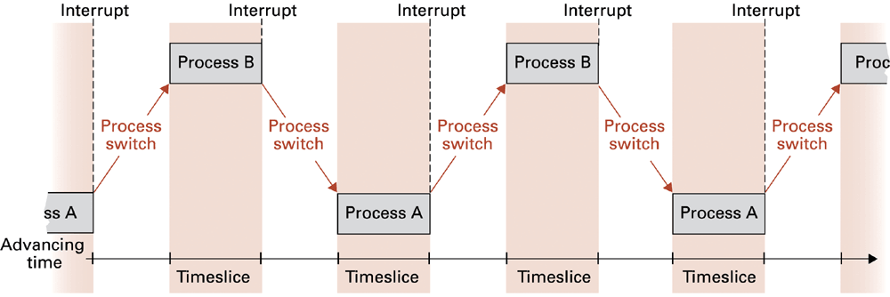
Figure 3.6 Time-sharing between process A and process B
A timeslice typically is no more than 0.05 seconds
When context switches occur frequently enough the illusion of parallelism is achieved.
3-<number>

Slide 30
Deadlock
Two (or more) processes block each other from continuing
  each process is waiting for a resource allocated to another
Conditions that lead to deadlock [all 3 needed]
  1. There is competition for non-sharable resources
  2. The resources are requested on a partial basis: i.e. having received some resources, a process will return later to request more
  3. Once a resource has been allocated it cannot be forcibly retrieved
3-<number>
Notes:
iki ya da daha fazla eylemin devam etmek için birbirlerinin bitmesini beklemesi ve sonuçta ikisinin de devam edememesi durumu. Bir işlem bir kaynak için talepte bulunur. Eğer bu kaynak müsait değilse, işlem bekleme durumuna geçer.  İstenilen kaynak başka işlemler tarafından kullanıldığından, işlem bekleme durumundan hiç çıkamayabilir
Çoğunlukla, deadlock'u önlemek ya da engellemek mümkün değildir. Bunun yerine,, deadlock tespiti ve işlemlerin yeniden başlatılması uygulanır. Bunun için, kaynak dağıtımını ve işlem durumlarını takip eden ve deadlock'u kaldırmak için işlemleri geri alan ya da yeniden başlatan algoritmalar kullanılır. Gerçekleşen bir deadlock'un tespiti, işlemler tarafından kilitlenmiş ya da talep edilen kaynaklar işletim sistemi tarafından bilindiği için nispeten kolaydır.

Slide 31
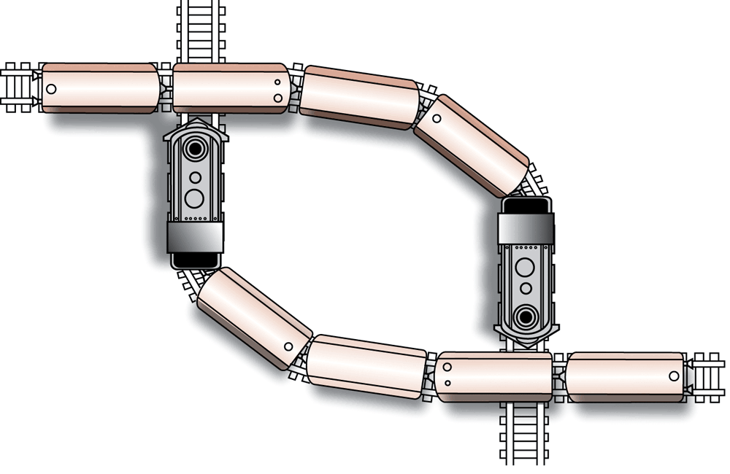
Figure 3.7 A deadlock resulting from competition for non-shareable railroad intersections
3-<number>

Slide 32
Deadlock problem can be removed by removing any one of these three conditions.
Techniques attacking 3rd condition fall into deadlock detection and correction category.
Techniques attacking first 2 conditions are known as deadlock avoidance schemes.
  Convert a non-shareable resource into a shareable one, or makes it appear shareable (e.g. Spooling)
  Each process can request all its resources at once
3-<number>

Slide 33
3.5 Security
Computer system security requires a well-designed, dependable operating system
Administrator or super user has privileged access to the operating system
  can monitor activity to detect destructive behaviour, malicious or accidental
  auditing software = software utilities to help
    identify attempts to login with incorrect password
    identify accounts where computer use has changed suspiciously
3-<number>

Slide 34
Security from attacks from within
Operating system prevents illegal access to resources
  Different memory for different processes
  Privileged instructions only allowed in kernel
    e.g. change content of memory limit registers
    change privilege mode of the CPU
3-<number>

