Slide 1
Networking and the Internet
4.1 Network Fundamentals
4.2 The Internet
4.3 The World Wide Web
4.4 Internet Protocols
4.5 Security
4-<number>

Slide 2
Network
A network is a set of computers which are linked together.
  The link can be with/without wire.
More precisely
A network is a group of nodes connected in a way that allows information to be exchanged between them.
A node is any device connected to the network, such as a Computer, Printer, Tape Backup
4-<number>
Notes:
The need to share information and resources among different computers led
naturally to linked computer systems, called networks, in which computers are
connected so that data can be transferred from machine to machine.

Slide 3
Network Applications
  File Storage/Sharing/Backup
  Printing
  E-mail (internal & Internet)
  World Wide Web access (HTTP)
  File transfer (FTP)
  Network Video (NVP)
  Chat (MSN, IRC)
  Intranet
4-<number>

Slide 4
Network classifications
On the basis of ownership of software:
Open network: communication software is freely available / public domain (e.g. the Internet).
Closed or proprietary network: communication software is licensed or owned
4-<number>

Slide 5
Network classifications
Local area network (LAN)
  normally consists of a collection of computers in the same general location, e.g. a single building or building complex such as a factory, hospital or university
  types include Ethernet and Token Ring
Wide area network (WAN)
  links computers (or LANs) over greater distances: in neighbouring cities or on opposite sides of the world.
  Biggest WAN is the Internet
4-<number>

Slide 6
Network topology
It is the pattern in which the machines are connected.
Ring
Bus
Star
Irregular
4-<number>

Slide 7
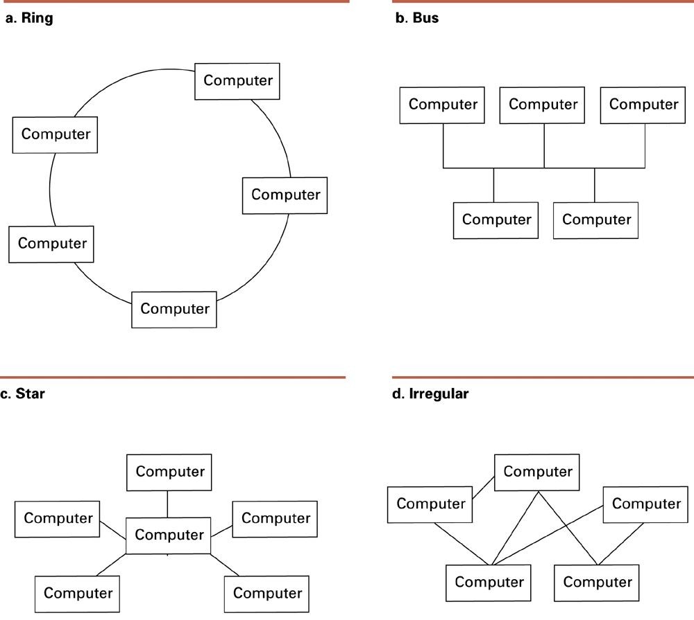
Figure 4.1 Network topologies
4-<number>

Slide 8
Ring topology
  machines are connected in one closed loop
Bus topology
  machines are all connected to a common communication line called a bus
Star topology
  one machine serves as a central focal point to which all the others are connected
4-<number>

Slide 9
Figure 4.1 Network topologies (cont’d)
4-<number>

Slide 10
A bus network may be constructed by linking computers to a central hub, which acts like a short bus: the hub relays any signal it receives out to all machines connected to it.
Thus the network looks like a star network, but operates like a bus network.
The difference is that in the star network the central device is a computer, that receives and process messages from other machines. In the bus network the hub provides a common communication path for the machines.
4-<number>
Notes:
Aradaki fark, yıldız ağında merkezi cihazın, diğer makinelerden mesajları alan ve işleyen bir bilgisayar olmasıdır. Veri yolu ağında (bus network) hub, makineler için ortak bir iletişim yolu sağlar

Slide 11
Protocols
Protocols are rules governing interprocess communication.
Network protocols establish rules for the conduct of network activities,
  e.g. transmission of messages between networked machines
  without rules all machines could transmit at the same time or fail to relay messages when needed
4-<number>
Notes:
For a network to function reliably, it is important to establish rules by which
activities are conducted. Such rules are called protocols.

Slide 12
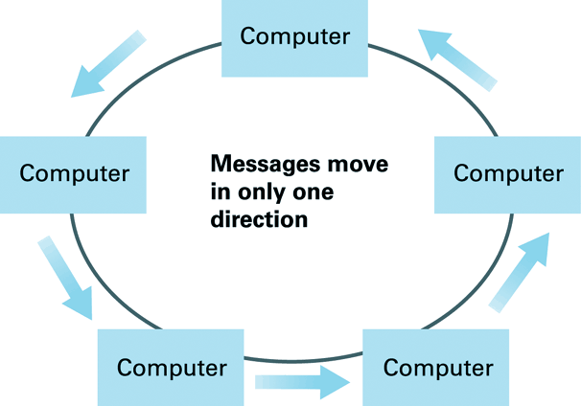
Figure 4.2: Communication over a ring network
4-<number>

Slide 13
Communication over a ring network
The token ring protocol was one approach to solving the problems of governing communication over a ring network:
All machines transmit messages in only one common direction: all messages move round the ring in the same direction by being forwarded from computer to computer
When a message reaches its destination, the destination machine keeps a copy of it and forwards a copy on. When the copy reaches the originating machine, that machine knows the message has been delivered and removes the message from the ring.
But if machines constantly transmit their own messages without forwarding other machines’messages this scheme will not work. The solution to this involves a unique bit pattern called a token
4-<number>

Slide 14
The token ring protocol
The token is passed around the ring.
A machine may transmit its own message only if it holds the token; a machine without the token can only forward messages.
If a machine receiving the token has messages of its own to transmit, then it transmits one message while holding the token. When this message has gone around the ring back to the machine, then the machine forwards the token to the next machine
In this way each machine in the ring has equal opportunity to send its messages as the token is passed on.
4-<number>
Notes:
Bir makine kendi mesajını ancak belirteci elinde bulunduruyorsa iletebilir; belirteci olmayan bir makine yalnızca mesajları iletebilir.Tokenı alan makinenin iletecek kendine ait mesajları varsa, tokenı tutarken bir mesaj iletir. Bu mesaj makineye geri gönderildiğinde, makine token bir sonraki makineye iletir.Bu şekilde halkadaki her makine, token aktarılırken mesajlarını göndermek için eşit fırsata sahip olur.

Slide 15
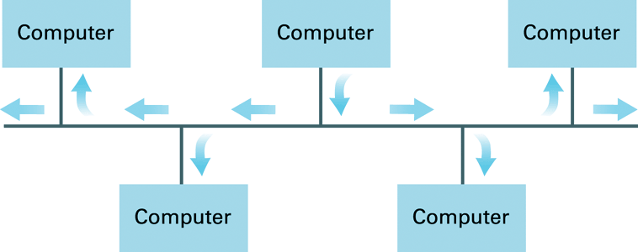
Figure 4.3: Communication over a bus network
Another protocol for coordinating message transmission is used in bus topology networks that is based on the Ethernet protocol collection : the CSMA/CD protocol.
4-<number>

Slide 16
The Carrier Sense, Multiple Access with Collision Detection (CSMA/CD) protocol controls the right to transmit messages in an Ethernet system:
Each message must be broadcast to all machines on the bus
Each machine monitors all messages, but keeps only those addressed to itself
A machine waits until the bus is silent before sending a message, then begins to broadcast it while still monitoring the bus
If another machine also starts transmitting both machines detect the clash, they pause for a short, random time period, then try to transmit again
4-<number>
Notes:
Carrier Sense, Çarpışma Algılamalı Çoklu Erişim (CSMA/CD) protokolü, bir Ethernet sisteminde mesaj iletme hakkını kontrol eder:
Her mesaj veriyolundaki tüm makinelere yayınlanmalıdır.
Her makine tüm mesajları izler ancak yalnızca kendisine gönderilenleri tutar
Bir makine mesaj göndermeden önce veri yolunun sessiz olmasını bekler, ardından veri yolunu izlerken mesajı yayınlamaya başlar.
Başka bir makine de iletime başlarsa, her iki makine de çakışmayı algılar, kısa, rastgele bir süre duraklar ve ardından tekrar iletim yapmayı dener.

Slide 17
Ethernet
A set of standards for implementing a LAN with a bus topology
Several versions now exist, reflecting technological advances and higher transfer rates, but with common features, including:
  the format for packaging data for transmission
  the use of CSMA/CD for controlling the right to transmit
4-<number>

Slide 18
Connecting networks
May need to connect existing networks to form an extended communication system.
Different methods/devices are needed according to the types of networks being connected
  repeater
  bridge
  switch
  router
4-<number>

Slide 19
Connecting networks
Segment: Any portion of a network separated, by a repeater, switch/hub, bridge or router, from other parts of the network
Repeater: a device that connects two buses into one longer bus.
4-<number>

Slide 20
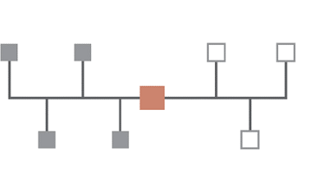
Connecting networks
A Repeater or Bridge connecting two buses
A Bridge only passes a message across the connection if the destination address lies on the other side of the connection.
So two machines on the same side of the bridge communicate without interfering with messages on the other side of the bridge
4-<number>

Slide 21
A switch connecting multiple buses
4-<number>

Slide 22
Connecting networks
A switch is essentially a bridge with multiple connections, connecting 2 or more buses.
Messages are relayed through the switch as appropriate to the destination address (as with a bridge) and this minimises the message traffic in each segment.
Repeaters, bridges and switches connect networks having compatible characteristics but sometimes we need to connect incompatible networks
4-<number>

Slide 23
Connecting incompatible networks
The different networks must be connected in a manner that builds a network of networks, known as an internet
In an internet the original networks continue to function as independent networks.
The connection between 2 networks is handled by a router
4-<number>

Slide 24
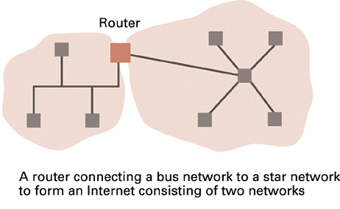
connecting two incompatible networks
4-<number>

Slide 25
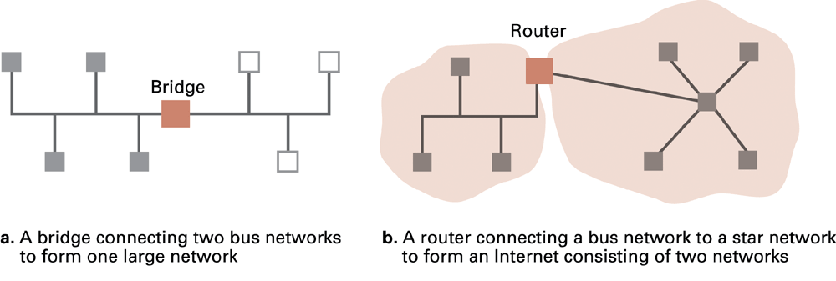
The distinction between a bridge and a router
4-<number>

Slide 26
Connecting 2 networks with a router
A router is a computer belonging to both networks
The router forwards messages in one network into the other network
The router must convert between the systems used in the two networks, e.g.
  the network protocols used
    the router receives a message using one protocol and transmits it using another
  the addressing systems used for messages
    a new internet-wide addressing system is established
4-<number>

Slide 27
Protocols
Protocols are rules governing interprocess communication.
E.g. whether the communication is client/server or peer to peer.
Encoding of information in a message.
Packaging and addressing for transmission.
Transmission and reception.
4-<number>

Slide 28
Processes
A process is the activity of executing a program.
A single program (e.g. Internet Explorer) may give rise to many processes on the same computer.
A process can be executing, ready or waiting.
4-<number>

Slide 29
Inter-process communication
Client-server model
  The client sends requests to the server
  One server, many clients
  Server must execute continuously
  Client initiates communication
Examples
  print server in a network
  file server
  database server
4-<number>
Notes:
is a distributed application framework dividing tasks between servers and clients, which either reside in the same system or communicate through a computer network or the Internet.

Slide 30
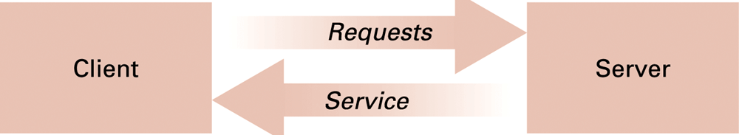
The client/server model
4-<number>
Notes:
Client: Girdiyi aldıktan sonra istemciye istek gönderen yazılımdır.
Server: İstemcilerden gelen istekleri alan ve işleyen yazılımdır. Sunucu, diğer bilgisayarların ihtiyaçlarını karşılamak için hizmetleri çalıştırmaya yönelik çalışır. Sunucular bir dosya sunucusu, veritabanı sunucusu, web sunucusu olabilir.

Slide 31
Inter-process communication
Peer-to-peer model (P2P)
  Two processes communicating as equals
  Peer processes can be short-lived
Examples
    File sharing on the Internet
      not using a central server (distribution centre)
    Gnutella file sharing network
    Instant messaging
4-<number>
Notes:
allowing two or more computer systems to connect and share resources without requiring a separate server or server software

Slide 32
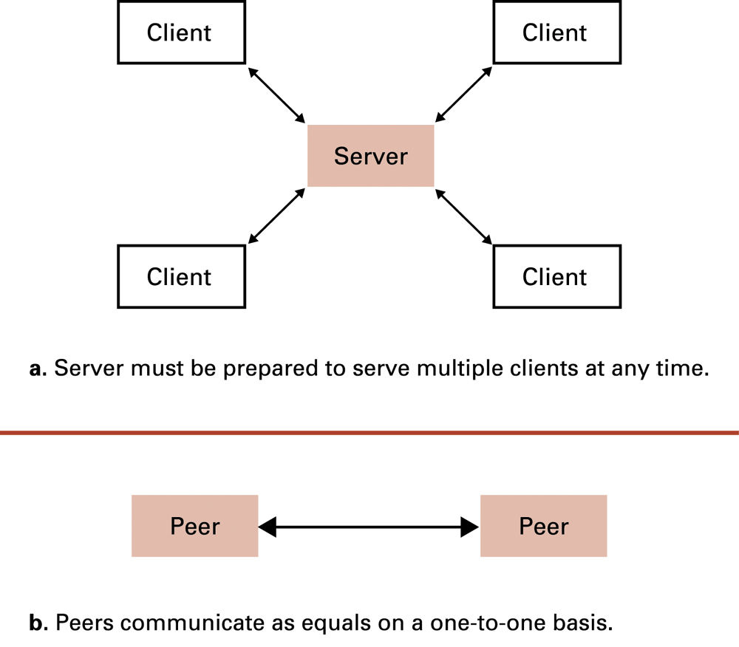
Figure 4.6 The client/server model compared to the peer-to-peer-model
4-<number>

Slide 33
Distributed systems
Systems with parts (software units) that run on different computers
  may imagine the processes as guests at the various machines where they reside
    leading to the computers in a network being called hosts
  Infrastructure usually provided by standardised toolkits
    Example: Enterprise Java Beans from Sun Microsystems
    Example: .NET framework from Microsoft
    Both have greatly simplified the development of distributed software systems
4-<number>

Slide 34
Distributed System
Software system containing components which execute on different computers in a network.
Examples: the Internet, World Wide Web, Video Conferencing, Cellular Phone Systems
4-<number>

Slide 35
The Internet
The Internet: one internet spanning the world
  Started by ARPA in 1973
  Today involves millions of machines
  No. of users worldwide (Oct 2023) about 5.3 billion (65.7% of the global population)
4-<number>

