Slide 1
GTU CSE CSE496 Mobile Application for Digital Law Platform
CSE 496
2nd Meeting
Elif Akgün
Supervisor: Prof. Dr. Hasari ÇELEBİ
November 2021

Slide 2
Content
Project Diagram and Description
Project Design Plan
What Did I Do?
Timeline
References

Slide 3
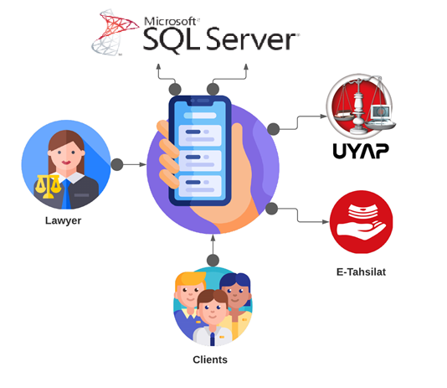
Project Diagram and Description
Communication between lawyers and their clients
Asks/answers questions
Appointments
Following cases
Payment
Sharing files

Slide 4
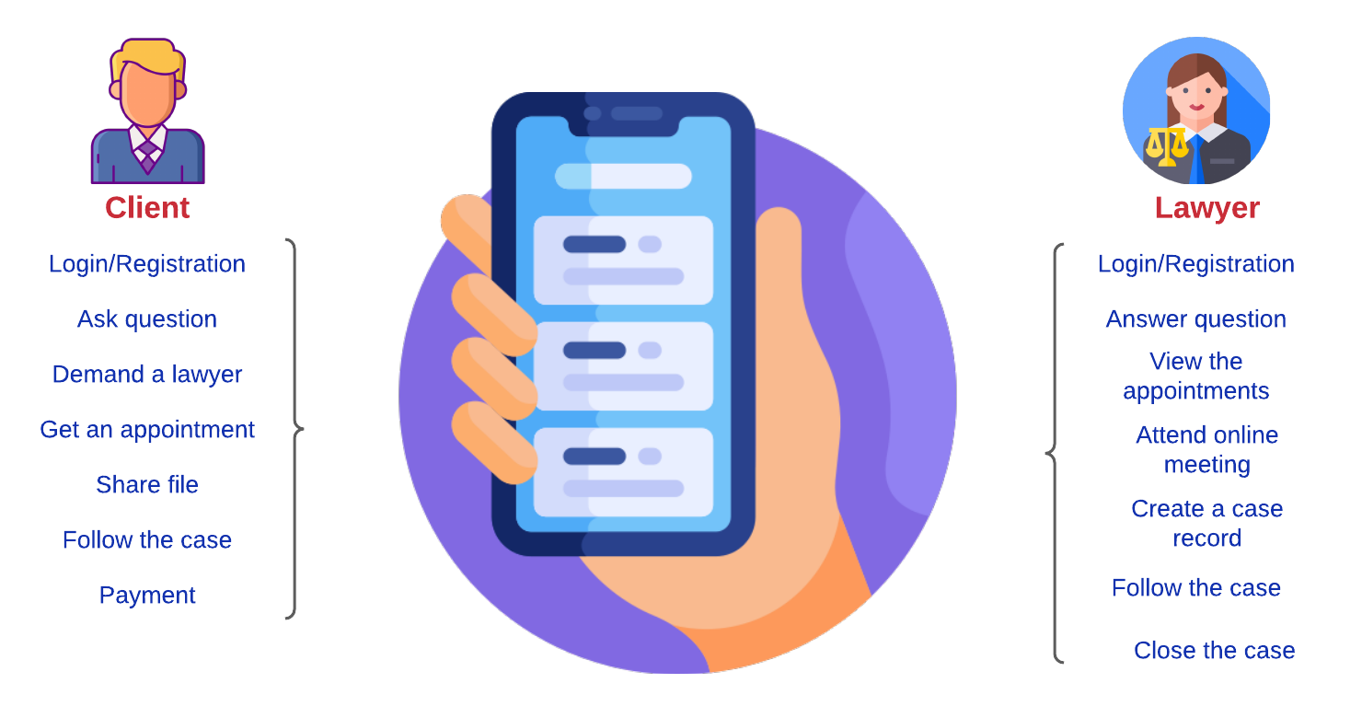
Project Design Plan

Slide 5
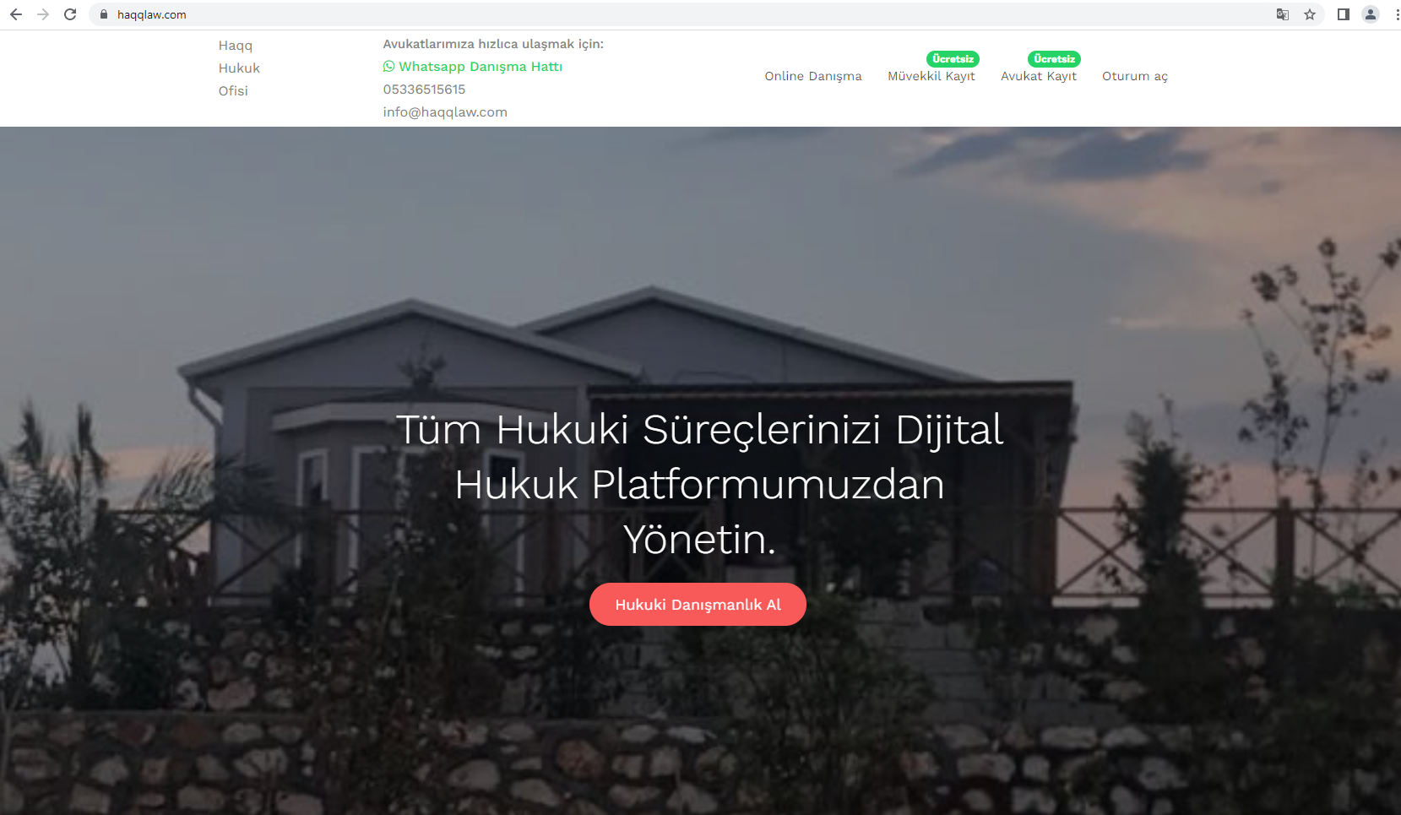

Slide 6
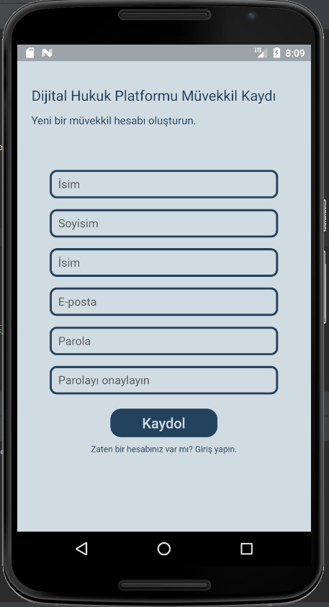
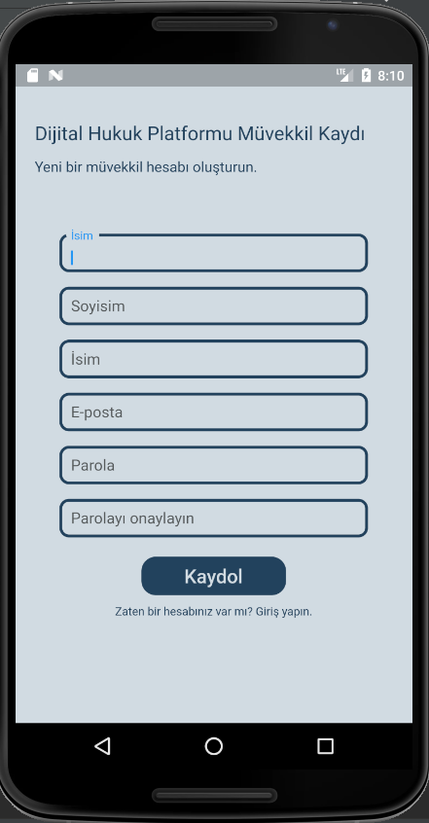
What Did I Do?-1

Slide 7
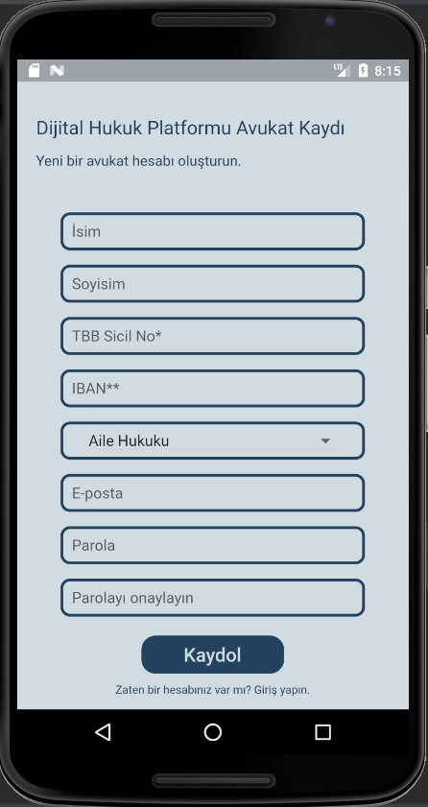
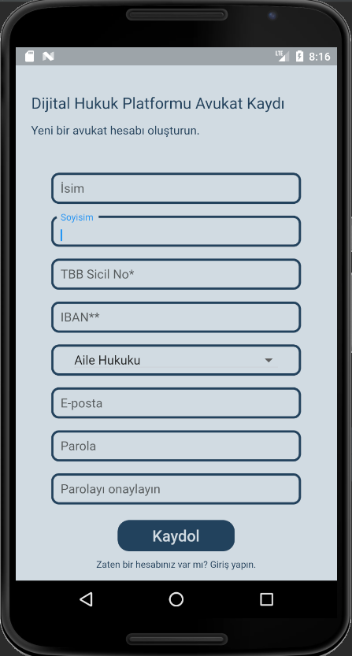
What Did I Do?-2

Slide 8
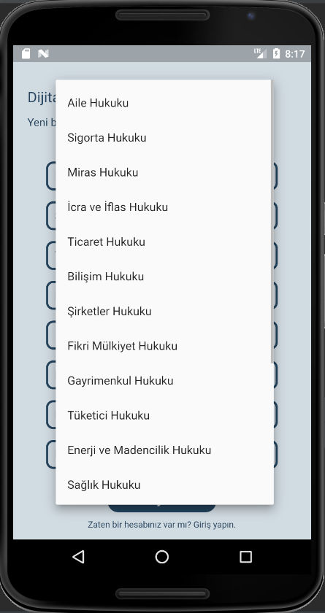
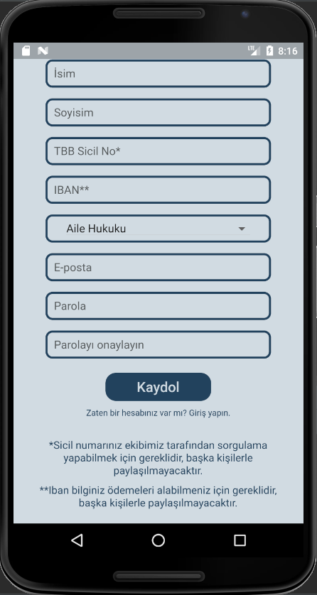
What Did I Do?-3

Slide 9
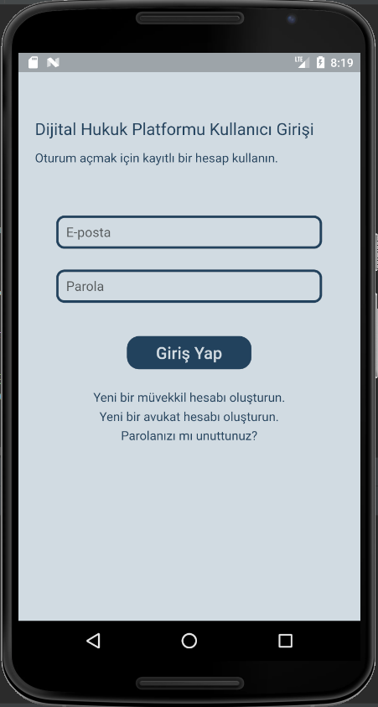
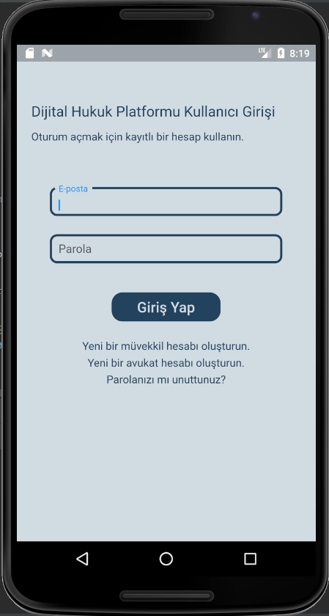
What Did I Do?-4

Slide 10

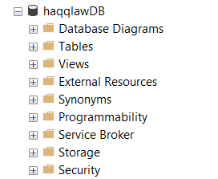
What Did I Do?-5
DB connection

Slide 11
Timeline
December 8, 2021 (3rd Meeting)
Demanding lawyer
Monitoring lawyers
Creating appointment
Checking appointments
January 19, 2022 (4th Meeting)
Asking/answering the questions
Following the cases
Sharing files
Video appointments
Payments

Slide 12
References
https://haqqlaw.com/
https://www.microsoft.com/tr-tr/sql-server/sql-server-2019
https://docs.microsoft.com/en-us/sql/ssms/download-sql-server-management-studio-ssms?view=sql-server-ver15
https://flutter.dev/

Slide 13
THANKS FOR LISTENING…

