Slide 1
GTU CSE CSE496 Mobile Application for Digital Law Platform
CSE 496
Final Presentation
Elif Akgün
Supervisor: Prof. Dr. Hasari ÇELEBİ
January, 2022

Slide 2
Content
Project Diagram and Description
Project Design Plan
Project Requirements
Home
Client
Lawyer
Success Criteria
References

Slide 3
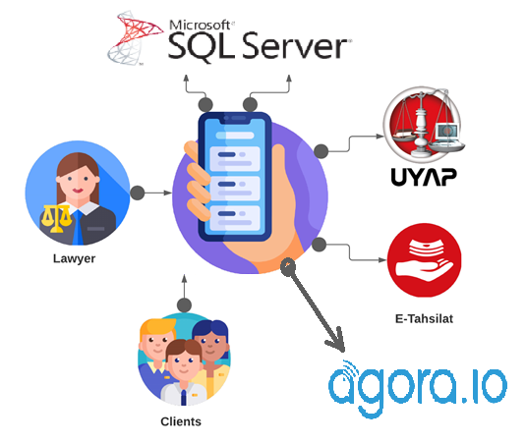
Project Diagram and Description
Communication between lawyers and their clients
Asks/answers questions
Requesting a lawyer
Appointments
Following cases
Payment
Sharing files

Slide 4
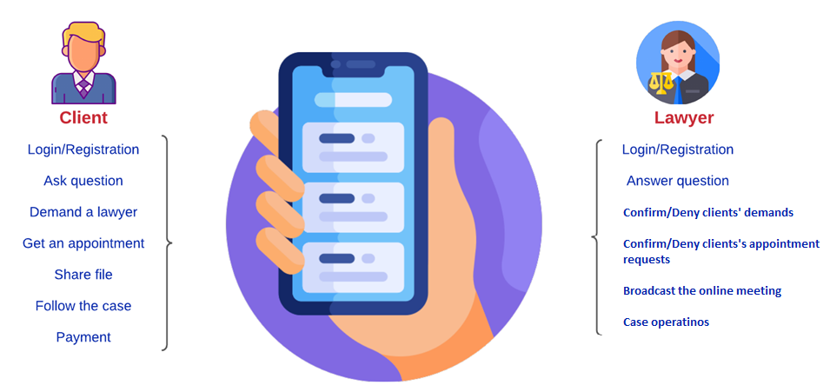
Project Design Plan

Slide 5
Project Requirements
Android Studio as IDE.
Flutter SDK.
Dart programming language.
UYAP system integration for case operations.
E-Tahsilat system integration for payment operations.
Firebase Authentication integration for register and login avitivites.
Firebase Cloud Firestore for keeping clients’ and lawyers’ data, messages, appointments.
Firebase Cloud Storage for keeping shared documents.
Agora.io integration for online meetings.

Slide 6
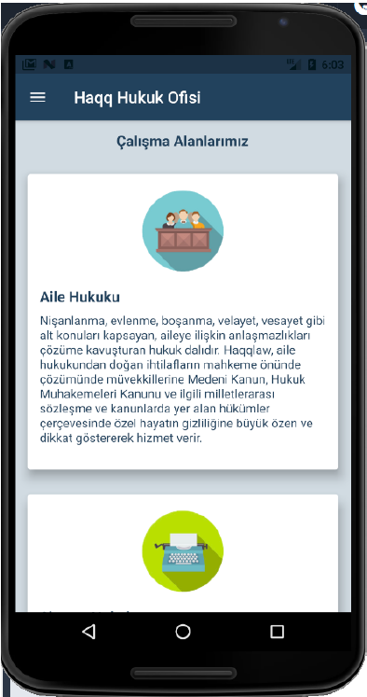
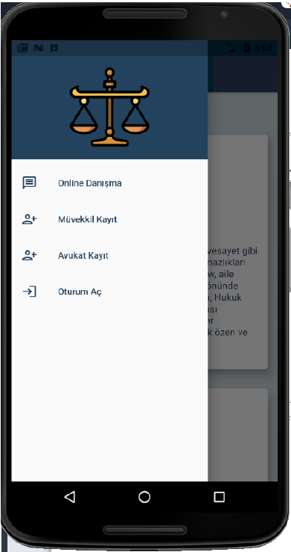
Home

Slide 7
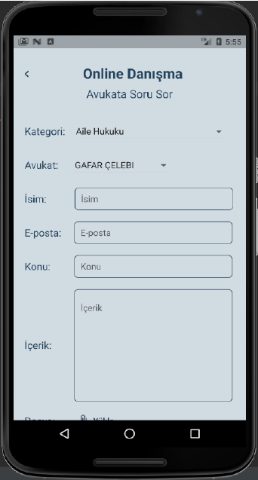
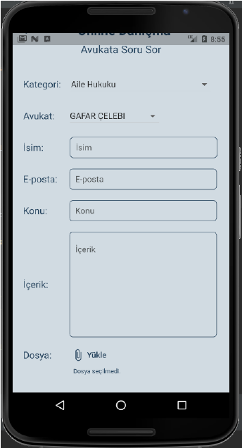
Home - Online Consultation

Slide 8
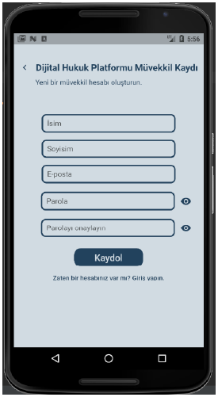
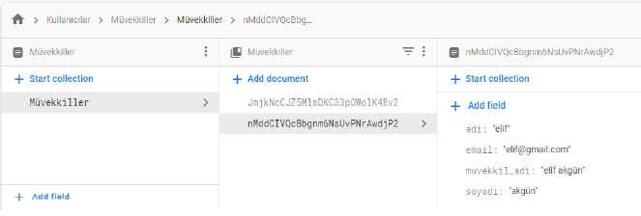
Home - Client Registration

Slide 9
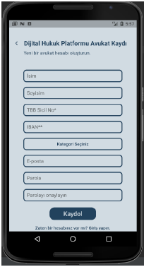
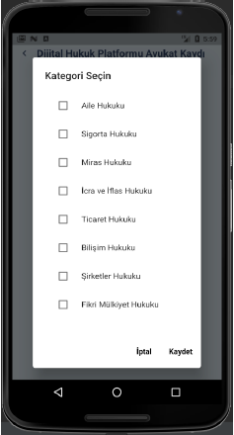
Home - Lawyer Registration - 1

Slide 10
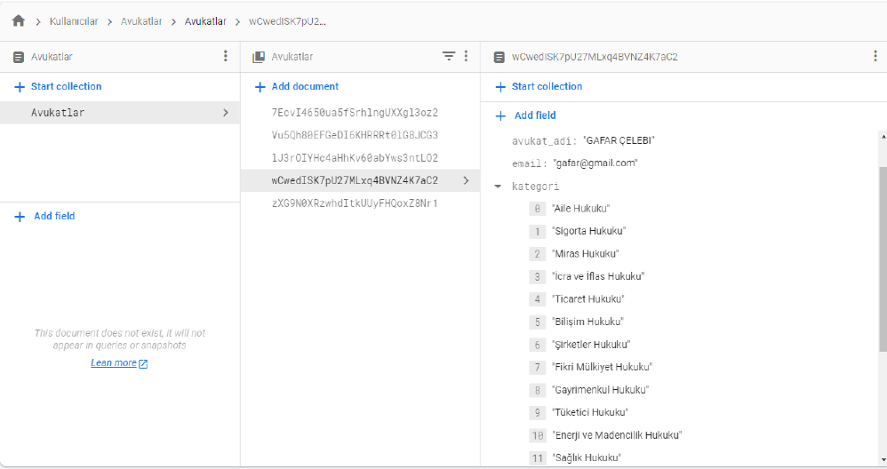
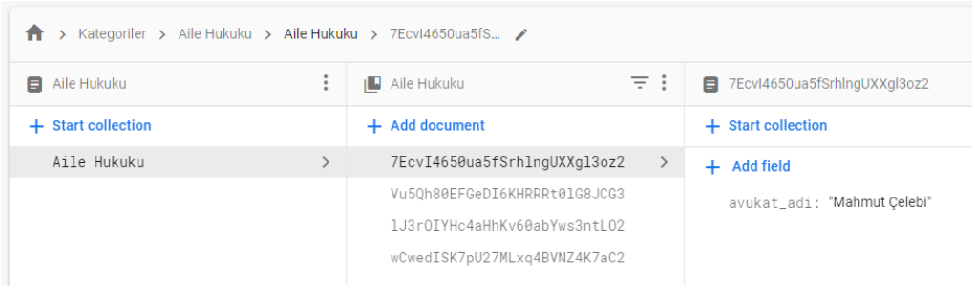
Home - Lawyer Registration - 2

Slide 11
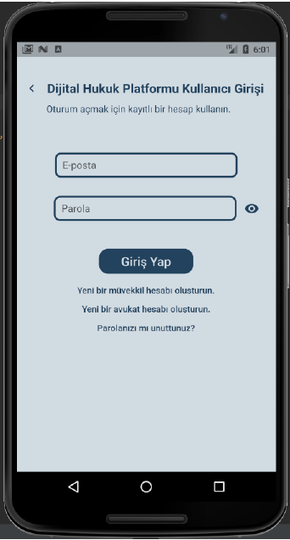
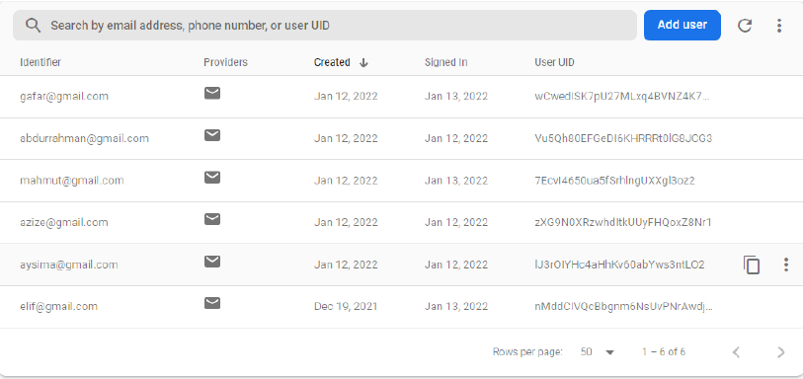
Home - Login

Slide 12
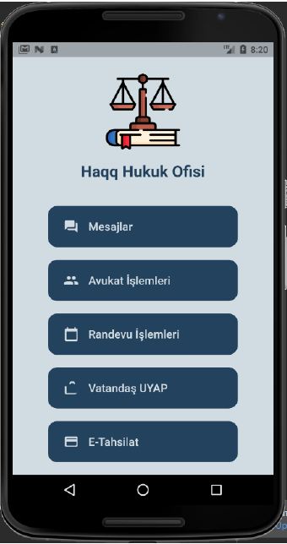
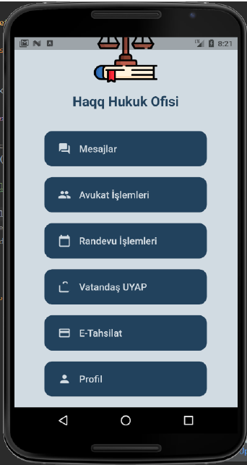
Client

Slide 13
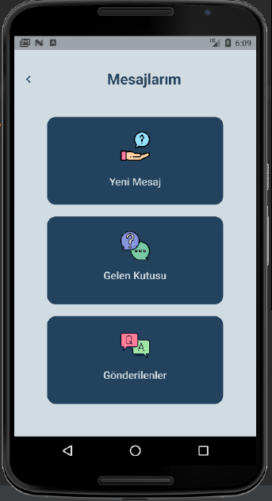
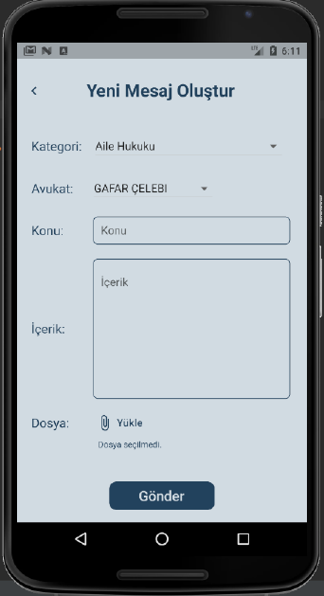
Client - Messages

Slide 14
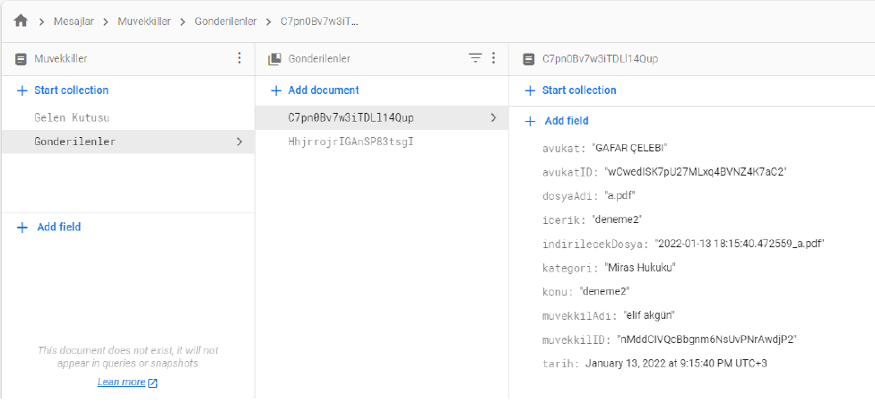
Client – Messages in DB

Slide 15
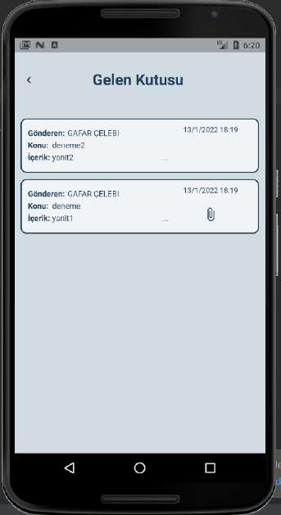
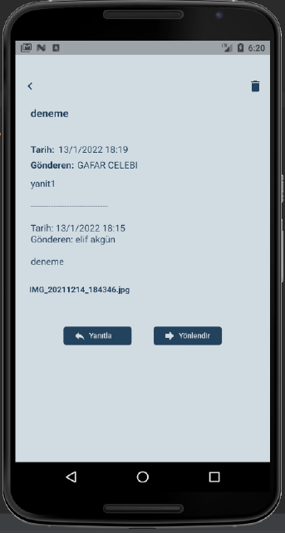
Client - Inbox

Slide 16
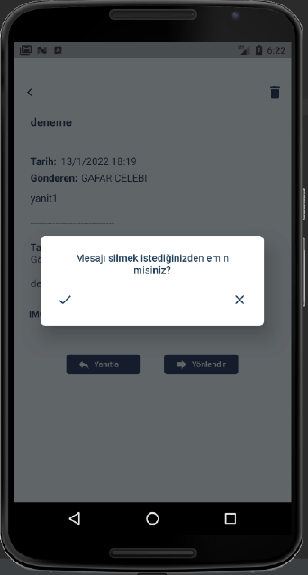
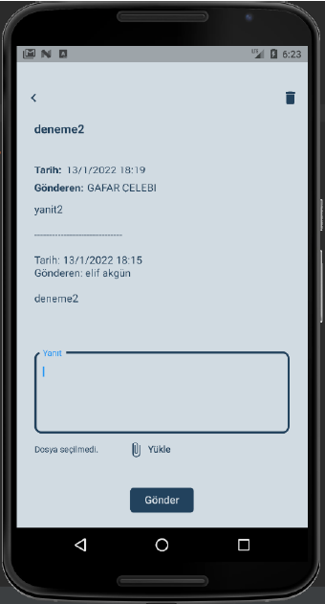
Client – Inbox - 2

Slide 17
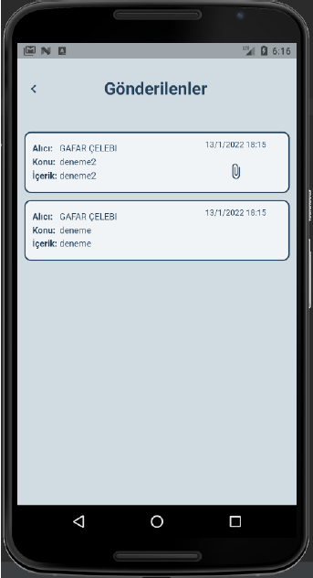
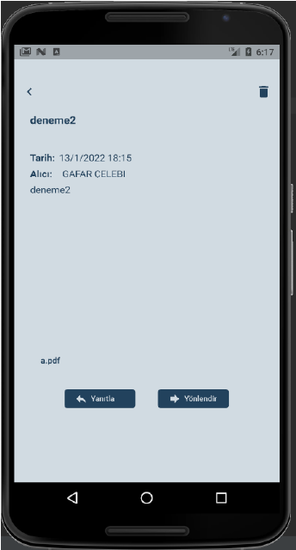
Client -Sent

Slide 18
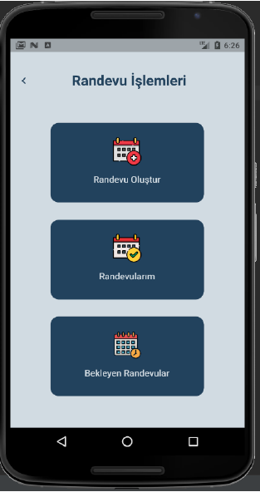
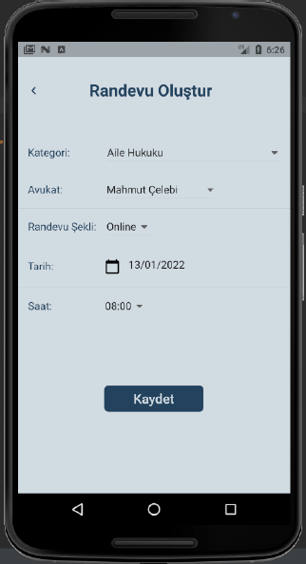
Client - Appointment Activities

Slide 19
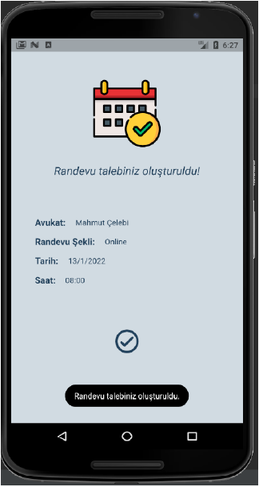
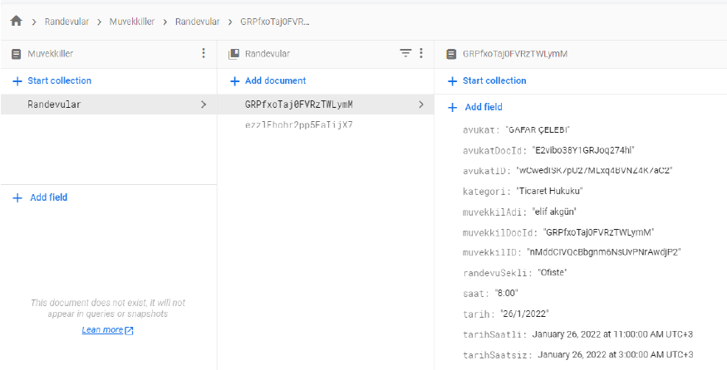
Client – Make Appointment

Slide 20
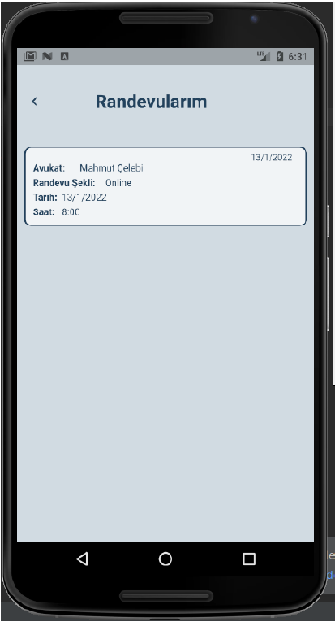
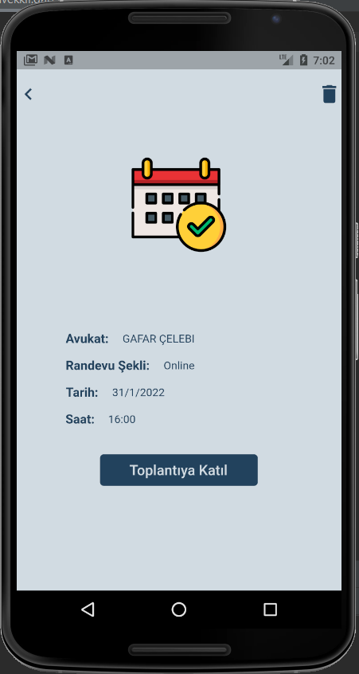
Client – Appointments

Slide 21
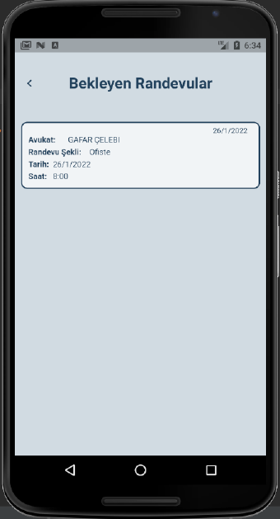
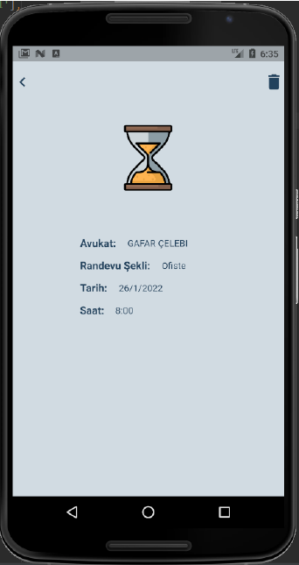
Client - Pending Appointments

Slide 22
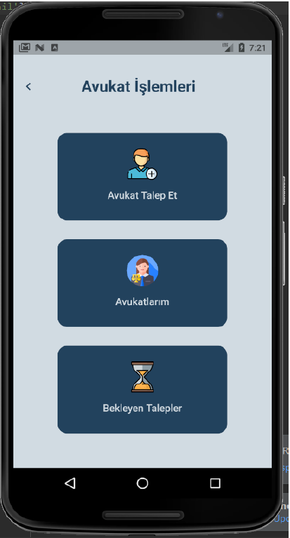
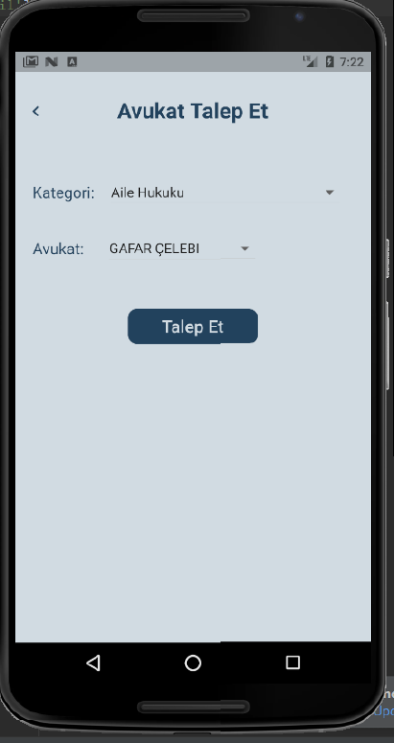
Client – Lawyer Activities

Slide 23
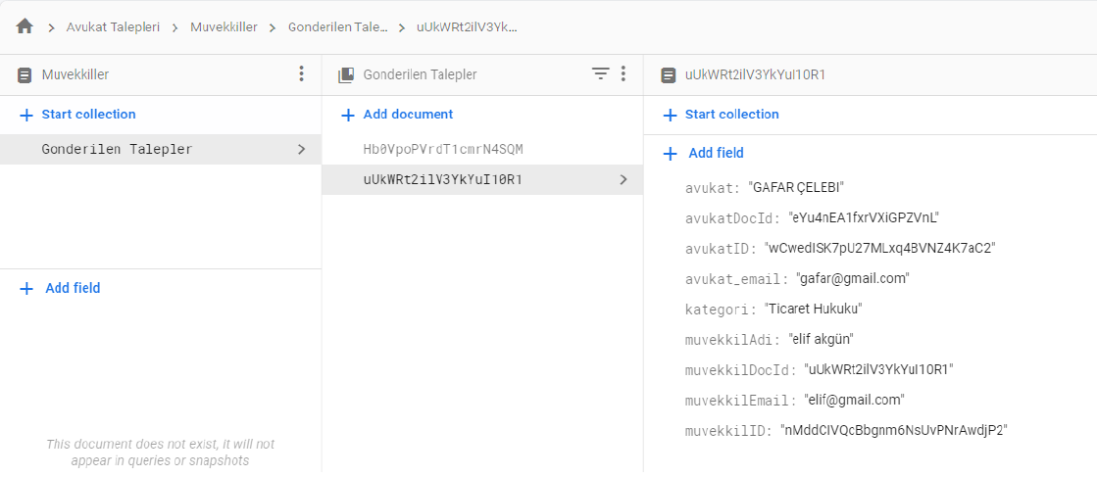
Client – Request Lawyer

Slide 24
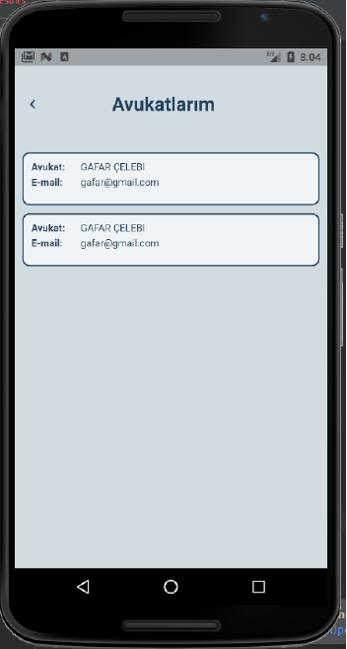
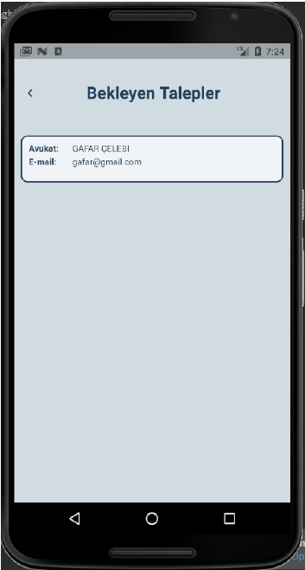
Client – Lawyers

Slide 25
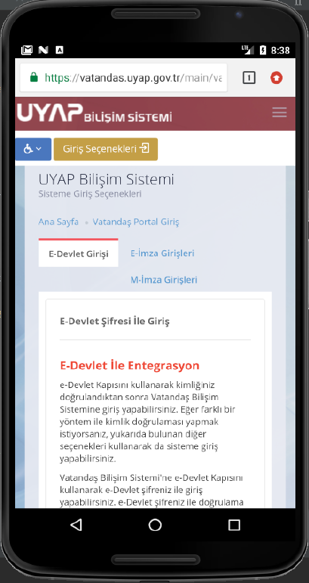
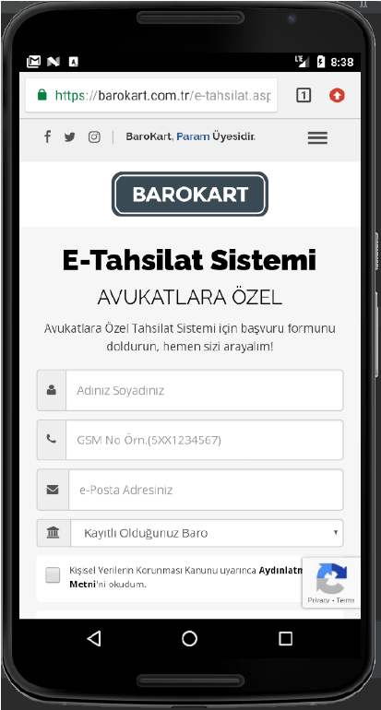
Client – UYAP, E-Tahsilat

Slide 26
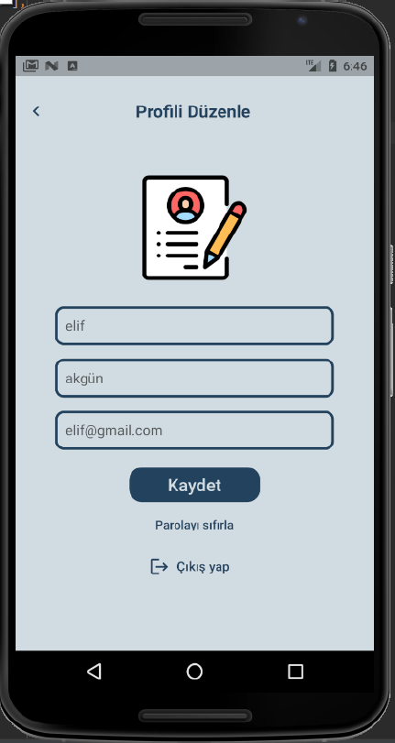
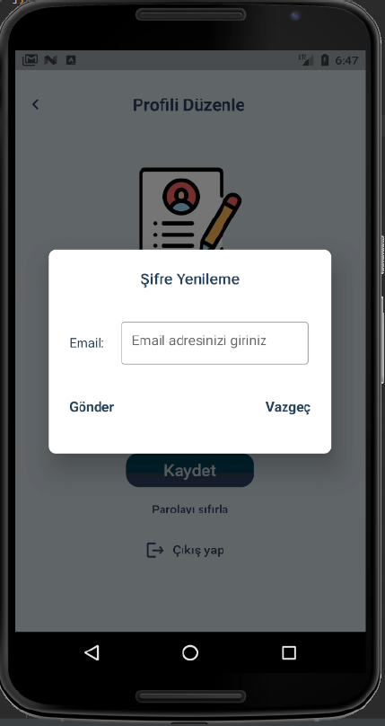
Client – Profile

Slide 27
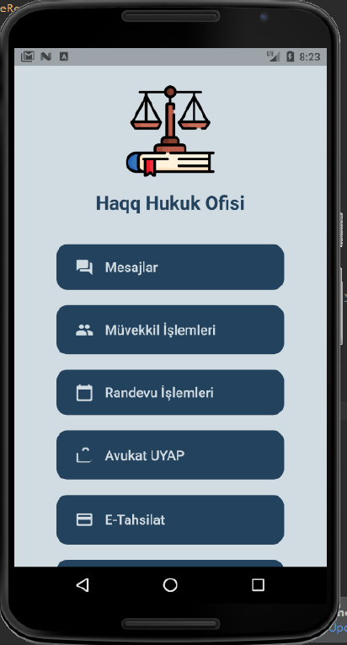
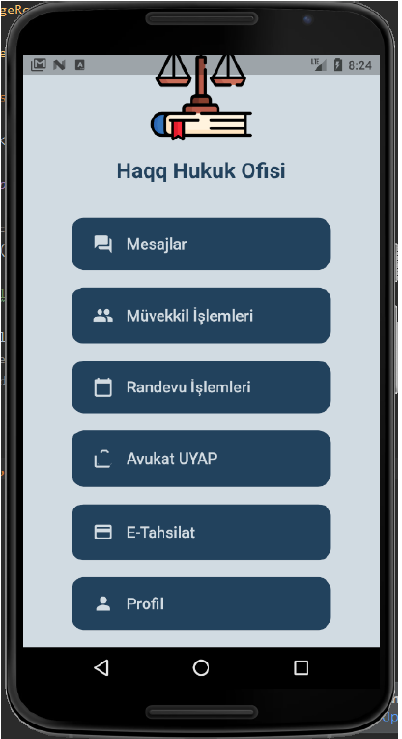
Lawyer

Slide 28
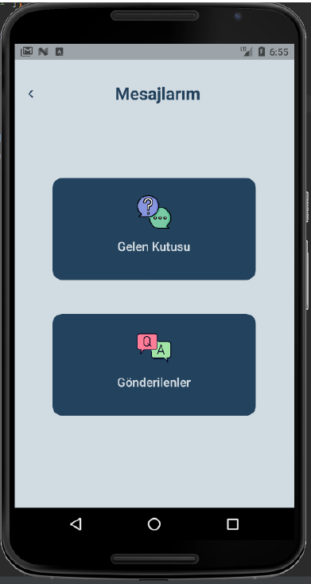
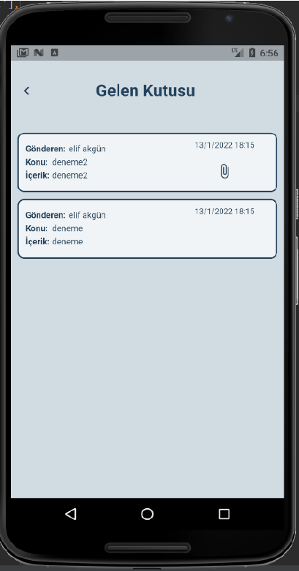
Lawyer – Messages

Slide 29
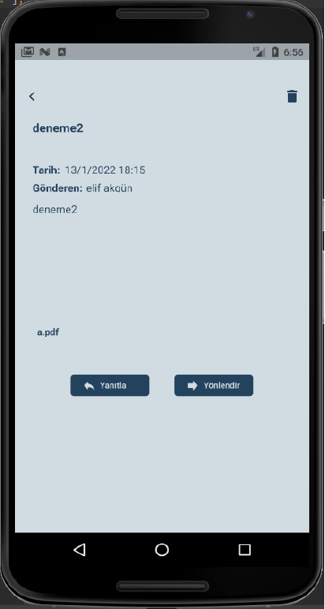
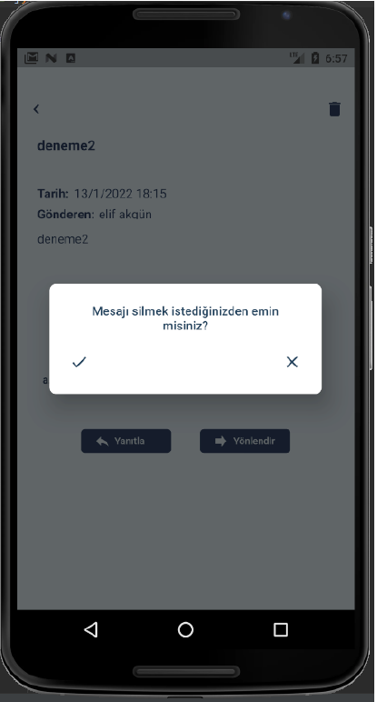
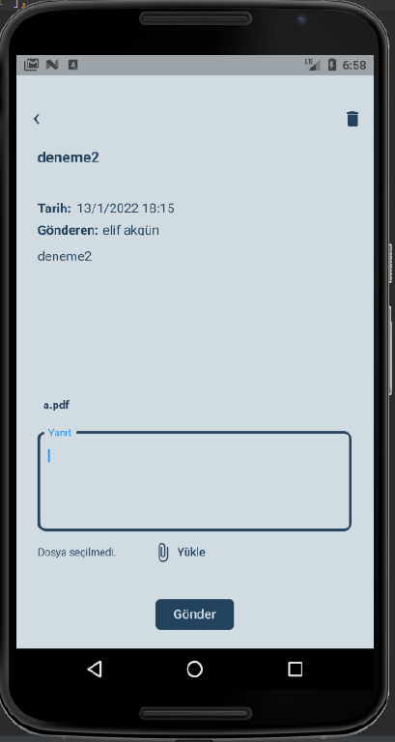
Lawyer – Messages - 2

Slide 30
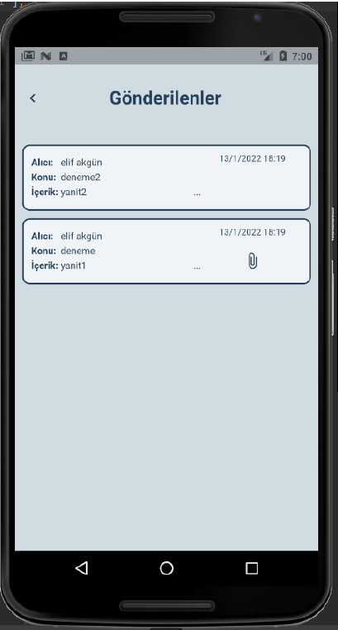

Lawyer – Sent

Slide 31



Lawyer - Appointment Activities

Slide 32


Lawyer – Pending Appointments

Slide 33



Lawyer - Client Activities

Slide 34


Lawyer – UYAP, E-Tahsilat

Slide 35


Lawyer – Profile

Slide 36
Success Criteria
The client can make an appointment and the appointment can be seen in the appointment list with a rate of 95%.
The questions asked by the clients can be seen with a rate of 95% per second.
Lawyer’s answers can be seen with a rate of 95% per second.

Slide 37
References
https://haqqlaw.com/
https://www.microsoft.com/tr-tr/sql-server/sql-server-2019
https://firebase.google.com/docs
https://dart.dev/.
https://flutter.dev/

Slide 38
THANKS FOR LISTENING…

