Slide 1
GTU CSE CSE496 Mobile Application for Digital Law Platform
CSE 496
Preliminary Presentation
Elif Akgün
Supervisor: Prof. Dr. Hasari ÇELEBİ
October 2021

Slide 2
Contents
Project Diagram and Description
Project Design Plan
Project Requirements-1
Project Requirements-2
Success Criterion

Slide 3
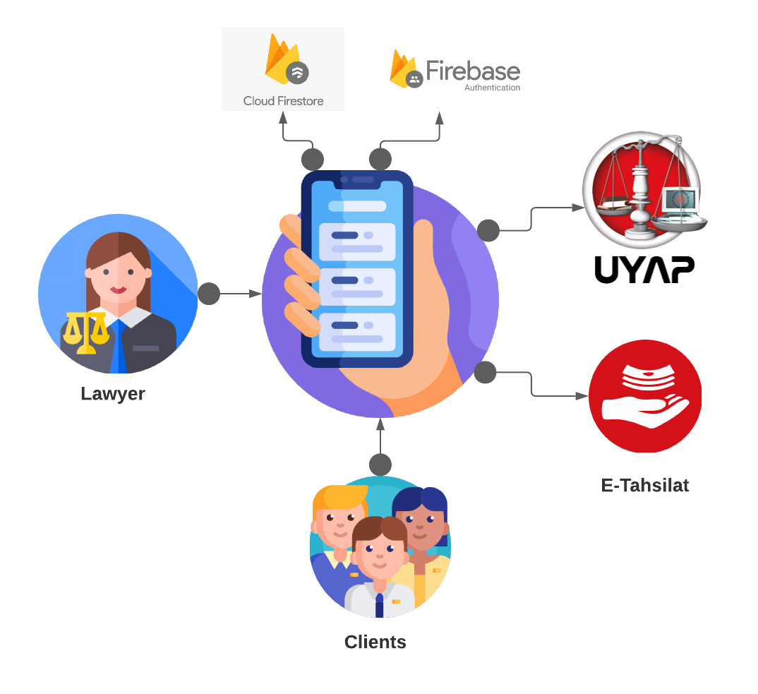
Project Diagram and Description
Communication between lawyers and their clients
Asks/answers questions
Appointments
Following cases
Payment
Sharing files

Slide 4
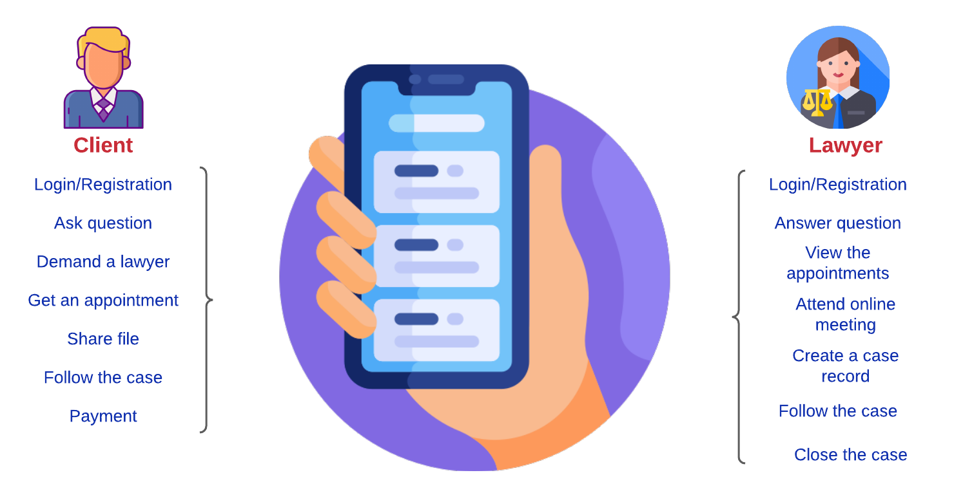
Project Design Plan

Slide 5
Project Requirements-1
Creating login and registration screen for clients and lawyers
Providing asking/answering the question
Creating appointment screen
Providing following the cases
Providing sharing files
Providing video appointment
Providing payments

Slide 6
Project Requirements-2
Project will be developed with using Android Studio IDE.
Firebase Firestore will be used for database.
Firebase Auth will be used for authentication.
UYAP will be used for following the cases.
E-Tahsilat will be used for payment.

Slide 7
Success Criterion
The client can make an appointment and the appointment can be seen in the appointment list with a rate of 95%.
The questions asked by the clients can be seen with a rate of 95% per second.
Lawyer’s answers can be seen with a rate of 95% per second.

Slide 8
References
https://firebase.google.com/docs/firestore
https://firebase.google.com/docs/auth
https://uyap.gov.tr/Genel-Bilgi
lucid.app/ (for diagrams)
www.flaticon.com/ (for icons)

