Slide 1
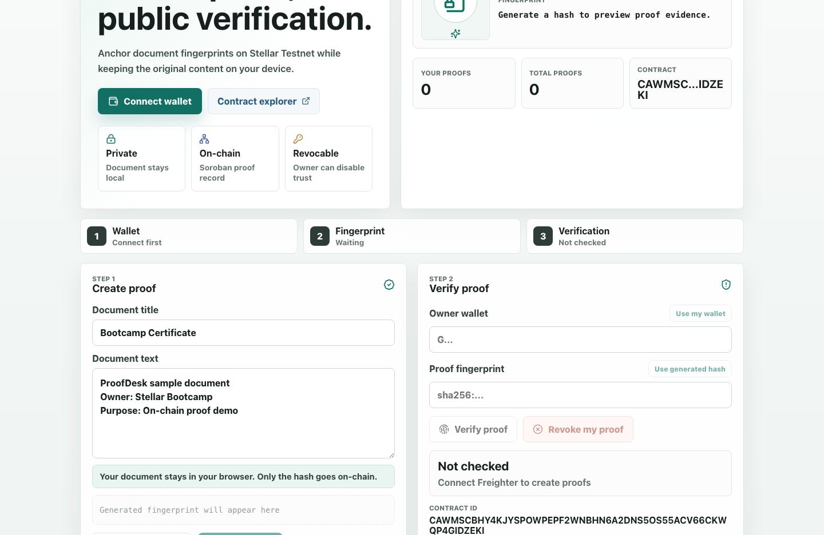
ProofDesk Stellar
Private proof, public verification.
A Soroban dApp for creating, revoking, and verifying document fingerprints on Stellar Testnet without uploading private document content.
Level 5 Blue Belt submission pack • August 2026
Live MVP + growth evidence workflow + pitch/demo assets
1

Slide 2
Teams need document trust without exposing the document.
Certificates, agreements, invoices, and completion records often need proof that a document existed and stayed unchanged. Uploading the original file creates unnecessary privacy and custody risk.
Current pain
Better outcome
Verification is scattered across screenshots, emails, manual signatures, and file uploads. Reviewers trust the channel more than the proof.
A wallet-owned on-chain fingerprint gives a public yes/no answer while the private document remains on the user's device.
Privacy-first verification turns a document into evidence without turning the document into stored data.
2

Slide 3
ProofDesk anchors only the fingerprint, then lets anyone verify it.
The product keeps the original text local, hashes it in the browser, and records the proof hash with owner wallet, title, timestamp, and active/revoked status in Soroban.
01
02
03
04
Connect
Fingerprint
Anchor
Verify
Tester connects Freighter on Stellar Testnet.
Browser creates a SHA-256 hash locally.
Owner signs a Soroban create_proof transaction.
Anyone checks owner + hash + active status.
3

Slide 4
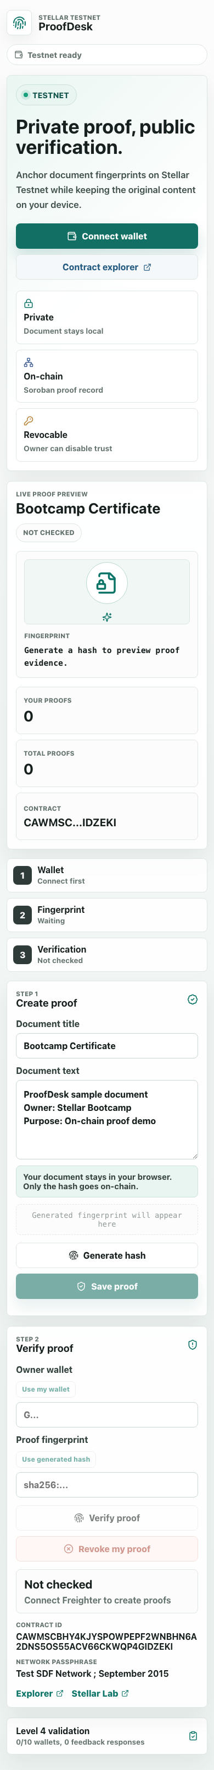
The MVP already demonstrates the full user flow.
Reviewers can test a live product path: connect wallet, generate a hash, save a proof, verify it, revoke it, and export validation evidence.
Live
Testnet
GitHub Pages deployment
Soroban contract
The Vite frontend is deployed with the Testnet contract configured for reviewer testing.
create_proof, verify_proof, revoke_proof, counts, and proof metadata are available on-chain.
4

Slide 5
The architecture separates private content from public trust.
Each layer has one responsibility: local hashing, wallet authorization, contract storage, and evidence collection for growth validation.
Layer
Role
ProofDesk implementation
Reviewer evidence
Frontend
Local UX + hashing
React, Vite, TypeScript, SHA-256 in browser
Live app screenshots
Wallet
User ownership
Freighter Testnet connection and signing
Signed wallet interactions
Contract
Durable proof state
Soroban proof record, counts, active/revoked status
Stellar explorer links
Ops
Growth proof
Analytics, feedback, monitoring, JSON/CSV export
Level 5 workbook + README
Docs
Submission clarity
Pitch deck, demo script, growth tracker
Repository-linked assets
5

Slide 6
Level 5 turns the MVP into a measurable growth experiment.
The next monthly review should show real onboarding, real Testnet activity, and a feedback loop that changes the product instead of only describing it.
50+
1 form
2 exports
Signed Testnet wallets
Feedback source of truth
Submission evidence
Use create_proof or revoke_proof as the qualifying transaction activity for each tester.
Google Form captures name, email, wallet, rating, transaction hash, use case, and feedback.
The app exports JSON/CSV while the workbook analyzes responses and improvement themes.
6

Slide 7
Feedback now produces a visible product iteration trail.
The Level 5 update added signed-wallet progress tracking, email-backed feedback capture, and export formats aligned with the bootcamp submission evidence.
Before
After
Validation UI was optimized for Level 4: 10 wallet interactions, feedback notes, and a JSON evidence snapshot.
Level 5 dashboard targets 50 signed wallets, captures tester email, and exports JSON plus CSV for analysis.
Improvement commit: c53d1762b97e2b492f5d79be0dde23a81d612ef5
7

Slide 8
The roadmap focuses on shareability, retention, and proof volume.
User feedback should decide sequencing, but the next phase is already scoped around features that make verification easier to repeat and share.
Phase
Product improvement
Why it matters
Evidence to use
Next
Shareable verification certificate
Reviewers can verify without re-entering every field.
Feedback themes + demo friction
Next
Batch proof creation
Power users can anchor multiple certificates or records.
Repeated use-case requests
Next
Proof history and saved hashes
Testers can return after the first transaction.
Retention signal from 50 users
Later
Hosted analytics endpoint
Submission evidence becomes easier to aggregate.
Export JSON/CSV comparison
Later
Mainnet readiness checklist
The product can graduate from testnet demo to real trust workflow.
Security and stability results
8

Slide 9
Submission is strongest when every claim links to evidence.
The repository now contains the deck, feedback workbook, Level 5 tracker, demo script, and README sections. The only items that must be filled with real data are the Google Form URL, demo video URL, and 50-user transaction proof.
Checklist item
Status
Where to link
Public GitHub repository
Ready
README quick links
Live deployed application
Ready
GitHub Pages URL
Pitch deck / PPT
Ready
docs/pitch/ProofDesk_Level5_Pitch_Deck.pptx
Feedback Excel export
Ready
docs/evidence/proofdesk-level5-user-feedback.xlsx
Demo video
Needs recording
Paste final video URL in README + tracker
50+ users + transactions
Needs real testers
Paste wallet and explorer links in tracker
Analytics / transaction screenshots
Needs final capture
Add screenshots after tester cohort
9

