Slide 1


Better Controlled, Better Remembered?
How Sense of Agency Shapes Recognition Memory Through Detection and Subjective Sense of Control
TUM-IAS SoA Workshop 2026: Sense of Agency in Real-World Applications
Elif Gezen | elif.gezen@psy.lmu.de
LMU Munich, Department of Psychology, Body Social Cognition and Action Lab
LMU Munich, Graduate School of Systemic Neurosciences

Slide 2
Background & Aim
Sense of Agency benefits recognition memory:
Lower-level
+
Higher-level
e.g., Synofzik et al., 2008
Sensorimotor control
Motor prediction
Prediction errors
Action–outcome congruence
Freedom of Choice
Subjective Feeling of Agency
Elif Gezen | elif.gezen@psy.lmu.de |TUM-IAS SoA Workshop 2026
2

Slide 3






Task Design
Control Detection / Incidental Encoding Phase
alternating high- & low-control
6 blocks of 20 trials
N = 38
Elif Gezen | elif.gezen@psy.lmu.de |TUM-IAS SoA Workshop 2026
3

Slide 4
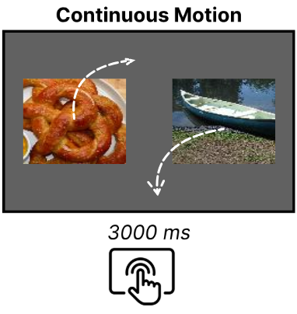
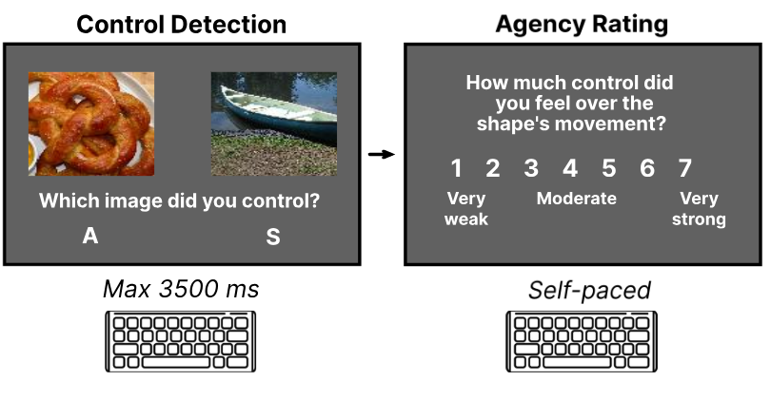
Hypotheses
Lower-level
Higher-level
recognition high > recognition low
recognition detected > recognitionnot detected
recognition controlled > recognition not controlled
subjective agency ratings → recognition
Elif Gezen | elif.gezen@psy.lmu.de |TUM-IAS SoA Workshop 2026
4

Slide 5
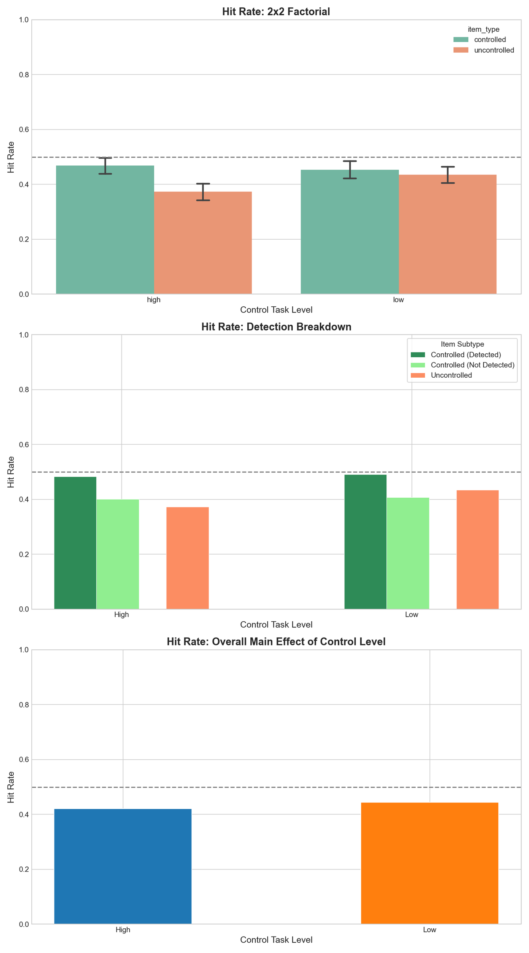
Results - Behavioral
Recognition Memory Performance
  d’ above chance for all participants
  Binomial GLMM on old items: said_old ~ item_type * control_condition + (1 | participant)
*
* p < 0.05
*** p < 0.001
Main Effect of Condition:
low control > high control
***
***
Main Effect of Control:
controlled items > uncontrolled items
***
Interaction Control x Condition:
main effect of control driven by high control
Elif Gezen | elif.gezen@psy.lmu.de |TUM-IAS SoA Workshop 2026
5

Slide 6
Results - Behavioral
Binomial GLMM on old items: said_old ~ detection_accuracy * control_condition + (1 | participant)
* p < 0.05
*** p < 0.001
Main Effect of Detection:
detected > undetected
***
***
No Interaction Condition x Detection
Elif Gezen | elif.gezen@psy.lmu.de |TUM-IAS SoA Workshop 2026
6

Slide 7
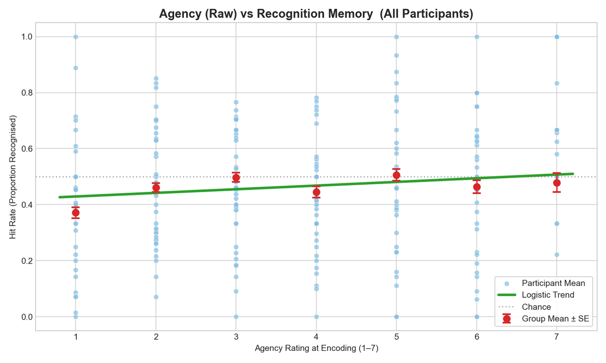
Results - Behavioral
Agency Rating vs Recognition Performance
Binomial GLMM on controlled items:
said_old ~ agency_z * control_condition + (1 | participant)
Elif Gezen | elif.gezen@psy.lmu.de |TUM-IAS SoA Workshop 2026
7

Slide 8
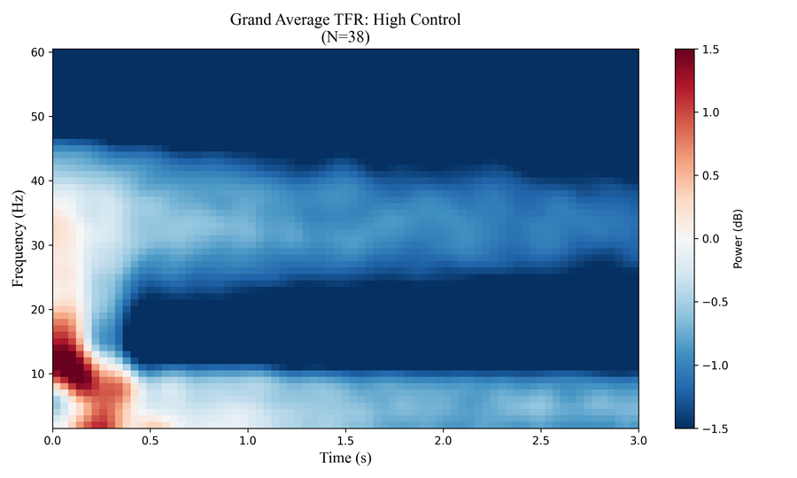
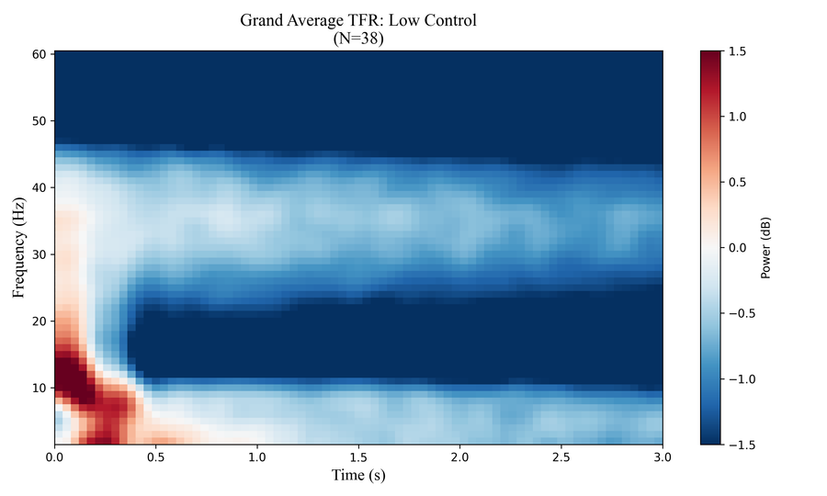
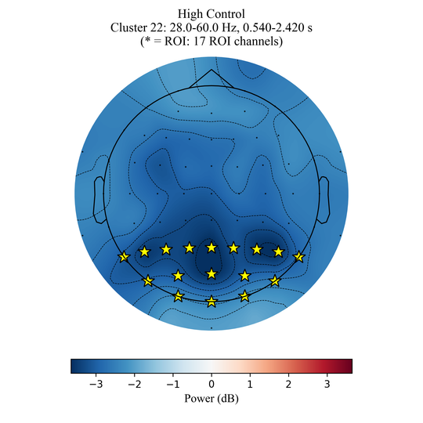
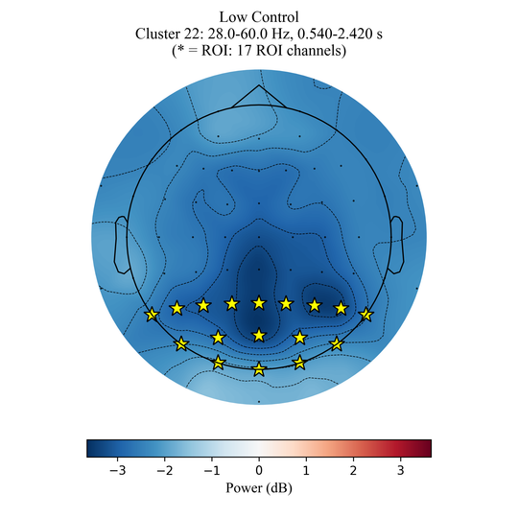
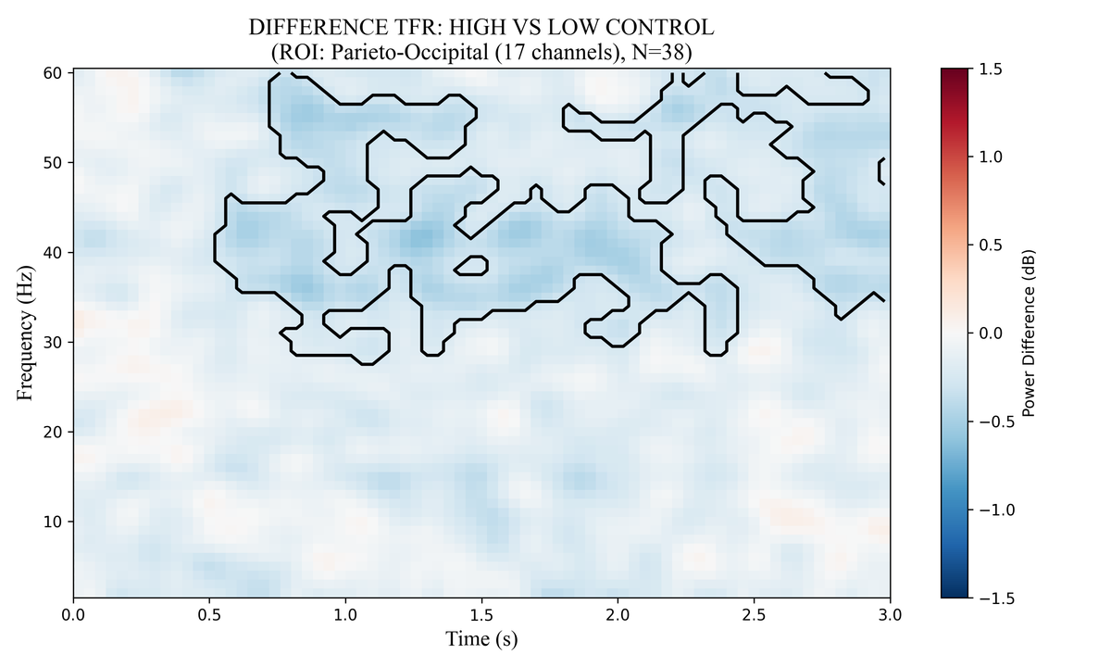
Results - Neurophysiological
Time-Frequency Analyses (cluster based permutation tests)
Main Effect of Condition
ROI: P*, O* (Wu et al., 2025)
Greater gamma-band power for low control
(less suppression)
Cluster 1: 0.54–2.42 s, 28–60 Hz, p = .014
Cluster 2: 1.82–2.98 s, 33–60 Hz, p = .040
Elif Gezen | elif.gezen@psy.lmu.de |TUM-IAS SoA Workshop 2026
8

Slide 9
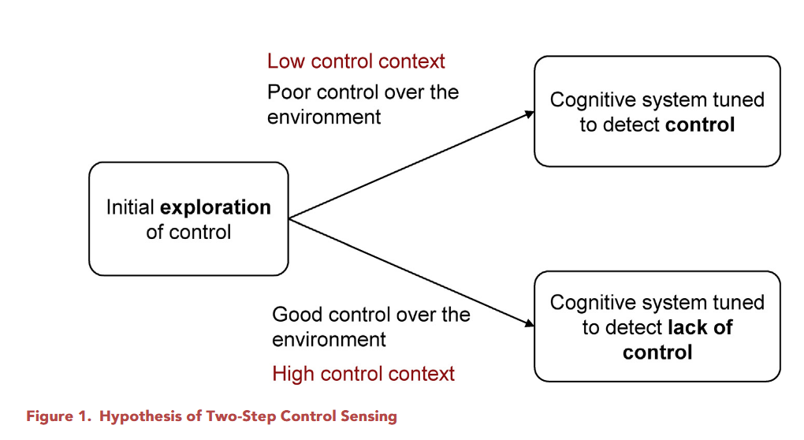

Interim Interpretation
Why did we get the opposite effect to what we expected?
Parieto-occipital gamma oscillations are related to, and SoA can be computed based on:
  prediction error (PE) monitoring (Engel et al., 2001; van Pelt et al., 2016; Wen & Haggard, 2020)
categorical perception of SoA created by order effects due to our within-subjects block design?
prediction error
Wen et al., 2020
Elif Gezen | elif.gezen@psy.lmu.de |TUM-IAS SoA Workshop 2026
9
Notes:
would occur only if existing expectation is high control (Wen & Haggard, 2018; Wen et al., 2020)

Slide 10
Interim Interpretation
Why did we get the opposite effect to what we expected?
Parieto-occipital gamma oscillations are related to, and SoA can be computed based on:
  prediction error (PE) monitoring (Engel et al., 2001; van Pelt et al., 2016; Wen & Haggard, 2020)
categorical perception of SoA created by order effects due to our within-subjects block design?
Elif Gezen | elif.gezen@psy.lmu.de |TUM-IAS SoA Workshop 2026
10
Notes:
would occur only if existing expectation is high control (Wen & Haggard, 2018; Wen et al., 2020)

Slide 11
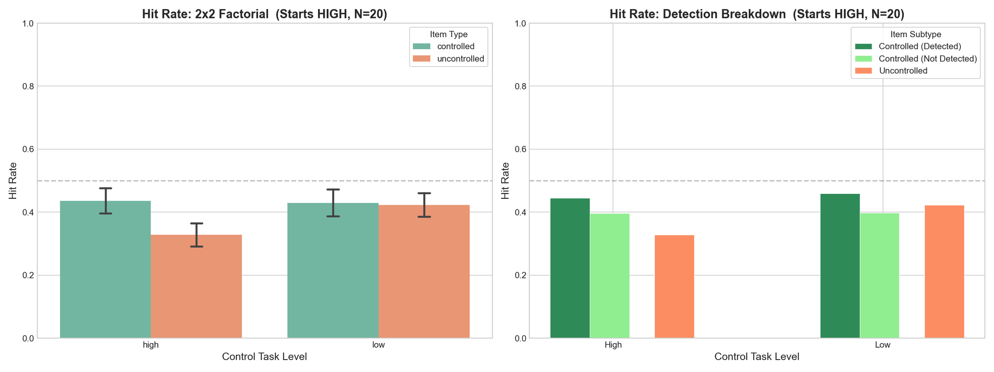
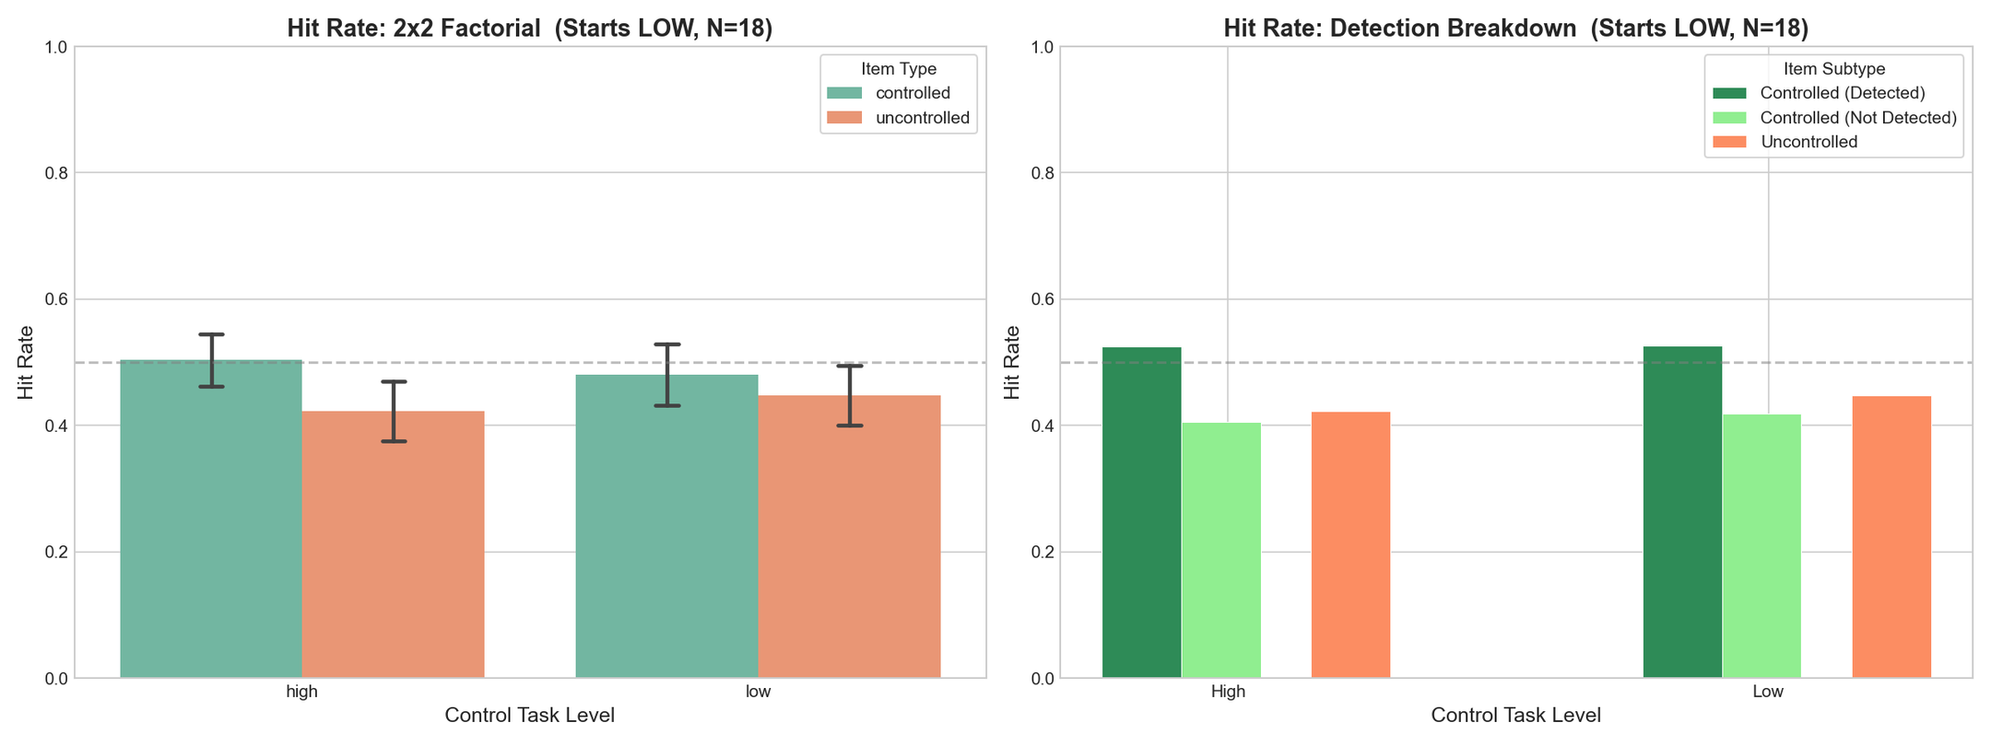
Results - Exploratory
Recognition Memory Performance (Hit Rates), Split by Starting Order
Binomial GLMM on all old items: said_old ~ control_condition * item_type * starts_with + (1 | participant)
*
Main Effect of Condition
driven by participants who started with high control
* p < 0.05
*** p < 0.001
*
* p < 0.05
*** p < 0.001
***
***
***
***
***
The controlled item advantage, and the benefit of correctly detecting control remains robust to order effects.
***
***
***
***
Elif Gezen | elif.gezen@psy.lmu.de |TUM-IAS SoA Workshop 2026
11

Slide 12
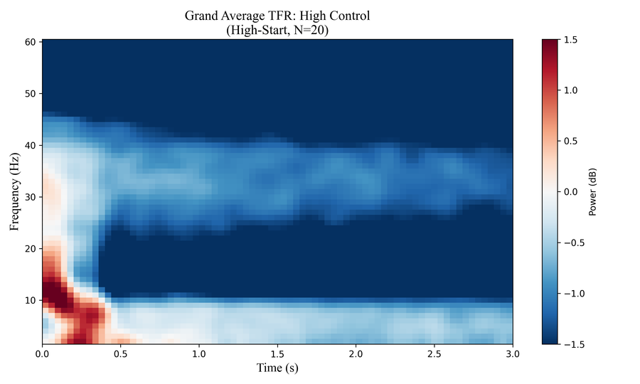
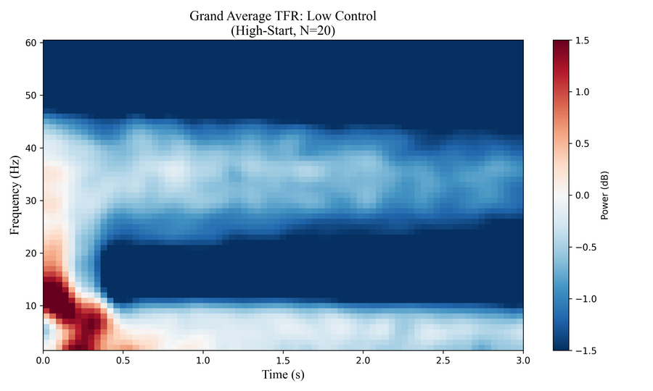
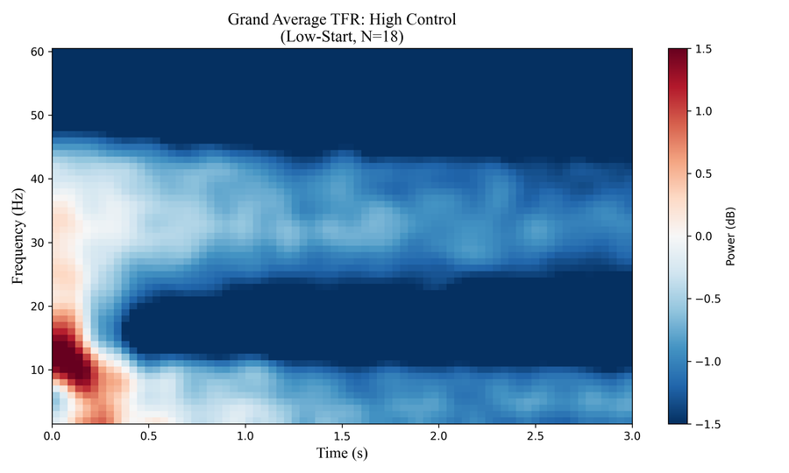
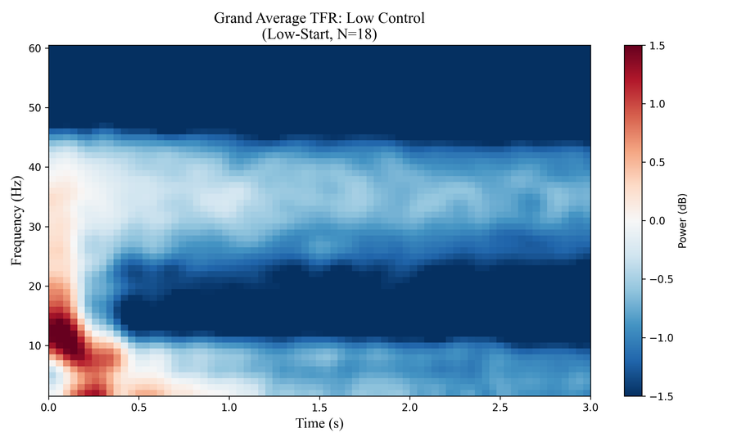
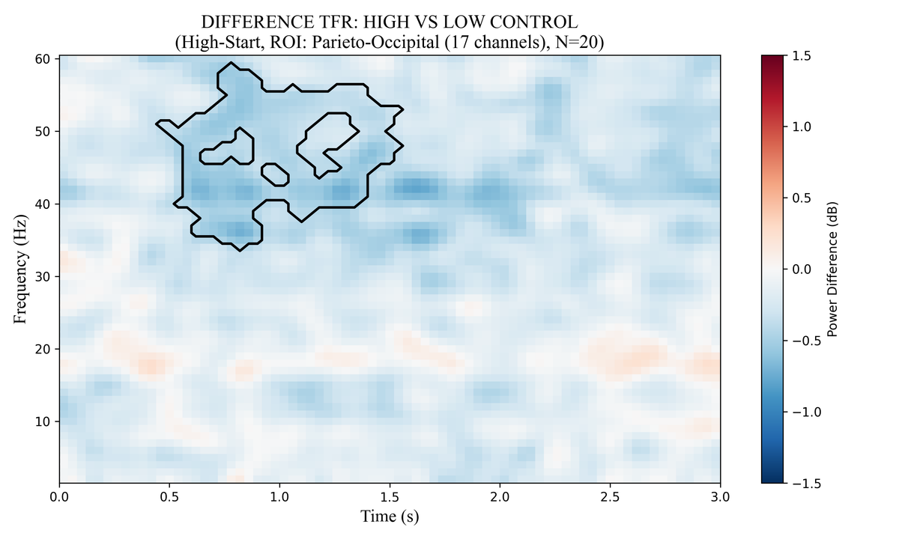
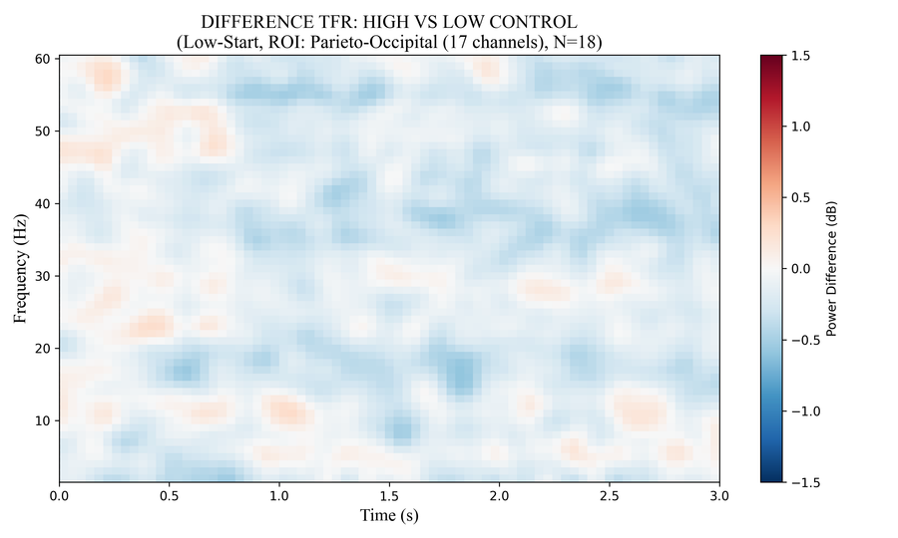
Results - Neurophysiological
Time-Frequency Analyses (cluster based permutation tests)
Main Effect of Condition
High-Start Subgroup
Low-Start Subgroup
High-start cluster: 0.46–1.54 s, 34–59 Hz, p = .028
Elif Gezen | elif.gezen@psy.lmu.de |TUM-IAS SoA Workshop 2026
12

Slide 13
Results - Summary
  Low control compared to high control over item movement enhances subsequent recognition performance.
    This effect is related to starting order (driven by participants who started with high control)
    It is accompanied by parieto-occipital gamma oscillations within 2 seconds from movement onset.
  Participants’ subjective agency ratings do not predict subsequent recognition performance.
  Controlled items are remembered better than uncontrolled ones in all conditions.
  Consciously detecting control enhances subsequent recognition performance regardless of control condition.
    This effect is robust to order effects.
Elif Gezen | elif.gezen@psy.lmu.de |TUM-IAS SoA Workshop 2026
13

Slide 14
Discussion
  Categorical perception of control rather than graded
    Control differences are perceived within 2 s of movement onset (Wen et al., 2020)
coherent representations → further processing in memory
Jensen et al., 2007
working memory maintenance → long term memory
Jensen et al., 2007
item-level subsequent memory effects
Osipova et al., 2006
reduction of control
prediction error
relative boost in saliency
attraction of attention
enhanced encoding?
adapted from Wen & Haggard, 2018
Elif Gezen | elif.gezen@psy.lmu.de |TUM-IAS SoA Workshop 2026
14

Slide 15
Results - Summary
  Low control compared to high control over item movement enhances subsequent recognition performance.
    This effect is related to starting order (driven by participants who started with high control)
    It is accompanied by parieto-occipital gamma oscillations within 2 seconds from movement onset.
  Participants’ subjective agency ratings do not predict subsequent recognition performance.
  Controlled items are remembered better than uncontrolled ones in all conditions.
  Consciously detecting control enhances subsequent recognition performance regardless of control condition.
    This effect is robust to order effects.
Elif Gezen | elif.gezen@psy.lmu.de |TUM-IAS SoA Workshop 2026
15

Slide 16
Discussion
advantage for the controlled item
advantage for conscious detection
Lower-level
Higher-level
  Low level action monitoring & judgements of agency are neurally distinguished processes (Miele et al., 2011)
  Predictive mechanisms that compute SoA might operate unconsciously (Wen et al., 2023)
  Embodied vs external SoA (Wen et al., 2023)
Elif Gezen | elif.gezen@psy.lmu.de |TUM-IAS SoA Workshop 2026
16

Slide 17
Limitations & Open Questions
  Is it the loss of control, or low control?
  trial-wise, more systematic manipulation of control
  Would the effect of control on memory translate to an item-level subsequent memory effect?
  design that allows for this (single images during encoding)
  Does partial loss of control (e.g. human-AI shared control) enhance memory for real-life occurrences?
Elif Gezen | elif.gezen@psy.lmu.de |TUM-IAS SoA Workshop 2026
17

Slide 18
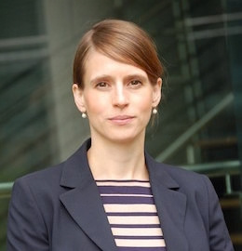


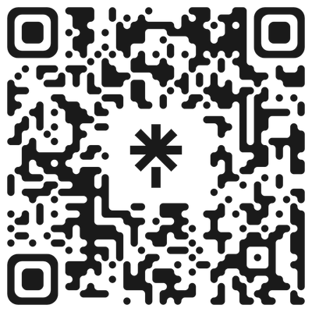
Thank You!
Contact Me
Simone Schütz-Bosbach
Püren Gürkan
Simon Knogler
Elif Gezen | elif.gezen@psy.lmu.de |TUM-IAS SoA Workshop 2026
18

