Slide 1
Rainfall Prediction
CSE454 - Project
Elifnur Kabalcı
1801042617

Slide 2
Content
Problem Definition
Data Cleaning
Exploratory Data Analysis(EDA)
Correlation Matrix
Encoding Categorical Data
Oversampling
Missing Data Pattern Analysis
Outlier Detection
MICE-Imputed Graphs - Pairplot Analysis
Data Standardizing and Feature Selection
Model Comparisons
Visualizing Decision Boundaries
Conclusion
Resources

Slide 3
Problem Definition
Develop a machine learning model to predict the likelihood of rainfall in Australia.
Utilize the "weatherAus.csv" dataset containing key meteorological variables like temperature, humidity, wind speed, and direction.
Provide reliable rainfall forecasts for individuals and businesses.
Aim is to provide recommendations for future rainfall event predictions.

Slide 4
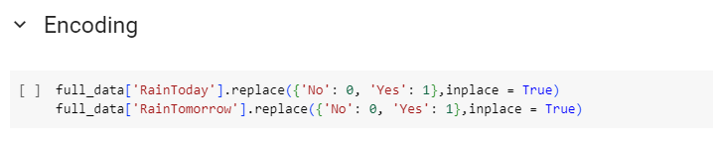
Data Cleaning
Fixed Nan values in the dataset.
RainToday and RainTomorrow features classified with 0’s and 1’s.

Slide 5
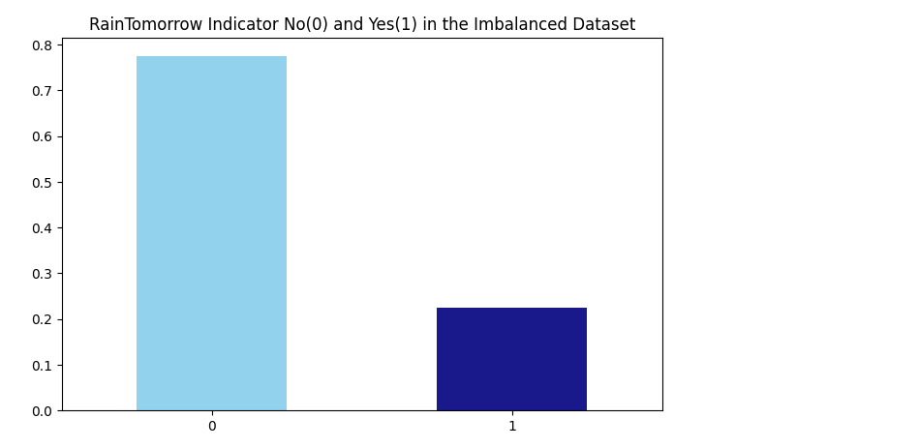
Exploratory Data Analysis
Distribution of RainTomorrow class

Slide 6
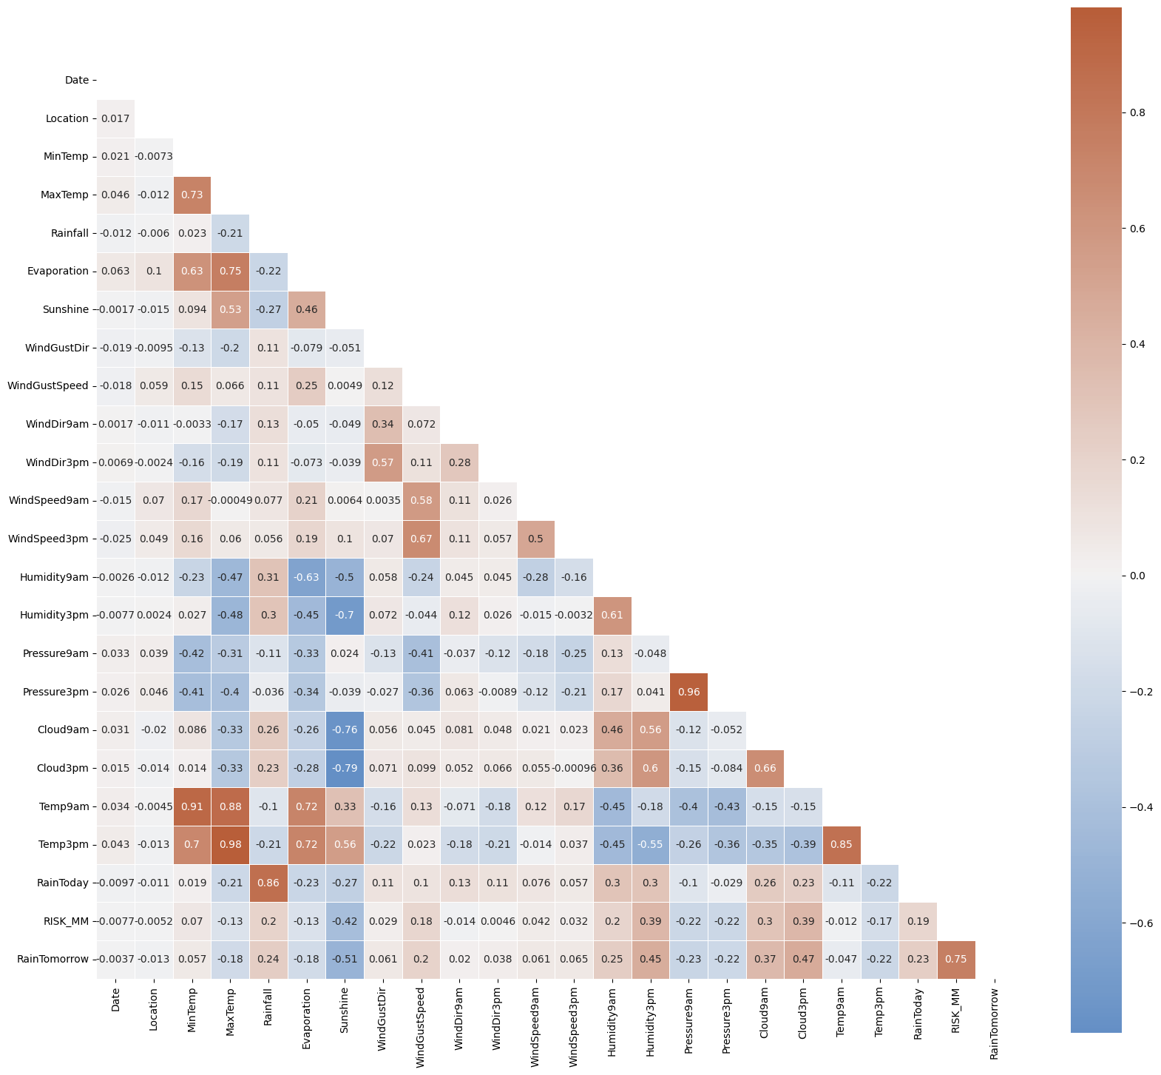
Correlation Matrix
A heatmap showcasing the strength and direction of relationships between dataset variables.
Correlation values range from -1 (perfect negative) to 1 (perfect positive), with 0 indicating no correlation.

Slide 7
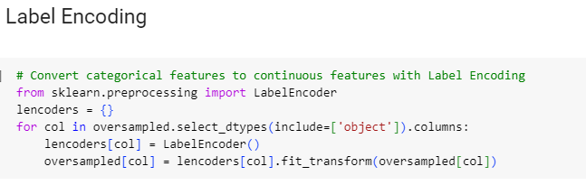
Encoding Categorical Data
Utilizes LabelEncoder from Scikit-learn for encoding.
Best for ordinal data where a ranking is inherent (e.g., 'small' as 0, 'medium' as 1).
Essential step to make categorical data understandable for ML algorithms.

Slide 8
Oversampling
Achieve class balance by increasing the minority class samples ('Yes’).
Method: Used of resample function from sklearn.utils to match 'Yes' samples with 'No' count.
Result: Balanced dataset with equal representation of both classes, around 50% each.

Slide 9
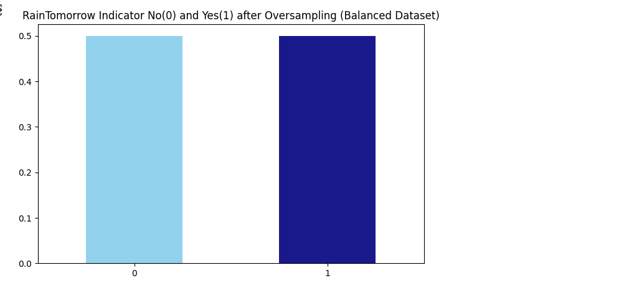
Oversampling – Advantages and Considerations
Benefit: Fairer and more consistent model predictions.
Challenge: Potential overfitting due to artificial replication of minority class samples.

Slide 10
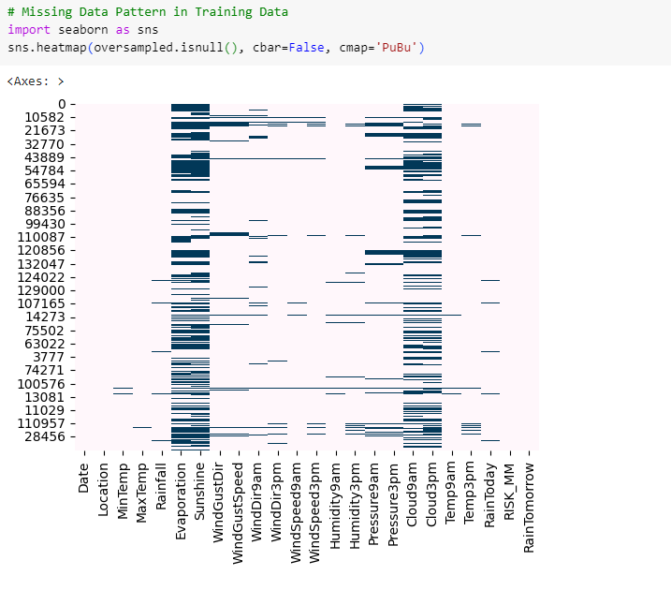
Missing Data Pattern Analysis
Heatmap showing missing data points in oversampled

Slide 11
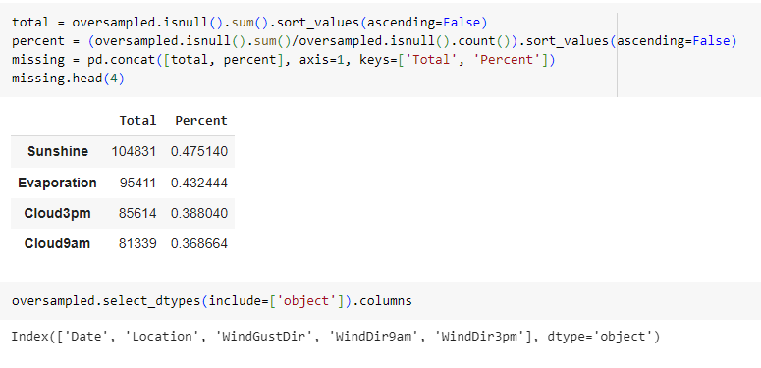
Missing Data Pattern Analysis
Calculation of missing values number and percentage in each column.

Slide 12
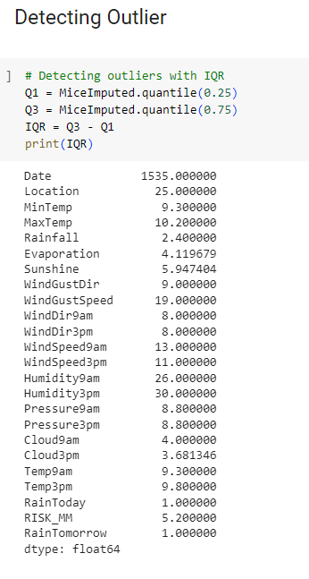
Outlier Detection
Method: Interquartile Range (IQR) method.
Process: Calculate Q1 (25% percentile) and Q3 (75% percentile) for each column in MiceImputed DataFrame.
IQR: Difference between Q1 and Q3, highlighting the middle 50% data spread.

Slide 13
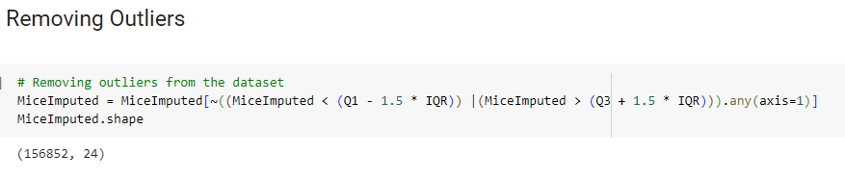
Outlier Detection - Removing
Implementation: Exclude values less than Q1 - 1.5IQR or greater than Q3 + 1.5IQR.
Technique: Use Boolean indexing (~) and any(axis=1) to remove rows with any outlier value.
Dataset reduced to 156,852 rows and 24 columns, indicating removal of outliers.

Slide 14
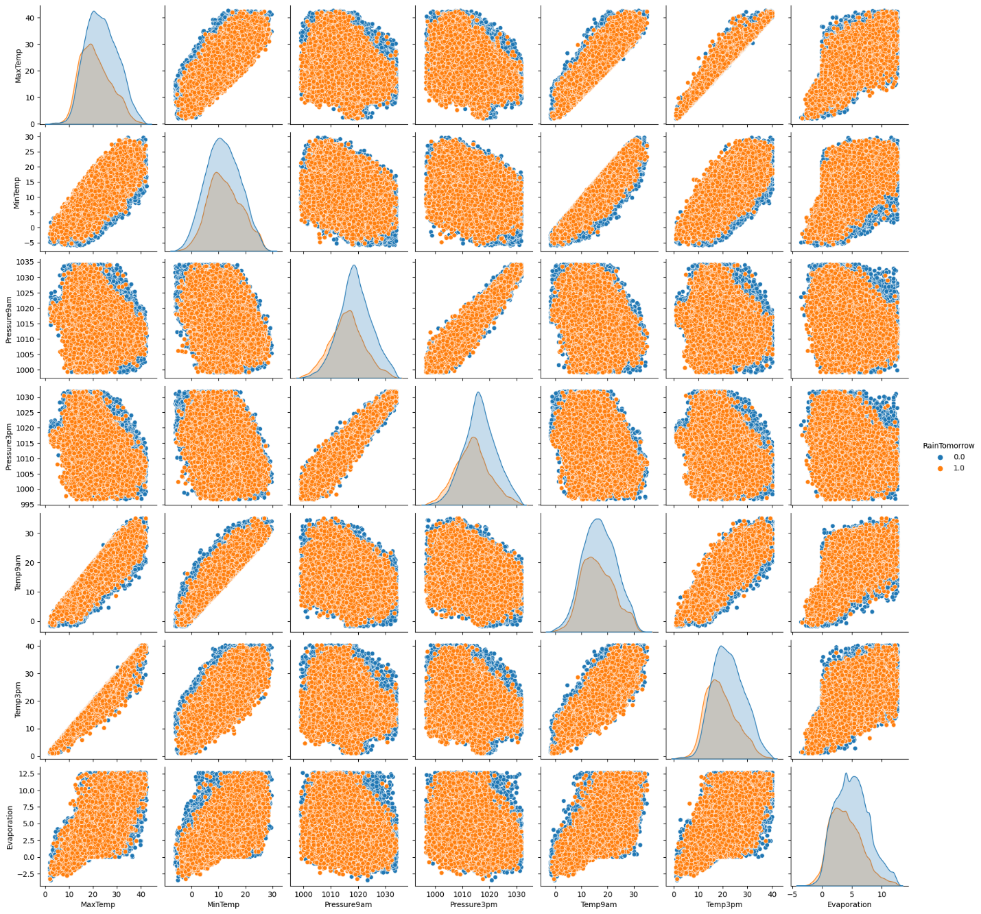
MICE-Imputed Graphs - Pairplot Analysis
Pairplot matrix using Seaborn's pairplot function.
Scatter Plots: Observe relationships between variable pairs (linear, non-linear, or no correlation).
Distribution Plots: Diagonal plots showing individual variable distribution.
Color Coding: Blue for no rain (0), orange for rain (1) days.
Positive correlation between MaxTemp and Evaporation (higher temperatures increase evaporation).
Almost perfect linear relationship between Pressure9am and Pressure3pm.
Rainy days typically show lower MaxTemp and Evaporation values.

Slide 15
Data Standardizing and Feature Selection
Scaling data using MinMaxScaler from the sklearn.preprocessing module.
Ensures all features are evaluated equally, critical for distance-based and optimization algorithms..
Using Chi-Square test to select important features for the target variable.
Reduces model complexity, improves training efficiency, and enhances model generalizability.

Slide 16
Model Comparisons
Algorithms | Best Accuracy
Logistic Regression | 78.96%
Decision Tree | 86.34%
Random Forest | 92.80%
XGBoost | 95.98%

Slide 17
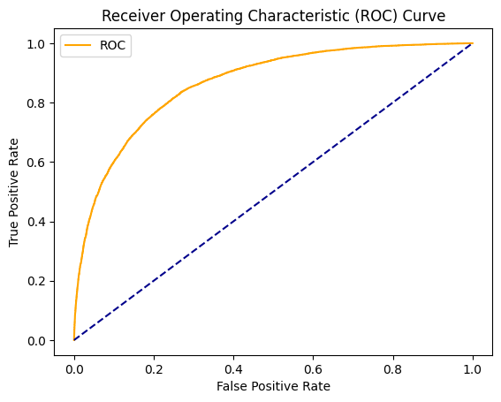
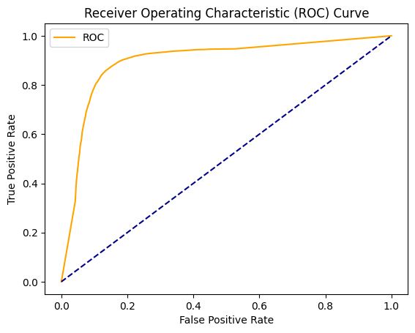
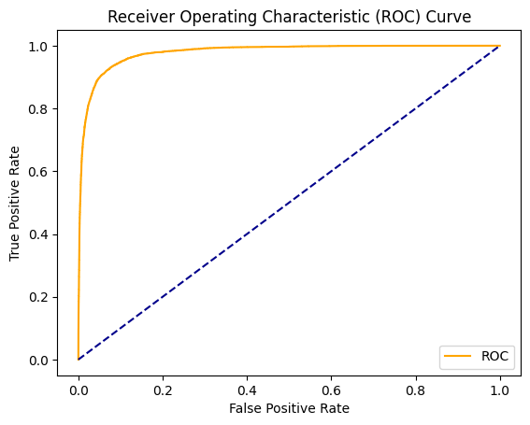

Model Comparisons - ROC Curves
Logistic Regression
Decision Tree
Random Forest
XGBoost

Slide 18
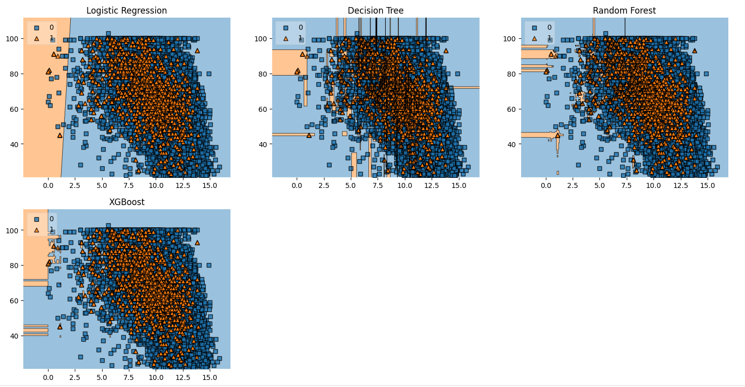
Visualizing Decision Boundaries
Visualization of decision boundaries for Logistic Regression, Decision Tree, Random Forest, XGBoost.
Basis: Classification based on "Sunshine" and "Humidity9am" features.
Logistic Regression: Linear and smoother boundary, suggesting linear separation.
Decision Tree: Irregular and sharper boundaries, potential overfitting indicator.
Random Forest: Complex yet regular boundaries, indicating diverse feature combination consideration.
XGBoost: Similar to Random Forest but smoother, capturing general trends more effectively.

Slide 19
Conclusion
Logistic Regression: Good baseline but room for improvement.
Decision Tree: Prone to overfitting, offers detailed insights.
Random Forest: Balanced and robust performance.
XGBoost: High accuracy, effective in handling complex patterns.

Slide 20
Resources
"Automated predictive analytics tool for rainfall forecasting." Scientific Reports. [Online]. Available: https://www.nature.com/articles/s41598-021-84102-0.
N. K. Goyal and V. Diwanji, "Machine learning techniques to predict daily rainfall amount." Journal of Big Data, vol. 6, no. 1, Dec. 2019. [Online]. Available: https://journalofbigdata.springeropen.com/articles/10.1186/s40537-019-0266-3.
N. Oswal, "Predicting Rainfall using Machine Learning Techniques," ResearchGate, 2020. [Online]. Available: https://www.researchgate.net/publication/341844875_Predicting_Rainfall_using_Machine_Learning_Techniques.
"Rainfall Prediction System Using Machine Learning Fusion for Smart Cities," PMC, 2021. [Online]. Available: https://www.ncbi.nlm.nih.gov/pmc/articles/PMC9099780/. [Accessed: Jan. 25, 2024].

Slide 21
Thank You

