Slide 1
BLG 527E Machine Learning
FALL 2021-2022
Assoc. Prof. Yusuf Yaslan & Assist. Prof. Ayşe Tosun
Clustering

Slide 2
Unsupervised Learning
The collection of unlabelled data
Discover the groups/clusters or patterns within the data
Dimensionality Reduction and Clustering are two important examples

Slide 3
Semiparametric Density Estimation
In parametric models, we assume a single model for p(x|C_{i})
Simple as the problem reduces to the estimation of a few parameters (e.g. mean and covariance for Gaussian)
The selected parametric model may be a source of bias.
Semiparametric density estimation, we assume a parametric model for each group in the sample. But we do not know how many groups we have in the data.

Slide 4
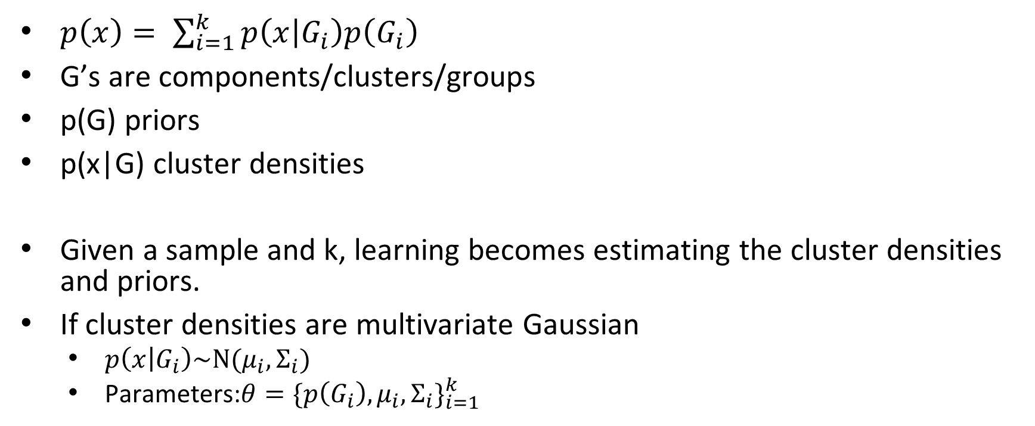
Mixture densities
$p\left(x\right)= \sum_{i=1}^{k}{p\left(x | G_{i}\right)p\left(G_{i}\right)}$
G’s are components/clusters/groups
p(G) priors
p(x|G) cluster densities
Given a sample and k, learning becomes estimating the cluster densities and priors.
If cluster densities are multivariate Gaussian
$p\left(x | G_{i}\right)\sim N(μ_{i},Σ_{i})$
Parameters:$θ={\{p\left(G_{i}\right),μ_{i},Σ_{i}\}}_{i=1}^{k}$

Slide 5
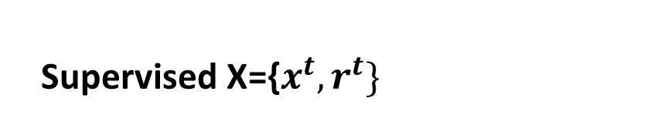
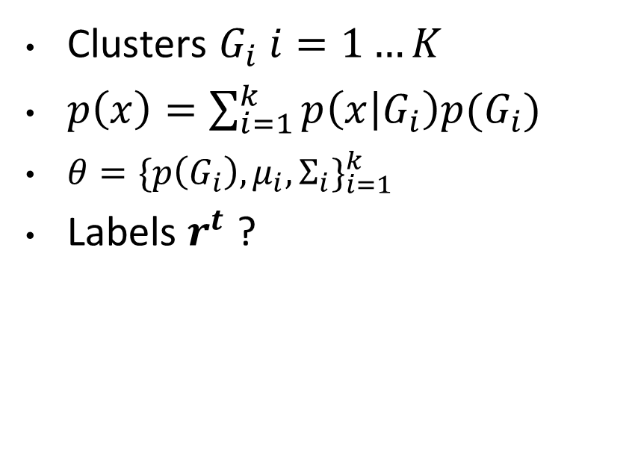

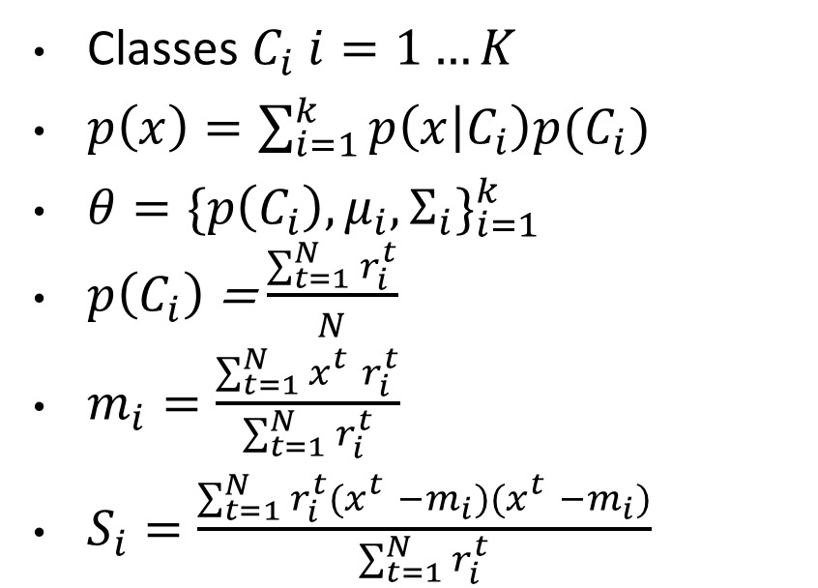
Classes versus Clusters
Supervised X={$x^{t}, r^{t}\}$
Unsupervised X={$x^{t}\}$
Classes $C_{i} i=1…K$
$p\left(x\right)=\sum_{i=1}^{k}{p\left(x | C_{i}\right)p(C_{i})}$
$θ={\{p\left(C_{i}\right),μ_{i},Σ_{i}\}}_{i=1}^{k}$
$p\left(C_{i}\right)$ = $\frac{\sum_{t=1}^{N}{r_{i}^{t}}}{N}$
$m_{i}=\frac{\sum_{t=1}^{N}{x_{}^{t}r_{i}^{t}}}{\sum_{t=1}^{N}{r_{i}^{t}}}$
$S_{i}=\frac{\sum_{t=1}^{N}{{r_{i}^{t}(x}_{}^{t}−m_{i}){(x}_{}^{t}−m_{i})}}{\sum_{t=1}^{N}{r_{i}^{t}}}$
Clusters $G_{i} i=1…K$
$p\left(x\right)=\sum_{i=1}^{k}{p\left(x | G_{i}\right)p(G_{i})}$
$θ={\{p\left(G_{i}\right),μ_{i},Σ_{i}\}}_{i=1}^{k}$
Labels $r^{t}$ ?
Notes:
First, estimate labels, then estimate parameters

Slide 6
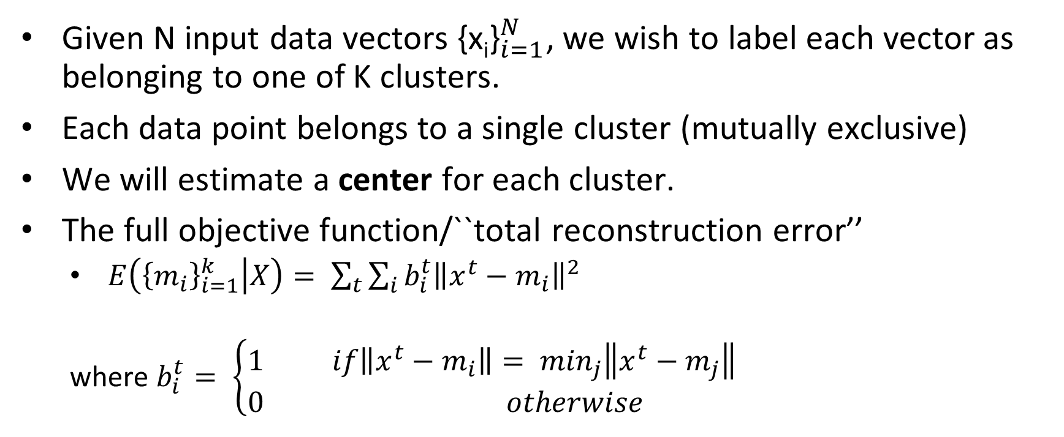
K-Means Clustering
Given N input data vectors ${\text{\{}\text{x}\text{i}\text{\}}}_{i=1}^{N}$, we wish to label each vector as belonging to one of K clusters.
Each data point belongs to a single cluster (mutually exclusive)
We will estimate a center for each cluster.
The full objective function/``total reconstruction error’’
$E\left({\left\{m_{i}\right\}}_{i=1}^{k} | X\right)= \sum_{t}{\sum_{i}{b_{i}^{t}{\left\|x^{t}−m_{i}\right\|}^{2}}}$
where $b_{i}^{t}= \left\{\begin{aligned}1 if\left\|x^{t}−m_{i}\right\|= \min_{j}\left\|x^{t}−m_{j}\right\| \\ 0 otherwise \end{aligned}\right.$
Cannot be optimized in closed form
Notes:
This objective function penalizes the distance between each data point and the center of the cluster
to which it is assigned. Hence, to minimize this error, we want to bring the cluster centers close to
the data it has been assigned, and we also want to assign the data to nearby centers.

Slide 7
Pseudocode for k-means
Initialization
Random labelling (not recommended)
Mean of all data + small random vectors to get k initial means
Random data points as centers
Principal components and take the means of these groups
Multiple restart
Figure from Alpaydin 2010. Chapter 7, Introduction to Machine Learning

Slide 8
Visualisation of k-means
CS229 Lecture notes, Andrew Ng, 2003

Slide 9
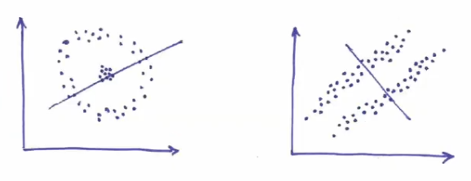
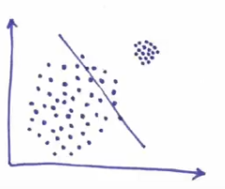
Drawbacks of k-means
It can stuck in local minima
It does not work on non-spherical clusters
inspired from Lecture Notes, D. Kobak, Clustering and EM, Uni of Tübingen

Slide 10
Mixtures of Gaussians (MoG)
Generalization of K-means
K-means works for clusters that are approximately spherical, MoG handle non-spherical and overlapping clusters.
MoG algorithms compute a “soft,” probabilistic clustering
MoG model is probabilistic, and so it can be used to learn probability distributions from data.

Slide 11
Example: Gaussian Mixture Density
From C. Bishop 2003 Mixture of Gaussians and EM Part I, BCS Summer School, Exeter

Slide 12
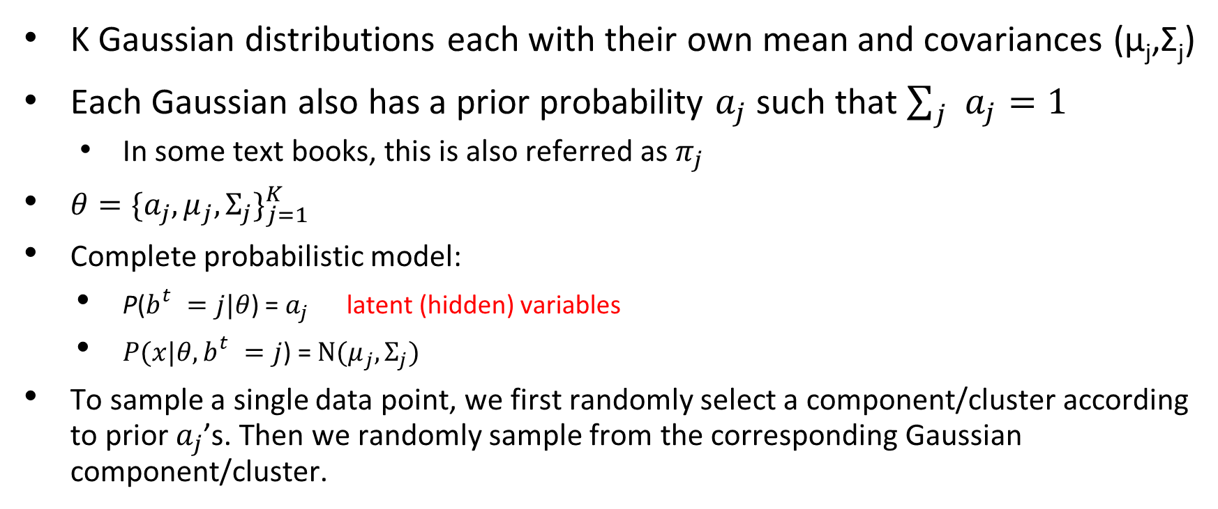
MoG Model
K Gaussian distributions each with their own mean and covariances (µ_{j},Σ_{j})
Each Gaussian also has a prior probability $a_{j}$ such that $\sum_{j}{a_{j}}=1$
In some text books, this is also referred as $π_{j}$
$θ={\{a_{j},μ_{j},Σ_{j}\}}_{j=1}^{K}$
Complete probabilistic model:
P($b_{}^{t}=j|θ$) = $a_{j}$ latent (hidden) variables
$P(x|{θ, b}_{}^{t}=j$) = $N(μ_{j},Σ_{j})$
To sample a single data point, we first randomly select a component/cluster according to prior $a_{j}$’s. Then we randomly sample from the corresponding Gaussian component/cluster.

Slide 13

MoG versus K-Means
In MoG, you can set shared and/or spherical covariance matrices.
If $Σ=σ^{2}Ι$ , this becomes close to K-Means
Suggestion: Start MoG with a k-means solution

Slide 14
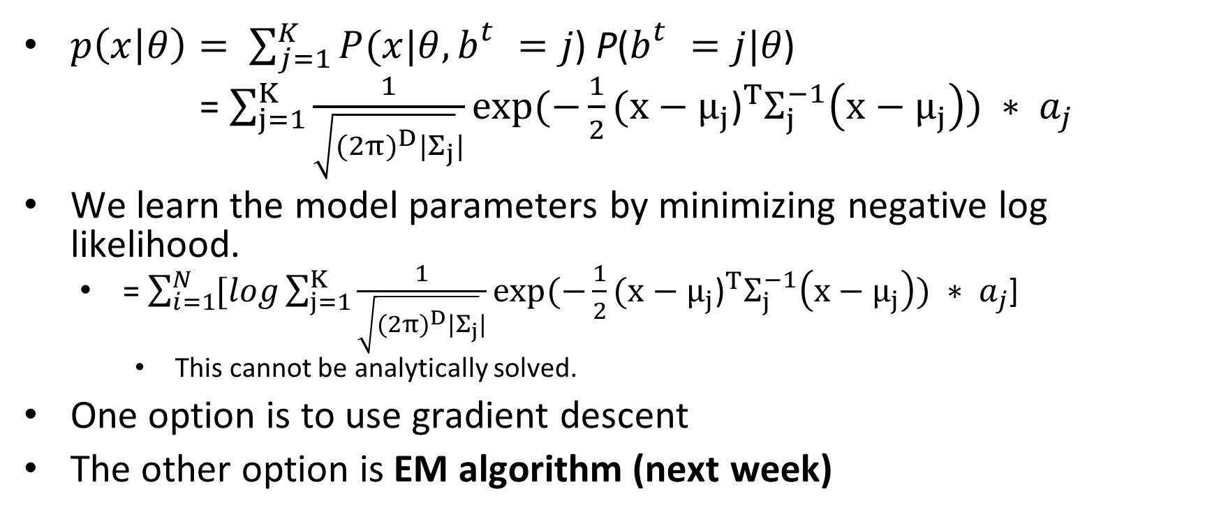
MoG model (cont’d)
$p\left(x | θ\right)= \sum_{j=1}^{K}{P(x|{θ, b}_{}^{t}=j\text{)} \text{P}\text{(}b_{}^{t}=j|θ\text{)}}$
= $\sum_{j=1}^{K}{\frac{1}{\sqrt{{(2π)}^{D}|Σ_{j}}|}exp⁡(−\frac{1}{2}{(x−μ_{j}\text{)}}^{T}Σ_{j}^{−1}\left(x−μ_{j}\right)\text{)} }{ ∗ a}_{j}$
We learn the model parameters by minimizing negative log likelihood.
= $\sum_{i=1}^{N}{[log}\sum_{j=1}^{K}{\frac{1}{\sqrt{{(2π)}^{D}|Σ_{j}}|}exp⁡(−\frac{1}{2}{(x−μ_{j}\text{)}}^{T}Σ_{j}^{−1}\left(x−μ_{j}\right)\text{)} }{ ∗ a}_{j}$]
This cannot be analytically solved.
One option is to use gradient descent
The other option is EM algorithm (next week)

Slide 15
Gradient descent versus EM
Both iterative
Both can converge to a local minimum
EM does not need a learning rate
Gradient descent requires post-processing on parameters such that the prior probabilities add up to 1, or all covariance matrixes are positive-definite

Slide 16
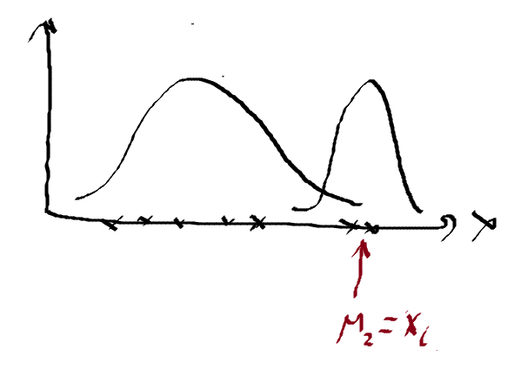
Divergence in MoG
Means converges/diverges to a single data point that maximizes the likelihood, as the covariance goes to 0.
In such cases,
Reset the algorithm by randomly setting a new mean and covariance
Put constraints on σ
MoG does not work on non-Gaussian components.
inspired from Lecture Notes, D. Kobak, Clustering and EM, Uni of Tübingen

Slide 17
After Clustering
CRM, Customer segmentation
As preprocessing to create new k dimensional space and fit different models for each dimension

Slide 18
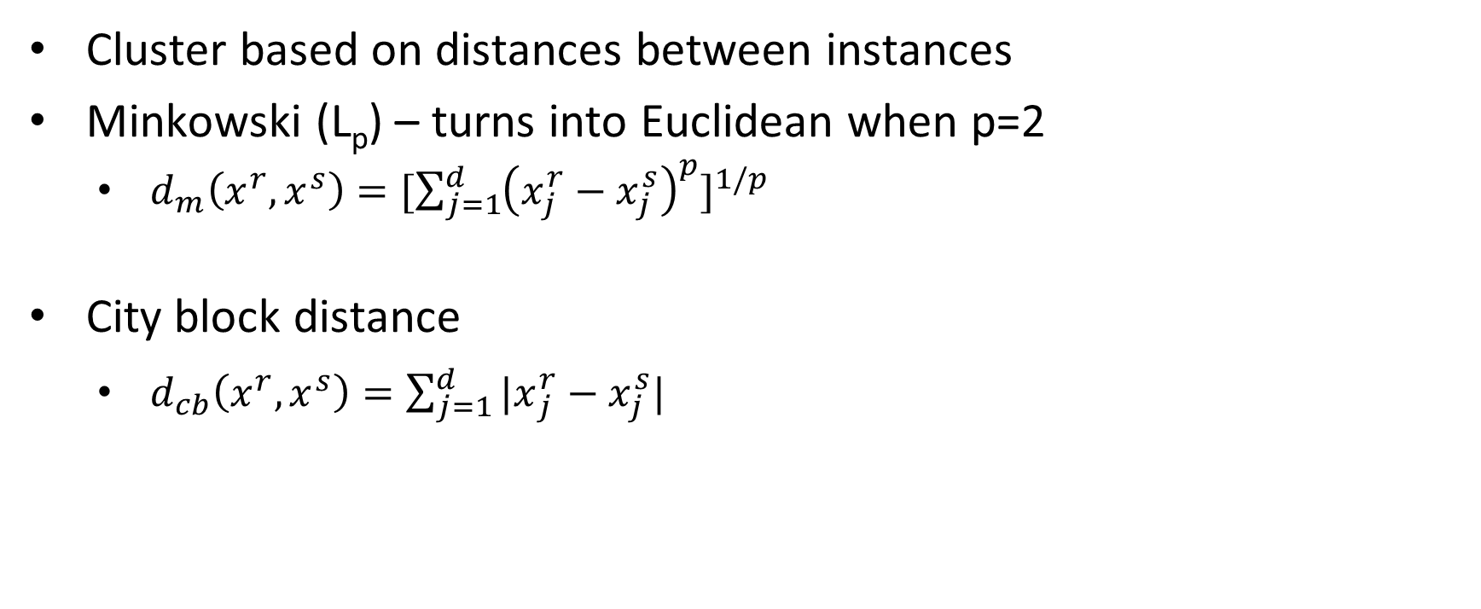
Hierarchical Clustering
Cluster based on distances between instances
Minkowski (L_{p}) – turns into Euclidean when p=2
$d_{m}\left(x^{r},x^{s}\right)={[\sum_{j=1}^{d}{{\left(x_{j}^{r}−x_{j}^{s}\right)}^{p}}]}^{1/p}$
City block distance
$d_{cb}\left(x^{r},x^{s}\right)={\sum_{j=1}^{d}{{|x}_{j}^{r}−x_{j}^{s}|}}^{}$

Slide 19
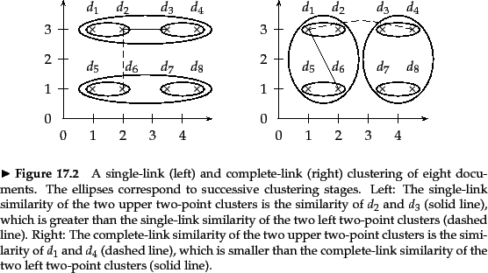
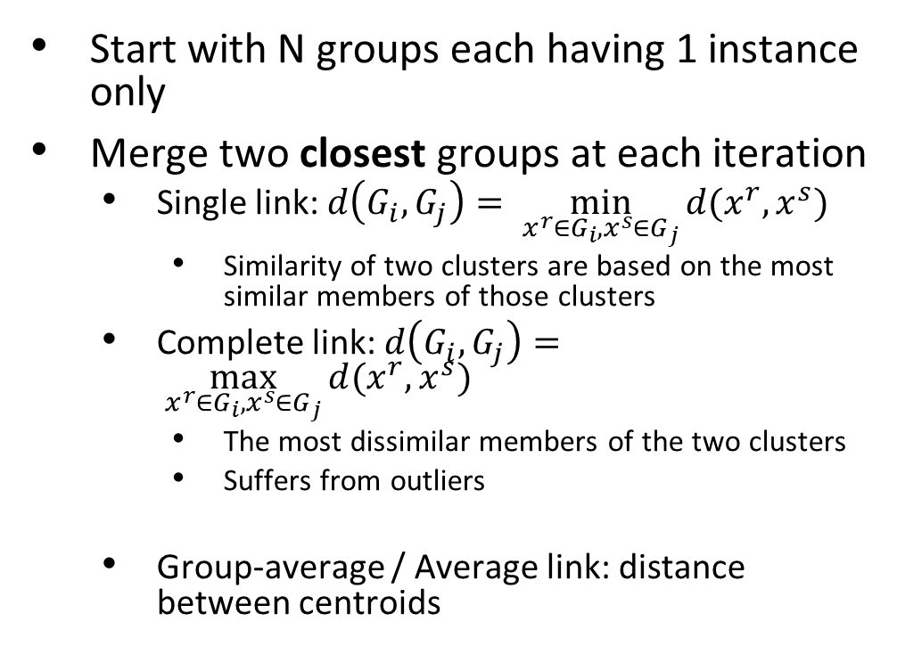
Agglomerative Clustering
Start with N groups each having 1 instance only
Merge two closest groups at each iteration
Single link: $d\left(G_{i},G_{j}\right)= \min_{x^{r}∈G_{i},x^{s}∈G_{j}}{d(x^{r},x^{s})}$
Similarity of two clusters are based on the most similar members of those clusters
Complete link: $d\left(G_{i},G_{j}\right)= \max_{x^{r}∈G_{i},x^{s}∈G_{j}}{d(x^{r},x^{s})}$
The most dissimilar members of the two clusters
Suffers from outliers
Group-average / Average link: distance between centroids
Figure from C.D. Manning, P.Raghavan and H. Schütze, Introduction to Information Retrieval, Cambridge University Press. 2008.

