Slide 1
Machine Learning Project – Option 3
Elif Özcan
İrem Onur

Slide 2
The Dataset Creation
While creating the dataset we used 6 features as follows: ”paper title, paper abstract, paper published conference, cited paper title, cited paper published conference, cited paper abstract”
We tried multiple ways to create the data.
For the final dataset we combined the text columns and categorized the conference columns.
After embedding the text data we used PCA for dimensionality reduction.
The train – test ratio is 0.7 to 0.3
 | ”all-MiniLM-L6-v2 | all-mpnet-base-v2 | paraphrase-MiniLM-L3-v2
Train | 5403, 197 | 5403, 262 | 5403, 173
Test | 2316, 197 | 2316, 262 | 2316, 173

Slide 3
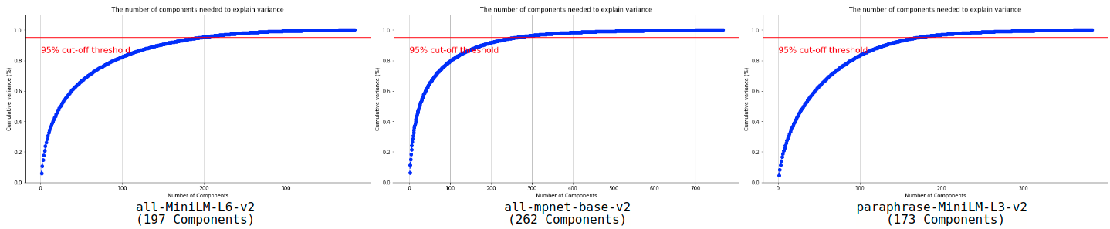
PCA Graphs

Slide 4
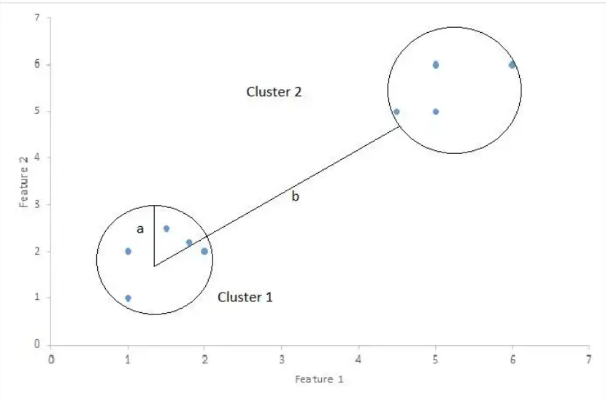
Performance Metrics
Silhouette Score: he Silhouette Score is used to measure the separation distance between clusters. It displays a measure of how close each point in a cluster is to points in the neighboring clusters. This measure has a range of [-1, 1].
Calinski-Harabasz Index: The score is defined as the ratio between the within-cluster dispersion and the between-cluster dispersion. A high CH means better clustering since observations in each cluster are closer together while clusters themselves are further away from each other.
Silhouette Score

Slide 5
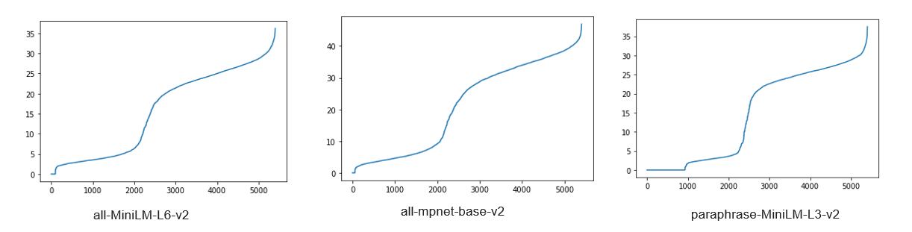
DBSCAN
DBSAN is a density based clustering algorithm which is groups data samples together based on their distances and minimum number of points to core.
For DBSCAN algorithm we optimized 3 parameters epsilon, min_samples and distance metric.
For epsilon we used Nearest Neighbors algorithm used the max value curvation.

Slide 6
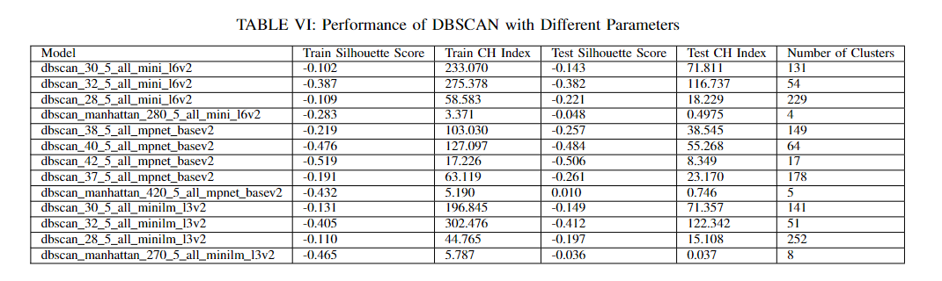
min_samples = 2 * dimensions or min_samples = dimensions + 1
For the distance metric we used euclidean and manhattan distances.

Slide 7
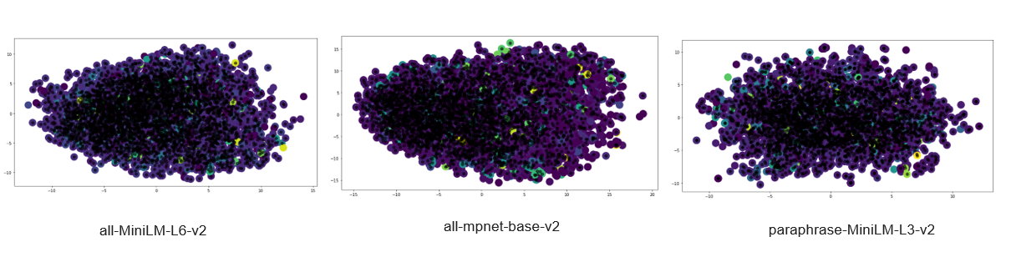
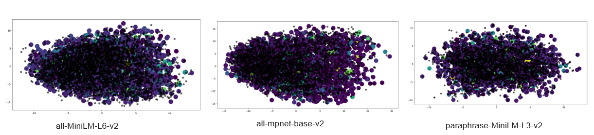
Training data
Test data

Slide 8
Gaussian Mixture
Gaussian mixture models assume that there are certain number of Gaussian distributions in data and each of this distributions are a cluster, and attempts to find mixture of multi-dimensional Gaussian probability distributions in the data, means that GMMs try to group data of a distribution into a cluster.
In GM algorithm we used n components, max iter, covariance type, init params for performance optimization.
For max iter we tried 100 and 1000, for the covariance type full and spherical and fot init params we used kmens, kmeans++, randon and random from data.
While determining the number of clusters we used both Akaike information criterion (AIC) or the Bayesian information criterion (BIC) adn Elbow method.

Slide 9
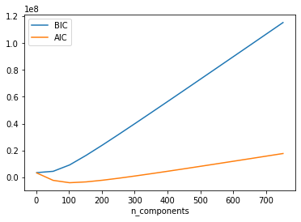
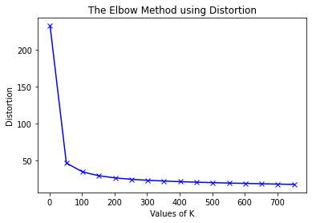

Slide 10
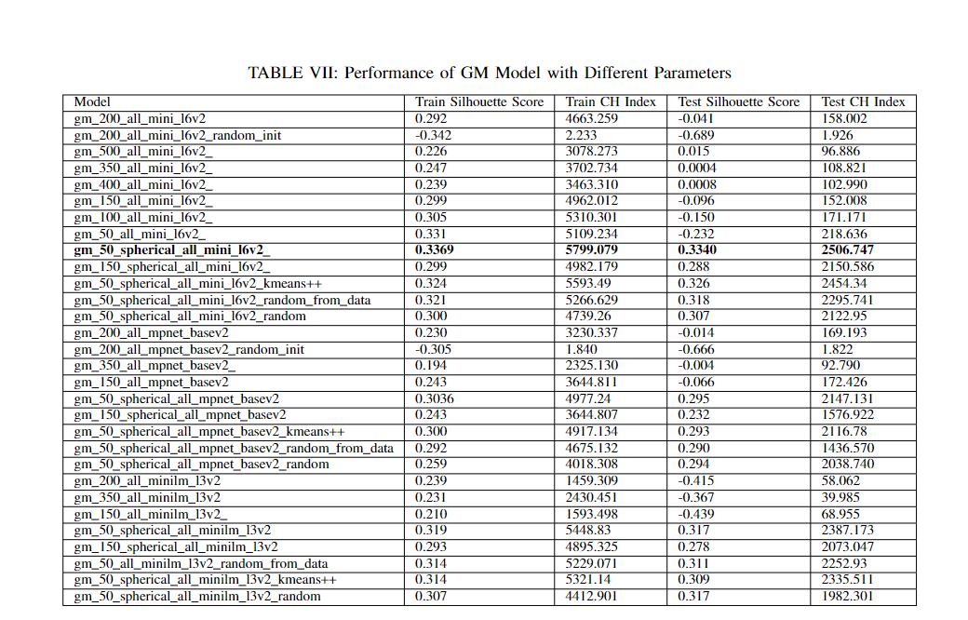

Slide 11
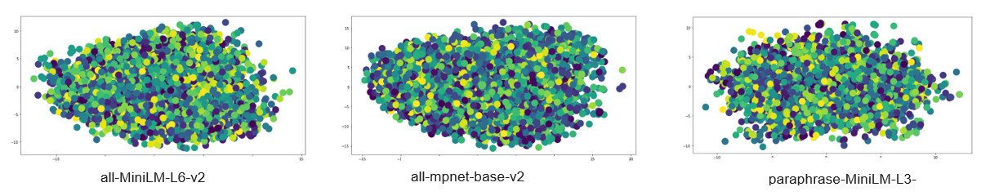
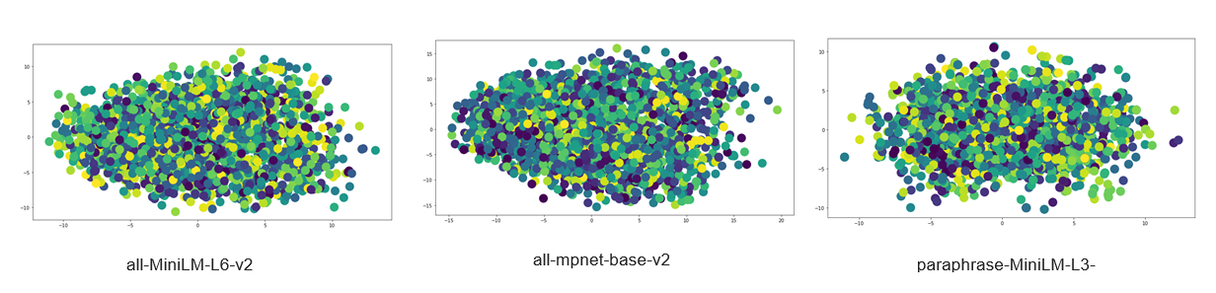
The GM Clustering Results on The Train Data (n components=50, covariance type =’spherical’, max iter=1000)
The GM Clustering Results on The Test Data (n components=50, covariance type =’spherical’, max iter=1000)

Slide 12
Clustering Analysis
The best model we obtained is Gaussian Mixture Model with number of clusters as 50, covariance type as ”spherical” and max iter parameter as 1000 with ”all-MiniLM-L6-v2” as pre-trained sentence transformer model.
The number of clusters are 50.

Slide 13
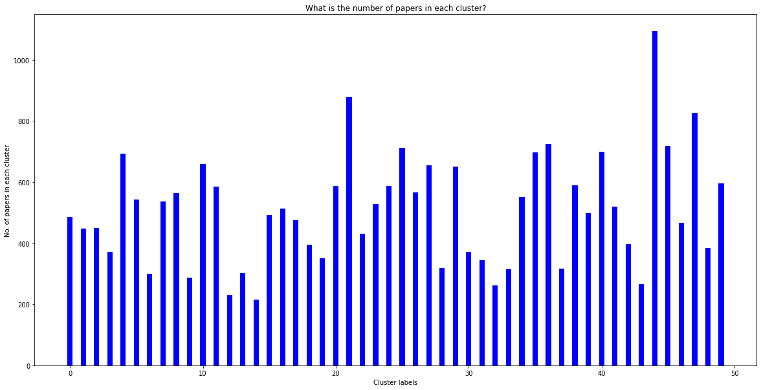

Slide 14
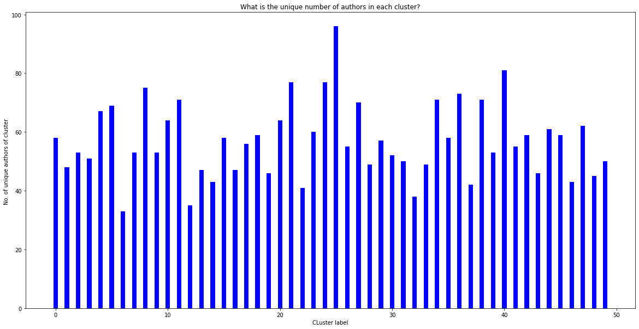

Slide 16
Clustering Authors
For clustering authors we combined the text data from the paper clustering of every author and embedded the data with the all-MiniLM-L6-v2 model
For the number of clusters we again used Elbow method.

Slide 17
Semantic Search
For sematic search we used ”msmarco-distilbert-base-v4” as pre-trained sentence transformer
Dataset we used ”paper abstract” as corpus and ”paper title” feature as text to find the closest paper
As performance measure we used sum of paper-title match over all data
The embedding models performance was 0.698 and for improving the performance we tried scaling the data nad then PCA for dimensionality reduction. After reducing the dimeonsions the data shape changed form (2587, 768) to (2587, 296) and the performance of the semantic search is improved to 0.761.

