Slide 1
Customer Retention
XGBoost and MLP
Enterprise Application

Slide 2
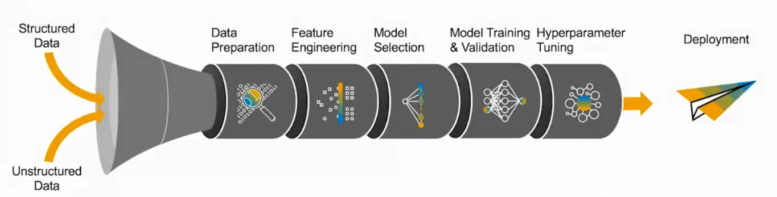
Machine Learning Pipeline
1
2
3
4
5

Slide 3
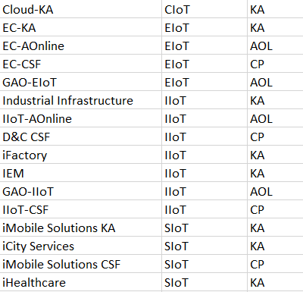
Data Preparation
Customer Categorization
Training data is derived from sales order starting from 2019 to today
Exclude sales orders for sectors: gaming, service and design
Exclude customers whose last order date is older than 2 years from today.
Generate customer features from sales orders: Recency, Frequency, Monetary
Calculate RFM score using quantile method
Standardize Monetary data to ensure all values are using z-score normalization
Encode customer type (one-hot-encoding):
Key Account (KA)
Channel Partner (CP)
E-Commerce Customer (AOL)

Slide 4
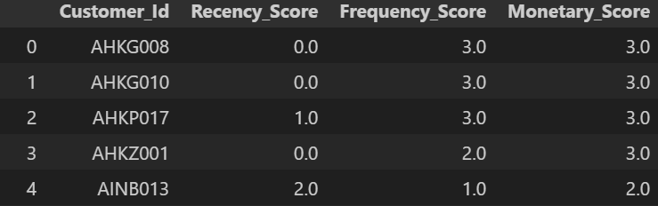
RFM Calculation
A rank (bin value) from 1 to 4 is given to the each Customer in terms of Recency, Frequency and Monetary values by using the quantile method.
As a result Recency, Frequency and Monetary Score of each customer is obtained
RFM_SCORE =
A1 x Recency_Score +
A2 x Frequency_Score +
A3 x Monetary_Score
Where a1, a2, a3 are the weights of each individual score.

Slide 5
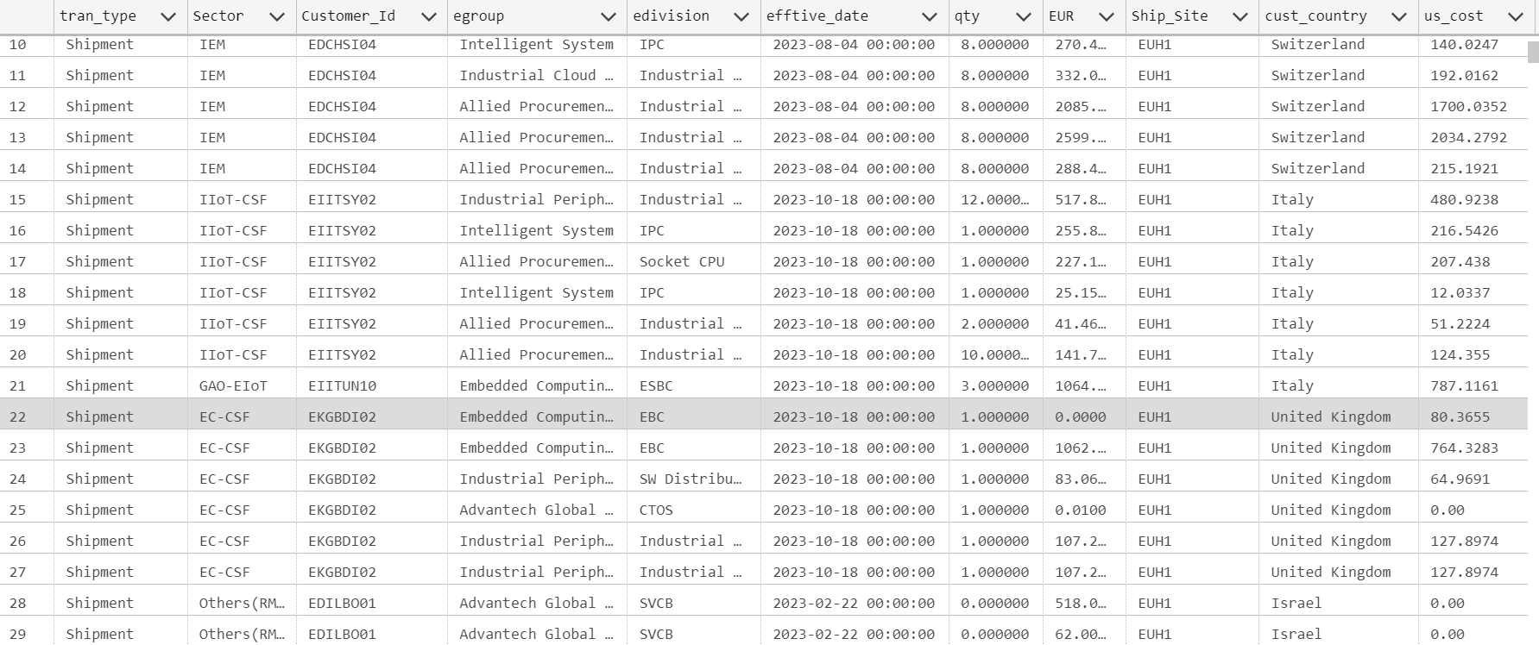
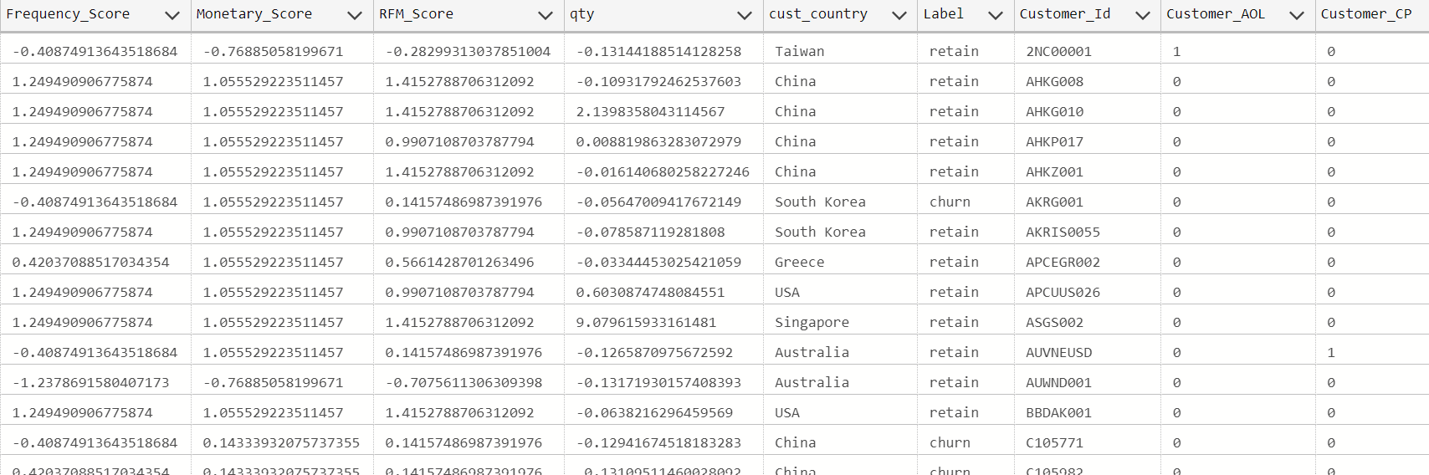
Example Training Data vs Original Data
Original data
Preprocessed data

Slide 6
Outlier Removal
Z-score is a statistical measure that quantifies how far a data point is from the mean in terms of standard deviations.
Z = (X - μ) / σ
The customers exceeding a certain threshold in terms of their Frequency and Monetary Value are identified as outliers.

Slide 7
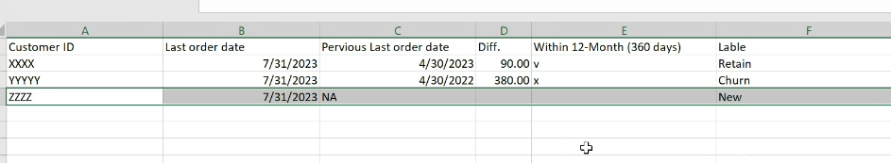
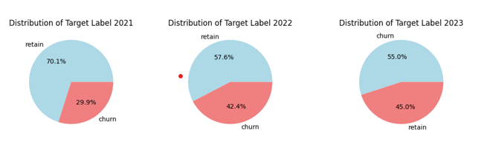
Label Strategy
365

Slide 8
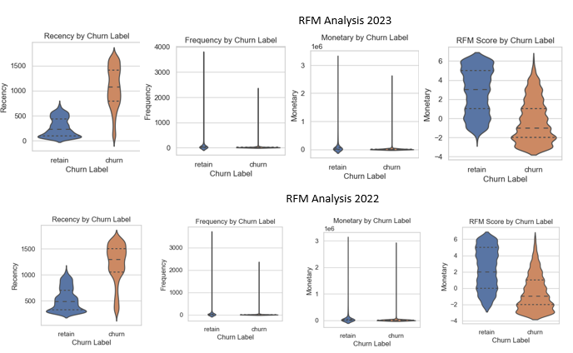
Data Analysis (EDA)

Slide 9
Feature Selection
When last time customer place an order? (Recency)
How often customer create orders? (Frequency)
How much amount a customer place order? (Monetary)
Recency, Frequency, Monetary (RFM) Score
Customer category: CP, KA, AOL
Total order quantity

Slide 10
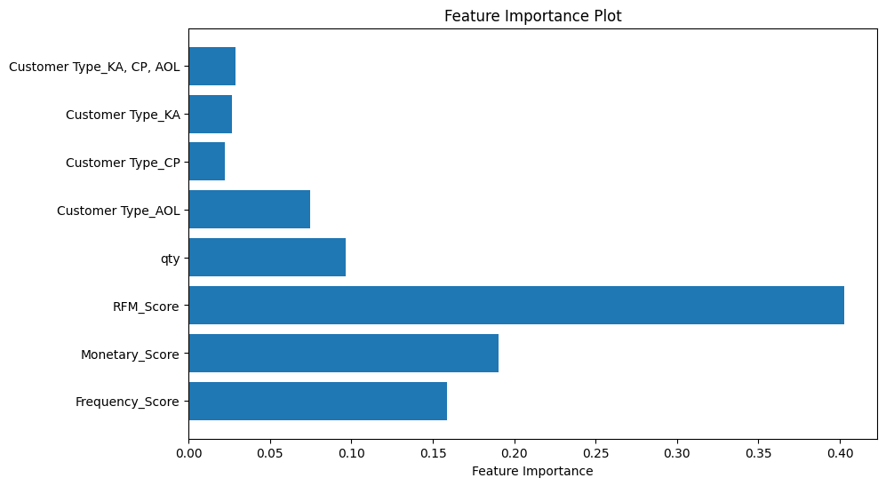
Feature Importance
Anova Test
Correlation Filter
Variance Filter
Mutual Information Gain

Slide 11
Model Selection
The models XGBoost and Multi-Layer Perceptron (MLP) are frequently used in similar tasks and are robust to the nature of our sales data.
XGBoost
Multi-Layer Perceptron
Learning Rate = 0.1
Max Depth = 5
N Estimators = 100
Epochs = 10-15 (Early stopping)
Batch size = 32
Two hidden layers with 64 and 32 neurons
Activation function, Sigmoid
Cost Function : binary-crossentropy
Reference:
https://www.researchgate.net/publication/341974494_Machine_LearningStructural_Equation_Modeling_Algorithm_The_Moderating_role_of_Loyalty_on_Customer_Retention_towards_Online_Shopping
https://thesai.org/Publications/ViewPaper?Volume=11&Issue=7&Code=IJACSA&SerialNo=85

Slide 12
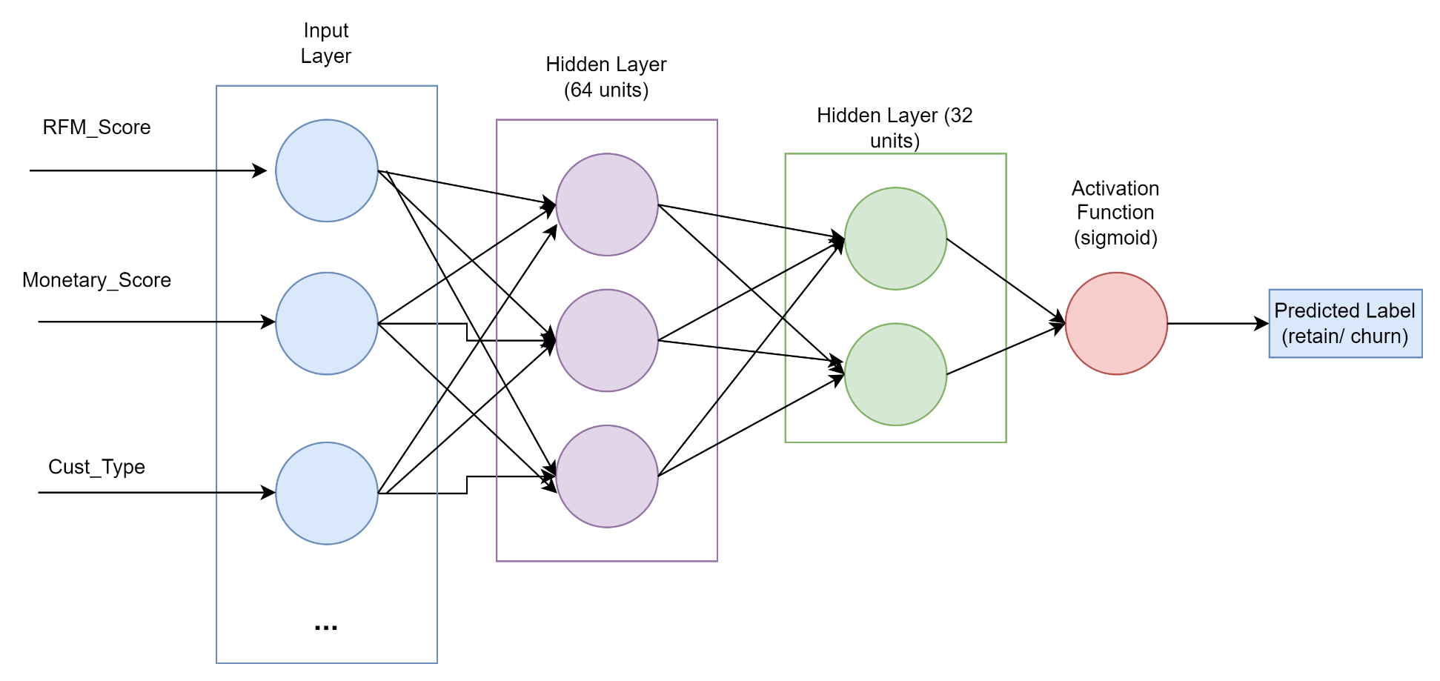
MLP STRUCTURE
…
Sigmoid function outputs the probability between 0 and 1 (probability of belonging to class 1)
To binarize, we consider the output probability. Retain if probability is > 0.5, churn otherwise.

Slide 13
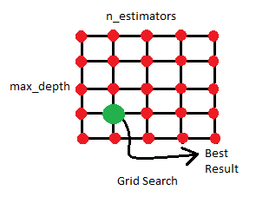
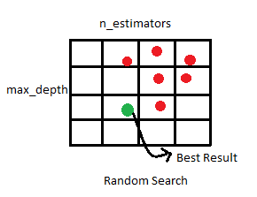
Hyperparameter Tuning
Hyperparameter tuning is performed using GridSearchCV algorithm.
The algorithms searches for the optimal subset of hyperparameters that give the best performance.
The hyperparameter optimization is implemented in a way that it optimizes the hyperparameters each time the training is performed.

Slide 14
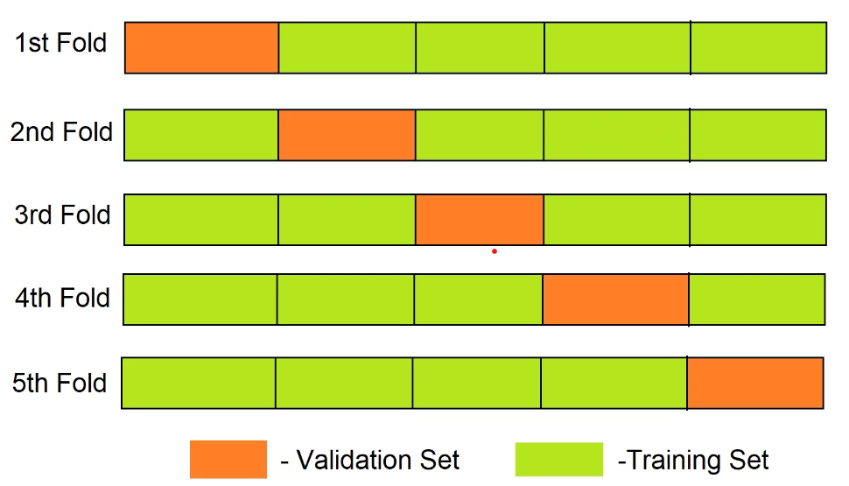
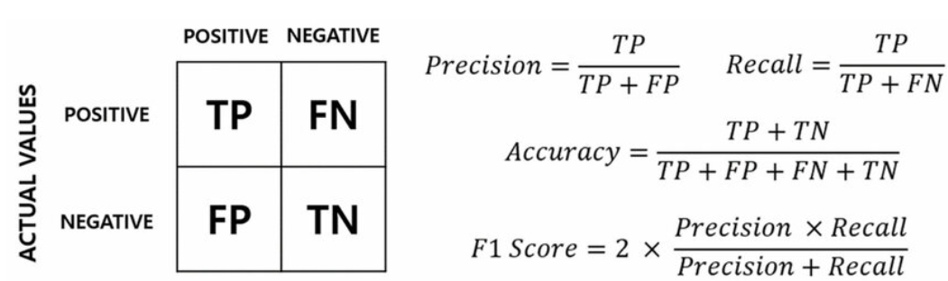
Model Training
In the training process, the data is split into the train and test sets using Stratified 5 Fold Cross Validation, then the intermediate training results are yielded.
The prioritized performance metrics used in the evaluation are precision, recall and F1-Score.
K-fold Cross validation

Slide 15
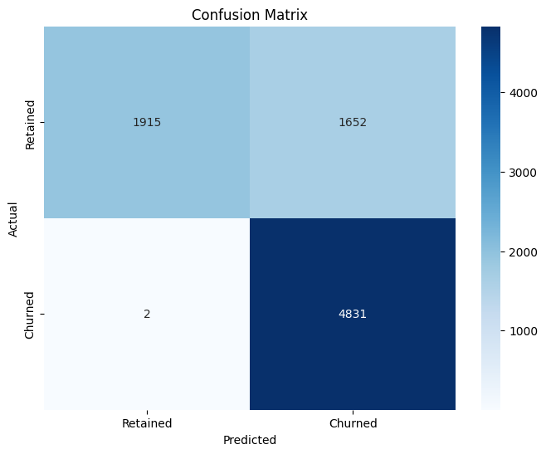
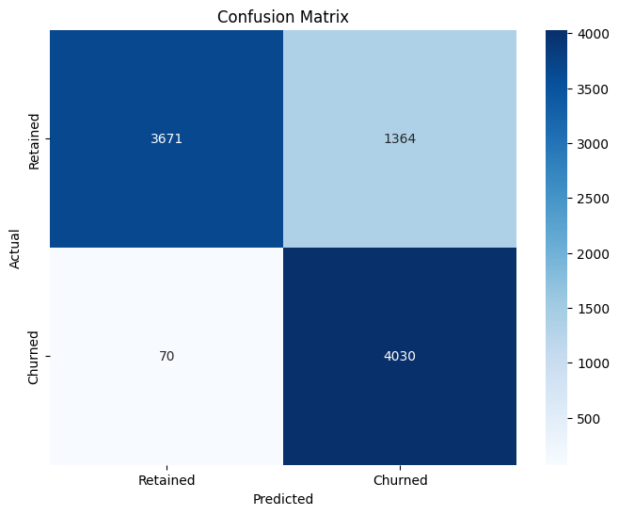
XGBOOST Performance
Prediction Year | F1-Score | Accuracy | Precision
2021 | 58% | 71% | 50%
2022 | 80% | 79% | 81%
2023 | 82% | 80% | 82%
2022
2023

Slide 16
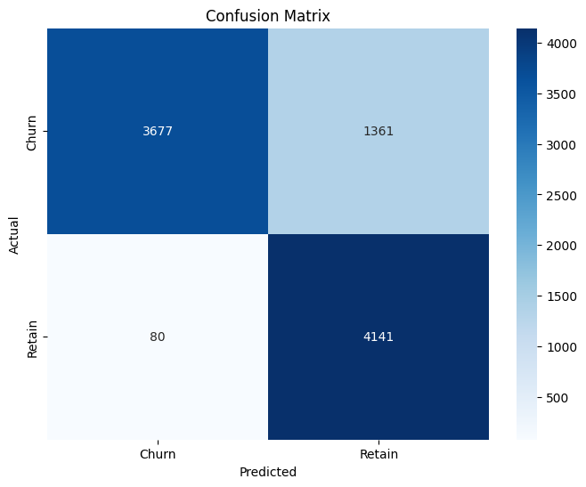

MLP Performance
Prediction Year | F1-Score | Accuracy | Precision
2021 | 41% | 70% | 49%
2022 | 82% | 82% | 80%
2023 | 83% | 82% | 81%
The retained customers indicate obvious pattern
2023
2022

Slide 17
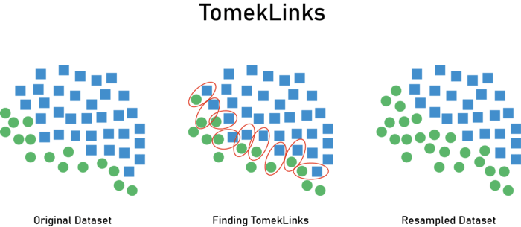
DATA IMBALANCE
Data imbalance causes the trained model to be biased, therefore it underfits the minority class.
In the case of 2021 : more than 70% of the customers are labeled as churn according to the labeling strategy.
To overcome the bias caused by class imbalance, we perform automatic under sampling to the training data via Tomek Links method
During Preprocessing
Check if one of the class makes up more than 60% of the dataset
If yes -> find the closest neighbors to the instances near the decision boundary (Euclidean distance)
Remove the found instances which belong to the majority class

Slide 18
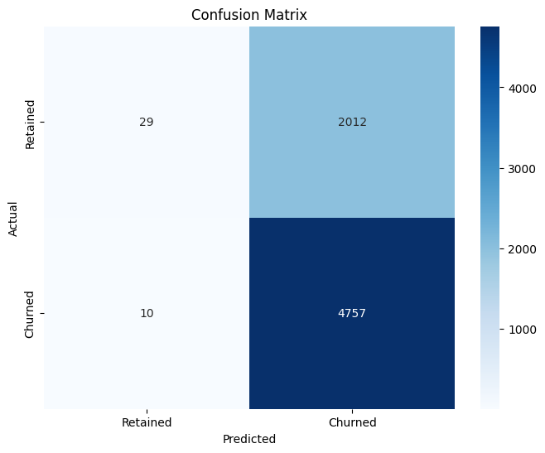
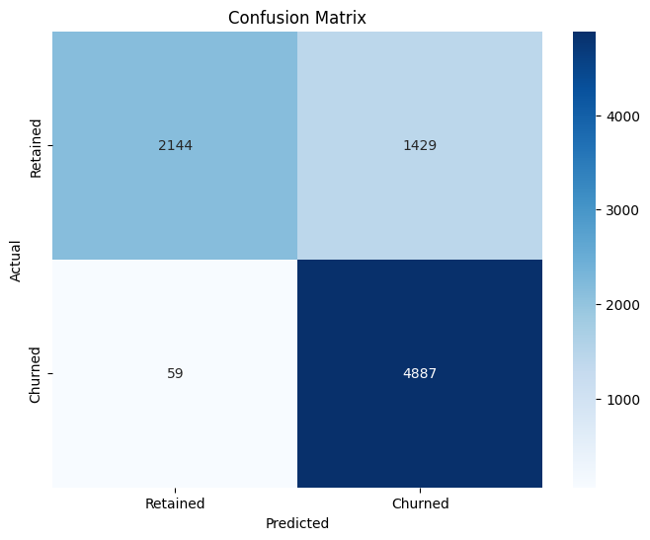
Data Balacing Impact
Results for 2021 | F1-Score | Accuracy | Precision
Imbalanced | 41% | 70% | 49%
Balanced | 79% | 80% | 85%
1346
695
There’s still some error, but much less compared to the imbalanced case

Slide 19
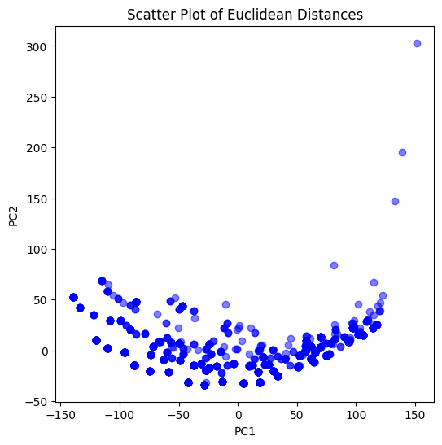
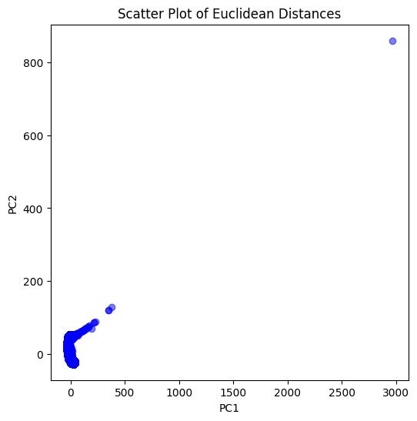
WHY MLP?
Both models perform reasonably well in terms of their performance metrics.
Incorrectly classified customers by the trained models are further investigated
The resulting analysis indicates that the incorrectly classified customers identified by MLP are indeed more closer to the opposite class.
Euclidean distance between incorrectly classified instances and the instances belonging to predicted class
XGBoost
DNN

Slide 20
XGBoost
DNN
First Principal Component of the Correct Class
First Principal Component of the Correct Class
First Principal Component of the Predicted Class
First Principal Component of the Predicted Class

Slide 21




Training Flowchart
1. Data (re)Training : to be scheduled once in 3 months
Fetch training data
Train model
Trigger python
Save model & model information
Trained Model

Slide 22

Inference & Data Update Flowchart
2. Data Update : To be scheduled daily
Connect and fetch most up-to-date data
Save prediction
Pass to the pipeline
Build features & preprocess
Trigger python
Predict churn
Save training/preprocessed data
Predictions

Slide 23
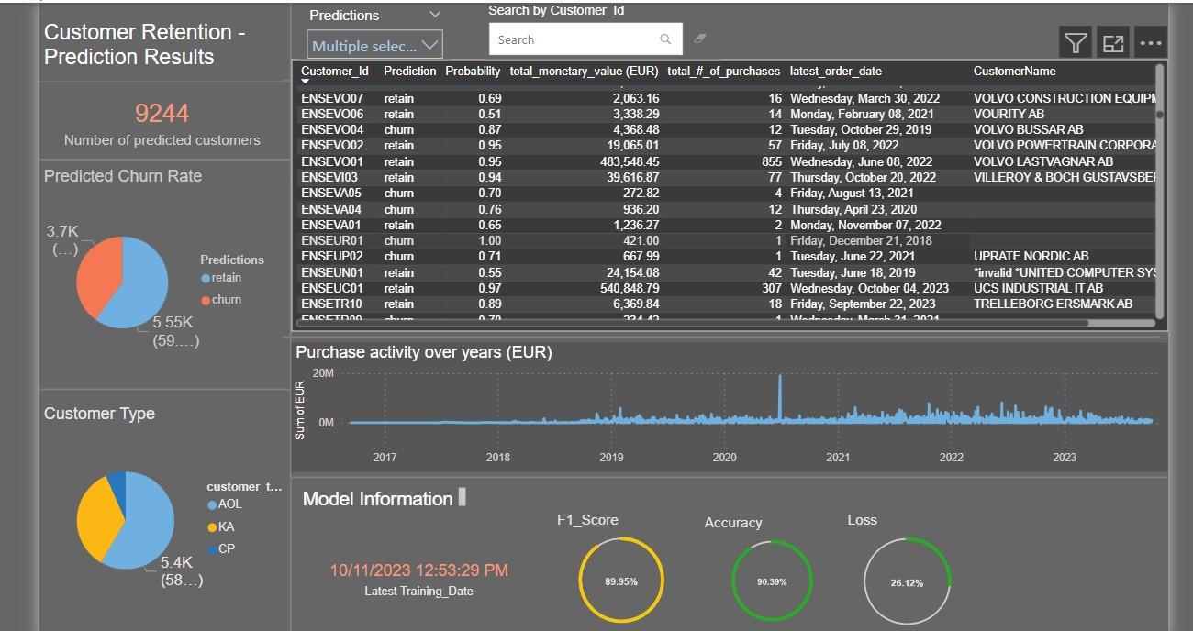

Slide 24
Business Cases
Personalized product recommendations to increase cross-selling and upselling
Predicting customer churn and offering tailored discounts or incentives to retain customers
Optimizing email marketing campaigns based on customer preferences and behaviors

Slide 25
Thank You !

