Slide 1
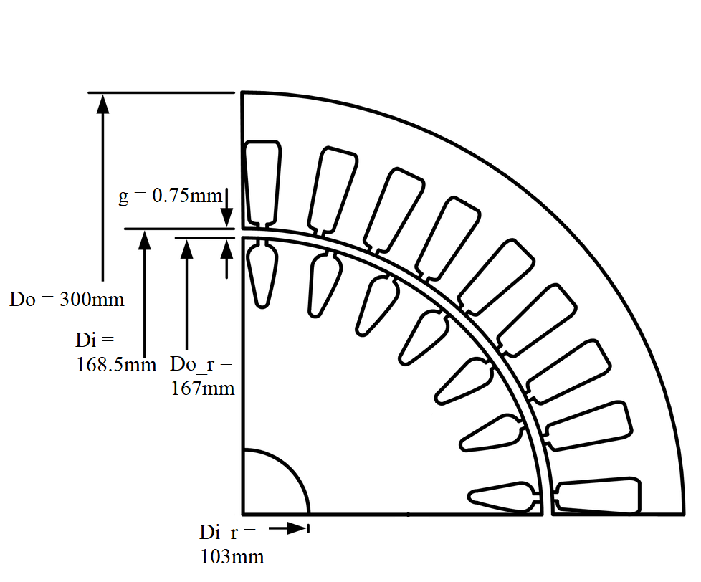
0.87mm
13mm
3.1mm
24mm
170
168.5
75

