Slide 1
Data Analysis
Pens & Printers

Slide 2
Business goals
Reduction of amount of unsold products in certain warehouses
low sales in certain regions causes pile up of unsold products which could have been sold in other regions
Development of marketing strategies based on
trends in high sales region
balance between supply and demand in low sales region

Slide 3
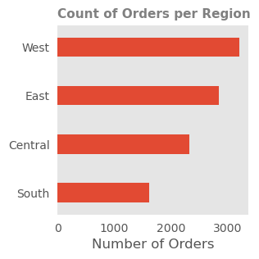
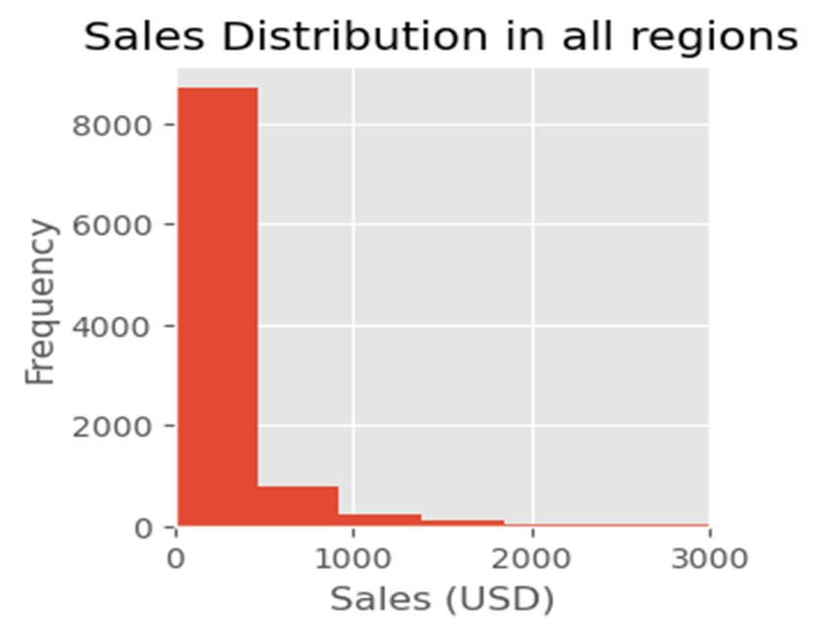
Key findings
Are there any products that do not sell as well in some locations?
The West has the highest number of orders while the South has the least number of orders.
Most orders are valued at less than one thousand dollars

Slide 4
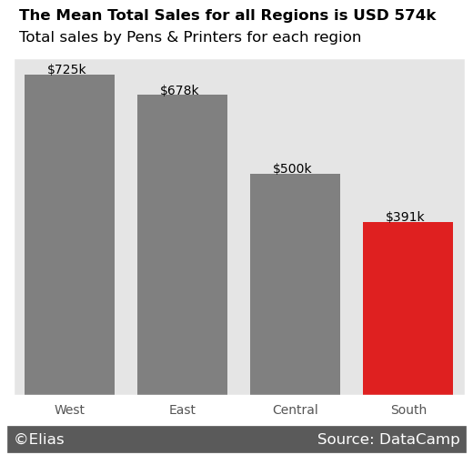
Key findings
Are there any products that do not sell as well in some locations?
The mean of the total sales for all regions is a little over usd 574k. The Central and South regions have total sales less than the mean of total sales for all regions. This is consistent with them having the lowest number of orders.

Slide 5
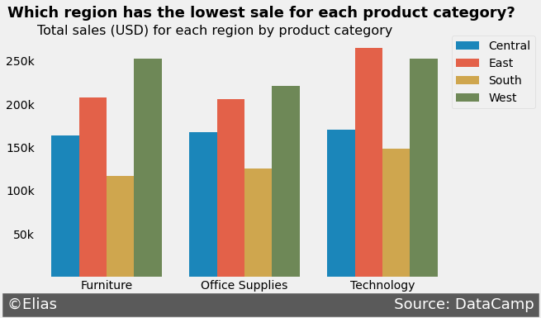
Key findings
Are there any products which do not sell as well in some locations?
Furnitures sell significantly lower in the South when compared to the West which sells at about double the total sales of the South.
Technology in the East also sells at almost double the amount in the South.

Slide 6
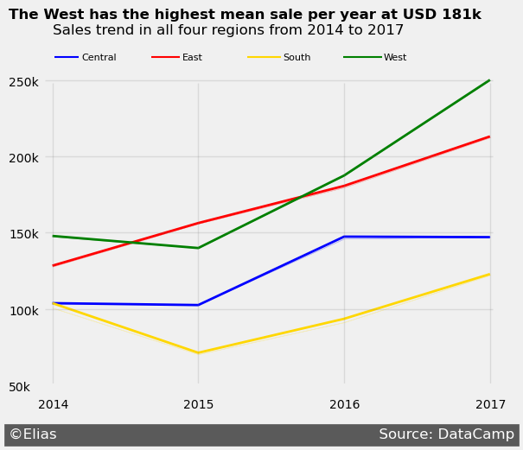
Key findings
Are there any other patterns over time in each region that you can find in the data?
The West and South appear to have followed the same trend since 2017 with the only difference being in total sales.
The East has experienced a progressive increase in total sales since 2014 even when other regions experienced dips or stagnancy.
The Central region only experienced increase in sales from 2015 to 2016 with plateaus for every other year.

Slide 7
recommendations
Reduction of unsold products in warehouses
More furniture products should be moved from the south to the west
More technology products should be moved from the south to the east.
The marketing department should conduct a research on
Reasons for steady growth in the East over those four years
Similarities between the South and West and the possibility of apply the strategies of the West to the South.
Reasons for lack of significant growth in the Central region

