Slide 1
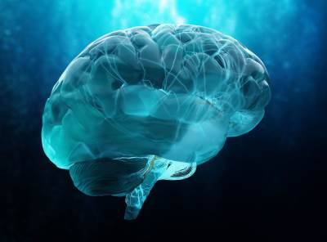
Using deidentified CT brain scan data to predict brain health in older people.
By Elijah Hayward
Supervisor: Gillian Dobbie
SCI077

Slide 2
Project Overview
Use machine learning (XGBoost) to predict dementia based on medical data.
Analyse the impact of CT brain scans and assisted residential care (ARC) data.
Focus on accurately diagnosing dementia.

Slide 3
Background
55+ million people affected globally.
Early diagnosis helps manage treatment and care.
Current diagnosis methods: clinical tests, medical imaging, psychological assessments.

Slide 4
Methodology
Given a dataset from Middlemore Hospital (165 patients).
Clean data and extract features
Perform feature selection and hyperparameter tuning
Run model using XGBoost package
Extract model results and metrics
Create new model and repeat

Slide 5
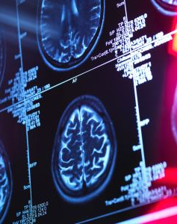
Key Results
Removed “Treatments for Dementia” in dataset
Best model was using Recursive Feature Elimination (RFE)
Performance:
Accuracy: 73.4%
Sensitivity: 84.5%
AUC: 75.9%
ARC data wasn’t very impactful on model performance but CT data was

Slide 6
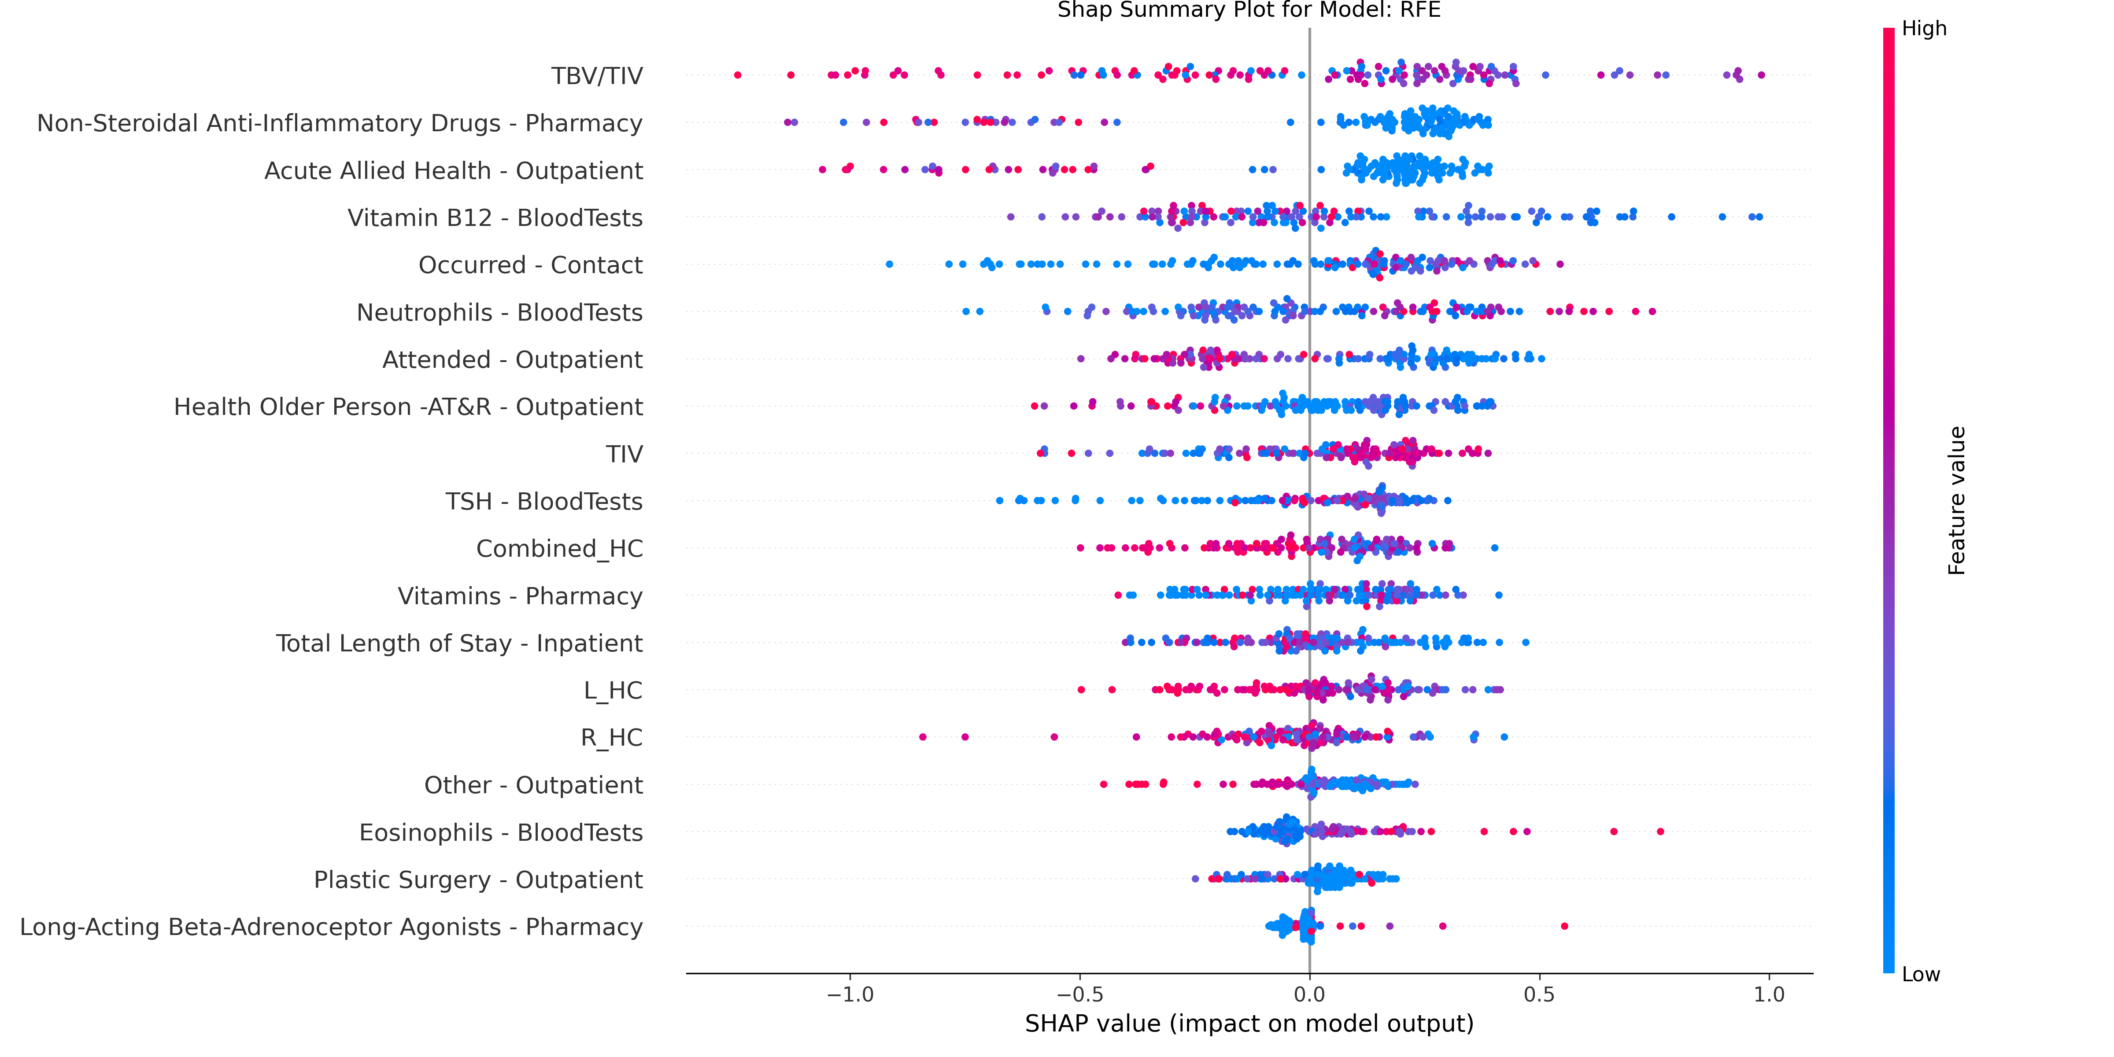
SHAP plot showing different features contribution

Slide 7
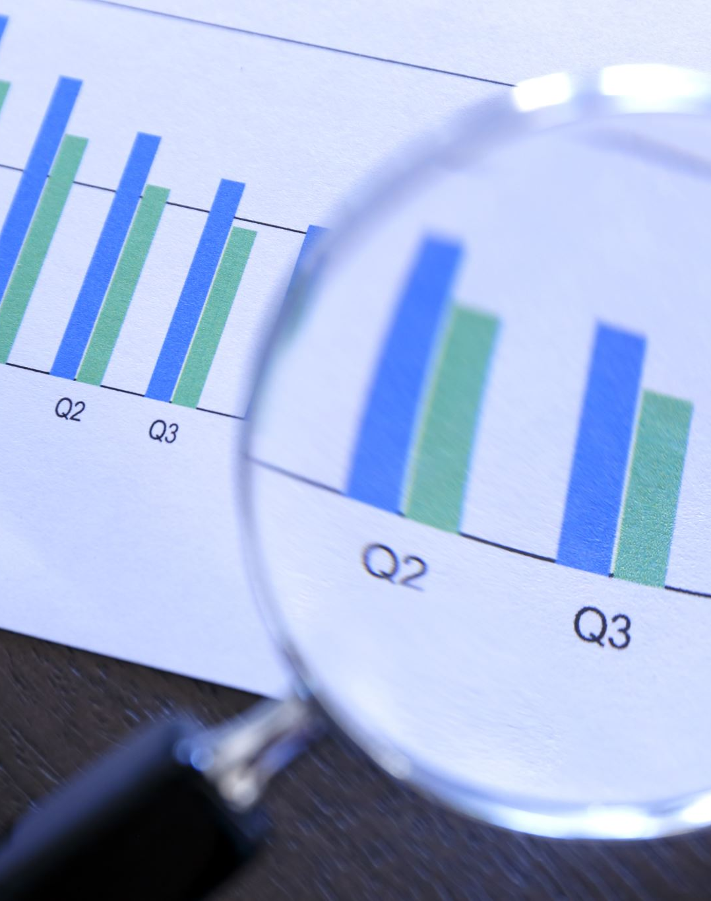
Conclusions
CT data useful when "Treatments for Dementia" feature is removed.
ARC data had minimal impact on model performance.
RFE helped simplify the model and improved accuracy by focusing on key features.

Slide 8
Future Work and Limitations
Create an indicator of future risk of developing dementia
1
Consider dates of data
2
Expand dataset to improve generalisability.
3

Slide 9

Acknowledgements
Gillian Dobbie
Cristian Gonzalez Prieto
Patrice Delmas

