Slide 1

Mushroom Edibility Prediction Micro-Project 1 https://github.com/elijahcw-git/ANA500-PFDS/tree/main/Microproject_1
Elijah C Walker
5 August 2023

Slide 2

Problem Statement
Background: A dataset containing various characteristics of mushrooms will be utilized to investigate which features are most indicative of a mushroom's edibility. The dataset consists of attributes like odor, cap color, veil color, and habitat, with the target variable "Class" having two categories: edible and poisonous. Distinguishing between poisonous and edible mushrooms is crucial, as ingestion of toxic mushrooms can lead to severe health issues, including hallucinations and even death. This study aims to explore the attributes that contribute to a mushroom's edibility to aid in better identification and decision-making.

Slide 3
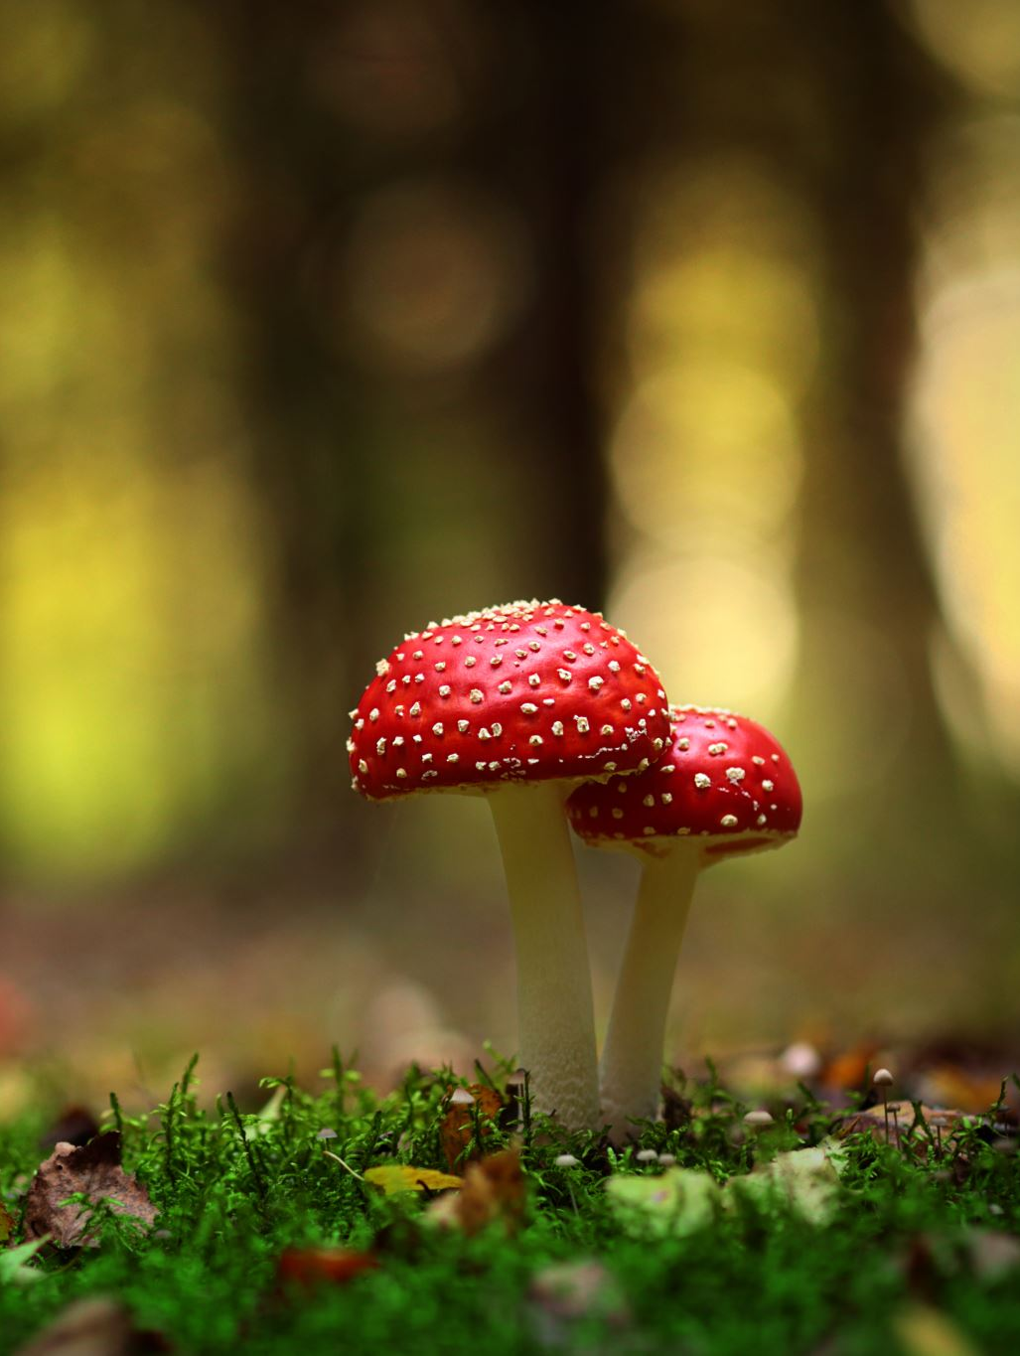
Objectives
Identify Indicative Characteristics: The primary objective is to determine which characteristics strongly correlate with a mushroom's edibility. By analyzing the dataset, we will identify the features (e.g., odor, cap color, veil color, habitat) that have the largest impact on a mushroom being poisonous or edible.
Assess the Significance of Notable Features: We will investigate whether certain features, such as odor, cap color, veil color, and habitat, provide significant indications of a mushroom's edibility. This analysis will shed light on the most noticeable characteristics that play a key role in classifying mushrooms.
Odor - A Key Indicator: We will specifically focus on the attribute "Odor" to understand its role as a potential indicator of a mushroom's toxicity. This exploration will provide insights into whether the smell of a mushroom can offer reliable clues about its edibility.
Cap Color, Veil Color, and Habitat: In addition to odor, we will also examine the attributes "Cap Color," "Veil Color," and "Habitat" to assess their significance in differentiating edible and poisonous mushrooms. Understanding the impact of these attributes can enhance our ability to make informed decisions when encountering mushrooms in various environments.
Machine Learning Model Evaluation: We will employ machine learning models, including logistic regression, naive Bayes, and neural networks, to predict the edibility of mushrooms based on the dataset's attributes. The models' accuracy will be evaluated to determine their effectiveness in correctly classifying mushrooms.

Slide 4
Approach
Data Exploration and Feature Analysis: We will perform exploratory data analysis on the mushroom dataset to gain insights into the characteristics of mushrooms. This step involves data preprocessing, handling categorical variables, and understanding the distribution of the target variable (edibility).
Feature Importance: Using statistical methods and machine learning algorithms, we will determine the most important features that influence a mushroom's edibility. This analysis will unveil the attributes that are strong indicators of whether a mushroom is poisonous or edible.
Odor as a Key Indicator: We will specifically investigate the attribute "Odor" to assess its significance in predicting a mushroom's edibility. This will involve visualizations and statistical tests to understand the relationship between different odors and mushroom toxicity.
Cap Color, Veil Color, and Habitat Analysis: We will also examine the attributes "Cap Color," "Veil Color," and "Habitat" to evaluate their impact on a mushroom's edibility. This will provide valuable insights into the importance of these characteristics in classifying mushrooms.
Machine Learning Model Evaluation: We will implement machine learning models, including logistic regression, naive Bayes, and neural networks, to classify mushrooms based on their attributes. The models will be trained and tested using appropriate evaluation metrics to gauge their accuracy in predicting mushroom edibility.

Slide 5
Hypothesis
Null Hypothesis (H₀):
There is no significant association between the attributes (odor, cap-color, veil-color, and habitat) and the edibility of mushrooms. In other words, these attributes do not provide any useful information to distinguish between poisonous and edible mushrooms.
Alternative Hypothesis (H_{A}):
There is a significant association between at least one of the attributes (odor, cap-color, veil-color, and habitat) and the edibility of mushrooms. At least one of these attributes can be used as a predictor for distinguishing between poisonous and edible mushrooms.

Slide 6

Program Design
This analysis will implement a program that takes a mushroom dataset and outputs a prediction of edible versus poisonous
The program will be implemented using Python and Jupyter notebook accompanied by the matplotlib, numpy, pandas, scikit-learn, seaborn, and tensorflow libraries.
The following steps will occur:
Acquire – Identify the dataset
Prepare – Perform any necessary pre-processing and exploratory data analysis
Analyze – Implement analytical techniques and create models
Report – Properly interpret and define results
Act - Application of results, comparison of results to null hypothesis

Slide 7
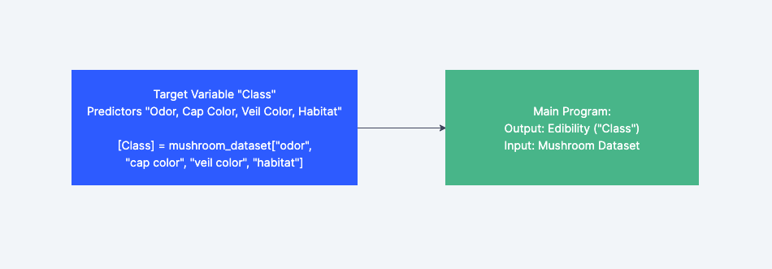
Hierarchy

Slide 8
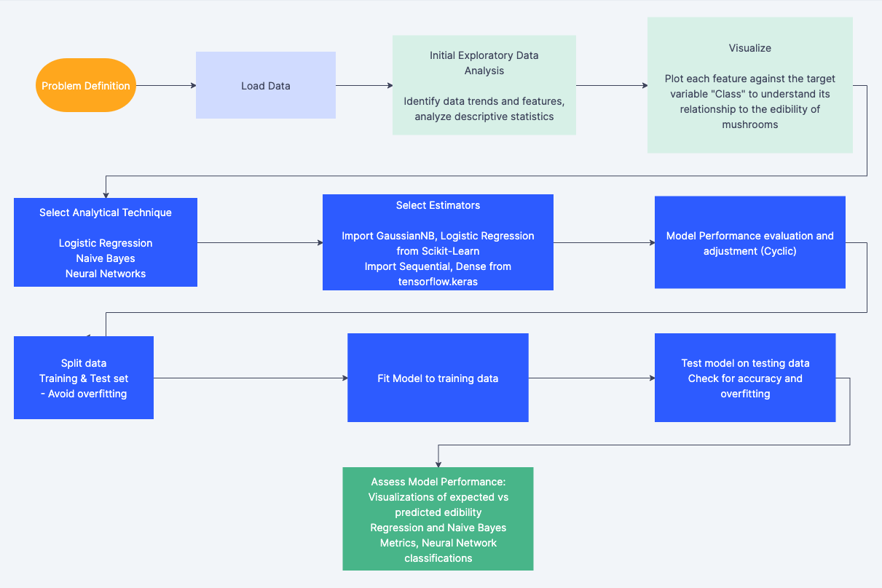
Legend (Colored):
Step 1 – Acquire
Step 2 – Prepare
Step 3 – Analyze + Assess Model
* Steps 4 and 5 (Report/Act) not shown and discussed later

Slide 9

Pseudocode
# Load the mushroom dataset from Kaggle
mushroom_dataset = LoadDataset('https://www.kaggle.com/datasets/vallabhadattap/mushroom-classification’)
# Explore and preprocess the mushroom dataset
PreprocessData(mushroom_dataset)
# Split the dataset into features (X) and target (y)
X, y = SplitFeaturesAndTarget(mushroom_dataset)
# Convert categorical attributes to numerical using LabelEncoder
X_encoded = EncodeCategoricalFeatures(X)
# Split data into training and testing sets
X_train, X_test, y_train, y_test = SplitTrainAndTestSets(X_encoded, y)
# Create and train the Naive Bayes classifier
nb_classifier = TrainNaiveBayesClassifier(X_train, y_train)

Slide 10
Pseudocode (Cont)
# Make predictions on the test set using Naive Bayes
y_pred_nb = PredictWithNaiveBayes(nb_classifier, X_test)
# Evaluate the Naive Bayes model
accuracy_nb = CalculateAccuracy(y_test, y_pred_nb)
classification_report_nb = GenerateClassificationReport(y_test, y_pred_nb)
# Create and train the Neural Network model
nn_model = TrainNeuralNetwork(X_train, y_train)
# Make predictions on the test set using Neural Network
y_pred_nn = PredictWithNeuralNetwork(nn_model, X_test)
# Evaluate the Neural Network model
accuracy_nn = CalculateAccuracy(y_test, y_pred_nn)
classification_report_nn = GenerateClassificationReport(y_test, y_pred_nn)
# Compare and present the results
PresentResults(accuracy_nb, classification_report_nb, accuracy_nn, classification_report_nn)

Slide 11
Acquire
The mushroom dataset used in this data analysis was acquired from Kaggle.com, a prominent platform for data scientists, machine learning practitioners, engineers, and researchers to access and share datasets. The dataset contains detailed information about various attributes of mushrooms, including odor, cap color, veil color, and habitat. The target variable in the dataset, labeled as 'class,' indicates whether a mushroom is poisonous or edible.
Data Source: https://www.kaggle.com/datasets/vallabhadattap/mushroom-classification
The primary objective of this analysis is to explore the relationships between different attributes and the edibility of mushrooms. By studying this dataset, we aim to identify the characteristics that significantly contribute to determining whether a mushroom is poisonous or safe for consumption. Accurate identification of edible and poisonous mushrooms is crucial, as ingesting toxic mushrooms can lead to severe health consequences, including hallucinations and even fatality.

Slide 12
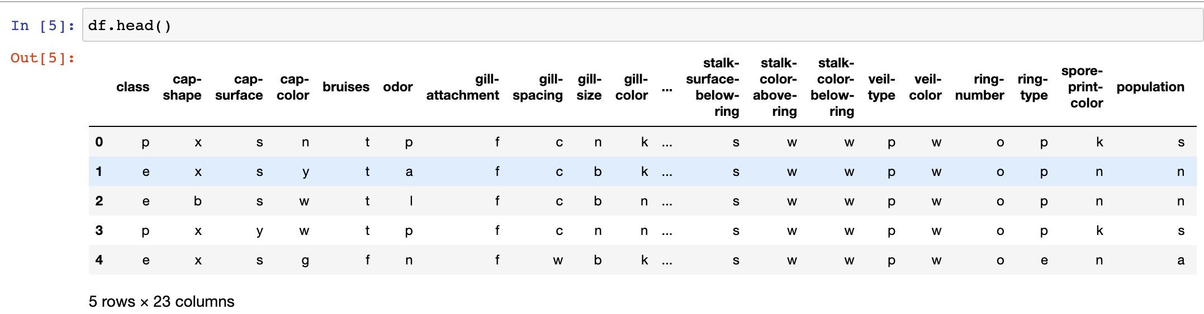
Prepare
Using Jupyter Notebook, exploratory data analysis (EDA) will be conducted, and any notable characteristics of the data will be noted and corrected to maintain the integrity of the analysis.
The pandas head() function shows the first 5 rows with no immediately obvious discrepancies and shows the dataset contains 23 variables

Slide 13
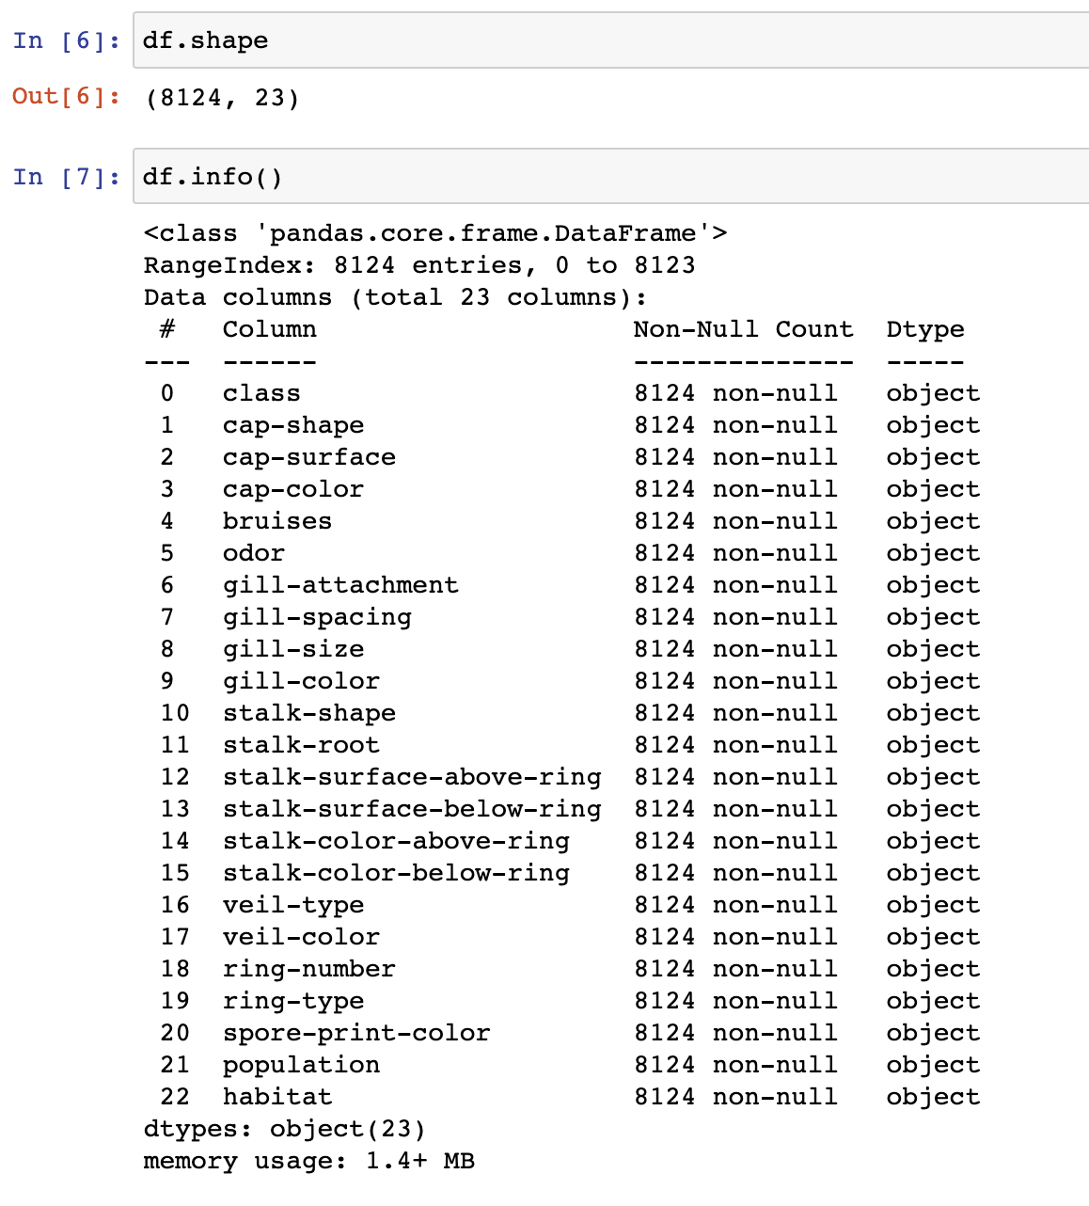
Prepare – Dataframe information
The dataframe contains 8,124 observations
All 23 variables are listed
All variables are categorical and categorized by letters respective to each column (letters are not ordinal or uniform across the data)

Slide 14
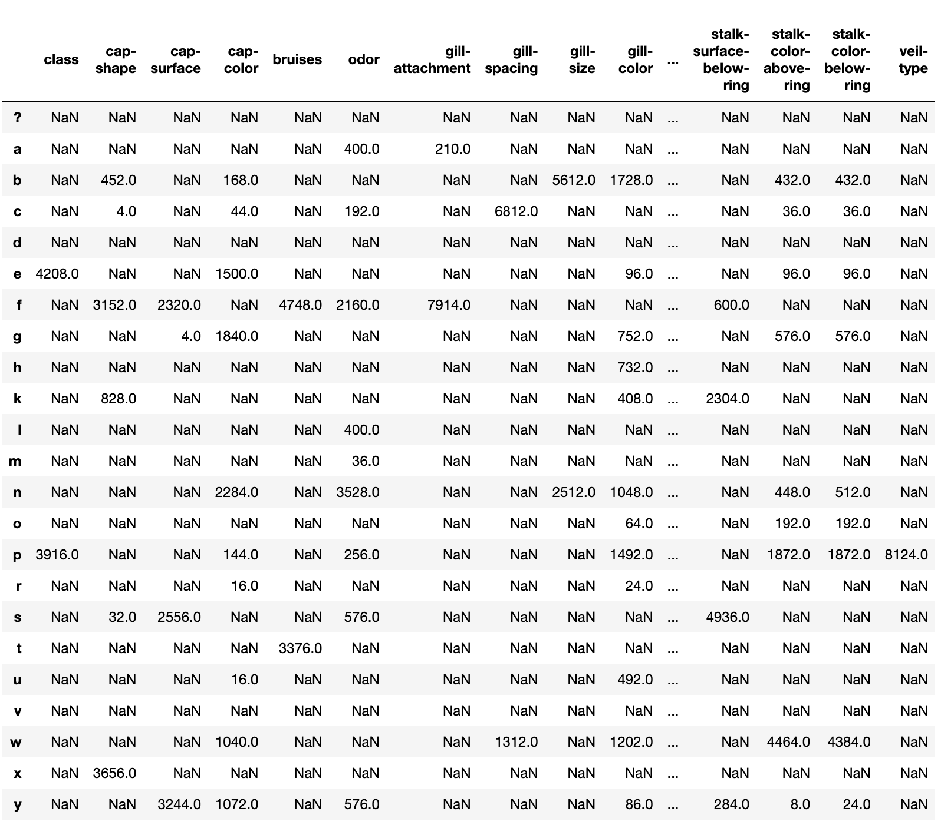
Prepare – Categorical Values
This is a merged dataset containing all possible categorical values a variable can take
Some appear to be ordinal alphabetic, others are intuitive.
Example – The class variable only contains values for “e” and “p” which stand for edible and poisonous, respectively.
It may be necessary to create dummy variables

Slide 15
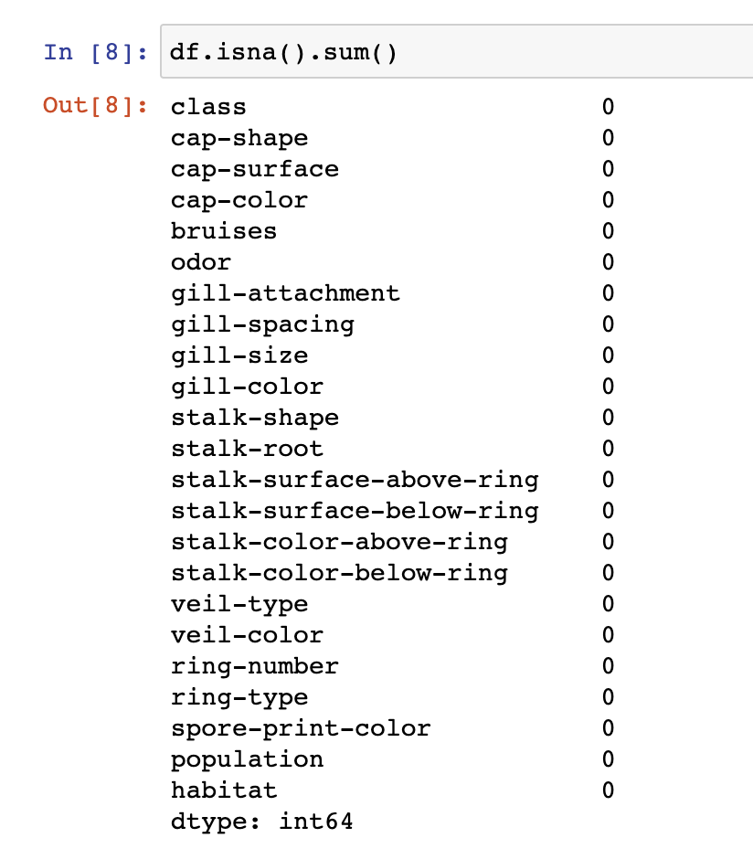
Prepare – Data Integrity
The dataset contains no missing values for any variable, suggesting high data integrity
There may be categorical imbalances in any of the variables, which could specify the need for certain classification algorithms

Slide 16
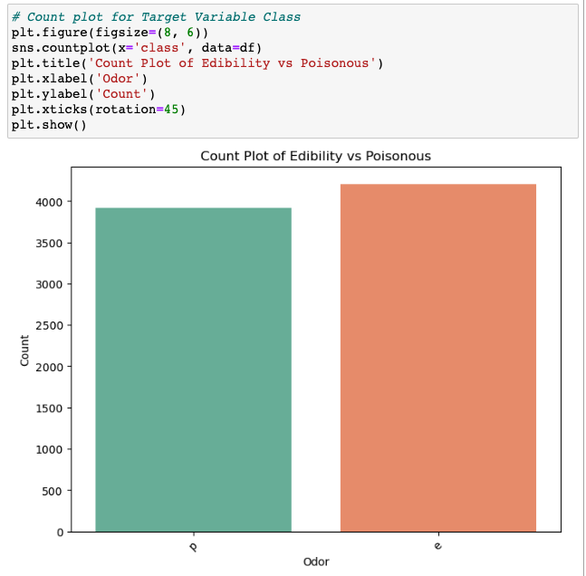
Prepare – Target Variable Distribution
The target variable is mostly even, slightly favoring the presence edible mushrooms
The imbalance is minimal, meaning weights may not need to be assigned

Slide 17
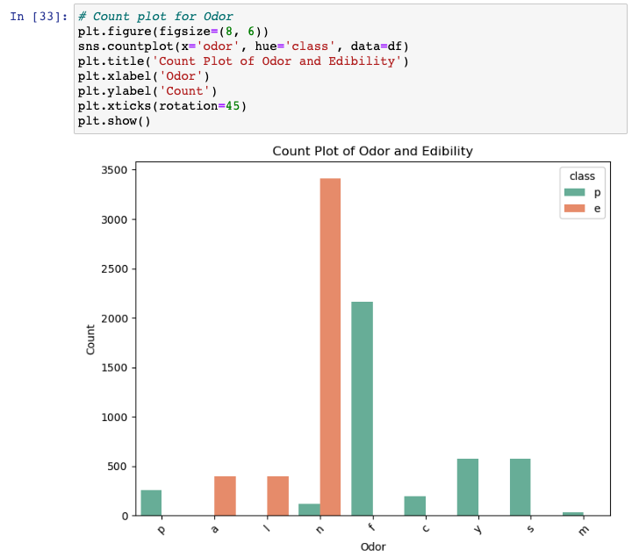
Prepare – Odor vs Edibility
There appear to be patterns where certain odors are more correlated to poisonous and edible mushrooms
The data is dominated by odor categories “n” and “f” where “n” means no odor and “f” means foul.

Slide 18
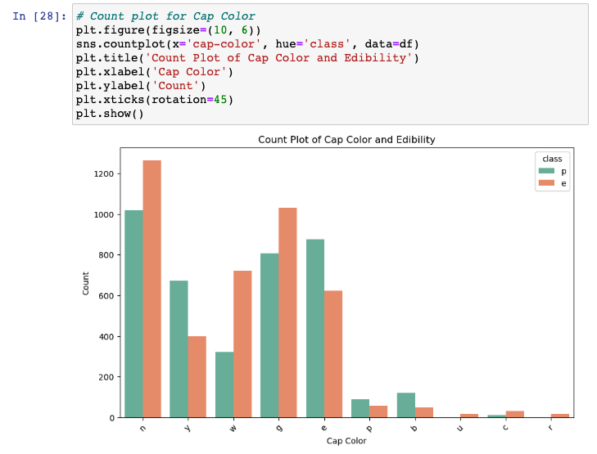
Prepare – Cap Color vs Edibility
Most mushrooms are brown (“n” category) and gray (“g” category).
Some colors such as green (“r” category) and a few others are hardly present.
Colors appear to alternative in having more edible or poisonous mushrooms from left to right and are not entirely dominated by one category (no/minimal correlation?)

Slide 19
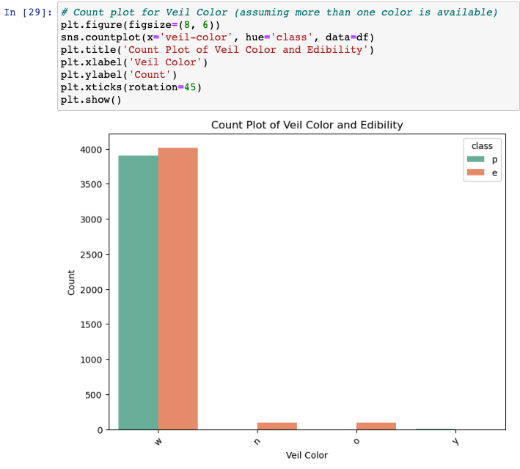
Prepare - Veil Color and Edibility
Almost every veil is white (“w”)
Suspect that this variable may not be useful in classification
Another variable may be selected

Slide 20
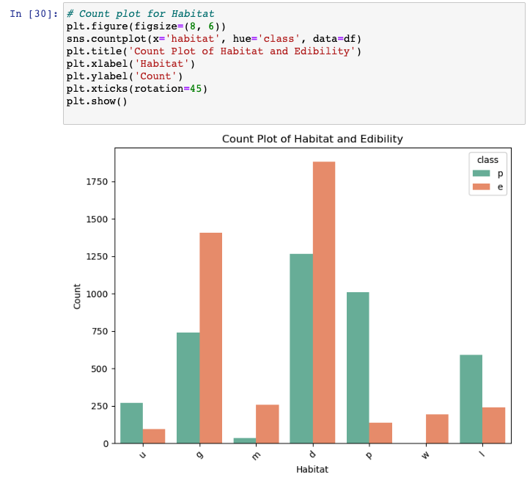
Prepare – Habitat vs Edibility
Every habitat appears to have a dominant class
Categories “g”, “m”, and “d” (grasses, meadows and woods) show more edible mushrooms.
Category “w” Waste shows no poisonous mushrooms
All other habitats are dominated by poisonous mushrooms

Slide 21
Prepare – Preliminary EDA results
The target variable is nearly balanced
All variables are categorical
There are no missing values
Some of the chosen predictor variables hint at no correlation to the target variable
They may be swapped for other variables
The possibility of creating dummy variables exists to allow more statistical analysis and algorithms

Slide 22

End of Micro Project 1

Slide 23
Analyze data
<select analytical technique, build models>

Slide 24
Report
<communicate results>

Slide 25
Act
<apply results, connect results with the chosen problem statement or business question>

