Slide 1
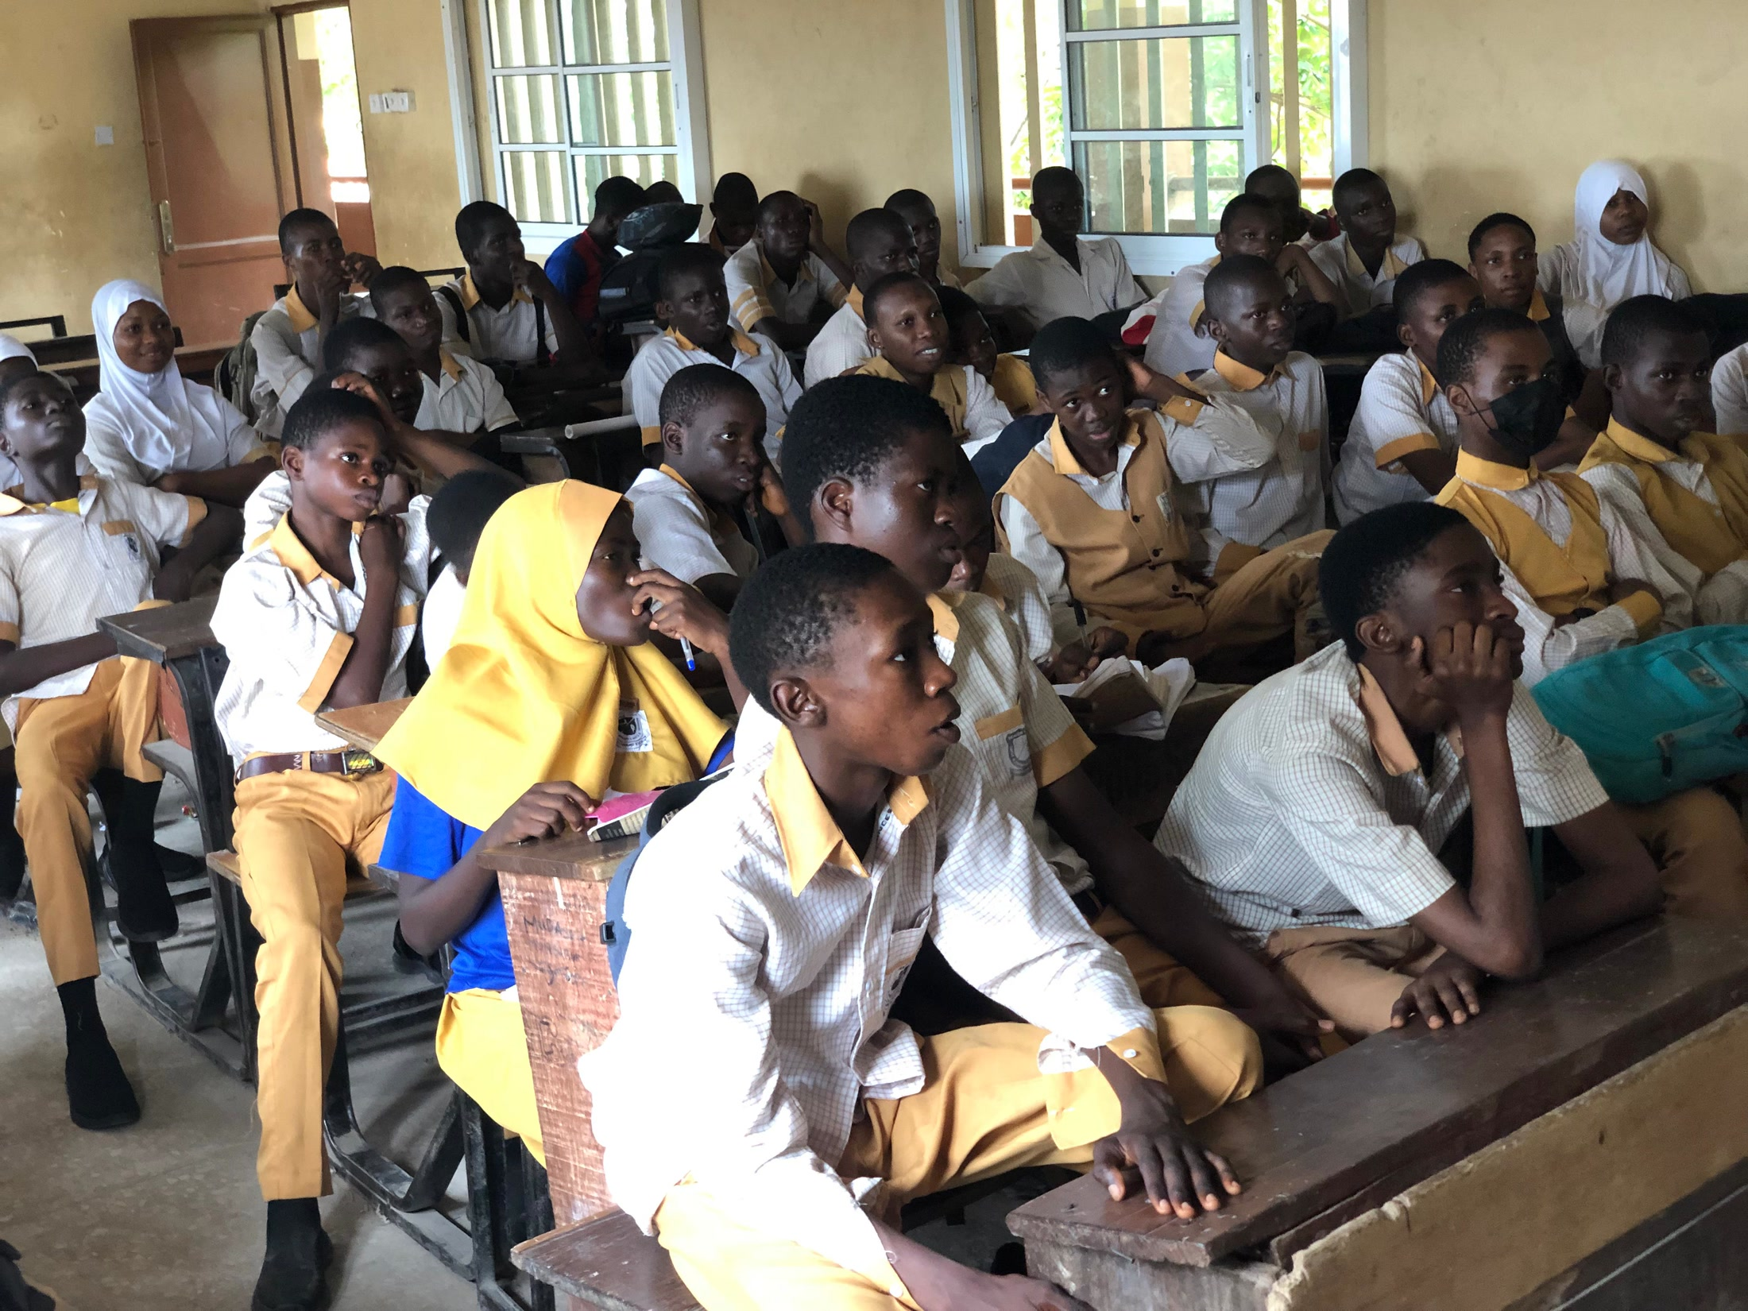
VerionX
Building the workforce
for the future.
We exist to equip people with know-how to maximise their potential on earth.
UloX — mastering the utility of AI
The agentic engineering trainer. Free, and live in the browser.
www.ulox.verionx.org
State High School
Notes:
Open on the room. VerionX already has 80,000 students in Nigerian classrooms through Ulo. UloX is the next rung: agentic engineering, free, live in the browser.

Slide 2
01 — WHERE THE GAP MOVED
Anyone can call a model.
The failures start after that.
Calling a model is easy
Agents fail in production
Training stops at the prompt
Three lines of code and an API key. Teams hit trouble after the first response, not before it.
They stall, loop without stopping, leak data through tool output and burn budget. Teams find out when a customer does.
Courses teach you how to word a request. They skip context, harness, loop, graph and safety.
WHAT A WORKING AGENT ACTUALLY NEEDS
6
1
18
disciplines, from prompt through to agentic
of the six that most courses reach
failure modes UloX drills by hand
VerionX · UloX
www.ulox.verionx.org 02
Notes:
The point: access to AI is cheap now. Reliability is what teams cannot buy, and it is what nobody is teaching.

Slide 3
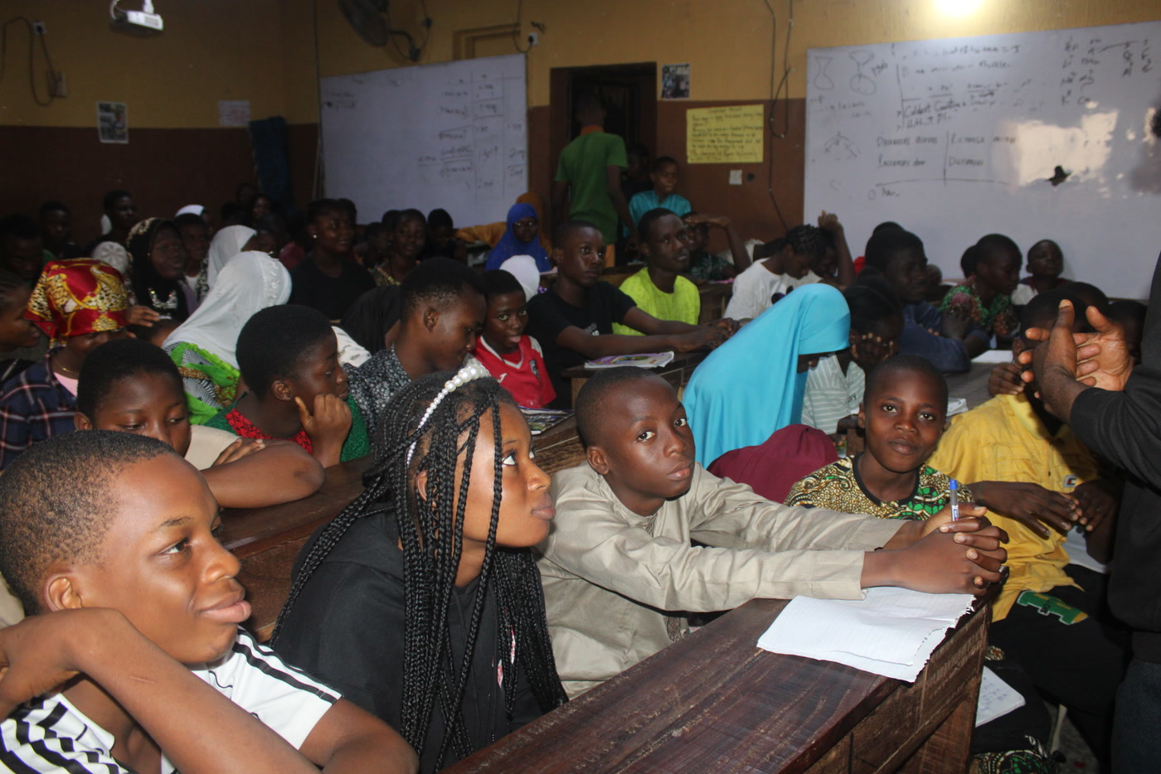
02 — WHY VERIONX EXISTS
Ulo and UloX answer the same
mission at two different stages.
MISSION
We exist to equip people with know-how to maximise their potential on earth.
Prominent Tech Learning Hub
VISION
WHERE EACH ONE FITS
Building the workforce for the future.
Ulo: gamified learning for school-age Nigeria. Learn, play, practise, prove, earn.
UloX: agentic engineering for the people who will build and run the systems.
VerionX · UloX
www.ulox.verionx.org 03
Notes:
Mission and vision verbatim. Ulo and UloX are two stages of the same answer.

Slide 4
03 — HOW THE TWO CONNECT
One ladder, from a first lesson
to a shipped system.
LEARN
PRACTISE
PROVE
BUILD
SHIP
Ulo
›
Ulo
›
Ulo
›
UloX
›
UloX
Lessons become play
Challenges and streaks
Skill, not completion
Repair broken agents
Bounded, observable systems
THE FRAMEWORK UNDERNEATH BOTH
ITOLS
Ulo teaches a student how to learn. UloX teaches an engineer how to build. Both run on ITOLS, so someone climbing from one to the other keeps the same way of instructing a model.
A proprietary VerionX framework for writing an AI instruction you can test.
VerionX · UloX
www.ulox.verionx.org 04
Notes:
One continuous ladder. ITOLS is the grammar a learner carries up it.

Slide 5
04 — ULOX
UloX hands you a broken agent
and asks you to repair it.
The method comes from chess training, where players work through positions instead of reading essays about chess.
Every drill starts broken
A search engine scores your fix
An unbounded loop. A router with two branches that both match. A guard that logs an attack and lets it through anyway.
A beam search solves the position first, so the hint you get is the opening move of a line that actually works.
The simulator runs it
Rated on what you solved
Each repair executes against mock tool responses. You watch it hold, or watch it fall over.
Glicko-2 ratings move with your results, in single player and in rated matches against other engineers.
VerionX · UloX
www.ulox.verionx.org 05
Notes:
Borrowed from chess: you study positions, not essays. The engine scores the repair.

Slide 6
05 — THE FRAMEWORK
A PROPRIETARY VERIONX FRAMEWORK
ITOLS
Created by Elijah Moses
Five layers that turn a prompt into a contract you can test.
I
Identity
Authenticity
Authority
Affirmation
Who the agent is
T
Tasks
Context
Content
Audience / Object
What it must do
O
Outcome
Fact
Flow
Synthesis
What finished looks like
L
Language
Clarity
Composure
Tone
How it must speak
S
Security
Guardrail
Control
Balance
What it must never do
Fifteen fields a reviewer can check, in place of a paragraph of prose. UloX teaches, drills and scores all five layers.
VerionX · UloX
www.ulox.verionx.org 06
Notes:
ITOLS is the IP, created by Elijah Moses and proprietary to VerionX. Five layers, three sub-layers each. Fifteen fields a reviewer can check.

Slide 7
06 — THE LOOP
Each discipline runs
the same four steps.
READ
FIX
BUILD
PROVE
A short idea, written at the level you picked.
A broken system, repaired inside a move limit.
The same pattern from nothing, graded by the simulator.
A certificate carrying a code anyone can check.
THREE THINGS THAT TOOK TIME TO BUILD
Drills we verified
Certificates you earn
A loop back in
A script brute-forces all 18 before release. Each one must be solvable inside its move limit, must not already be solved, and must be reachable by the hint the app gives.
The server re-derives every requirement before it issues one. A learner cannot tick the build step for themselves.
Publish a build and anyone can open the link, replay the run and fork it into their own Lab.
VerionX · UloX
www.ulox.verionx.org 07
Notes:
The four steps, and the three things that took real work to build.

Slide 8
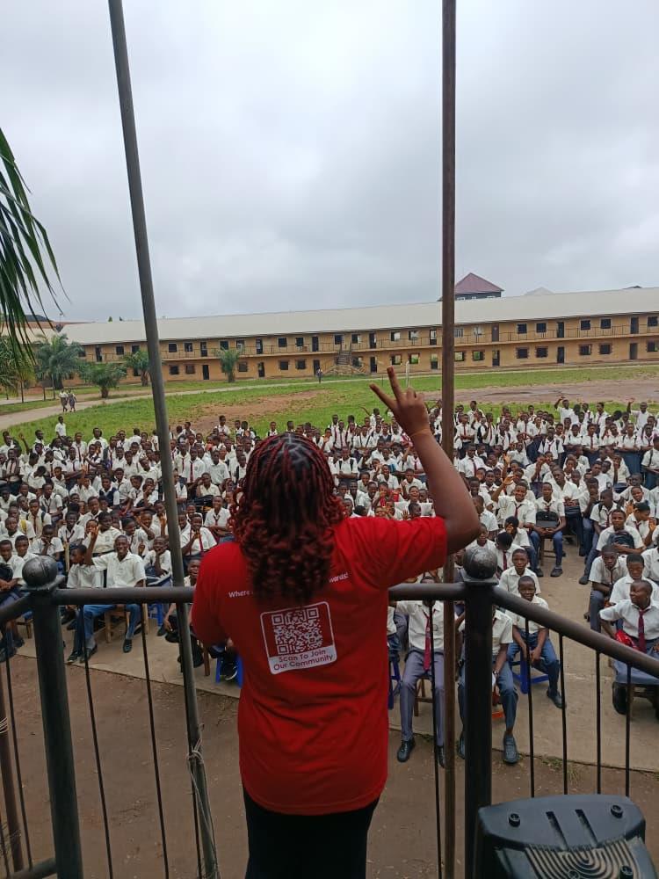

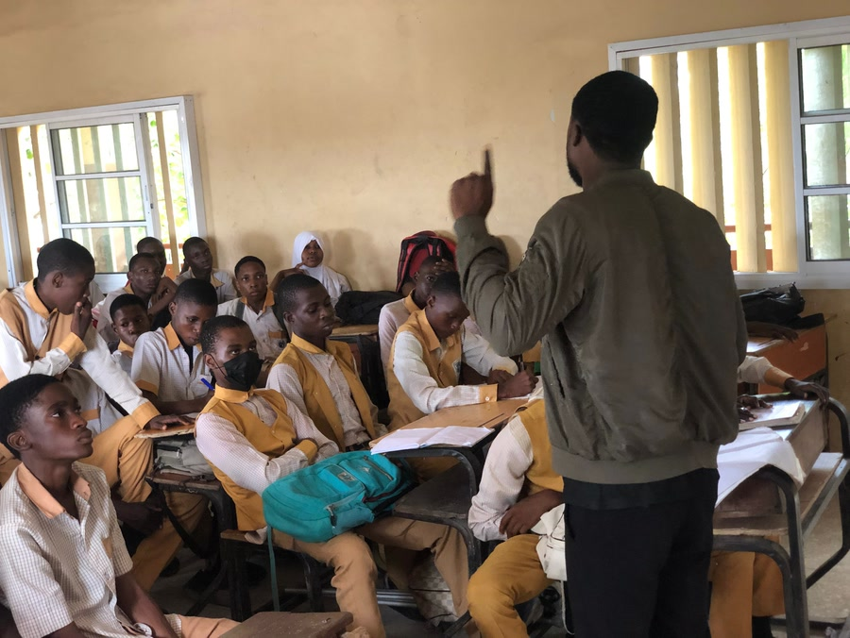

07 — PROOF
We are past the idea stage.
Owerri City High School
Holy Child, Calabar
State High School
Community drive, Lagos
ULO — WHAT THE OUTREACH HAS REACHED
80,000
40
7
1.2M+
100+
students engaged in 10 months
secondary schools activated
universities engaged
teachers via Nigeria Teachers
student ambassadors
ULOX — WHAT IS LIVE TODAY
18
6
94
250
154
drills, each proved solvable
disciplines with guided builds
roadmaps pulled live
glossary terms, alias-aware
one-page field notes
Federal Government: co-partner on the national refugee re-skilling programme. Nigeria Teachers (1.2M+ members). UNILAG, FUTO, UNICAL, LASU, UNIBEN and Bauchi State University. Ten AI labs being set up in schools.
VerionX · UloX
www.ulox.verionx.org 08
Notes:
Ulo numbers come from the 2026 deck. UloX numbers are what is live and countable in the product today.

Slide 9
08 — MARKET AND TIMING
65 million students, and almost no
training in how AI systems fail.
$10B
65M
70%
98M
Africa's EdTech market by 2026
students in Nigeria alone
of Nigerians are under 30
children and youth out of school in sub-Saharan Africa
HolonIQ
UNESCO
UN DESA / NBS
UNESCO
WHY NOW
Boards are telling their teams to add AI. Few of those teams have anyone who can make an agent behave under failure, attack or cost pressure.
UloX runs free in a browser and is live today. The route to market is the one Ulo has already walked: Nigeria, then West Africa, then the wider continent.
VerionX · UloX
www.ulox.verionx.org 09
Notes:
Two markets stacked: the EdTech base Ulo already sells into, and the AI-skills gap UloX is built for.

Slide 10
09 — ROADMAP AND THE ASK
From a launched product
to a scalable platform.
PHASE 1 · 0–12 MONTHS
PHASE 2 · 12–24 MONTHS
PHASE 3 · 24–36 MONTHS
Optimise
Monetise
Scale
Open the first learning hub. Deepen the gamification engine. Ship the agentic curriculum. Prove engagement.
Convert premium subscribers. Sign institutional licences. Run enterprise and government reskilling on UloX.
Expand across Nigeria and West Africa. Grow the learning economy. Win large institutional contracts.
THE ASK
₦50,000,000
40%
The Ulo learning hub
30%
Product, gamification and the UloX curriculum
to turn a launched product into a scalable learning platform.
18%
School, university and enterprise expansion
12%
Learn2Earn pilot and impact measurement
VerionX · UloX
www.ulox.verionx.org 10
Notes:
The ask is unchanged in size; this shows where UloX sits inside it.

Slide 11
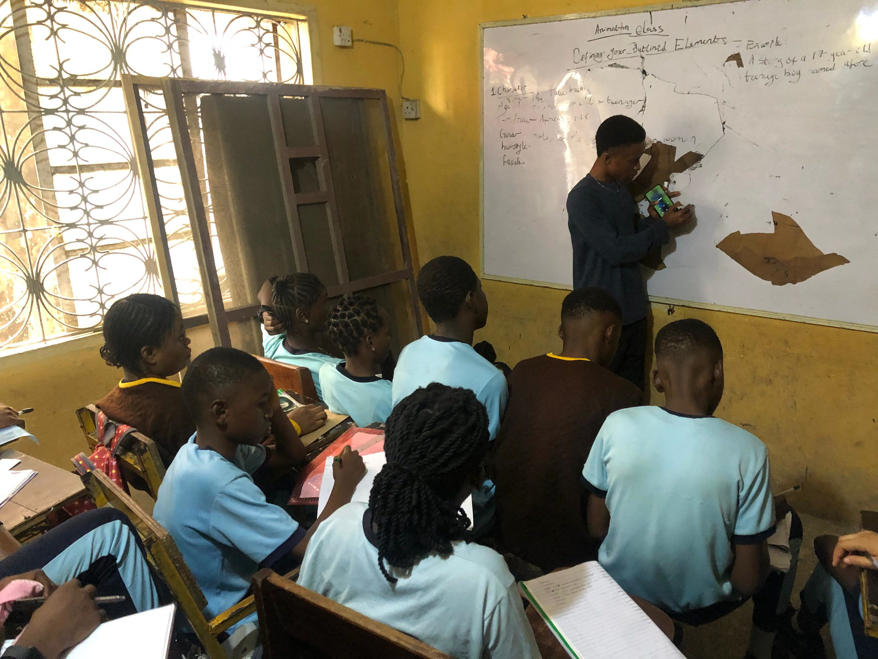
The future of learning is not
consuming more content.
It's becoming more capable.
We exist to equip people with know-how to maximise their potential on earth.
Building the workforce for the future.
Try it now
VerionX
www.ulox.verionx.org
ITOLS is the intellectual property of Elijah Moses.
Notes:
Close on the room, and send them to the live product.

