Slide 1
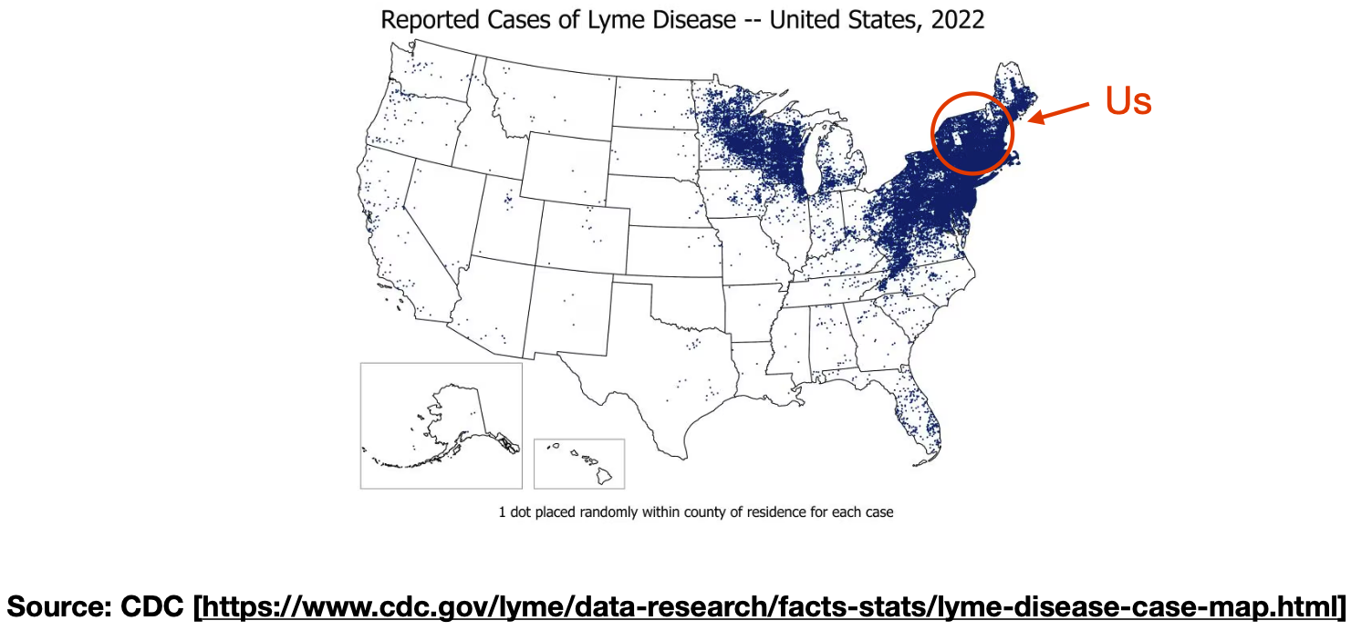

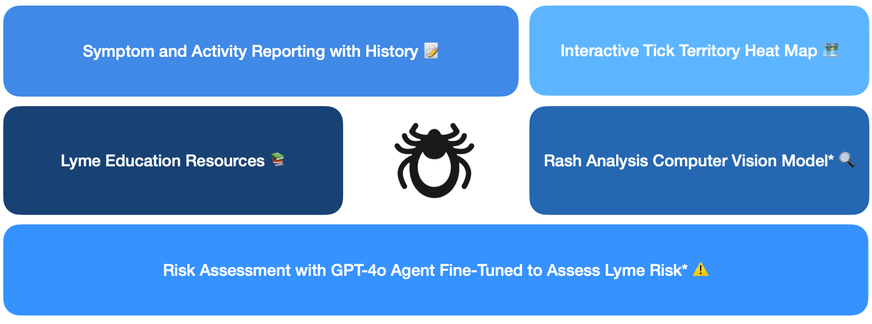
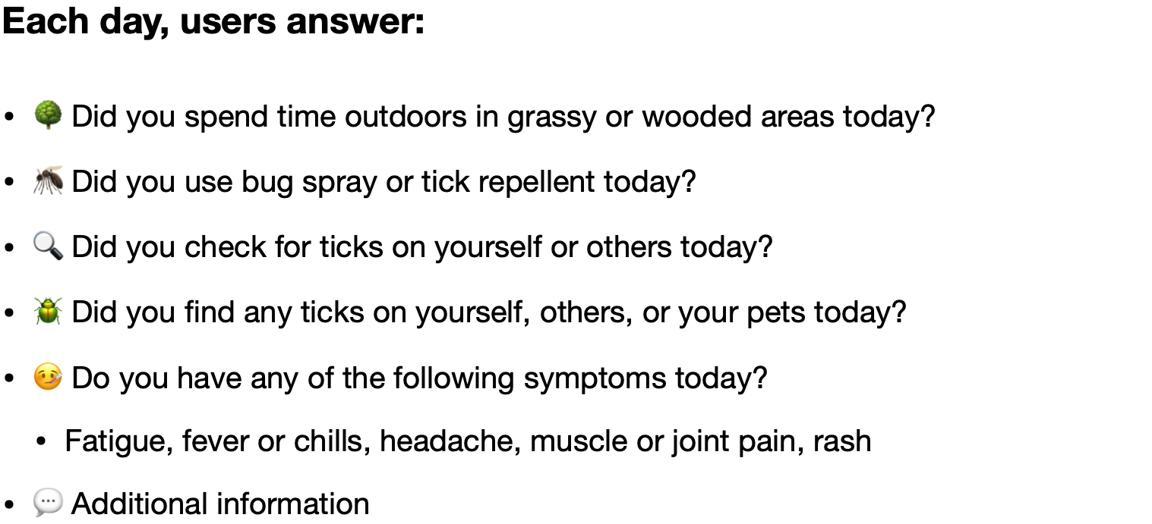


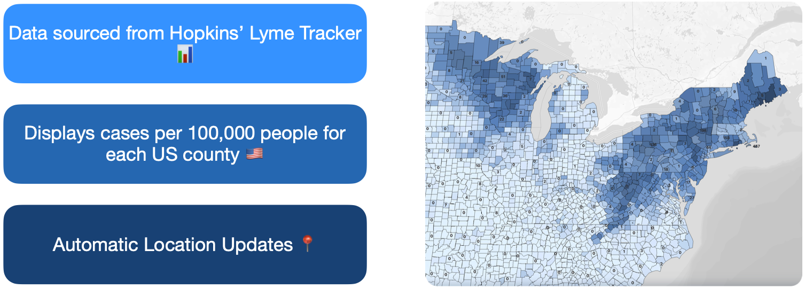







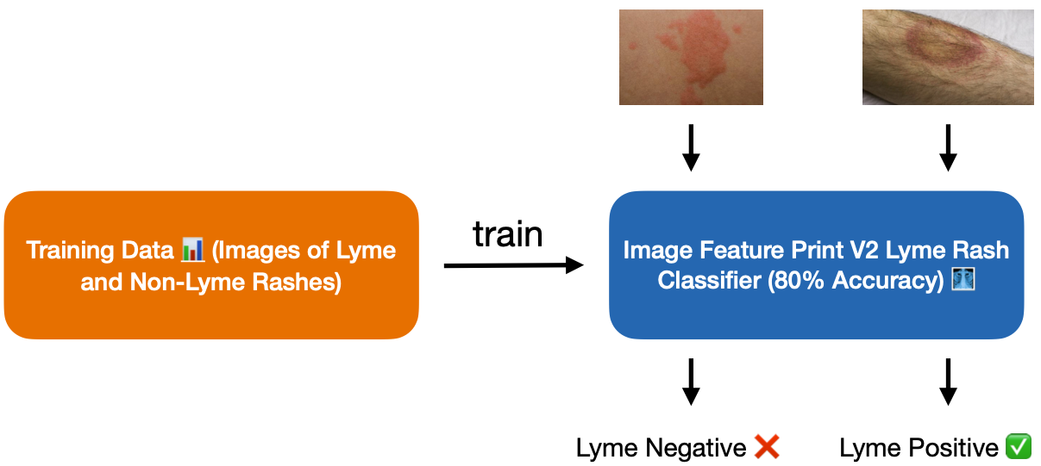

Lymely: The World’s First AI-Powered Lyme Disease App
Motivation & Approach 🤔
Symptom and Activity Reporting
with History 📝
Interactive Tick Territory Heat Map 🗺️
Lyme Education Resources 📚
Rash Analysis Computer Vision Model* 🔍
New: Fast, free, on-device Lyme risk assessment with conditioned Llama-3.2-8B quantized to 4-bit* 🧑‍⚕️
Activity Tracking & Risk Assessment* 🧑‍⚕️
Local inference environment
Risk Score (0-100)
Doctor urgency (not urgent, very urgent, etc.)
Estimated Lyme stage (0-3)
Report with citations (claim [n])
Evidence ([n]: user activity)
Report History 📝
Signs and Symptoms of Lyme (CDC) 🤕
System Prompt
llama3_2_3B_4bit
Stages of Lyme (Mayo Clinic) 📈
Risk Assessment Instructions 💬
Interactive Tick Territory Heat Map 🗺️
Tools Used & References 🛠️
Hopkins Lyme Tracker - The data used to create the tick map is from Hopkins' Lyme Tracker.
CDC - The early Lyme disease symptoms used to educate the Llama 3.2 model are from the CDC.
Mayo Clinic – Additional symptoms and stages of Lyme disease are retrieved from the Mayo Clinic.
Lyme Disease Erythema Migrans Rashes Dataset - The dataset used to train the rash classification model, courtesy of Edward Zhang at Dartmouth College.
Rash Analysis Computer Vision Model* 🔍
GitHub 🧑‍💻
Disclaimer*
AI predictions may be inaccurate, and Lymely does not diagnose users. Users should always see a doctor about symptoms regardless of whether Lymely believes they may be due to Lyme.

