Slide 1
Forecasting NBA Game Attendance Using Historical Data Analysis
Elijah Sartin

Slide 2
Data Collection System
Python based
Packages
BeautifulSoup
RE (Regular Expression)
requests
httplib2
Time
Datetime
MySQL Connector
Data stored in MySQL db
Basketball-reference.com
Variables
Game Time
Game Date
Arena
Home Team
Home Wins
Home Losses
Away Team
Away Losses
Attendance

Slide 3
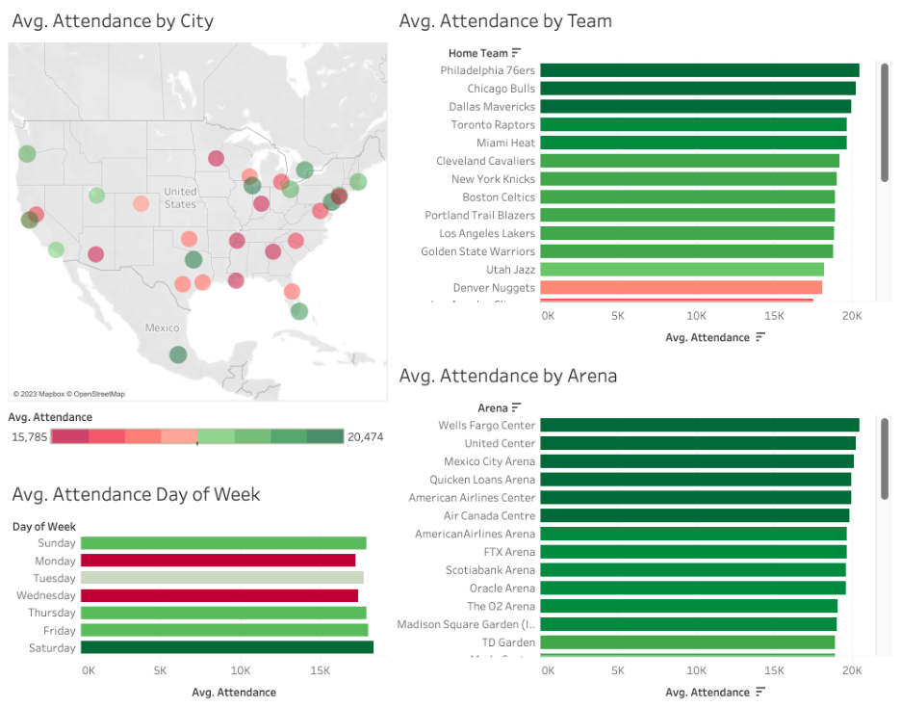
Exploratory Data Analysis & Data Dashboard
EDA using Python
NumPy
Pandas
Seaborn
Matplotlib
Data Dashboard using Tableau
Mapping
Distributions

Slide 4
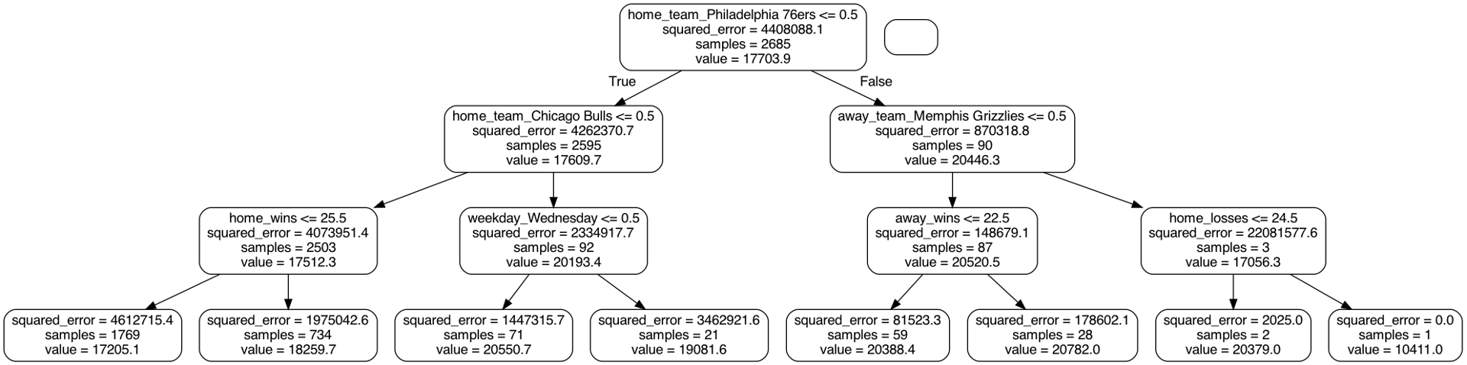
Predictive Model
Data run through Random Forest Regression and Linear Regression
Scitkit-learn used for Modeling
Some variables modified prior to running the models
 | MAE | MAPE | MSE | R²
Random Forest | 808.04 | 4.98% | 1,458,290 | 0.6611
Linear Regression | 968.32 | 5.93% | 1,718,082 | 0.6008

Slide 5
Summary
Data Collection System
Exploratory Data Analysis
Data Dashboard
Predictive Model
Tools Used
Python
Various Packages
MySQL
Tableau
Reflection
DCS was rather enjoyable
Provide more context for models
Fix linear regression issues
Run more models to compare

Slide 6
Questions?

