Slide 1
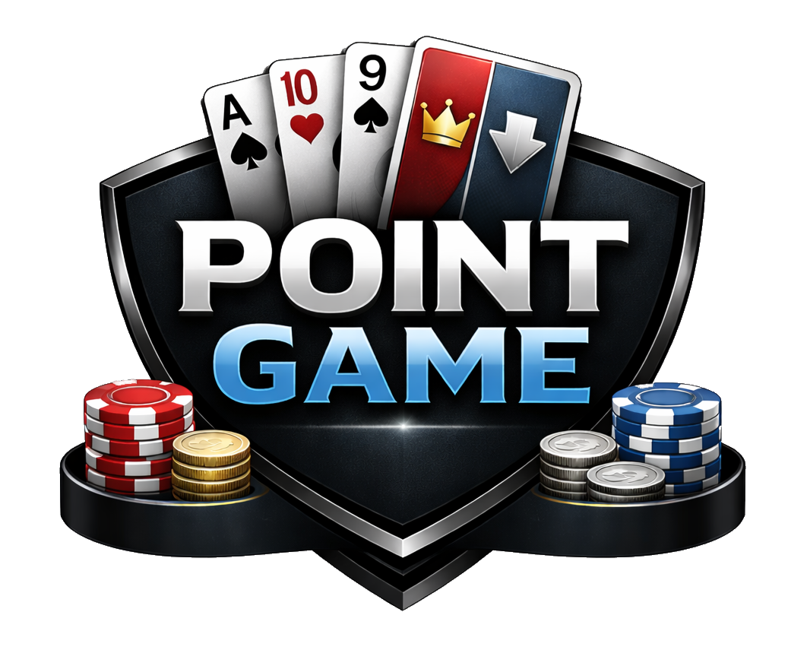
REAL-TIME MULTIPLAYER CARD GAME · SERVERLESS ON AWS
Point Game
POINT GAME
01

Slide 2
THE GAME
What is Point Game?
Poker's structure, blackjack's scoring, with a two-sided pot.
1
Blackjack-style values
2
High and low, at once
Each card scores a point value: Ace is 1 or 11, face cards 10, the rest at rank. The value of your hand is the sum.
The strongest high total and the weakest low total each win. Players secretly declare High, Low, or Both before the reveal. To win both you must win or tie the high and low.
3
Discard on the board
4
Split pots & side pots
As community cards appear, any private card matching the board is discarded face-up.
The pot divides between the high and low sides, across side pots when players are all-in for different amounts.
POINT GAME
02

Slide 3
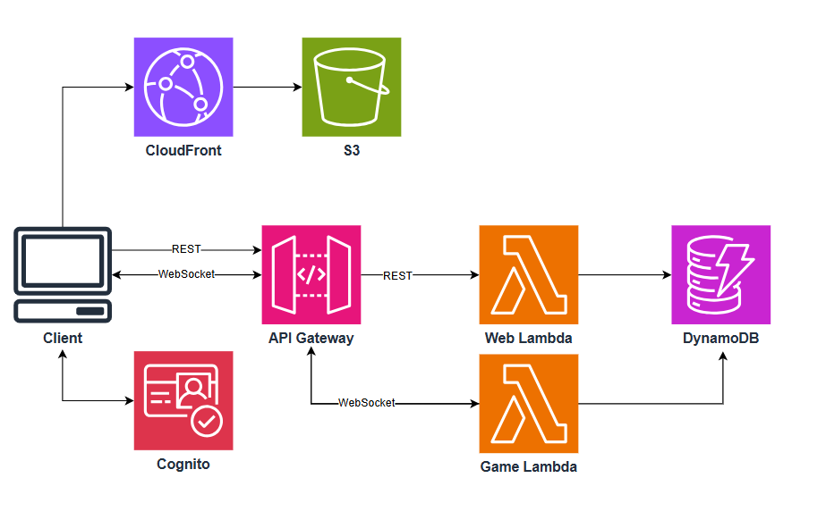
SYSTEM DESIGN
Design principle: every action is a stateless cycle. read state → validate → apply → persist → broadcast. Nothing lives in memory
POINT GAME
03

Slide 4
HOT PATH
One player action
1
2
3
4
5
6
Click
Route & auth
Validate
Apply & Log
Schedule Timers
Broadcast
Client validates locally for UX, then sends a WebSocket message.
API Gateway routes to the game Lambda; the connection is identified by its connectionID.
Engine checks the action against authoritative state (right player, legal amount, etc.)
New state written with a conditional write on the sequence number.
Schedule an Event Bridge to act as timer for moving the game long.
A privacy-filtered view is fanned out to every seat at the table.
Steps 4-6 are three separate chunks. If the Lambda dies between them, the system must be able to self heal. This can be done with client resyncs, outbox + atomic writes, or a broadcasting sweeper.
POINT GAME
04

Slide 5
TOPICS
Five interesting topics
Concurrency
Turn timers
Private views
Sequence-versioned optimistic writes keep two racing actions from ever corrupting a pot.
Scheduled events fire and ensure stale events are dropped.
State is filtered per recipient so no hole card or declaration ever leaves the server until showdown.
Inter-round queue
Showdown
Joins, leaves, and config changes wait in a queue and flush cleanly between hands.
Side pots, split pots, and multiple winners create a very complicated showdown algorithm.
POINT GAME
05

Slide 6
DEEP DIVE · CONCURRENCY
Optimistic concurrency, no locks
Every state write is a compare-and-set on a version number. Two actions read version N. Both try to write expecting N. DynamoDB serializes writes to the item, so exactly one succeeds and bumps to N+1 then the other is rejected and its client resyncs.
EXAMPLE
Player A · reads v5
Player B · reads v5
No stuck tables
DynamoDB · write if gameSeq = 5
A crashed lock-holder could freeze a hand.
Contention is very unlikely
Poker has one legal actor at a time; OCC really guards player-vs-timer races.
A wins gameSeq → 6
B rejected Stale gameSeq → resync
One-line mechanism
Concurrency control is a single conditional expression, easy in DynamoDB.
POINT GAME
06

Slide 7
DEEP DIVE · TIMERS
All timers fire
Lambda can't wait, so the turn clock lives in EventBridge and is verified when it fires. timerSeq != gameSeq due to other game state updates.
Turn begins tag state timerSeq = 7
Schedule EventBridge event fires in 31s · payload timerSeq 7
Event fires · Lambda compares payload to state current timerSeq still 7?
MATCH - player has not acted force the c/f through the same game lambda
MISMATCH – player already acted do nothing
Why not cancel the timer when a player acts? Cancellation is its own race and adds an API call to every action. Letting stale events fire and do nothing is simple, cheap, and always correct.
POINT GAME
07

Slide 8
DEEP DIVE · PRIVACY
Filter game state per player
Anything sent to a client is public. So the server creates a public state then adds private information per recipient before it ever hits the wire.
AUTHORITATIVE STATE
Player A sees
Deck order
Own cards
B, C cards hidden
A's hole cards
Privacy filter (additive)
Declarations hidden
Board cards
B's hole cards
C's hole cards
Player B sees
All declarations
Own cards
A, C cards hidden
Pot & board
Declarations hidden
Board cards
Cost: N filtered payloads per action. Cost can be cut in half by sending action along with game state in one broadcast.
POINT GAME
08

Slide 9
DATA MODEL
Nine Tables
Single-table design optimizes for join-shaped access, but this system never has reads in that way. Separating out into many tables makes design and implementation simpler.
Game State
Action Log
Hand Snapshots
PK tableID · one item
PK handID · SK seq
replay anchors
Connection Store
Turn Timers
Inter-Round Queue
connID ↔ player + GSI
scheduled deadlines
PK tableID · SK seq
Users
Ledger
Game Tables
identity + GSI
chip movements
config & status
If we wanted to move towards a single table design, all tables in blue could be combined using the tableID as the PK, and using the SK to classify
POINT GAME
09

Slide 10
COST
Cheapest exactly where it lives
At scale, DBs generally push the cost for serverless design. Here, every action costs only a small read and write, which stays cheap even at scale because of the turn-based nature. The real driver is WebSocket messages: one player action fans out to every seat at the table.
EST. MONTHLY COST · 1,000 CONCURRENT PLAYERS
$0
idle cost per table
1
conditional write = concurrency
9
purpose-built tables
WebSocket messages can easily be cut in half if we include more front end lifting.
POINT GAME
10

Slide 11
CLOSING
Defined as much by the roads not taken
Although each alternative below has strengths, they were rejected for specific reasons.
Stateful game server
SQS FIFO per table
Single-table design
State in memory, single-writer, trivial timers.
Serializes every write, zero conflicts, ever.
The typical DynamoDB pattern with fewer tables.
WHY NOT
WHY NOT
WHY NOT
Rejected: idle cost, plus deploys and crash recovery is hard, especially to not lose live hands.
Rejected: adds queue latency and is favored for lots of throughput. More complex without the need for it
Rejected: it pays off only for join-shaped access this system never has.
Serverless. Every piece is right-sized to the game. Stateless compute because actions are seconds apart, a key-value store because access is always for a key, scheduled events because turns just need an okay clock. The result costs almost nothing at rest and stays simple under load.
POINT GAME
pointgame.live
11

