Slide 1






Kerberos: Your All-Access Pass to the Network
KERBEROS 101
Prove who you are once. Collect tickets. Skip the password parade.
Fun fact: named after Cerberus, the three-headed guard dog of Greek myth. Three heads, one job: keep the wrong people out.
A secure, ticket-based protocol that verifies users and services without ever sending your password across the network.
Strong authentication
Secure resource access
Single Sign-On
Less credential exposure
Native to Active Directory
You've used it at: Windows logins · File servers · SharePoint · SQL Server · Enterprise apps
Notes:
Picture a big hotel. You show your ID once at the front desk, and they hand you a key card. After that you flash it at the gym, the restaurant and the conference room, and nobody asks for your passport again.
That is Kerberos. You authenticate once with a trusted authority called the Key Distribution Center (KDC), and it hands you tickets that open the doors you're allowed through. Your password never travels the network again.
Fun fact: the name comes from Cerberus, the three-headed dog guarding the underworld. Spoiler for the next slide: Kerberos has three heads too.
Talking points:
- Kerberos is the default authentication protocol in Active Directory.
- Passwords are never sent directly; encrypted tickets do the talking.
- It powers Single Sign-On: better experience AND better security.
- Why it exists: protect credentials, stop password interception, enable SSO, secure enterprise resources.
- Common places: Windows domain logins, file servers, SharePoint, SQL Server, enterprise apps.
Key line: "Authenticate once, access many resources securely."

Slide 2


Meet the Three-Headed Guard Dog
Client, KDC, Service: three heads, three jobs, one very trusted relationship
KDC: Key Distribution Center
Lives on your Domain Controller
It's me!
Authentication Service (AS)
Checks your ID and hands out the TGT
Trust
Client
Service Server
Your workstation. Asks nicely for access.
File shares, SQL, SharePoint, apps. Trusts the KDC.
Here are your tickets
Ticket Granting Service (TGS)
Swaps your TGT for service tickets
Then show the ticket to the service to get in
● Blue = authentication ● Green = ticket issuance ● Gray = resource access
Notes:
Meet the three heads of our guard dog.
Head 1, the Client: your workstation, the one asking for access.
Head 2, the KDC (Key Distribution Center): the trusted authority and the heart of Kerberos. In Active Directory, your Domain Controllers play this role. It has two jobs: the Authentication Service (AS) proves who you are and hands out your Ticket Granting Ticket; the Ticket Granting Service (TGS) trades that TGT for tickets to specific services.
Head 3, the Service Server: file servers, SQL Server, SharePoint, application servers. It never talks to you about passwords; it simply trusts tickets issued by the KDC.
That trust relationship is everything. Notice the path along the bottom: the KDC doesn't walk you to the door. The client carries the ticket to the service itself.
Talking points:
- Domain Controllers act as Kerberos KDCs.
- Authentication (who are you?) and authorization (what can you reach?) are separated.
- Every component has one distinct responsibility.
- Trust relationships are critical.

Slide 3
6 Steps from Hello to Access Granted
1
Sign in
2
Get your TGT
3
Ask for a service ticket
Show your ID at the front desk. Credentials go in once.
The AS checks you out and hands over your master wristband.
Flash the wristband: "One gym pass, please."
4
TGS issues the ticket
5
Present the ticket
6
Access granted
A pass made for that one service and nothing else.
Tap it at the server's door. No password in sight.
The server validates the ticket and the door beeps green.
TGT = master pass. Service ticket = one-door pass. Guest list: Kerberos (port 88), LDAP, DNS, AD. Clocks must agree and tickets expire.
Notes:
Six steps, one smooth entrance.
1. Sign in: you authenticate with the KDC once.
2. Get your TGT: the Authentication Service validates you and issues a Ticket Granting Ticket, your master pass.
3. Ask for a service ticket: when you need a resource, you show the TGT to the Ticket Granting Service.
4. TGS issues the ticket: it creates a Service Ticket specific to that service.
5. Present the ticket: your client hands that ticket to the target server.
6. Access granted: the server validates it and lets you in.
Protocols involved: Kerberos (TCP/UDP 88), LDAP, DNS and Active Directory services.
Key advantage: passwords are never repeatedly transmitted across the network.
Talking points:
- TGT = master pass. Service ticket = resource access pass.
- Kerberos provides mutual authentication: you verify the server, the server verifies you.
- Time synchronization is critical.
- Tickets have expiration times.

Slide 4
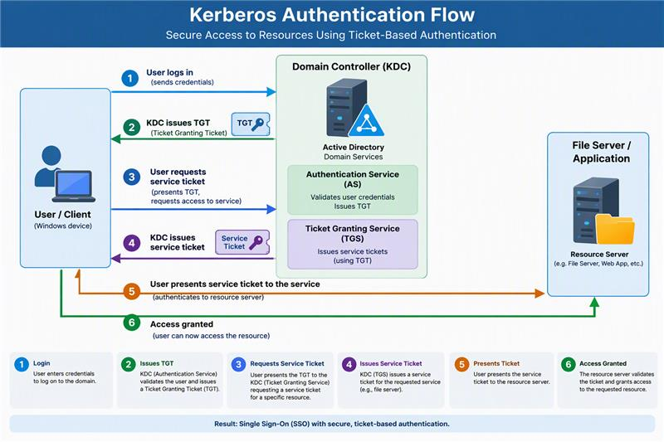
Notes:
Six steps, one smooth entrance.
1. Sign in: you authenticate with the KDC once.
2. Get your TGT: the Authentication Service validates you and issues a Ticket Granting Ticket, your master pass.
3. Ask for a service ticket: when you need a resource, you show the TGT to the Ticket Granting Service.
4. TGS issues the ticket: it creates a Service Ticket specific to that service.
5. Present the ticket: your client hands that ticket to the target server.
6. Access granted: the server validates it and lets you in.
Protocols involved: Kerberos (TCP/UDP 88), LDAP, DNS and Active Directory services.
Key advantage: passwords are never repeatedly transmitted across the network.
Talking points:
- TGT = master pass. Service ticket = resource access pass.
- Kerberos provides mutual authentication: you verify the server, the server verifies you.
- Time synchronization is critical.
- Tickets have expiration times.

Slide 5







The Good, the Bad, and the Golden Ticket
Superpowers
Villains
Shields Up
Single Sign-On bliss
Fewer password-reset calls
Scales across the enterprise
Mutual authentication
Encrypted, short-lived tickets
Replay attack protection
Pass-the-Ticket attacks
Golden Ticket attacks
Sloppy service accounts
Clock drift breaks auth
Patch Domain Controllers
Enable MFA
Protect privileged accounts
Monitor ticket activity
Secure service accounts
Financial services
Banking app access
Healthcare
Patient records
Government
Identity across sensitive systems
Enterprise IT
Windows environments
Notes:
Most organizations use Kerberos every single day without anyone noticing. Every time an employee opens a file share, a SQL database, SharePoint or an internal app, Kerberos is quietly working behind the scenes.
The good: Single Sign-On, fewer helpdesk password requests, enterprise scale, and strong security. Traffic is encrypted, tickets are short-lived, mutual authentication means both sides prove who they are, and replay protection stops captured tickets from being reused.
The bad: Pass-the-Ticket and Golden Ticket attacks, misconfigured service accounts, and time synchronization failures. A Golden Ticket attack exploits compromised high-privilege credentials, so watch for abnormal ticket activity.
The shields: patch Domain Controllers, enable MFA, protect privileged accounts, monitor ticket activity, and secure service accounts.
In the real world: financial services (employee access to banking applications), healthcare (patient records), government (identity protection across sensitive systems) and enterprise IT (Windows environments).
Talking points:
- Kerberos balances usability and security.
- SSO reduces user friction.
- Ticket protection is critical, and monitoring helps catch attacks.
- Adoption is widespread.

Slide 6
5 Things to Remember
1
Kerberos is ticket-based authentication
Skip these
2
Passwords don't keep traveling the network
Ignoring time sync
Weak service accounts
Excess admin privileges
No ticket monitoring
Weak DC security
3
The KDC is the trusted authority
4
TGT + service tickets = Single Sign-On
5
It's the backbone of Active Directory auth
Do these
Keep Domain Controllers secure
MFA + Conditional Access
Monitor authentication logs
Rotate service credentials
Follow least privilege
Kerberos acting up? Check the usual suspects
DNS
Time sync
Ticket validity
DC health
SPNs
Authenticate once. Access everywhere. Securely. Questions?
Notes:
Quick recap: Client asks, KDC verifies, you get a TGT, you swap it for a service ticket, and the resource lets you in.
Five takeaways: Kerberos is ticket-based. Passwords aren't repeatedly sent over the network. The KDC is the trusted authority. TGTs and service tickets make Single Sign-On work. And it is the backbone of Active Directory authentication.
Common mistakes to skip: ignoring time synchronization, weak service account security, excessive administrative privileges, no ticket monitoring, poor Domain Controller security.
Best practices to do: keep Domain Controllers secure, enable MFA and Conditional Access, monitor authentication logs, rotate service account credentials, follow least privilege.
When something breaks, think: DNS, time synchronization, ticket validity, Domain Controller health, and Service Principal Names (SPNs). Those five cause most Kerberos headaches.
Close with: "Authenticate once, access everywhere, securely." Then open the floor for questions.

