Slide 2
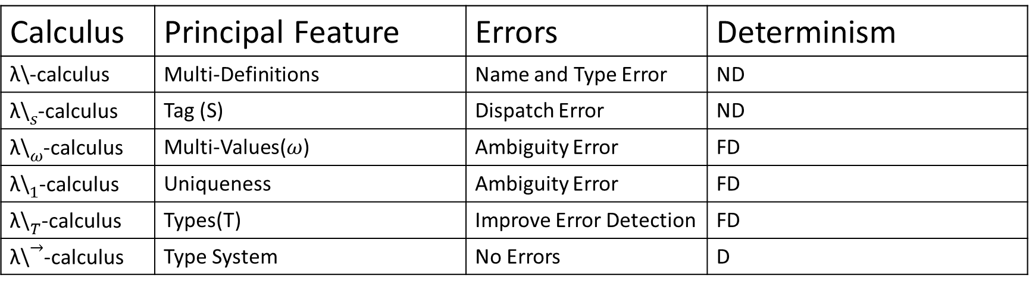
Calculus | Principal Feature | Errors | Determinism
λ\-calculus | Multi-Definitions | Name and Type Error | ND
${\text{λ}\text{\backslash }}_{s}$-calculus | Tag (S) | Dispatch Error | ND
${\text{λ}\text{\backslash }}_{ω}$-calculus | Multi-Values($ω$) | Ambiguity Error | FD
${\text{λ}\text{\backslash }}_{1}$-calculus | Uniqueness | Ambiguity Error | FD
${\text{λ}\text{\backslash }}_{T}$-calculus | Types(T) | Improve Error Detection | FD
${\text{λ}\text{\backslash }}^{→}$-calculus | Type System | No Errors | D

Slide 3
λ\-calculus
Non deterministic semantic, with branches that reduce to a value and other ending in error.
Name error detection.
Type error detection.
Without any type information in the syntax of the language.
Uses the explicit substitution.

Slide 4
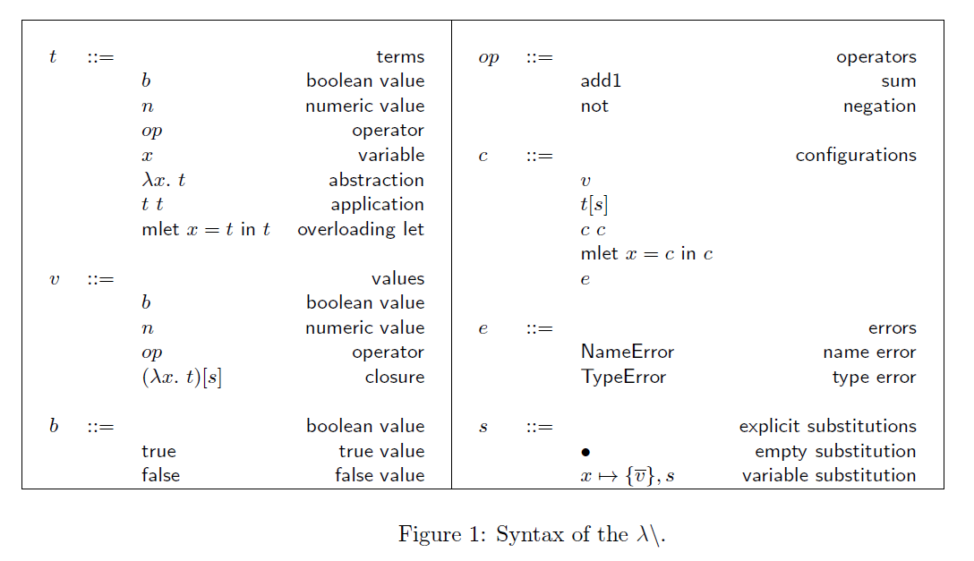
λ\-calculus

Slide 5
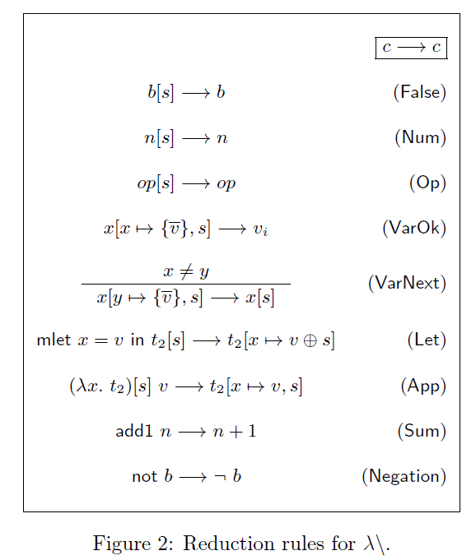
λ\-calculus

Slide 6
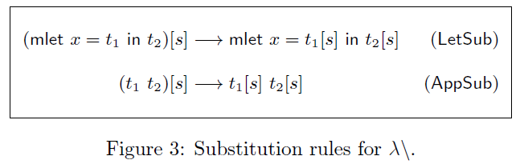
λ\-calculus

Slide 7
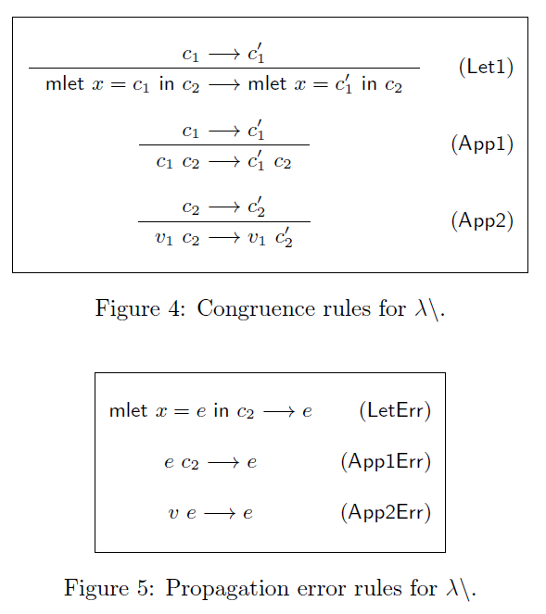
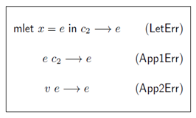
λ\-calculus

Slide 8
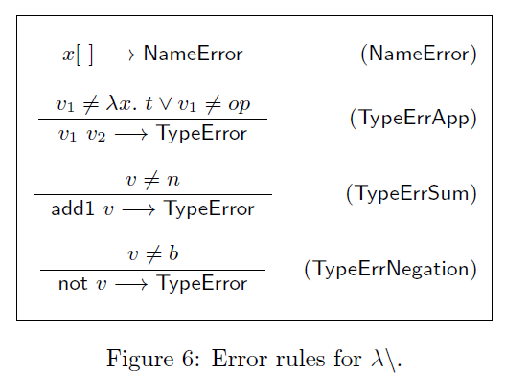
λ\-calculus

Slide 9
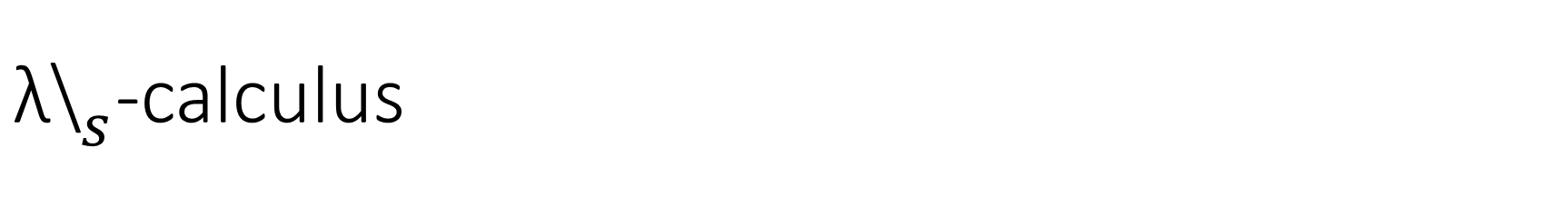
${\text{λ}\text{\backslash }}_{s}$-calculus
Non deterministic semantic, with branches that reduce to a value and
other ending in error.
Name error detection.
Type error detection.
Dispatch error detection.
Without any type information in the syntax of the language.
Semantic "tag driven", introducing at tag.

Slide 10
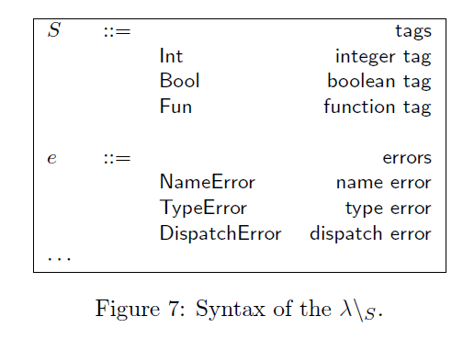
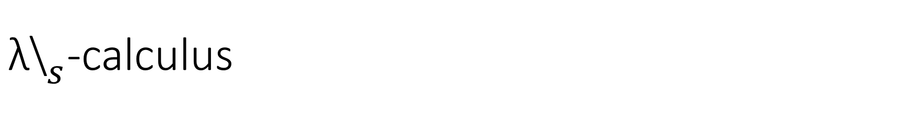
${\text{λ}\text{\backslash }}_{s}$-calculus

Slide 11
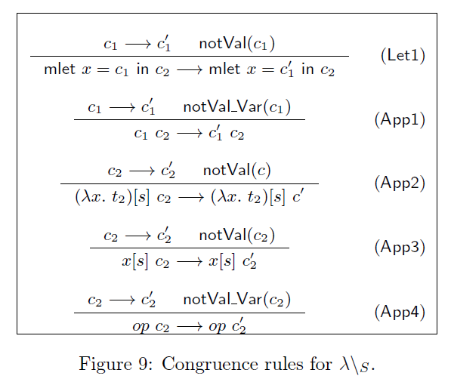
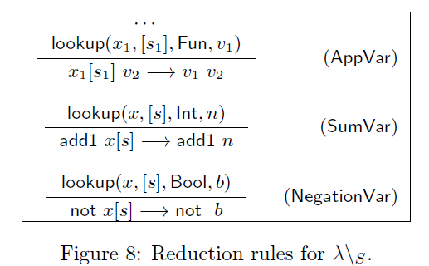
${\text{λ}\text{\backslash }}_{s}$-calculus

Slide 12
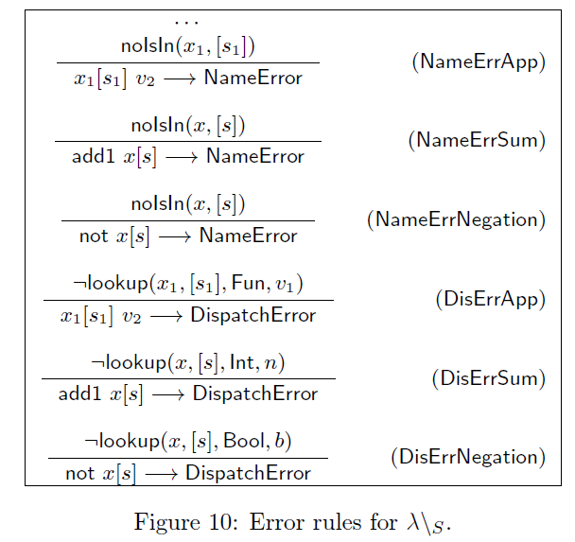
${\text{λ}\text{\backslash }}_{s}$-calculus

Slide 13
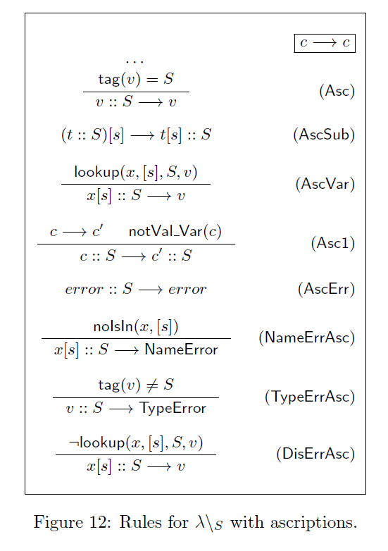
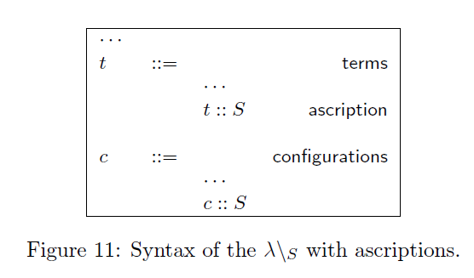
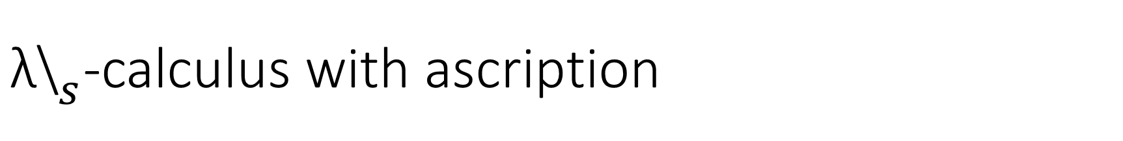
${\text{λ}\text{\backslash }}_{s}$-calculus with ascription

Slide 14
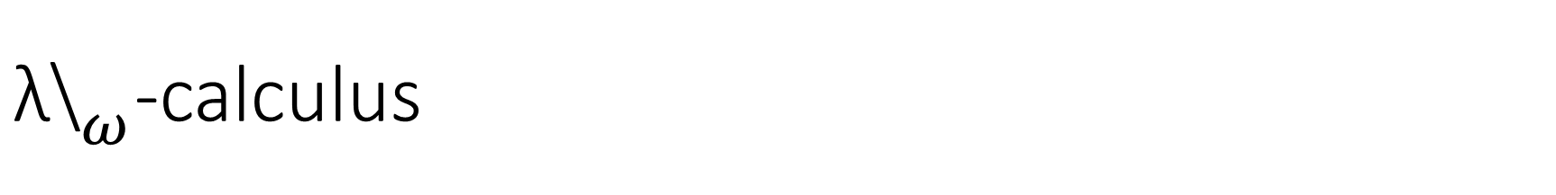
${\text{λ}\text{\backslash }}_{ω}$-calculus
Deterministic semantic. With the use of multi-values a program can reduce to a set of value.
Name error detection.
Type error detection.
Dispatch error detection.
Ambiguity error detection.

Slide 15
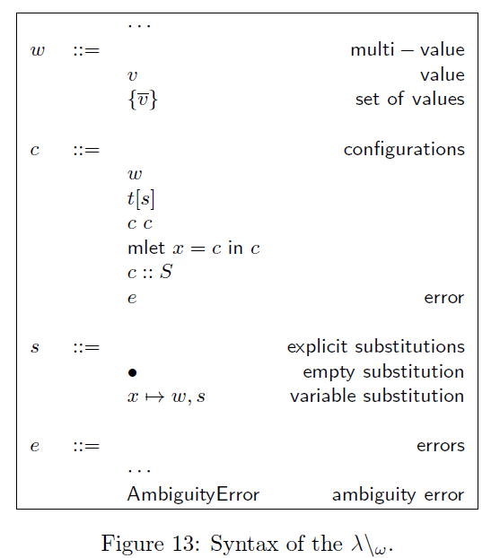
${\text{λ}\text{\backslash }}_{ω}$-calculus

Slide 16
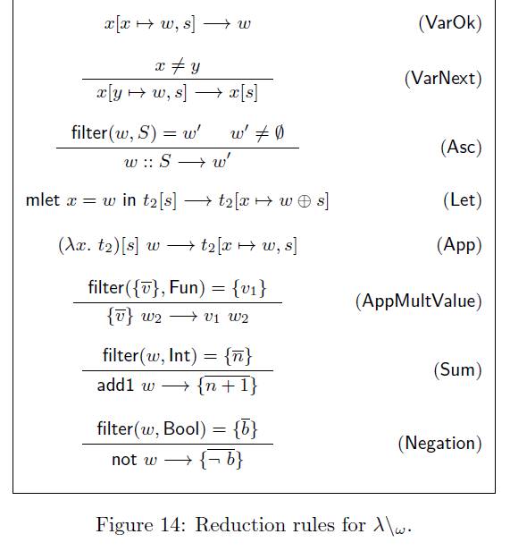
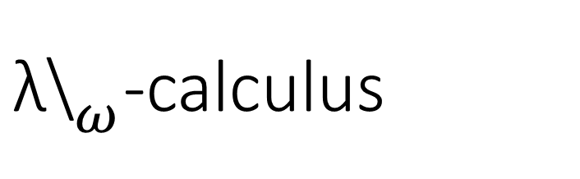
${\text{λ}\text{\backslash }}_{ω}$-calculus

Slide 17
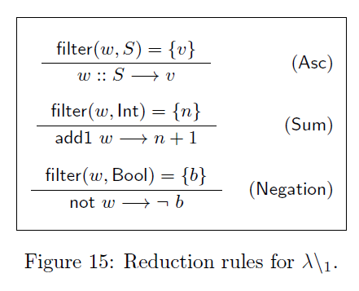
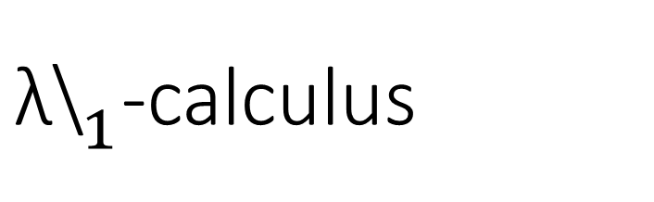
${\text{λ}\text{\backslash }}_{1}$-calculus

Slide 18
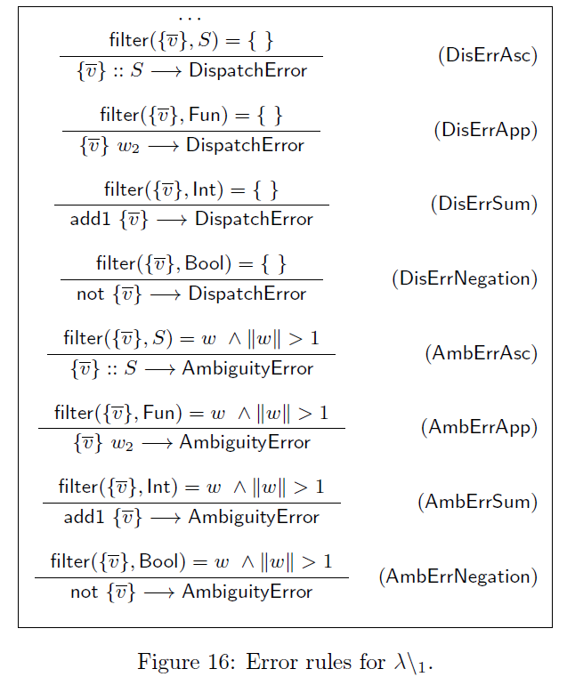
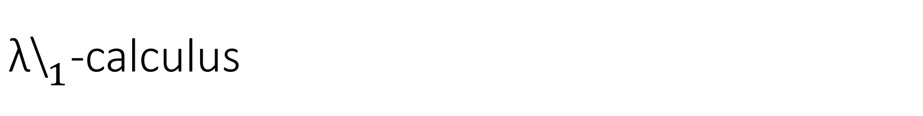
${\text{λ}\text{\backslash }}_{1}$-calculus

Slide 19
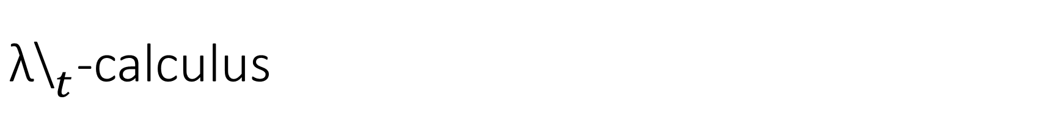
${\text{λ}\text{\backslash }}_{t}$-calculus
Deterministic semantic. With the use of multi-values a program can reduce to a set of value.
Type error detection.
Dispatch error detection.
Ambiguity error detection.
Type annotation in lambda functions.
More expressive than Strict Language, with the use structural tags.
Do not support context-dependent overloading.

Slide 20
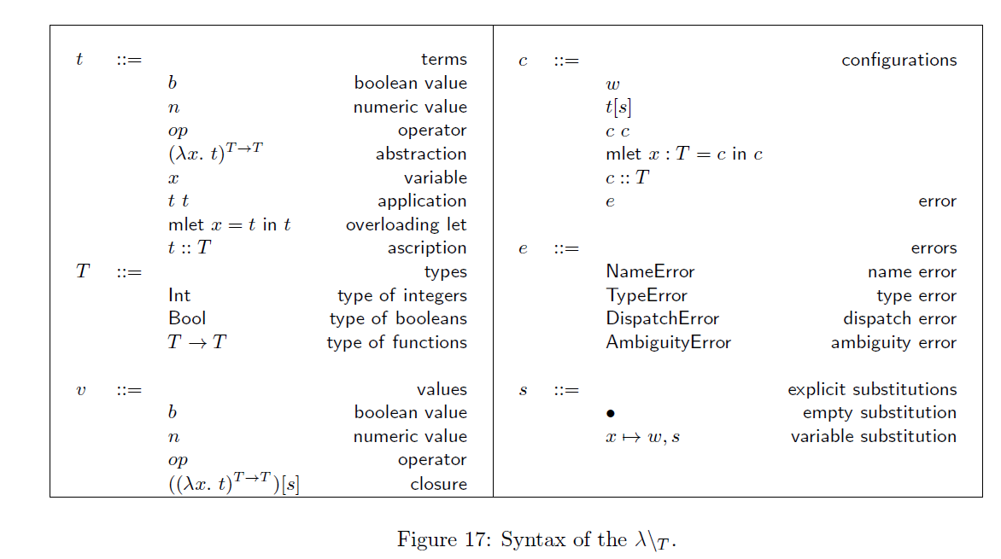
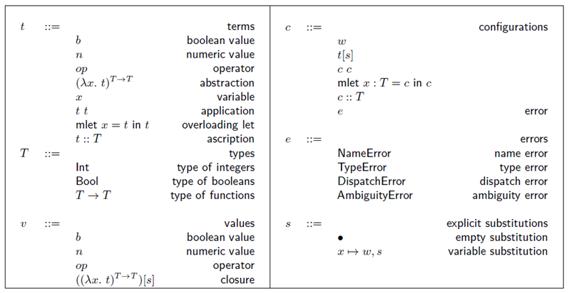
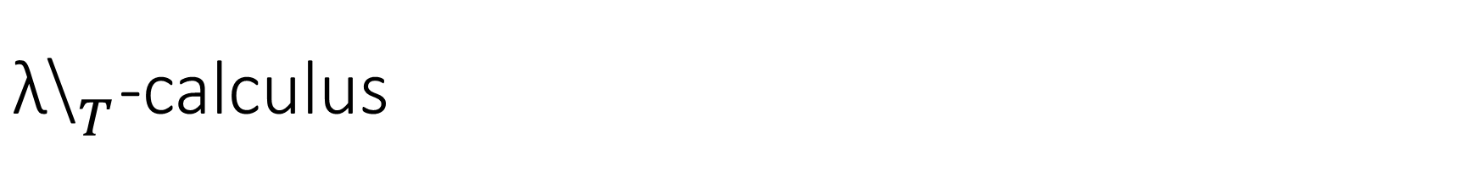
${\text{λ}\text{\backslash }}_{T}$-calculus

Slide 21
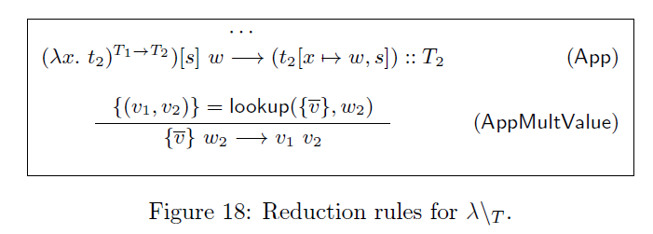
${\text{λ}\text{\backslash }}_{T}$-calculus

Slide 22
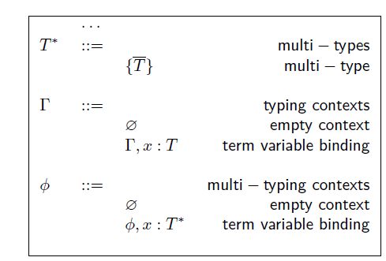
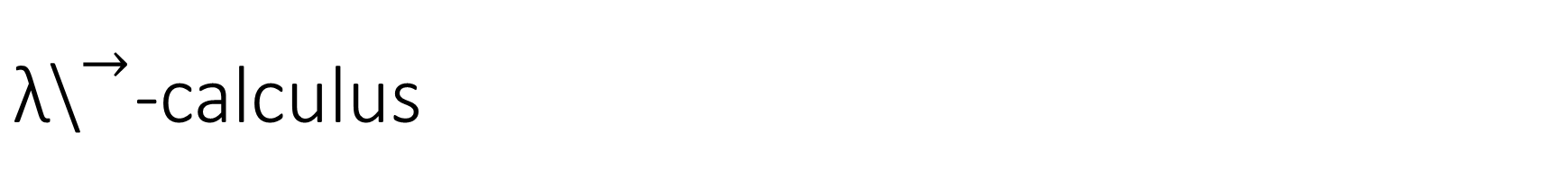
${\text{λ}\text{\backslash }}^{→}$-calculus

Slide 23
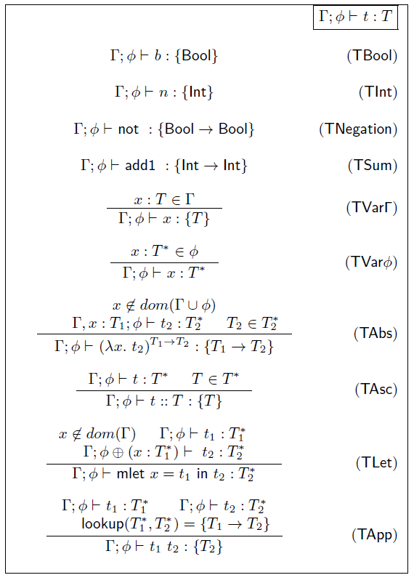
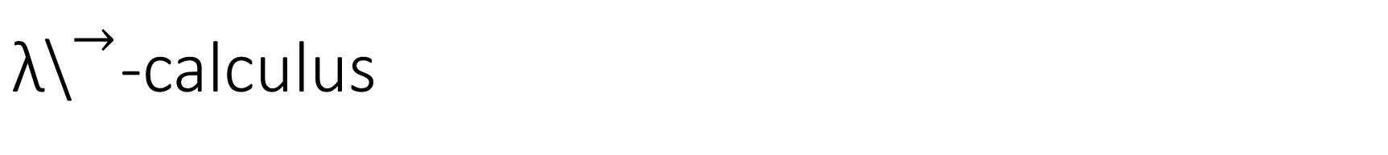
${\text{λ}\text{\backslash }}^{→}$-calculus

