Slide 2
Flexible Language
Non deterministic semantic, with branches that reduce to a value and other ending in error.
Name error detection.
Type error detection.
Without any type information in the syntax of the language.
Uses the explicit substitution.

Slide 3
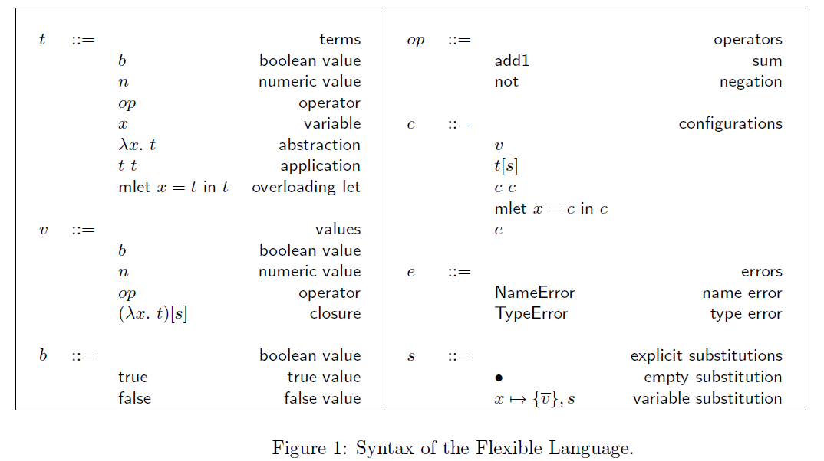
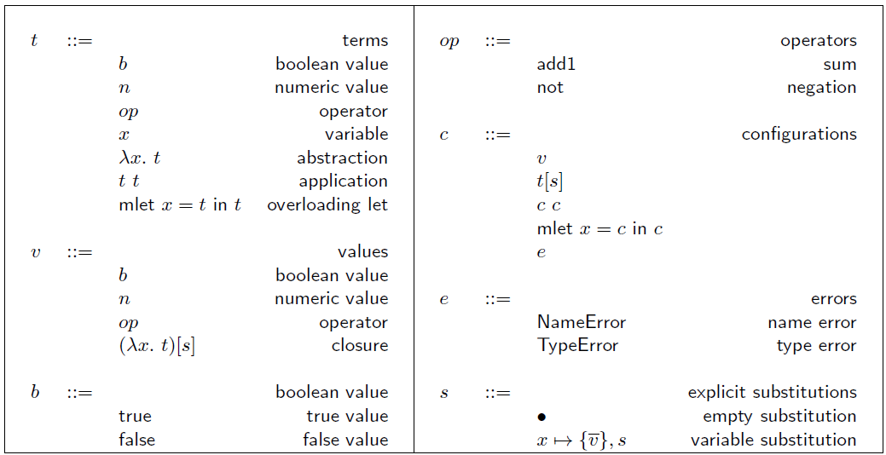
Flexible Language

Slide 4
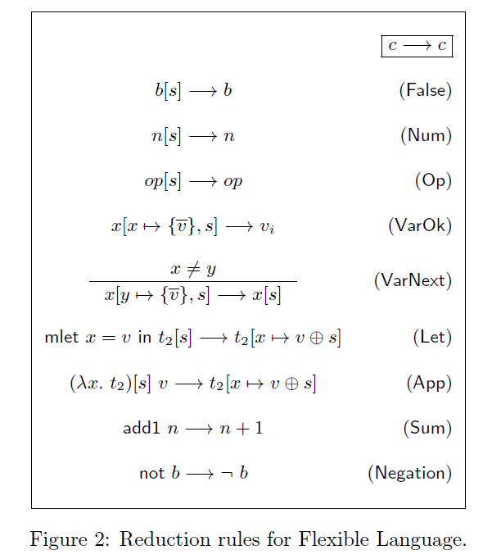
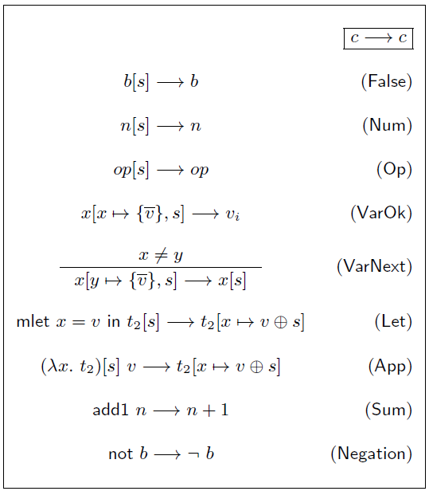
Flexible Language

Slide 5
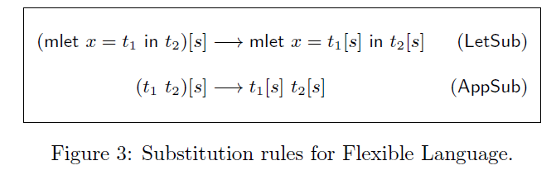
Flexible Language

Slide 6
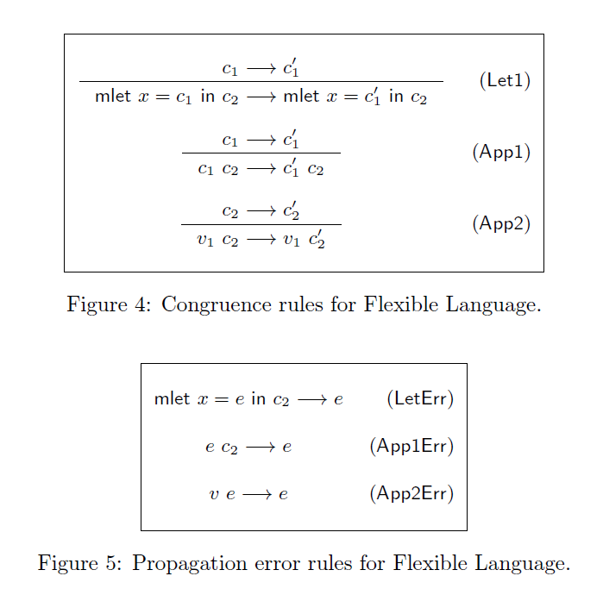
Flexible Language

Slide 7
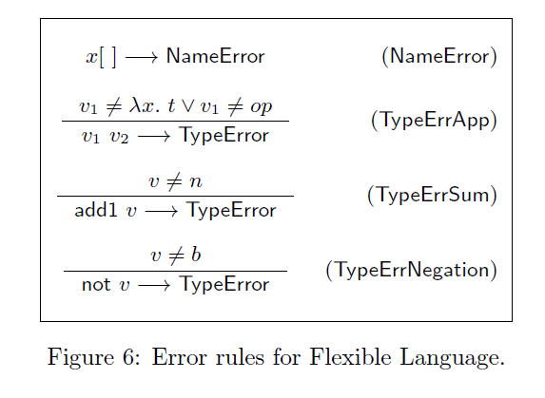
Flexible Language

Slide 8
Tag Driven Language
Non deterministic semantic, with branches that reduce to a value and
other ending in error.
Name error detection.
Type error detection.
Dispatch error detection.
Without any type information in the syntax of the language.
Semantic "tag driven", introducing at tag.

Slide 9
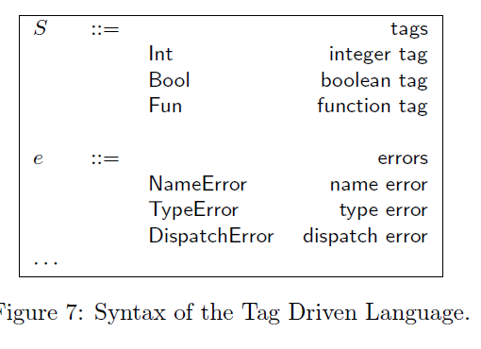
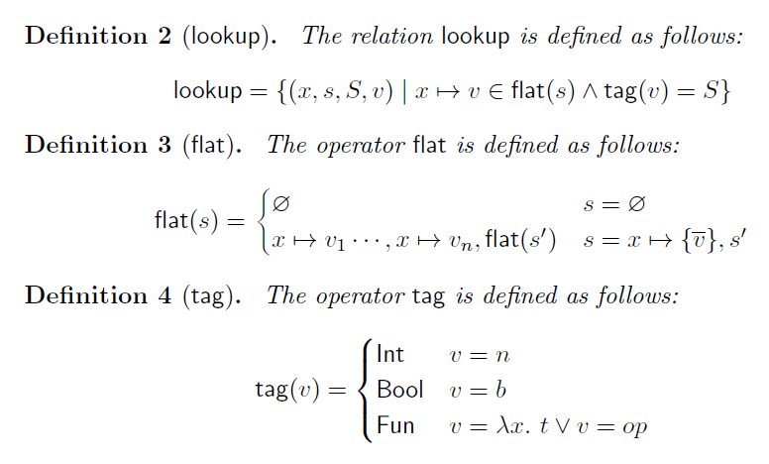
Tag Driven Language

Slide 10
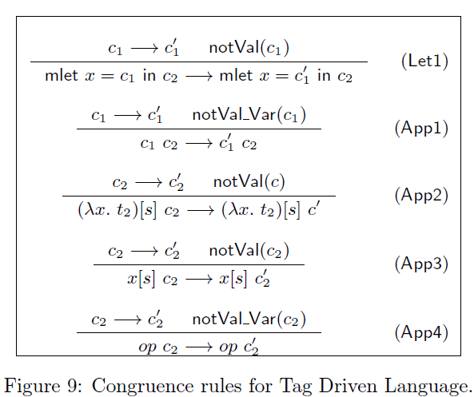
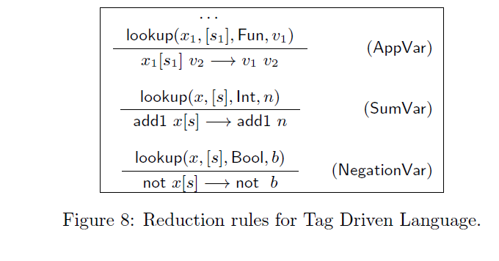
Tag Driven Language

Slide 11
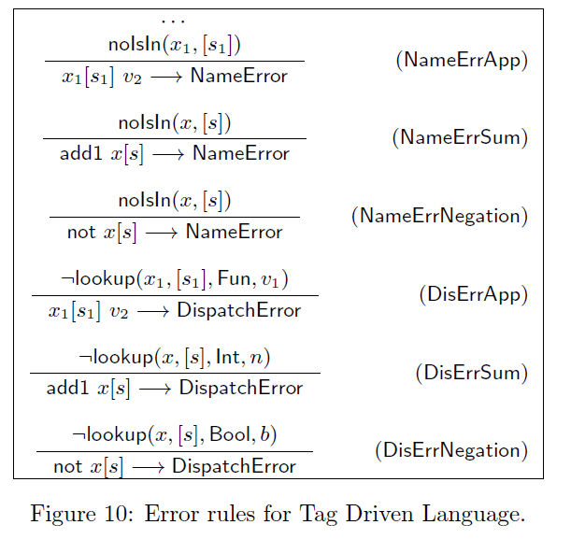
Tag Driven Language

Slide 12
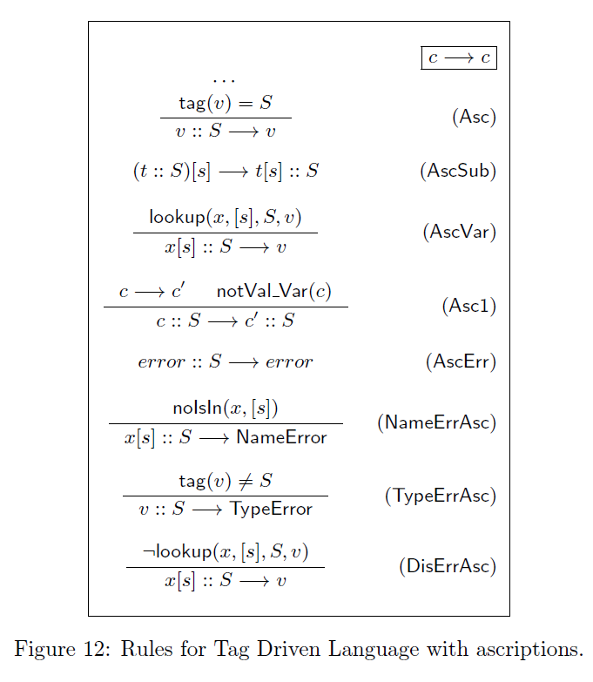
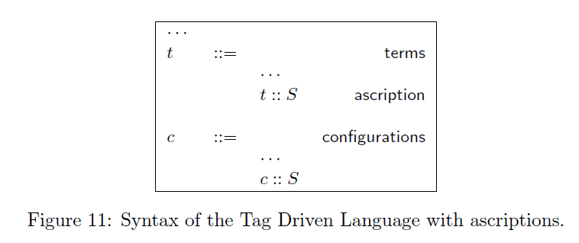
Tag Driven Language with ascription

Slide 13
Strict Language
Deterministic semantic. With the use of multi-values a program can reduce to a set of value.
Name error detection.
Type error detection.
Dispatch error detection.
Ambiguity error detection.

Slide 14
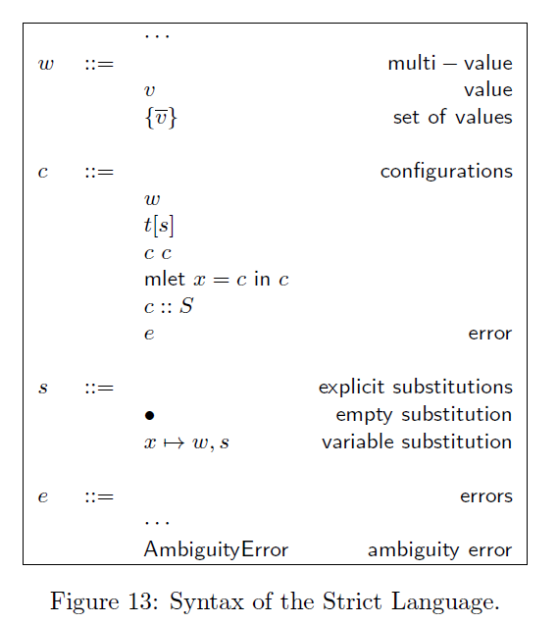
Strict Language

Slide 15
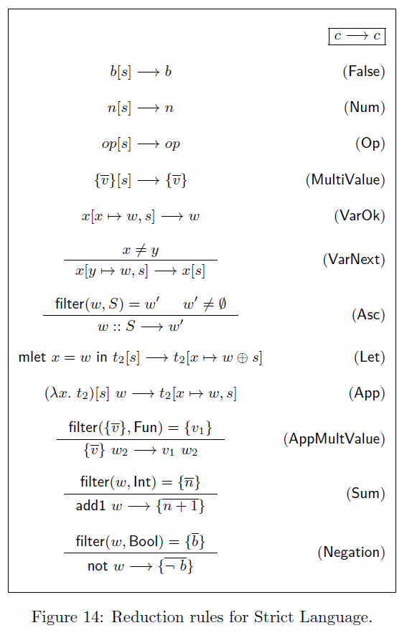
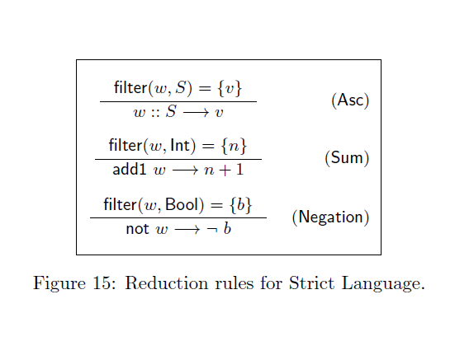
Strict Language

Slide 16
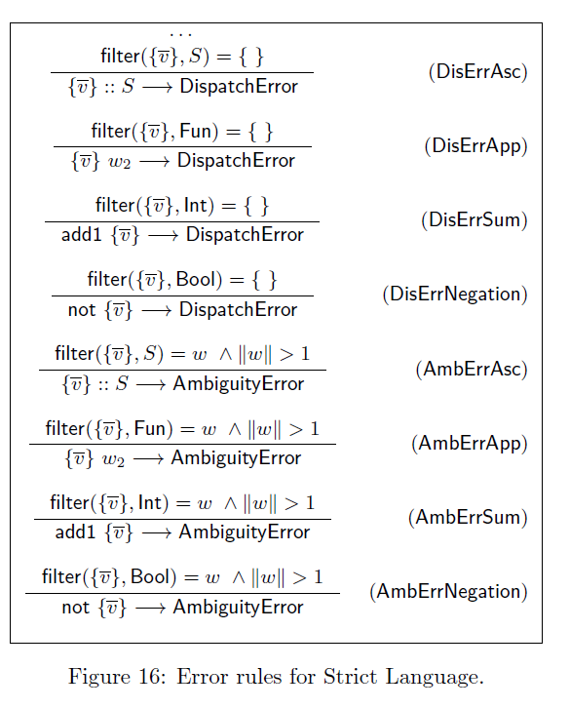
Strict Language

Slide 17
Overloading Language
Deterministic semantic. With the use of multi-values a program can reduce to a set of value.
Type error detection.
Dispatch error detection.
Ambiguity error detection.
Type annotation in lambda functions.
More expressive than Strict Language, with the use structural tags.
Do not support context-dependent overloading.

Slide 18
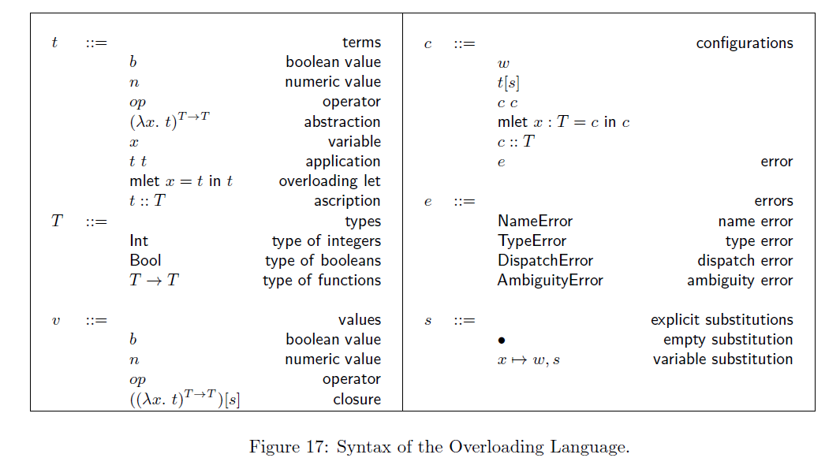
Overloading Language

Slide 19
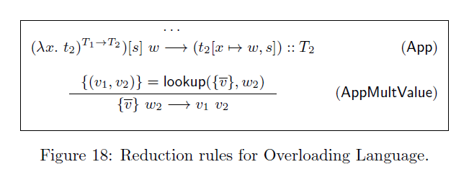
Overloading Language

Slide 20
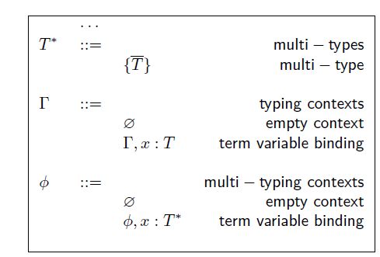
Static semantic for Overloading Language

Slide 21
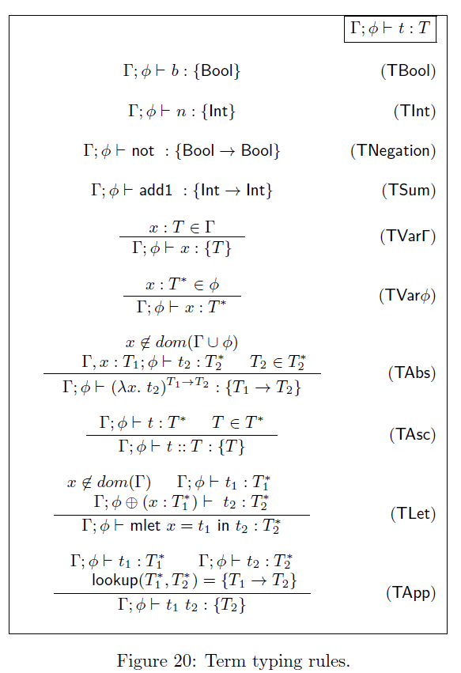
Static semantic for Overloading Language

Slide 22
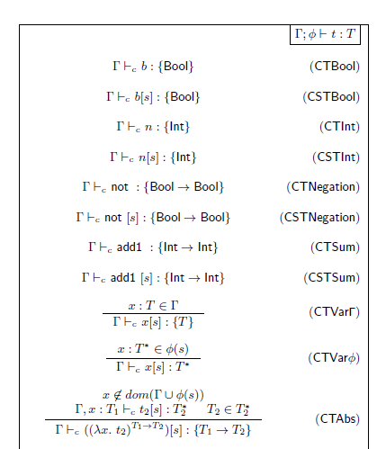
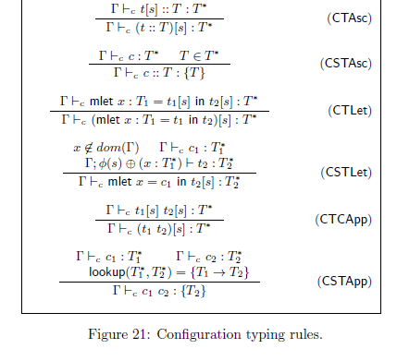
Static semantic for Overloading Language

