Slide 1
Word Puzzle Game for LLMs
By: Elijah Mansur

Slide 2
New Project Overview
Small LLM solves a word puzzle game similar to scrabble or bananagrams
Model finds as many valid words from randomly sorted list of random English letters to minimize the amount of unused characters
A letter can only be used once
Example:
"puzzle": "IRCUMERHRETNSAHTNEIPWGE", "solution": ["WHERE", "TUNES", "CHAMP", "RETIRING"]
This problem has an ideal solution that uses each letter once
Finding an ideal solution may be an exponential time problem
Finding a good solution, not ideal solution may be polynomial time
How a human might approach this problem
Morphological approach

Slide 3
Project Goals
If a model can solve the problem with 20 random english letters, can it perform well on a problem with for random english letters? 100 english letters? 1000 letters?
Supervised Fine Tuning and Reinforcement Learning project
Models such as DeepSeekR1 have demonstrated ability to reason with RL
Goal - To show effectiveness of fine tuning for readability and format
Goal - To replicate DeepSeekR1 SFT + RL recipe
Goal - Evaluate RL model in out of distribution scenarios

Slide 4
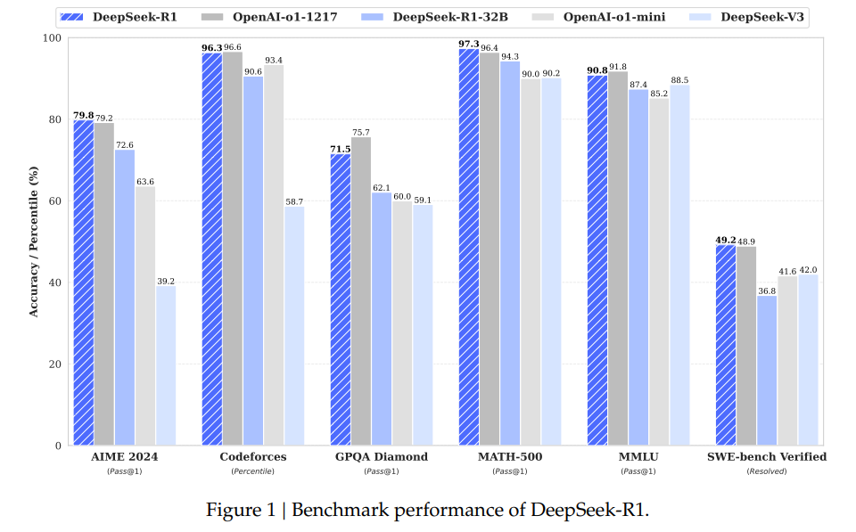
DeepSeek-R1: Incentivizing Reasoning Capability in LLMs via Reinforcement Learning

Slide 5
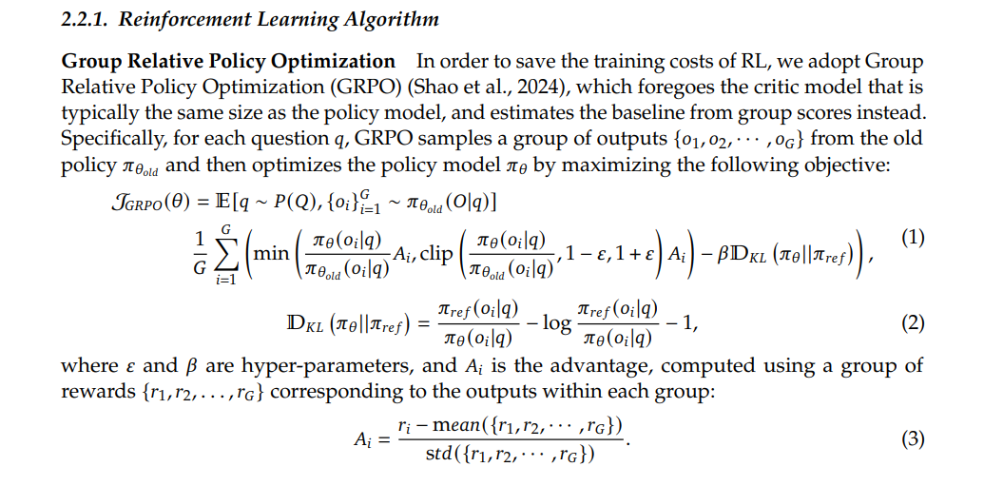
GRPO

Slide 6
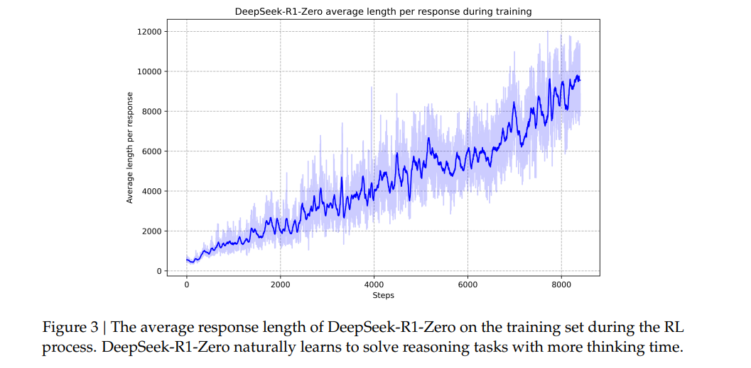
Emergent property - Response Length of Model During RL

Slide 7
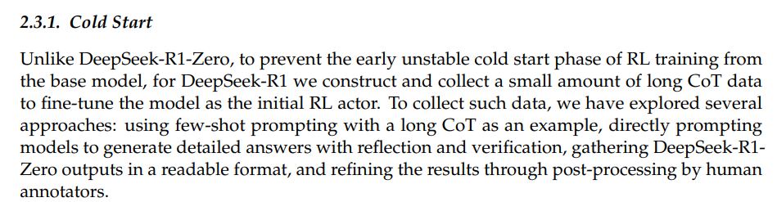
Cold Start for RL

Slide 8
Project Steps
Build fine tuning dataset with high quality examples of word puzzle problem solving Chain of Thoughts (CoT)
Utilize Supervised Fine Tuning (SFT) with dataset so model follows certain format preferences
Perform RL with fine-tuned model with longer sequences of letters
Evaluate model in out of distributions settings
More letters than used in training
Different language
New characters

Slide 9
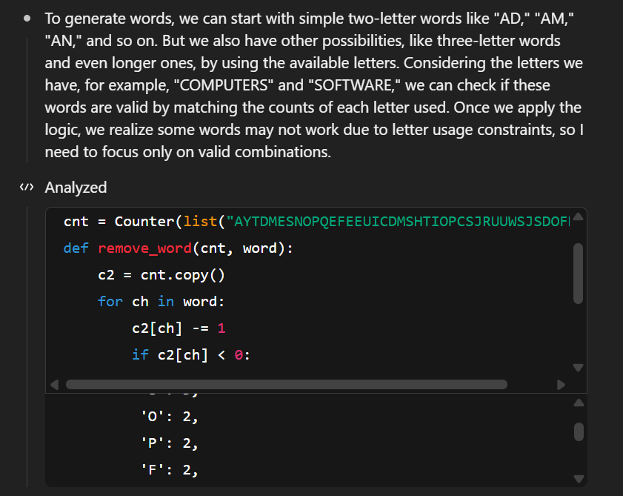
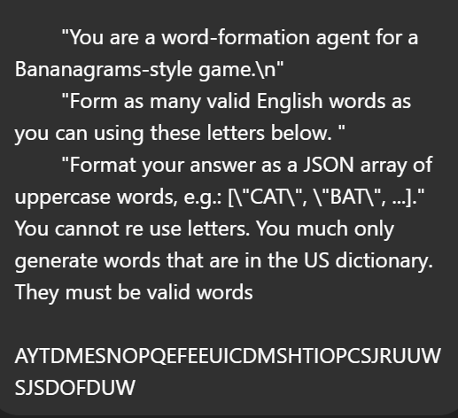
Observations of Current SOTA Models
O4-mini high model uses tool calls to solve this word problem and to keep track of used letters
Programmatic state of game
Without an easy way to “memorize/track” which words have been used in the sequence, LLMs may struggle

Slide 10
Idea - Chain of Thought Generation With Python Script
Teach model to maintain key game state in chain of thought and exhibit useful behaviors
Utilize Python script to programmatically generate useful chain of thoughts that help the model in a few ways:
Model sorts the random letters alphabetically
Model identifies prefixes and suffixes in common english words
Model identifies rare letter combinations such as QU in quiet
Model identifies vowel combinations such as EA in search
Model learns to remove letters from list of remaining letters when it identifies a valid word
Input: build_cot(puzzle, words, unused_count)
Iterate over each word and identify key characteristics in each word

Slide 11
Chain of Thought Creation Steps
Pick 5 random words from the English dictionary based on frequency of use (top 10,000)
Shuffle the characters in these words randomly to generate a random string which represents the start of the game
Programmatically generate CoTs that represent the morphological reverse engineering of the words into their prefixes and suffixes
Dataset:
19,000 training examples
1,000 validation examples

Slide 12
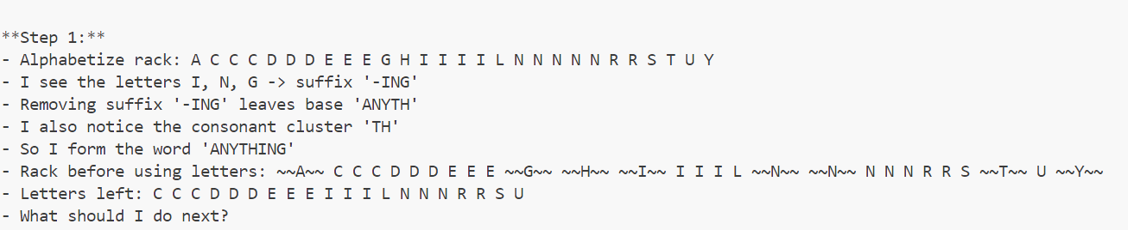
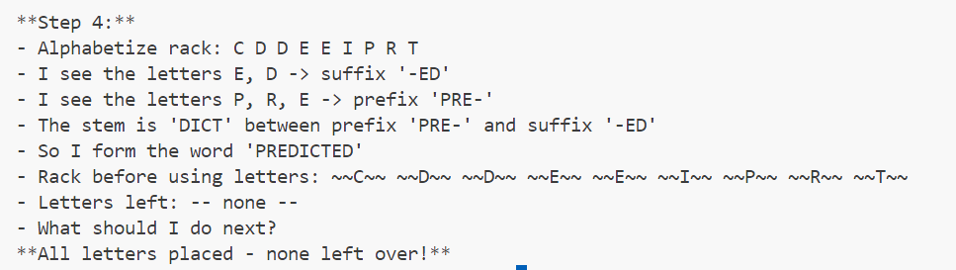

Slide 13
Qwen2.5-1.5B-Instruct
Great at instruction following and resilient to various system prompts
Multilingual support
Number of Parameters: 1.54B
Number of Layers: 28

Slide 14
System Prompt
You are a word-formation agent for a Bananagrams-style game. A conversation between User and Assistant. The user asks a question, and the Assistant solves it. The assistant first thinks about the reasoning process in the mind and then provides the user with the answer. The reasoning process and answer are enclosed within <think> </think> and <answer> </answer> tags.

Slide 15
User Message
Available letters (each can be used once): {available_letters} \n\nForm as many valid English words as you can using these letters. Return your answer as a JSON array of uppercase words, e.g.: ["CAT", "BAT"].

Slide 16

Open R1 Github Repository
Maintained by Hugging Face and open source community
Provides modules for Supervised Fine Tuning and Reinforcement Learning
Provides details on how to reproduce of Deep Seek R1 paper

Slide 17
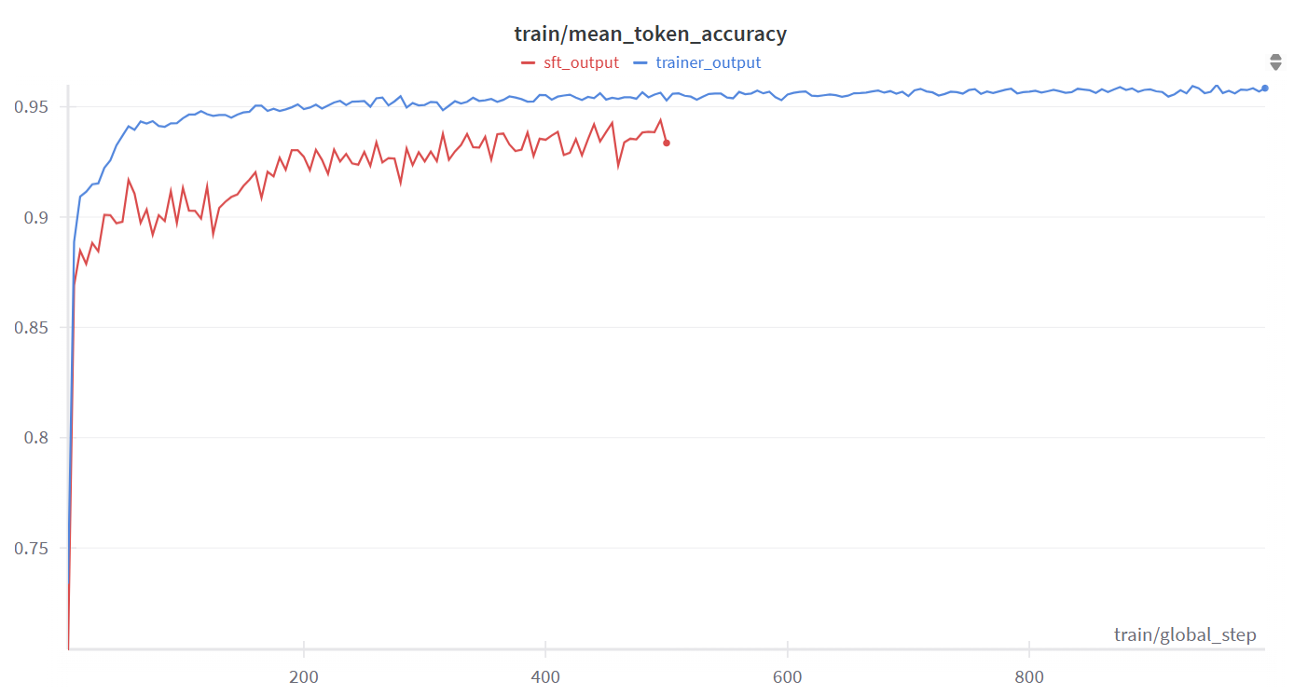
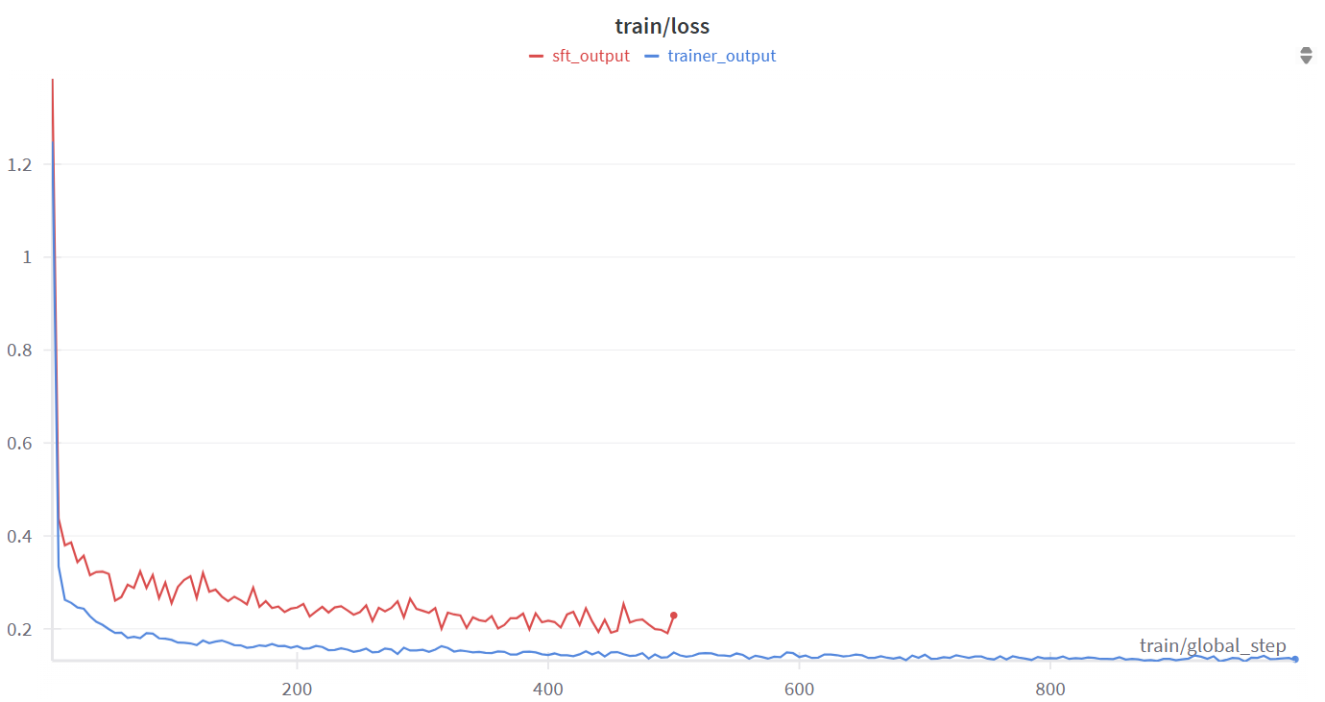
Supervised Fine Tuning Results - 2 Runs on OSC
Cardinal cluster 1 H100 GPU
Ran into out of memory issues
Per_device_train_batch_size by default is 8 per GPU
Second training examples using Per_device_train_batch_size=1
With these changes, still encountered out of memory errors
Mean Token‑Prediction Accuracy during SFT
Training Loss (Cross‑Entropy) vs Global Step

Slide 18
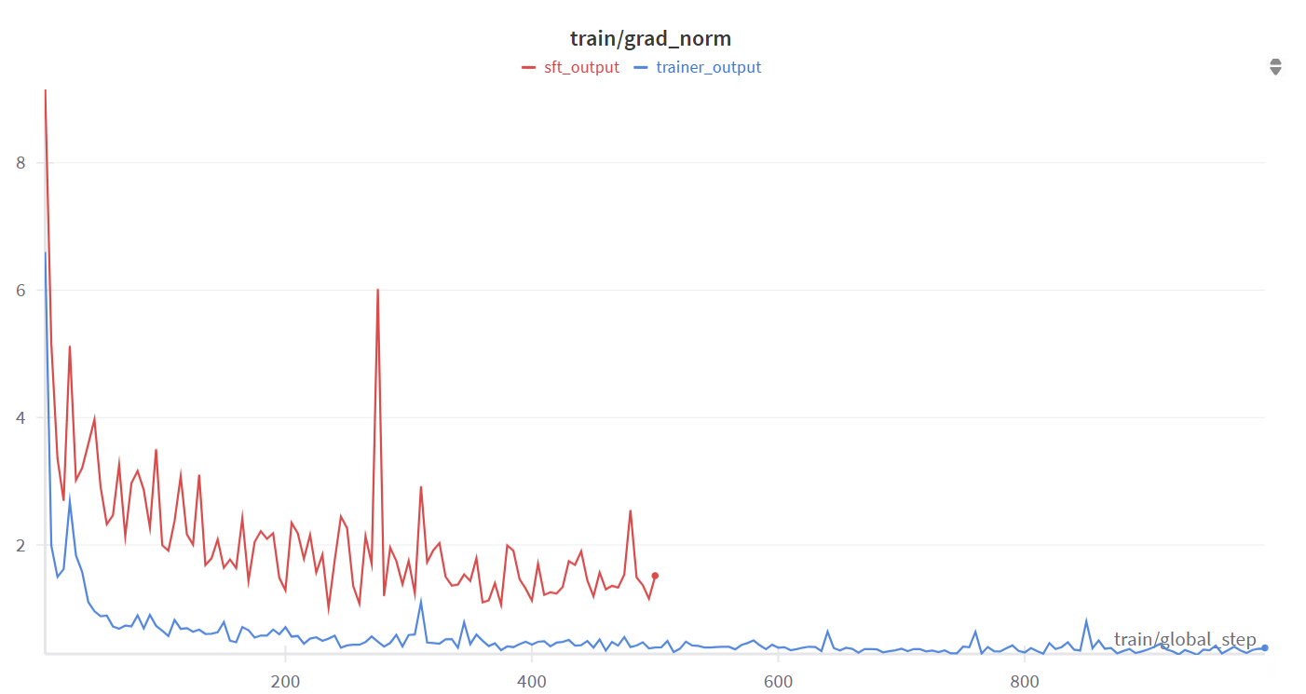
Supervised Fine Tuning Results
Training Gradient Norm over Optimization Steps

Slide 19
Conclusion and Next Steps
Progress building CoT dataset and performing SFT runs on OSC supercomputer
Next step - Perform reinforcement learning using GRPO similar to R1 implementation
Further exploration - how should the reward function be structured?
Reward for number of characters remaining
Difficulty of the words found
Difficulty of the characters used
Correctness of identified word
How common is the identified word
How can the model be incentivized to use more reasoning steps and/or correct mistakes?

Slide 20
References
Guo, Daya, Dejian Yang, Haowei Zhang, Junxiao Song, Ruoyu Zhang, Runxin Xu, Qihao Zhu et al. "Deepseek-r1: Incentivizing reasoning capability in llms via reinforcement learning." arXiv preprint arXiv:2501.12948 (2025).
Qwen/Qwen2.5-1.5B-instruct · hugging face. Qwen/Qwen2.5-1.5B-Instruct · Hugging Face. (n.d.). https://huggingface.co/Qwen/Qwen2.5-1.5B-Instruct
Huggingface. (n.d.). Huggingface/open-R1: Fully open reproduction of DeepSeek-R1. GitHub. https://github.com/huggingface/open-r1

