Slide 1
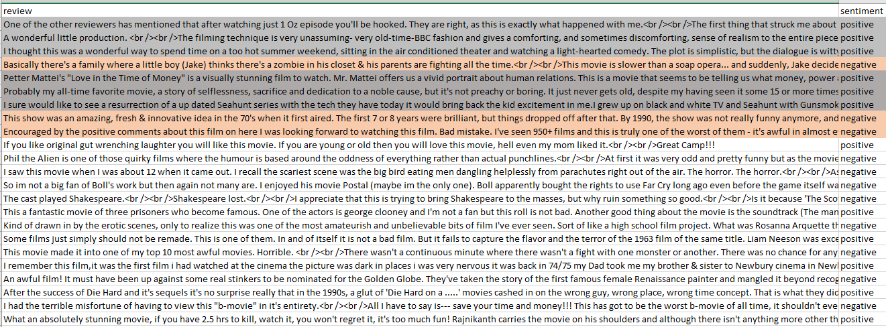
IMDB REVIEWS EDA
Elina Nussbaum
Are negative remarks longer?
Are positive remarks better spelled?
Can we use words from negative and positive remarks to identify sentiments in other datasets?
Does a commonly used sentiment analyzer match the sentiment provided in the dataset?

Slide 2
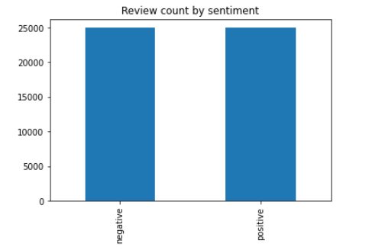
IMDB REVIEWS EDA
Elina Nussbaum
Dataset split equally between positive and negative

Slide 3
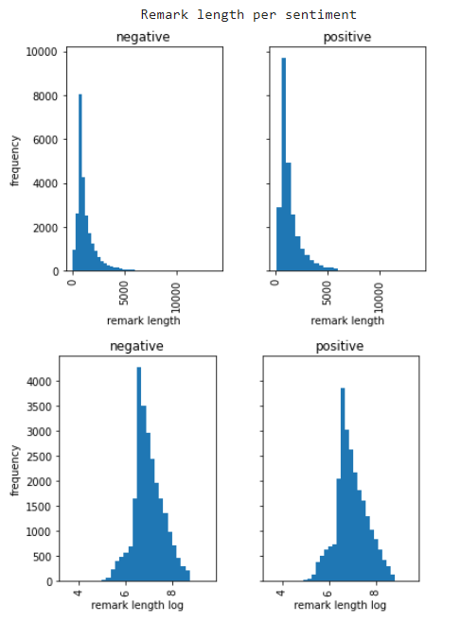
IMDB REVIEWS EDA
Elina Nussbaum
Seems positive remarks are slightly longer but in general,
are very similar in length to negative remarks distribution.

Slide 4
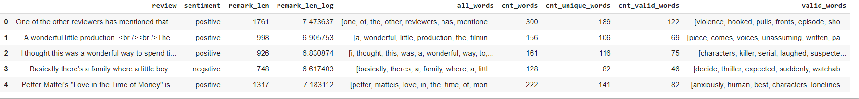
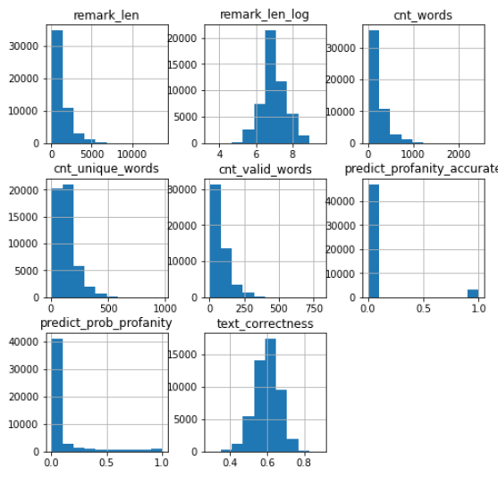
IMDB REVIEWS EDA
Elina Nussbaum
Clearing html tags, digits and punctuation provided a word list.
Narrowing down the list to unique and valid words according to the English dictionary.

Slide 5
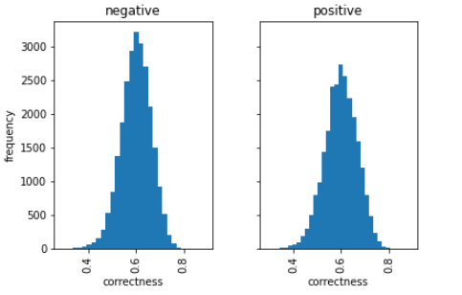
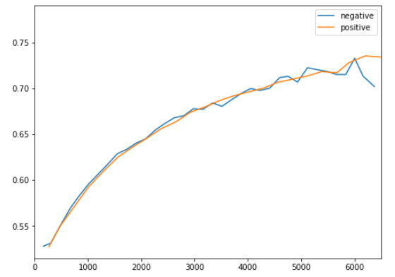
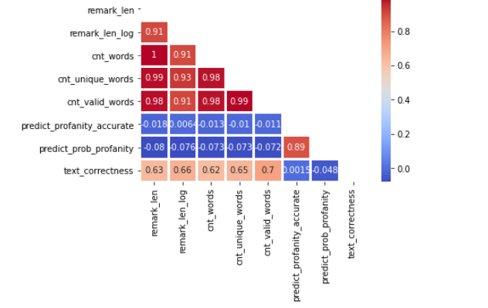
IMDB REVIEWS EDA
Elina Nussbaum
Surprisingly, spelling correctness per sentiment shows that the negative remarks have better spelling
Even more surprisingly, longer remarks have better spelling

Slide 6
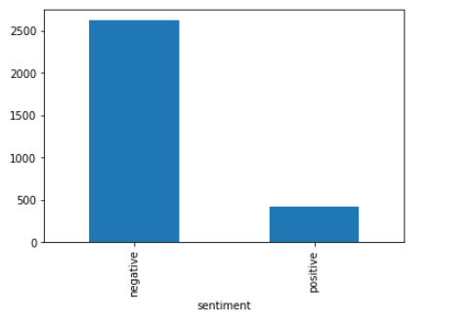
IMDB REVIEWS EDA
Elina Nussbaum
Profanity, as excepted, mainly appears in negative remarks

Slide 7
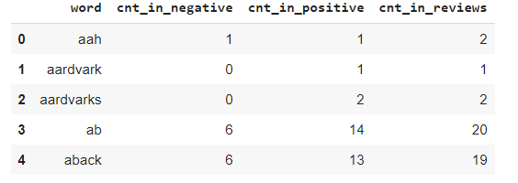
IMDB REVIEWS EDA
Elina Nussbaum
Narrowing down all remarks to a list unique valid words in all remarks allows counting occurrences in negative and positive remarks

Slide 8
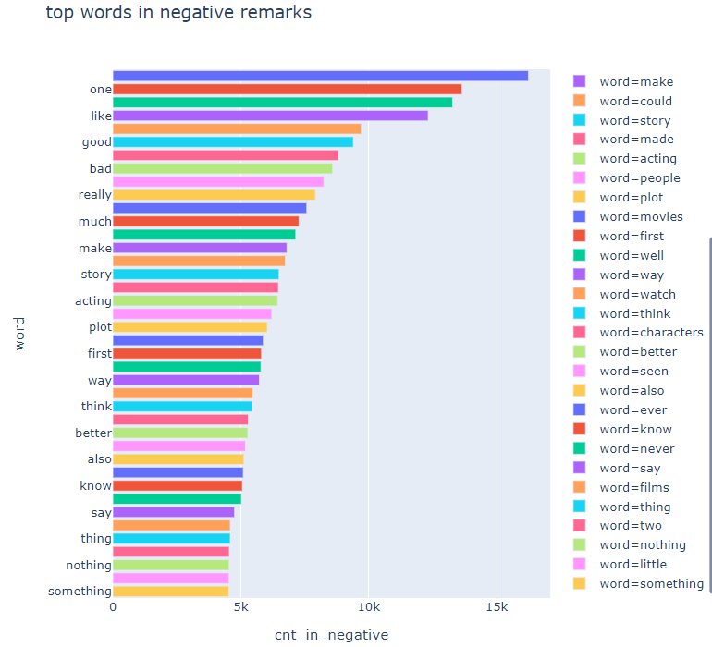
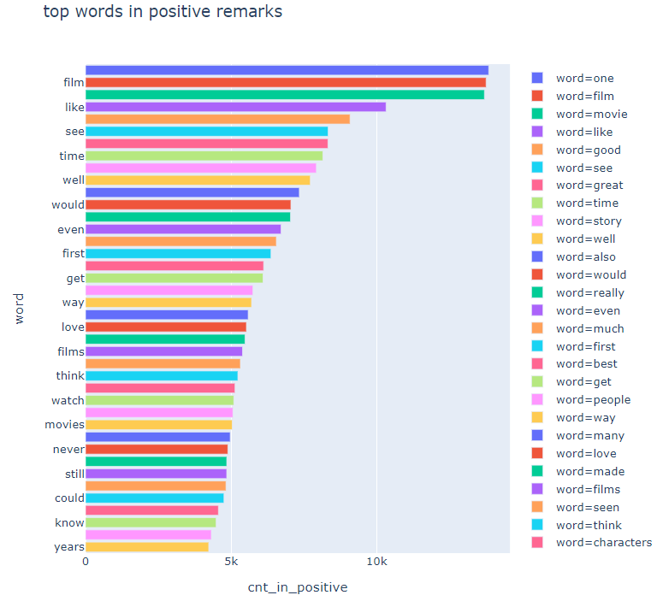
IMDB REVIEWS EDA
Elina Nussbaum

Slide 9
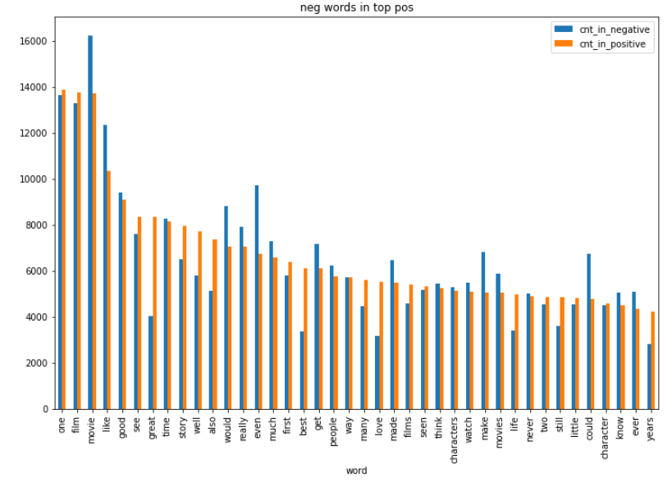
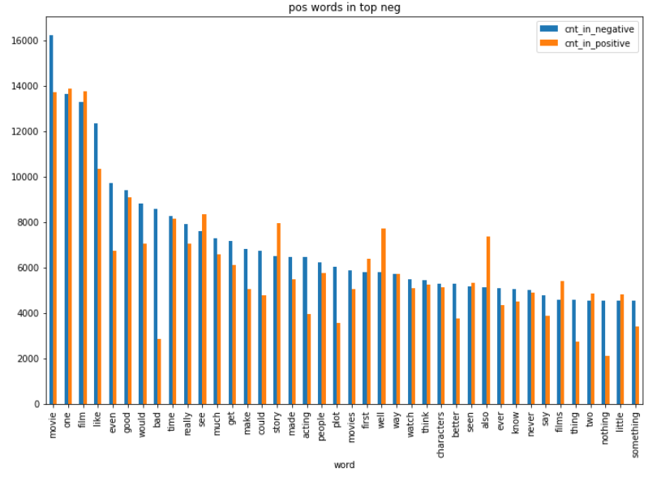
IMDB REVIEWS EDA
Elina Nussbaum
Checking top positive words in negative remarks and vice versa shows that most top negative and top positive words
are the same, except for the logical exceptions “good, great, … “ in negative remarks and “bad” n good remarks.

Slide 10
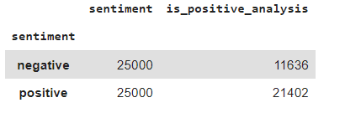
IMDB REVIEWS EDA
Elina Nussbaum
Running the remarks against commonly used sentiment analyzer matches sentiment in positive remarks much better than negative remarks.
https://www.nltk.org/api/nltk.sentiment.html
The similarity of word usage in negative and positive remarks and the mismatch of sentiment analysis of negative remarks
in comparison to nltk’s analyzer does not allow to use imdb’s dataset to run sentiment analysis.

