Slide 1
Tau Expression in Response to ProNGF Treatment in BFCNs

Slide 2
Background

Slide 3
Published Context
ProNGF — the precursor form of Nerve Growth Factor — was recently shown to drive retrograde axonal degeneration of basal forebrain cholinergic neurons (BFCNs) through the p75^{NTR} receptor and induction of amyloid precursor protein (APP).

Slide 4
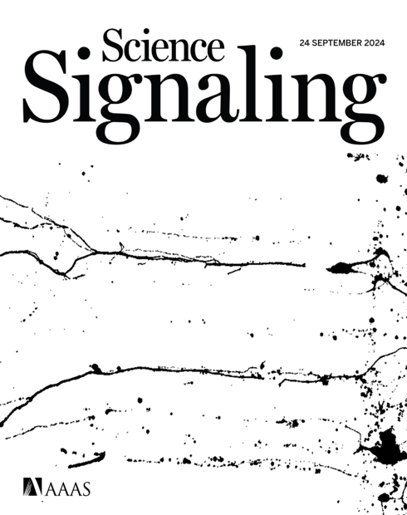
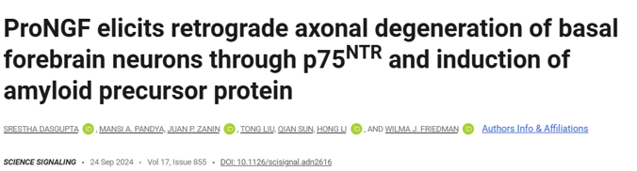

Slide 5
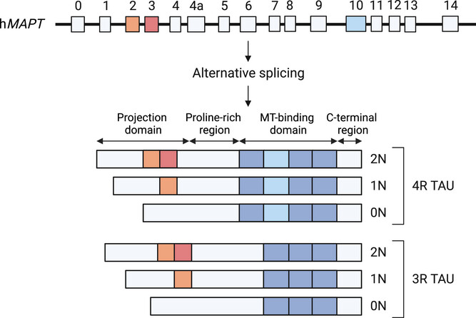
Tau isoforms in the adult human brain

Slide 6
Six brain isoforms are generated by alternative splicing of MAPT exons 2, 3, and 10 (0N/1N/2N × 3R/4R).
Exon 10 inclusion → 4R Tau, which increases MT-binding affinity vs 3R.

Slide 7
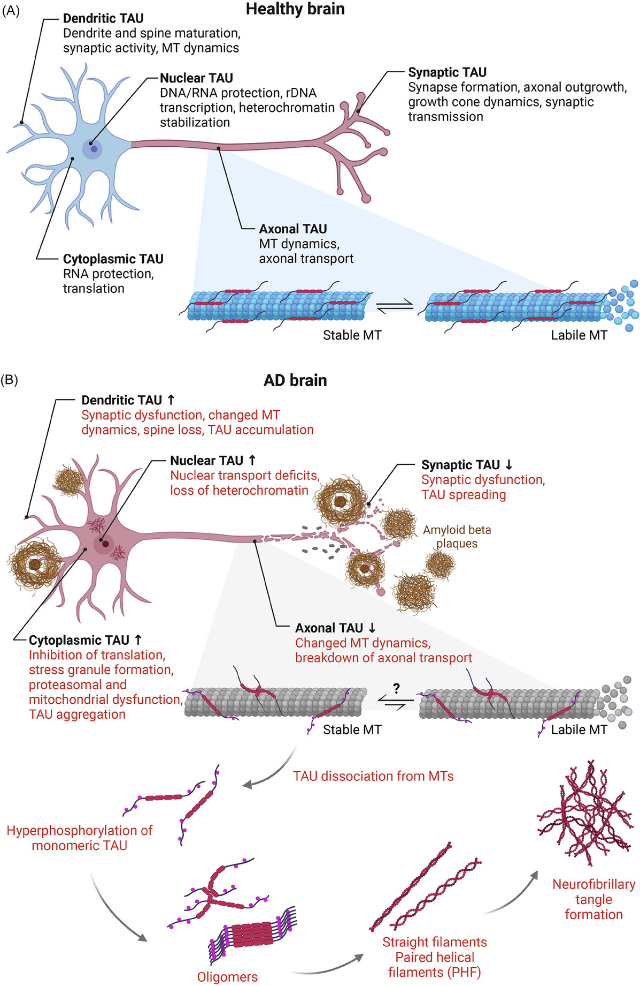
Additional roles of Tau beyond microtubule binding

Slide 8
Tau biology is compartment-specific (axon, dendrite, synapse, nucleus) and shifts in AD with somatodendritic missorting, impaired transport, and aggregation.
Use this to motivate why Tau can act as an upstream regulator of multiple axonal stress/degeneration pathways.

Slide 9
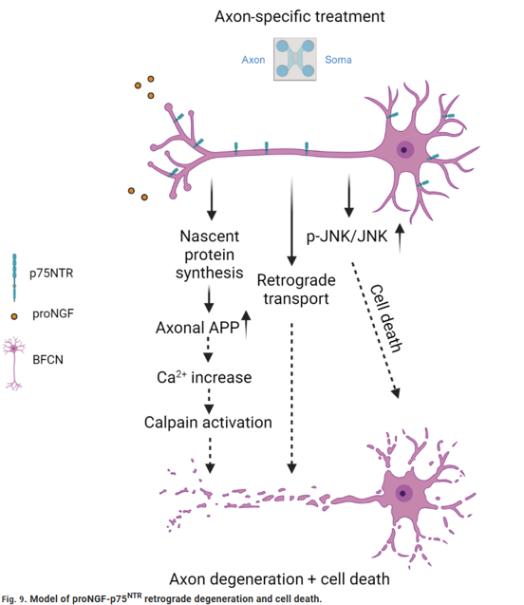
The Mechanism
ProNGF acts selectively on axons, triggering a cascade that leads to both axon degeneration and cell death:
Axon-specific proNGF → p75^{NTR} activation
↑ Nascent protein synthesis in axons, including APP
APP↑ → Ca²⁺ increase → Calpain activation
Concurrent retrograde p-JNK/JNK signalling → cell death

Slide 10
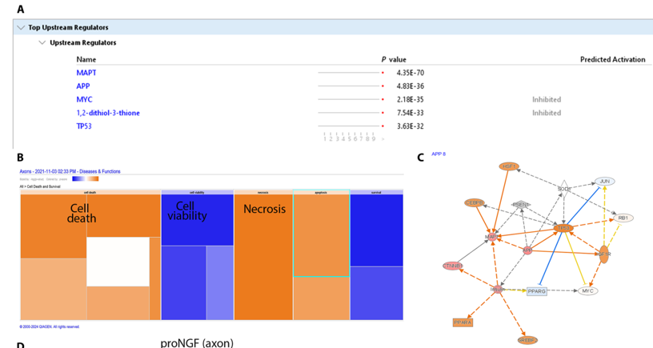
Prior Lab Data — Ingenuity Pathway Analysis (IPA)
To identify which upstream regulators are activated by axonal proNGF treatment, BFCNs were cultured in filter chambers that physically separate axons from cell bodies.
Axons were treated with proNGF for 30 minutes
Newly synthesised proteins were labelled with O-propargyl-puromycin (OPP)
After a 2-hour labelling window, axonal lysates were collected and analysed
IPA of the axonal proteome revealed MAPT (tau) and APP as the top upstream regulators (p = 4.35×10⁻⁷⁰ and 4.83×10⁻³⁶, respectively), with predicted downstream effects on cell death and necrosis.

Slide 11
Rationale for This Study
The IPA data pointed to tau (MAPT) as a central upstream regulator of the axonal response to proNGF — yet the specific changes in tau protein expression and phosphorylation state had not been characterised.
This study asks:
Does proNGF treatment alter total tau and phospho-tau levels in the axon and soma compartments of BFCNs?
We used Western blotting with antibodies targeting three phosphorylation sites — pThr181, pSer202/pThr205 (AT8), and pSer622 — alongside pan-tau, to capture both the abundance and phosphorylation state of tau across compartments.

Slide 12
Total Tau Increase in Response to ProNGF Treatment

Slide 13
Overview
ProNGF treatment was applied to compartmentalized basal forebrain cholinergic neuron cultures.
Western blotting was used to assess changes in total Tau and phospho-Tau protein levels across soma and axon compartments.

Slide 14
Tau Phosphorylation Sites for Antibodies used
In this research, I quantified tau phosphorylation using three antibodies that report distinct tau states:
pThr181 (p-tau181): commonly used biomarker-associated phosphorylation site that tracks Alzheimer’s disease-related tau pathology in CSF and plasma and is widely used for staging/stratification. (Context review: https://pmc.ncbi.nlm.nih.gov/articles/PMC10839341/) Key kinases: GSK-3β, CDK5.
AT8 (pSer202/pThr205): canonical neuropathology epitope used to detect early and established pathological tau (pre-tangles/tangles) in tissue; often treated as a marker of disease-associated tau phosphorylation. (Epitope/usage context: https://www.alzforum.org/alzantibodies/tau-at8-phospho-tau-ser-202-thr-205) Key kinases: GSK-3β, MAPK, CDK5.
pSer622: a C-terminal tau site sometimes assessed in biochemical studies; interpretation can depend on antibody specificity and isoform context, and is typically considered alongside broader phosphorylation patterns rather than as a standalone “core biomarker” site. (Phosphorylation landscape context: https://pmc.ncbi.nlm.nih.gov/articles/PMC10839341/) Key kinases: Casein kinase 1 and 2, GSK-3β.

Slide 15
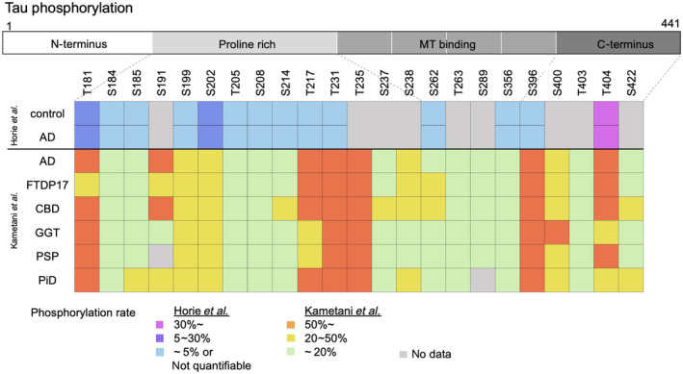
Phosphorylation Patterns of Tau
The figure shows the phosphorylation sites of tau identified in each disease and the frequency (Horie et al. and Kametani et al.)

Slide 16
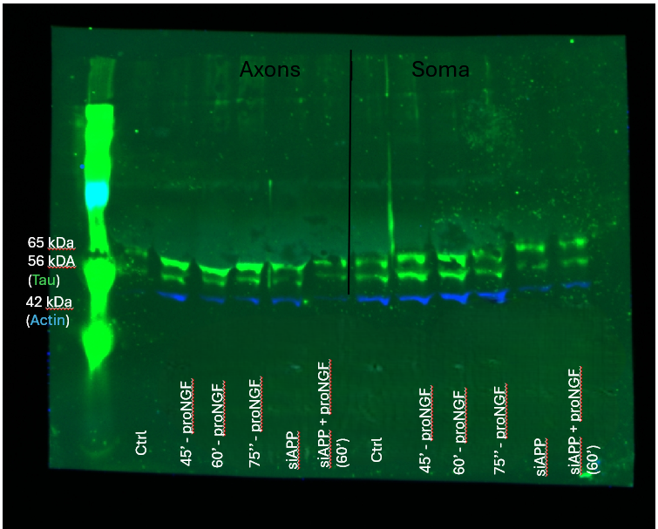
Composite Western Blot — All Compartments
Western blot analysis of Tau and actin expression. Composite image.

Slide 17
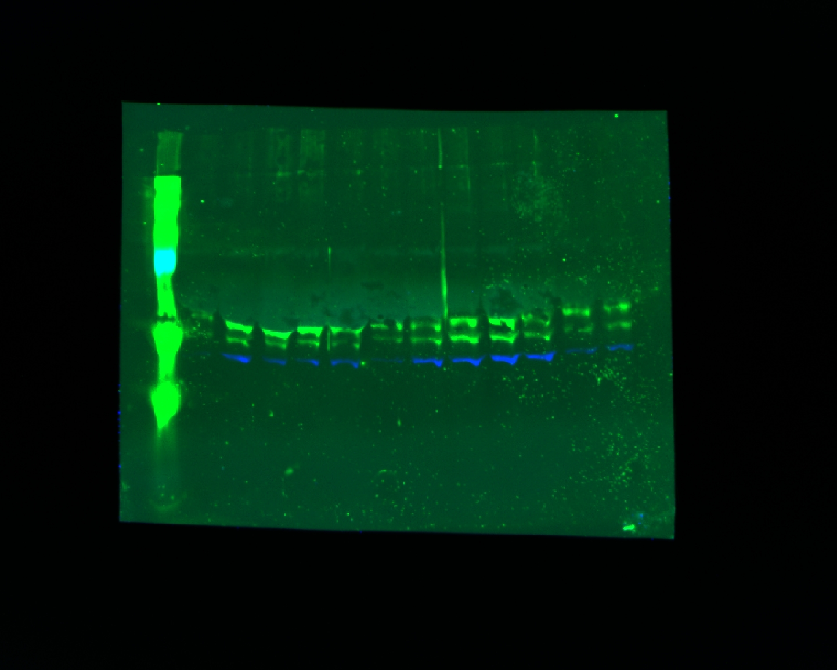
Representative Composite Image
Representative composite image showing actin (blue) and Tau (green).

Slide 18
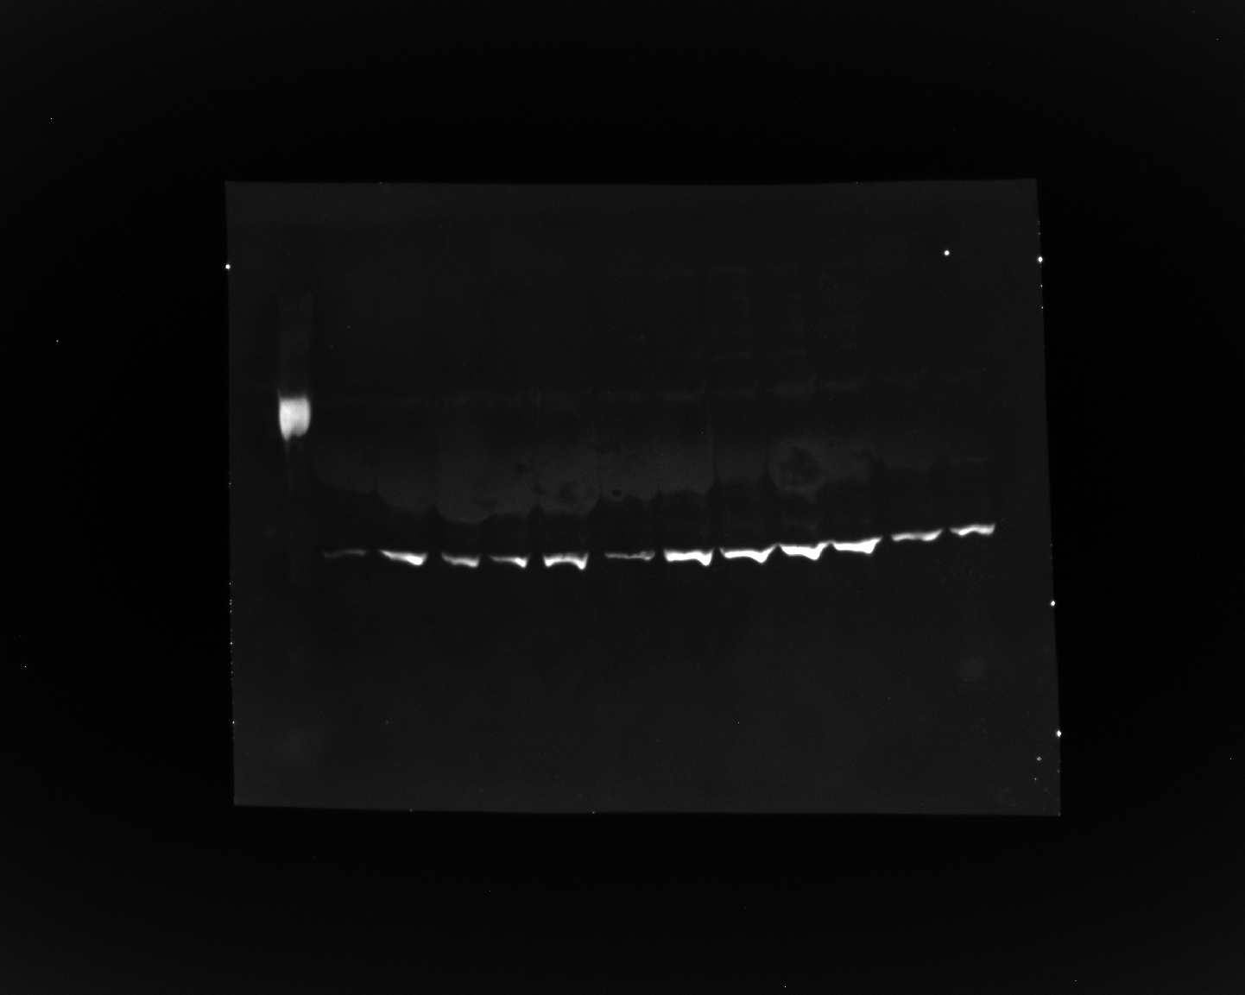
Green Channel — Actin & Phospho-Tau (800CW)
Green channel image showing actin (mouse) and phospho-Tau (rabbit; pSer202/pThr205).

Slide 19
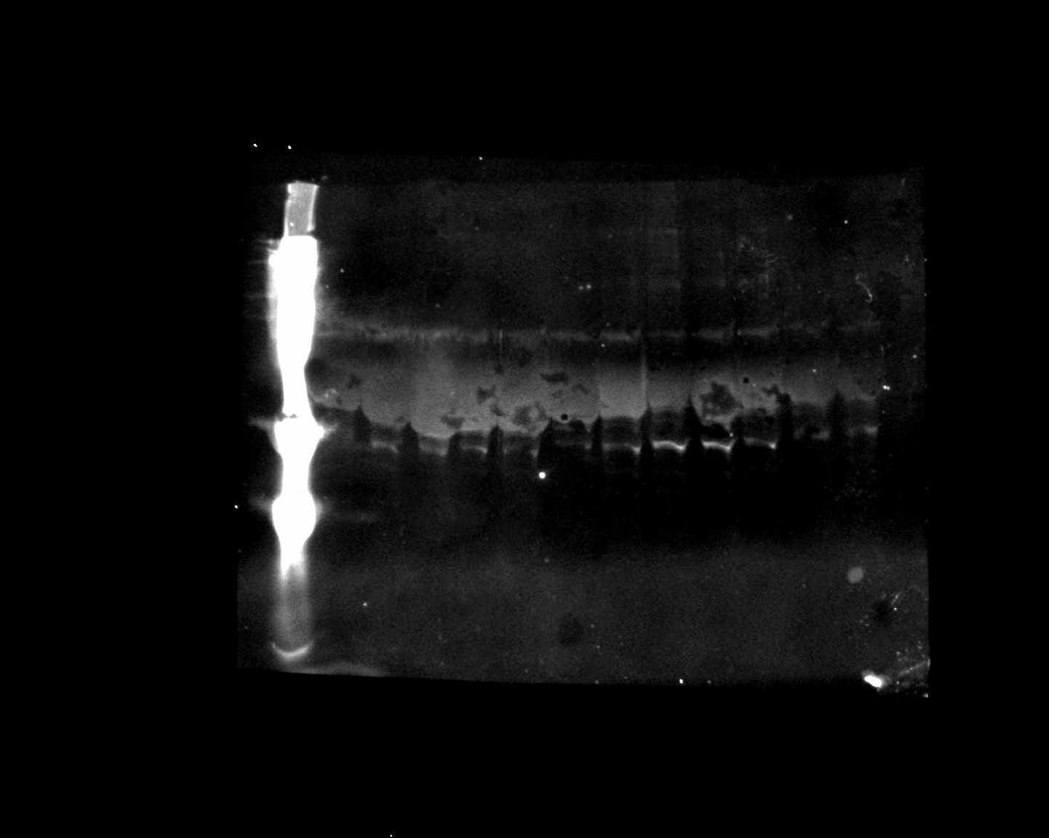
Red Channel — Total Tau (pan-Tau; Rb-237)
Red channel image showing total Tau (pan-Tau; Rb-237).

Slide 20
Soma-Only Repeat Western Blot

Slide 21
Overview
A repeat Western blot was performed on soma-only fractions from the same samples as above.
Targets: phospho-Tau (pSer622), pan-Tau, and actin.

Slide 22
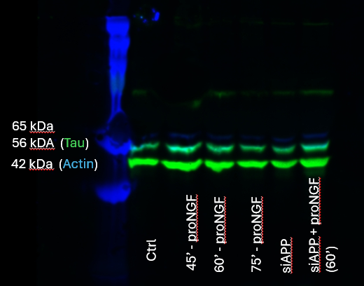
Soma-Only Composite Western Blot
Western blot analysis of phosphoTau, panTau and actin expression. Composite image.

Slide 23
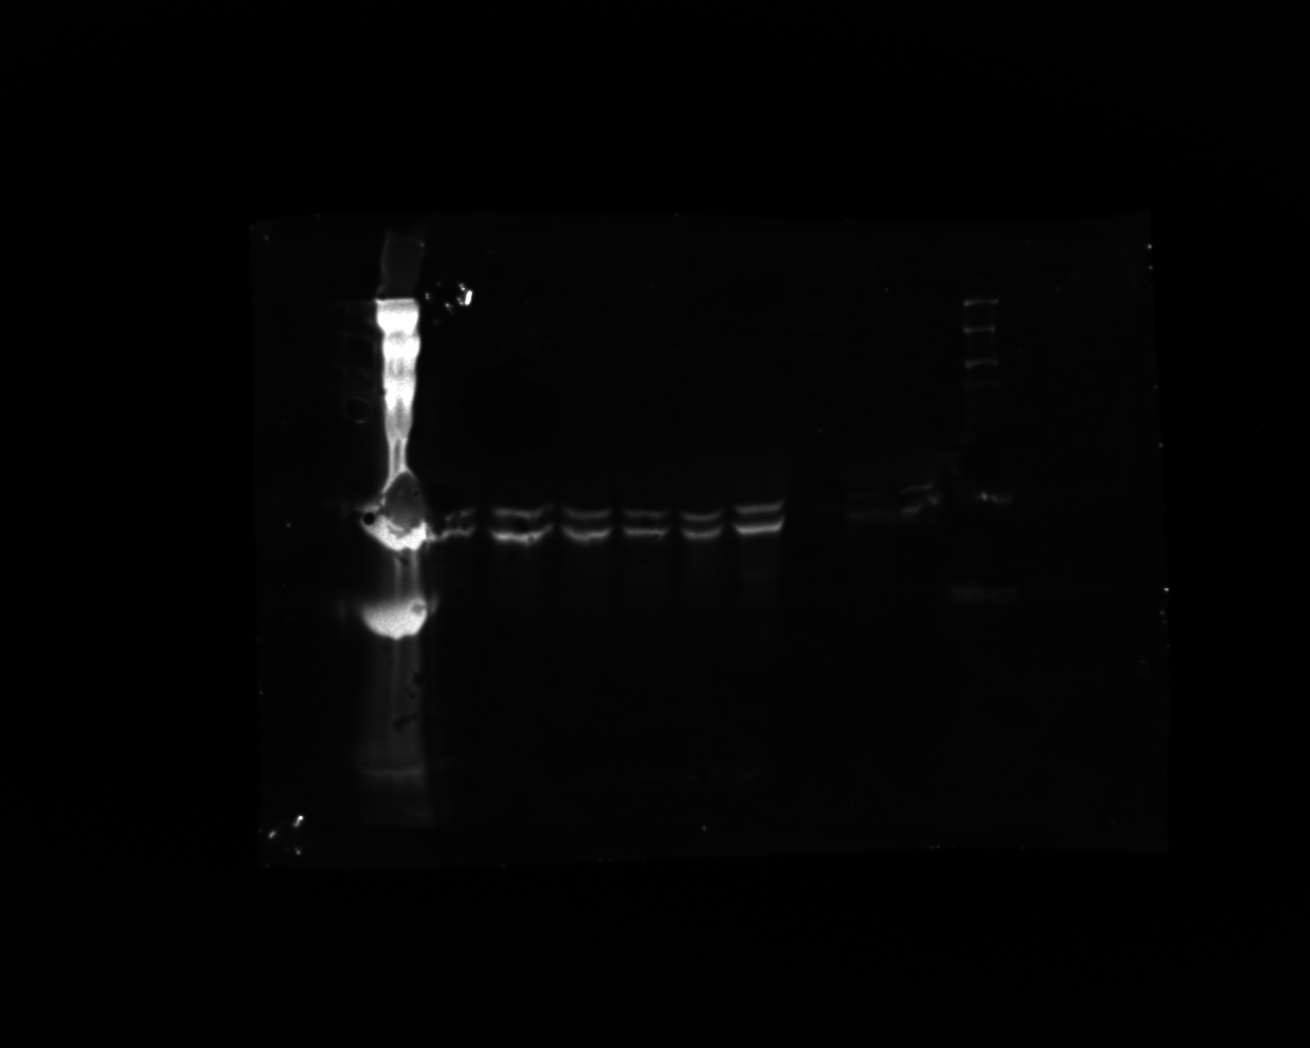
Red Channel — Phospho-Tau at Ser622 (680RD)
Red channel image showing phospho-Tau at Ser622 (pSer622).

Slide 24
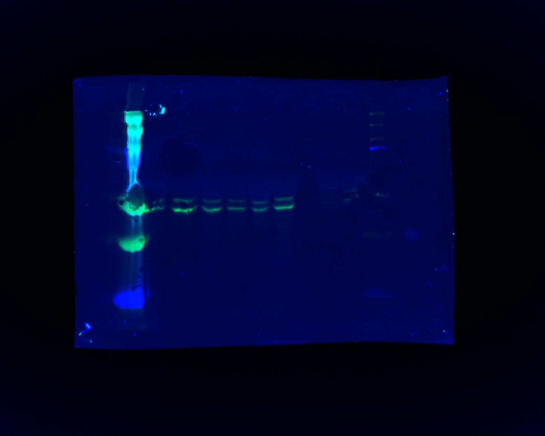
Composite — pSer622 & Pan-Tau
Composite image: phospho-Tau at Ser622 (red channel) and pan-Tau (green channel; Red antibody = Rabbit, Green antibody = Mouse).

Slide 25
Summary

Slide 26
Key Findings
IPA of axonal lysates after proNGF treatment identified MAPT (tau) and APP as the top upstream regulators, motivating a direct biochemical assessment of tau
ProNGF treatment induces changes in total Tau levels detectable by Western blot
Phosphorylation at pSer202/pThr205 and pSer622 sites assessed across compartments
Soma-only repeat blots confirm signal specificity in the cell body fraction
Next steps: Quantification of band intensities and normalization to actin loading control

