Slide 1
AI applications in academic research
Naim Bro
Escuela de Gobierno
Universidad Adolfo Ibáñez
Instituto Milenio Fundamento de los Datos
Miércoles 17 de mayo

Slide 2
Plan
Science of science literature on productivity and creativity
Processing the literature
Demo
Prototyping
Conclusion: A research and creativity

Slide 3
The science of science

Slide 4
Topic selection
Essential Tension Hypothesis (Kuhn & Epstein 1979):
Scientists need to strike a balance between exploring well-established knowledge (tradition) and venturing into new, uncharted areas of knowledge (innovation)
Conservative strategies are more common in research due to career advancement needs (Aleta et al 2019)
Scientists who diversify their research tend to have a higher impact (Li et al 2022; Huang et al 2022)

Slide 5
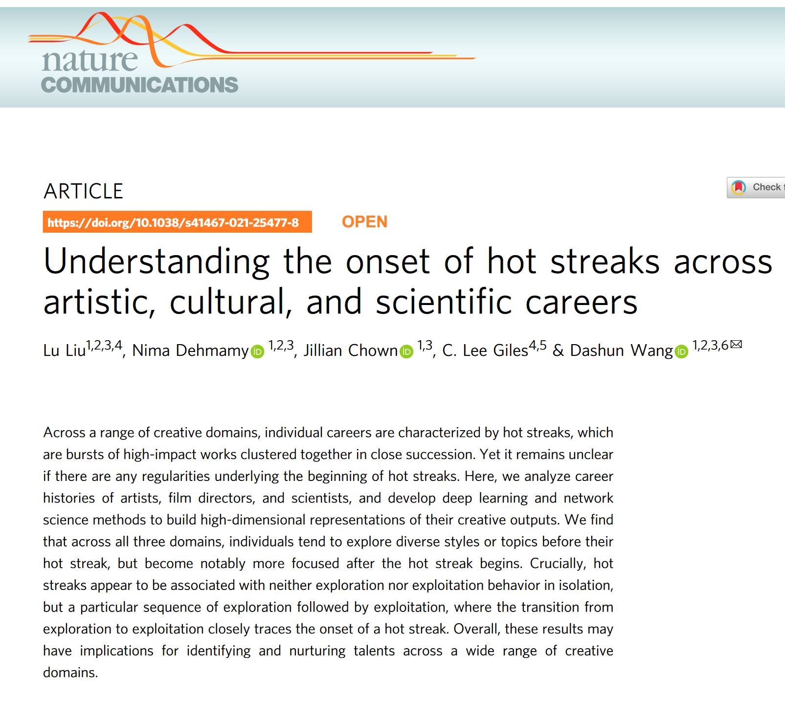
Hot Streaks
Sequences of exploration followed by exploitation, with the transition coinciding with the onset of a hot streak
Liu et al 2021

Slide 6
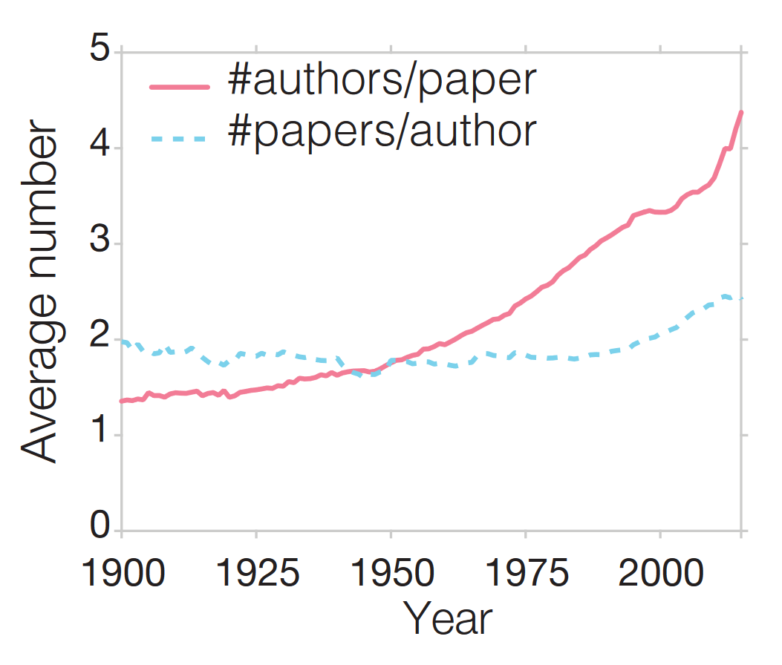
Increasing importance of teams
Wang & Barabasi 2021

Slide 7
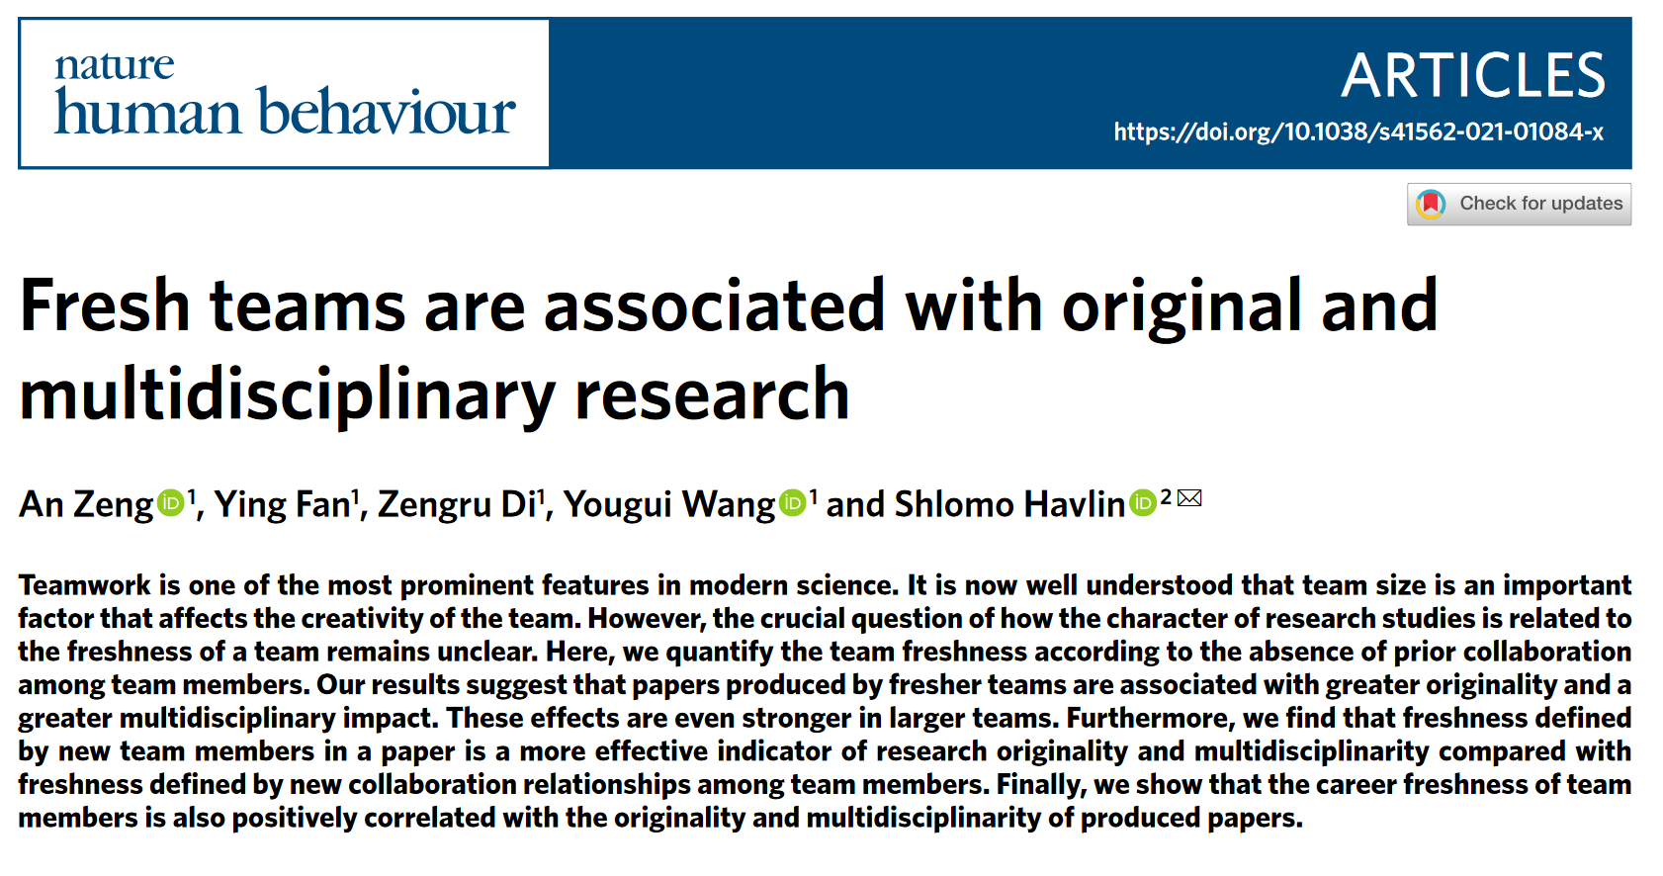
New collaborations
Fresh teams, comprising collaborators who haven't worked together before, are associated with higher levels of disruption and more radical innovations.
Zeng et al 2021

Slide 8
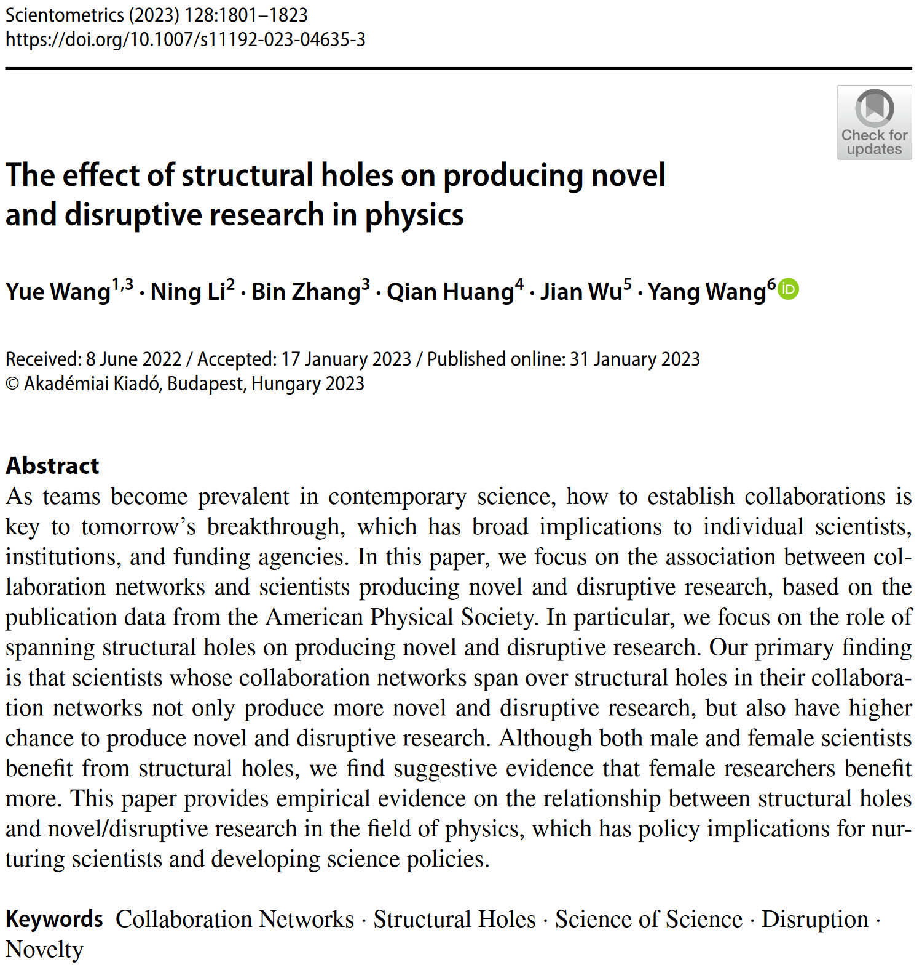
Structural Holes
Scientists whose collaboration networks bridge structural holes tend to produce more novel and disruptive research.
Structural holes represent gaps between non-redundant contacts in a network, providing opportunities for information brokerage and innovation.
Wang et al 2021

Slide 9
Syntopical reading with AI

Slide 10
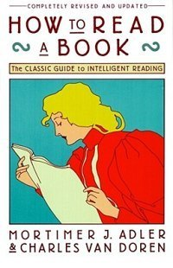

Slide 11
Steps in syntopical reading
Create a list of books on your topic
Inspect them, and decide which books say something important about the topic
Find the relevant passages in each book
Bring the authors into an imaginary conversation with each other
Define the key concepts used by each author
Establish a neutral terminology that can be used to compare and contrast the different views
Formulate your own questions and issues about the topic
Try to answer your questions and resolve your issues by synthesizing the insights from all the books

Slide 12
Syntopical reading with AI
Choose a question or topic
Find the seed papers
elicit
consensus
scite
Build a systematic list of papers
inciteful
litmaps
Parse the papers
lateral
Interact with the parsed papers
chatGPT
Generate text
lex
* I use Zotero as reference manager, which connects with some of the apps above

Slide 13
Demo:
Choose a research question

Slide 14
Prototyping papers

Slide 15
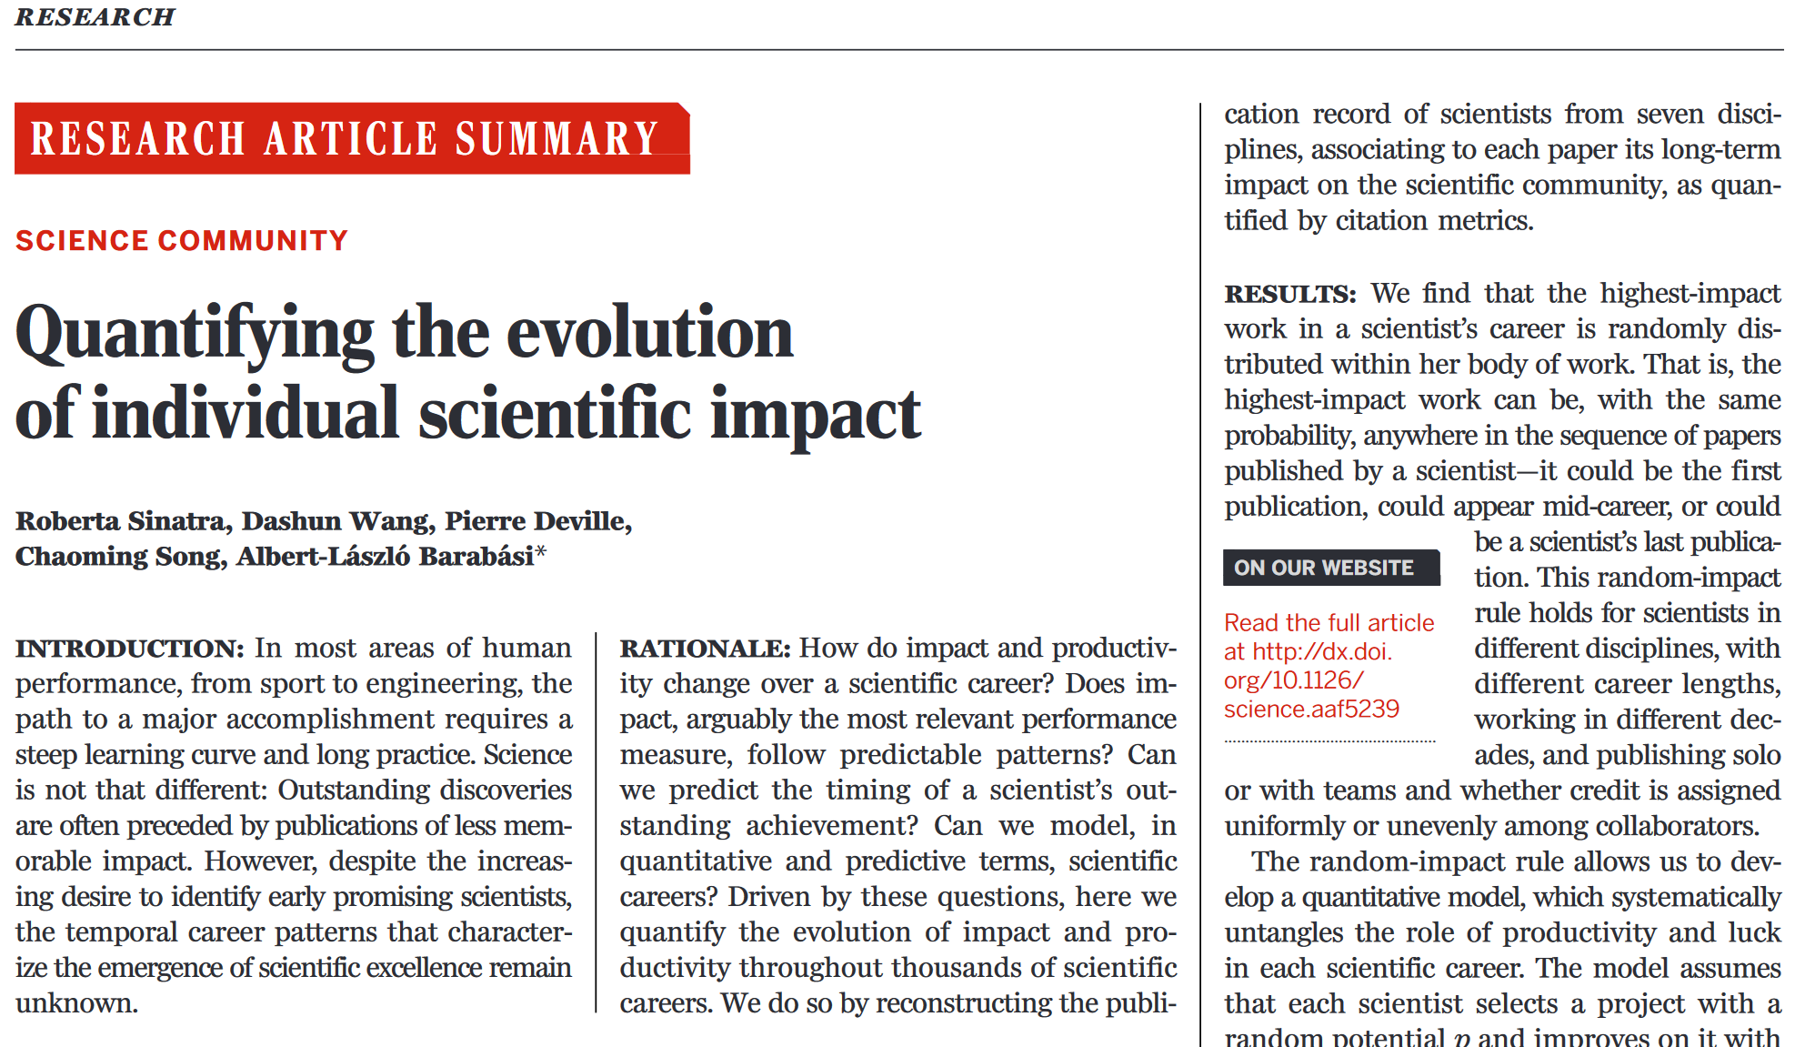
The problem
For every idea we work on, we have N ideas lingering in the back of our heads
With scarce mental bandwidth, these ideas may not mature
Sinatra et al 2016: it’s difficult to predict which paper will make the greatest impact

Slide 16
Prototyping a paper
Generate an extended abstract as fast as possible
Imperfect
Incomplete
But round
Obtain initial feedback
Find collaborators
Benefits:
Store in external memory
Mature and clarify ideas
Facilitates a more intentional formation of collaboration networks

Slide 17
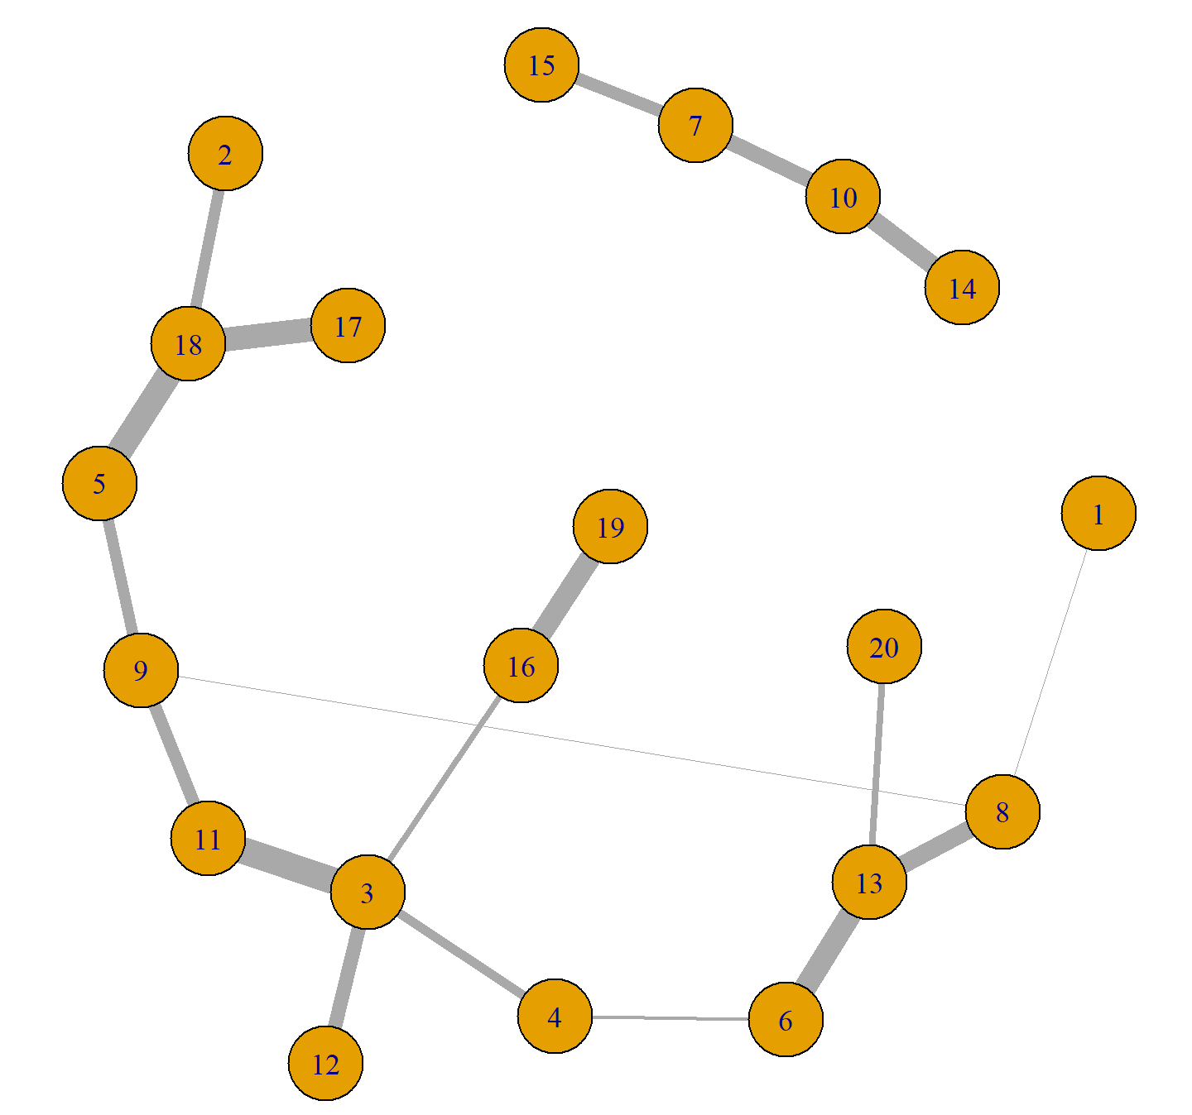
Conclusion: the promises of AI in research
AI's capability to process existing knowledge shifts humans’ task towards coming up with ideas
Creativity as a graph: different domains of knowledge are nodes, and connections between these domains are edges
AI allows us to cover nodes much faster than before, which increases the opportunities for reassembling ideas in novel ways.

Slide 18
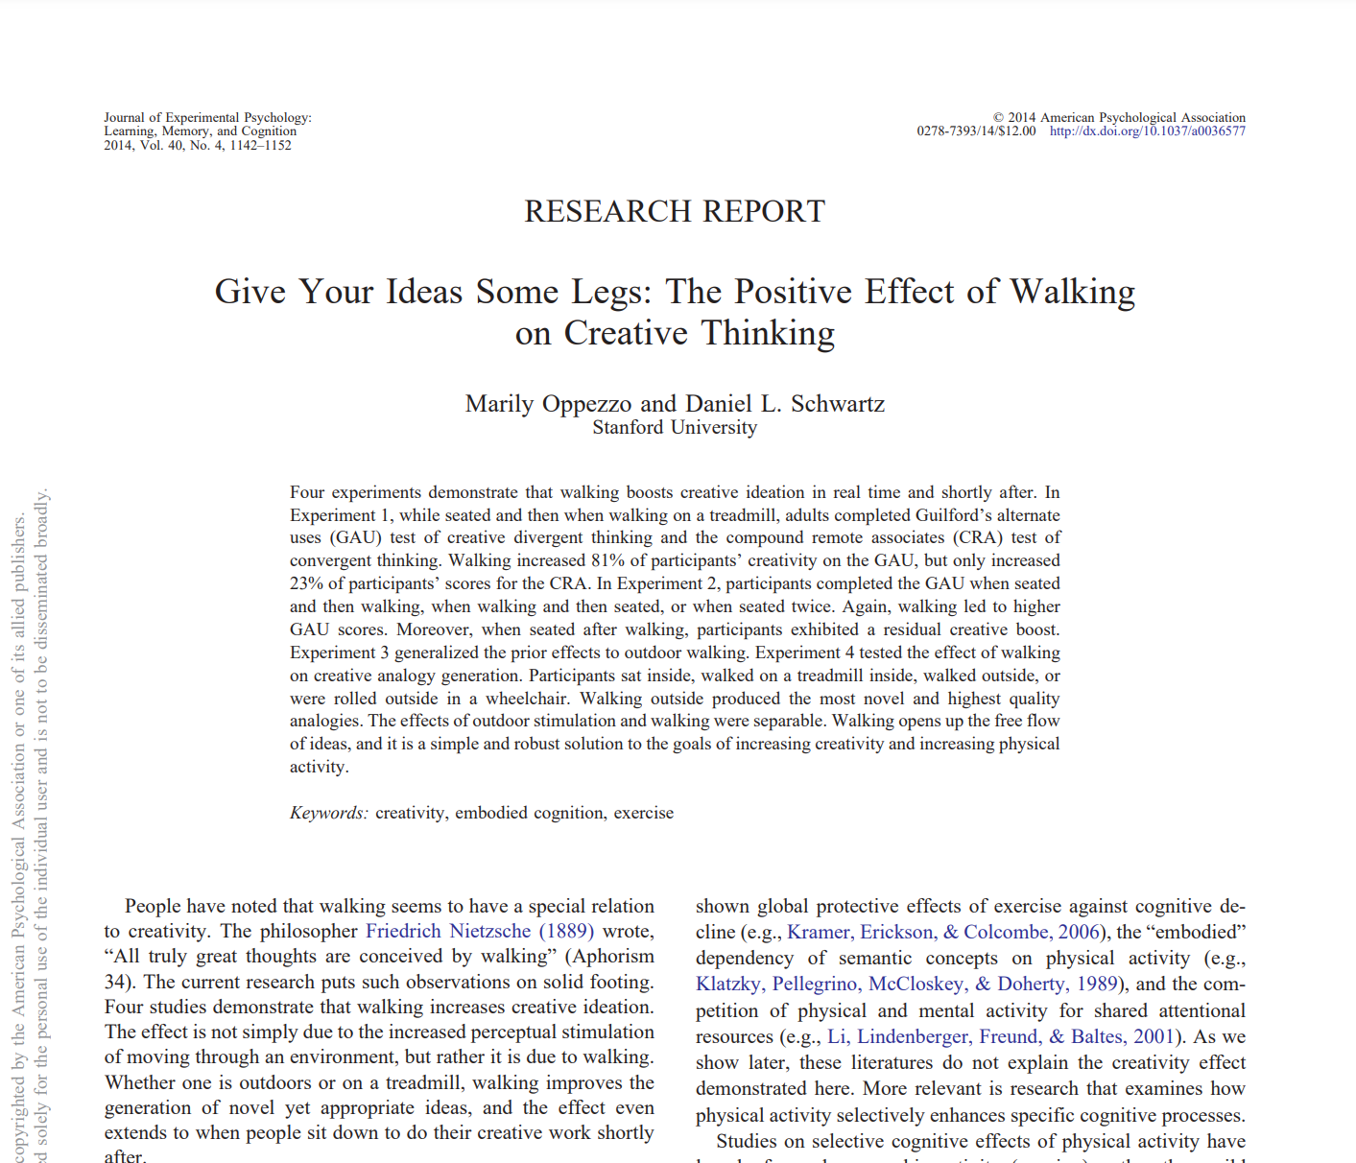
Bonus
audiopen
Notes:
Experiment 1: 48 college students, creative tests, seated vs walking on a treadmill
Experiment 3: 40 students, creative tests, seated vs walking outside

Slide 19
Gracias!

