Slide 1


Retail Company
Pricing Analysis
  Presented by Yuxin Huang, Elina Izmaylova

Slide 2
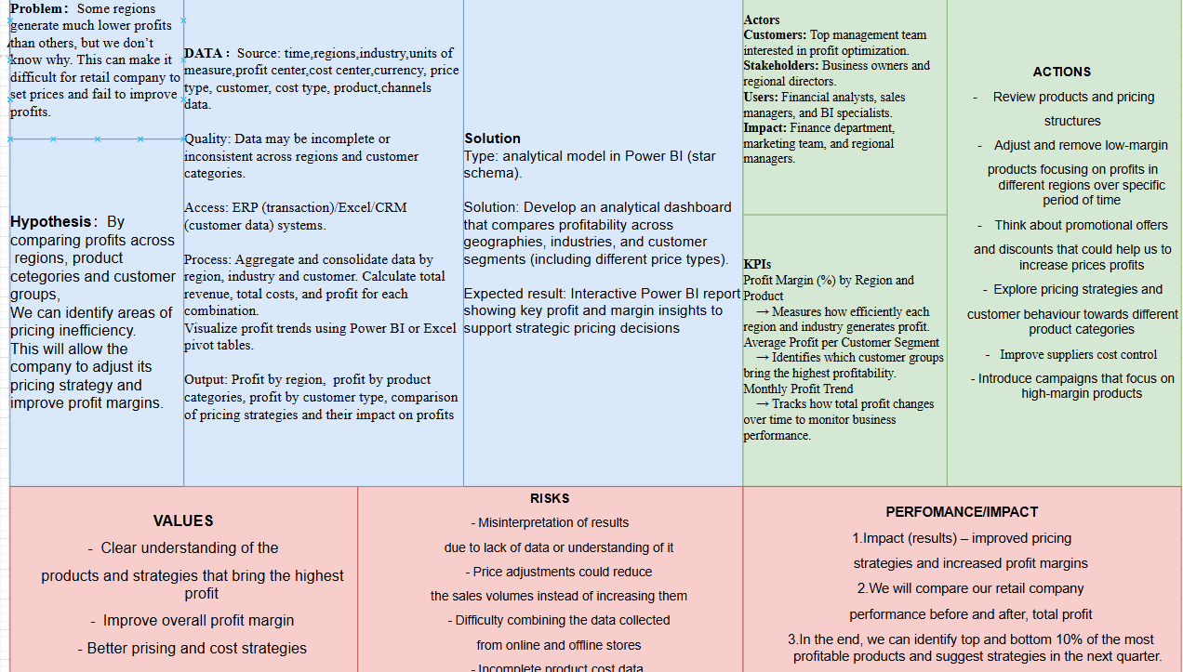
Data Use Case Canvas

Slide 3
Management area：pricing
1
analysis profit
region
customer group
hypothesis:
area of pricing inefficiencies
product categories
2
goal：
Increase profits
3
Optimize pricing

Slide 4
Actors：
kpis:
  Client : Pricing Department
  Stakeholders: Pricing Manager, Regional Director
  Users: Financial Analysts, Sales Managers, BI analyst
  Affected :Departments: Marketing, Supply Chain, Finance, Sales
  profit
  profit margin
  revenue

Slide 5

Value
  Clear understanding of the products and strategies that bring the highest profit
  Improve overall profit margin
  Better prising and cost strategies

Slide 6
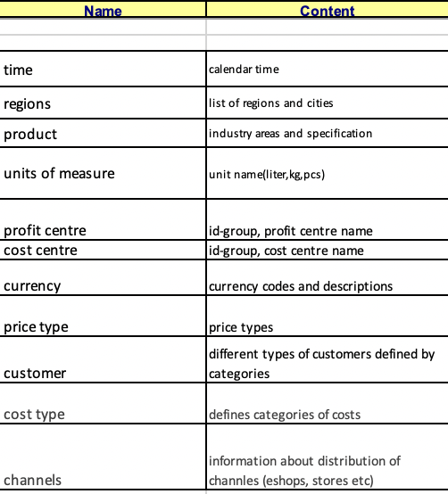
Dimension

Slide 7
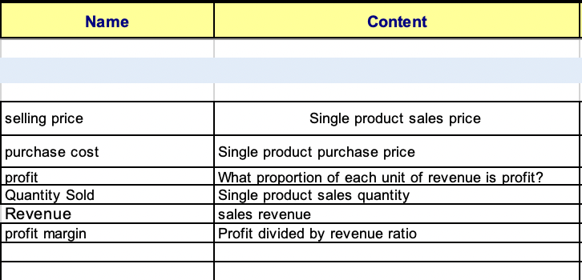
Metric:

Slide 8
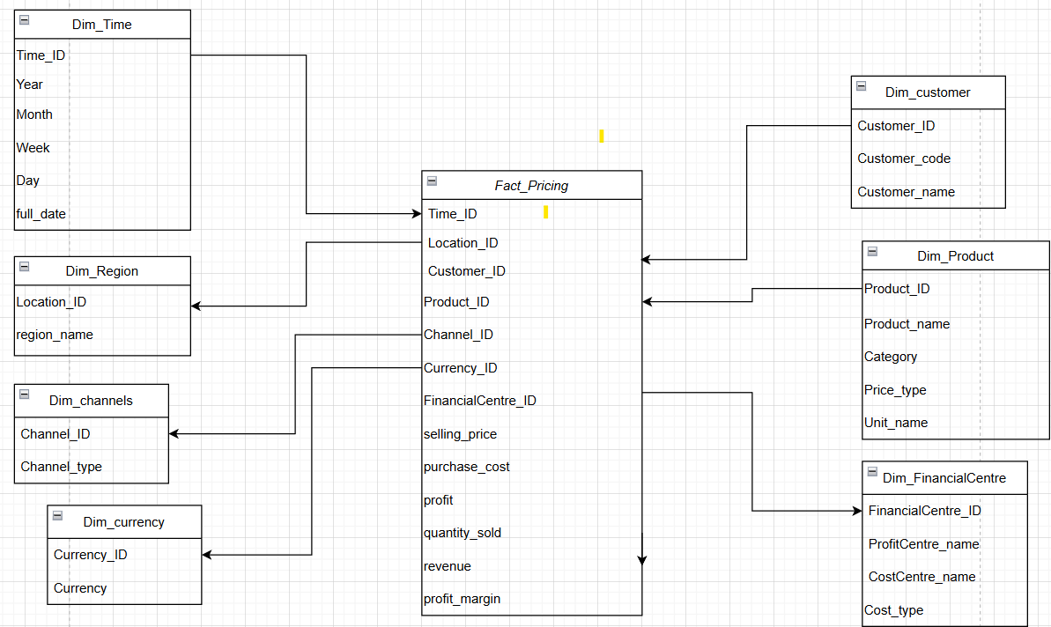
Star - Schema

Slide 9

  Thank you very much!

