Slide 1




Student Exam Scores
Python
ANALYSIS
By Elina Izmaylova

Slide 2

TABLE OF CONTENT
01
Introduction
05
Score Distributions
02
Main Questions
06
Perfomance by Demographics
03
07
Dataset Overview
Hypothesis
04
Methodology
08
Insights and Conclusion

Slide 3

INTRODUCTION & RESEARCH QUESTIONS
  Analyze score distributions by gender, parental education, schoolsup and famsup
  Test the hypothesis: "Does the 'test preparation course' lead to a statistically significant difference in 'math score'?" (Use a T-test).
  Visuals: Histograms, box plots, and a seaborn pairplot of all three scores, colored by test preparation course.

Slide 4

DATASET OVERVIEW
  381 students
  Subjects: Math & Portuguese
  Time periods: G1, G2, G3 (3 grading periods)
  Key variables: Gender, Parent Education,
Support System (family and school)
  Test preparation indicator: 'paid' (extra paid classes)

Slide 5

METHODOLOGY
ANALYTICAL APPROACH
1. Descriptive Statistics
- Score distributions (histograms)
- Group comparisons (box plots)
2. Statistical Testing
- T-test for hypothesis
- Significance level: α = 0.05
3. Visual Analysis
- Pairplot for score relationships
- Hue-based comparisons for interactions

Slide 6
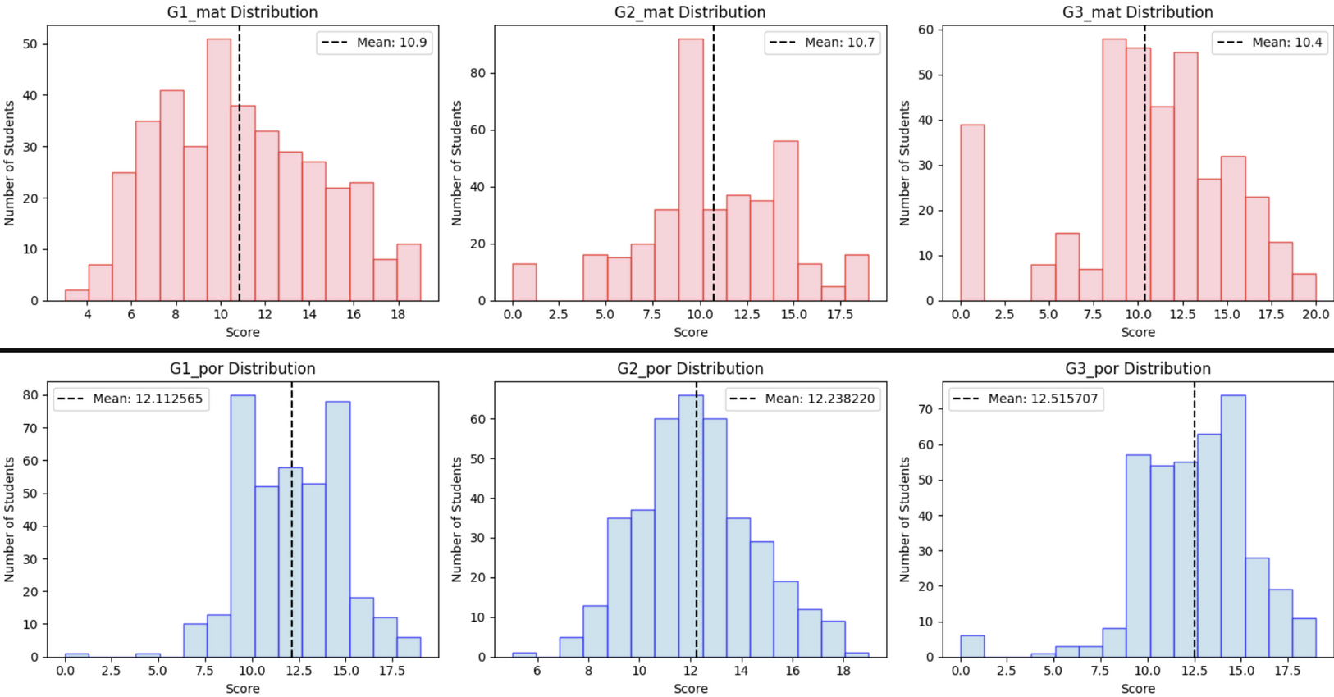
SCORE DISTRIBUTIONS
  Both math and Portuguese scores have relatively similar distributions
  Most students score in middle score ranges (10-15)
  Some extreme low/high performers esepecially in G2 of the math and G1 of Portuguese
  Mean values have a decreasing pattern for math scores while it increases for Portuguese

Slide 7
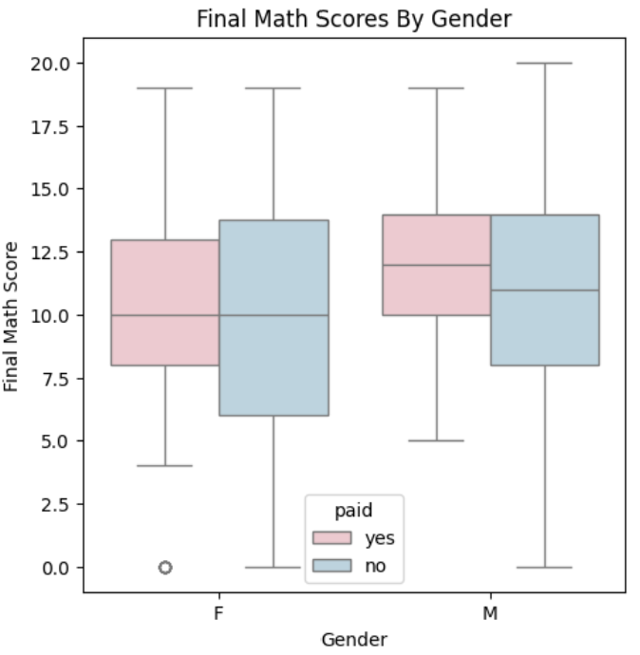
GENDER & PARENT EDUCATION
  Male students outperform females in math
  The average score for female students is the same with or without test preparation
  while for male students the average score is higher (12.5) with test preparation than those who did not have any additional preparation for the math exam

Slide 8
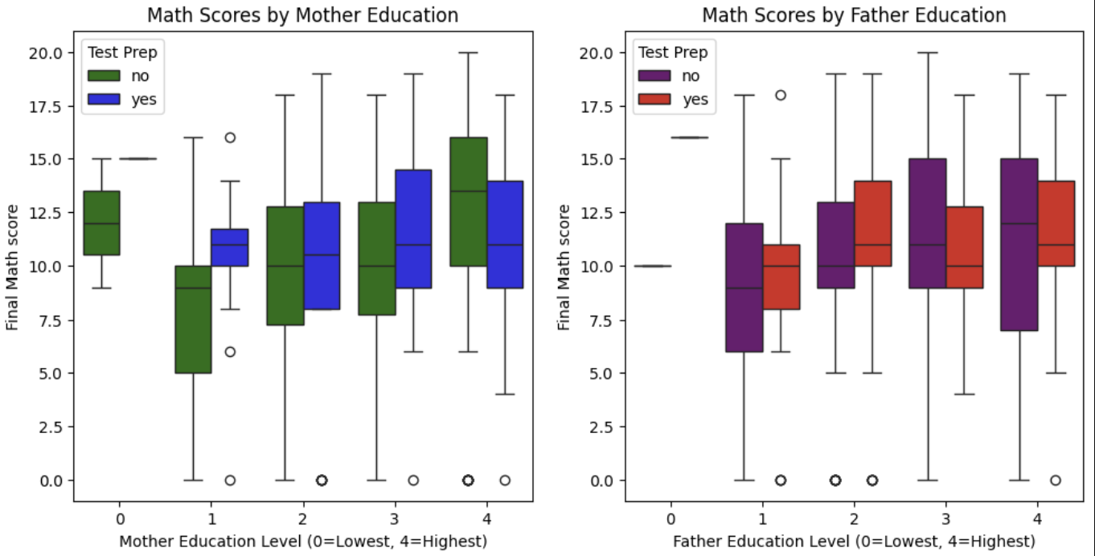
GENDER & PARENT EDUCATION
  Higher parent education → Higher student scores
  Mother's education shows stronger correlation
  the students with no preparation and high parental education tend to have higher scores than those with it

Slide 9
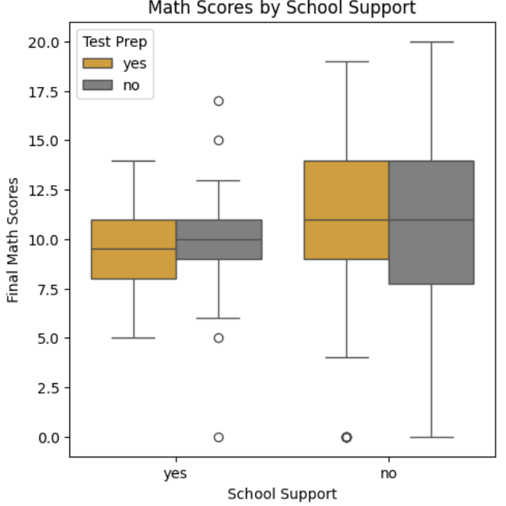
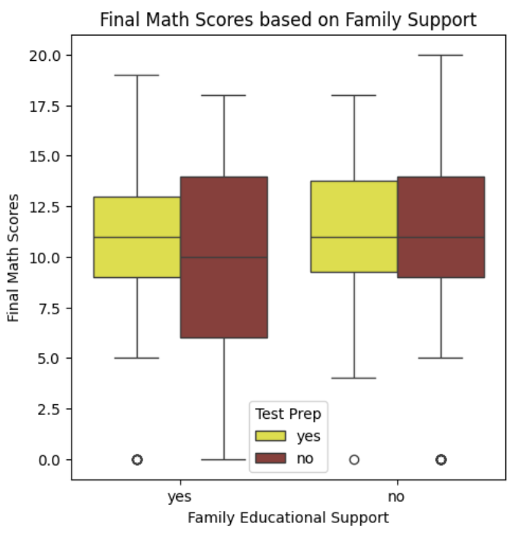
SUPPORT SYSTEMS
  Family Support does no increase math scores in general but on average students with family support score higher
  Average: With support 11.5 vs Without 10
  Similarly ineffective
  Average: With support 9.5 vs Without 10.5

Slide 10

MAIN HYPOTHESIS TEST
RESULTS
"Does the 'test preparation course' lead to a statistically significant difference in 'math score'?"
  Students WITH test preparation: 177
  Students WITHOUT test preparation: 205
  Average score of students WITH test preparaton: 10.89
  Average score of students WITHOUT test preparaton: 9.95
  FAIL TO REJECT THE NULL HYPOTHESIS:
“There is not enough evidence to prove that test preparation courses
lead to significant difference in the final math score reults”
t-statistic = 1.9649
p_value = 0.0502

Slide 11
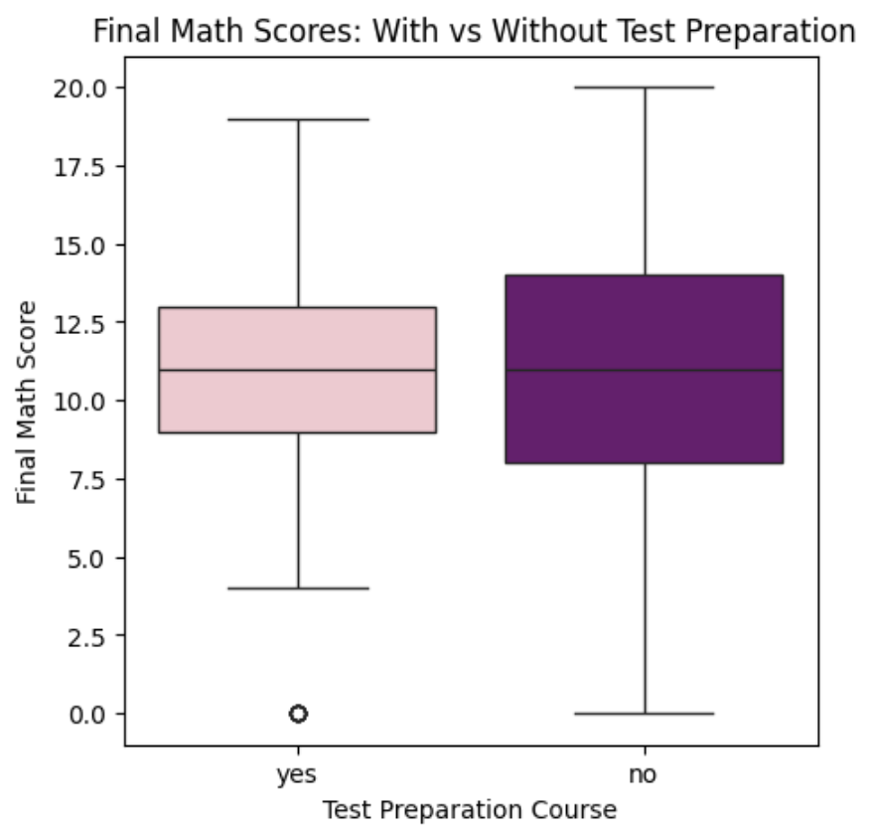
VISUAL EVIDENCE
  the boxplot shows that students without test preparation scored higher than students with test preparation

Slide 12
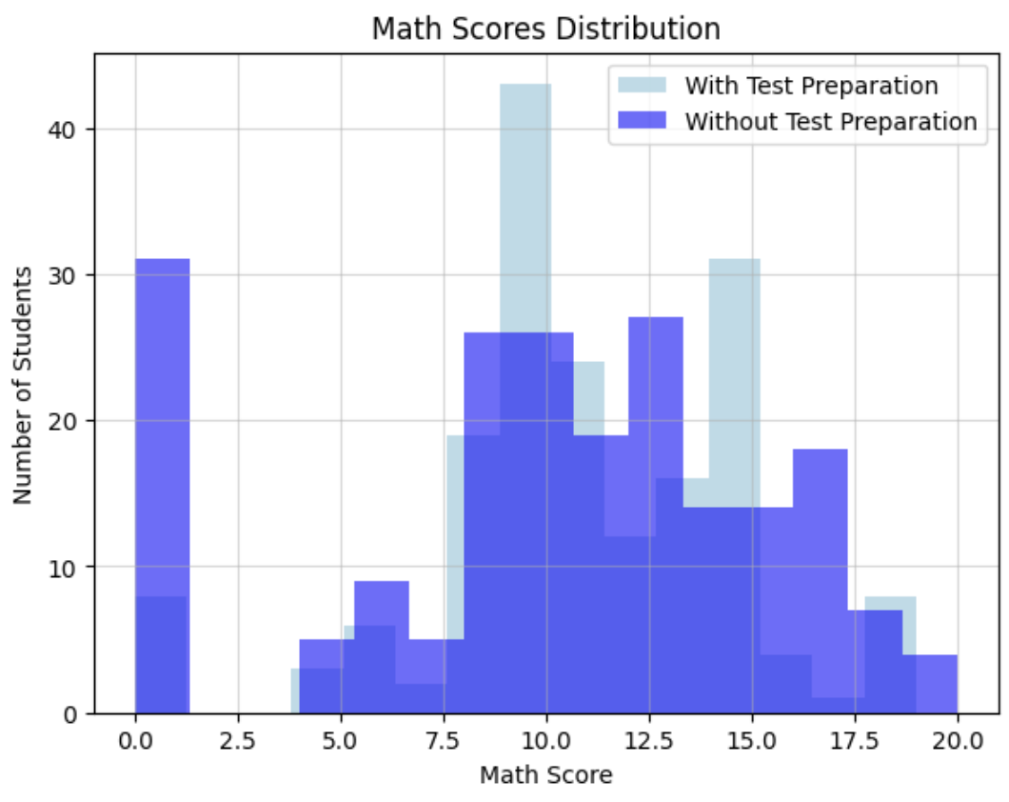
VISUAL EVIDENCE
  There is a significant overlap between groups implying what t-test proved - test preparation is not the main factor affecting score results
  most students score in the range from 8-15 points
  with test preparation more students have high scores and it is less divers while students without test preparation have more lower scores

Slide 13

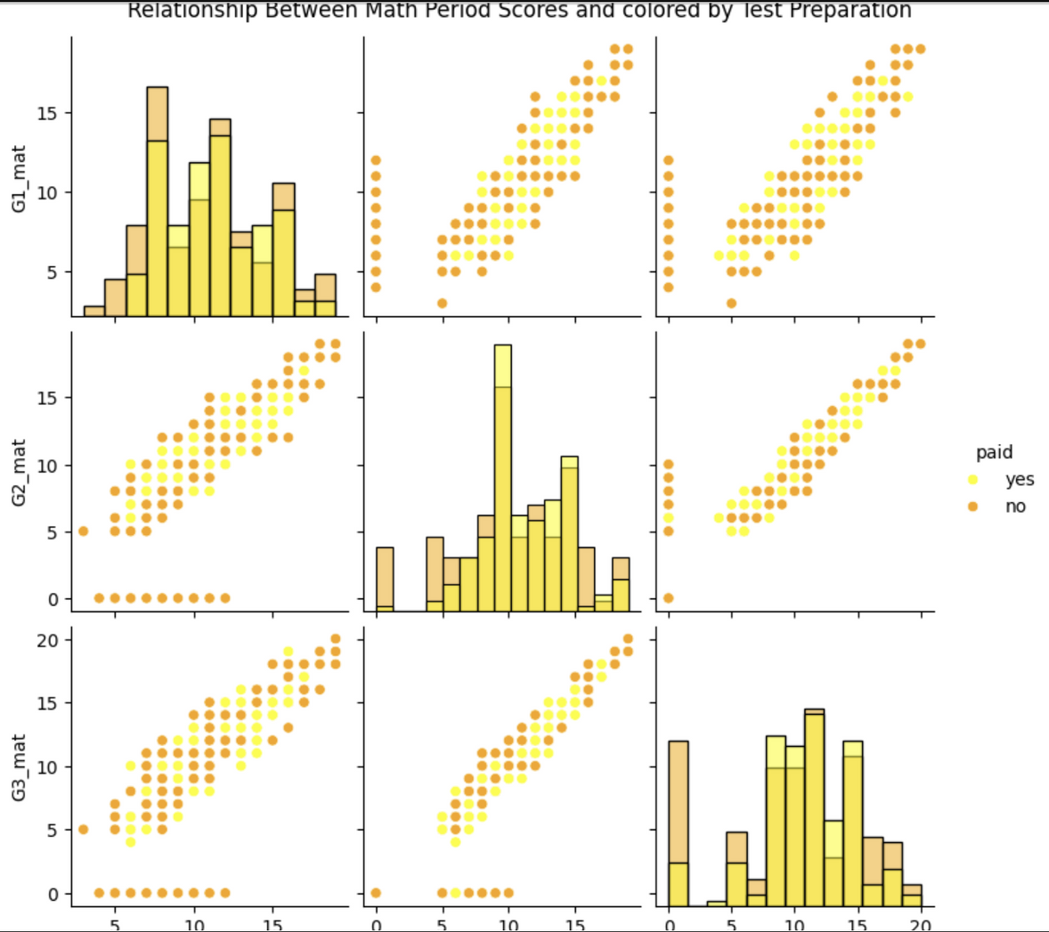
VISUAL EVIDENCE
Histograms:
• All three periods show similar score patterns
• Most students score 10-15 out of 20
• Few extreme low/high performers
Scatter Plots:
STRONG POSITIVE CORRELATIONS
  G1 to G2: Strong relationship
  G2 to G3: Even stronger
  G1 to G3: Direct connection through G2
  Early performance predicts later success
Test Preparation:
• No clear separation between groups
• Similar regression lines for both colors
• Preparation doesn't change the relationship pattern

Slide 14
INSIGHTS AND CONCLUSION
POSSIBLE EXPLANATIONS:
1. Selection bias (weaker students seek help)
2. Ineffective preparation methods
3. Preparation may reduce independent study time
4. Natural ability matters more than extra classes
  EXPECTED: Test preparation → Higher scores
  FOUND: Test preparation → No benefit (or slight disadvantage)

Slide 15
INSIGHTS AND CONCLUSION
FOR SCHOOLS:
• Re-evaluate test preparation programs
• Consider targeted help for truly struggling students
• Focus on teaching quality over extra classes
FOR STUDENTS:
• Self-study and understanding > + preparation
• Identify personal learning gaps
• Quality of study > quantity of preparation
FOR PARENTS:
• Consider if paid courses provide value
• Focus on building consistent study habits

Slide 16
INSIGHTS AND CONCLUSION
  Test preparation shows no significant benefit
  Background factors (gender, parent education) matter more
  Support systems need quality improvement
  Sometimes less is more - focus on effective learning, not just more preparation

Slide 17
THANK YOU

