Slide 1
Machine Learning in Bioinformatics
Homework 3 - Project Proposal

Slide 2
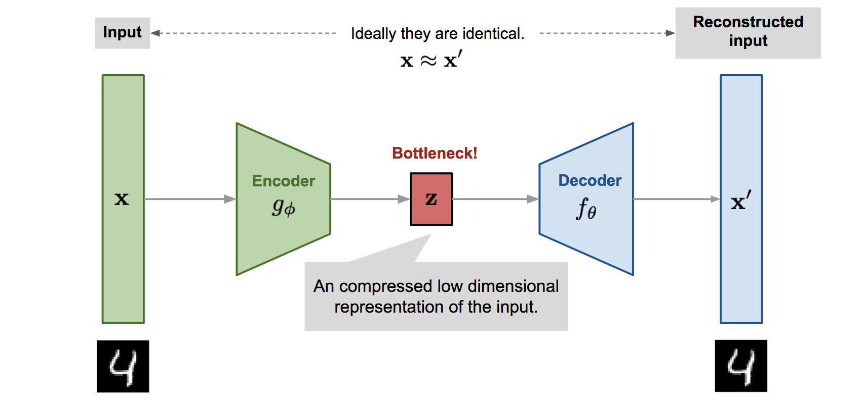
CovAEd-19 - Autoencoders for unsupervised clustering of
unaligned genome sequences
Team members:
Emil Johansson - SNU ID: 2019-81125,
Björn Bebensee - SNU ID: 2019-21343,
Eric Lindgren - SNU ID: 2020-81634
Data to use
Full Covid dataset
Objective – We aim to study number 1), but in case of no success we will proceed with 2).
1) Primary: Study clustering of unaligned sequences by using autoencoders.
2) Backup: Perform phylogenetic analysis on 300 Covid sequences from different countries.
Tool/algorithm to use
1). Self-designed Sequential Auto Encoder (SAE), PCA & t-SNE
2). MUSCLE, HMMER and iQTree (for visusalization)

