Slide 1
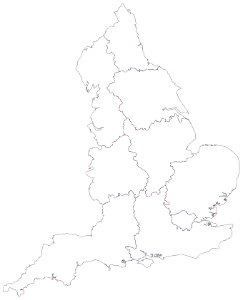
Field 1 (heavy soil)
Field 2 (medium soil)
Field 3 (light soil)
Heavy/ medium soil
1: D_{h}-R_{h}
7: D_{l}-R_{h}
13: D_{l}-R_{l}
Light soil
2: D_{h}-R_{h}
8: D_{l}-R_{h}
14: D_{l}-R_{l}
NORTH
Field 4 (heavy soil)
Field 5 (medium soil)
Field 6 (light soil)
Heavy/ medium soil
3: D_{h}-R_{h}
9: D_{l}-R_{h}
15: D_{l}-R_{l}
Light soil
4: D_{h}-R_{h}
10: D_{l}-R_{h}
16: D_{l}-R_{l}
Field 7 (heavy soil)
Field 8 (medium soil)
Field 9 (light soil)
CENTRAL
Heavy/ medium soil
5: D_{h}-R_{h}
11: D_{l}-R_{h}
17: D_{l}-R_{l}
Light soil
6: D_{h}-R_{h}
12: D_{l}-R_{h}
18: D_{l}-R_{l}
EAST

