Slide 1
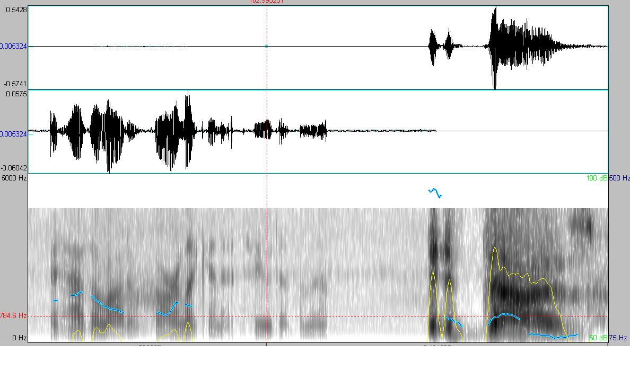
Sentence Unit Detection in Conversational Dialogue
Speaker B
Speaker A
Prosodic features
it has a lot of garlic in it too does n't it
i it does
Sentence Units
<question>
<statement>
Elizabeth Lingg, Tejaswi Tennetti, Anand Madhavan
Notes:
1) Title and people 2) A slide on explaining disfluencies (examples: question, backchannel, statement)3) A slide on the data available4) Effect of pre-pos tags: 1, 2, 3 grams. Effect of pre-pos tags: 1, 2, 3 grams. Bin sizes.5) Club backchannel words into a class (mhm, oh yeah)6) Features based on prior sentence tag Switchboard versus Fisher data7) Prosodic features effects of energy, F0, pause duration 8) Average F0 based feature9) References

Slide 2
Dataset used
LDC2009T01
English CTS Treebank with Structural metadata
Highlights
Fisher and Switchboard audio clips
Words annotated with POS tags
Sentence units labeled:
Question
Statement
Backchannel
Incomplete
Notes:
1) Title and people 2) A slide on explaining disfluencies (examples: question, backchannel, statement)3) A slide on the data available4) Effect of pre-pos tags: 1, 2, 3 grams. Effect of pre-pos tags: 1, 2, 3 grams. Bin sizes.5) Club backchannel words into a class (mhm, oh yeah)6) Features based on prior sentence tag Switchboard versus Fisher data7) Prosodic features effects of energy, F0, pause duration 8) Average F0 based feature9) References

Slide 3
Prediction results
Final results of predictions with the best features chosen
Notes:
1) Title and people 2) A slide on explaining disfluencies (examples: question, backchannel, statement)3) A slide on the data available4) Effect of pre-pos tags: 1, 2, 3 grams. Effect of pre-pos tags: 1, 2, 3 grams. Bin sizes.5) Club backchannel words into a class (mhm, oh yeah)6) Features based on prior sentence tag Switchboard versus Fisher data7) Prosodic features effects of energy, F0, pause duration 8) Average F0 based feature9) References

Slide 4
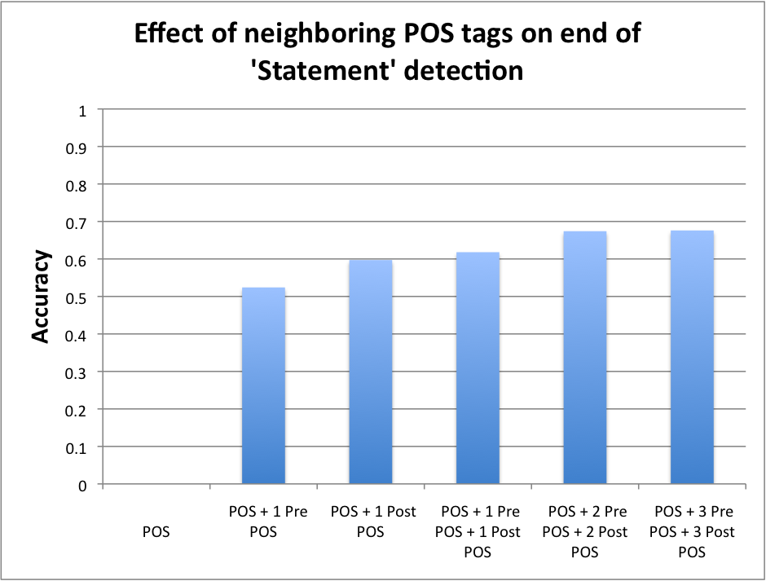
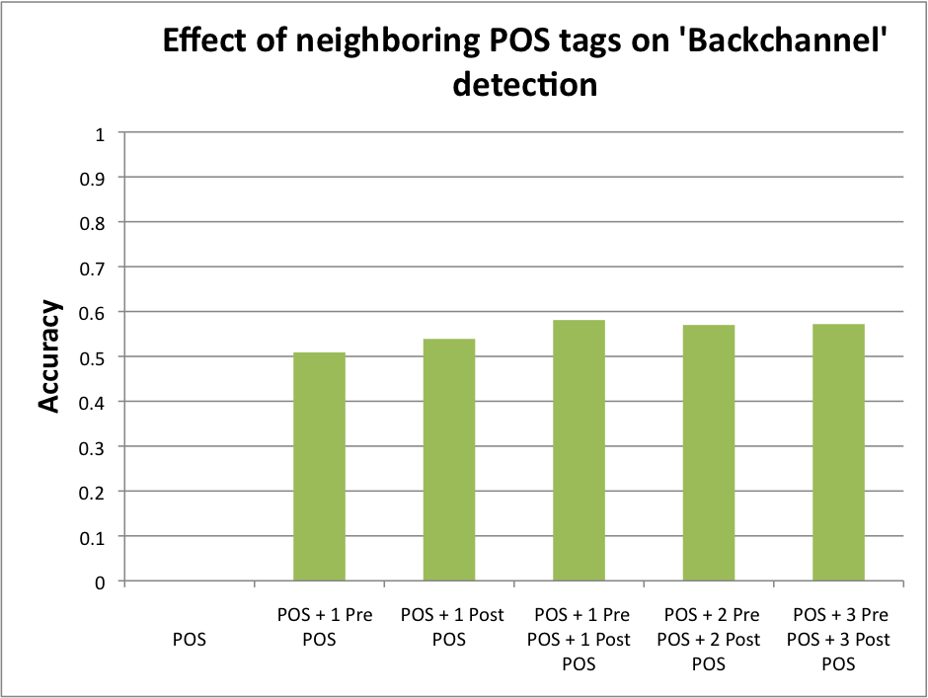
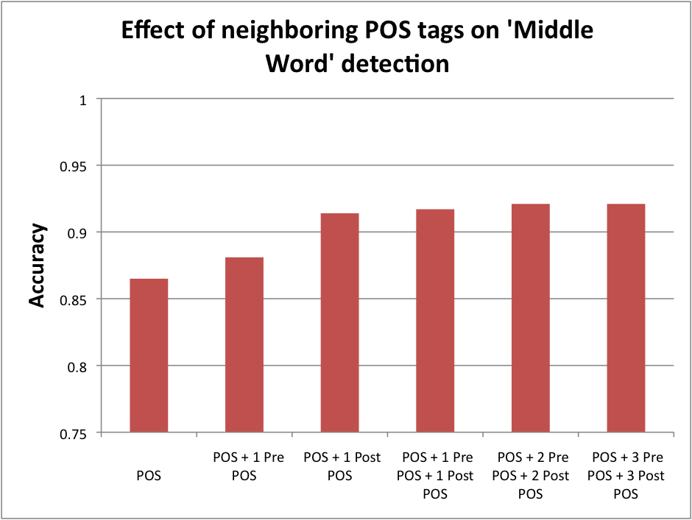
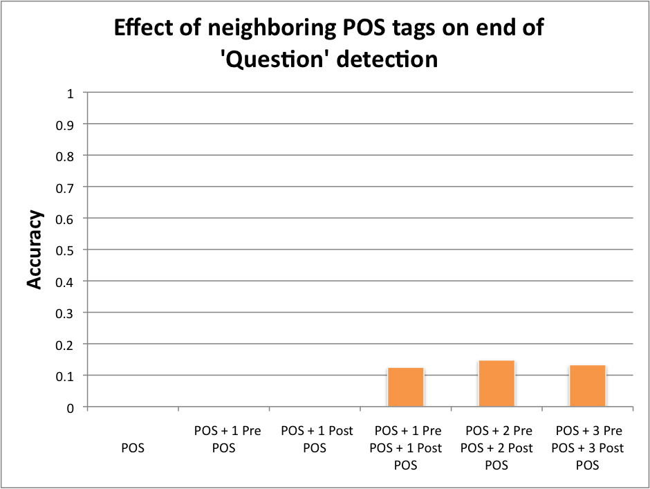
Effect of POS tags
Notes:
1) Title and people 2) A slide on explaining disfluencies (examples: question, backchannel, statement)3) A slide on the data available4) Effect of pre-pos tags: 1, 2, 3 grams. Effect of pre-pos tags: 1, 2, 3 grams. Bin sizes.5) Club backchannel words into a class (mhm, oh yeah)6) Features based on prior sentence tag Switchboard versus Fisher data7) Prosodic features effects of energy, F0, pause duration 8) Average F0 based feature9) References

Slide 5
Effect of special words for backchannel identification
Club words like ‘mhm’, ‘oh yeah’ etc into a separate class and see if it helps in predicting backchannel better
Effects on other sentence units
Notes:
1) Title and people 2) A slide on explaining disfluencies (examples: question, backchannel, statement)3) A slide on the data available4) Effect of pre-pos tags: 1, 2, 3 grams. Effect of pre-pos tags: 1, 2, 3 grams. Bin sizes.5) Club backchannel words into a class (mhm, oh yeah)6) Features based on prior sentence tag Switchboard versus Fisher data7) Prosodic features effects of energy, F0, pause duration 8) Average F0 based feature9) References

Slide 6
Miscellaneous features
Previous sentence class prediction (faked as well as true)
Length of sentence so far or number of words so far (that have not been classified yet)
Notes:
1) Title and people 2) A slide on explaining disfluencies (examples: question, backchannel, statement)3) A slide on the data available4) Effect of pre-pos tags: 1, 2, 3 grams. Effect of pre-pos tags: 1, 2, 3 grams. Bin sizes.5) Club backchannel words into a class (mhm, oh yeah)6) Features based on prior sentence tag Switchboard versus Fisher data7) Prosodic features effects of energy, F0, pause duration 8) Average F0 based feature9) References

Slide 7
Prosodic features
F0
F0 normalized
Pause duration for speaker
Energy
Length of word
Pause length before word
Word pitch range
Energy
Energy normalized
Notes:
1) Title and people 2) A slide on explaining disfluencies (examples: question, backchannel, statement)3) A slide on the data available4) Effect of pre-pos tags: 1, 2, 3 grams. Effect of pre-pos tags: 1, 2, 3 grams. Bin sizes.5) Club backchannel words into a class (mhm, oh yeah)6) Features based on prior sentence tag Switchboard versus Fisher data7) Prosodic features effects of energy, F0, pause duration 8) Average F0 based feature9) References

Slide 8
Prosodic features
F0
F0 normalized
Pause duration for speaker
Energy
Length of word
Pause length before word
Word pitch range
Energy
Energy normalized
Notes:
1) Title and people 2) A slide on explaining disfluencies (examples: question, backchannel, statement)3) A slide on the data available4) Effect of pre-pos tags: 1, 2, 3 grams. Effect of pre-pos tags: 1, 2, 3 grams. Bin sizes.5) Club backchannel words into a class (mhm, oh yeah)6) Features based on prior sentence tag Switchboard versus Fisher data7) Prosodic features effects of energy, F0, pause duration 8) Average F0 based feature9) References

Slide 9
Prosodic features
n-gram prosodic features
Notes:
1) Title and people 2) A slide on explaining disfluencies (examples: question, backchannel, statement)3) A slide on the data available4) Effect of pre-pos tags: 1, 2, 3 grams. Effect of pre-pos tags: 1, 2, 3 grams. Bin sizes.5) Club backchannel words into a class (mhm, oh yeah)6) Features based on prior sentence tag Switchboard versus Fisher data7) Prosodic features effects of energy, F0, pause duration 8) Average F0 based feature9) References

Slide 10
References
Enriching Speech Recognition With Automatic Detection of Sentence Boundaries and Disﬂuencies, Yang Liu, Elizabeth Shriberg, Andreas Stolcke, Dustin Hillard, Mari Ostendorf and Mary Harper
...
Notes:
1) Title and people 2) A slide on explaining disfluencies (examples: question, backchannel, statement)3) A slide on the data available4) Effect of pre-pos tags: 1, 2, 3 grams. Effect of pre-pos tags: 1, 2, 3 grams. Bin sizes.5) Club backchannel words into a class (mhm, oh yeah)6) Features based on prior sentence tag Switchboard versus Fisher data7) Prosodic features effects of energy, F0, pause duration 8) Average F0 based feature9) References

