Slide 1
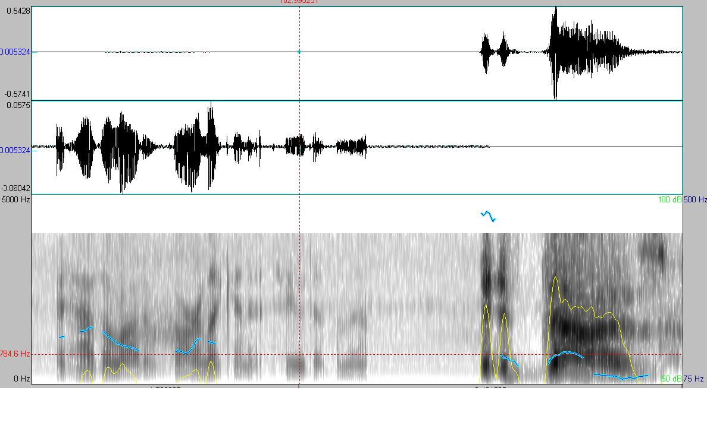
Sentence Unit Detection in Conversational Dialogue
Speaker B
Speaker A
Prosodic features
it has a lot of garlic in it too does n't it
i it does
Sentence Units
<question>
<statement>
Elizabeth Lingg, Tejaswi Tennetti, Anand Madhavan
Notes:
1) Title and people 2) A slide on explaining disfluencies (examples: question, backchannel, statement)3) A slide on the data available4) Effect of pre-pos tags: 1, 2, 3 grams. Effect of pre-pos tags: 1, 2, 3 grams. Bin sizes.5) Club backchannel words into a class (mhm, oh yeah)6) Features based on prior sentence tag Switchboard versus Fisher data7) Prosodic features effects of energy, F0, pause duration 8) Average F0 based feature9) References

Slide 2
Dataset used
LDC2009T01
English CTS Treebank with Structural metadata
Highlights
Fisher and Switchboard audio clips
Words annotated with POS tags
Sentence units labeled:
Question
Statement
Backchannel
Incomplete
Notes:
1) Title and people 2) A slide on explaining disfluencies (examples: question, backchannel, statement)3) A slide on the data available4) Effect of pre-pos tags: 1, 2, 3 grams. Effect of pre-pos tags: 1, 2, 3 grams. Bin sizes.5) Club backchannel words into a class (mhm, oh yeah)6) Features based on prior sentence tag Switchboard versus Fisher data7) Prosodic features effects of energy, F0, pause duration 8) Average F0 based feature9) References

Slide 3


Methodology
Corpus XML
Corpus WAV
Stream of words
it has garlic in it too does n't it i it does
f0, intensity..
POS tags
Word
Features
Lexical and prosodic
feature soup
Classifier
(Decision Tree J48)
Notes:
1) Title and people 2) A slide on explaining disfluencies (examples: question, backchannel, statement)3) A slide on the data available4) Effect of pre-pos tags: 1, 2, 3 grams. Effect of pre-pos tags: 1, 2, 3 grams. Bin sizes.5) Club backchannel words into a class (mhm, oh yeah)6) Features based on prior sentence tag Switchboard versus Fisher data7) Prosodic features effects of energy, F0, pause duration 8) Average F0 based feature9) References

Slide 4
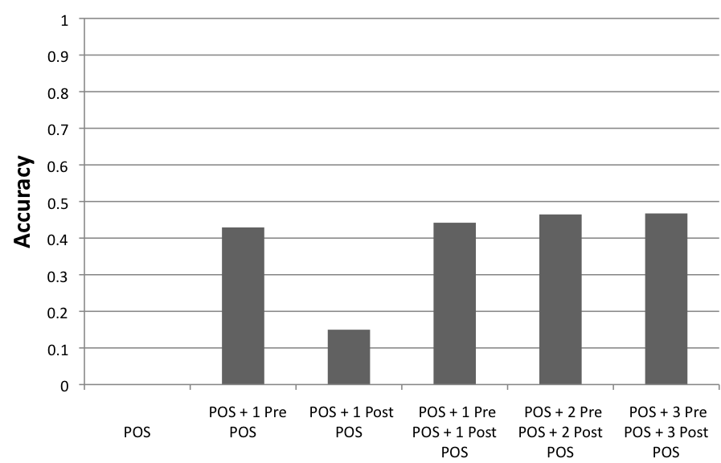
Effect of POS tags on ‘end of sentence’ detection
“and so do other people”
Just post word POS tags don’t help
CC RB VB JJ NNS
$POS+CC+RB+VB+JJ+NNS+$POS
VB
RB+VB
VB+JJ
RB+VB+JJ
CC+RB+VB+JJ+NNS
Notes:
1) Title and people 2) A slide on explaining disfluencies (examples: question, backchannel, statement)3) A slide on the data available4) Effect of pre-pos tags: 1, 2, 3 grams. Effect of pre-pos tags: 1, 2, 3 grams. Bin sizes.5) Club backchannel words into a class (mhm, oh yeah)6) Features based on prior sentence tag Switchboard versus Fisher data7) Prosodic features effects of energy, F0, pause duration 8) Average F0 based feature9) References

Slide 5
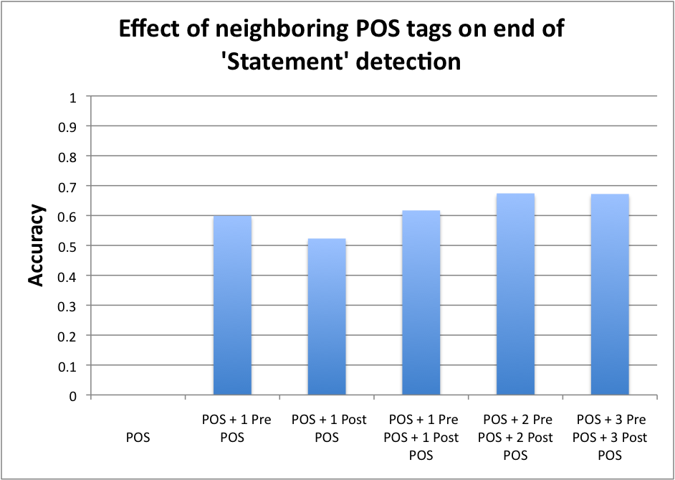
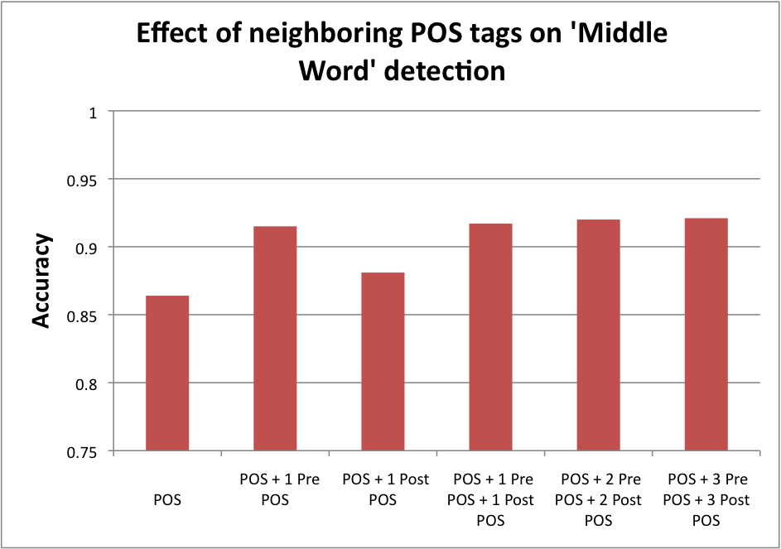
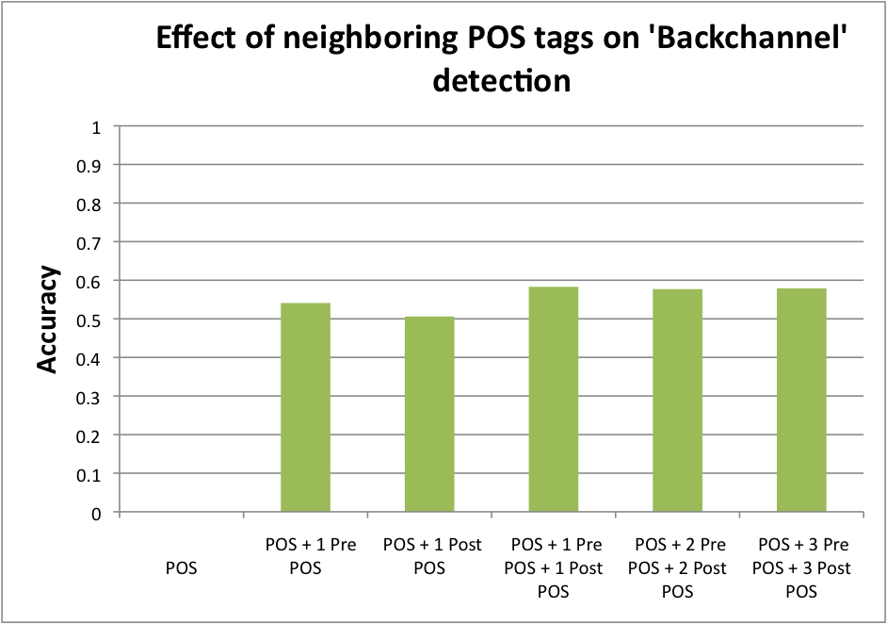
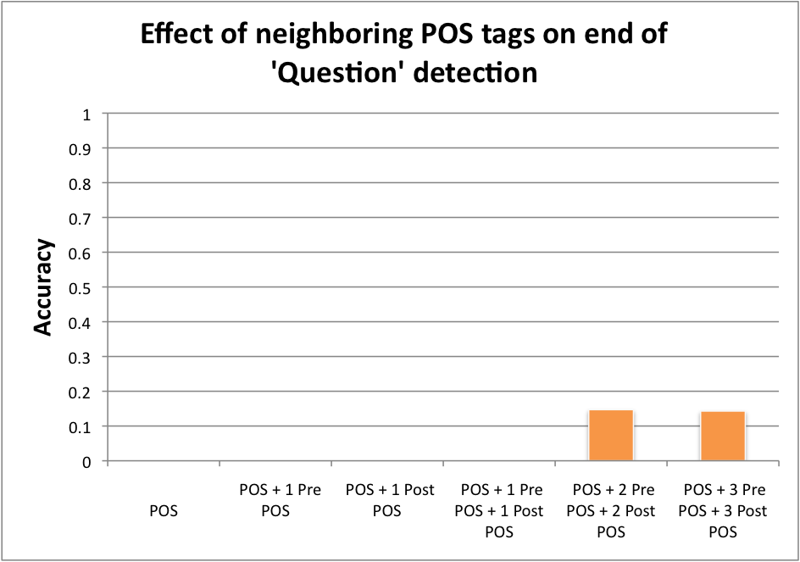
Effect of POS tags on various Sentence-Unit classes
“cs224s course rocks.”
“cs224s course rocks.”
“mhm”
“cs224s course rocks?”
Notes:
1) Title and people 2) A slide on explaining disfluencies (examples: question, backchannel, statement)3) A slide on the data available4) Effect of pre-pos tags: 1, 2, 3 grams. Effect of pre-pos tags: 1, 2, 3 grams. Bin sizes.5) Club backchannel words into a class (mhm, oh yeah)6) Features based on prior sentence tag Switchboard versus Fisher data7) Prosodic features effects of energy, F0, pause duration 8) Average F0 based feature9) References

Slide 6
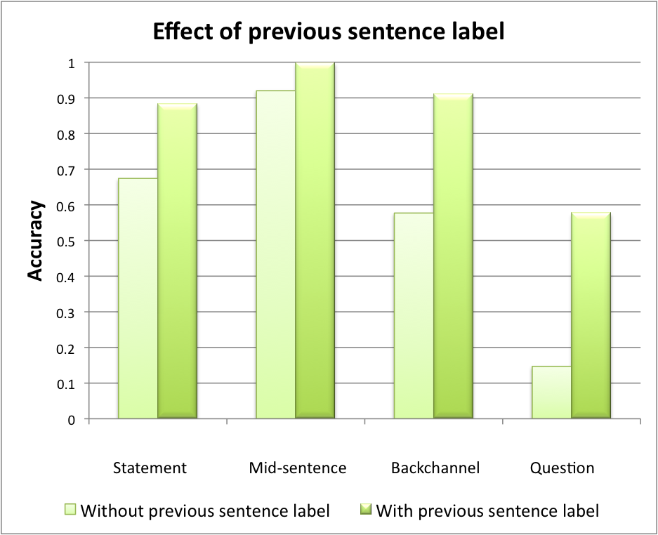
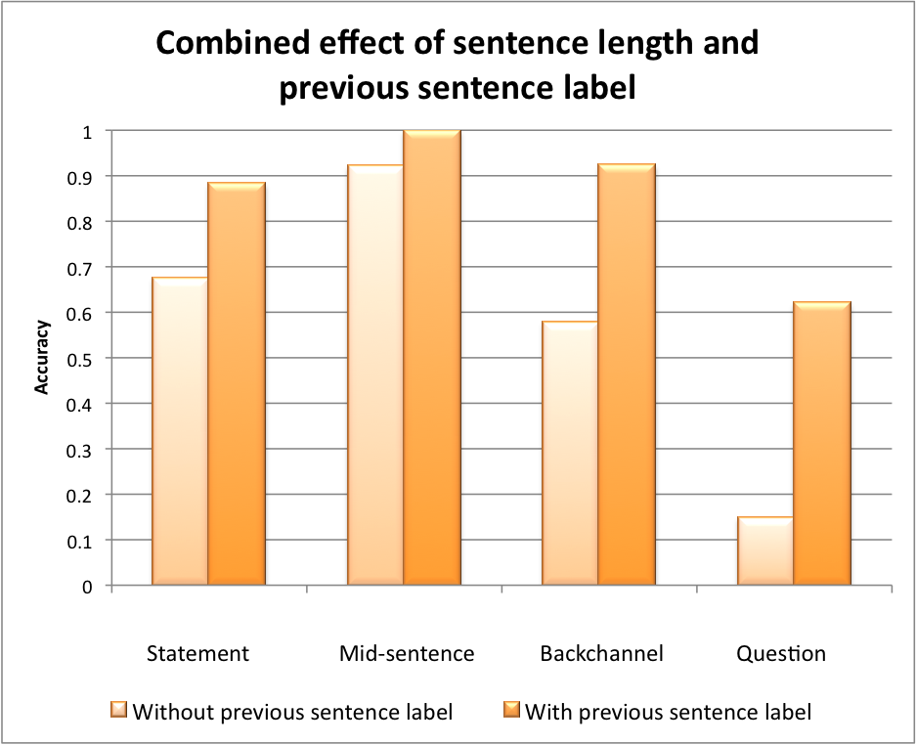
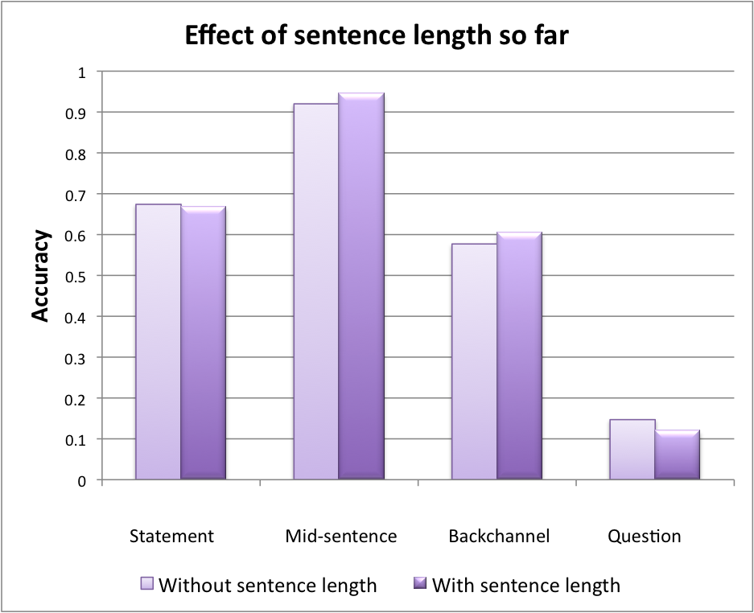
Previous Sentence Label helps
(SU following question is probably a Question)
Length of unclassified contiguous word stream seen so far
improves backchannel detection
(since they are short)
Notes:
1) Title and people 2) A slide on explaining disfluencies (examples: question, backchannel, statement)3) A slide on the data available4) Effect of pre-pos tags: 1, 2, 3 grams. Effect of pre-pos tags: 1, 2, 3 grams. Bin sizes.5) Club backchannel words into a class (mhm, oh yeah)6) Features based on prior sentence tag Switchboard versus Fisher data7) Prosodic features effects of energy, F0, pause duration 8) Average F0 based feature9) References

Slide 7
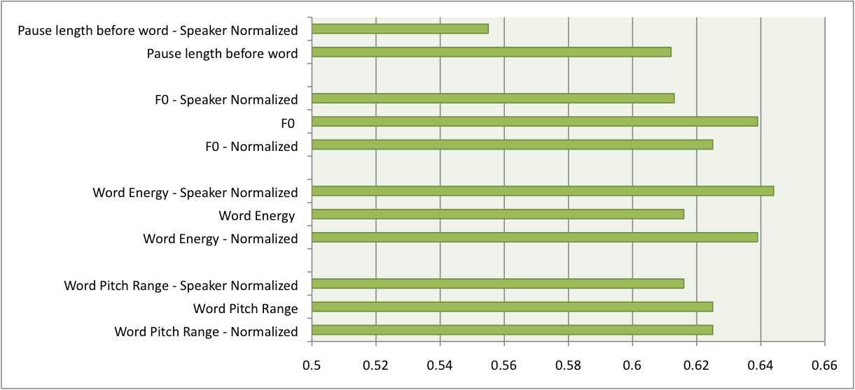
Effect of prosodic features on improving ‘Question’ classification
Notes:
1) Title and people 2) A slide on explaining disfluencies (examples: question, backchannel, statement)3) A slide on the data available4) Effect of pre-pos tags: 1, 2, 3 grams. Effect of pre-pos tags: 1, 2, 3 grams. Bin sizes.5) Club backchannel words into a class (mhm, oh yeah)6) Features based on prior sentence tag Switchboard versus Fisher data7) Prosodic features effects of energy, F0, pause duration 8) Average F0 based feature9) References

Slide 8
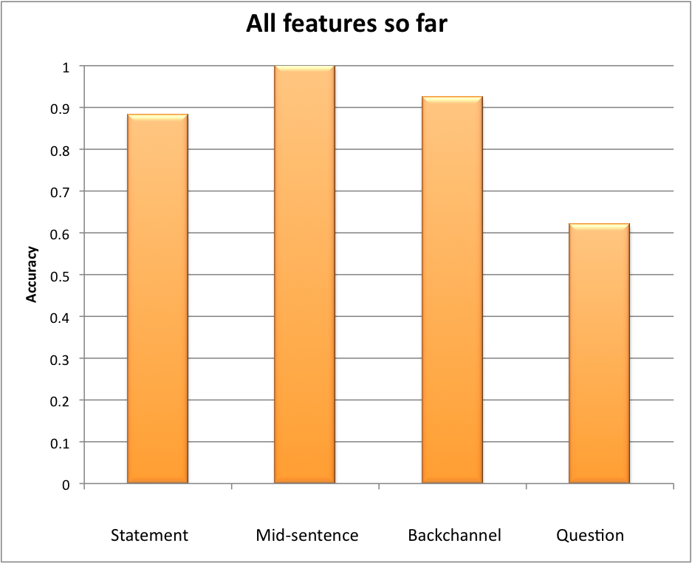
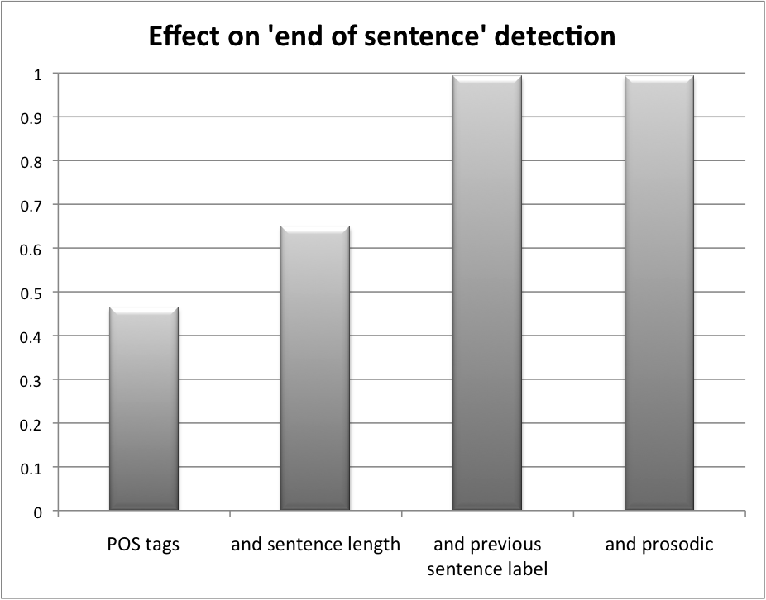
Combining all features, we are able to get up to 99% accuracy on classifying a word as a “end of sentence unit” or not:
However, lesser accuracy when trying to classify individual classes. Specifically, gives only 62% accuracy with ‘Questions’
Notes:
1) Title and people 2) A slide on explaining disfluencies (examples: question, backchannel, statement)3) A slide on the data available4) Effect of pre-pos tags: 1, 2, 3 grams. Effect of pre-pos tags: 1, 2, 3 grams. Bin sizes.5) Club backchannel words into a class (mhm, oh yeah)6) Features based on prior sentence tag Switchboard versus Fisher data7) Prosodic features effects of energy, F0, pause duration 8) Average F0 based feature9) References

Slide 9
References
Enriching Speech Recognition With Automatic Detection of Sentence Boundaries and Disﬂuencies, Yang Liu, Elizabeth Shriberg, Andreas Stolcke, Dustin Hillard, Mari Ostendorf and Mary Harper
Yang Liu, Elizabeth Shriberg, Andreas Stolcke, Barbara Peskin, Jeremy Ang, Dustin Hillard, Mari Ostendorf, Marcus Tomalin, Phil Woodland, and Mary Harper. 2005. Structural Metatada Research in the EARS Program,. ICASSP 2005.
Yang Liu, Elizabeth Shriberg, Andreas Stolcke, Dustin Hillard, Mari Ostendorf, Barbara Peskin, and Mary Harper. 2004. The ICSI-SRI-UW Metadata Extraction System, ICSLP 2004.
Snover, Matthew, Bonnie Dorr and Richard Schwartz. 2004. A Lexically-Driven Algorithm for Disfluency Detection. Short Papers Proceedings of HLT-NAACL 2004. Boston: ACL. 157--160.
Acknowledgements
Dr. Dan Jurafsky for encouragement and office hours
Yun-Hsuan Sung for advice on how to proceed with this project
Uriel Cohen Priva for assistance with obtaining the LDC2009T01 corpus
Notes:
1) Title and people 2) A slide on explaining disfluencies (examples: question, backchannel, statement)3) A slide on the data available4) Effect of pre-pos tags: 1, 2, 3 grams. Effect of pre-pos tags: 1, 2, 3 grams. Bin sizes.5) Club backchannel words into a class (mhm, oh yeah)6) Features based on prior sentence tag Switchboard versus Fisher data7) Prosodic features effects of energy, F0, pause duration 8) Average F0 based feature9) References

